Slide 1



RiskCity
Introduction to Frequency Analysis of hazardous events

Slide 2
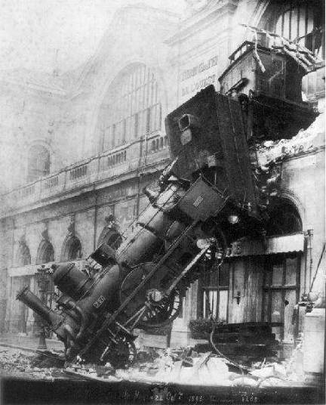
Extreme Events
“Man can believe the impossible. But man can never believe the improbable.”
- Oscar Wilde
“It seems that the rivers know the [extreme value] theory. It only remains to convince the engineers of the validity of this analysis.”
–E. J. Gumbel
Linda O. Mearns NCAR/ICTP

Slide 3
Objective of FA exercise
The objective of this exercise is to practice different methods of frequency analysis for floods and for earthquakes and to gain insight in magnitude – frequency relationship.
Keep in mind that the methods presented in this exercise are just a selection of all existing methods.
In this exercise ILWIS is not being used.

Slide 4
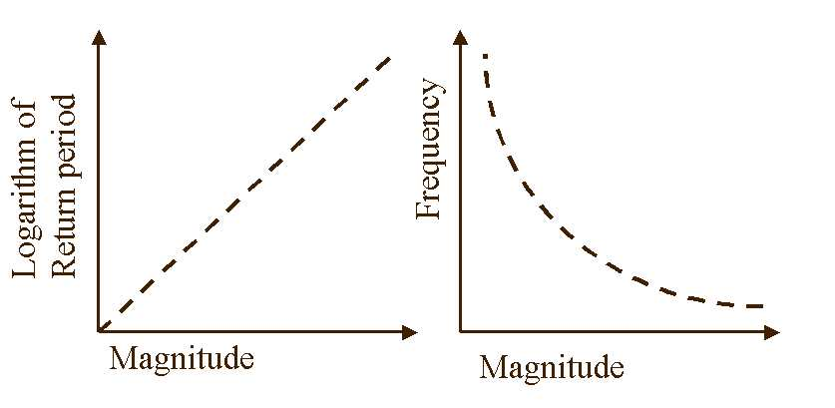
M-F relationship
Magnitude-frequency relationship is a relationship where events with a smaller magnitude happen more often than events with large magnitudes.
Magnitude is related to the amount of energy released during the hazardous event, or refers to the size of the hazard.
Frequency is the (temporal) probability that a hazardous event with a given magnitude occurs in a certain area in a given period of time.
ISL 2004
Notes:
Introduction to GIS
4

Slide 5
M-F relationship
The M – F relationship does hold true for many different disaster types, but as can be seen in the table, not for all:
 | Disaster type | Occurrence possible | M - F relationship
Hydro-meteorological | Lightning Hailstorm Tornado Intense rainstorm Flood Cyclone/ Hurricane Snow avalanche Drought | Seasonal (part of the year) Seasonal (storm period) Seasonal (“tornado season”) Seasonal (rainfall period) Seasonal (rainfall period) Seasonal (cyclone season) Seasonal (winter) Seasonal (dry period) | Random Poisson , gamma Negative binomial Poisson, Gumbel gamma, log-normal, Gumbel Irregular Poisson, gamma Binomial , gamma
Environmental | Forest fire Crop disease Desertification Technological | Seasonal (dry period) Seasonal (growing season) Progressive Continuous | Random Irregular Progressive Irregular
Geological | Earthquake Landslide Tsunami Subsidence Volcanic eruption Coastal erosion | Continuous Seasonal (rainfall period) Continuous Continuous Intermittent (magma chamber) Seasonal (storm period) | Log-normal Poisson Random Sudden or progressive Irregular Exponential , gamma
ISL 2004
Notes:
Introduction to GIS
5

Slide 6
Flooding
Return period/exceeding probability
Extreme value distribution by Gumbel method
Intensity-duration-frequency relationships

Slide 7
Flooding
Return period/exceeding probability
Maximum daily preciptation (mm)
What is the return period of a rain event over a 100 mm/day ?
1
3
5
1
Between 1935 and 1978: 9 events
6
8 Intervals, ranging from 1 to 16 years
16
5
The sum of the intervals =
4 + 1 + 1 + 16 +3 + 6 + 5 + 5 = 41
Average = 41/8 = 5.1 years
4
Annual exceedence probability of a rain event over 100 mm/day = 100 / 5.1 = 19.5 %

Slide 8
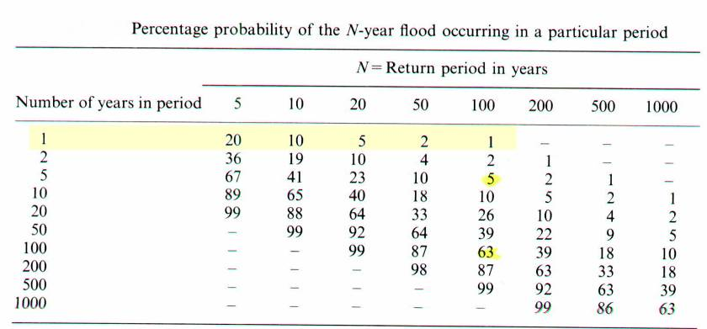
Flooding
Return period/exceeding probability
For the average annual risk!
Q₁₀₀ has a greater probability of occurring during the next 100 yrs (63%) than during the next 5 years ( 5%)

Slide 9
Flooding
Frequency Analysis

Slide 10
Flooding
Frequency Analysis
12
10
8
Frequency
6
4
2
0
450
500
550
600
650
700
750
800
850
900
950
Rainfall classes (mm)

Slide 11
Flooding
Frequency Analysis
Mean: 642 mm
Standard deviation: 110 mm
P(R < 642) = 0.5
P(R > 642) = 0.5
P(532 < R < 752) = 0.683
P(422 < R < 862) = 0.954
P(312 < R < 972) = 0.997
0.683
0.954
0.997
-3
-2
-1
X
+1
+2
+3

Slide 12
Flooding
Unfortunately, a large amount of events is right skewed;
Magnitude of events are absolutely limited at the lower end and not at the upper end. The infrequent events of high magnitude cause the characteristic right-skew
The closer the mean to the absolute lower limit, the more skewed the distribution become
The longer the period of record, the greater the probability of infrequent events of high magnitude, the greater the skewness

Slide 13
Flooding
The shorter the time interval of recording, the greater the probability of recording infrequent events of high magnitude, the greater the skewness
Other physical principles tend to produce skewed frequency distributions: e.g. drainage basin size versus size of high intensity thunderstorms.
12
10
8
Frequency
6
4
2
0
450
500
550
600
650
700
750
800
850
900
950
Rainfall classes (mm)

Slide 14
Flooding
Solution to right-skewness:
Use Extreme Value transform (other names: Double exponential transform or Gumbel transformation):
Rank the values from the smallest to the largest value
Calculate the cumulative probabilities: P=R/(N+1)*100%
Plot the values against the cumulative probability on probability paper and draw a straight line (best fit) through the points
From the line, estimate the standard deviation and mean
Estimate all other required probabilities versus values

Slide 15
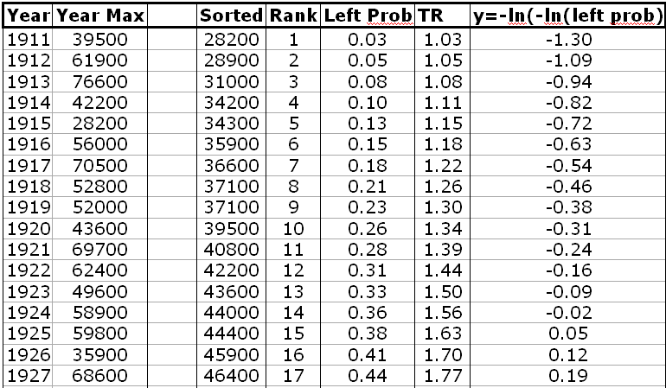
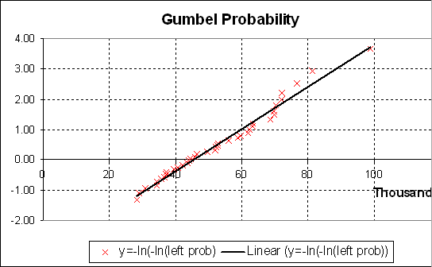
Flooding
Extreme value distribution by Gumbel method

Slide 16
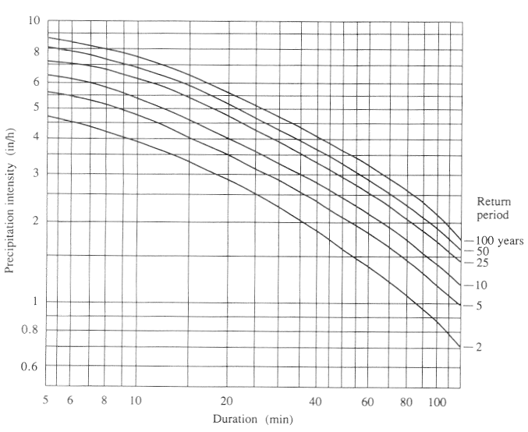
Flooding
Intensity-duration-frequency relationships
Intensity
Duration
IDF curves are calculated for a certain station and it cannot be extrapolated to other areas.

Slide 17
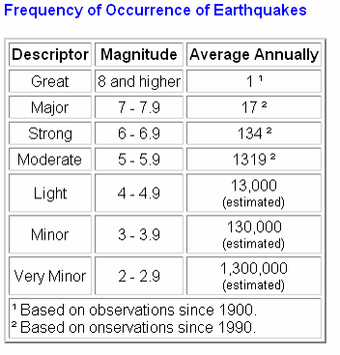
Earthquakes
Per day
0.5
4
36
360 (every 4 minutes….)
3600 (every 24 seconds….)

Slide 18
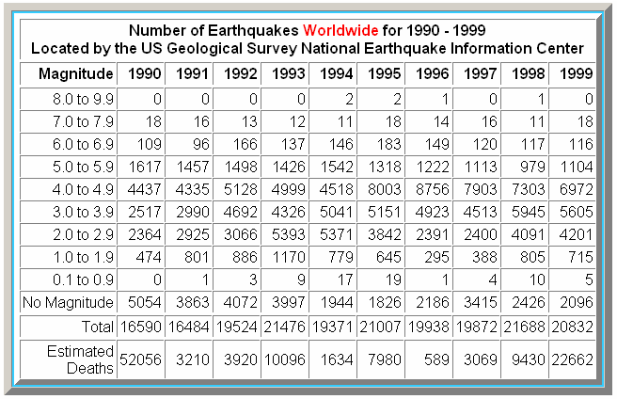
Earthquakes

Slide 19
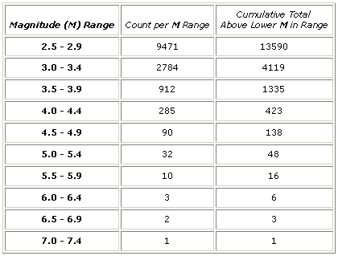
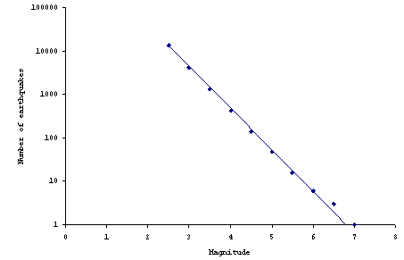
Earthquakes
The Gutenberg-Richter Relation
log N(M) = a – bM
Gutenberg-Richter plots are made for various data sets all over the world, and most of them end up having a b value very close to 1, usually slightly less.

