Slide 1
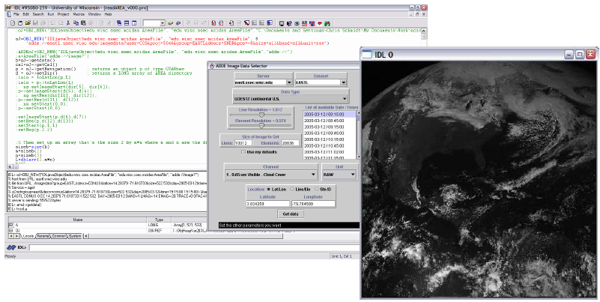
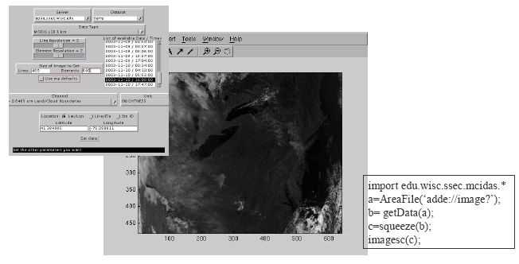
Client add-ons:
IDL/ENVI (ADDE)
MatLab (ADDE)
ArcGIS (OpeNDAP)
ITC-IDV (both)
Contact person
dave.santek@ssec.wisc.edu
Contact person
dave.santek@ssec.wisc.edu

Slide 2
How to Install on the ArcGIS 9.2

Slide 3
BEFORE YOU START
To install the OPeNDAP Connector, you must have the following previously installed on your system:
ArcGIS 9.2 ArcGIS 9.2 Service Pack 3,4 available for download on ESRI’s website, www.esri.com.
Java Run-Time Environment 6
.NET Framework 2.0 or 3.0
.NET Support for ArcGIS Desktop INSTALLATION

Slide 4
NET Support for ArcGIS Desktop INSTALLATION
Control Panel → Add Remove Programs

Slide 5
NET Support for ArcGIS Desktop INSTALLATION
Control Panel →

Slide 6
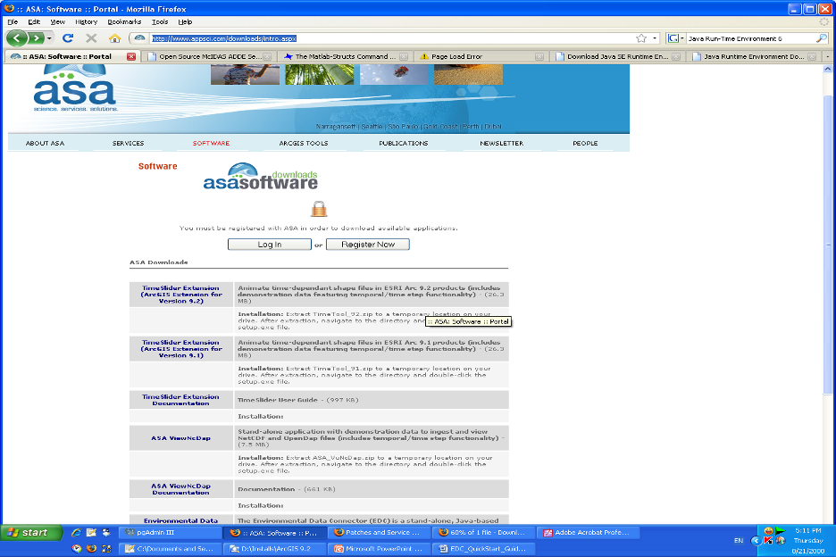
Environmental Data Connector (EDC) Extension татах хэлбэр
http://www.appsci.com/downloads/intro.aspx

Slide 7
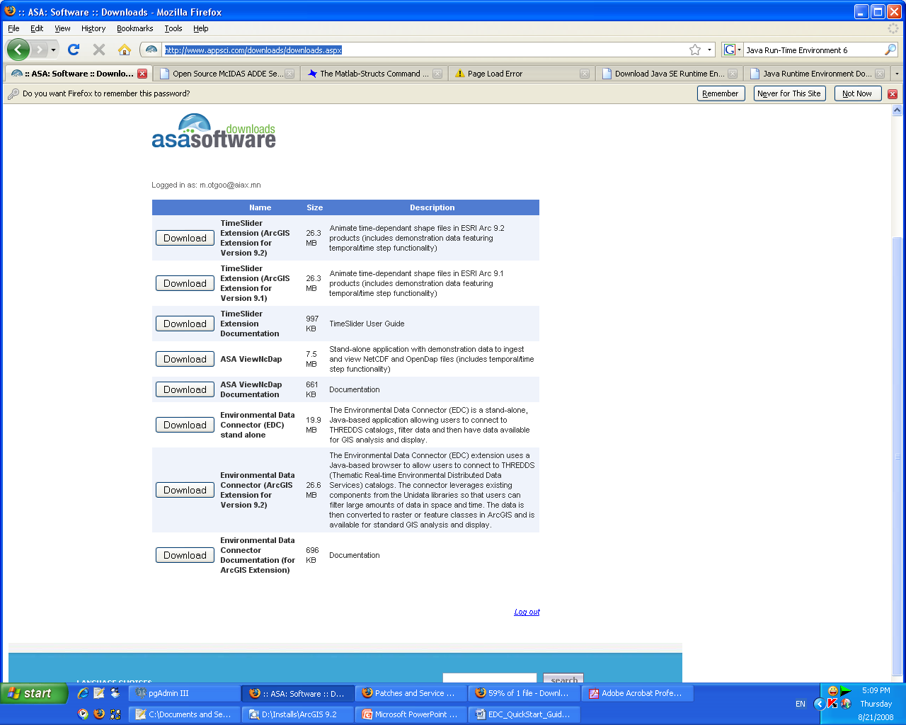
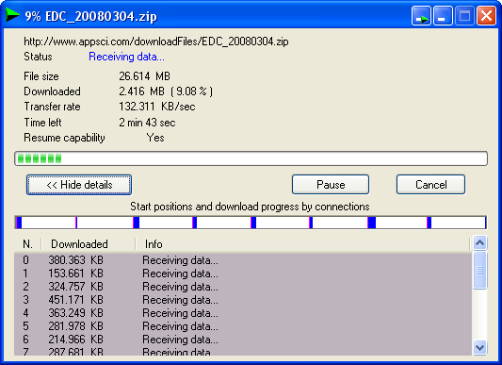
Extract to C driver

Slide 8
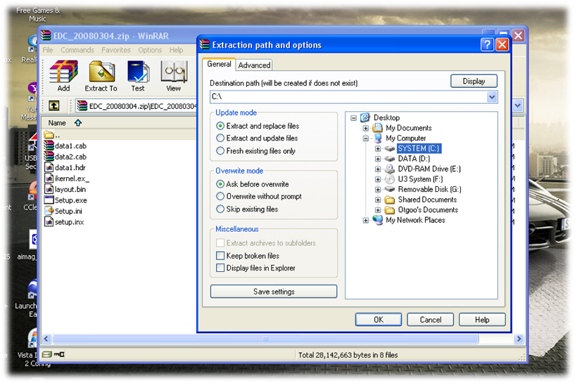
Extracting process

Slide 9
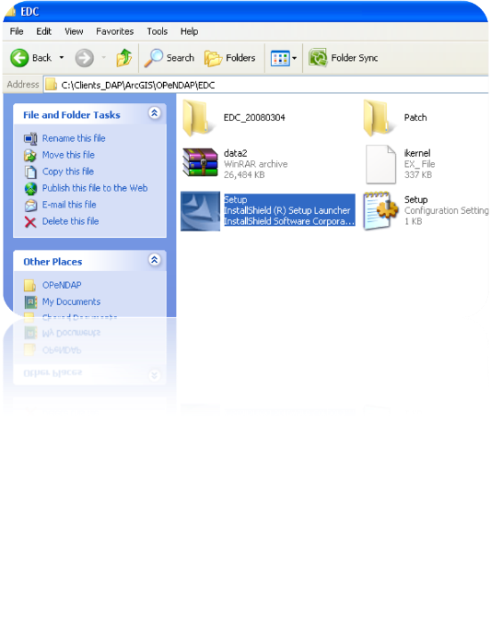
Extracted File
Run Setup.exe to begin the
installation.

Slide 10
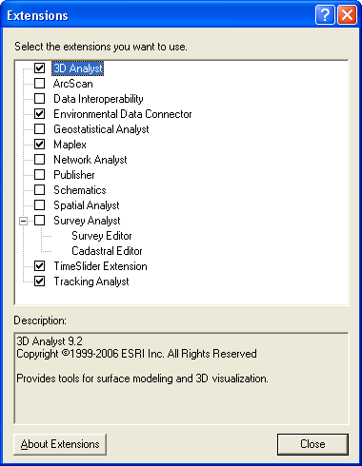
ArcGIS → Tools → Extentions
Go to Tools > Extensions. Check the box next to the Timeslider Extension to turn it on.
Check the box next to the Environmental Data Connector to turn it on. Click Close.

Slide 11
Click this menu
The Environmental Data Connector will appear as a new menu in the main menu bar.

Slide 12
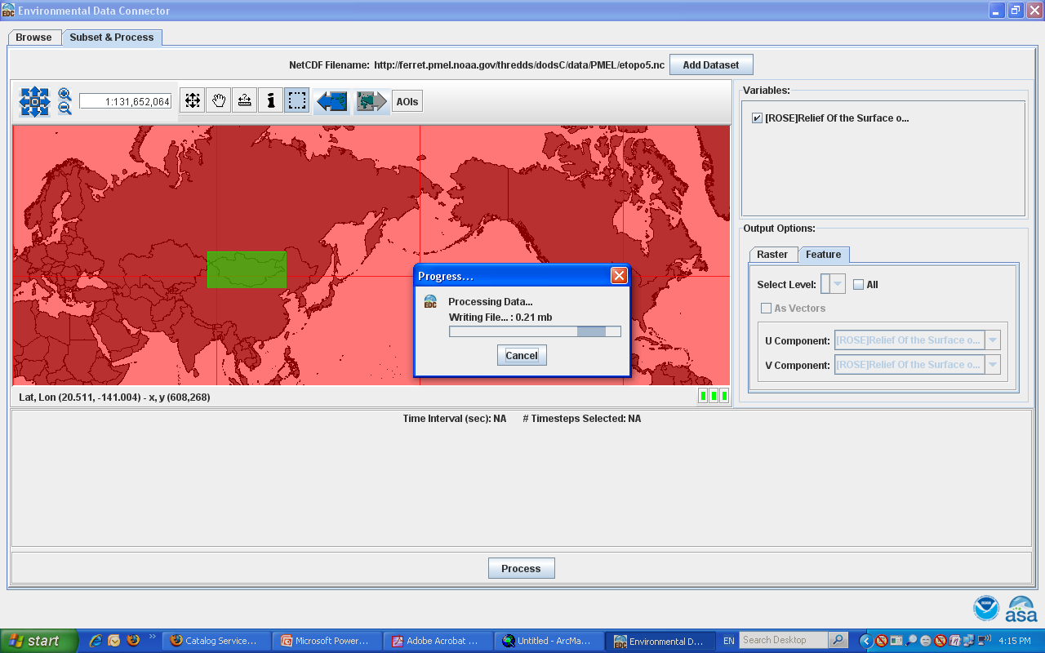

Slide 13
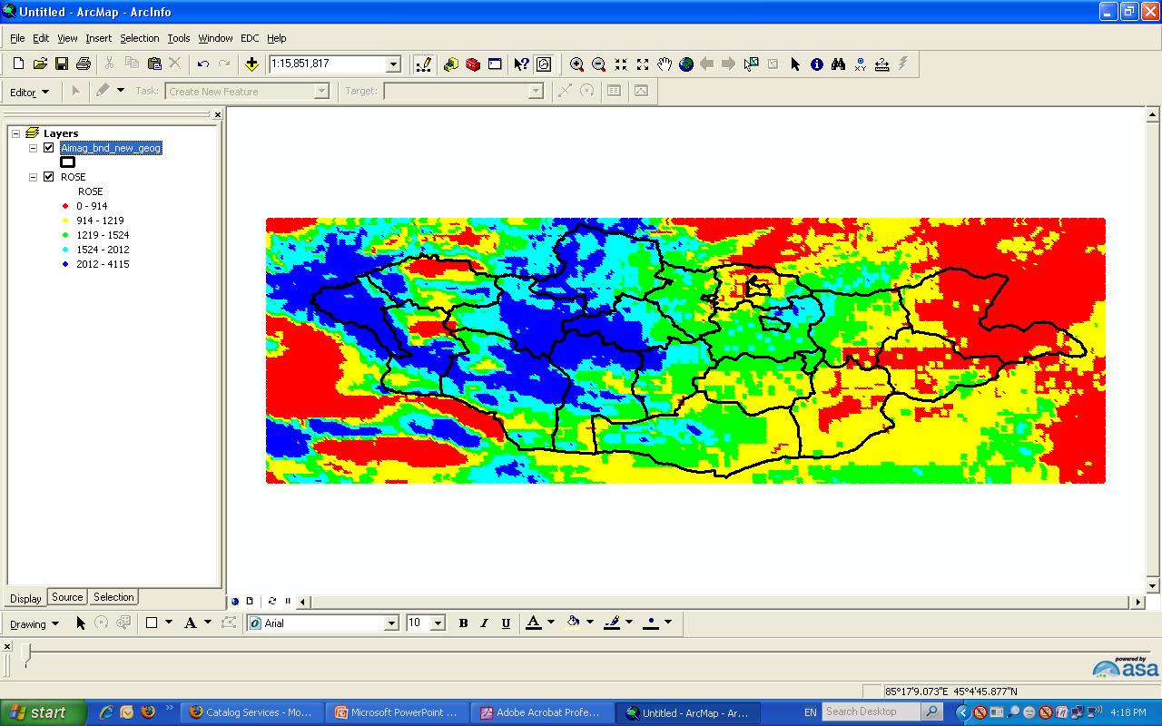

Slide 14
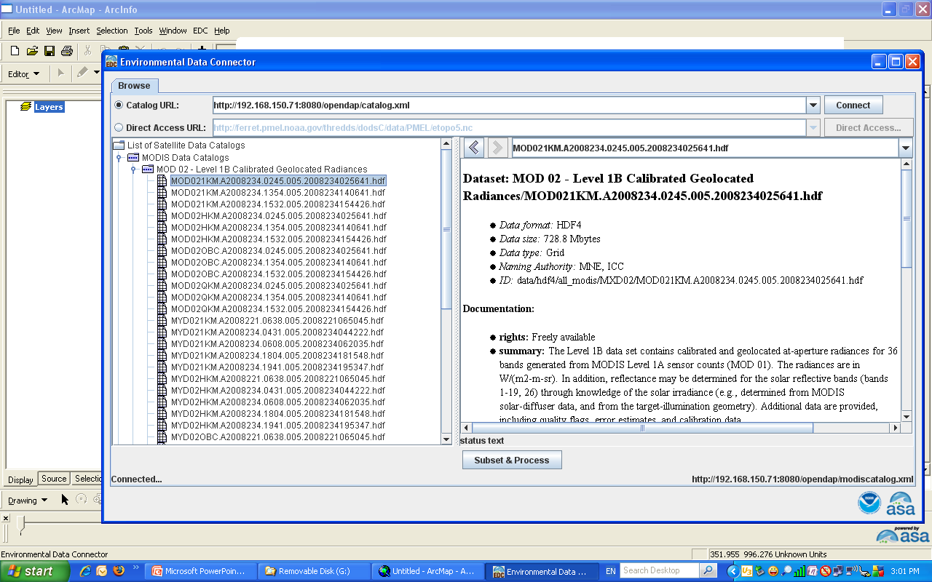

Slide 15
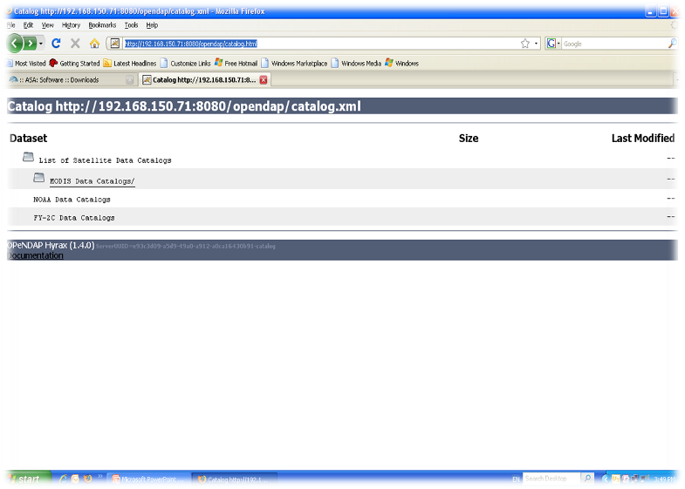
Web Based Interface
http://192.168.150.71:8080/opendap/catalog.html

Slide 16
