Slide 1
Workshop
ENV 6.5-1
April 7-8, 2011
Yola

Slide 2
Challenge 6.5 & ENV 6.5-1
Challenge 6.5 Mobilising environmental knowledge for policy, industry and society
ENV.2012.6.5-1 Developing community-based environmental monitoring and information systems using innovative and novel earth observation applications

Slide 3
Challenge 6.5 & ENV 6.5-1
Policy priorities
Policy innovation
Co-operative planning
Environmental governance
Uptake & exploitation
of knowledge
Revision EU policy (air quality)
Sectors (energy, transport, agri,
Forestry, fisheries, health etc)
Advanced data mgmt strategies
E-collaboration platforms
Data sharing
Data standards, quality, reliability
Methods & standards
Integrated Assessment
Integrative
Interdisciplinary
Action-oriented
Acceptance activities
Transparency
Knowledge mgmt
Accountability
Responsiveness
Pilot cases
Citizen participation
Community priorities
Citizens’ observatories
Community based-monitoring
Community-based data collection,
Interpretation
Community decision making
Citizen empowerment
Highly innovative monitoring technologies
e.g. low-cost reliable micro-sensors,
smart phone applications, etc

Slide 4
Challenge 6.5 & ENV 6.5-1
Policy priorities
Policy innovation
Co-operative planning
Environmental governance
Uptake & exploitation
of knowledge
Revision EU policy (air quality)
Sectors (energy, transport, agri,
Forestry, fisheries, health etc)
Advanced data mgmt strategies
E-collaboration platforms
Data sharing
Data standards, quality, reliability
Methods & standards
Integrated Assessment
Policy
Science
Integrative
Interdisciplinary
Action-oriented
Acceptance activities
Transparency
Knowledge mgmt
Accountability
Responsiveness
Pilot cases
Relations
Citizen participation
Community priorities
Citizens’ observatories
Community based-monitoring
Community-based data collection,
Interpretation
Community decision making
Citizen empowerment
Citizens
Industry
Highly innovative monitoring technologies
e.g. low-cost reliable micro-sensors,
smart phone applications, etc

Slide 5
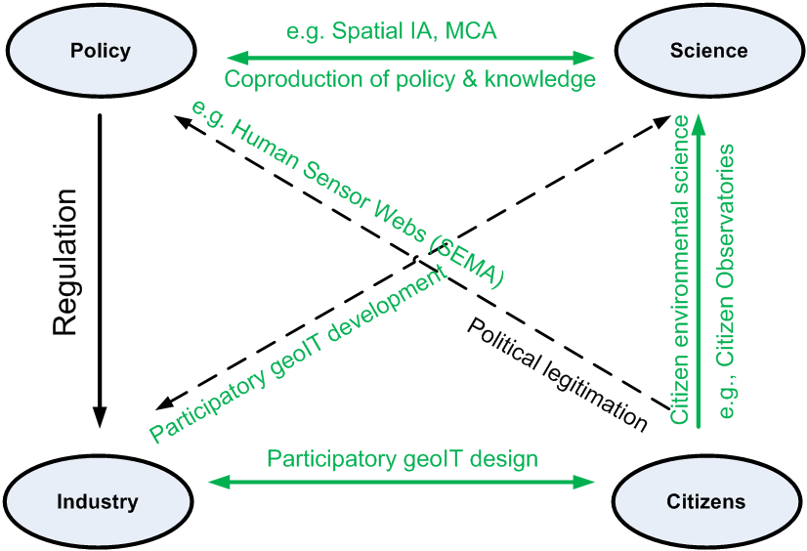

Slide 6
The “ecology” of existing effective federations of citizen associations, environmental agencies, and official Environmental Science
Case studies
Capacity and awareness building

Slide 7
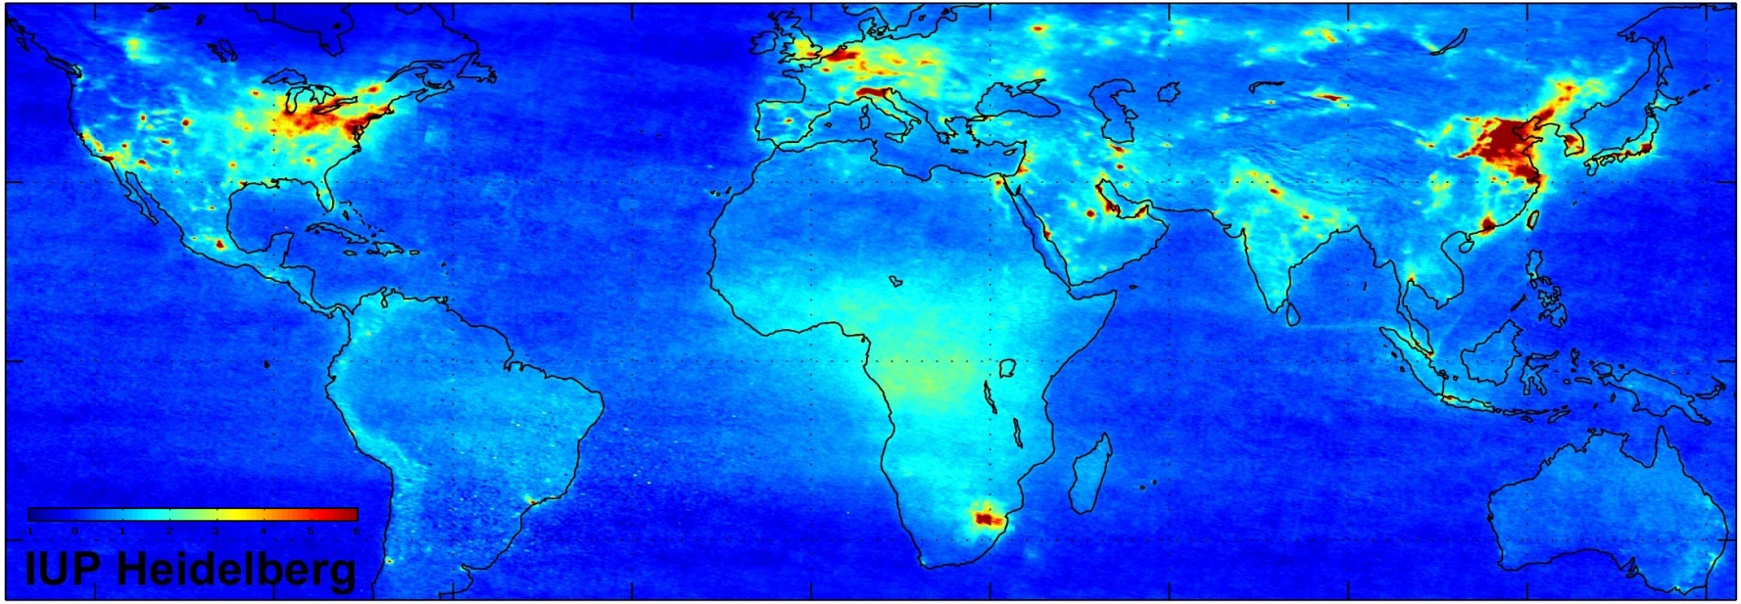
Global air quality map of NO2 levels
(Source: ESA and Heidelberg Univ., 2004)
A map with a shocking message for the Dutch

