Slide 1
52°North Simon Jirka – s.jirka@52north.org VGIrisk Workshop - April 2011
Notes:
1

Slide 2
52°North
Collaboration platform for research-oriented open source software development
Advance the bi-lateral transfer of knowledge between research and practice
Transform the innovations into practical technological solutions

Slide 3
52°North
Private company following a non-profit approach
SME (Small and Medium-sized Enterprises)
Principal partners
University of Münster, Institute for Geoinformatics (Münster, Germany)
con terra GmbH (Münster, Germany)
ITC (Enschede, The Netherlands)
ESRI Inc. (Redlands, CA, USA)

Slide 4
Interests
Sensor Web → integrating observations into SDIs
Human observations / VGI as new types of observation sources
Combining conventional sensors with human observations
Profiling of Sensor Web standards
User Interfaces

Slide 5
Interests
Profiling of Sensor Web standards
How to use SWE for human observations?
Adjustments of SWE to fit to human observations?
Filtering of human observations (HO)
Processing of human observations
Security / privacy aspects
Building a generic toolbox for VGI / HO
VGI and cloud computing → scalability

Slide 6
Capabilities, Expertise and Special Strengths
Expertise on Sensor Web
OGC Sensor Web Enablement (SWE)
Standards based framework for accessing and encoding observations, alerting based on observations and tasking of sensors/observers
Experience from many applied projects how to use SWE in practice
Active involvement in the standardization process

Slide 7
Capabilities, Expertise and Special Strengths
Software development
52°North Sensor Web suite
Implementations of all OGC SWE standards: SOS, SAS/SES, SPS, WNS
User friendly clients
Broad user and developer community
Customisation of Sensor Web components

Slide 8
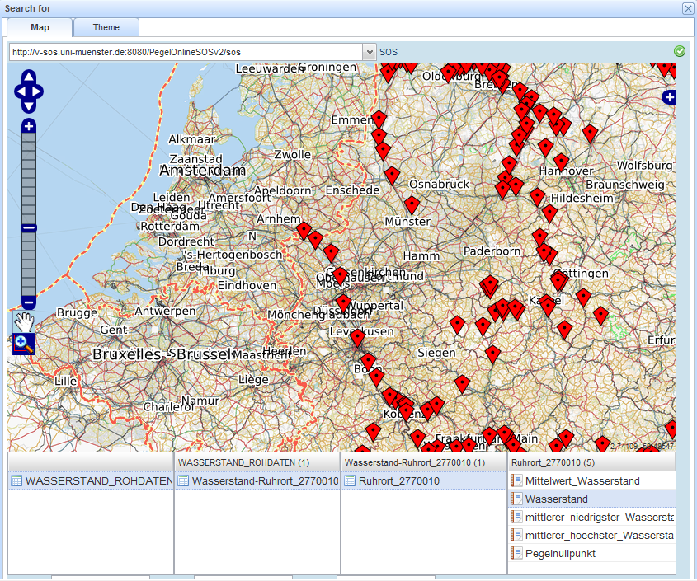
Open Source SWE Clients
Notes:
8

Slide 9
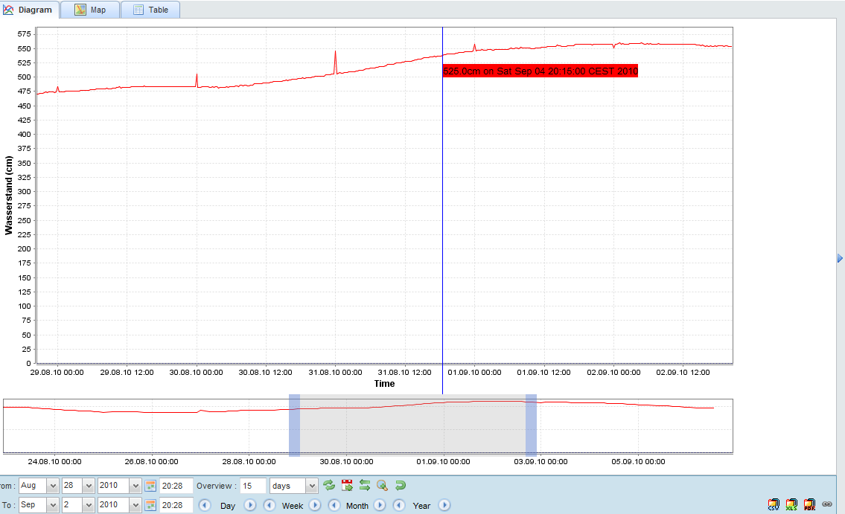
Open Source SWE Clients
Notes:
9

Slide 10
Capabilities, Expertise and Special Strengths
Project background
European projects, e.g.
EO2HEAVEN → environmental data for health
GeoViQua → data quality
Human Sensor Web project
Customer projects (e.g. for public authorities)

Slide 11
Capabilities, Expertise and Special Strengths
Potential contribution
Architecture design
Software development
Provision of a development/communication platform
Dissemination

Slide 12
Thanks!
Questions? Comments?

