Slide 1
Using agent-based modelling to depict basin closure in the Naivasha basin, Kenya: a framework of analysis
P. R. van Oel, A. van der Veen, R. Becht

Slide 2
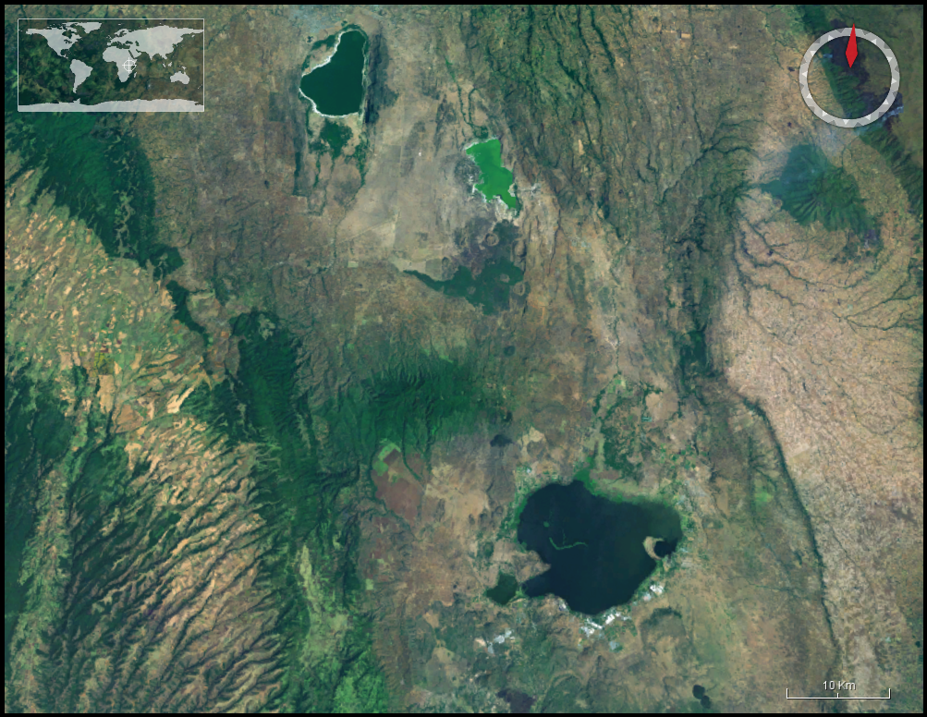
EOIA Naivasha project
Earth Observation (EO)
Integrated Assessment (IA) Modeling
Stakeholder meetings and communication
Hydrology study
Socioeconomic study
Governance study
Limnology study
Ecology study

Slide 3
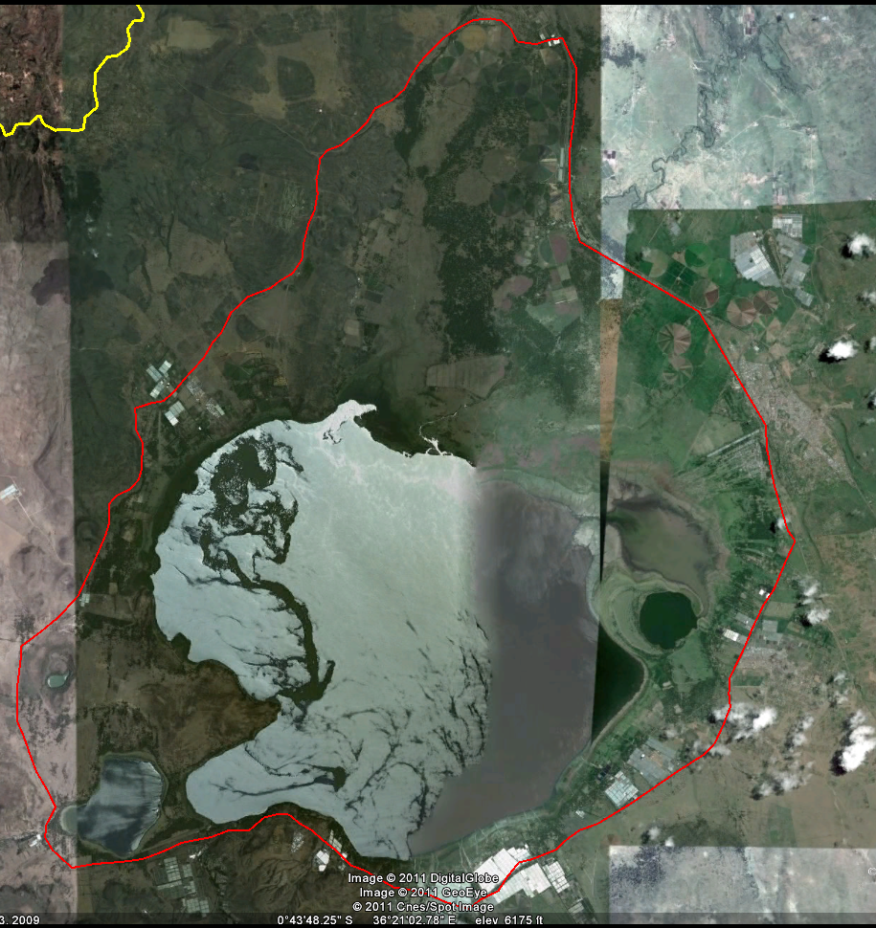
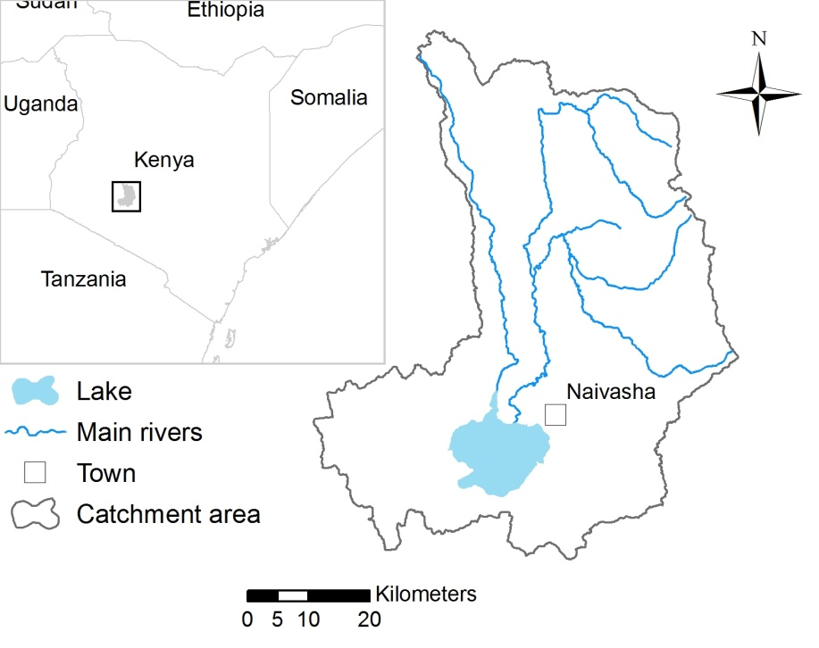
The Naivasha basin

Slide 4
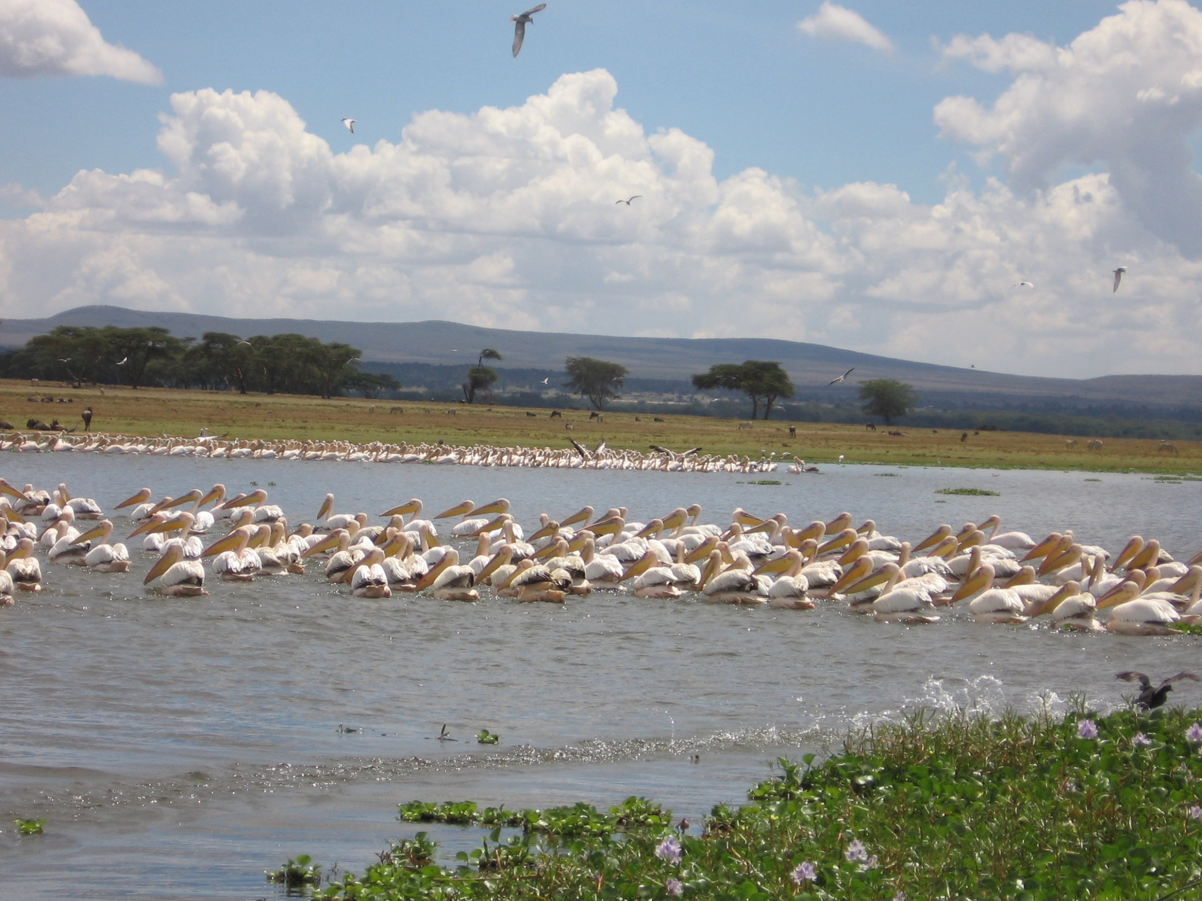
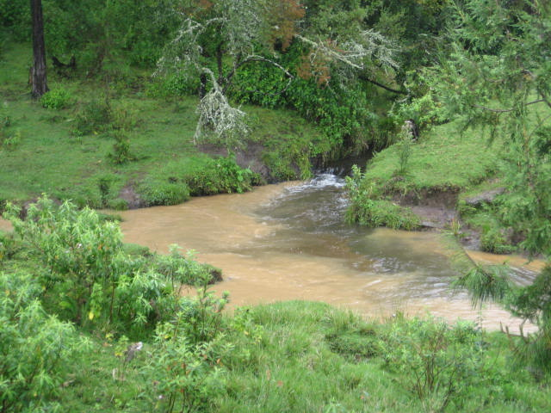

Slide 5
(River) Basin closure
River basins or sub basins are closed when commitments cannot be
met (Molle et al., 2010)
Environmental Service (e.g. runoff)
Payment for Environmental Service (PES)
River basin
Hydraulic link
Local resource
Lake system
Socioeconomic link

Slide 6
Agent-based modelling
Autonomous, interacting agents.
Many ABMs involve spatiotemporal framework.
Agents satisfy internal goals
using (nonlinear) rules, leading to decisions and actions
Agent rules may be based on:
Rationality
Heuristics
Learning
Model outcome: emergent patterns at higher level of aggregation

Slide 7
Objective of This study
Explore how ABM can be used for analyzing basin closure in
Naivasha, Kenya
Moreover, exploring the effectiveness of PES by studying emergent
patterns at the basin level

Slide 8
METHOD
Agent behavior (alternative livelihoods: water use, land use)
Agent strategies influenced by:
Local resources (e.g. water, infrastructure)
Socio-economic network (copy successful behavior, trading)
Experiences in recent years (rainfall, experiences other agents)
Emergence at the basin level
Spatiotemporal patterns of water availability (basin closure)
Land cover patterns

Slide 9
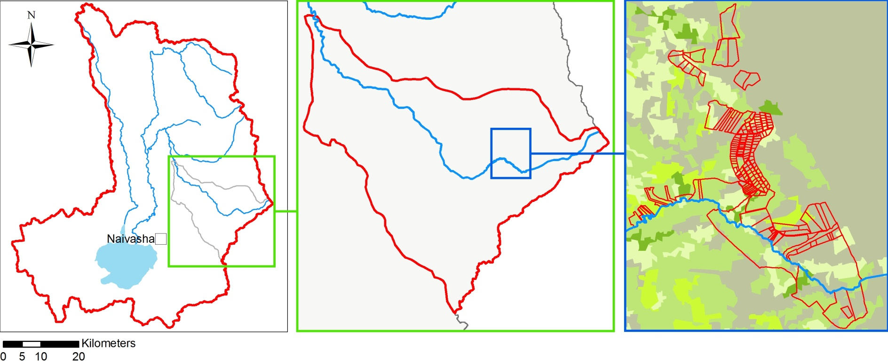
Levels of decision-making
Basin level authority
Sub basin level (user associations)
Local level (resource users)
WOTRO EOIA project Naivasha
9

Slide 10
Model overview
State variables and scales:
Temporal extent: several decades, 1-day time-step
Water availability in local resources
Water management decisions at the basin level (e.g. lake levels)
Processes and scheduling:
biophysical dynamics (hydrology, plant growth)
land use decisions by local agents
water management decisions

Slide 11
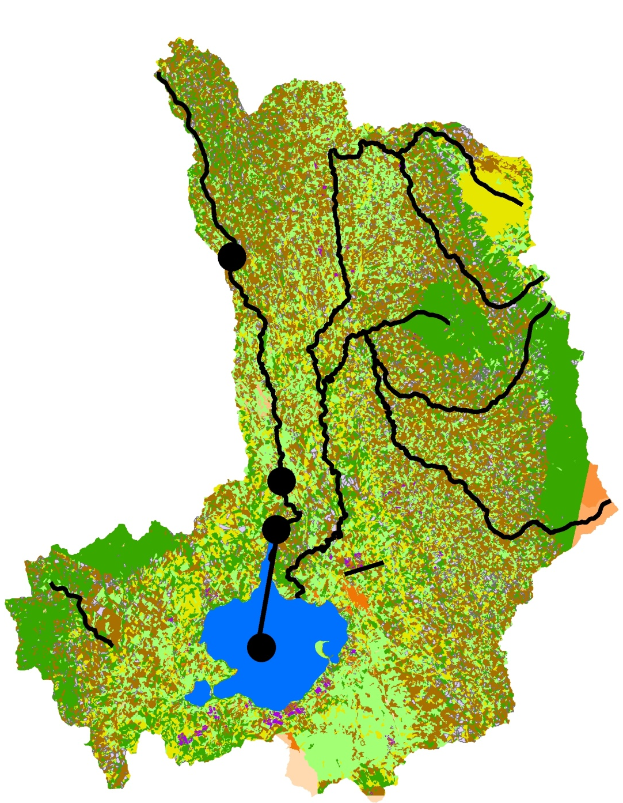
Q
W
R
R
P
ET
S
P
E
Inundation
zone

Slide 12
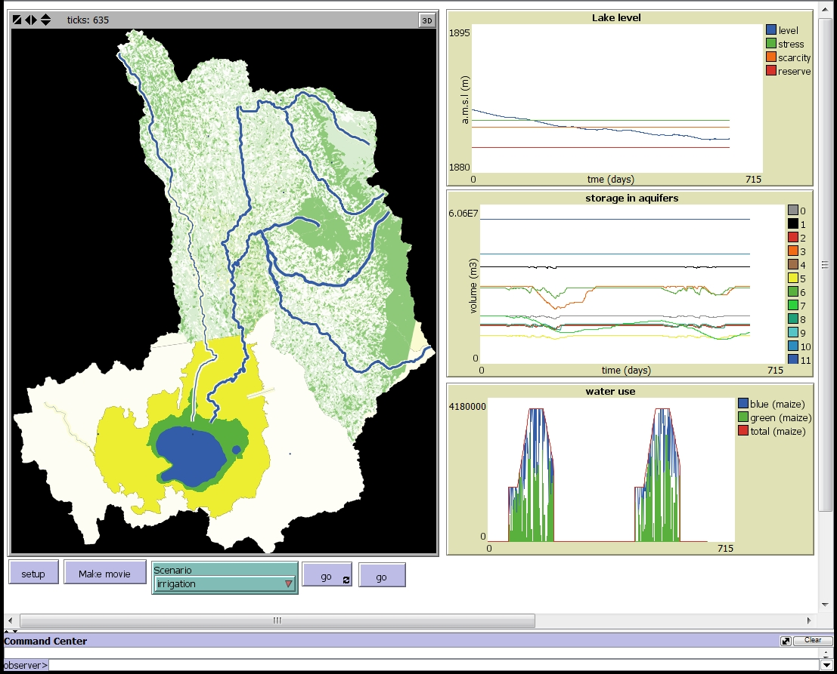
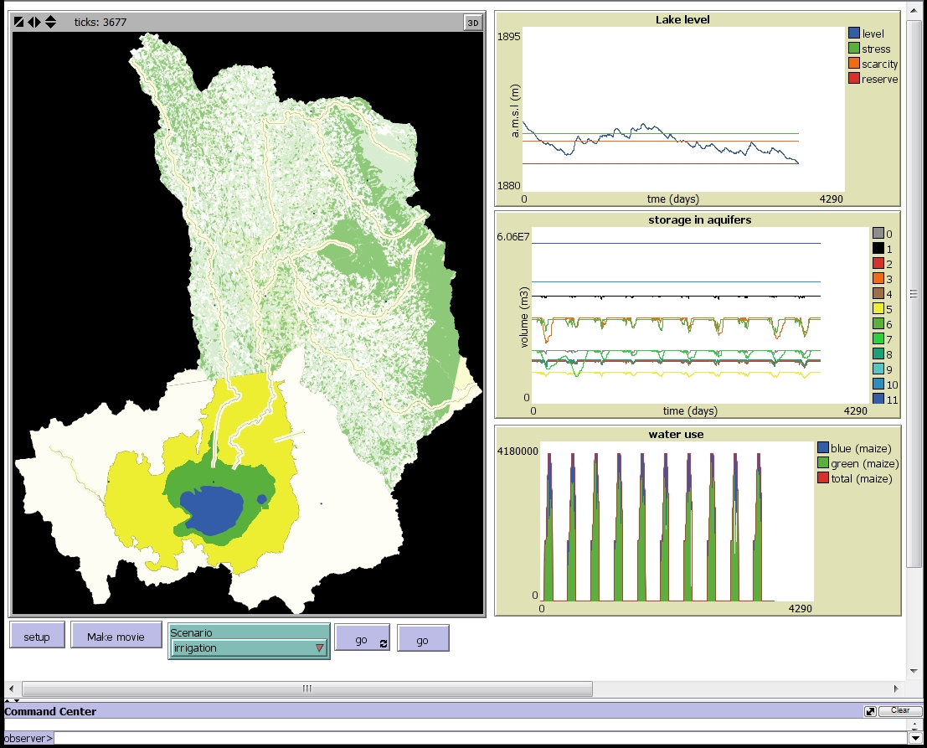
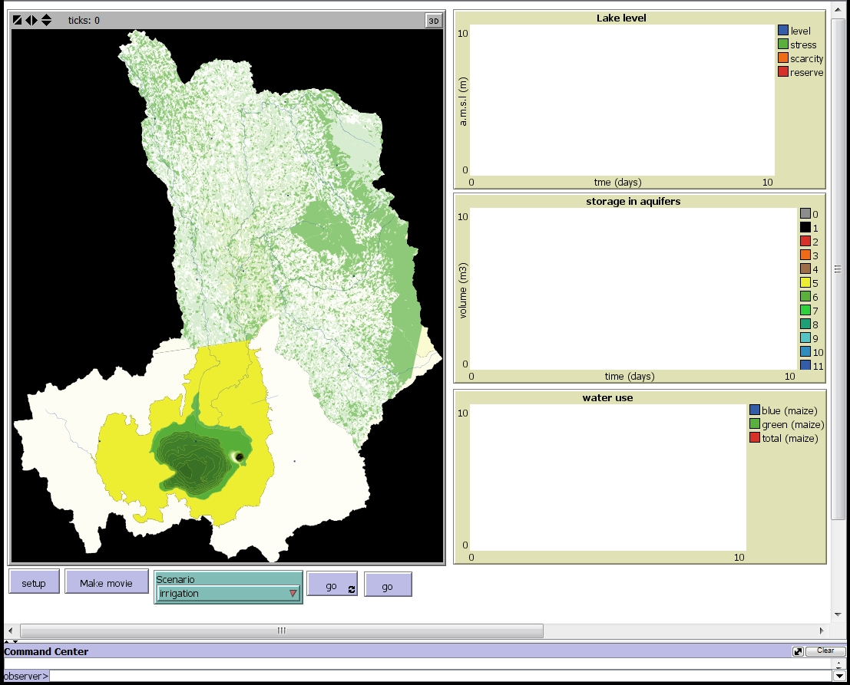
ABM model

Slide 13
Model test (Physical)
Meteorological data 1960 -1980
PES Scenario A: 25% farmers irrigate crops
PES Scenario B: 25 % farmers change cropland into grassland

Slide 14
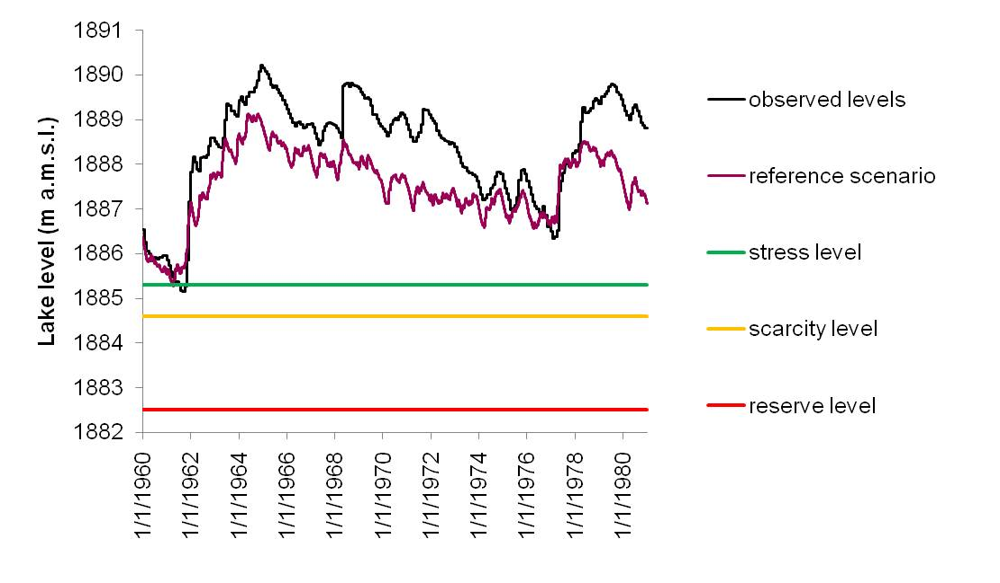
Results: Lake levels

Slide 15
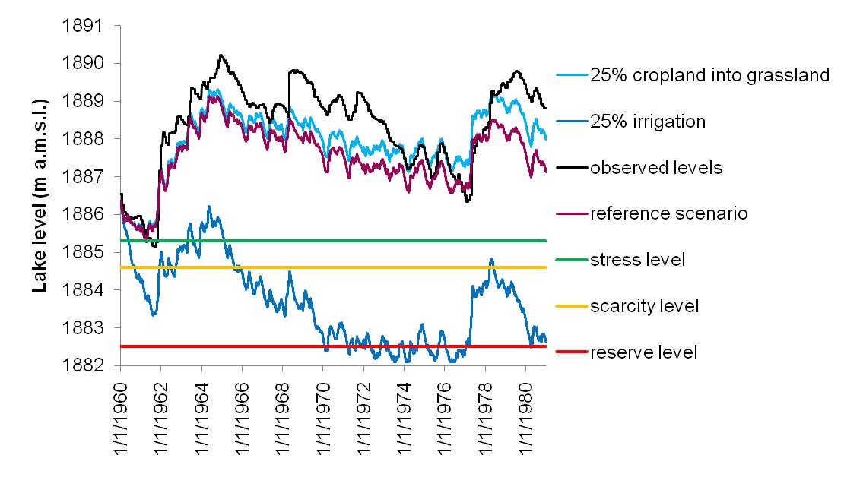
Results: Lake levels

Slide 16
OUTCOME preliminary results
The impact of changing land use is limited with regard to runoff
The impact of water abstractions for irrigation is considerable
This suggests that PES should aim at limiting excessive irrigation
rather than restoring natural vegetation

Slide 17
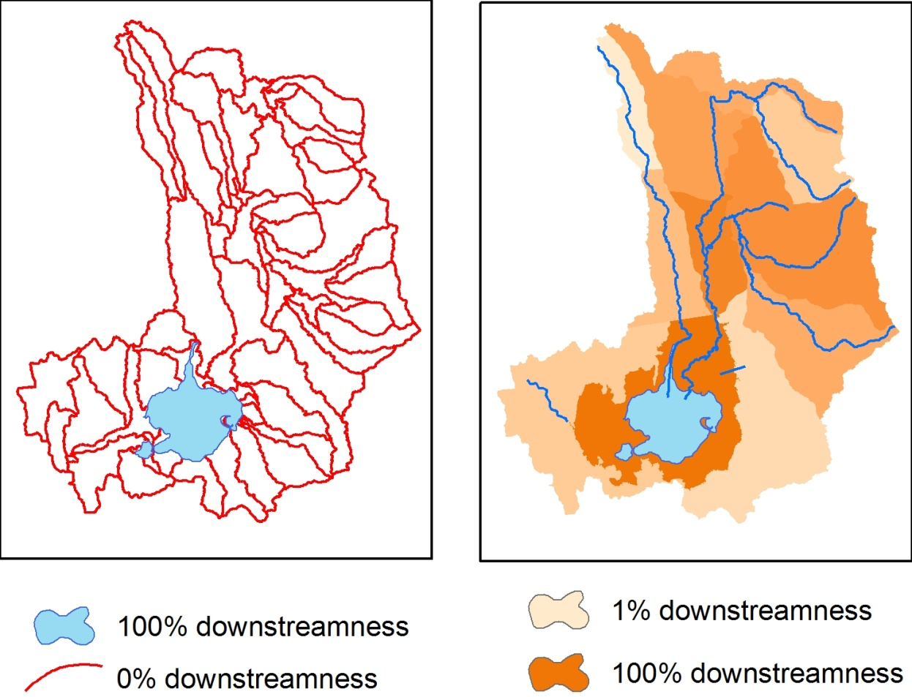
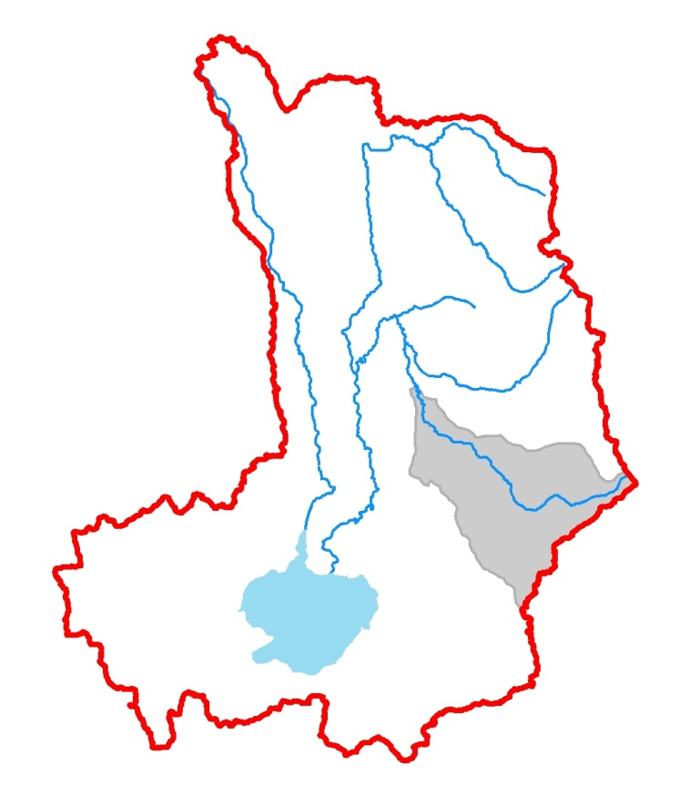
Results: Downstreamness (D_{x}) *
Every location x can be characterized by the size of its upstream catchment (A_{up,x}) relative to total basin (A_{tot})
x
A_{up,x}

Slide 18
downstreamness of water availability (WA)
D_{WA} changes as volumes at different locations change. For a basin with n local resources the D_{WA} is:
100%
D_{WA}
0%
Time

Slide 19
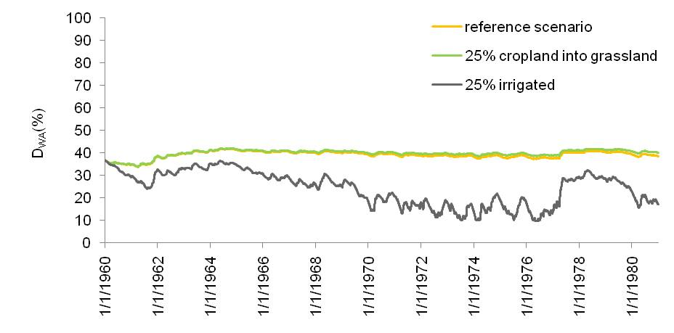
downstreamness of water availability (D_{WA})

Slide 20
CONCLUSIONs
The use of spatially-explicit ABM is a relevant tool for:
Studying basin closure
Studying the process of adoption of PES
Analyzing the effectiveness PES at the basin level

Slide 21
FUTURE WORK
Surveys in the field for designing valid heuristic models of decision-making by agents
The model may be extended to also indicate impacts of PES on:
Water quality
Socio-economic indicators
Ecological indicators.

Slide 22
Questions?

Slide 23
EOIA PROJECT APPROACH 2010 - 2014
Defining the project
problem, system, indicators, scenarios
x,t scales
Stakeholder process (I)
Database
Modeling and assessment
Models, EO
Stakeholder process (II)
Evaluation of results and
Visualization
Indicator maps (GIS)

Slide 25
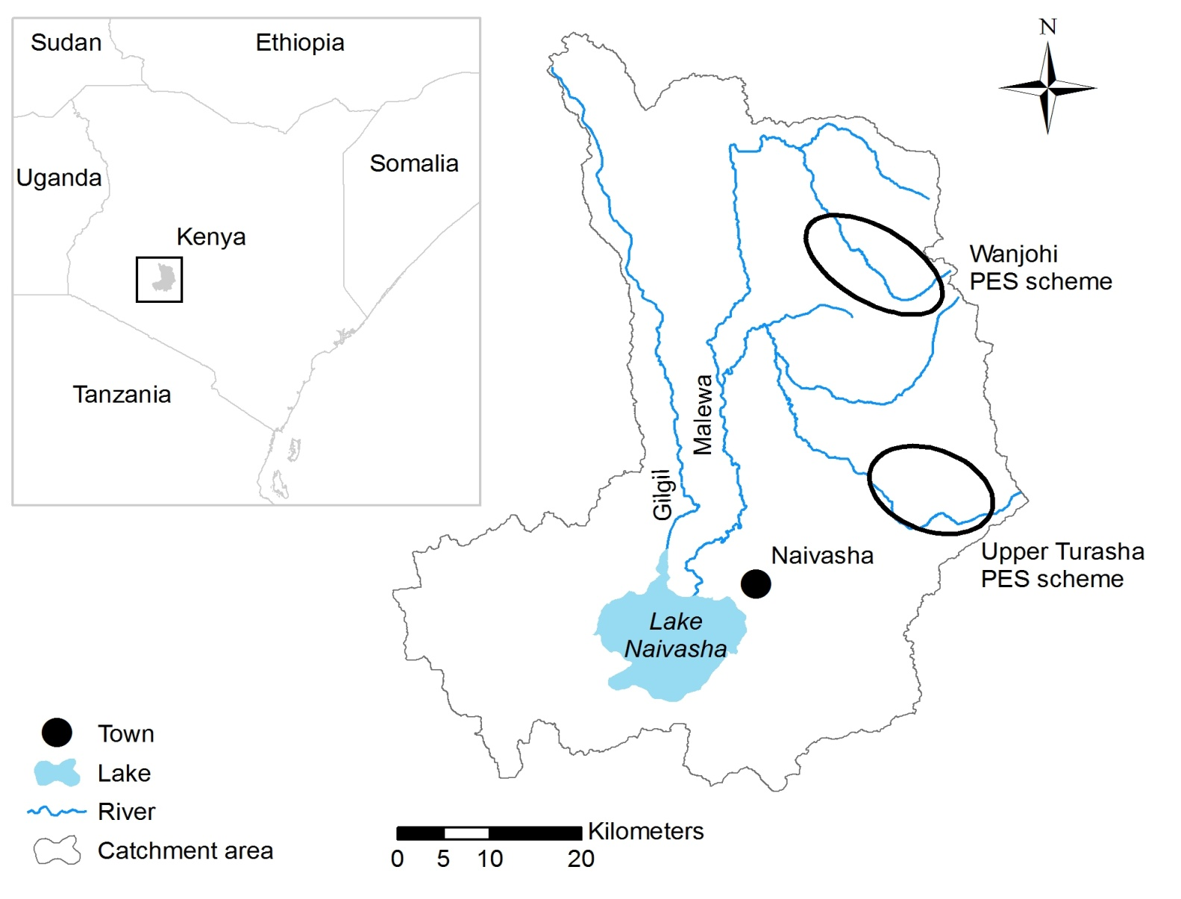
FUTURE WORK
In the Naivasha basin small scale PES schemes are applied at two locations. Good opportunity for:
validating our modeling approach
exploring the potential
of up scaling current PES
schemes.

Slide 26
DISCUSSION
For projecting the spatially-explicit developments with regard to adopting PES by individuals a process-based ABM model is preferred over a pattern-based approach (e.g. including spatial autocorrelation) because it may be
more helpful in understanding the process of adoption
more accurate in predicting land use change developments.

Slide 27
EXAMPLE FOR Measuring BASIN Closure
Trend associated with minor closure
Actual runoff (Q)
More natural runoff (Q_{nat})
Trend associated with major closure
0
Change in stored volumes in upstream catchment (∆S)
Not closed.

