Slide 1
Applying geospatial information to integrate food production, diets and nutrition status for a healthier food systems in rural Ethiopia
Habtamu Guja Bayu
Supervisors:
Dr Mariana Belgiu (ITC), Dr Kaleab Baye (AAU), Prof. Alfred Stein (ITC)
October 12 2023
PhD Research Progress
Ethiopian Education Network to Support Agricultural Transformation
EENSAT Project

Slide 2
Objectives:
Examining adequacy of essential nutrients from local production
[macro- and micronutrient, anti-nutrients, relative bioavailability, determining the proportion at risk of inadequate nutrient intake]
Evaluating the associations between food production diversity and intra-household dietary diversity from agroecologically diverse rural areas in Ethiopia
Determinants of micronutrient deficiencies among women and nutrition status of children: a multilevel analysis from rural Ethiopia.

Slide 3
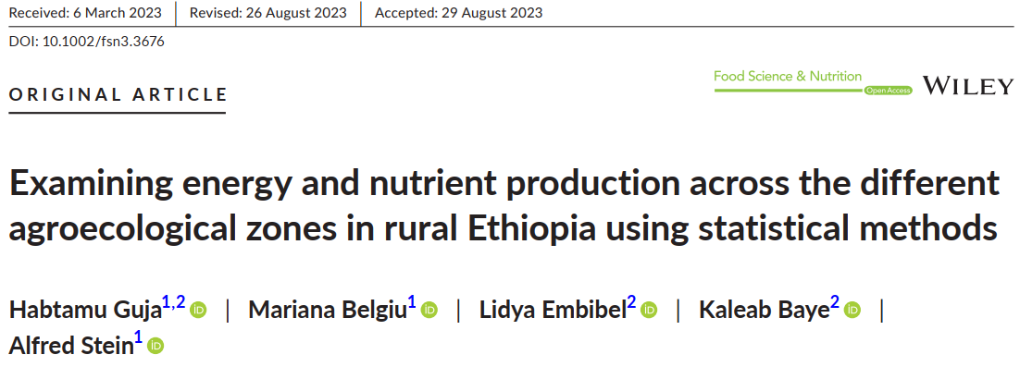
Activities done so far
Published first paper

Slide 4
Activities done so far…
Second paper is submitted & under review [Journal of Food Security]

Slide 5
Remaining activities
Third paper
Determinants of micronutrient deficiencies among women and nutrition status of children: a multilevel analysis from rural Ethiopia.
➔ Recently received the remaining lab results
➔ Currently, I am working on paper 3
➔ The first draft will be ready by end of October
Dissertation document [first draft] will be ready by end of November.
PhD defense is tentatively scheduled towards end of February 2024.
Date of my return to Ethiopia is not decided yet [Discussion… supervisors/EENSAT]
Notes:
Determinants of maternal and child undernutrition: a multilevel analysis from rural Ethiopia.

Slide 6
Ethiopian Education Network to Support Agricultural Transformation
EENSAT Project
Habtamu Guja Bayu
h.g.bayu@utwente.nl

