Slide 1
UAS general knowledge
G. Parodi
Notes:
1

Slide 2
Laws of motion
Newton's 1st Law (Law of Inertia): Every object in a state of uniform motion tends to remain in that state of motion unless an external force is applied to it.
Newton's 2nd Law (Law of Acceleration): The acceleration of an object as produced by a force is directly proportional to the magnitude of the force, in the same direction as the force, and inversely proportional to the mass of the object.
Newton's 3rd Law (Law of Action and Reaction): For every action there is an equal and opposite reaction.
Bernoulli's principle (fluid dynamics): An increase in the speed of a fluid occurs simultaneously with a decrease in pressure.
Torque: Torque is the rotational force of an object moving around an axis. This is highly relevant in aircraft motors as they produce rotational energy and, due to Newton’s 3rd law, also reaction energy. It is this reaction energy which means you need a tail rotor (anti-torque rotor) on a helicopter.

Slide 3
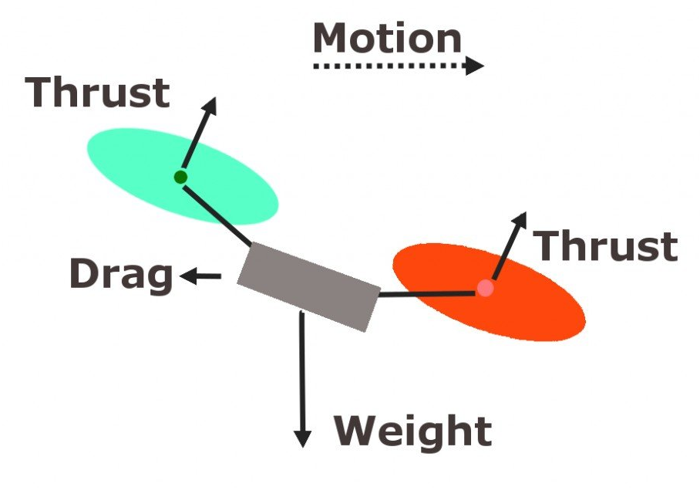
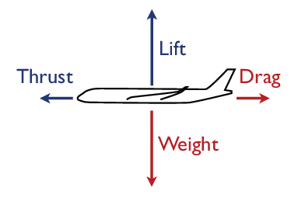
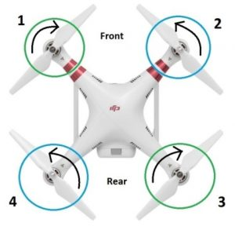
The four forces of flight
4 forces: vector quantity
Thrust >> drag in aircrafts
Lift > weight
Thrust ⬄ than weight in quadcopters
Opposite rotation is required to compensate 3rd Newton law’s.

Slide 4
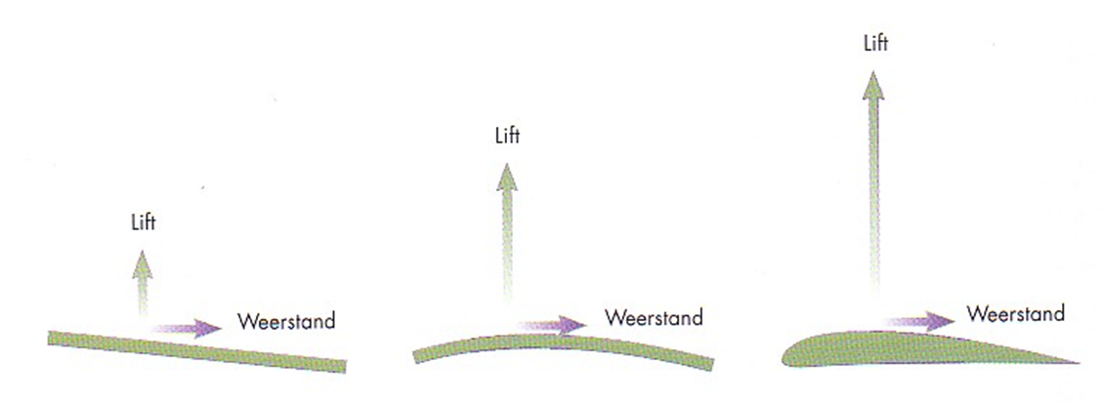
Lift power vs Weight. Thrust vs drag
The design of the wing is important for the lift power. Lift power is the result of several of effects. One is the so-called Bernoulli effect: a reaction power because of the air pressure, air flow, air speed and design of the wing. The most important is of course the combination of motor power and ailerons.
The weight is just the weight located in the center of gravity of the aircraft, aiming at the center of Earth.
Drag is the resistance to motion of aircraft through the air and acts in the same direction and parallel to the airflow over the aircraft.
Thrust counteracts the drag and it is provided by the engines.
DRAG
DRAG
DRAG

Slide 5
Stall
The angle of attack is the angle between the wing chord and relative airflow. With a low angle of attack, airflow is smooth and creates a moderate amount of lift.
As the angle of attack increases the lift force builds up to a peak, then the airflow begins to break away from the surface of the wing starting at the trailing edge.
A stall occurs when the airflow breaks away completely, resulting in a sudden loss of lift.

Slide 6
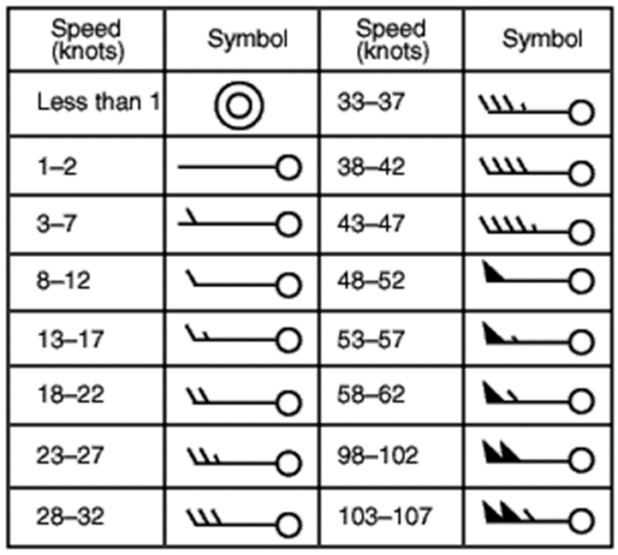
Environmental conditions and performance
Main factors affecting performance:
Wind: usually till Beaufort 4= 7 m/s = 13 knots
Air density: F(T,H) reducing with height.
Temperature
Humidity
Drones have a rated service ceiling.
Phantom: 19685 feet (6000 m, but don’t try)
At sea level:
At this elevation

Slide 7
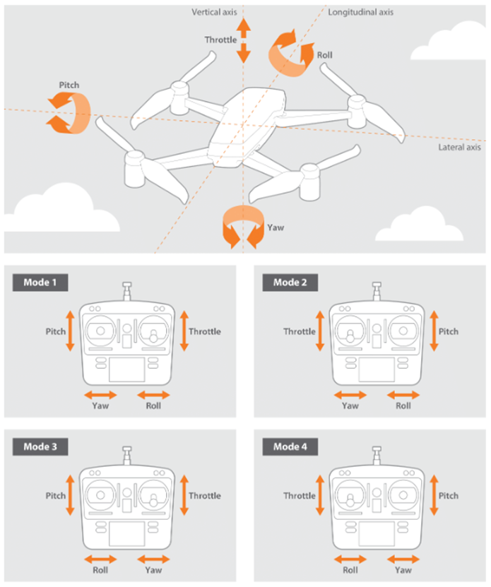
Data link
Commonly, the RPA system will make use of two or three data links for the exchange of information between the RPA and the GCS (ground control station):
The (transmitter) uplink (most of the time the 2.4 GHz) is used to command the RPA in diverse flight scenario’s.
The (receiver) Downlink (also 2.4 GHz) is used for the communication RPA to GCS. The RPA gives information on position, height, distance, speed and flight direction.
The video downlink (most of the time the 5.8 GHz (band width) will be used for the video and photo data. The video link is more limited in transmission.

Slide 8
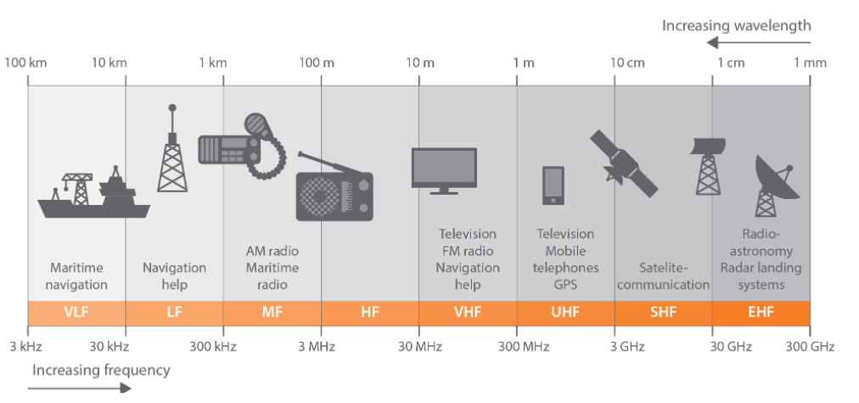
Radio frequency spectrum and wavelength

Slide 9
Range & interference
Radio Controllers ratio >> allowed operating range (but in normal conditions)
You must keep VLOS. Flying behind buildings will lose signal and link. Precaution!!
Interference: thunderstorms, cumulus nimbus, electric equipment, generators, powerlines, and other equipment using similar frequencies.
Kpindex: indicates the strength of disturbances in the earth’s magnetic field (geomagnetic field). The Kp-index has a value between 0 and 9. The disturbances can lead to radio interference. If the Kp index is higher than 5 the interference can affect both the radio link between the ground station and the UA, and GNSS reception.
Check the signal indicator in the controller.

Slide 10
Flight modes
Fully manual: this is usually only available on racing drones. In this mode the pilot has to control all aspects of the UA's operation. Flying a UA in this mode is very difficult because it is unstable.
Stabilised/attitude mode (atti mode): the Flight Controller keeps the UA in a horizontal attitude when the sticks of the transmitter are in the neutral position. When the sticks are moved, the UA will mimic the exact angle of tilt of the sticks. Note that the UA will still drift with the wind, unless corrected by the pilot. Not use under wind conditions.
Position hold (GPS mode): this is the easiest to control. The pilot moves with the sticks an imaginary point in the sky that the drone follows
Programmed flight: the UA flies from one preprogramed waypoint to another. This is particularly useful for surveys. It is a legal requirement that the pilot can take over control at any time. This means that the pilot must have the ground station at hand all the time.
Intelligent flight modes: the UA flies a maneuver or tracks a subject without input from the pilot (for example DJI active track or quick shots)

Slide 11
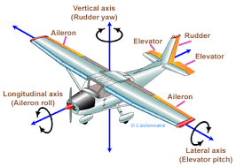
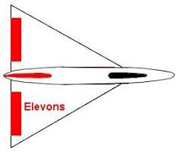
Primary flight control in fixed wings
Ailerons: it controls the movement around the longitudinal axis: ROLL.
Elevators: movement around the lateral axis: PITCH.
Rudder: movement around the vertical axis YAW.
Elevon (Special): elevator and aileron combined (Delta wings)

Slide 12
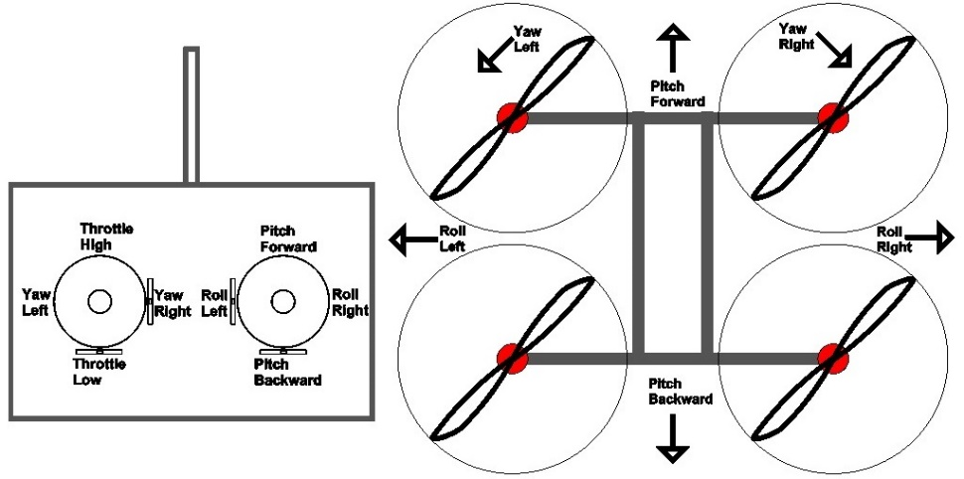
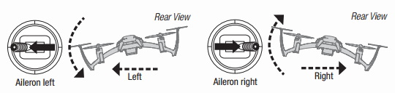
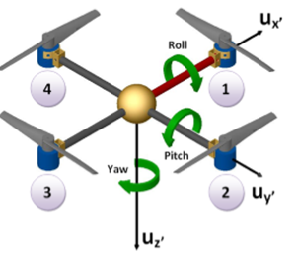
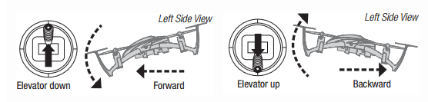
Primary controls in quadcopters
All movements are controlled by individual but coordinated variations in the speed of the 4 rotors
Roll: moves your quadcopter left or right.
Pitch: moves the quadcopter forwards or backwards
Yaw: rotation on fixed position
Roll
Pitch

Slide 13
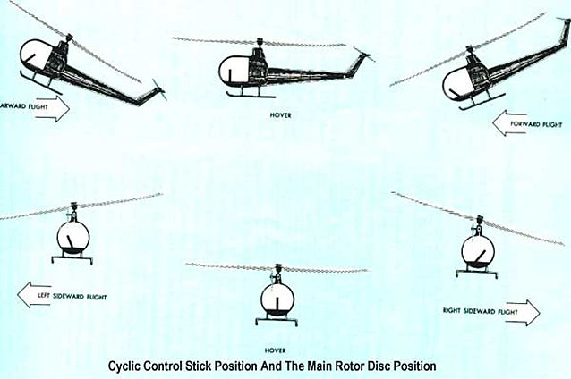
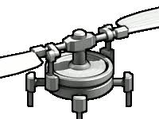
Primary flight control in helicopters
The engine of a single rotor helicopter has (most of the time) during the flight a constant rotation speed. All the 3 movements (pitch , roll and yaw) of this air vehicle must be done by rotating the single rotor in different positions.
To do so, the helicopter is equipped with a so-called swash plate.

Slide 14
sensors
Inertial Measurement Unit (IMU): a small chip containing a three-axis gyroscope and three-axis accelerometer (used to measure linear acceleration) and sometimes also a compass. The UA uses data from this chip to measure its movement and orientation in the air. No IMU = No drone. Most modern drones have at least two IMUs for redundancy and higher accuracy.
Compass: measures the direction of the ambient magnetic field. A compass can be used for navigation. This magnetic field changes with location and a compass calibration is needed when operating in a new location.
Altimeter: shows you the height at which you are flying. The altimeter works by measuring changes in air pressure during flight.
Proximity sensor: usually used to measure distance to the ground, which can be useful when taking off and landing. They are also used to detect obstacles around the UA.
Optical flow sensor (vision positioning with DJI drones): detects lateral movement of the UA, allowing the flight controller to hold the UA in position without GNSS.
Warning indicators (status LED): shows the status of the UA. This can be to show battery level, signal strength, flight mode, or even if you get too close to an object.

Slide 15
limitations
Maximum Take-off Mass (MTOM) is the maximum allowed mass of the entire UA. This limitation should be specified by every UA manufacturer in the UAS user manual. Beyond MTOM is unstable.
The Centre of Gravity (CG) is not fixed but moves forwards or backwards, left or right along the axes, depending on how the UA is loaded. It is essential that its centre of gravity remains within certain limits called CG envelope; otherwise, will not fly. See UA manual.
Wind: Do not fly when wind > see specs. Be aware of log-law (see apps). Pay attention to turbulence close to objects.
Temperature: see specs. High temperature affect the drone and mainly batteries.

Slide 16
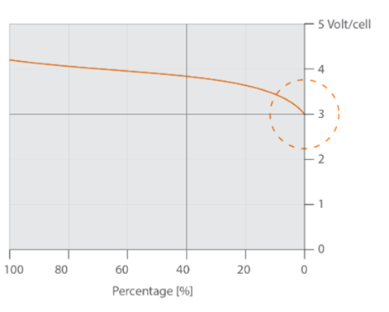
Limitations batteries
Most common rechargeable battery for RPAS is the Lithium-ion-Polymeer battery, so called “lipo” batteries.
Main characteristics:
Dry battery without heavy metals;
Not to used till exhaustion (keep a minimum of 1-5%);
Slow discharging (5% per month);
No memory effects (Could be recharged at any time, even after short use)
With high consumption fast backward capacity;
Dangerous due to chemical substance; Maintenance and transport procedure required
Stabilized charging device is needed;

Slide 17
Controlling the UAS: take-off
Most UAs need to be armed before they will take off, and will be described in the UAS user manual.
For rotorcraft (multirotors and helicopters):
Start the motor(s)
Increase the power to take-off (default left stick)
Use pitch and roll controls to keep the UA stable (default right stick)
For airplanes (fixed wings):
Start the motor
Increase the throttle to full (default left stick)
When there is sufficient airspeed, lift the nose of the UA to take off (default right stick)

Slide 18
During flight
Orientation control (UA is facing in different directions) is one of the most important skills to learn while hovering or flying various patterns.
For rotorcraft (multi-rotors and helicopters):
Practice hovering over a spot, using small pitch and roll corrections. Maintain a constant height above the ground by adjusting the power
When flying various patterns or manoeuvres you should be able to stop at any point, for example to avoid an obstacle.
For airplanes (fixed wings):
Make sure to maintain a safe airspeed. You should not need full throttle in normal flight, but if the UA flies to slow it may stall and crash. Find a throttle setting that is just right, every UA will handle differently.
Practice making coordinated turns, by rolling into the turn and lifting the nose slightly to maintain height.

Slide 19
landing
Landing the UA is usually the most difficult part of flying. Plan the descent carefully and keep the UA stable when approaching to land.
For rotorcraft (multirotors and helicopters):
Return to the landing area, and hover in place.
Start descending by decreasing the power, while keeping the UA steady with pitch and roll corrections.
Once on the ground, stop motor(s) immediately.
For airplanes (fixed wings):
Plan the approach to the landing area, so that the UA lands into the wind.
Line up with the landing area (runway), decrease the throttle and lower the nose of the UA to start descending.
Just before landing, decrease the throttle completely (idle) and use pitch and roll corrections to gently land the UA. After landing turn off the UA.

Slide 20
Safety features: Failsafe
This is what happens if the UA loses signal: Usually RTH, landing on spot, hover for quadcopters and loiter for fixed wings
RTH: triggered automatically or on purpose: climbs (set it before the flight – 15 to 20 m higher) then moves to home and descend. Descending spot is the take-off or manual.
Direct landing: best option when indoors, using the VPS. Sometimes the drone does it if safety was overpassed (gusts)
Hover: Stays in the air till battery is 15% and then it lands
Loiter: circling around over a place, till connection is restated otherwise it lands dur to low battery

Slide 21
Proximity sensor
The addition of a proximity sensor gives the UA more functionality and makes it safer to fly. The most common proximity sensors are ultrasonic. These sensors work best over hard surfaces like concrete. Over surfaces such as grass the signal can be absorbed and the proximity sensor will be less effective.
These sensors are used most to measure distance to the ground, which can be useful when taking off and landing. They are also used to detect obstacles around the UA.

Slide 22
Geofencing (important)
Based on GNSS information received by the UA certain areas such as no-fly zones can be activated and prevent the UA from taking off. Geo-fencing can also be used to warn the pilot when flying close to sensitive areas for example, or cause the UA to land.
No-fly zones databases are updated regularly, so make sure to be familiar with the UAS user manual and how to update these zones for your UAS. Usually, the software automatically checks for updates and warns you when the system is outdated, but you can usually update manually via the settings menu on the UAS.

Slide 23
Height and distance limit
Much like geo-fencing, maximum height and distance limits can (MUST) usually be set up on the UA.
Refer to the UAS user manual when setting these limitations, usually done via the settings menu on the UAS. 120 m should be the standard maximum height for all flights, but sometimes setting a lower height is safer if you are expecting other airspace users for example.

Slide 24
Detect and avoid systems
Some of the current generation of UAs already integrate detect and avoid systems . They can detect objects and limit or stop their movement to prevent collisions.
These techniques will be further developed so UAs will be able to detect other aircraft and manoeuvre automatically to avoid one another

Slide 25
Remote identification systems
These are electronic system that transmit information about the UA such as a registration number or operator details. This information can be used by the authorities to identify whether the UA is allowed to fly in a certain area or not.
This remote ID should be updated when necessary to display the correct information, and should be updated in accordance with the UAS user manual, usually down via the settings menu on the UAS.

Slide 26
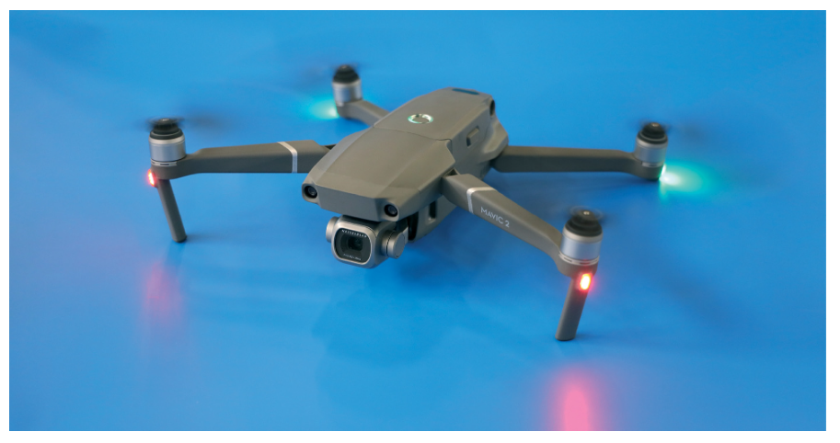
Warning indicators
Most UAs today use a status LED (light) mounted on the UA which can change colour and flash in different ways to communicate important information to the pilot. It is also possible to have warning indicators on the pilot’s controller or ground station, often using a buzzer instead of a light so the pilot doesn’t need to take their eyes off the UA.
The most used functions of warning indicators include:
Battery level
GNSS signal strength
Control signal strength (RSSI)
Flight mode
Failsafe
Distance from the pilot
Speed

Slide 27
Safety considerations: Payload
Before and after every flight you must do a quick check of the UA: can you see any damage, are all components secure, is the battery connected correctly, is there any damage to the propellers, etc.?
If the UA has a removable payload, it is especially important to check that it is secured correctly. If the payload were to come loose during flight, it could seriously affect the stability of the UA (CG) or injure people on the ground.
Alteration of the payload may (will) cause a change in the position of the center of gravity, with flying consequences.

Slide 28
Danger of spinning propellers
MAXIMUM PRECAUTION
UA propellers are usually made from carbon fibre, plastic or from wood. The edges can be sharp and when spinning fast can cause serious injuries. There have been reported cases of deep wounds or permanent damage to the eyes.

Slide 29
Safe handling of batteries - 1
Most UAs use Lithium batteries. This is because they can store large amounts of energy, are lightweight, and are able to discharge very quickly without being damaged.
The downside to these kinds of batteries is that they can catch fire or even explode if handled incorrectly. If a lithium battery is damaged (by dropping, a hard landing, etc.) it is safest to stay away from it for at least half an hour. After that you can carefully investigate how serious the damage is.

Slide 30
Lithium battery voltage - 2
Lithium batteries are very sensitive, and must remain between specific voltages. A single lithium cell has a nominal (average) voltage of 3.7V.
It should never be charged to more than 4.2V or discharged below 3V. The minimum voltage of a LiPo is not exact. Some LiPo batteries can be discharged up to 3V safely, while others may be significantly damaged. It is therefore wise to add a safety margin. Generally, 3.5V is used as a minimum cell voltage.

Slide 31
Charging lithium batteries - 3
You must always charge lithium batteries with a suitable charger and read the manuals of the batteries and the charger. Never charge batteries with a charging current higher than that advised by the manufacturer. If the charging current is too high the batteries can be damaged or ignite.
Always charge batteries at room temperature and never charge batteries which are very cold (< 0°C) or hot (> 45°C) to prevent damaging the batteries.

Slide 32
Battery storage - 4
Lithium batteries should be stored in a battery bag, at room temperature, in a dry place. The storage temperature limits are given in the battery manual, and are often between -20° and +30°C.
Ideally a battery should be stored with around 60% charge. With the cell voltage roughly in the middle this helps prevent the battery from being damaged by falling below the minimum voltage. Storing a full battery means that if something were to go wrong the battery will release its maximum amount of energy, but by storing it at 60% means there is less energy and a more stable battery.
Batteries slowly lose power during storage. This is known as self-discharging. As a result, during storage a battery can reach a low charge state which can damage it. So even if you do not use a battery for a few months you have to check it and, if necessary, top up the charge.

Slide 33
Travelling with batteries - 5
When transporting batteries in your own vehicle you must protect them against damage. It is a good idea to keep them in battery bags.
There are restrictions on transporting lithium batteries on aircraft. Both ICAO and IATA (International Air Transport Association) have produced regulations and guidelines (support). Airlines also have their own regulations, which may be stricter than the ICAO and IATA regulations.

Slide 34
Maintenance
Safe and efficient operations depend on effective maintenance. The maintenance is usually described in detail in the UAS user manual.
The UA needs to be maintained in accordance with procedures determined by the manufacturer. They can specify the frequency of which maintenance must be done, usually every number of hours or flights where certain parts have to be checked, cleaned or replaced.
If you work for a small operator you probably undertake the maintenance yourself. But even if the operator has a maintenance technician, you, as the pilot, still have the ultimate responsibility for the UA during the operation.

Slide 35
Software updates
Updating the firmware and software can be very useful, especially when it comes to fixing bugs, improving accuracy and adding new features. However, it can also drastically change the way the UAS works and the flight characteristics of the UA.
It is always recommended to wait a while before updating when a new update is released, so that you can check with other users and the manufacturer whether it is safe or not. After any update it is recommended to test the UAS as far as possible on the ground in a controlled environment to ensure that everything is functioning correctly before performing a test flight.
Never update just before a mission

Slide 36
Lecture End

