Slide 1
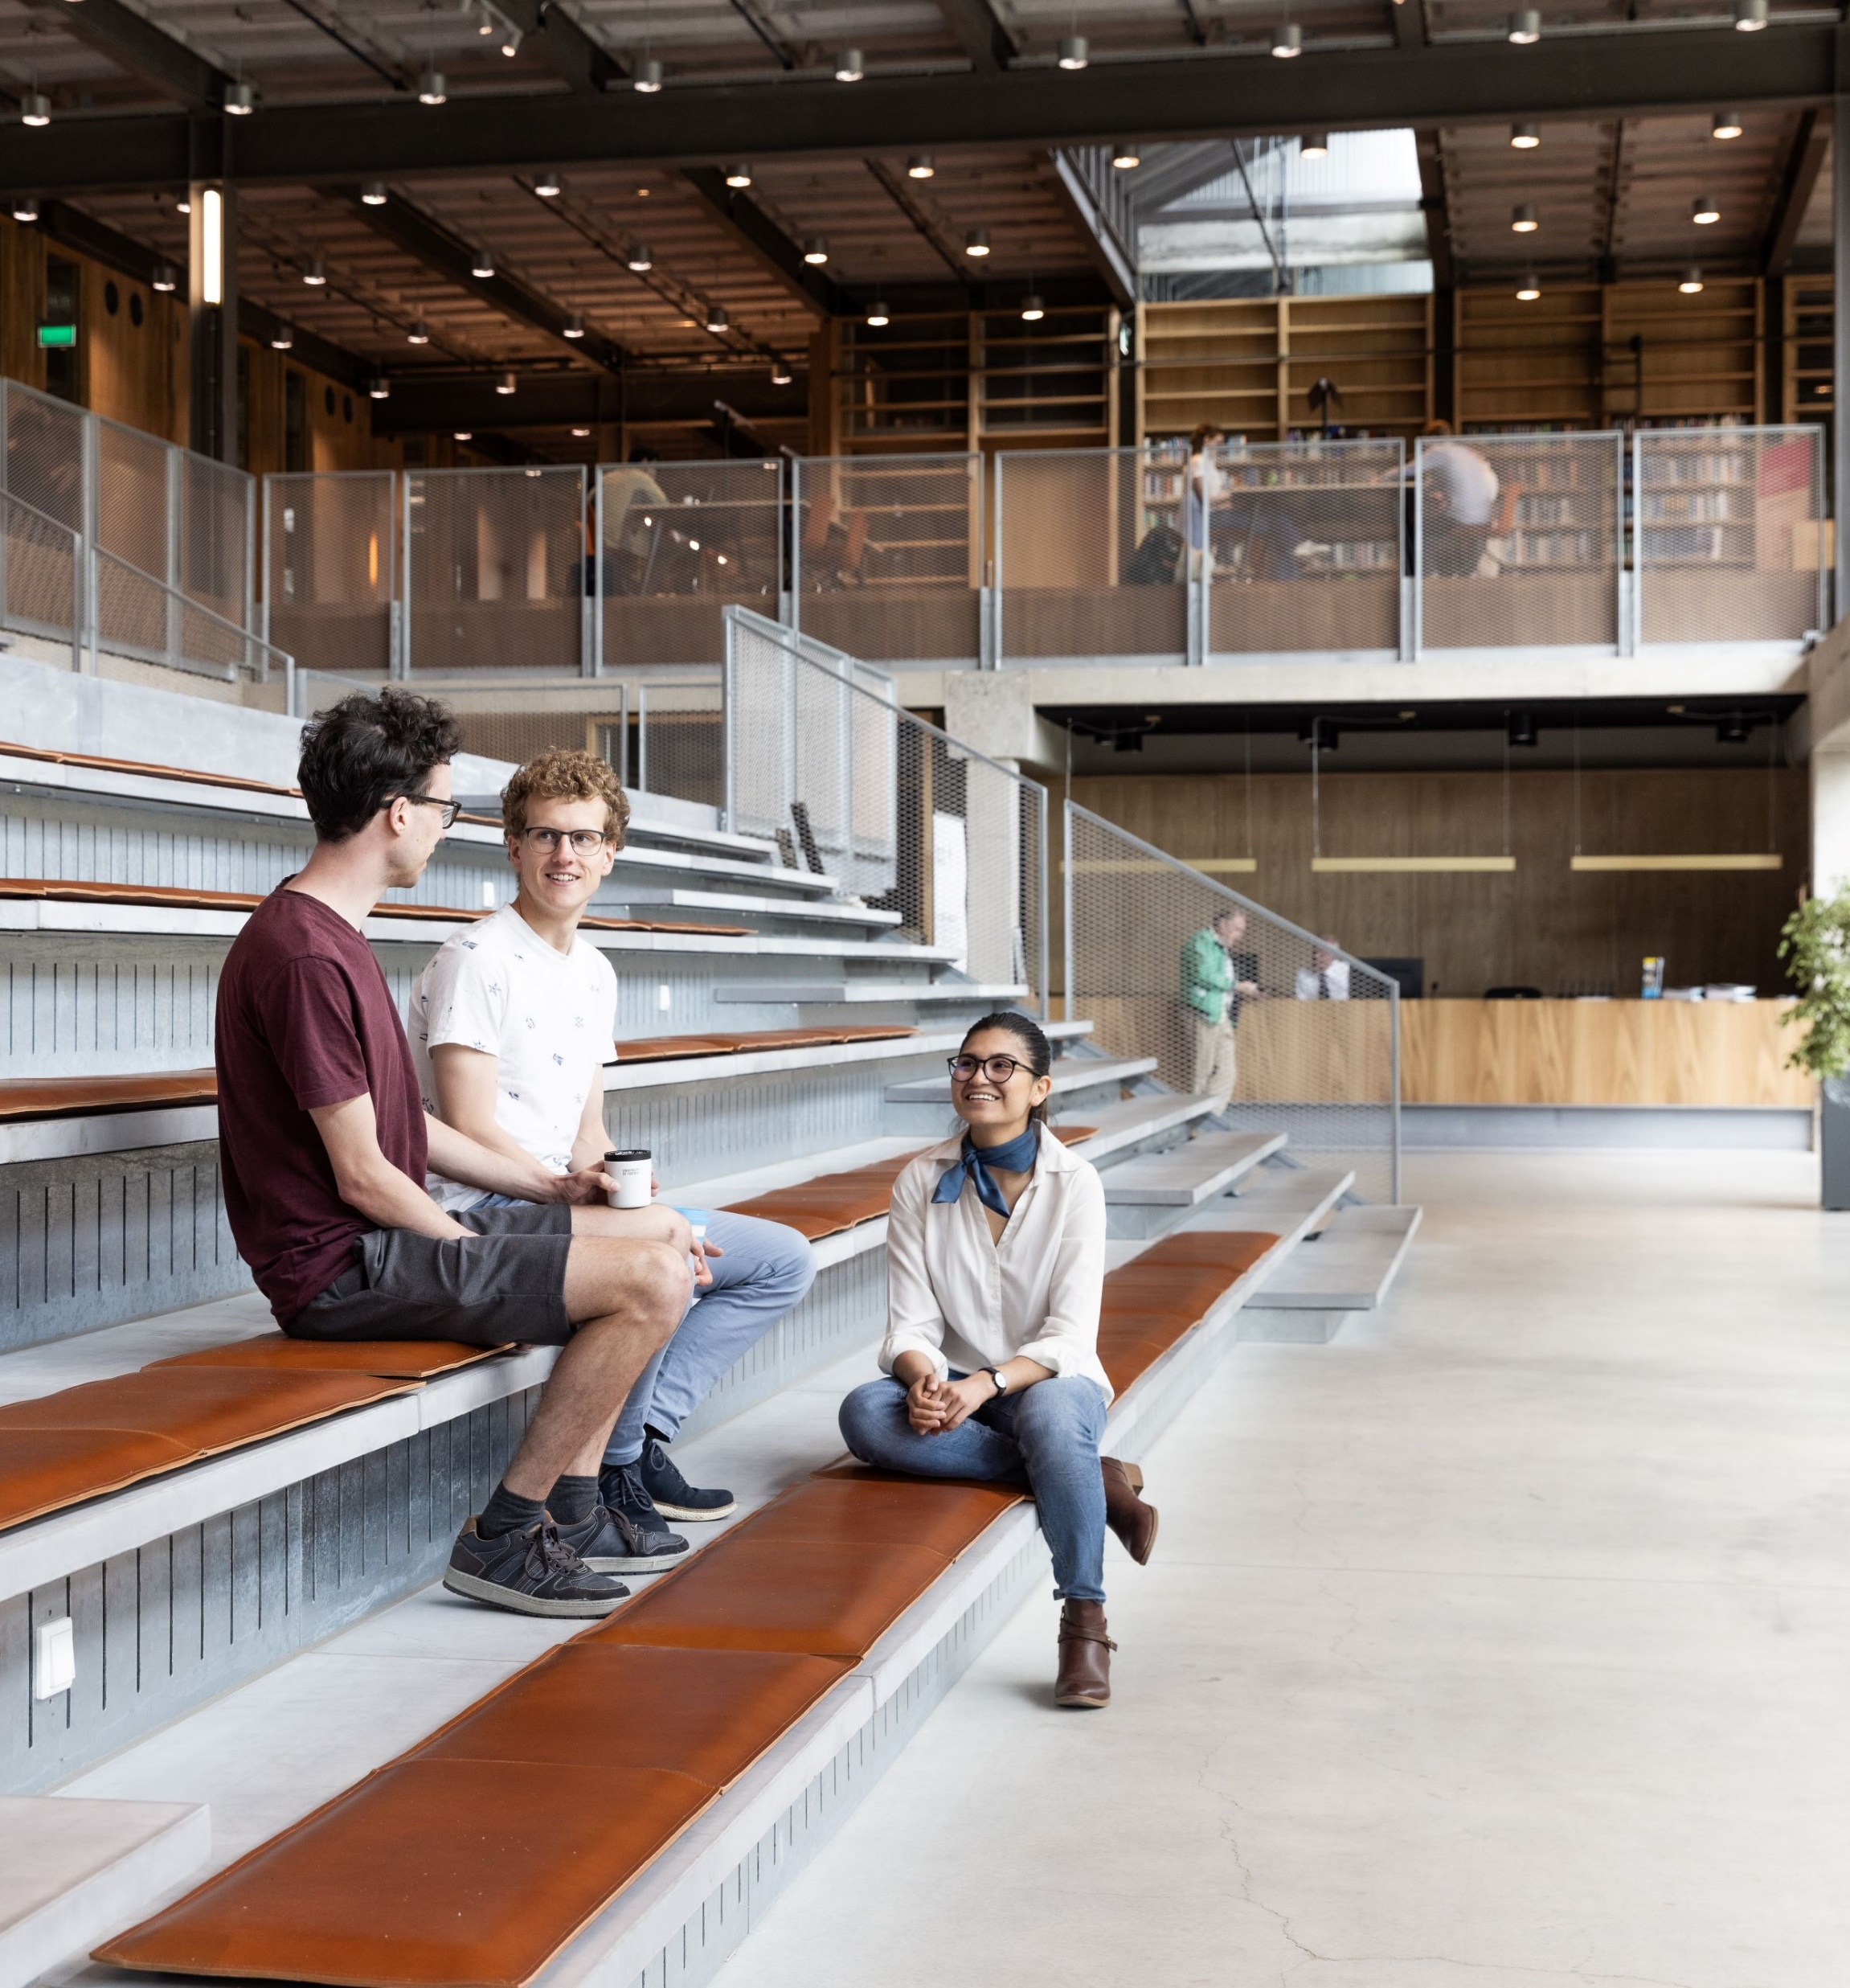
Eensat presentation
Faculty of Geo-information Science and Earth Observation (ITC)
Organisation and management of higher education
Michiel Bresser - m.c.Bresser@utwente.nl
Emile Dopheide – emile.Dopheide@utwente.nl

Slide 2
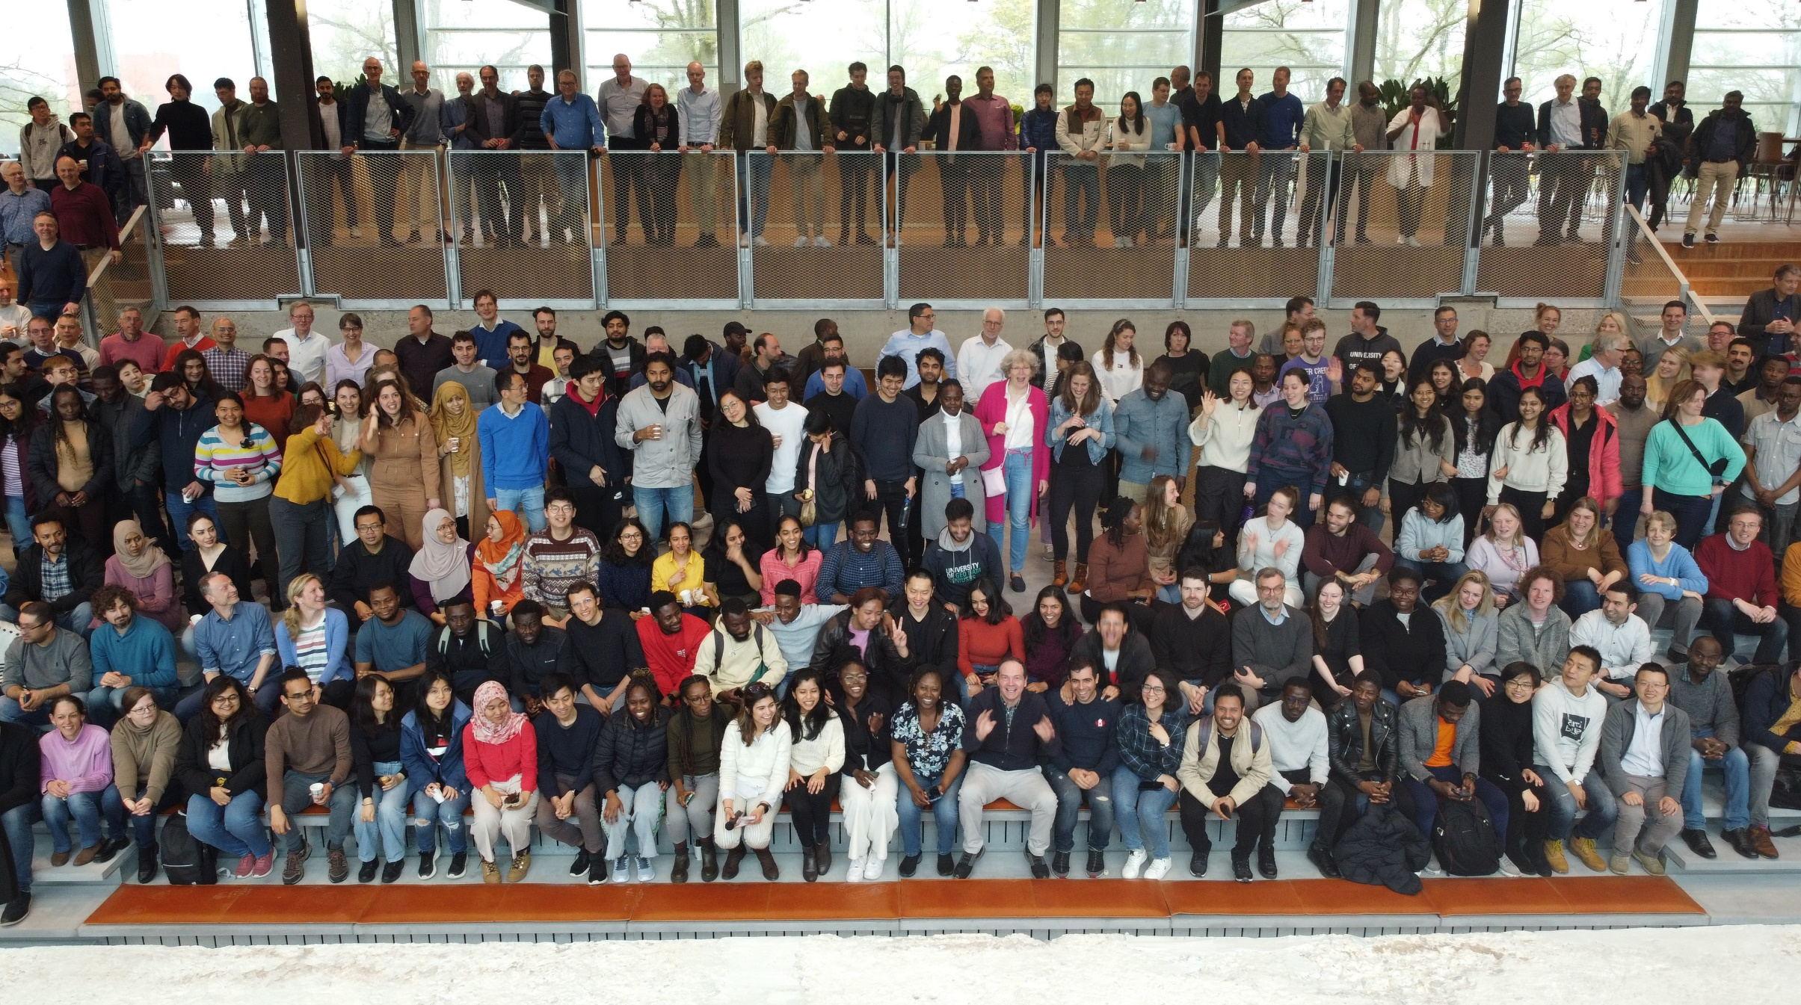
Who is who?
Faculty of Geo-information Science and Earth Observation (ITC)
Short introduction and expectations

Slide 3
schedule
09:15 – 09:30: Welcome & introduction
09:30 – 10:15: Dutch Higher Education System
10:15 – 10:45: Experiences from Ethiopia
10:45 – 11:00: Coffee break
11:00 – 12:15: UT Vision on education & education @ UT
12:15 – 13:45: Lunch break
13:45 – 15:30: Education & Administration @ ITC
15:30 – 16:00: Wrap up & Lessons learned
16:15 – 16:45: Geoversity presentation by Peter Oostrom

Slide 4





Slide 5
Dutch higher education system
We would like to start of with a short movie:
Education system in the Netherlands

Slide 6
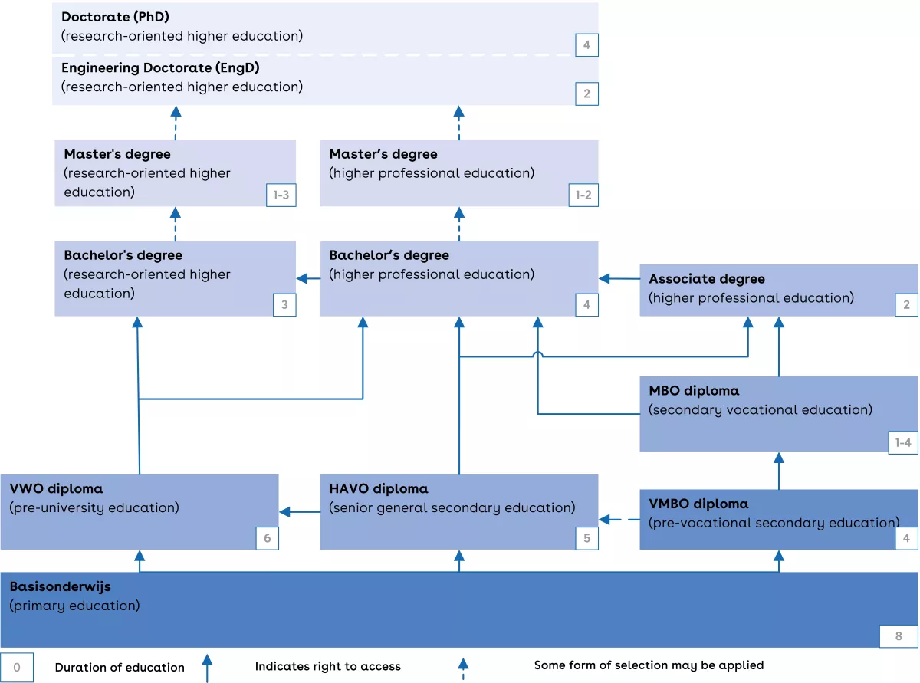
Dutch higher education system

Slide 7
Dutch higher education system
There are 2 types of higher education in the Netherlands:
  research-oriented higher education (wetenschappelijk onderwijs, WO).
  higher professional education (hoger beroepsonderwijs, HBO)
There are separate types of higher education institutions for WO and HBO
  WO: universities (universiteiten)
  HBO: universities of applied sciences (hogescholen)

Slide 8
Dutch higher education system
WO-universities
HBO: universities of applied sciences

Slide 9
Dutch higher education system
WO-universities

Slide 10
Bachelor’s degree
WO bachelor's programmes focus mainly on theory/academic research.
Duration: 3 years.
Study load: 180 ects (1 ects = 28 study hour).
Content:
A first-year phase leading to a first-year certificate;
(Theoretical) education in 1 area of specialisation or a major/minor structure
Often followed by a short thesis in the 3rd year.
Admission requirements: a VWO diploma or an HBO first-year certificate (propedeuse) and sometimes extra requirements (e.g. a specific subject combination)
Function of the diploma: access to a WO master's programme
Diploma: Bachelor of Arts (BA)/Bachelor of Science (BSc)/Bachelor of Laws (LLB).
A bachelor’s degree is classified as level 6 of the dutch qualifications framework (NLQF).

Slide 11
Master’s degree
WO master's programmes follow after WO bachelor's programmes. Focus mainly on
theory/academic research.
Duration:
  1 year (60 ECTS; most specialisations);
  2 years (120 ECTS; technical and natural sciences specialisations, and research masters in various specialisations);
  3 years (180 ECTS; medicine, veterinary medicine, pharmacy and dentistry).
Content: specific specialisation and training in research methods; mostly includes a compulsory thesis.
Admission requirements: a WO bachelor's degree, sometimes with extra requirements.
Function of the diploma: access to a PhD programme (Doctor/PhD or PDEng) or work.
Diploma: Master of Arts (MA), Master of Science (MSc), Master of Laws (LLM), Master of Business Administration (MBA).
Traditional Dutch titles:
  ingenieur (ir.) – after a completed degree programme in the field of technology, agriculture and the natural environment.
  meester (mr.) – after a completed degree programme in law.
  doctorandus (drs.) – after a completed degree programme in other fields of study.
  A master’s degree is classified as level 7 of the Dutch Qualifications Framework (NLQF).

Slide 12
Dutch higher education system
WO-universities

Slide 13
Engineering doctorate (Engd)
The 3 universities of technology (incl. UT) also offer EngD programmes.
Duration: 2 years.
Content: emphasis on technological design; more focused on practice and business/industry than the PhD programme.
Admission requirements: usually a WO master's degree and extra requirements, such as a motivation letter.
Diploma: the title of Engineering Doctorate (EngD).
An Engineering Doctorate (EngD) is classified as level 8 of the Dutch Qualifications Framework (NLQF).

Slide 14
Doctor/phd
Duration: generally 4 years (often without ECTS).
Content: conducting independent research, possibly in combination with training, and the writing of a dissertation.
Admission requirements: usually a WO master's degree and extra requirements, e.g. a personal presentation and a research plan.
Diploma: the degree of Doctor (dr.) or PhD, following public defence of the dissertation.
A degree of Doctor/PhD is classified as level 8 of the Dutch Qualifications Framework (NLQF).

Slide 15
Dutch higher education system
WO-universities

Slide 16
EU: bologna process
Process that started after 29 European Ministers of Education signed the Bologna Declaration in 1999
Creating a European Area for Higher Education (EHEA): “An open space that allows students, graduates, and higher education staff to benefit from unhampered mobility and equitable access to high quality higher education”, including:
a system based on 2 cycles, undergraduate and graduate, also known as the bachelor-master structure.
in 2003 a third cycle was added for doctoral programmes.
European Credit Transfer and Accumulation System (ECTS)
ECTS are awarded upon successfully completed studies
1 academic year corresponds to 60 ECTS
1 ECTS = 25-30 hours of workload
1 ECTS in NL = 28 hours of workload

Slide 17
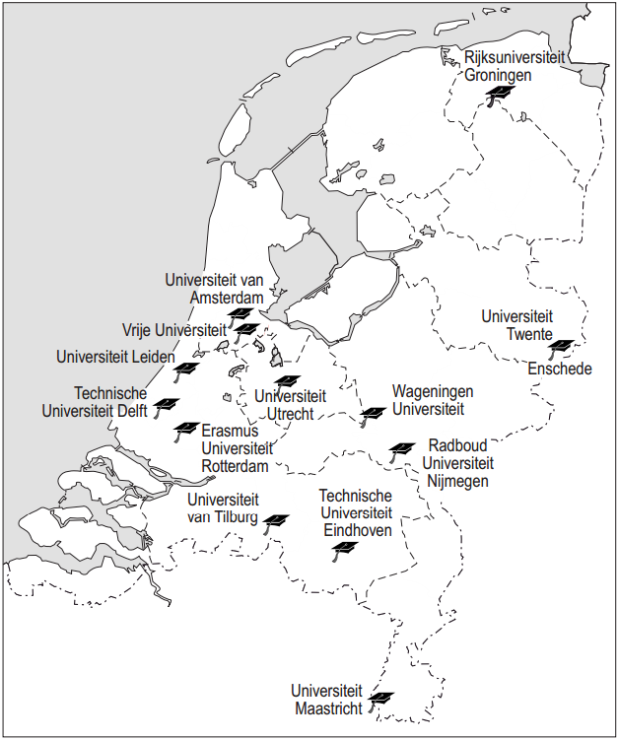




13 universities + 1 open university
All public
4 out of the 13 universities are
technical universities
Open
University

Slide 18
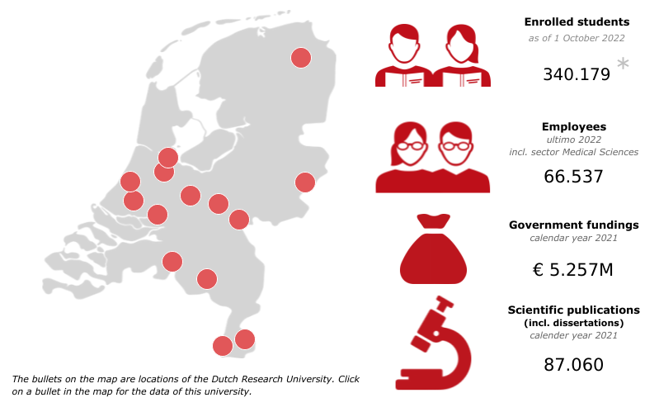

Slide 19
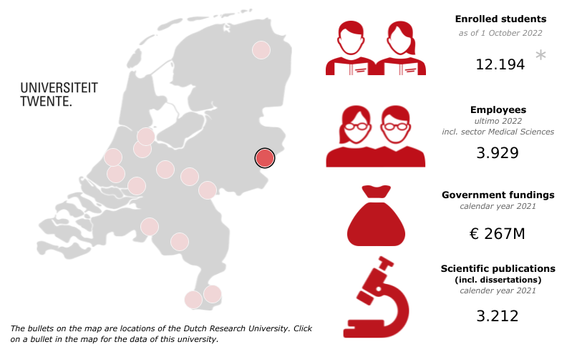
(4%)
(6%)
(5%)
(4%)

Slide 20
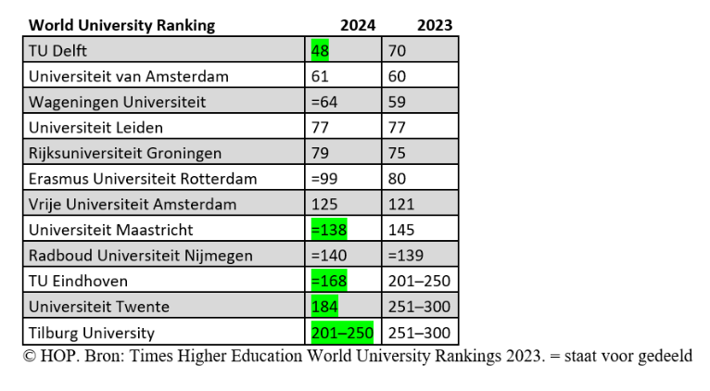
World University Ranking
Please note:
University Utrecht is missing, because they object against these rankings !!!

Slide 21
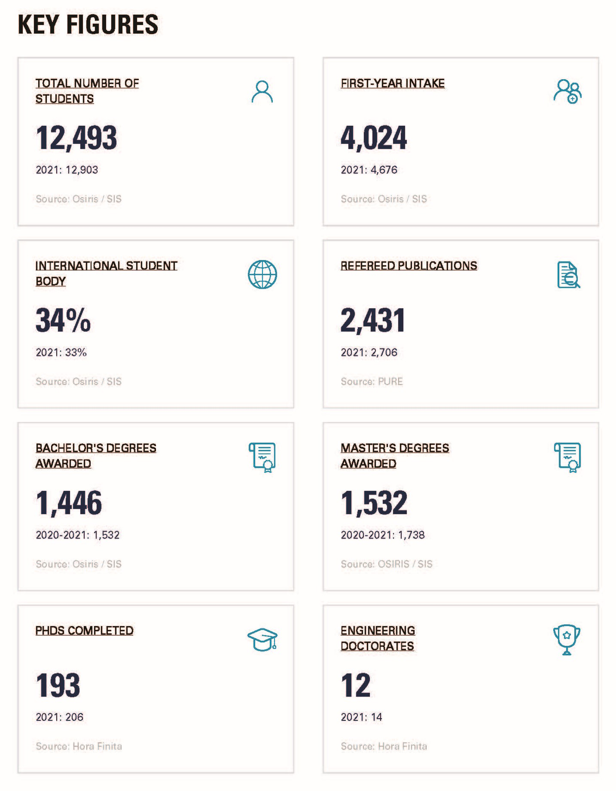
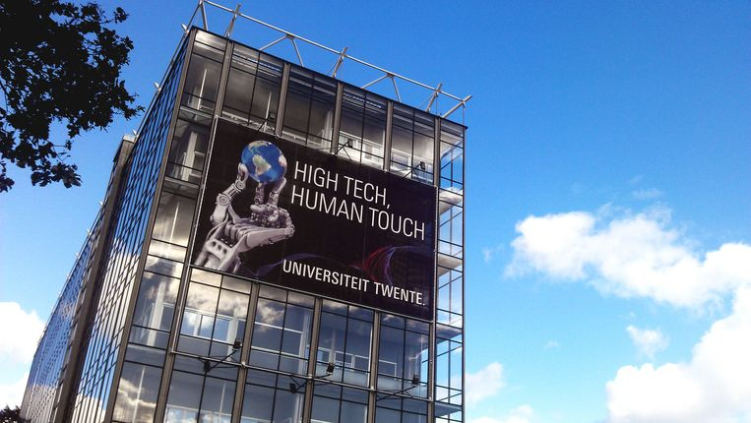
2022

Slide 22
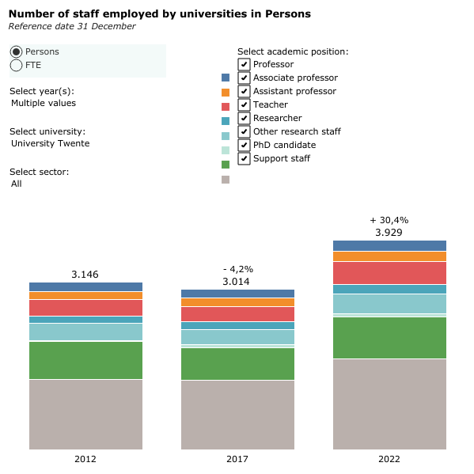
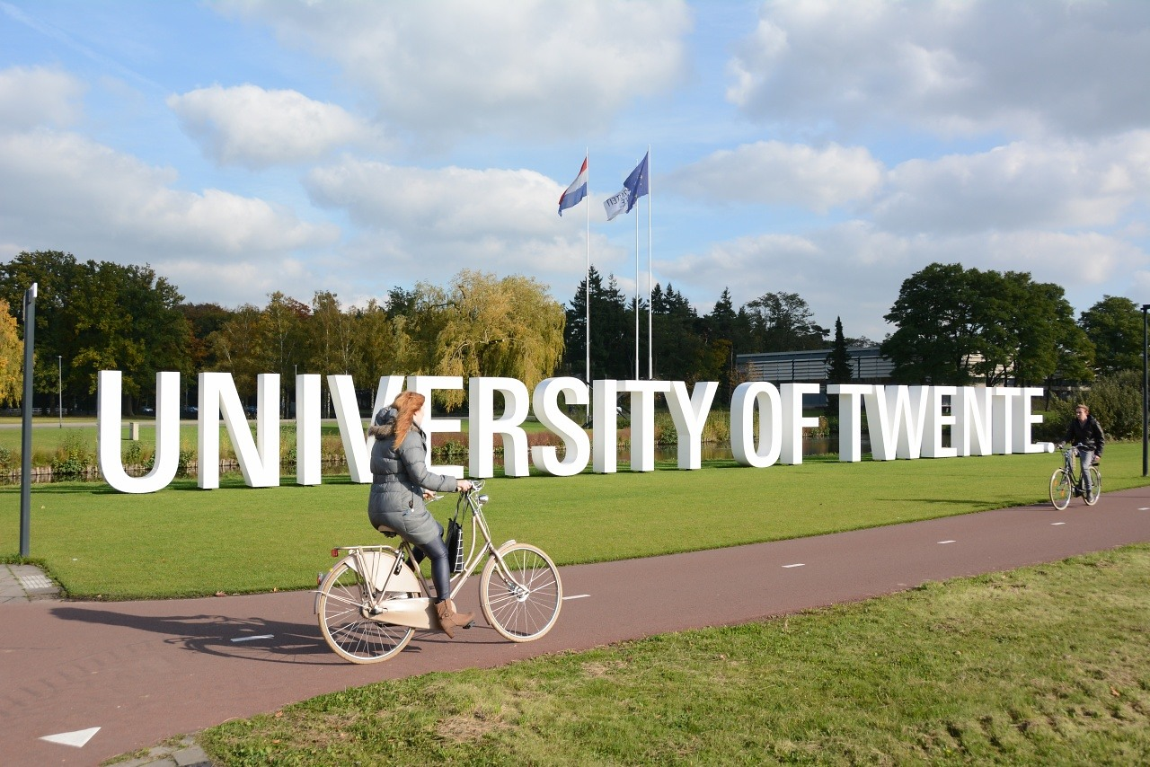

Slide 23
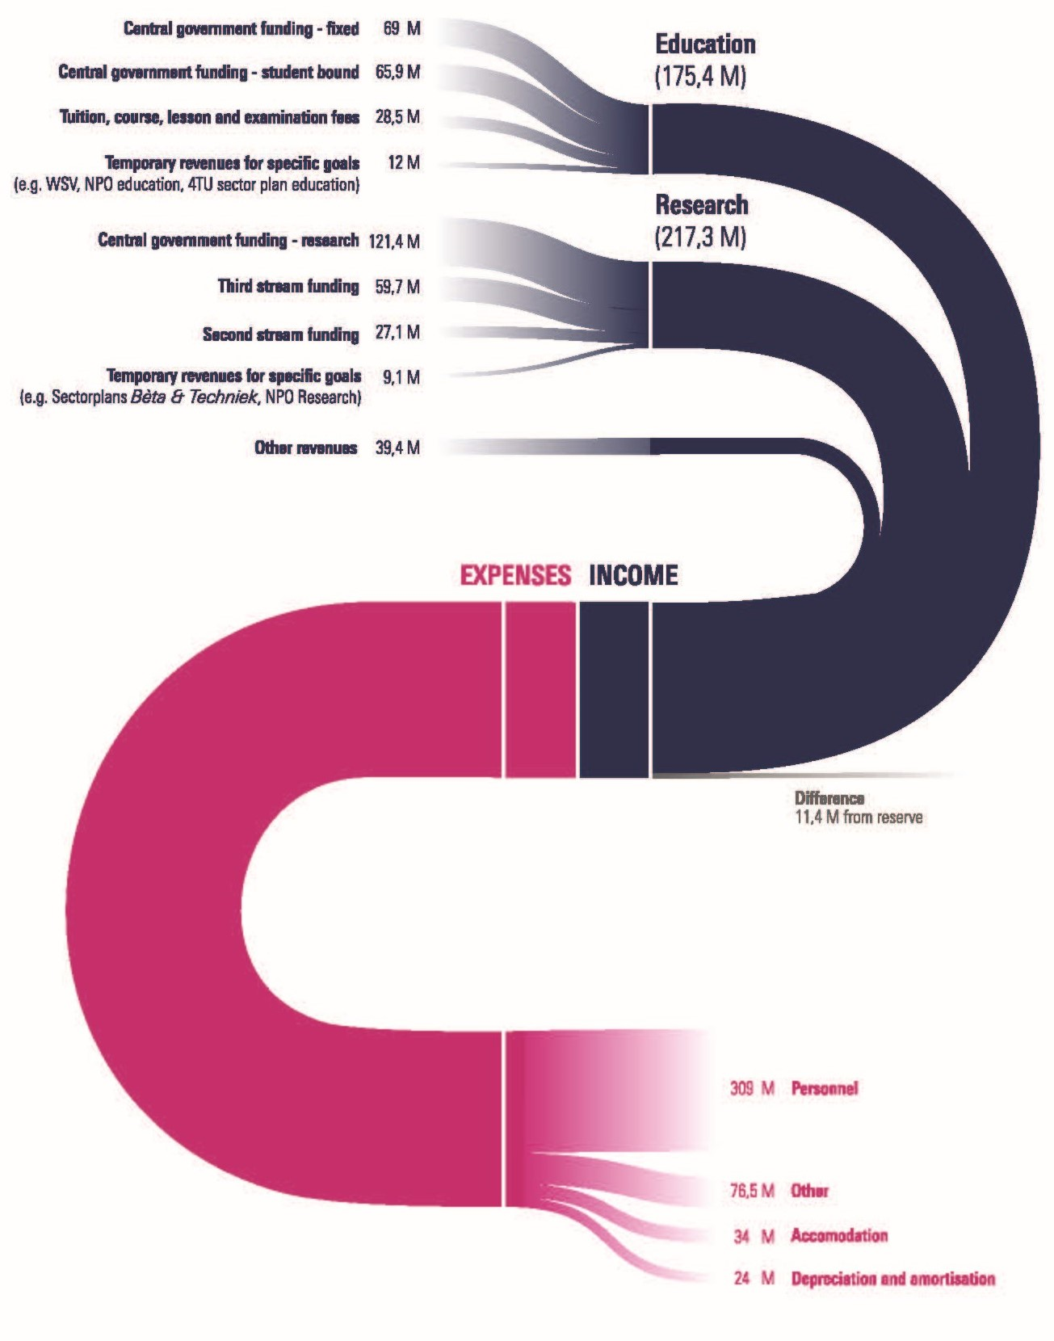
UT 2022
What is coming in and what is it being spent on ??

Slide 24
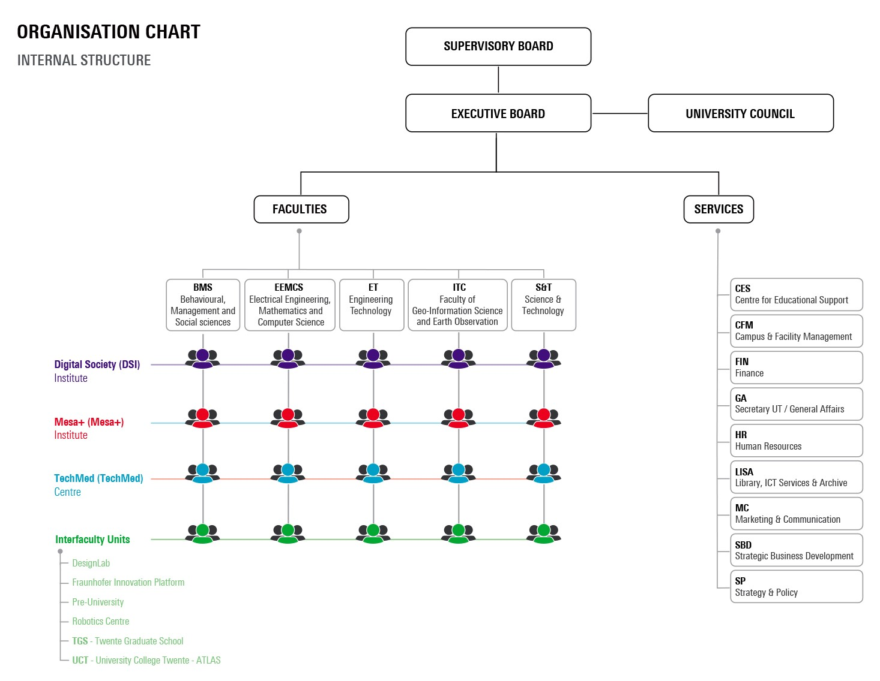
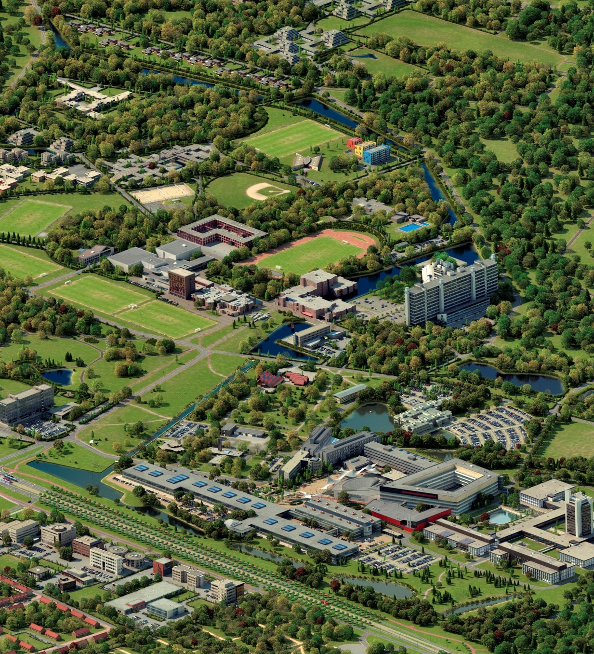

Slide 25

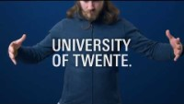

Slide 26
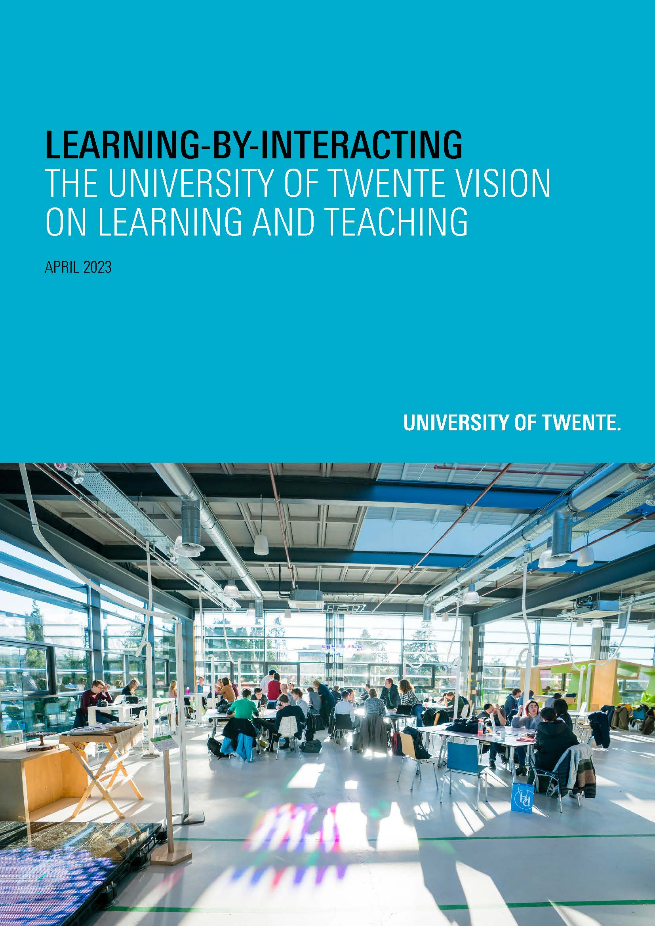
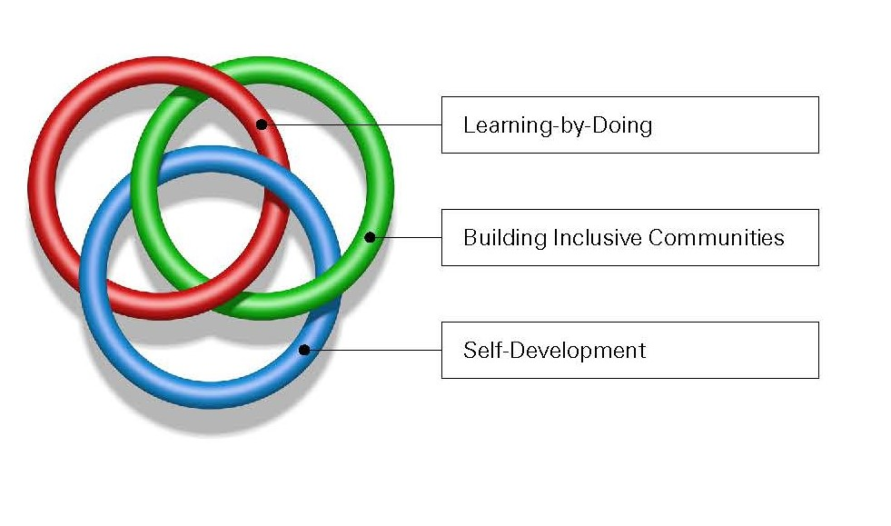
UT vision on learning and teaching

Slide 27
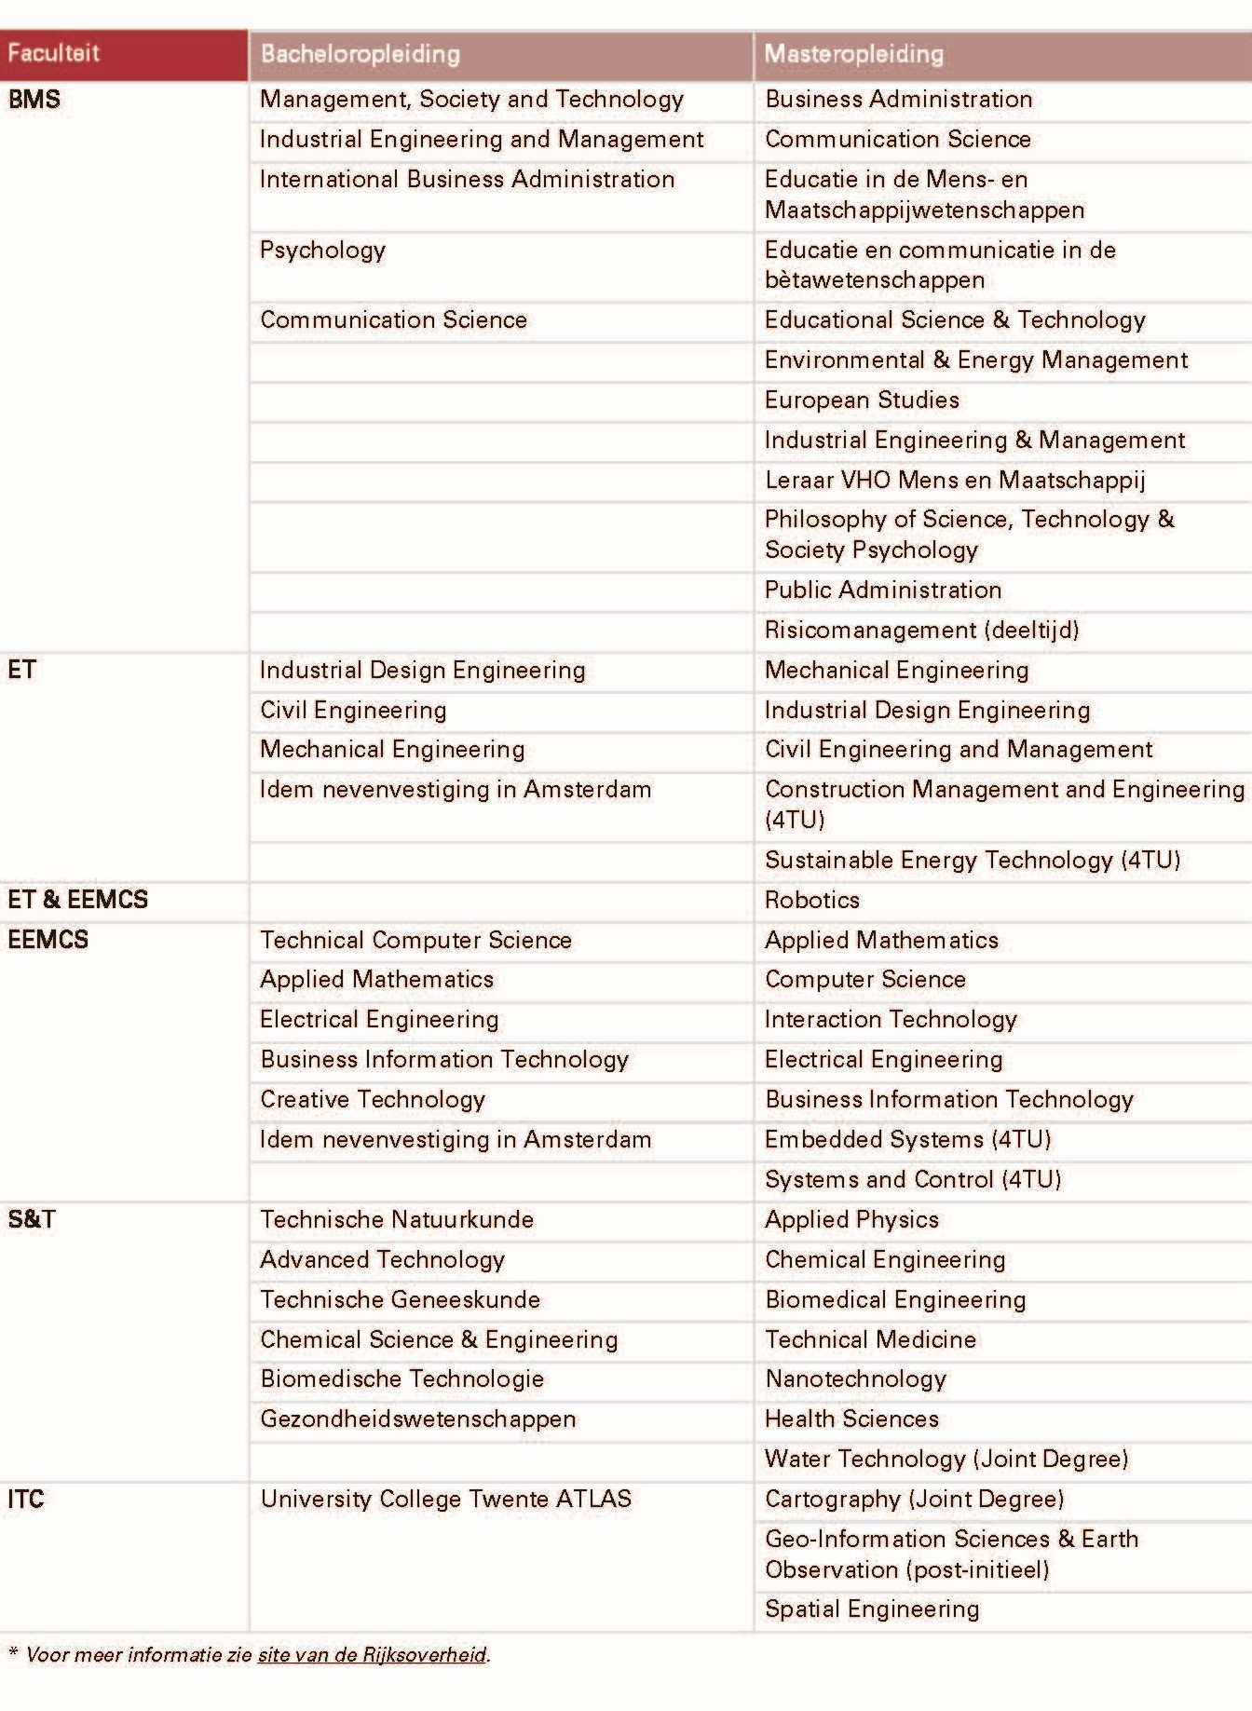
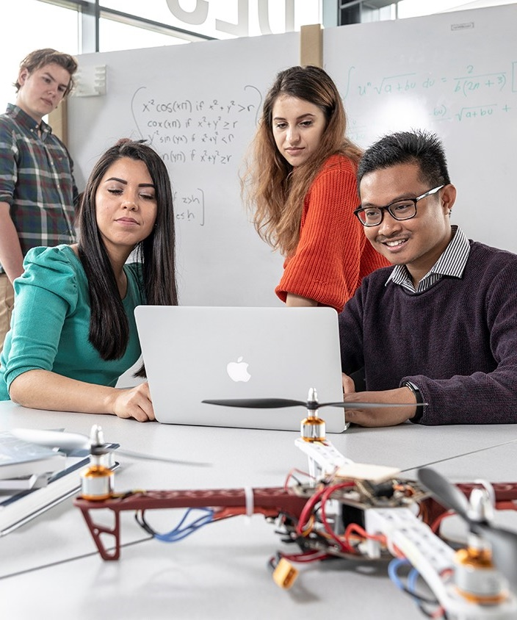
Educational
Programmes
5
12
4
6
6
7
6
7
1
3
Total
22
35

Slide 29
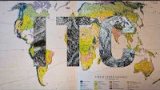


Slide 30



Facts and figures ITC
92
SUPPORTING STAFF
SCIENTIFIC STAFF
190
SUPPORTING STAFF
SCIENTIFIC STAFF
77%
10%
13%
22%
34%
44%
DUTCH
EU
NON-EU
EU
DUTCH
NON-EU
Notes:
* Per May 2023

Slide 31
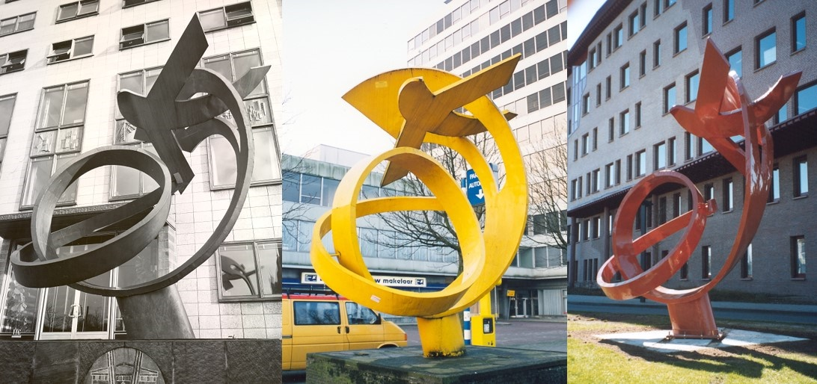
Faculty
Faculty Board, incl. Dean
Scientific Departments
Earth Observation Sciences (ITC-EOS)
Geo-information Procession (ITC-GIP)
Applied Earth Sciences (ITC-AES)
Natural Resources Management (ITC-NRM)
Urban and Regional Planning and Geo-information Management (ITC-PGM)
Water Resources (ITC-WRS)
Support departments
Finance
Human resources
Marketing &Communication
Education Support (BOOZ)
Faculty Bureau incl. Educational Unit, Project Services and Research unit
Education programmes with programme management

Slide 32

Education management @ITC

Slide 33
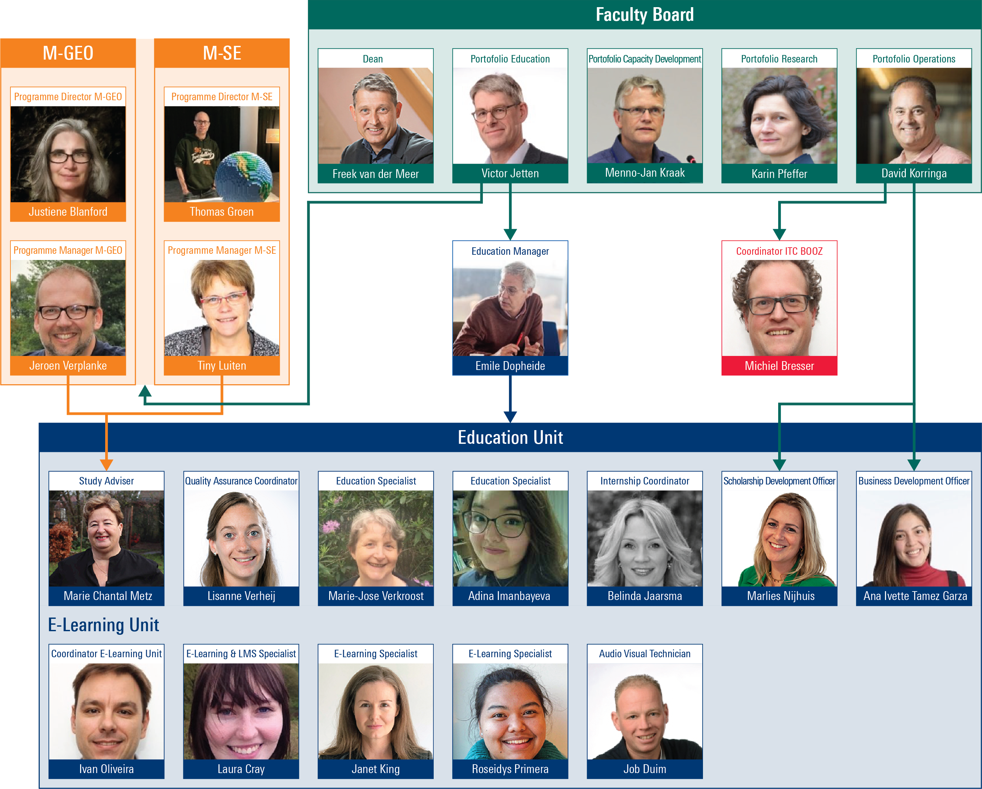

Slide 34
Other important bodies in Education
Programme management
Programme director
Programme manager
Examination Board
assesses whether each student meets the programme requirements for obtaining a degree
Programme committee
    a participation body (4 staff and 4 students)
    advises on the quality of education.
    each study programme has a programme committee
  University council
    central participation body that has a say in UT policy at central level (consent and advice)
    9 staff and 9 students (elected)
  Faculty council
    Same at Faculty level
    5 staff and 5 students (elected)

Slide 35
Education & administration @ ITC
In this part of the presentation, we address the following topics:
Challenges
Courses at ITC
Master Geo-Information Science and Earth Observation (M-GEO)
Application & Admission M-GEO
Student Support

Slide 36
challenges
For the (near) future, ITC faces several challenges:
Student numbers
National debate on internationalization
National knowledge safety discussion
Scholarship dependencies
Student well-being
E-learning and AI (ChapGPT)
Life Long Learning

Slide 37
Challenges at your universities
Do you face challenges or uncertainties that can impact your university, and could you elaborate on them?

Slide 38
Courses at ITC (1)
Master Geo-information science and earth observation ~ 65
24 months
120 EC
MSc diploma & diploma supplement
Master Spatial engineering ~ 15
24 months
120 EC
MSc diploma & diploma supplement
Postgraduate Geo-information science and earth observation ~ 7
12 months
60 EC
PG certificate & course record

Slide 39
Courses at ITC (2)
Master cartography ~ 25
Joint degree with Munich (DE), Dresden (DE) & Vienna (A)
24 months
120 EC
Joint MSc diploma & diploma supplement
Master geo-information science and earth observation for environmental modelling (GEM) ~ 15
Double degree with Lund (S), Tartu (ES) & Louvain (BE)
24 months
120 EC
MSc diploma & diploma supplement per institute

Slide 40
Courses at ITC (3)
Master geographical information management and applications (GIMA) ~ 30
Joint degree with Utrecht (NL), Wageningen (NL) & Delft (NL)
24 months (fulltime & parttime possibilities)
120 EC
Joint MSc diploma & diploma supplement
Short courses
Credit bearing or non-credit bearing course
A course that can be part of a master’s programme
Course certificate and possibly a course record
Tailor Made courses
A course tailor-made to the needs of the students
Course certificate – no EC or grades
Short courses & Tm courses will also be on display in the Geoversity platform

Slide 41
Courses at your universities
Can you say something about the (type of) courses that you offer at your university?

Slide 42
Master geo-information science and earth observation
The M-GEO programme is financed by the Dutch Ministry of Foreign Affairs, opposed to the other education programmes within the University of Twente, who are financed through the Ministry of Education, Culture and Science.
This means that the NL and EU student also pay the full institutional tuition fee (EUR 17.000 instead of EUR 2.314) if they follow the M-GEO programme.

Slide 43
Master geo-information science and earth observation
The M-GEO programme is visualized in an online Study Guide.
This online Study Guide provides a clear insight for students as to the content of the programme and the different courses.

Slide 44
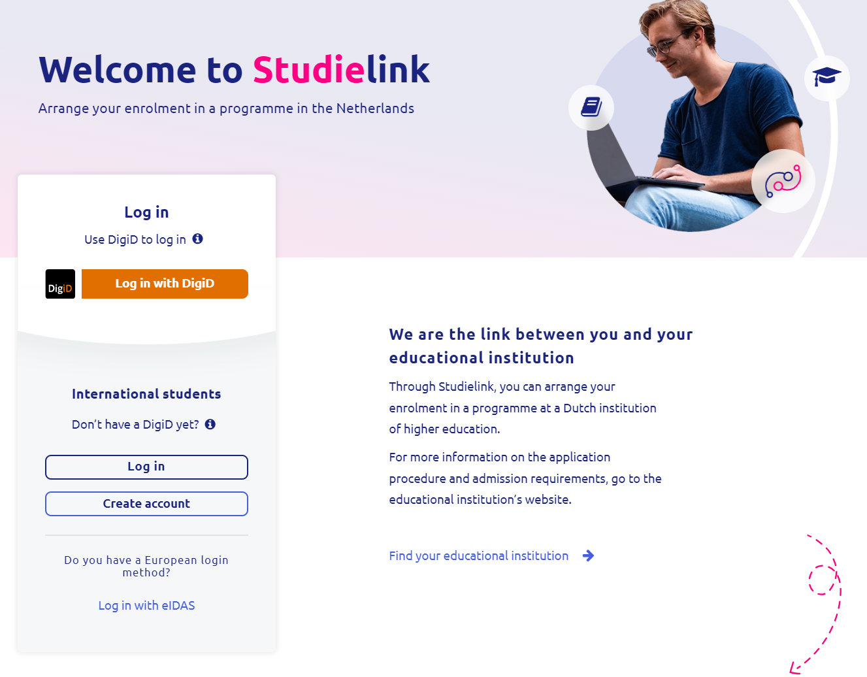
Application & admission M-GEO (1)
All students for Higher Education must apply through the national application portal called StudieLink.
After selecting the programme and location, the student is transferred to Osiris, where the Admission department manages all applications.
To be eligible for the M-GEO programme, a student needs to provide:
A bachelor’s degree including grade list
A valid ID document
A motivation letter
A resumé
The result of an English language test (if required)
The Admission & Registration department ensures this is submitted in time and provide the pro-forma invoice.

Slide 45
Application & Admission M-GEO (2)
Students are made aware of scholarship possibilities during the Admission process. Students need to apply for a scholarship themselves.
Students have until June 10 to meet the payment requirements:
Tuition fee year 1 fully paid
Visa costs fully paid
Insurance costs for full programme fully paid
Costs of living proven through bank statement or fully paid
Tuition fee year 2 can be paid in instalments after year 1
Costs of living year 2 can be proven through bank statement, fully paid or paid in instalments

Slide 46
Student support
What can a student expect during their period at ITC?
Guidance and help throughout their study period, both academically and non-academically
We provide the academic schedules
We provide the certification documents for every programme
We support the education programmes
Supporting SAB in organizing social events (trip to Keukenhof, International Sports Day, etc.)

Slide 47
Application, admission and student support in Ethiopia
Could you share how the application & admission process and the student support in Ethiopia is arranged?

