Slide 1
Entrepreneurship at ITC
Parya Pasha EENSAT visit, 6 Oct 2023

Slide 2
Personal experience
Mothership Hackathon 2020
Raising Coral Costa Rica
Space4Good
SBIC Ignition programme
From project to business idea
Coaching (business development, legal, finance)
Copernicus Accelerator
Mentorship
Connections and exposure

Slide 3
ESA BIC
European Space Agency’s Business Incubation programme
18 – 24 months
50k Seed Funding
Technical support (ESA and partners)
Expert advice
Community and network
Develop, test, and validate
Product development
User engagement
Business plan
Fund raising
Expertise and team development

Slide 4
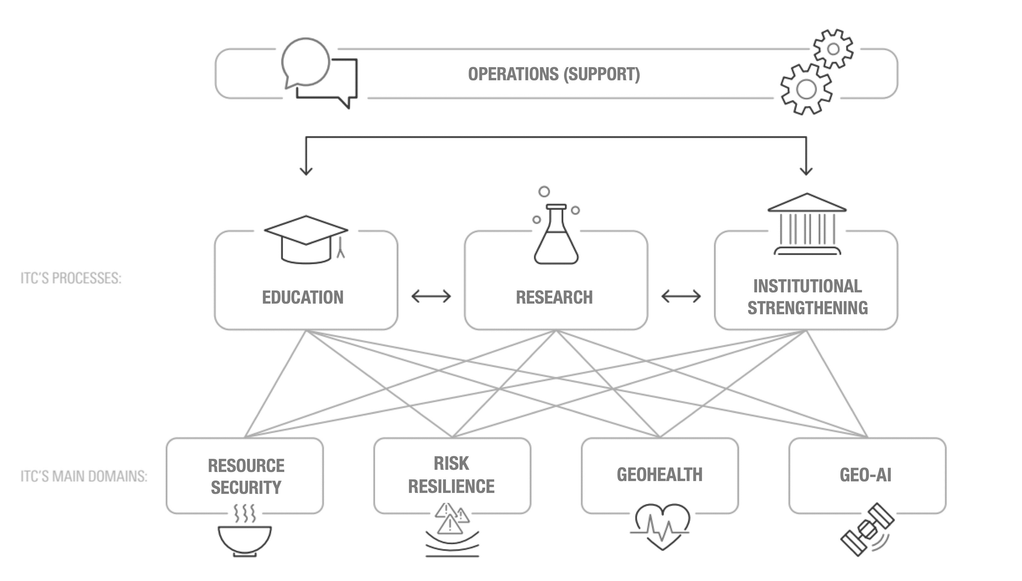
Entrepreneurship and Private Sector Partnerships
Connection with the UT entrepreneurial support
KTO and TTO
Connecting industries
NL Space ecosystem
NL entreprise agency

Slide 5
One Space Hub
To Support Space Entrepreneurial Journey from Education to ScaleUp

Slide 6
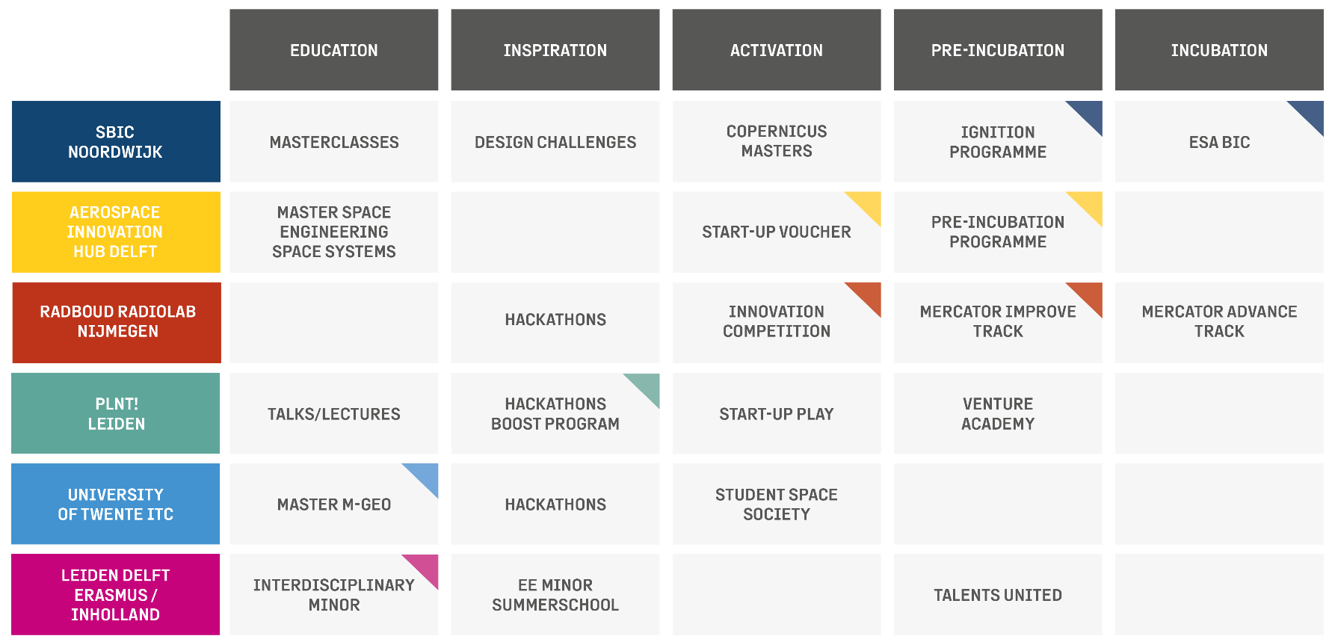
OSH Partners

Slide 7
OSH Objectives
To create a “Comprehensive Menu” of the programmes
To strengthen and link the programmes within OSH
To provide a guided user journey and correct entry points
To increase outreach and promote the OSH
To ensure sustainability and continuity of the OSH after project

Slide 8
OSH Objectives
To create a “Comprehensive Menu” of the programmes
To strengthen and link the programmes within OSH
To provide a guided user journey and correct entry points
To increase outreach and promote the OSH
To ensure sustainability and continuity of the OSH after project
Platform
Programme Guide

Slide 9
Entrepreneurship in Geoversity
Life-Long-Learning
Personal Learning Path
Skills development
Market pull for innovation
Connections, Community, and Network

Slide 10
Expansion - Partners
Partnerships for valorization and entrepreneurship
Additional expertise
Scaling globally
Alumni

Slide 11
Academic Support Partner Φ-lab
POTENTIAL
Source university / R&D team(s)
Develop (shared) vision and roadmap
Organise the support as needed from the ecosysteem
Identify sectors for business
Support Technology roadmap
MARKET (CREATION)
Via proof-of-concept, prototypes, MVP’s to application-relevant pilot systems/services
Supply and demand: create onset for sustainable market
Specific business case development
Φ-lab initiates and facilitates the road to impact
Discovery & Research
basic principles – concept design
Commercialization
System complete – System in operation
Innovation
exp. proof of concept – lab validation – validation in rel. environ. – business implementation

Slide 12
Way forward…
Challenges
Opportunities
Best practices
Collaboration
Contact: p.pasha@utwente.nl

