Slide 1
Professionalisation of academics as teachers
Higher Education
Notes:
Introduction. What do they expect? What do they want answers to?
Academics in Europe are not as well prepared for teaching as they are for research. And it is important that they are prepared. One of the reasons for this is that countries in Europe are transforming their economies into knowledge-based economies, which requires research to be shared with society. Through teaching, higher education plays an important role in disseminating and promoting the use of research. Another reason is the internationalization of universities. Universities attract students from different countries with different levels of knowledge/skills. Universities have recognised the importance of teaching skills. In 2006, the first universities started professionalisation trajectories. In 2008, all national universities recognised each other’s professionalisation trajectories. The University Teaching Qualification (UTQ) was a fact.

Slide 2
What is the University teaching qualification (UTQ)?
Notes:
The UTQ certifies the teaching competence of teachers in Academic Education.
The UTQ is recognized by 14 Dutch Universities since 2008. Some Belgian universities have also joined this mutual recognition.(e.g. Antwerpen en Leuven).
The UTQ is mandatory for all teaching staff at the University of Twente and embedded in the HR cycle.

Slide 3
WHY TEACHER PROFESSIONALISATION?
Recognize and reward teaching;
Improve the quality of Academic Education and University teaching;
More objective justification of the ‘quality’ of the teaching staff;
Continuous teacher development;
Establishing competence levels;
Improving inter-university mobility.
Notes:
Recognising and rewarding teaching is important for the professionalisation of teachers. This is a direct result of the University of Twente's desire to create an environment where teaching is as important as research.
What does it look like?

Slide 4
Teachers work on different competencies
Design
of education
Teaching and supervising
Testing
& assessment
Evaluating
Teaching
Notes:
The UTQ provides basic knowledge, it is a starting point for the professionalisation of teachers, not an endpoint.

Slide 5
Subcompetencies
explain how their course is embedded in the curriculum or degree programme as a whole.
design teaching based on the principles of ‘constructive alignment’.
design active, effective, and efficient learning methods and learning materials.
design their teaching with respect to the specific (curricular) characteristics and needs of the students.
design their teaching in a practically and logistically feasible (do-able) way
Design
of education

Slide 6
Subcompetencies
prepare an educational meeting.
conduct an educational meeting and reflect on their performance.
supervise students, individually and in groups.
Teaching and supervising

Slide 7
Subcompetencies
design and implement the assessment of student development and learning outcomes.
analyse the assessment results and draw conclusions.
Testing
& assessment

Slide 8
Subcompetencies
conduct an evaluation and collect information (data) purposefully to improve their teaching.
analyse evaluation results, draw conclusions, and pinpoint areas for improvement
Evaluating
Teaching

Slide 9
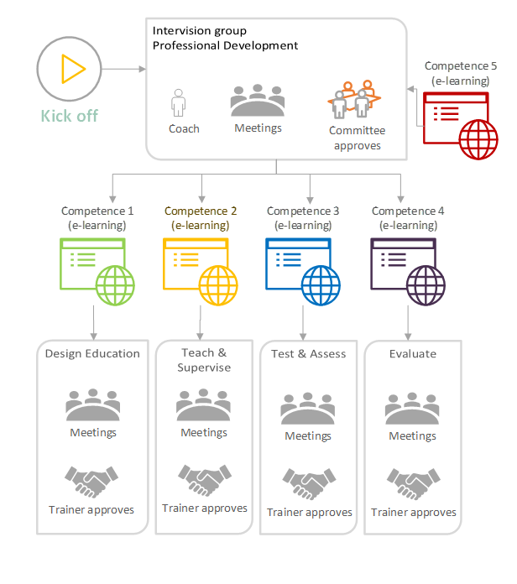
How is the utq organized?
Notes:
Important concepts:
Evidence-based pedagogical and didactical knowledge
Personalized trajectory
Community Learning
Workplace learning
Coaching
Teachers work on their professionalisation (competence 5) in the coaching group. Here they:
Formulate their own vision on teaching and learning
Manage their work as a teacher and can collaborate in a teaching team
Relflect on their work as a teacher and on their future professional development in teaching

Slide 10
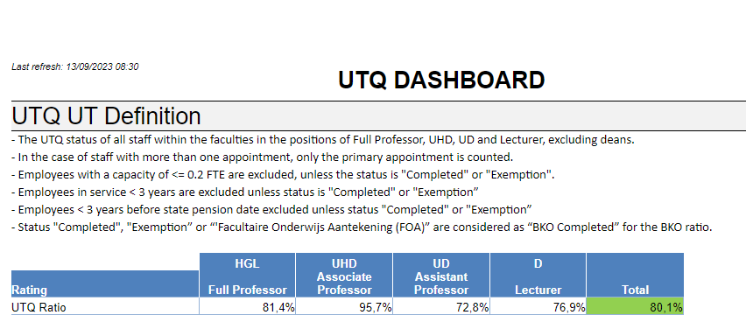
Numbers?

Slide 11
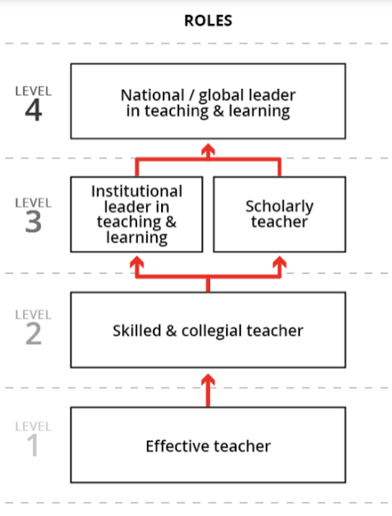
SUTQ, Educational leadership programme, SUEQ
Masterclasses
UTQ
Notes:
We use the Career Framework for University Teaching. This is a global collaboration to improve the reward and recognition of university teaching.
Masterclasses: activate the learning brain, blended learning, CBL, formative assessment, Microlectures etc.
ELP: Developments like the rapid social (research in educational science, psychology and neuroscience) and technological developments (ITC), lead to a greater need for academics who are able to take a leading role in education. People who can formulate a vision and who can direct innovation and improvements in education. Formal and informal leaders who have profound insight into the processes of teaching, learning and curriculum development.
SUEQ (senior university examination qualification): more in-depth knowledge about all the aspects of assessment. Relevant for example teachers who are a member of the examination board.
https://www.teachingframework.com/about/
Next slides example of session of the UTQ course 1.

Slide 13
Notes:
Use what you've learned. Not just in the same situations, but also in different situations. This is called transfer of learning, being able to use information in different situations.
When do you typically need to use what you have learned in a different situation? When you are solving problems.

Slide 14
Notes:
Do you remember this from your student days? When you were trying to solve a homework or exam problem (multiplication, subtraction, division and addition.
)? Students can get completely lost when the teacher changes a seemingly small detail. This is also due to a lack of learning transfer.
Let’s have a look at another example.

Slide 15
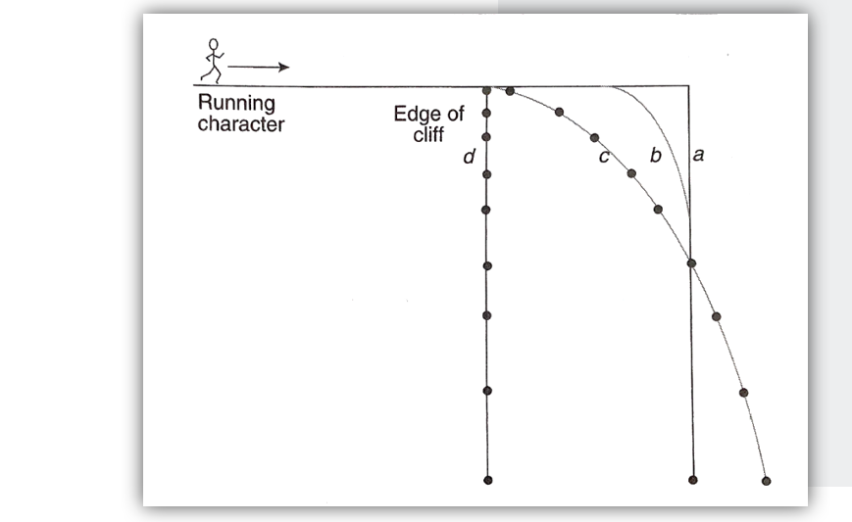
Notes:
High school and university students (first-year bachelor students) with the proper background (Newtonian conception of motion ) were asked: How does this moving figure fall over a cliff?
What did they answer? Most students answer D, but the correct answer is C. So they have not fully grasped the idea behind the law of motion. They probably know the law but do not fully understand the concept.
Why is that?

Slide 16
Notes:
According to Kratwohl, you need 4 kinds of knowledge to solve problems.
This isn’t always a linear process. You can think about a certain problem (metacognition) and come to the conclusion that you miss certain knowledge. A novice has mainly concrete knowledge whereas an expert has also abstract knowledge.
Teachers often assume their students are able to apply all 4 types of knowledge, but in general, most master students are somewhere between ‘conceptual’ and ‘procedural’ knowledge.
How can you use this framework? If you want your teaching to be more effective, it’s also good to know a little bit about the information processing in the brain, i.e. how people learn.

Slide 17
Notes:
Is it a matter of pouring in the information?

Slide 19
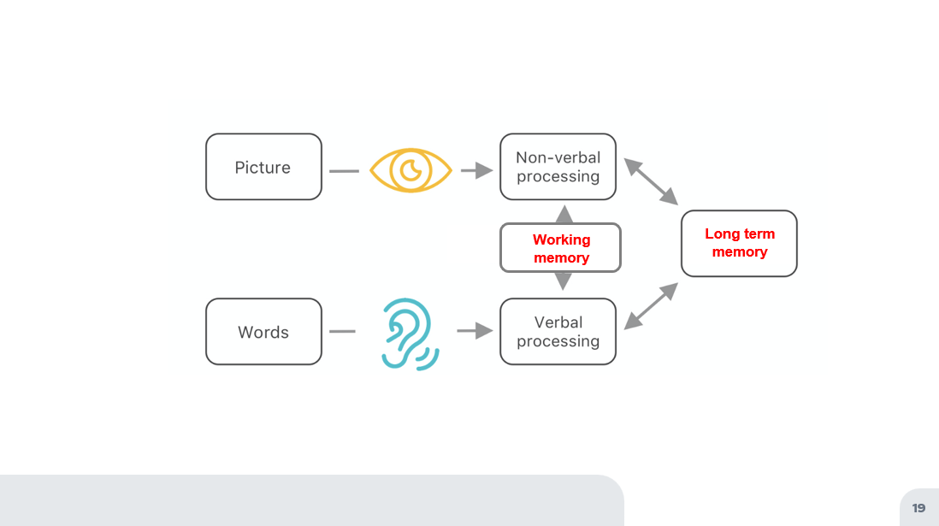
Notes:
People have separate channels for processing visual and verbal information and these channels are ably to actively process only a limited amount of material in a channel at one time (also called working memory).
Visual: can hold information for about half a second. Please note that printed text are also visuals for the brain.
Verbal: can hold 5-7 items at once for a few seconds.
The amount of information that your working memory can hold at one time is called ‘Cognitive load’. And your working memory can easily be overloaded.
Source: https://www.learningandthebrain.com/blog/obsessed-with-working-memory-part-i/

Slide 20
Notes:
Exercise (do this in your head, don’t write it down):
Think of the five workdays of the week.
Now, go ahead and put those five words into alphabetical order.
Source: https://www.learningandthebrain.com/blog/obsessed-with-working-memory-part-i/

Slide 21
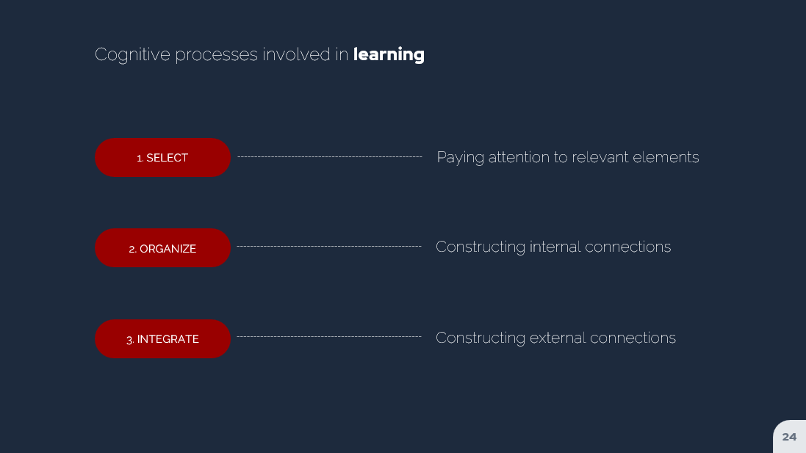
Notes:
To succeed at that with the exercise, you undertook four mental processes.
First, you selected relevant information. Specifically, you selected the instructions that you read. And, you looked into your long-term memory to select the workdays of the week.
Next, you held that information. If you had let go of the instructions, or of the days of the week, you couldn’t have completed the task.
Third, you reorganized the days of the week according to the instructions. You started with a chronological list (Monday, Tuesday, Wednesday…), and converted it into an alphabetical lest (Friday, Monday, Thursday, Tuesday, Wednesday).
In many WM tasks (but not this one), you might not only reorganize, but also combine information. If, for instance, you added up 7+12+4+18+6 in your head, you selected, held, and combined those numbers into a new number.

Slide 22
Questions?
Notes:
Slide 22 in H5P

