Slide 1
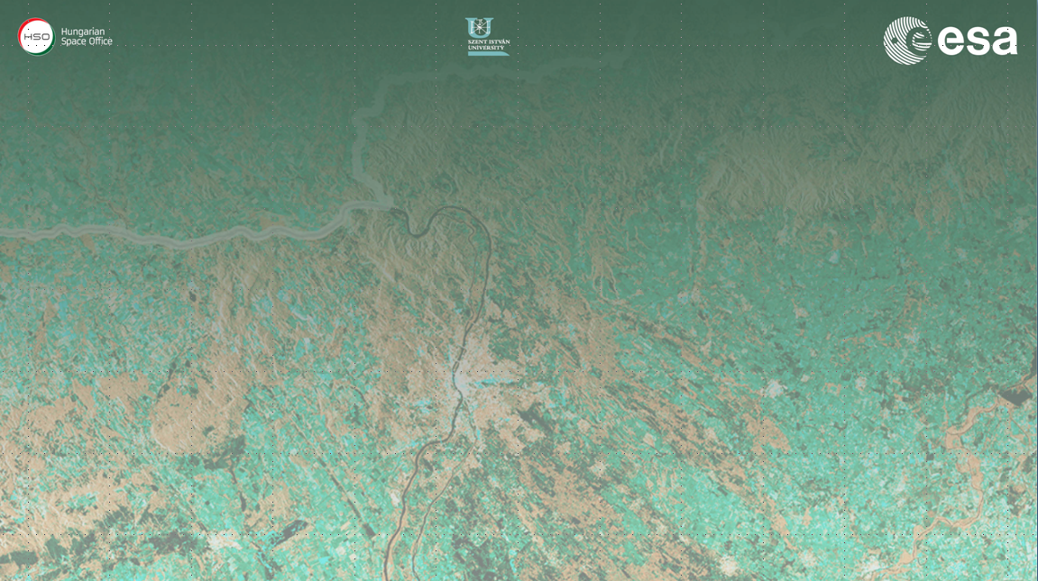
Forest SAR & Coherence
(Practical Session 2)
Erxue Chen Lei Zhao
Chinese Academy of forestry

Slide 2
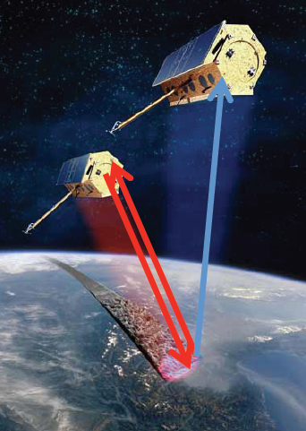
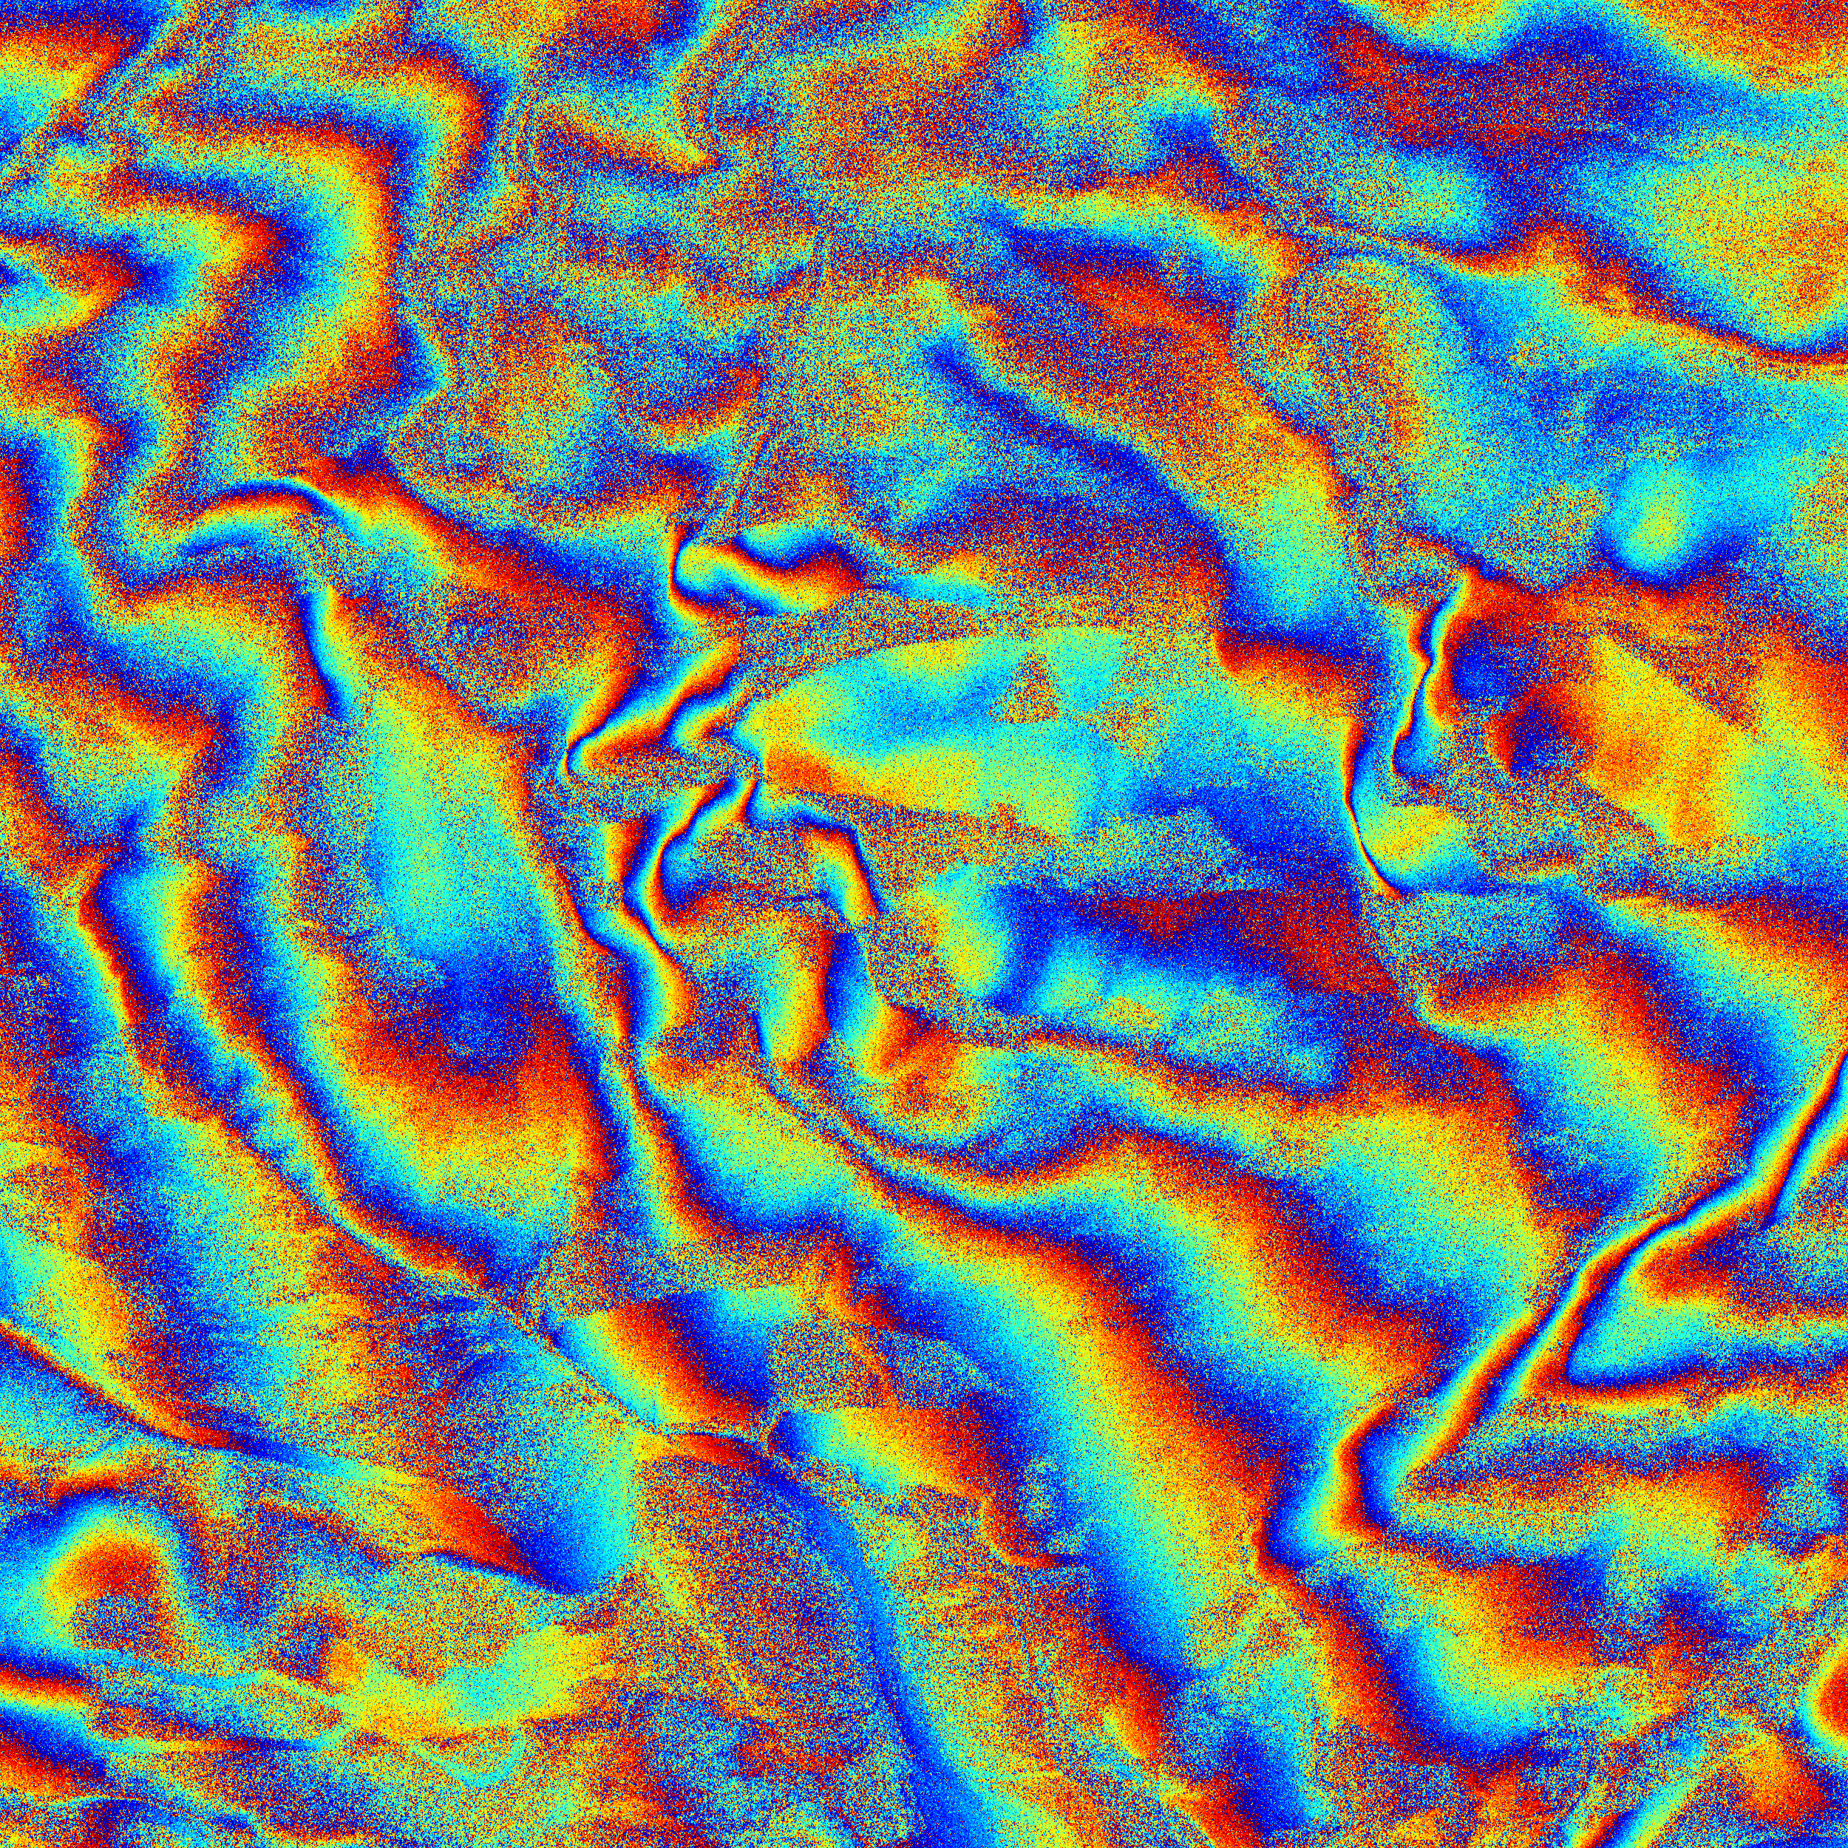
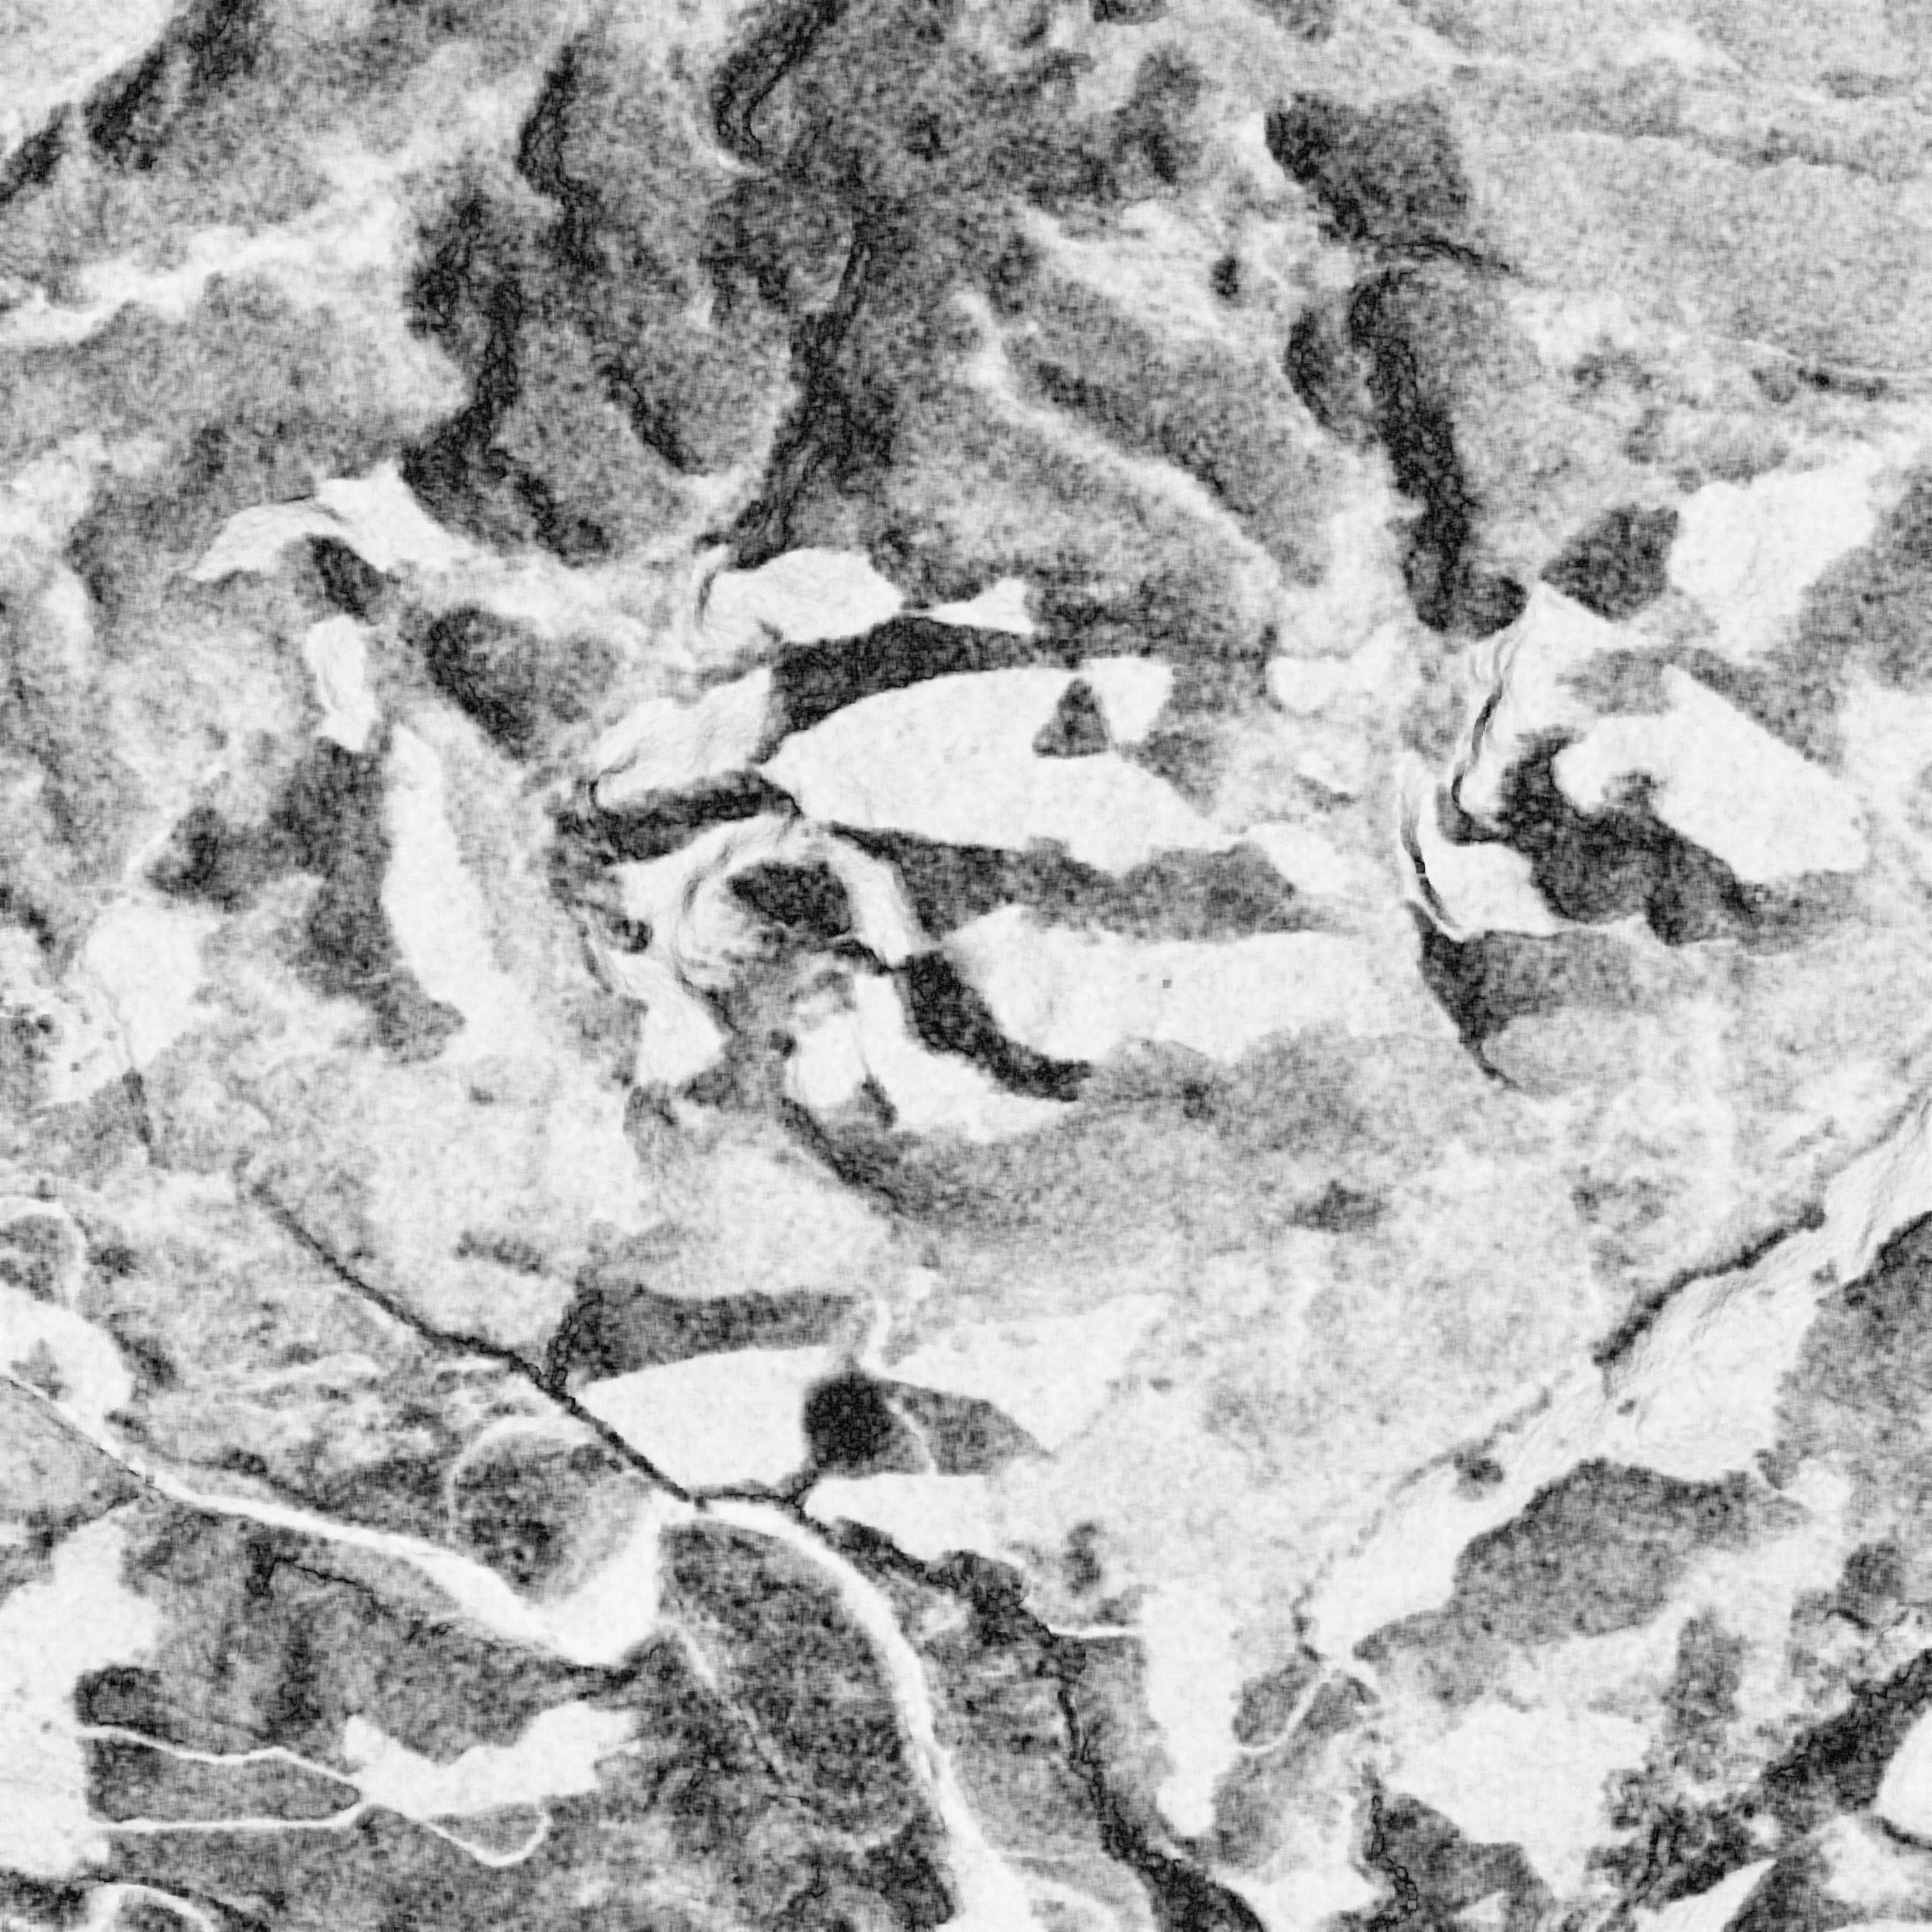
Forest Height inversion Based on Coherence
Software required: PolSARpro & SNAP
Tandem-X

Slide 3
Acknowledgements
This practical is based on the tutorial presented at POLInSAR 2013. (Prof. Cloude)
Tandem-X Radar Data provided courtesy of DLR, Germany.
Lidar Forest height validation Kmz file provided courtesy of Canadian forestry Service, Victoria, BC

Slide 4
VOLUME COHERENCE MODEL
Topographic Phase:
Vertical Wavenumber:
If f(z) = 1 , a constant structure function, the volume coherence model becomes a function only of tree height.

Slide 5
SINC model
Based on the SINC model, forest height can be inverted as long as we obtain k_{z} and coherence (γ_{VOL}).
f(z) = 1
Only two unknown parameters!

Slide 6
Working plan
Part 1. Coherence Estimation
Load Tandem-X data
Select Sub-Region
InSAR set up
Interferogram
Flat earth estimate
Flat earth remove
Coherence
Save Coherence Magnitude
Geocoding Coherence
Part 2. K_{z} calculation
Fixed K_{z}
Ambiguity height (hoa)
Local K_{z}
Local incidence angle file (θ_{loc})
Angle of incidence center (θ₀)
Part 3. Height inversion

Slide 7
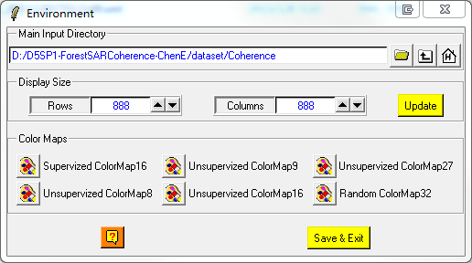
Step1: Load Tandem-X data

Slide 8
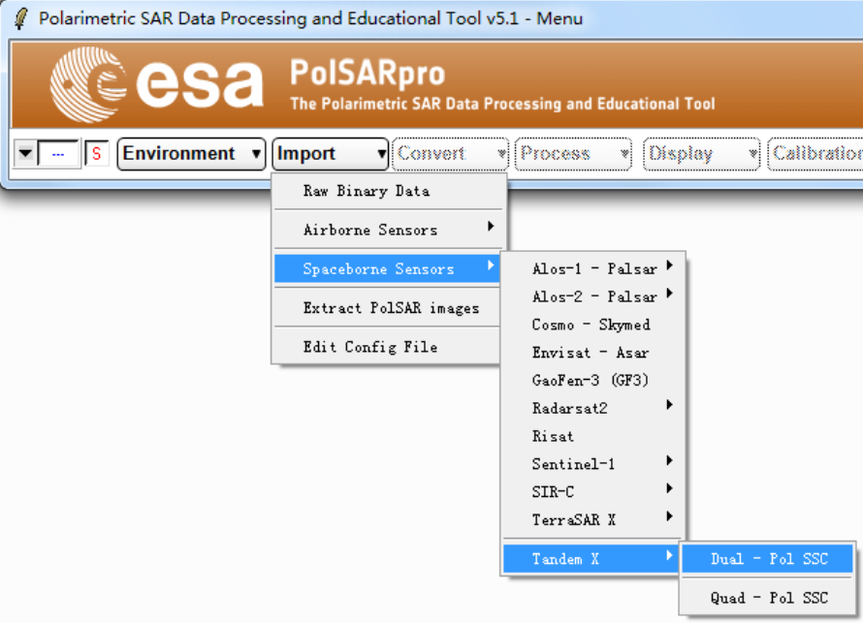
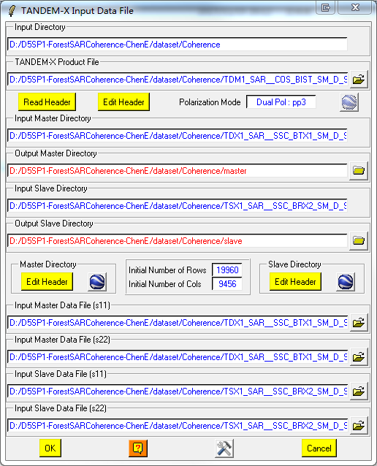
Step1: Load Tandem-X data
1
2
3

Slide 9
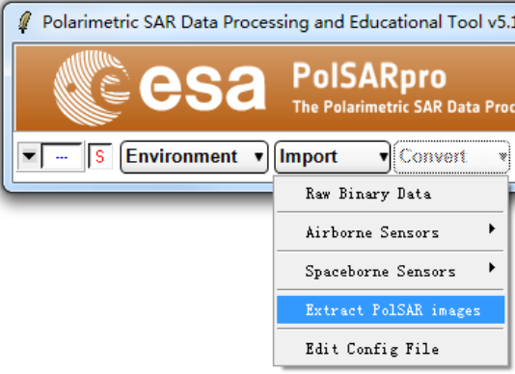
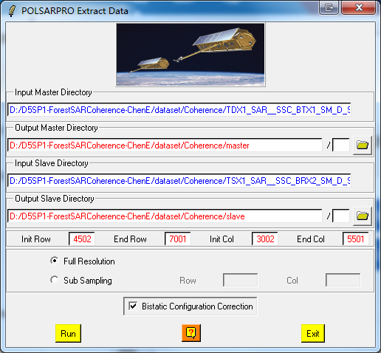
Step2: Select Sub-region
Notes:
Select region 25002500 pixels
4502 – 7001 row select
3002 – 5501 column select
Be sure to select ‘Bistatic Configuration Correction’

Slide 10
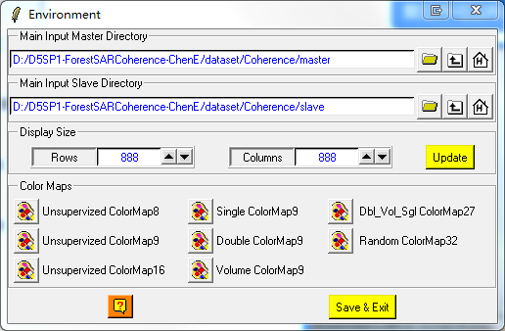
Step3: InSAR set up

Slide 11
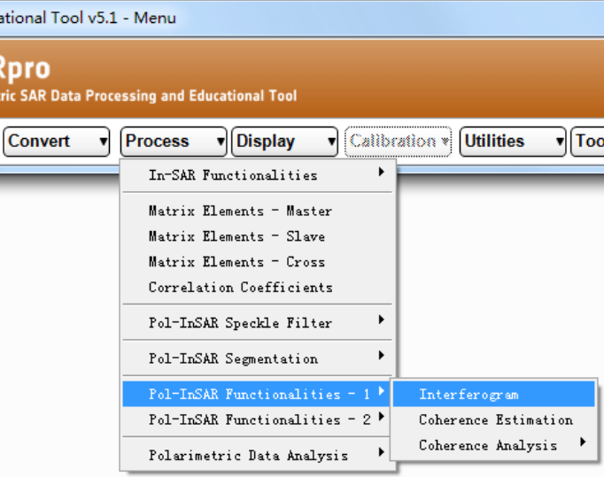
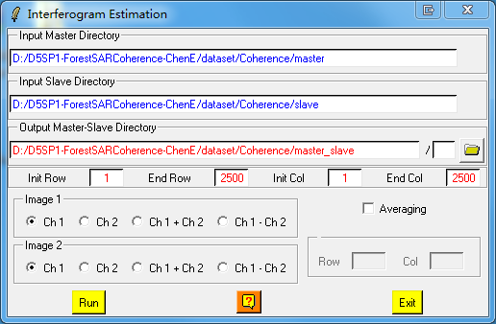
Step4: Interferogram

Slide 12
Step4: Interferogram
interferogram_Ch1_Ch1.bmp

Slide 13
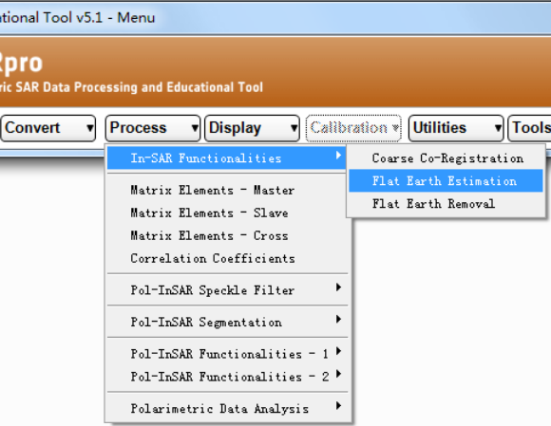
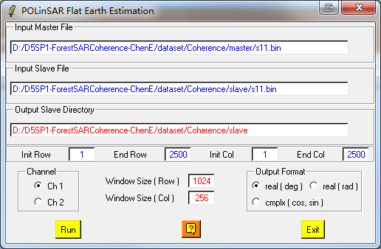
Step5: Flat earth estimate

Slide 14
Step5: Flat earth estimate
flat_earth_fft.bmp

Slide 15
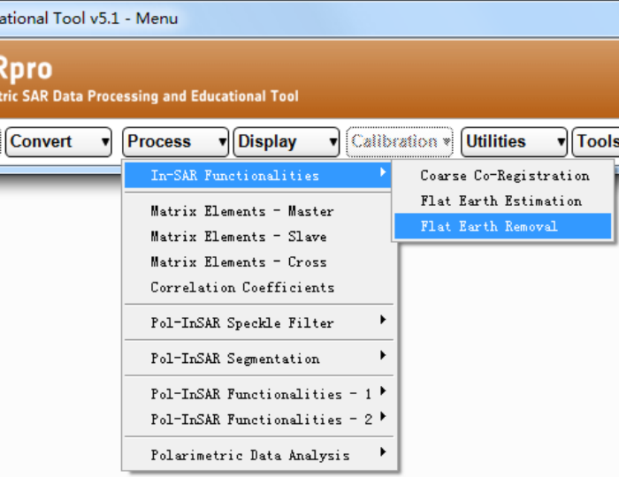
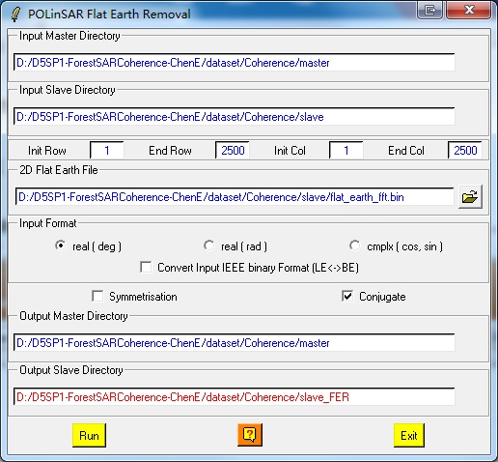
Step6: Flat earth remove

Slide 16
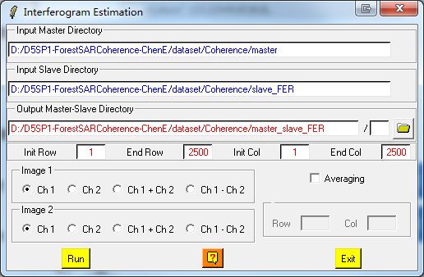
Step6: Flat earth remove
Check the effect of flat earth remove

Slide 17
Step6: Flat earth remove
Check the effect of flat earth remove

Slide 18
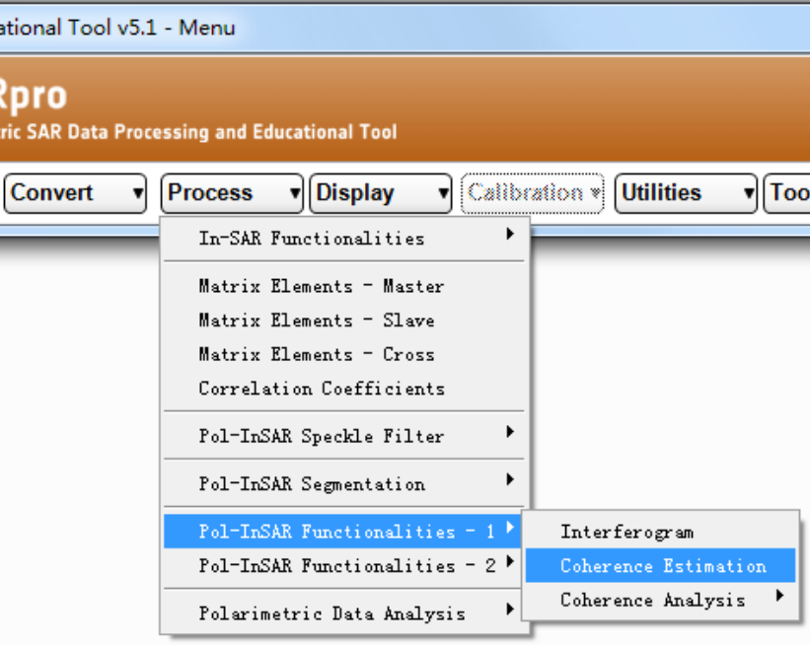
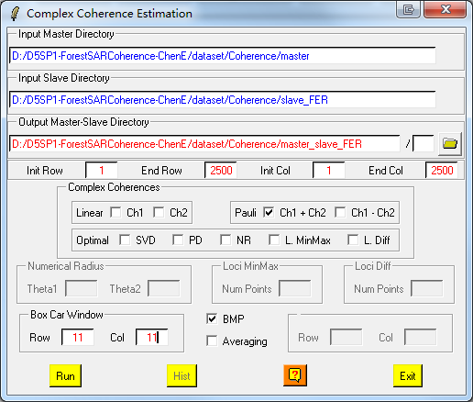
Step7: Coherence Estimation

Slide 19
Step7: Coherence Estimation
cmplx_coh_Ch1pCh2_mod.bmp

Slide 20
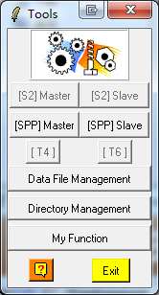
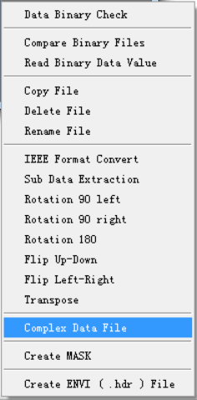
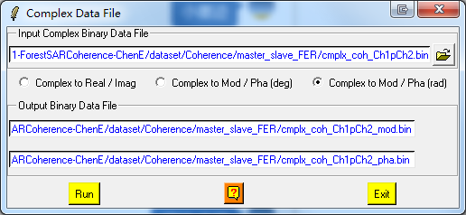
Step8: Save Coherence

Slide 21
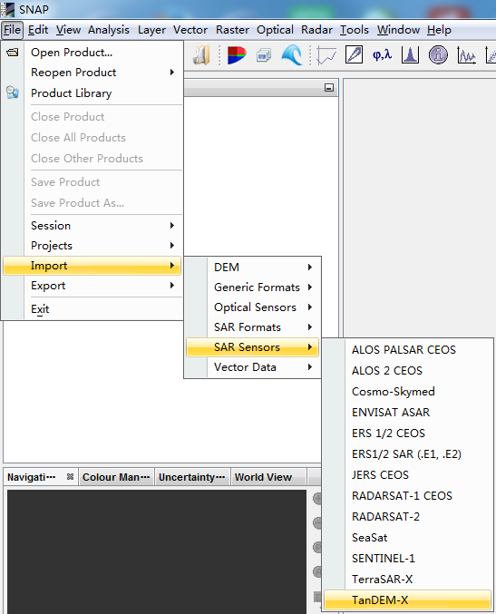
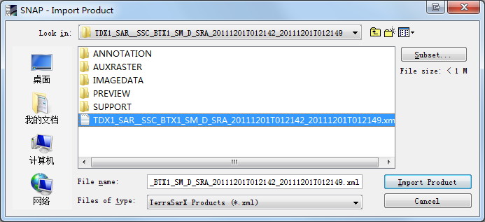
Step9: Geocoding Coherence
Step 9.1 : Sub-region Header File Ready (Orbit data).

Slide 22
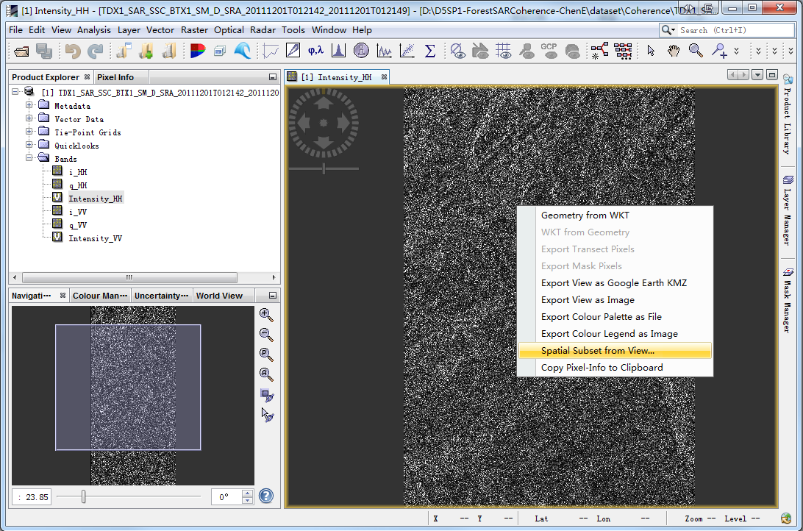
Step9: Geocoding Coherence
Step 9.1 : Sub-region Header File Ready (Orbit data).
Right Click !

Slide 23
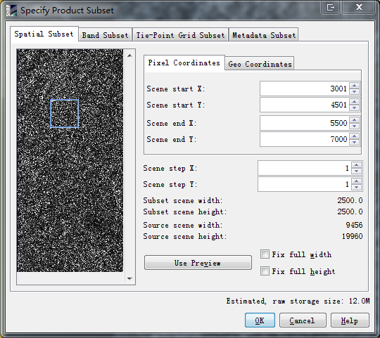
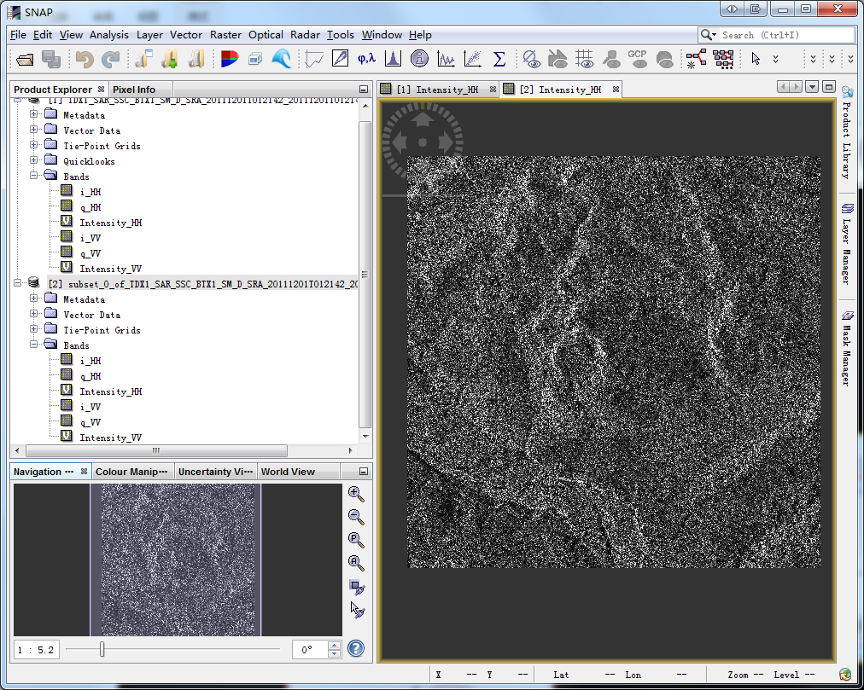
Step9: Geocoding Coherence
Step 9.1 : Sub-region Header File Ready (Orbit data).
Notes:
Select region 25002500 pixels
Y : 4501 – 7000 select
X：3001 – 5500 select

Slide 24
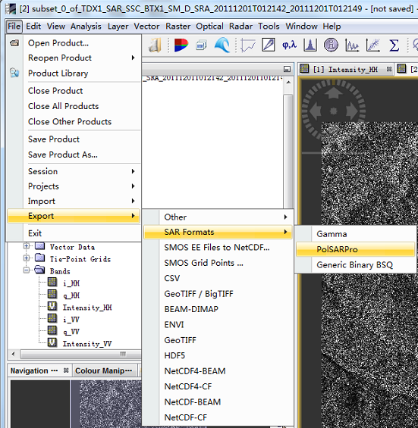
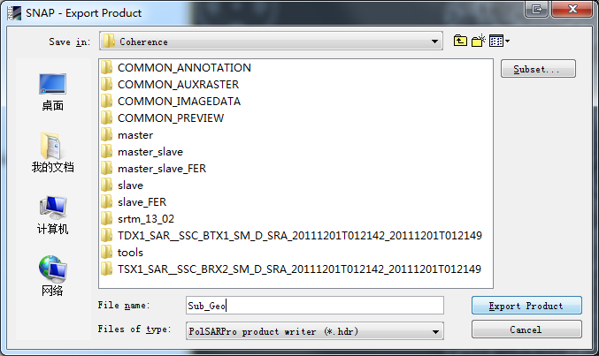
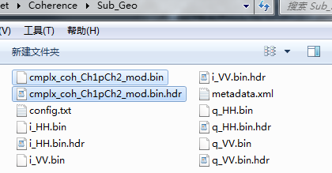
Step9: Geocoding Coherence
Step 9.1 : Sub-region Header File Ready (Orbit data).
Modify the file name,
Like ‘Sub_Geo’.
Copy the ‘cmplx_coh_Ch1pCh2_mod.bin’ and ‘cmplx_coh_Ch1pCh2_mod.bin.hdr’ to ‘Sub_Geo’ folder.

Slide 25
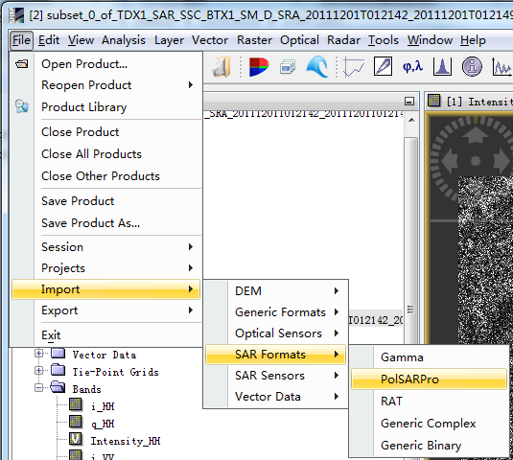
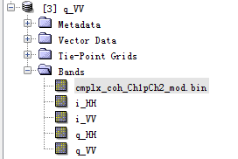
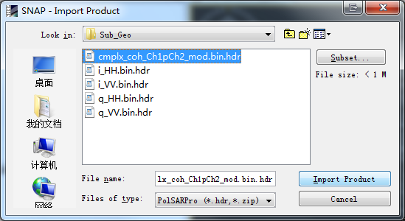
Step9: Geocoding Coherence
Step 9.2 : Coherence Geocoding

Slide 26
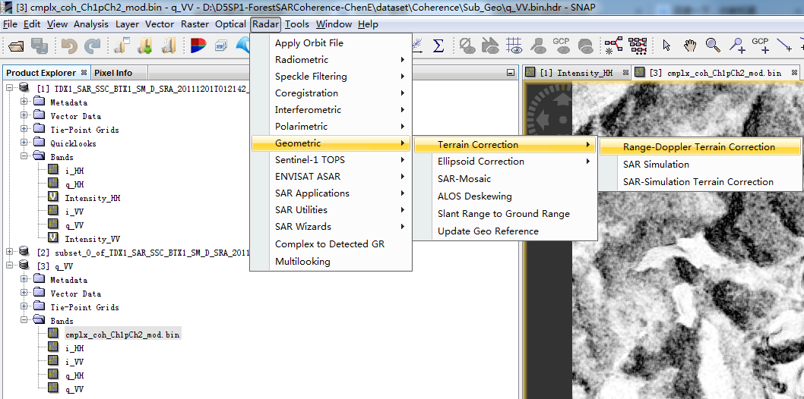
Step9: Geocoding Coherence
Step 9.2 : Coherence Geocoding

Slide 27
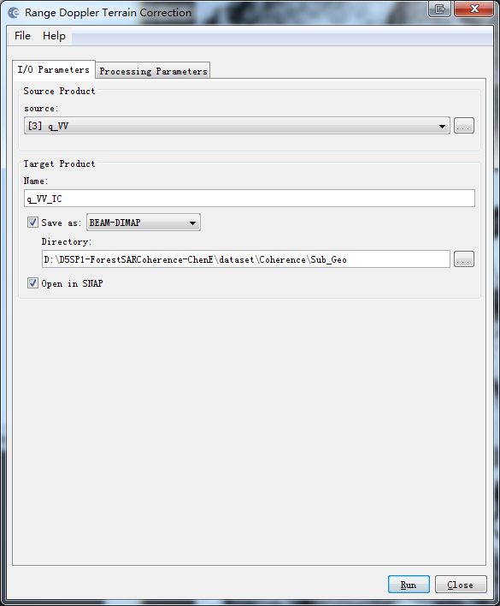
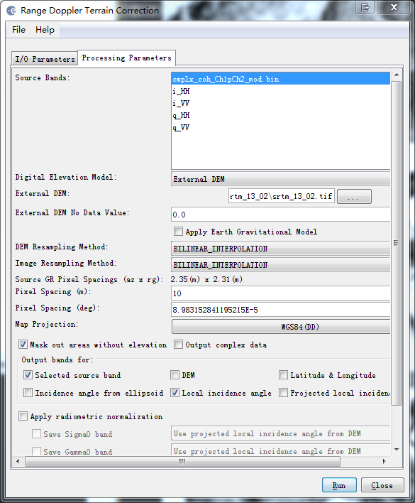
Step9: Geocoding Coherence
Step 9.2 : Coherence Geocoding
3
2
\Coherence\srtm_13_02\srtm_13_02.tif
4
1
5
6
7

Slide 28
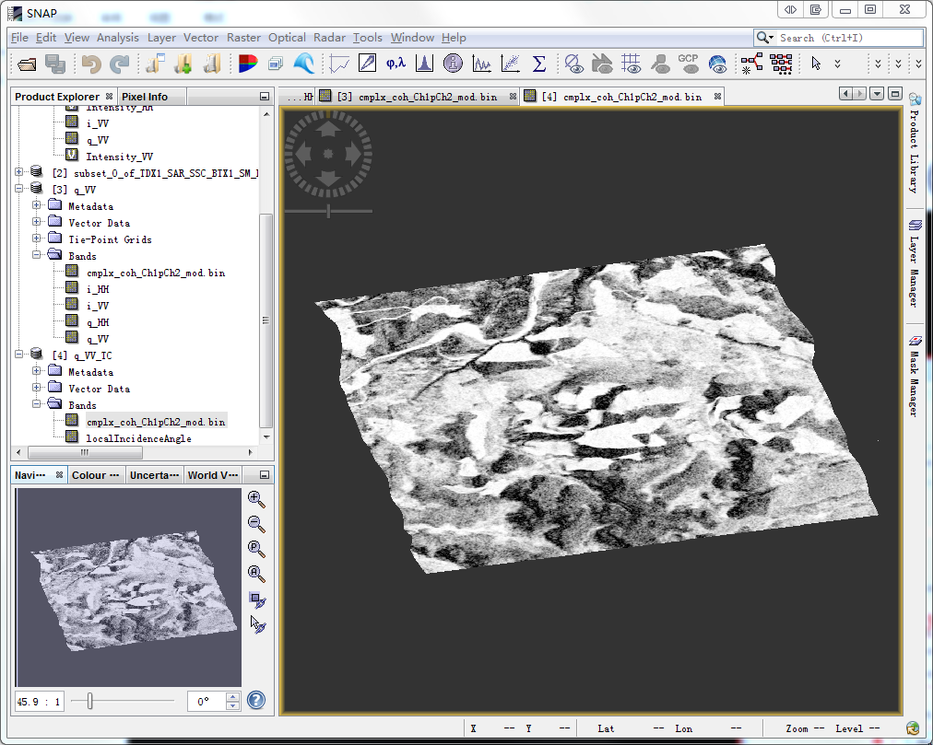
Step9: Geocoding Coherence
Step 9.2 : Coherence Geocoding
Geocode
Coherence

Slide 29
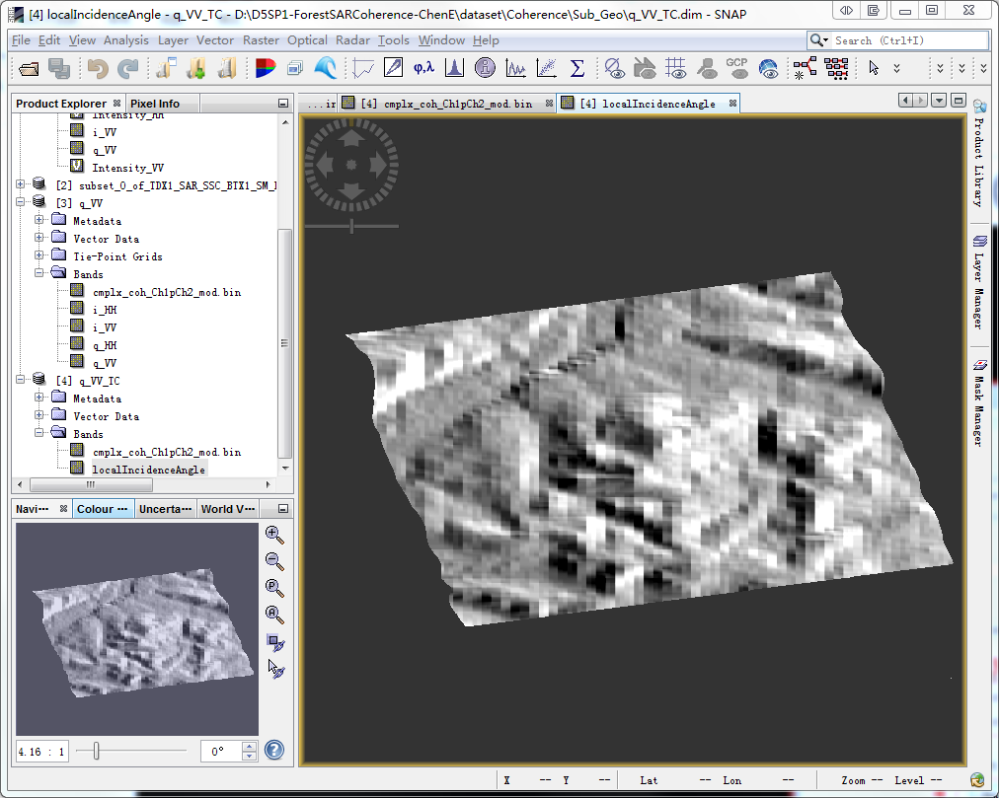
Step9: Geocoding Coherence
Step 9.2 : Coherence Geocoding
Geocode local
incidence angle

Slide 30
Step10: Fixed K_{Z}
Fixed K_{z}
Ambiguity height (hoa)
Fixed K_{z} = 0.176
hoa can be find in the header file of Tandem-X data:
TDM1_SAR__COS_BIST_SM_D_SRA_20111201T012142_20111201T012149.xml

Slide 31
Step11: Local K_{Z}
Local K_{z}
Local incidence angle file (θ_{loc})
Angle of incidence center (θ₀)
θ₀ can be find in the header file of Sub-region data:
..\Coherence\Sub_Geo\metadata.xml
θ₀ = (22.2138 + 24.3927)/2 = 23.3033 2 π sin(θ₀ ) /hoa = 0.0697

Slide 32
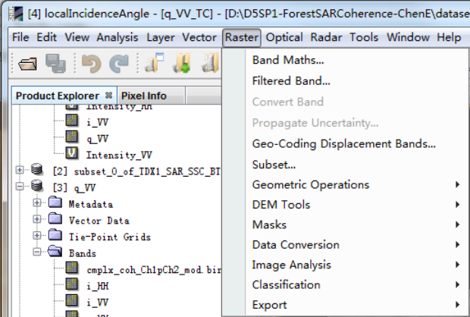
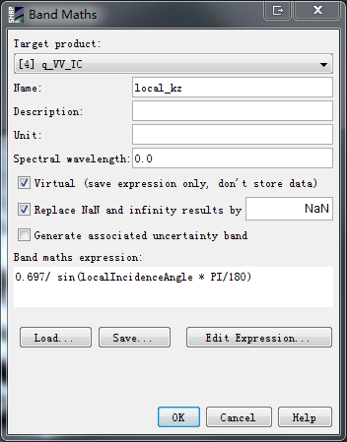
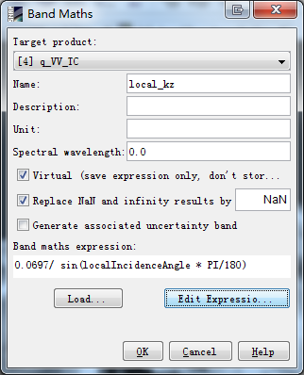
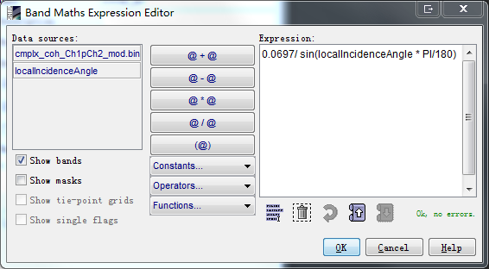
Step11: Local K_{Z}
1
3
2
4
5
6
7

Slide 33
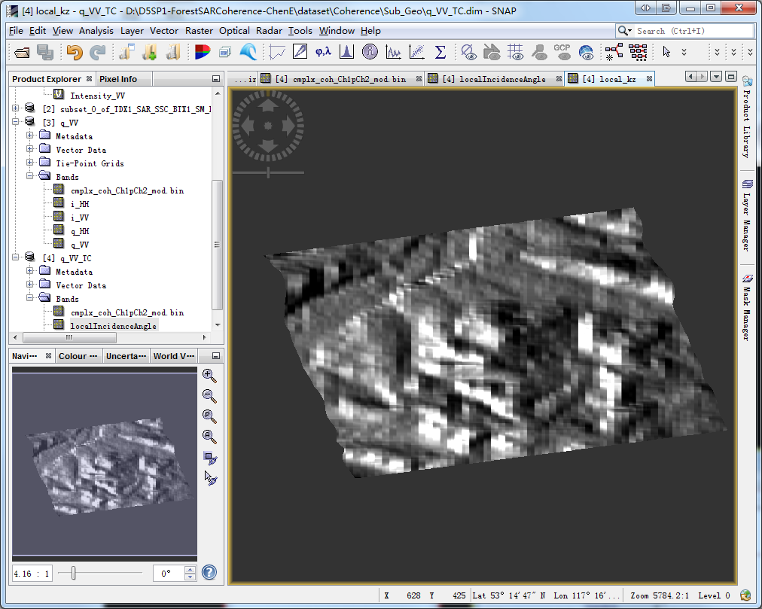
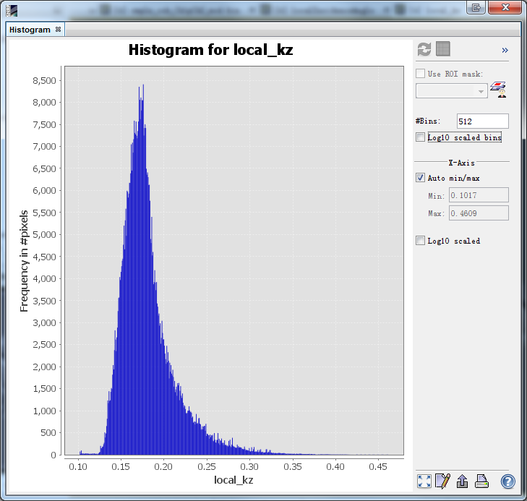
Step11: Local K_{Z}

Slide 34
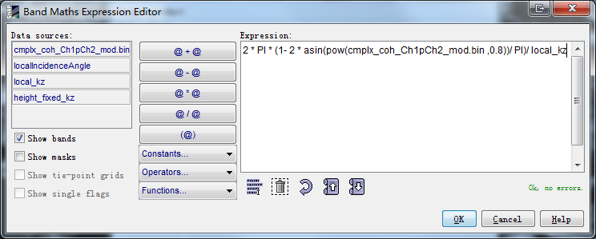
Step12: Height inversion
Based on Fixed K_{Z} :

Slide 35
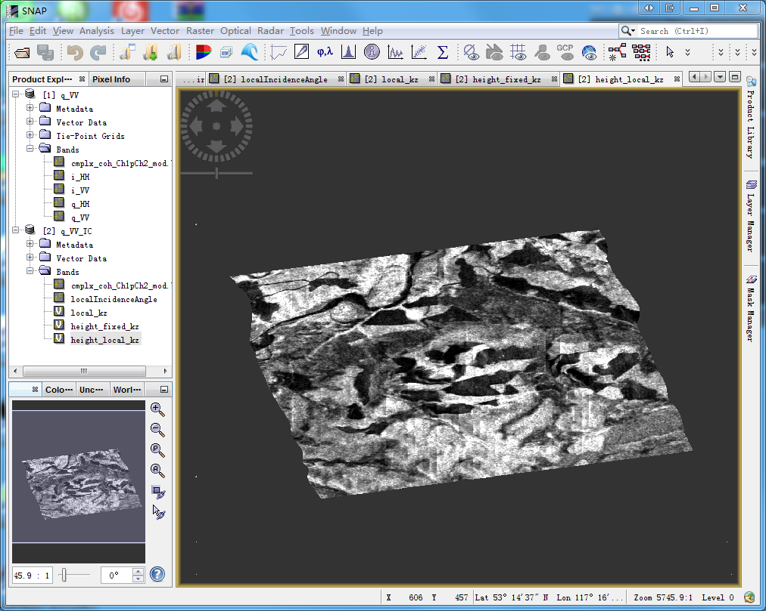
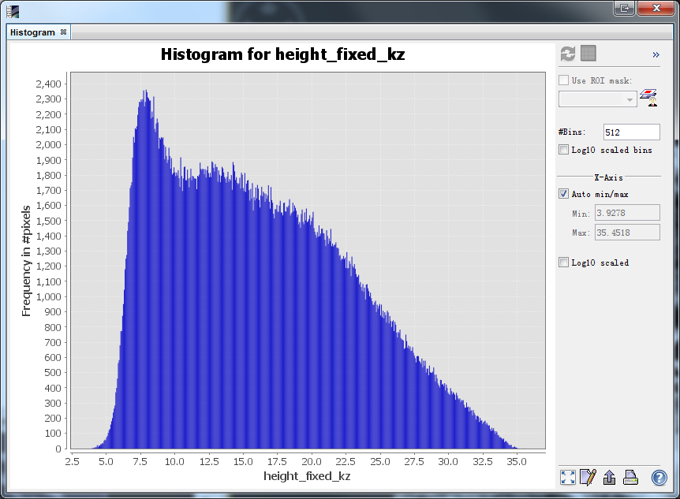
Step12: Height inversion
Based on Fixed K_{Z} :

Slide 36
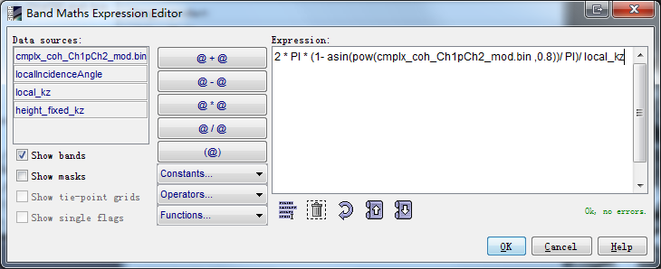
Step12: Height inversion
Based on Local K_{Z} :

Slide 37
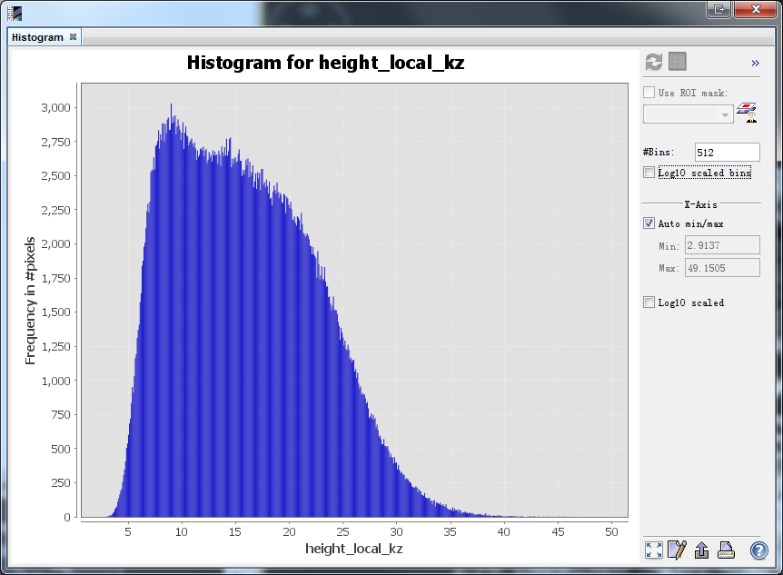
Step12: Height inversion
Based on Local K_{Z} :

Slide 38
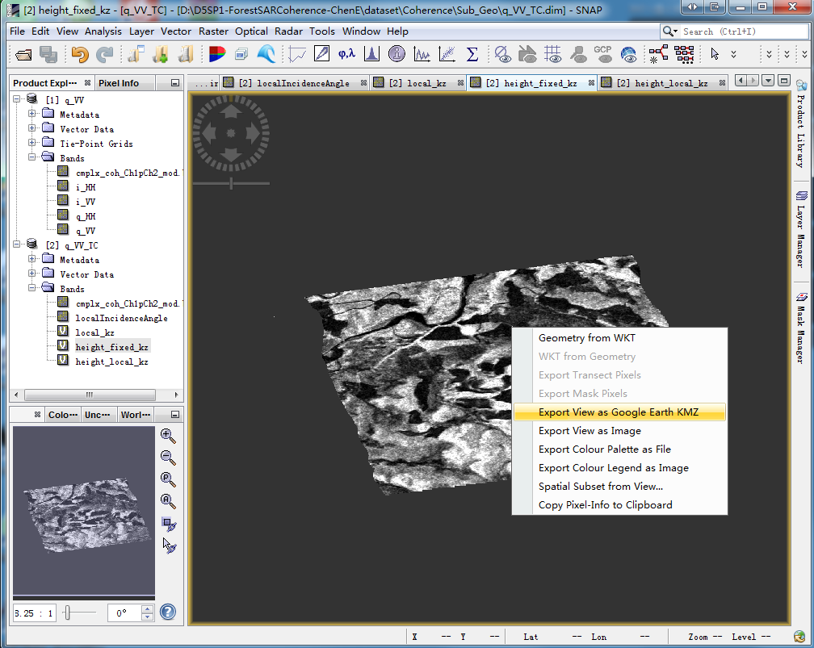
Step12: Height inversion
Convert the height inversion result to kmz file.

Slide 39
Step12: Height inversion
LiDAR Height
Based on Fixed Kz
Based on Local Kz

Slide 40
Questions ?

