Slide 2
Presentation Overview
Copernicus Data Access
Sentinel Application Platform | SNAP
Science Toolbox Exploitation Platform | STEP
Copernicus Sentinels (Missions & Products Overview)

Slide 3
Copernicus Data Access
Sentinel Application Platform | SNAP
Science Toolbox Exploitation Platform | STEP
Copernicus Sentinels (Missions & Products Overview)

Slide 4

The Copernicus Programme
A Space Flagship Programme run by EU and ESA
Dedicated satellites (“Sentinels”):
S1: Radar Mission
S2: High Resolution Optical Mission
S3: Medium Resolution Imaging and Altimetry Mission
S4: GEO Atmospheric Chemistry Mission
S5P/S5: LEO Atmospheric Chemistry Missions
S6/Jason-CS: Altimetry Mission

Slide 5
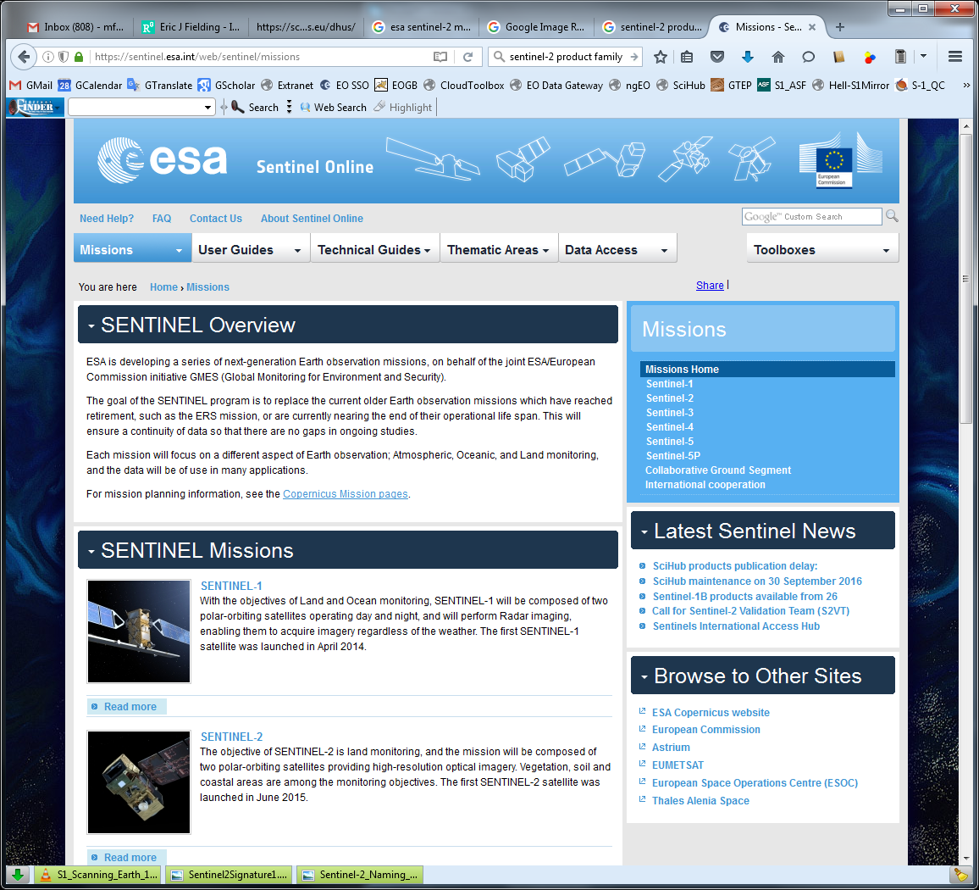
Sentinel Online | The Official Sentinel Website https://sentinel.esa.int/web/sentinel/home

Slide 6
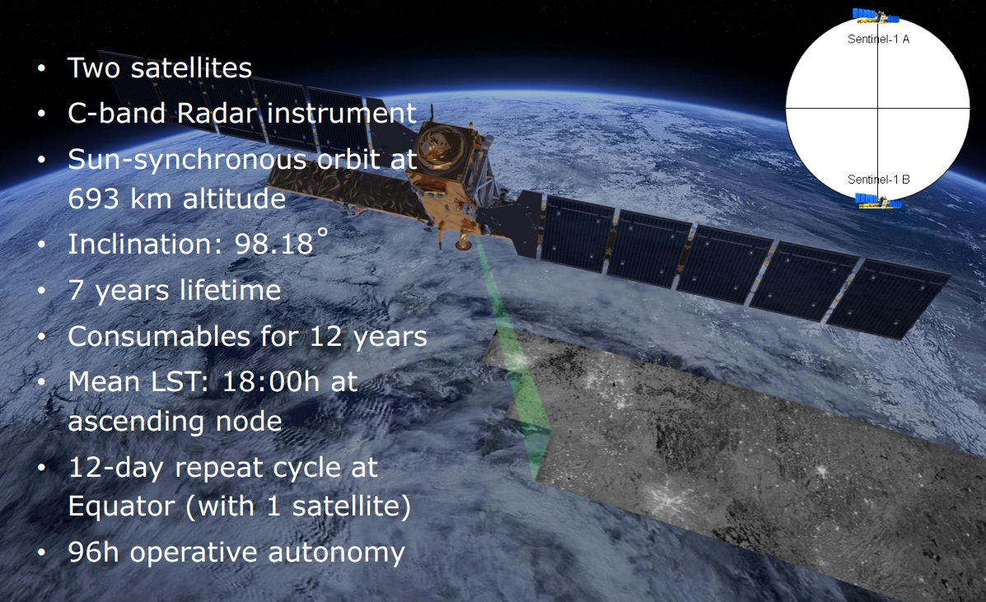
Sentinel-1 Mission Overview

Slide 7
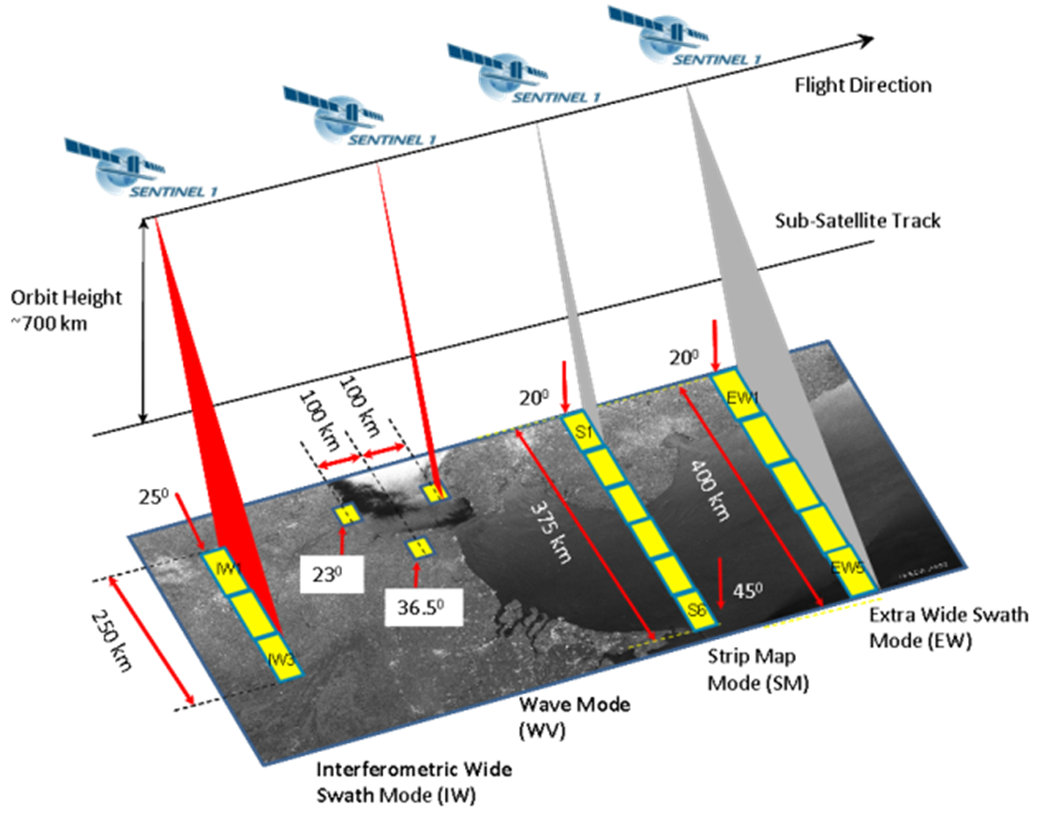

Sentinel-1
Mission Profile
S-1 SAR can be operated in 4 exclusive imaging modes with different resolution and coverages.
Resolution: 20 x 40m
Single and dual Polarisation
Polar areas, and ocean relevant areas
Can be used for interferometry
Resolution: 5m x 5m
Single and dual Polarisation
Emergency Services-Disater Monitoring
Composed of
Stripmap imagettes
Single polarisation
Pre-defined mode over open oceans
Resolution: 5m x20m
Single and dual Polarisation
Pre-defined mode over Land

Slide 8
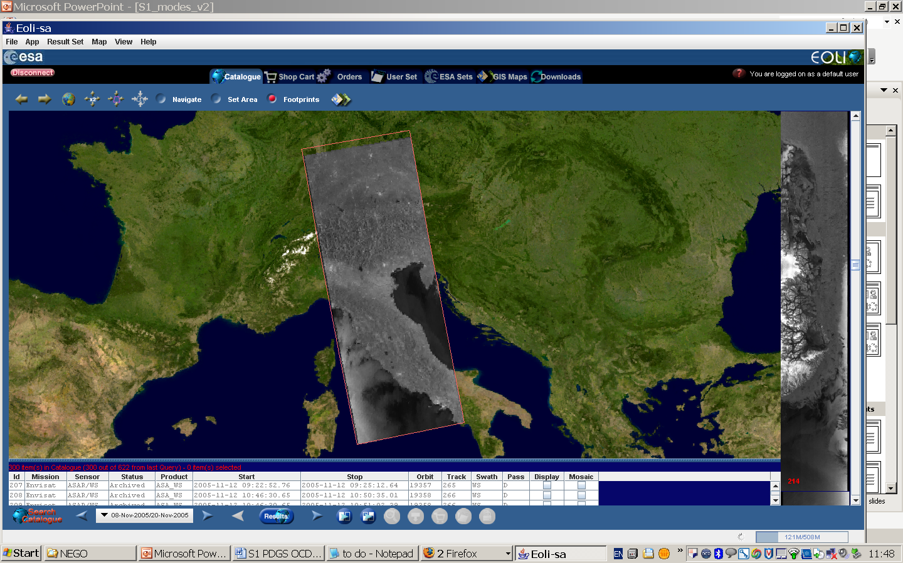
Extra Wide
Swath Mode (EW)
Sentinel-1 Acquisition Modes 2/2
46º
19º
For all of these operating modes, the same family of S-1 products is available to users from the S-1 Core PDGS.
400 Km
250 Km
45º
Interferometric Wide Swath Mode (IW)
Mode Rate | SAR Mode
High Bit Rate (HBR) | IW
 | EW
 | SM (S1 -> S6)
Low Bit Rate (LBR) | WV
30º
46º
Stripmap Mode (SM)
19º
400 Km
S6
S1
80 Km
The systematic processing into specific product type is done according to pre-defined areas definition (cf. HLOP) while other product types will be available on request in offline (see processing concept tables)
23º
Wave Mode (WV)
36º
100 Km
200 Km
Sentinel-1
Acquisition
Modes
Notes:
S1 Acquisition modes

Slide 9
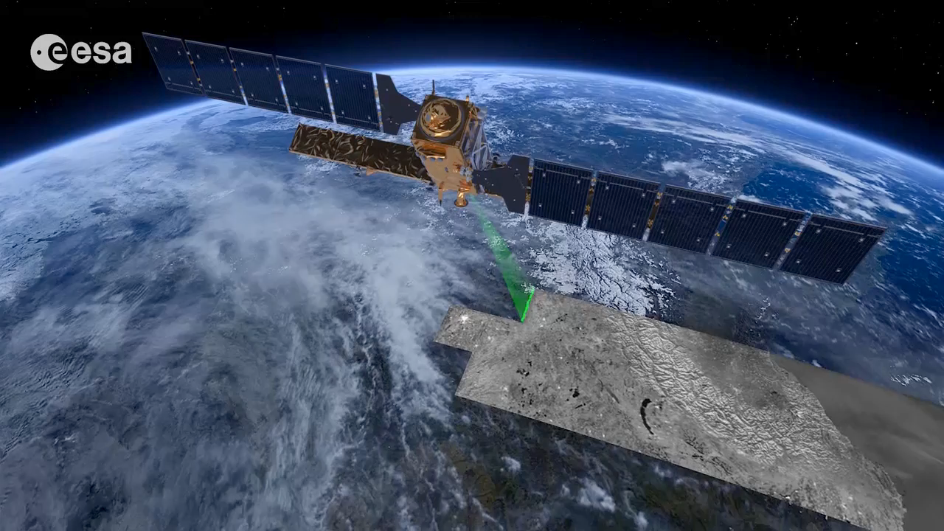
Terrain Observation
by Progressive Scans
(TOPS)
Image Acquisition in TOPS
Interferometric Wide Swath mode (IW)
Notes:
Sentinel-1 carries an advanced synthetic aperture radar that works in several specialised modes to provide detailed imagery for Europe’s Copernicus programme. These data will be used for applications such as monitoring the oceans, including shipping lanes, sea ice and oil spills. It also provides data to map changing land cover, ground deformation, ice shelves and glaciers, and can be used to help emergency response when disasters such as floods strike and to support humanitarian relief efforts at times of crisis.

Slide 10
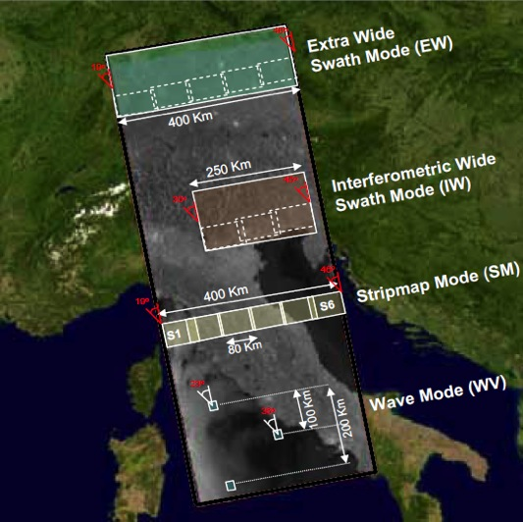
Sentinel-1 Operational Modes
GRD Level 1 product resolution | Swath Width | Polarisation
50m (3 ENL) | > 400 km | HH+HV or VV+VH
20m (5 ENL) | > 250 km | HH+HV or VV+VH
9m (4 ENL) | > 80 km | HH+HV or VV+VH
50m (140 ENL) | 20x20 km² at 100 km spacing | HH or VV
Operational Modes
Interferometric Wide (IW)
default mode over land

Slide 11
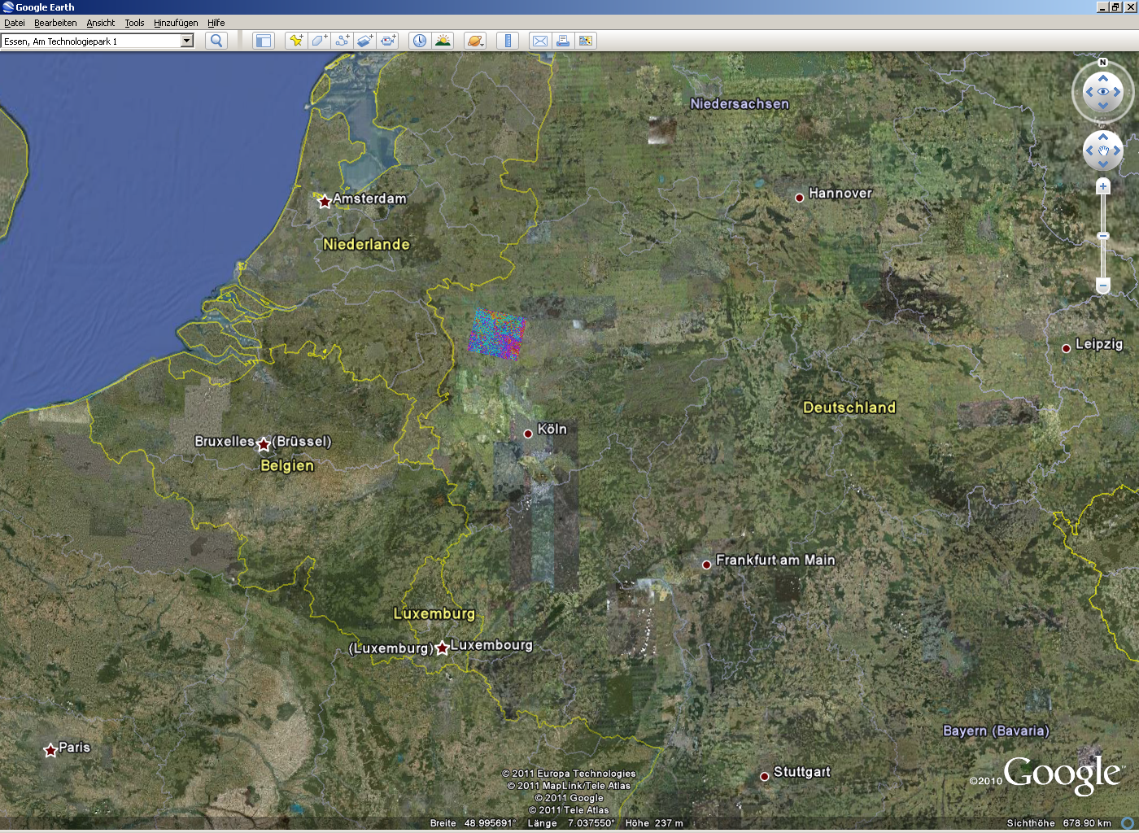
Sentinel-1 Swath Coverage
TerraSAR-X
Stripmap
30 km
ERS
100 km
Sentinel-1
250 km

Slide 12
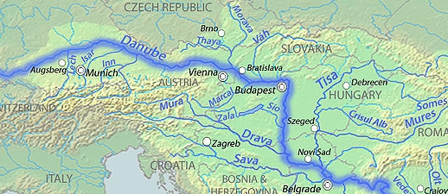
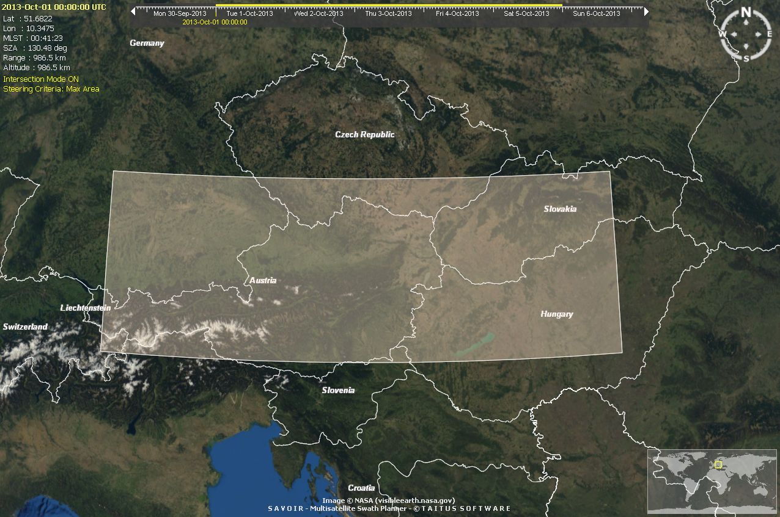
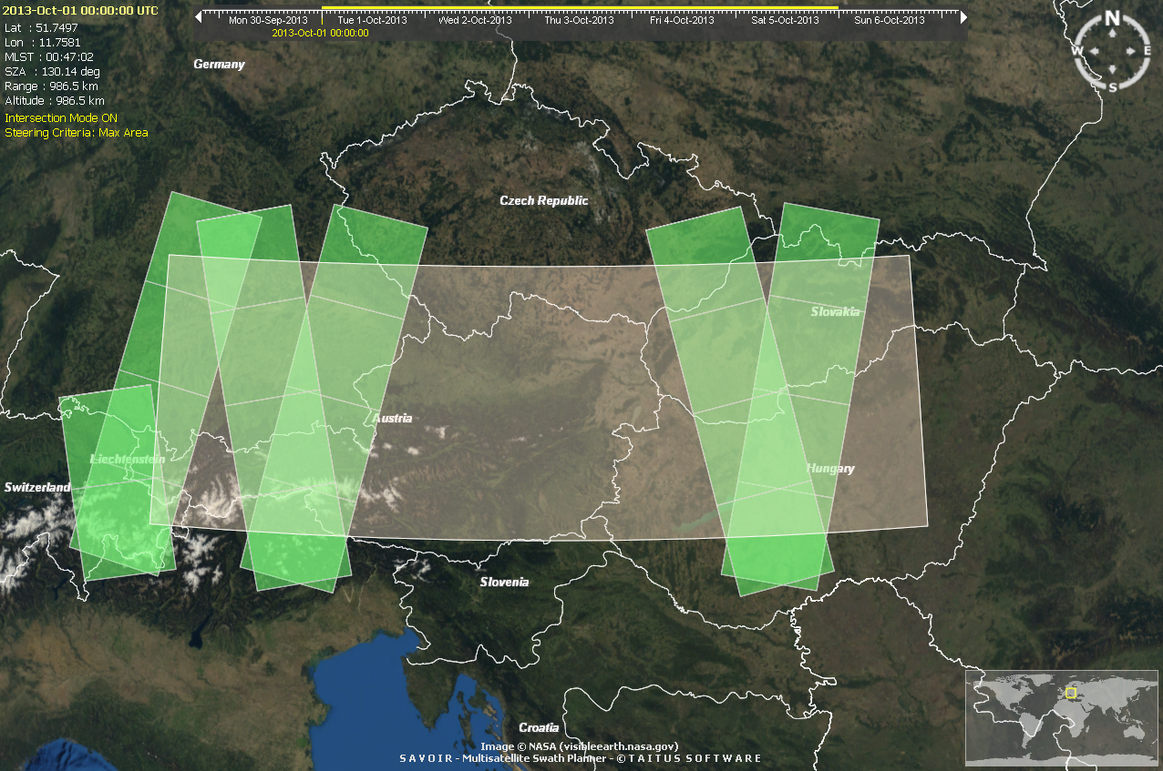
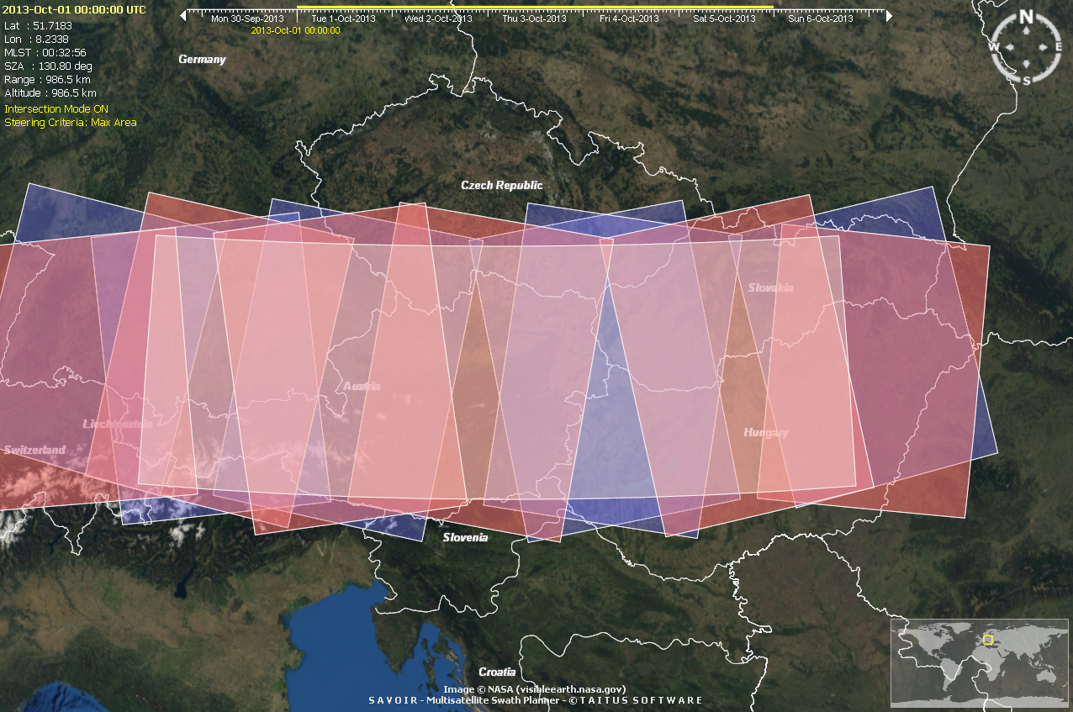
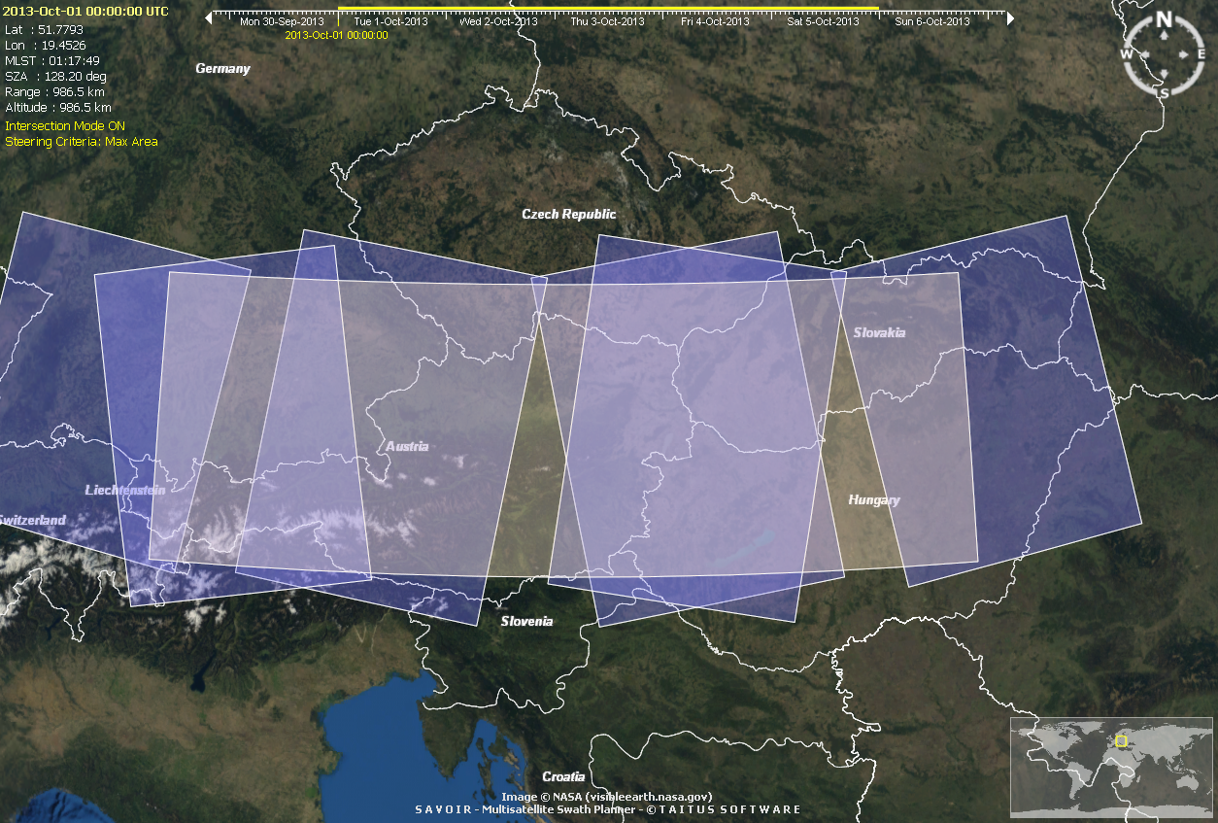
Sentinel-1 Improved Spatial Coverage
Sentinel-1 vs ENVISAT 5-day coverage
Until 2012:
ENVISAT
2014+:
Sentinel1A
2016+:
Sentinel1A/B

Slide 13
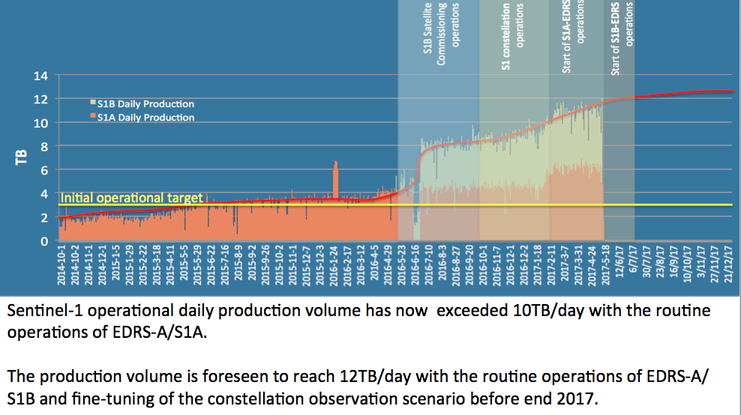
Sentinel-1 Constellation Operations Status
SAR daily production volume evolution

Slide 14
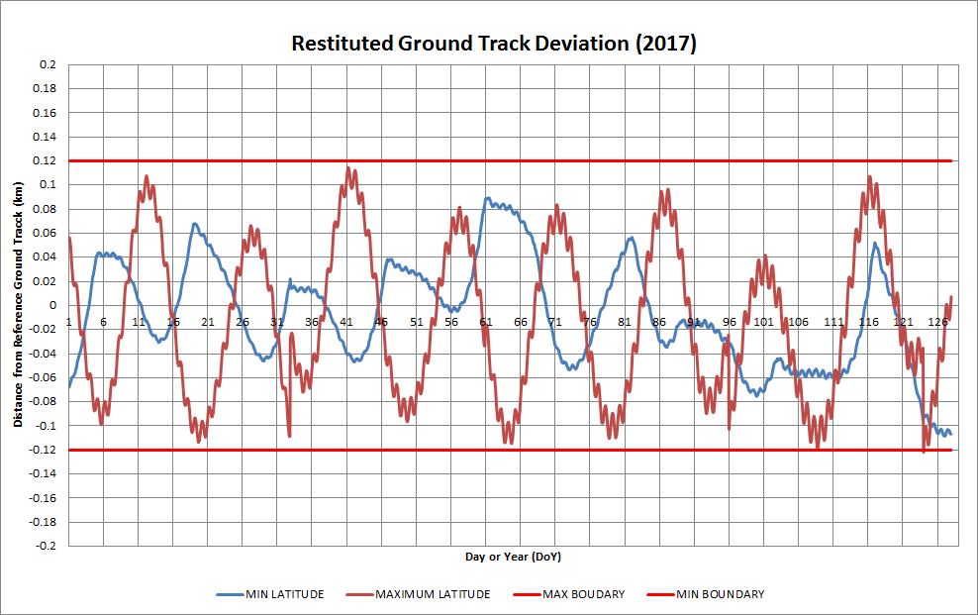
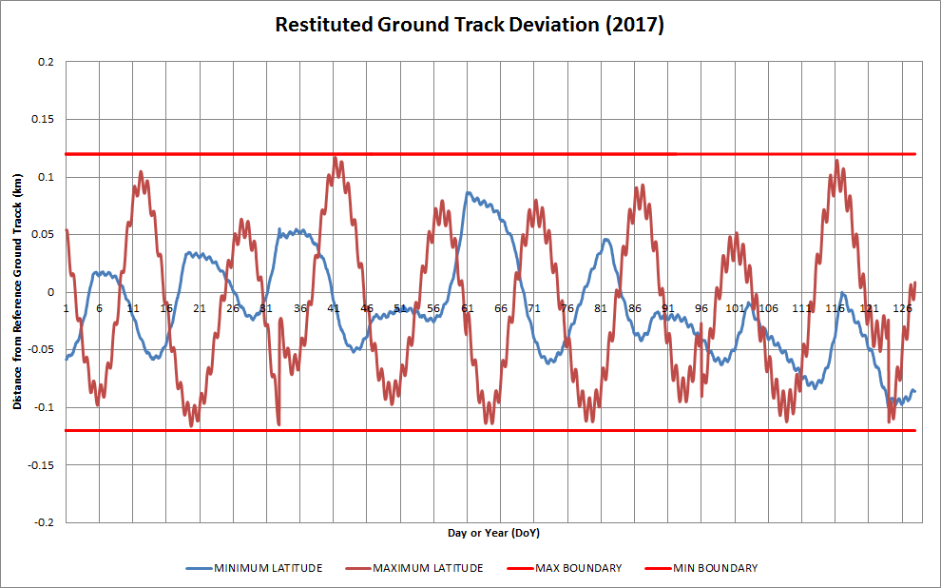
S1A & S1B Orbit Maintenance
S1A
S1B

Slide 15
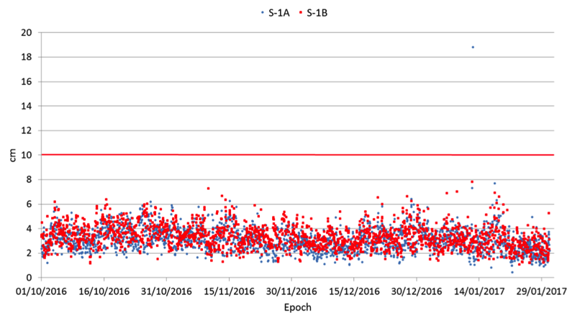
Sentinel-1 Precise Orbit Determination | Restituted Orbits
Average of daily 2D rms [cm]
 | S1A | S1B
< 3 cm | 51.10% | 39.50%
< 5 cm | 96.90% | 94.30%
< 10 cm | 99.80% | 99.60%
< 20 cm | 99.90% | 99.60%
Restituted orbit products (AUX_RESORB)
2D rms is about 5cm,well below the 10cm specifications

Slide 16
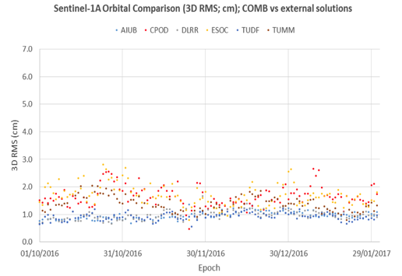
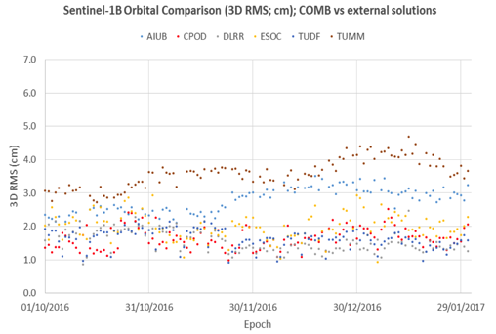
Sentinel-1 Precise Orbits
SAR daily production volume evolution
Precise orbit products (AUX_POEORB)
3D rms is about 2cm, well below the 5cm specifications
S1A | Average of daily 3D rms [cm]
min | 0.9
average | 1.7
max | 1.3
specification | 5
S1B | Average of daily 3D rms [cm]
min | 1.6
average | 2.0
max | 1.7
specification | 5

Slide 17
Operational enhancements relevant to “InSAR users"
Ease user access to S1 orbital information: Q3-4 2017
Watch the Sentinels On-line News
Orbit information is currently available at:
https://qc.sentinel1.eo.esa.int/mpl_orbpre/
https://qc.sentinel1.eo.esa.int/aux_resorb/
  A simplified FTP access to the S1 auxiliary files (processing and orbital information) will be available to all users in the coming weeks.
  Both accesses will be available contemporarily for sufficient time to allow users to migrate to the new access point.
  The availability of the new access will be announced on the Sentinels on-line (https://sentinel.esa.int/)

Slide 18
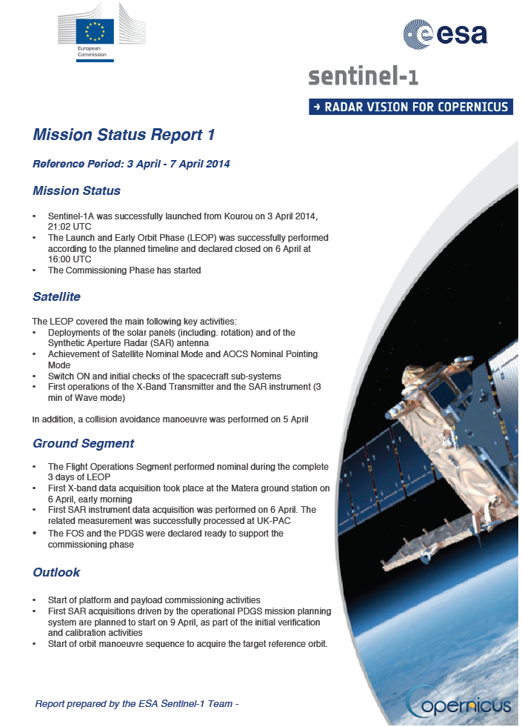
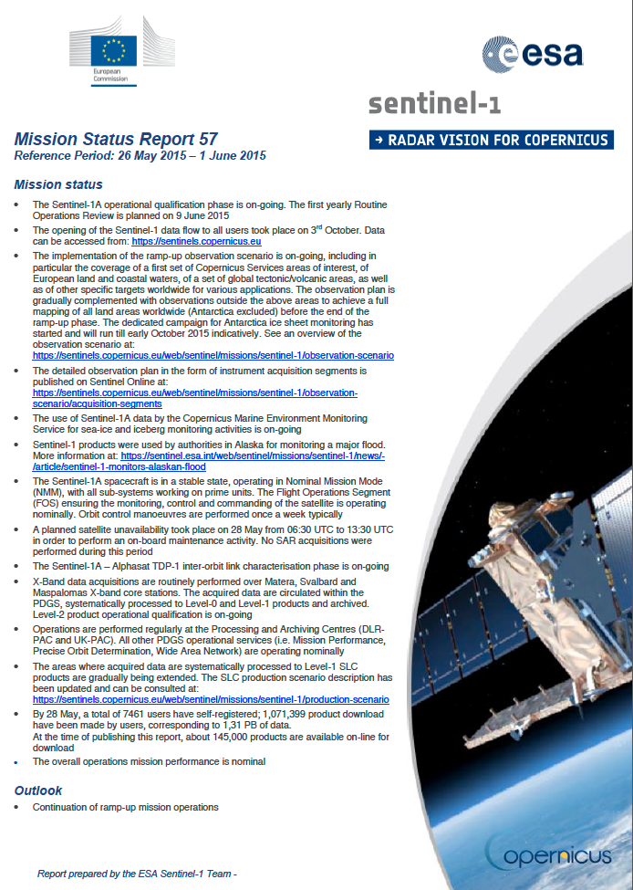
Weekly Mission Status Reports published online
https://sentinel.esa.int/web/sentinel/missions/sentinel-1/mission-status

Slide 19
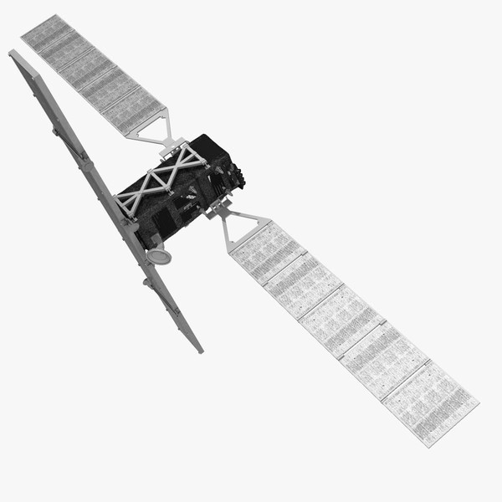
Sentinel-1
Product Family

Slide 20
Sentinel-1 Operational Product Family
SM
IW/EW
S-1 Core product family
Level 0
Level 1
Level 2
OCN
GRD
RAW
Medium Res. (MR)
High Res. (HR)
Full Res. (FR)
SLC
Resolution class
~90m
~20m SM/IW ~50m EW
~10m
WV

Slide 21
Sentinel-1 Operational Product Family
LEVEL-0 PRODUCTS
Level-0 products contain the compressed, unprocessed instrument source packets, with additional annotations and auxiliary information to support the processing.
SAR Level-0 products for SAR SM, IW and EW modes are made available to the S-1 users.
LEVEL-1 PRODUCTS
Level-1 Slant-Range Single-Look Complex Products (SLC):
SLC products provide focused data in slant-range geometry, single look, containing phase and amplitude information.
Level-1 Ground Range Detected Geo-referenced Products (GRD):
Focused data is projected to ground range, detected (phase information is lost) and multi-looked.
Data is projected to ground range using an Earth ellipsoid model, maintaining the original satellite path direction and including complete geo-reference information.
LEVEL-2 PRODUCTS
Level-2 (waves, wind, radial velocity) products
Ocean wind field, swell wave spectra and surface radial velocity information as derived from SAR data. L2 ocean products are available for all modes (although information content may slightly vary per mode)

Slide 22
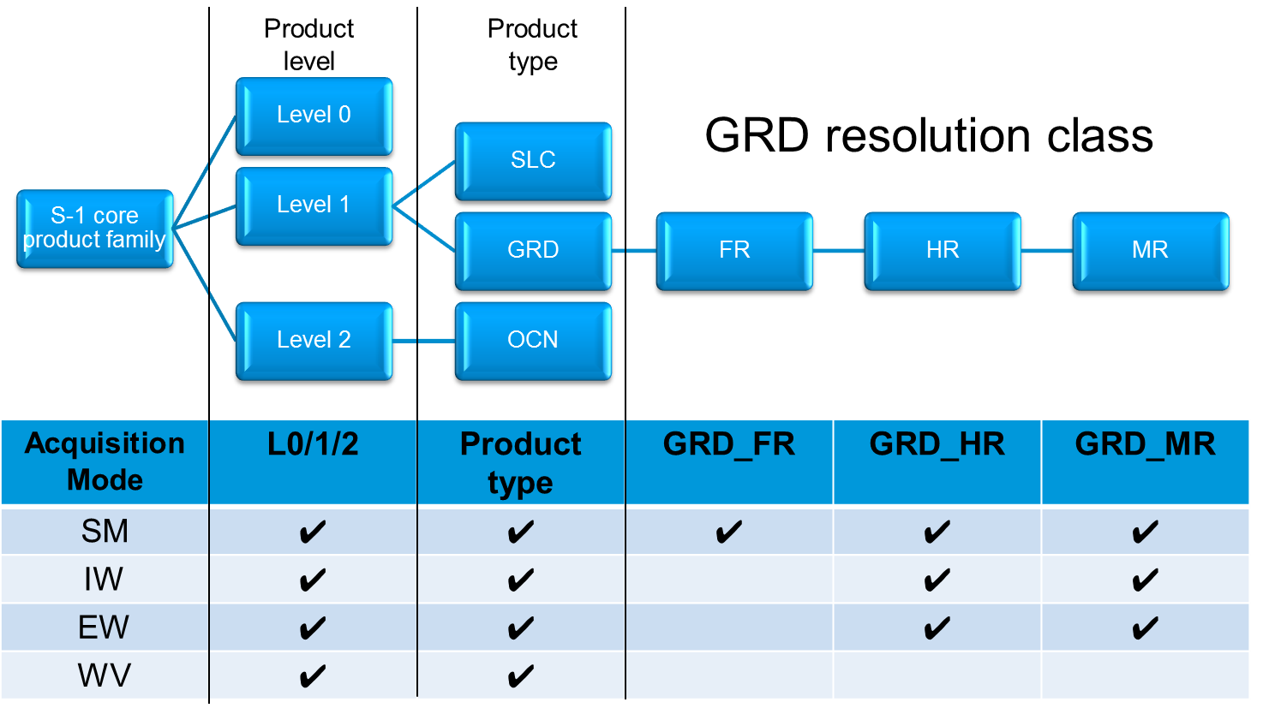
Sentinel-1 Operational Product Family

Slide 23
Sentinel-1 Operational Product Family
Instrument Mode | Product Type | Resolution Class | Spatial Resolution [m]
SM | SLC |  | [1.7 x 4.3] to [3.6 x 4.9]
 | GRD | FR | < 10 m
 |  | HR | < 25 m
 |  | MR | < 100m
IW | SLC |  | [2.7 x 22] to [3.5 x 22]
 | GRD | HR | < 25m
 |  | MR | <100m
EW | SLC |  | [7.9 x 42] to [14.4 x 44]
 | GRD | HR | < 50m
 |  | MR | <100m

Slide 24
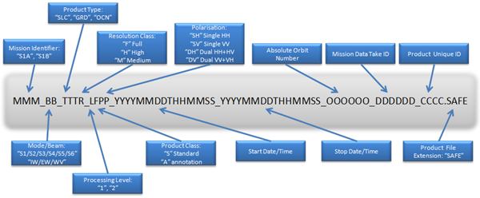
Sentinel-1 Products Name Formatting

Slide 25
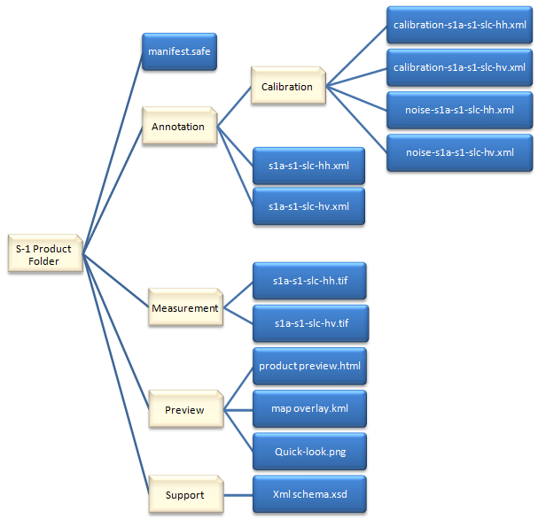
Sentinel-1 Level 1 Product Formatting
Sentinel-1 data products are distributed using a SENTINEL-specific variation of the Standard Archive Format for Europe (SAFE) specification.
The SAFE format has been designed to act as a common format for archiving and conveying data within ESA Earth Observation archiving facilities.
The SENTINEL-SAFE format wraps a folder containing image data in a binary data format and product metadata in XML
A SENTINEL product refers to a directory folder that contains a collection of information. It includes:
a manifest.safe file
subfolders for measurement data
a preview folder containing KML and HTML preview files
an annotation folder
a support folder containing the XML schemes

Slide 26




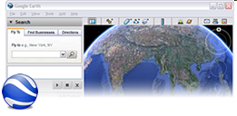

Sentinel-1 Operational User Products Format
XML
Manifest
GeoTIFF
Measurement
Data
Data
(e.g. img.,
param.)
Quicklook
PREVIEW
Google Earth
Map overlay
Map
PRODUCT*
KML
Preview
HTML
HTML product preview
ANNOTATIONS
Annotations
Products metadata
XML
SUPPORT
XML Schema
XML Schema files for measurement data and annotations
XSD

Slide 27
Copernicus Data Access
Sentinel Application Platform | SNAP
Science Toolbox Exploitation Platform | STEP
Copernicus Sentinels (Missions & Products Overview)

Slide 28
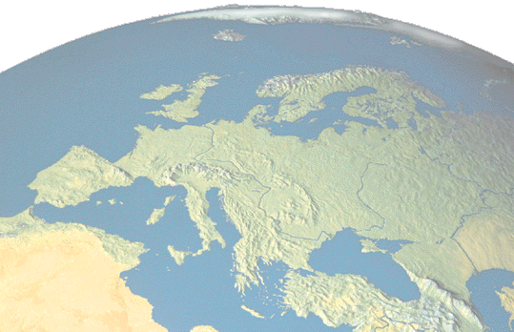
Facilitating Access to EO data
A constant ESA objective:
→ Ease access to Earth Observation data
ESA EO data policy:
→ free of charge, open (and of high quality)
Constant upgrade of ground segment for easier access to EO data including Near Real Time (NRT) and reprocessing
Need to address “heritage” data for future use
→ Need to anticipate the way users will use EO data in future
(e.g. exploitation platform, data/algorithm toolboxes)

Slide 29



ESA Earth Observation Data Policy | PAST
  To stimulate a balanced development of Science, Public Utility and Commercial Applications, consistent with the mission objectives
  To maximize the beneficial use of data from ESA EO satellites
ESA Data Policy
ERS and Envisat
  Free datasets
  Open access and free of charge. User registration and acceptance of ESA Terms & Conditions are required
  Restrained datasets
  Free of charge. The submission of a Project (Full) Proposal and acceptance of the ESA Terms & Conditions are required, after its evaluation a quota will be assigned
Earth Explorers
Data Policy of individual data providers
In some case a reproduction cost (e.g. ALOS) or Specific Restrictions (limitations of quota, geographical restrictions, etc.) to the use of data may be applied for TPM
ESA - Third Party
Missions

Slide 30
Historical Missions Data Access
How to Obtain ENVISAT (A)SAR On-The-Fly Data
On The Fly (OTF) data products are freely available to ESA registered users via the EOLI-SA client.
Users can search and browse all products openly, but a registration on the ESA EO Data Portal is order required to download.
In order to register and to be granted access to the available products, users are required to follow the steps below:
Create an EO-SSO account following the instructions (for users who have not registered already).
Apply for (A)SAR OTF Data
  Level 1 (ASAR_IMS - ASAR_IMP - ASAR_APS - ASAR_APP)
  Users can access (A)SAR OTF Standard Service (Level 1 data products) by submitting a Fast Registration.
  Access will be automatically enabled at registration submission. Users will receive an email containing access details.
  Level 0 (ASAR_IM - ASAR_APC - ASAR_APH - ASAR_APV)
  Users can access (A)SAR OTF Level 0 data products by submitting a Data Service Request justifying and describing the data needs. Please note that access to Level 0 Data is not part of the standard OTF Service and it will be granted in exceptional cases. Requests will be evaluated and feedback will be provided usually within 2 weeks.
The service is being rolled out gradually (ASAR WS from December 2016, and ERS IM from Q1 2017).
Quality of Service : In order to allow a fair share of resources the dissemination system allows data download with the following rules:
Users can download only a fixed number of products per day (from 00:00 to 23:59 UTC) → Standard service up to 5 products per day
Users can perform only a limited number of requests or download in parallel
Because not all online disseminated data is immediately available for download, as there might be products that need to be processed, the consumption of daily quota occurs already when the product is requested and not when the download begins. However, even if daily quota is over, users are allowed to download the products already requested or not yet available at request time.

Slide 31
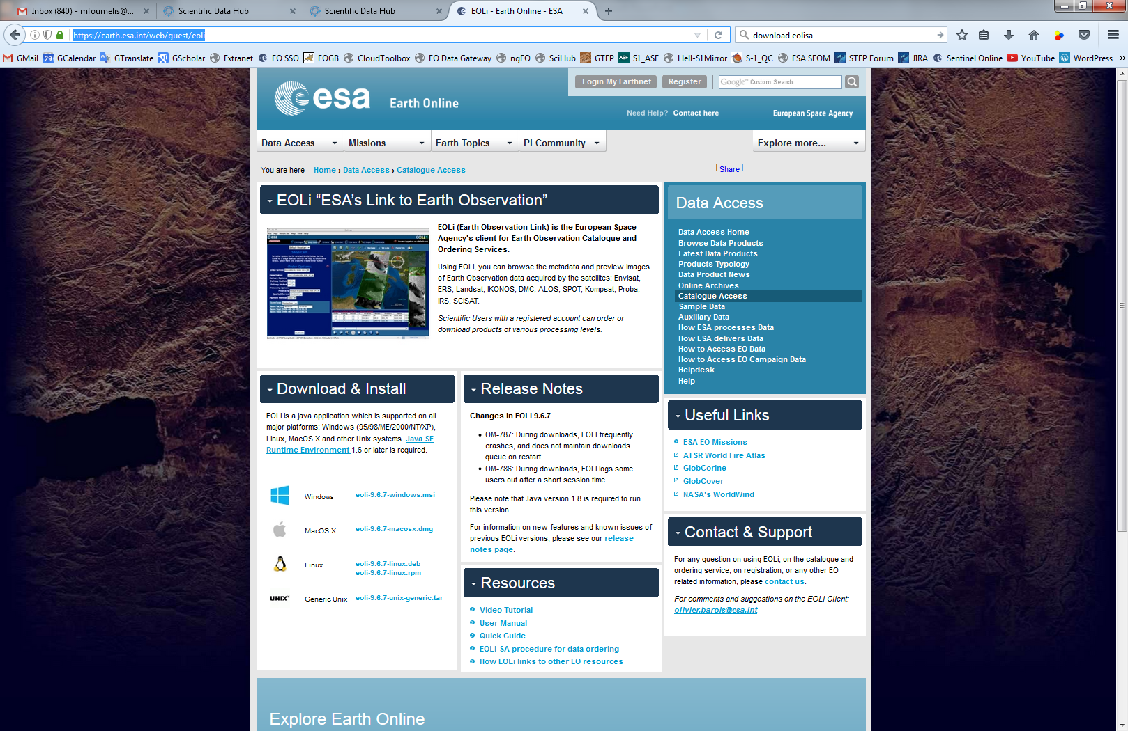
Historical Missions Data Access
ESA Link to Earth Observation | EOLi

Slide 32
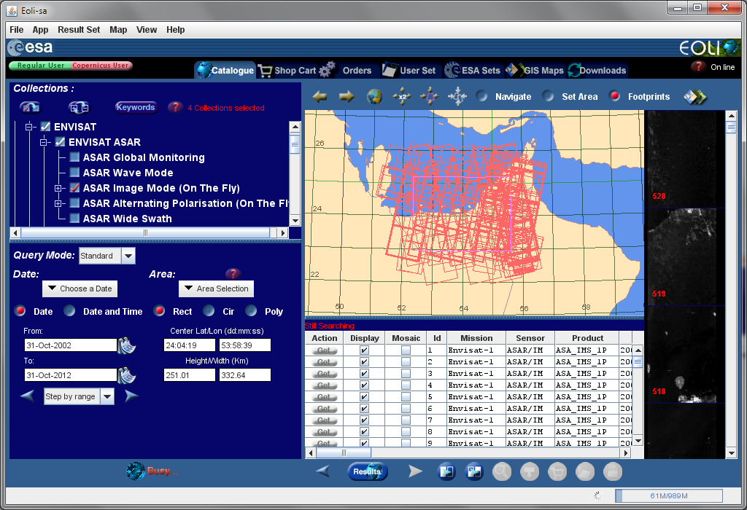
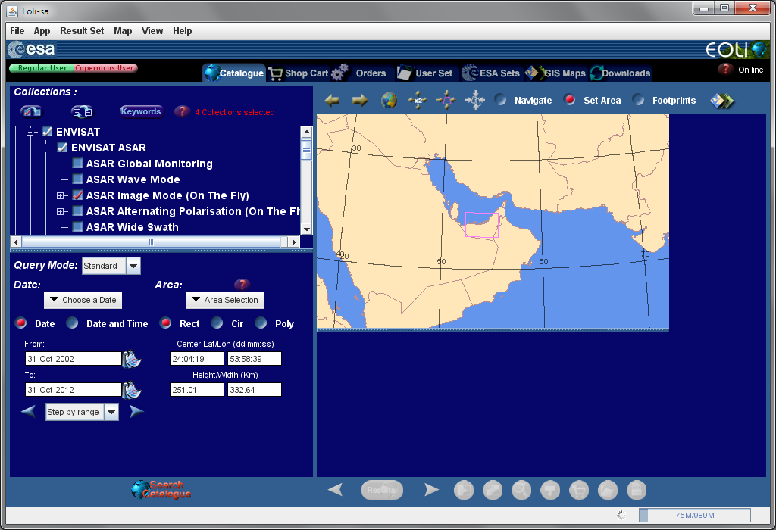
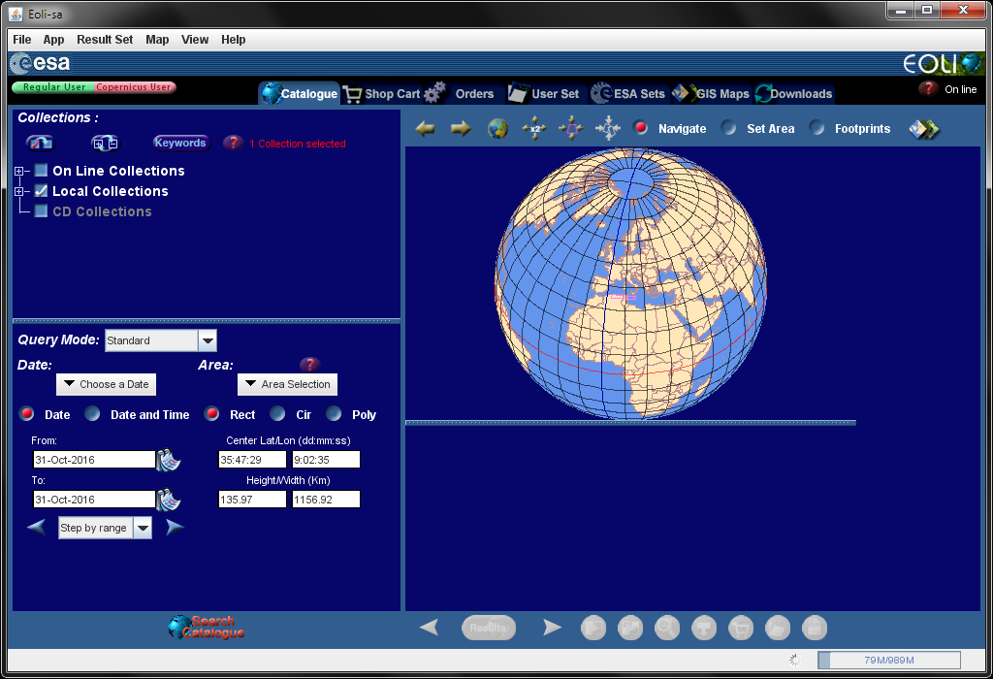
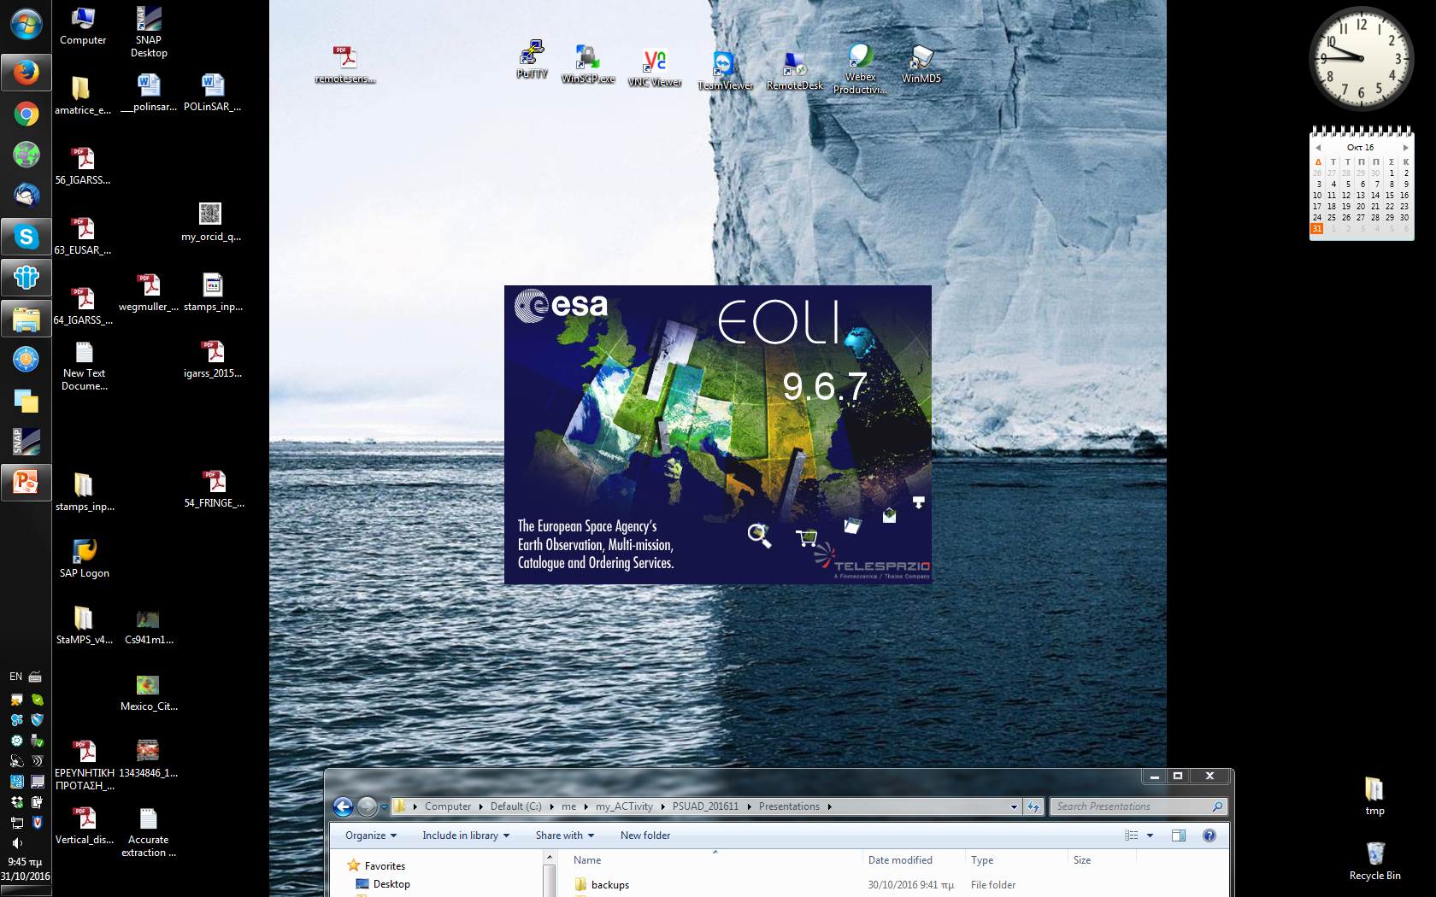
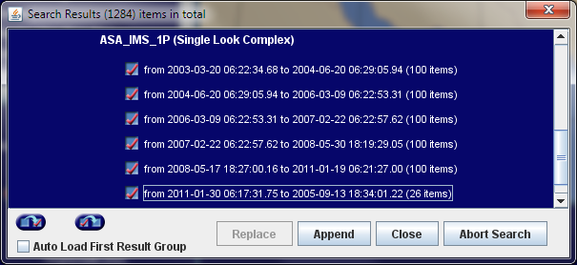
EOLi | Earth Observation Link

Slide 33
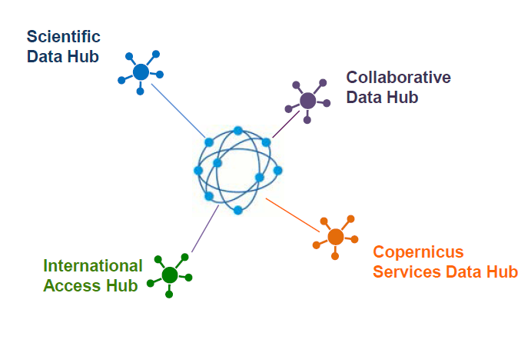
ESA Operated Sentinel Data Hubs
The open access Sentinel Data Hub, for anyone
Sentinel data access, for European partners (e.g. CNES, DLR)
Sentinel data access,
for international partners (e.g. NASA)
Sentinel data access, for Copernicus services (e.g. marine, land)

Slide 34
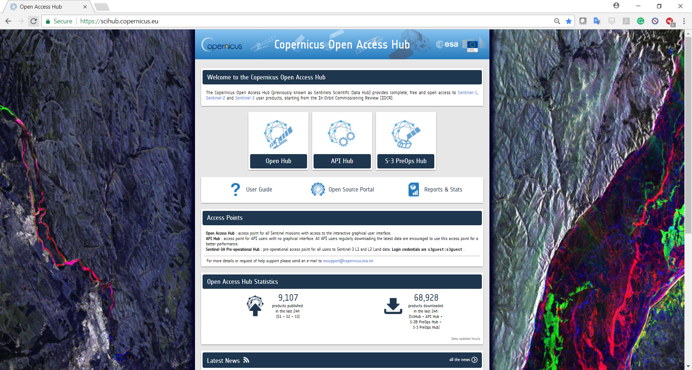
Copernicus Open Access Hub
https://scihub.copernicus.eu/
visited on 30/10/2016

Slide 35
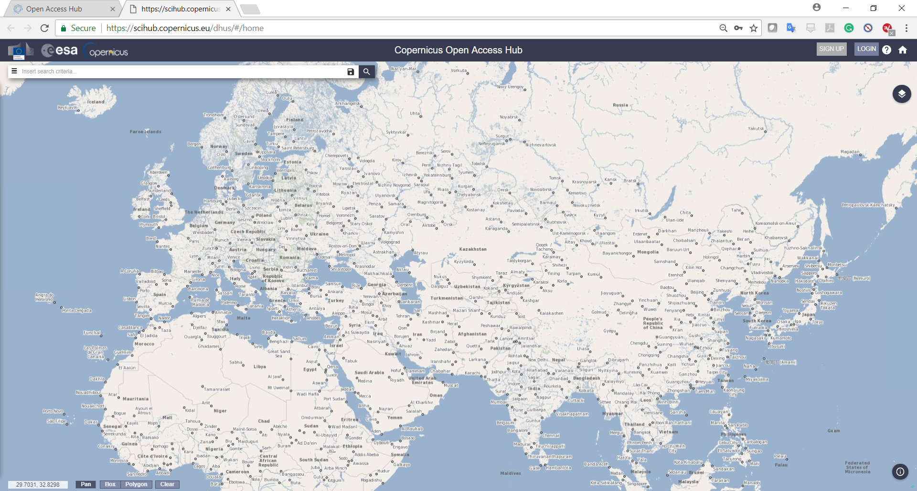
Copernicus Open Access Hub | https://scihub.copernicus.eu/

Slide 36
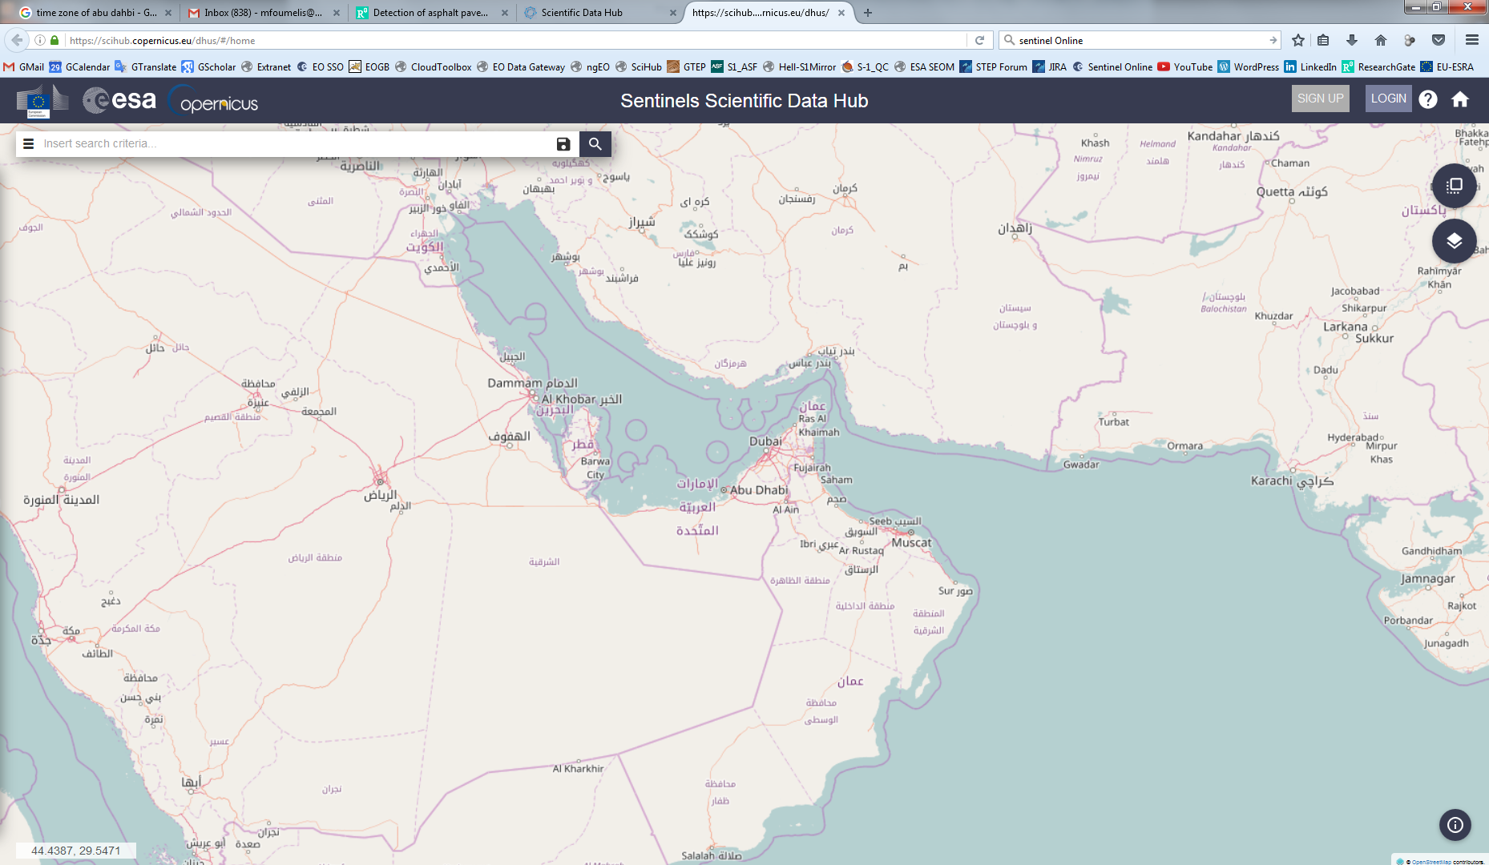
Copernicus Open Access Hub | https://scihub.copernicus.eu/

Slide 37
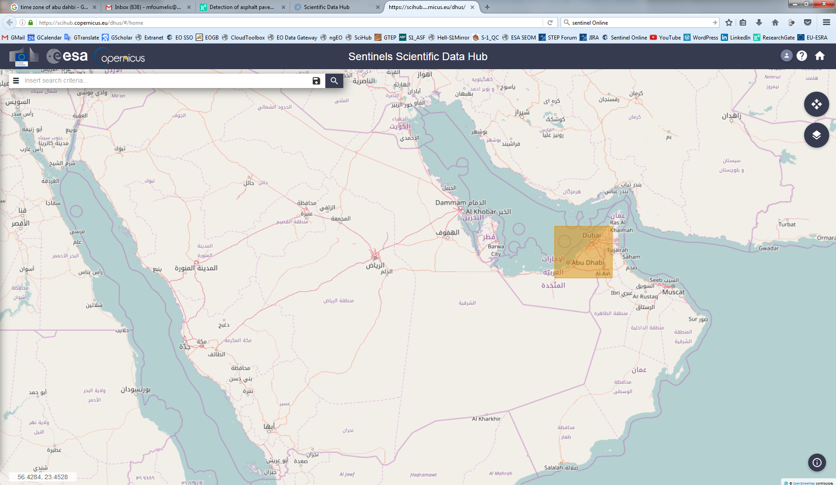
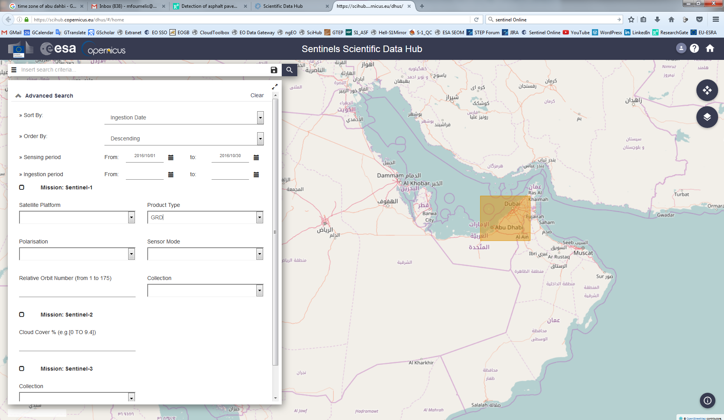
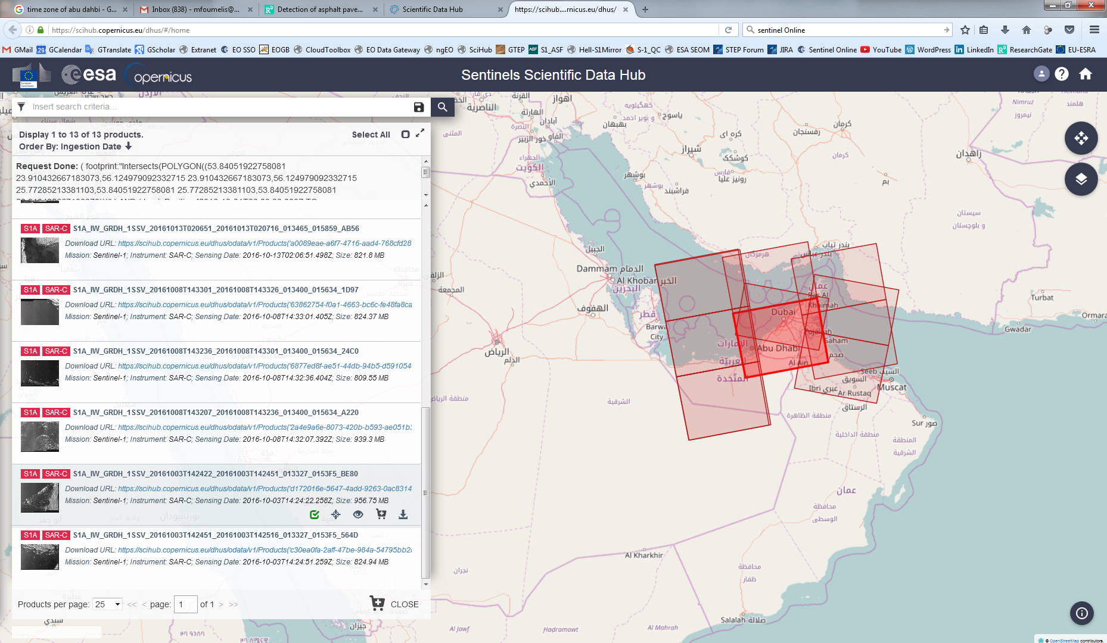
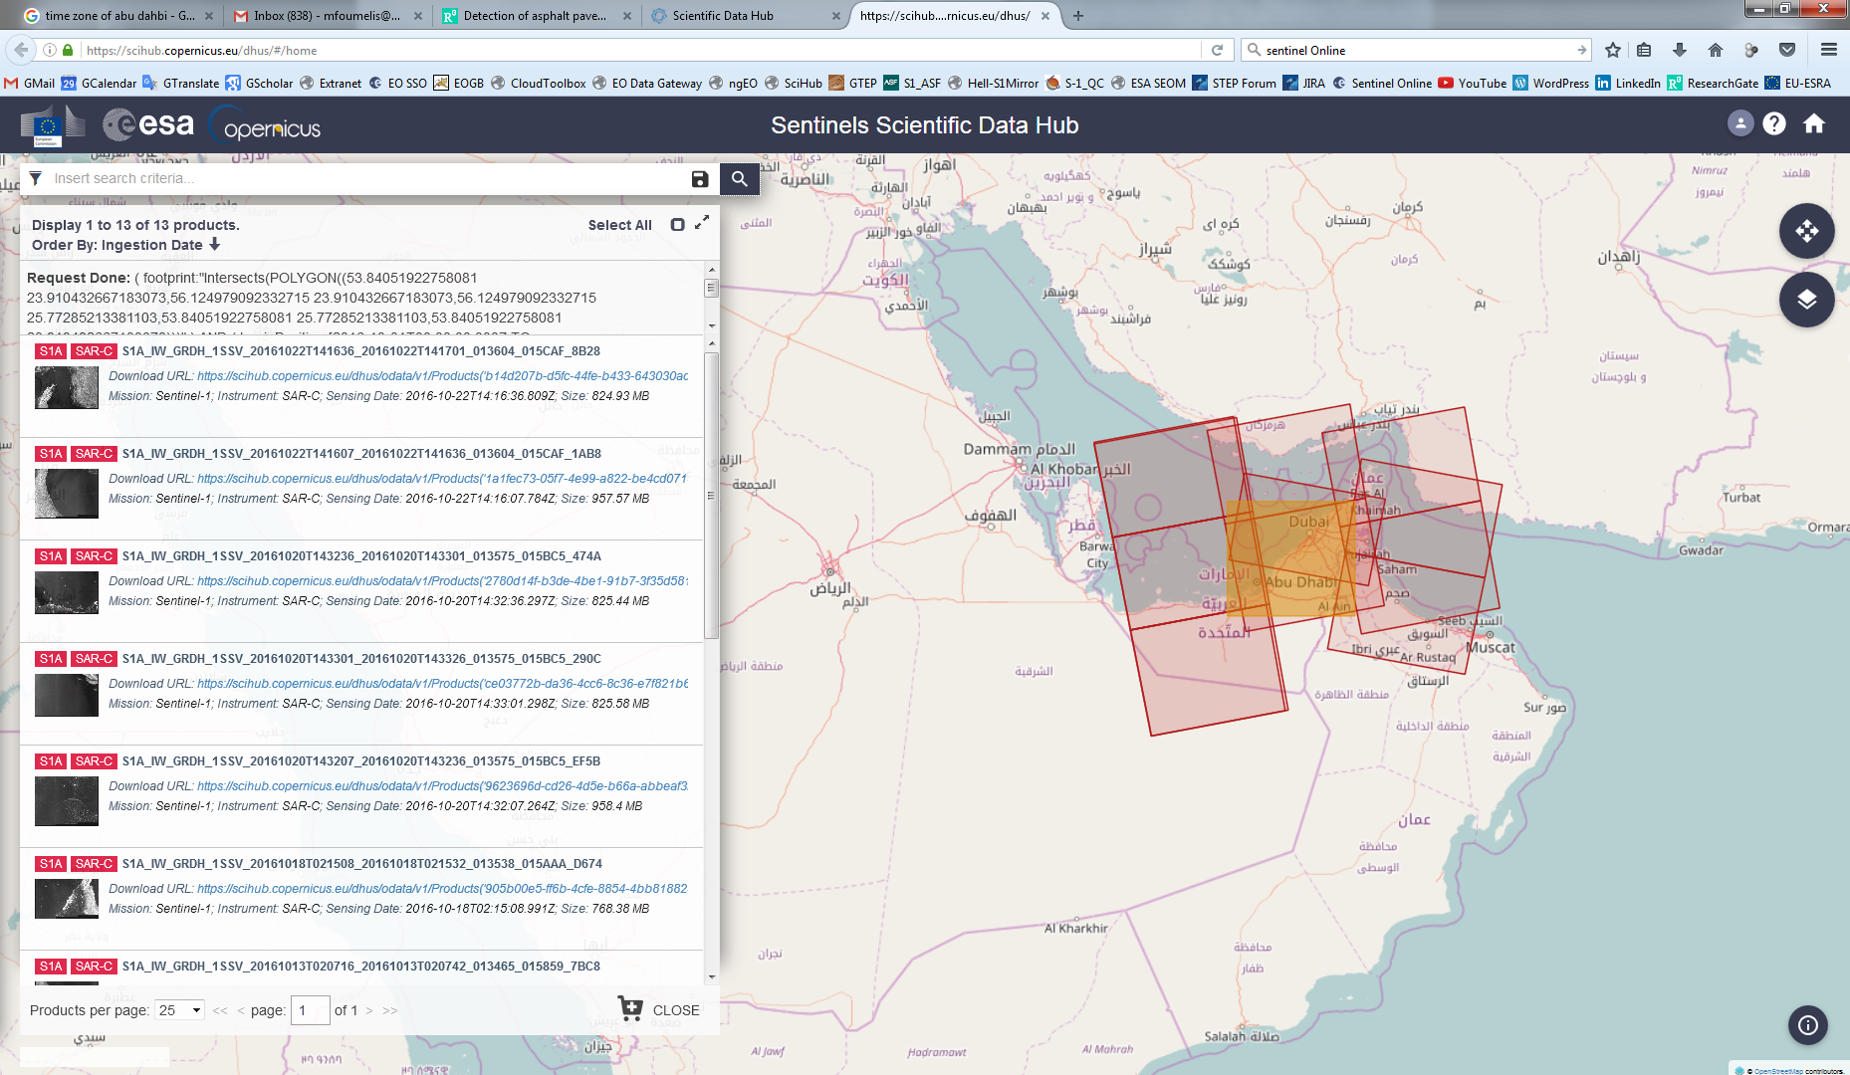
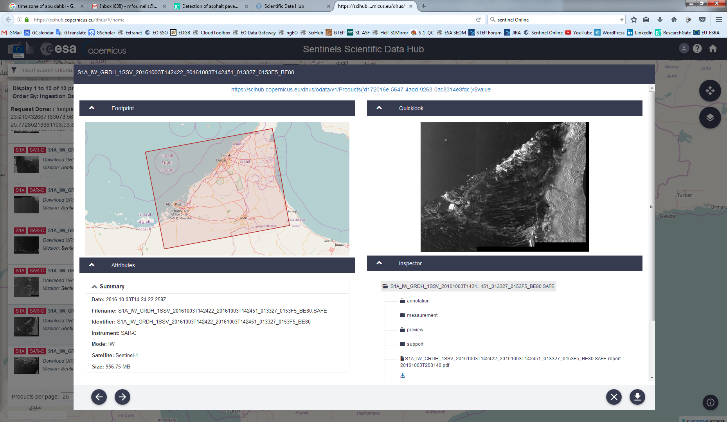
Copernicus Open Access Hub | https://scihub.copernicus.eu/
Download

Slide 38
Copernicus Data Access
Sentinel Application Platform | SNAP
Science Toolbox Exploitation Platform | STEP
Copernicus Sentinels (Missions & Products Overview)

Slide 39

SNAP
The common architecture for all Sentinel Toolboxes and SMOS Toolbox is called Sentinel Application Platform (SNAP).
SNAP architecture is ideal for Earth Observation processing and analysis due the following technological innovations: Extensibility, Portability, Modular Rich Client Platform, Generic EO Data Abstraction, Tiled Memory Management and a Graph Processing Framework.
Activity funded through SEOM element of ESA’s EOEP-4 (www.seom.esa.int)
Notes:
39

Slide 40
SeNtinel Application Platform | SNAP
SAR Toolbox (S1TBX)
  Scientific toolbox for the handling and post-processing of data products from Sentinel-1 SAR mission
High Resolution Optical Toolbox (S2TBX)
  Toolbox for the visualisation, analysis and post-processing of data products from Sentinel-2 multi-spectral optical data
Medium Resolution Optical Toolbox (S3TBX)
  Toolbox for the processing and analysis of Sentinel 3 OLCI and SLSTR
Developer forum
  Requirements addressing a common platform issues
  Define the platform roadmap
  Coordinate horizontal activities across the three toolboxes

Slide 41















Multi-Mission Scientific Platform
Development Consortia

Slide 42

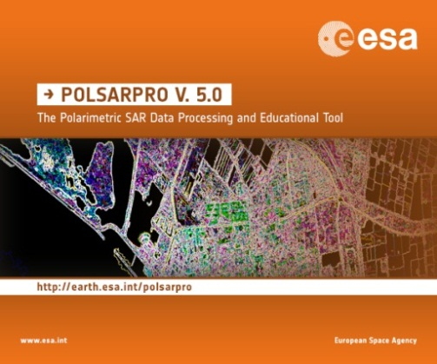

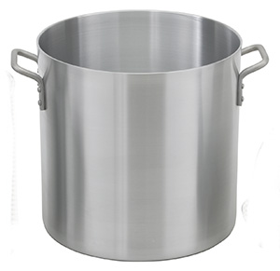








SNAP Development History
ESA Polarimetric SAR Data Processing and Educational Tool
Built on prior toolbox development
User Developed Plugins

Slide 43
How to Measure Success
The success of the Toolboxes can only be measured in terms of user acceptance.
User acceptance is gained
  if we provide the tools that users need;
  if users enjoy working with tools we provide;
  if we ensure that these tools grow, improve and evolve while they are being used;
  if we support and train the users in using the tools;
  if we maintain the tools and retain the efforts users already invested in understanding and applying the tools;
  if we let users participate in a sustainable Toolbox development.

Slide 44
SNAP Cardinal Requirements
CR 1 Openness
CR 2 Multi-mission support
CR 3 Extendibility & Modularity
CR 4 Portability
CR 5 Easy operability
CR 6 Building on heritage
CR 7 Performance

Slide 45




Benefits of SNAP
Developed as open source software
Common Java core framework
Joint development plan for Sentinel toolboxes
Interchangeable Java/Python plugins
Portable engine to Cloud infrastructure
Single installer
SNAP “Server Configuration”

Slide 46
SNAP
Releases & Features

Slide 47
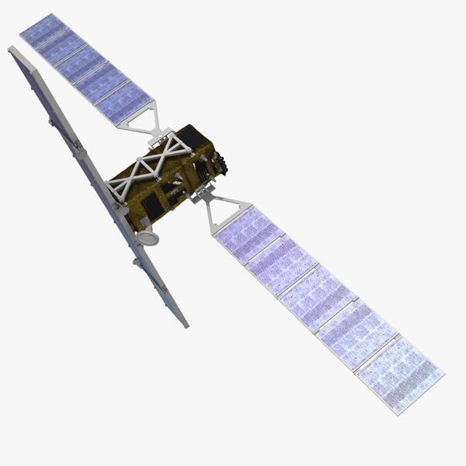
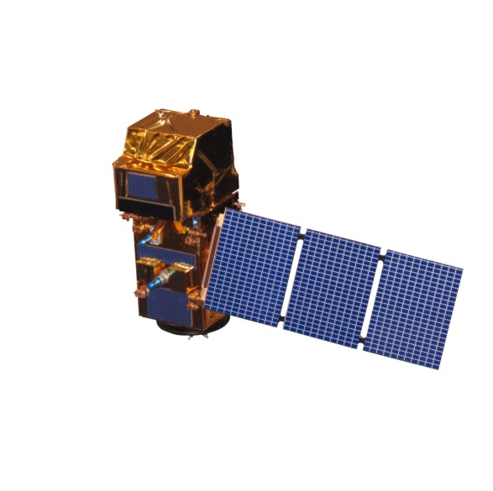
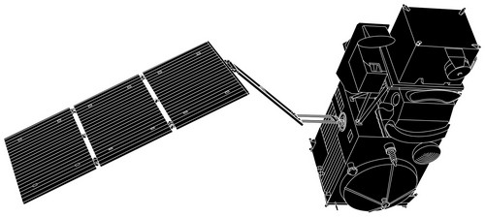
SNAP First Release
Release v1
Sept 29 2014
Empower the EO community to better exploit the large archives of the Sentinels and heritage missions in both research and operational usage.
Evolve the architecture to ensure that the software will be capable of supporting the large data products and ever growing volumes of EO data.

Slide 48
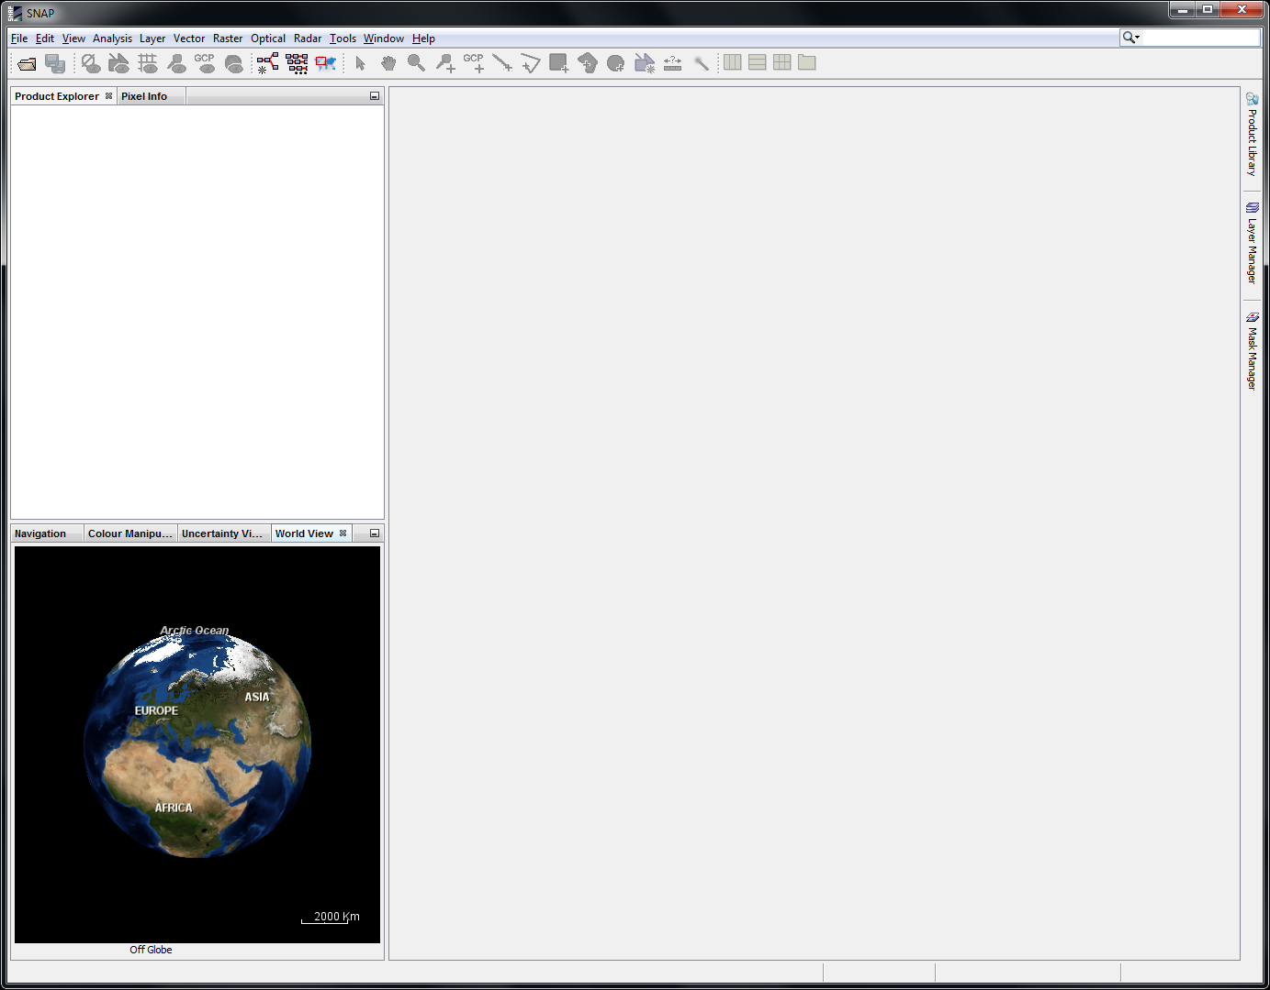
SNAP | Familiar but Enhanced Look and Feel
AOI Monitoring
Product Library
Graph Builder
Batch Processing
Layer Manager
Navigation
Colour Management
World Map

Slide 49
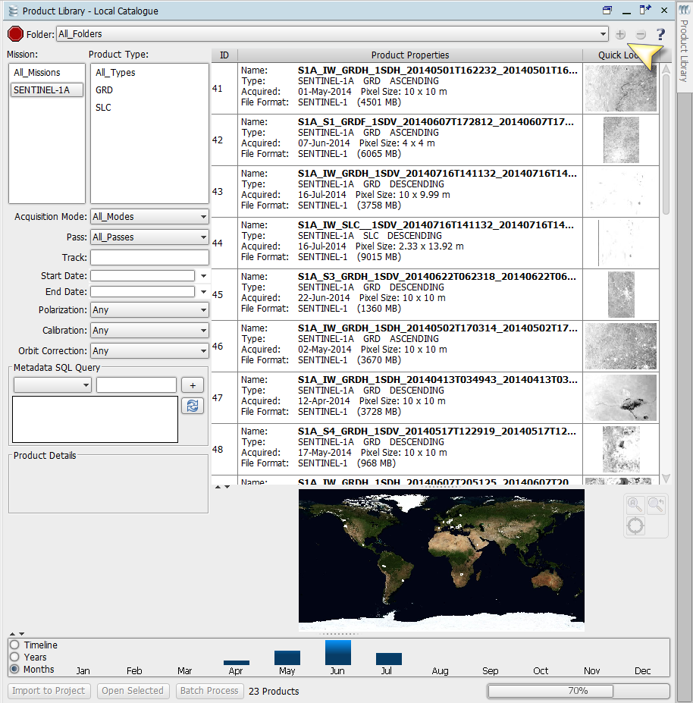
SNAP Product Library
Use the Product Library to scan folders with local products
Select your area of interest
Select your product types

Slide 50
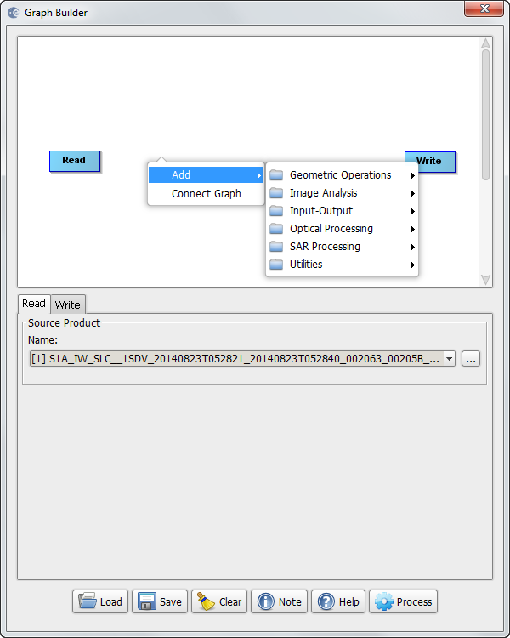
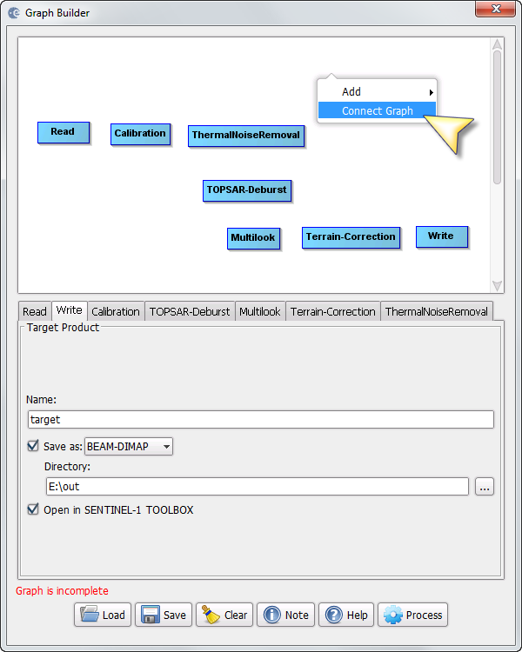
SNAP Graph Building
Right click to add operators from
the context menu:
  Calibration
  Thermal Noise Removal
  Deburst & Merge
  Multilook
  Range Doppler Terrain Correction
  Connect the graph

Slide 51
SNAP SAR Toolbox (S1TBX)
Evolution of ESA’s NEST SAR Toolbox
Maintain and enhance existing functionality from NEST
Continue to support ESA and TPM
Calibration
Speckle Filtering
Terrain Correction
Ellipsoid Correction
SAR Simulation
Mosaicking
Re-projection
Co-registration
Interferometry
SENTINEL-1
ENVISAT ASAR
ERS-1 & 2
RADARSAT-2
TerraSAR-X/TanDEM-X
ALOS PALSAR
COSMO-Skymed

Slide 52
SNAP SAR Toolbox (S1TBX)
Sentinel-1
Product Reading
Sentinel-1
Functionalities
All modes and all product levels
Level-0 (Metadata only)
Level-1 SLC/GRD
Level-2 OCN
Support for reading zip files directly
Support for BigTIFF
Calibration
Thermal Noise Removal
Slice Assembly
TOPSAR Deburst and Merge
SLC to GRD Processing

Slide 53




Deburst and Merge S-1 TOPS Data (Level 1 SLCs)

Slide 54
TOPSAR InSAR Chain
Support from SEOM R&D projects
  S1-INSARAP: SENTINEL-1 INSAR PERFORMANCE STUDY WITH TOPS
  An ESA project kicked off in March 2014 after successful contract negotiations (www.seom.esa.int).
“Validation and scientific exploitation of the interferometric performance of TOPS mode on Sentinel-1 mission”
Full exploitation of S-1 mission interferometric capacity
Development of advanced algorithms for TOPS data
Demonstrate continuity of ESA’s C-band SAR observations
Credits: DLR

Slide 55




SNAP Sentinel-1 TOPS Interferometry | New Zealand Earthquake
S-1 TOPS DInSAR
S1A_20161010_S1A_20161116
Terrain Corrected
Wrapped Interferogram
Co-seismic Interferogram
in SAR geometry

Slide 56



Sentinel-1 LOS Displacements | New Zealand Earthquake
ASCENDING
DESCENDING
S1A_20161103
S1A_20161115
S1A_20161010
S1A_20161116

Slide 57
Iteration Plan
Tell ESA what you would like to see!
Release 1 (Sept 2014)
  TOPS GRD processing and coregistration
  All basic support for S1 (Read/Write, Calibrate, Orbits, Slice Assembly, etc.)
Release 2 (Jan 2015)
  TOPS SLC Coregistration, TOPS INSAR, Smart Installer, L2 Visualisation
Release 3 (May 2015)
  Processing Previews, Task Queue
Release 4 (Sept 2015)
  Basic Polarimetric tools, Supervised Classification, Multi-resolution S2 products support
Release 5 (Nov 2016)
  Change detection, Offset tracking, further optimizations, odds and ends

Slide 58

SNAP Sentinel-1 Toolbox | Release Notes

Slide 59

SNAP Sentinel-1 Toolbox | Release Notes

Slide 60



SNAP Download Statistics

Slide 61
SNAP
Cloud Exploitation Platform

Slide 62
Cloud Exploitation Platform (CEP)
Login
Query the available data in the remote repository
Create a processing chain
Submit a processing job to the cloud service
Retrieve result
Smoothly utilize a Cloud Computing Platform where data repositories and high performance processing capabilities are available
Facilitate entry into Cloud Processing Services through the familiar and user friendly graphical interface of the Toolboxes

Slide 63
Toolbox “Server Configuration”
Toolbox Engine

Slide 64
Copernicus Data Access
Sentinel Application Platform | SNAP
Science Toolbox Exploitation Platform | STEP
Copernicus Sentinels (Missions & Products Overview)

Slide 65

step.esa.int | Science Toolbox Exploitation Platform

Slide 66






step.esa.int | Science Toolbox Exploitation Platform
SNAP Download page
Access to Beta versions for testing
Information on Sentinel Toolboxes’ development including Frequently Asked Questions (FAQs)
Notes:
66

Slide 67

step.esa.int | Science Toolbox Exploitation Platform
Technical documentation for both end-users and developers
Notes:
67

Slide 68


step.esa.int | Science Toolbox Exploitation Platform
Step-by-step tutorials including
YouTube videos
Notes:
68

Slide 69


step.esa.int | Science Toolbox Exploitation Platform
Technical forum, gathering user feedback and communicating results
Notes:
69

Slide 70













SNAP
All-in-One Environment

Slide 71
www.brgm.fr
谢谢

