Slide 1
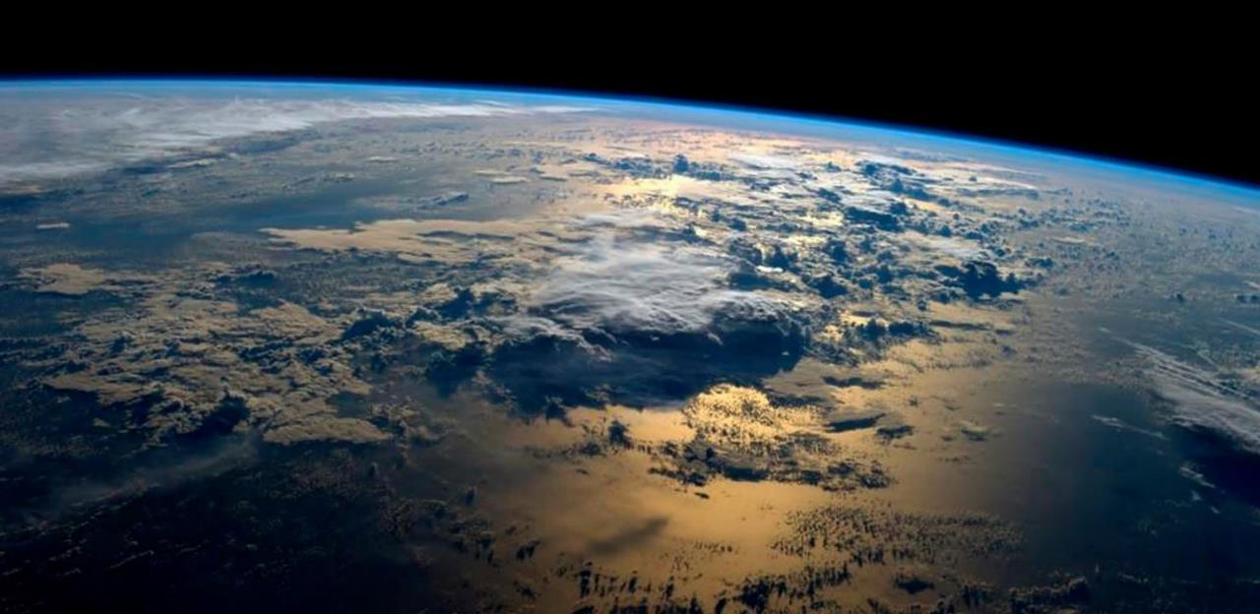
ITC ENSCHEDE, THE NETHERLANDS
Gateway to international knowledge exchange focusing on capacity building and institutional development
Photograph: NASA/REID WISEMAN/EPA

Slide 2
IN THIS PRESENTATION
1
2
3
4
5
6
7
Introduction to the University of Twente
ITC Faculty
of Geo-Information
and Earth Sciences
Knowledge field
Education
Research
Capacity Development
Collaboration

Slide 3
INTRODUCTION TO
THE UNIVERSITY
OF TWENTE

Slide 4
ITC FACULTY OF GEO-INFORMATION SCIENCE AND EARTH OBSERVATION UNIVERSITY OF TWENTE
In 2010, ITC became a faculty of the University of Twente (UT)
Preservation of its distinctive character and mission
More firmly embedded in Dutch academic education system
Cross-disciplinary approach, leading to innovative research and education in different areas
Since 2018, University College Twente merged with ITC
1
Notes:
On Januari 1st 2010, the International Institute of Geo-Information Science and Earth Observation (ITC) became a faculty of the University of Twente. The merger has been implemented in a way that preserves the distinctive character and mission of the ITC. As a university faculty, ITC is more firmly embedded in the Dutch academic education system. Furthermore, the integration with the University of Twente will lead to innovative research and education in areas such as energy, environment, climate change, water, geo-information and earth observation, and disaster management.

Slide 5
UNIVERSITY OF TWENTE
An entrepreneurial campus university established in 1961
Over 10,000 students
3,300 staff members

Slide 6
HIGH TECH HUMAN TOUCH
Societal impact: making a real difference
Synergy: excellence in combinations
Entrepreneurship and innovation
Internationalization: tomorrow’s global citizens

Slide 7
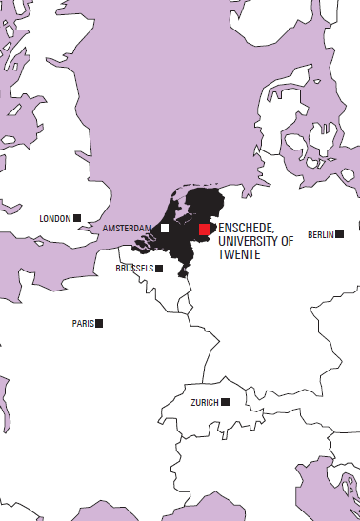
LOCATION THE NETHERLANDS IN THE CULTURAL HEARTLANDS OF EUROPE
Enschede
A distinctive modern and lively university town
At the Eastern border of the Netherlands
Surrounded by remarkable spots of natural beauty and tranquility
Excellent connections to Amsterdam, Brussels, Paris, London, Zurich and Berlin
An ideal center of operations
1

Slide 8
EDUCATION
Educational programmes are offered by the five faculties:
Behavioural, Management and Social Sciences
Electrical Engineering, Mathematics and Computer Science
Engineering Technology
Geo-Information Science and Earth Observation
Science and Technology
Integrated master's and PhD programmes for outstanding graduate students who aim at a career in scientific research in the:
Twente Graduate School
1

Slide 9
MISSION
Engage in ground-breaking research
Have profound societal impact
Excel in Innovative Education
Construct multi-disciplinary answers to the grand challenges of tomorrow’s world

Slide 10
11,136
STUDENTS
3,150
EMPLOYEES
2,307
SCIENTIFIC
PUBLICATIONS
IN 2018
€315m
ANNUAL BUDGET
241
PhD DEFENSES IN 2018
1000
START-UPS
45,000
ALUMNI
UNIVERSITY OF TWENTE
IN NUMBERS

Slide 11
ITC FACULTY OF GEO-INFORMATION SCIENCE AND EARTH OBSERVATION

Slide 12
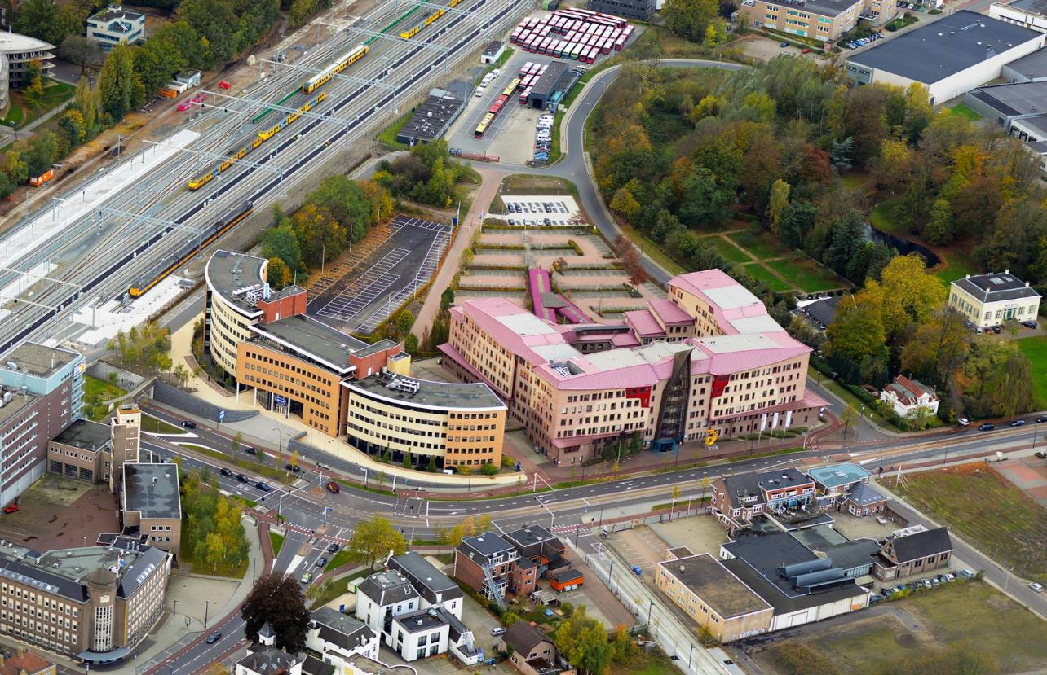
Itc, Enschede, the netherlands
Gateway to international knowledge exchange focusing on
capacity building and institutional development

Slide 13
ITC ESTABLISHED IN 1950 BY MINISTER WILLEM SCHERMERHORN
1950 International Training Centre for Aerial Survey, ITC
2010
Faculty of Geo-Information Science and Earth Observation, ITC University of Twente
1968
International Institute for Aerial Survey and Earth Sciences, ITC
2002
International Institute for Geo-Information Science and Earth Observation, ITC
1985
International Institute for Aerospace Survey and Earth Sciences, ITC

Slide 14
WHAT’S ITC ALL ABOUT? GEO-INFORMATION MANAGEMENT, WORLDWIDE AND INNOVATIVE
One of the world’s foremost education and research establishments in geo-information science and earth observation
A wide range of disciplines and activities in this field
Contribute to capacity building in partner countries
Solving real world problems
Multicultural environment with staff and students from over 190 countries
2

Slide 15
ITC 2020 MORE SPACE FOR GLOBAL DEVELOPMENT
ITC’s mission is to develop global capacity, particularly in less developed countries, and to utilize geosazpatial solutions to deal with national and global problems
GEO-ICT and earth observation are our innovative geospatial technology domains
2

Slide 16
ITC 2020 MORE SPACE FOR GLOBAL DEVELOPMENT
Our vision is that spatial solutions will play an increasingly important role in meeting many of mankind’s complex challenges (often wicked problems), such as climate change, population growth, and related claims for sufficient and secure food, water, energy, health, land and housing provision.
Therefore, our goal is to enhance our standing as an internationally recognized knowledge hub in the spatial domain, renowned for its collaborative educational and research activities, particularly in the global South
2

Slide 17
60
CERTIFICATES
286
ISI JOURNAL
ARTICLES
27
PhD DEFENSES
131
OTHER SCIENTIFIC
PUBLICATIONS
66
EXTERNAL (ONGOING) PROJECTS
448
REGISTERED NEW STUDENTS
over
23,500
ALUMNI
136
PhD CANDIDATES
ITC IN NUMBERS (2018)

Slide 18
SIX SCIENTIFIC DEPARTMENTS OPERATING AS CENTRES OF EXCELLENCE
Covering the different fields of disciplinary interest that encompass ITC's core mission:
Earth Observation Science
Earth Systems Analysis
Geo-information Processing
Natural Resources
Urban and Regional Planning and Geo-information Management
Water Resources
2

Slide 19
FACILITIES
Well equipped building:
Lecture rooms
MSc rooms
Auditorium
State-of-the-art computer facilities
Laboratory facilities
Restaurant
Library

Slide 20
FACILITIES
LODGING ACCOMMODATION
Well furnished rooms or apartments
STUDENT SUPPORT
Student affairs office
Sports and social activities
Lifelong e-mail accounts

Slide 21
KNOWLEDGE FIELD

Slide 22
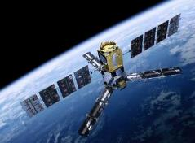
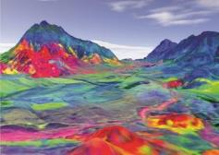
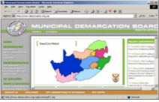
DATA COLLECTION
Satellite data
Aerial data
Digital Maps
Field measurements
Tabular data
GIS ANALYSIS
Modelling
Internet GIS
Processing Synthesis
DATA & INFORMATION DISSEMINATION
Web portals
Internet GIS
KNOWLEDGE FIELD

Slide 23
GEO-INFORMATION SCIENCE AND EARTH OBSERVATION
GIS conceptual models
USAGE application models
EO
observation models
Combination of tools and methods for the
Collection
Storage
Processing
…of geo-spatial data and for the dissemination and use of these data and of services based on these data
observe
analysis
update model
3

Slide 24
APPLICATION
food security
water management
urban planning
land administration
disaster management
strengthening civil society
earth sciences
environmental management and biodiversity

Slide 25
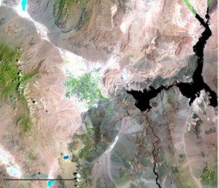
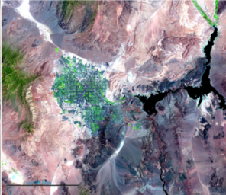
EARTH OBSERVATION
Collect data about the earth’s surface and subsurface
Based on aerospace survey techniques
Remote sensing, aerial photography, radar, airborne electronic-scanning devices, satellites
UAVs / Drones
1984
2007
Growth in the Desert Las Vegas
Sensor: L5 TM. Source: USGS
3

Slide 26
UAVs / Drones
Advantages
Less expensive then conventional aircraft
Operation is less complex (but still needs skilled operator)
Can be rapidly deployed
Can be used without fixed (airport) facilities
Can carry wide range of sensors
Data rapidly available
Ideal for mapping / monitoring small areas in high detail
Caution …. Not toys!
Observe regulations
1984
2007
3

Slide 27
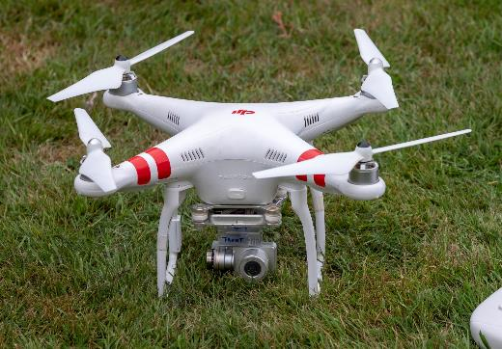
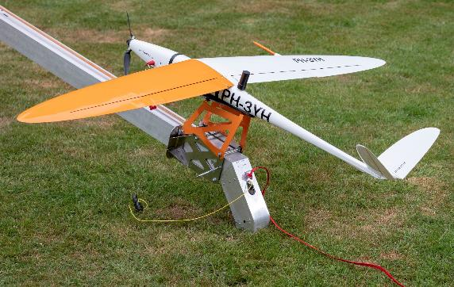
Two Main UAV types (+ Hybrid)
Rotorcraft
Fixed wing

Slide 28
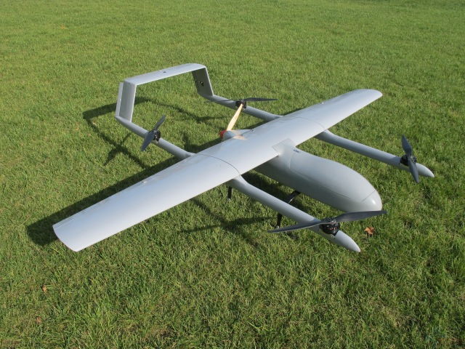
Hybrid
Fixed Wing with VTOL
Similar endurance and capabilities to fixed wing
Can take-off at any location
Can be flown like a multirotor

Slide 29
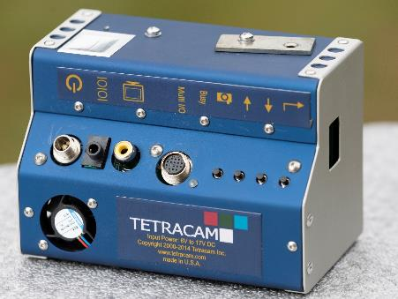
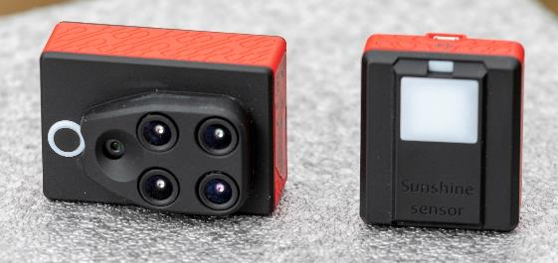
Sensors
‘Conventional’ digital camera
Multispectral / Infra red Camera
Thermal Infrared Camera
Laser scanner (LIDAR)

Slide 30
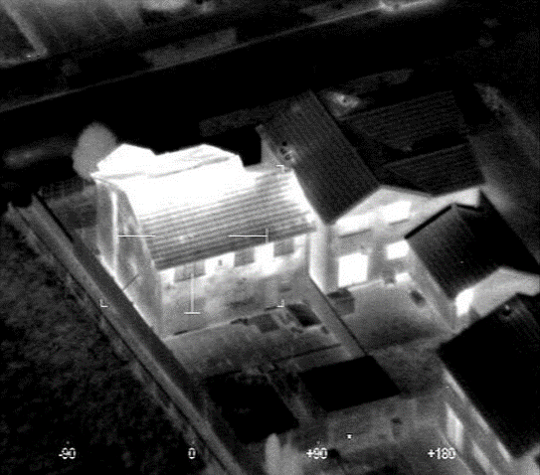
Thermal IR Sensor applications
Search and Rescue
Firefighting
Heat analysis of a structure
1984
2007
3

Slide 31
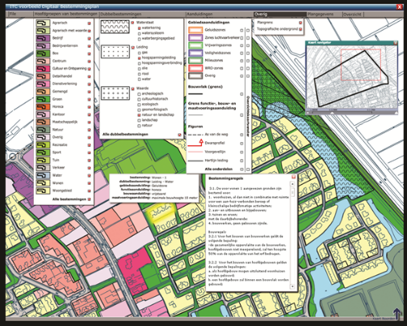
GEOGRAPHICAL INFORMATION SYSTEMS
Database used to:
Store
Manipulate
Access
Transform
Study trend patterns
Examine environmental issues
Simulate outcome of project proposal or planning procedures
Data collected through earth observation
3

Slide 32
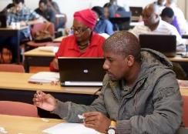
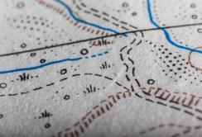
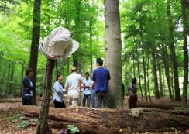
EDUCATION
RESEARCH
CAPACITY DEVELOPMENT
ITC’S CORE ACTIVITIES

Slide 33
EDUCATION IN
A MULTICULTURAL ENVIRONMENT

Slide 34
TARGET GROUP
Young and mid-career professionals and scientists
From developing and emerging countries
Increasingly professionals from industrialized countries

Slide 35
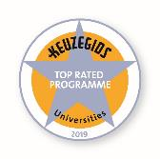
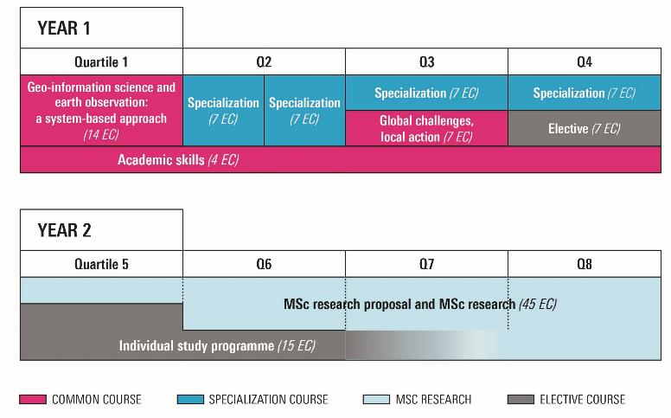
GEO-INFORMATION SCIENCE AND EARTH OBSERVATION 2-year Master’s programme
A programme based on research
Entry level: BSc
4

Slide 36
GEO-INFORMATION SCIENCE AND EARTH OBSERVATION 2-year Master’s programme
Specializations
Applied Remote Sensing for Earth Sciences
Geoinformatics
Land Administration
Natural Hazards and Disaster Risk Reduction
Natural Resources Management
Urban Planning and Management
Water Resources and Environmental Management.
Tailor-made specialization
4

Slide 37
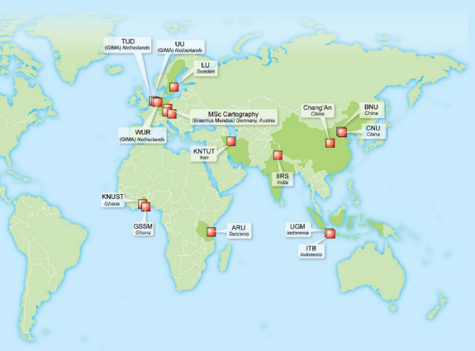
GEO-INFORMATION SCIENCE AND EARTH OBSERVATION 2-year Master’s programme
Study options
Fulltime Master’s at ITC
Blended Master’s
Joint educational programmes
4

Slide 38
MASTER SPATIAL ENGINEERING
2-year Master’s programme
Research-based educational programme
Entry level: BSc
Combining technical and socio-economic knowledge with a strong basis of spatial data analysis and modelling

Slide 39
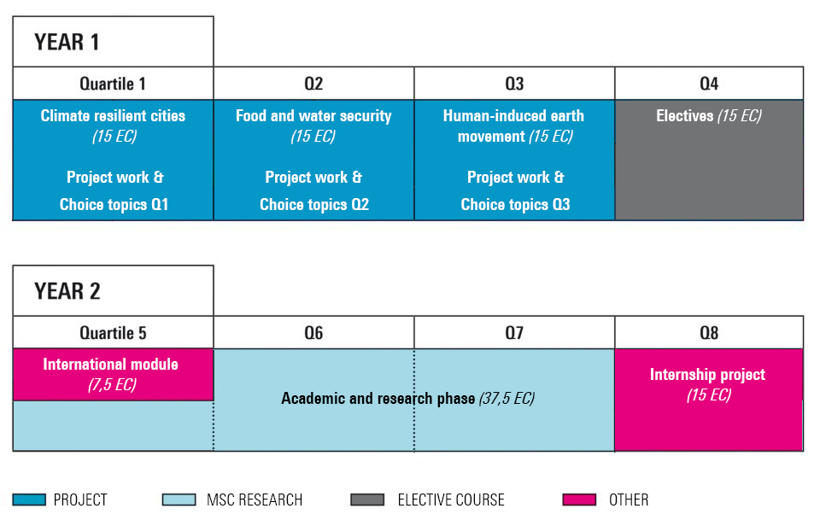
(14 EC)
Academic Skills (1 EC)

Slide 40
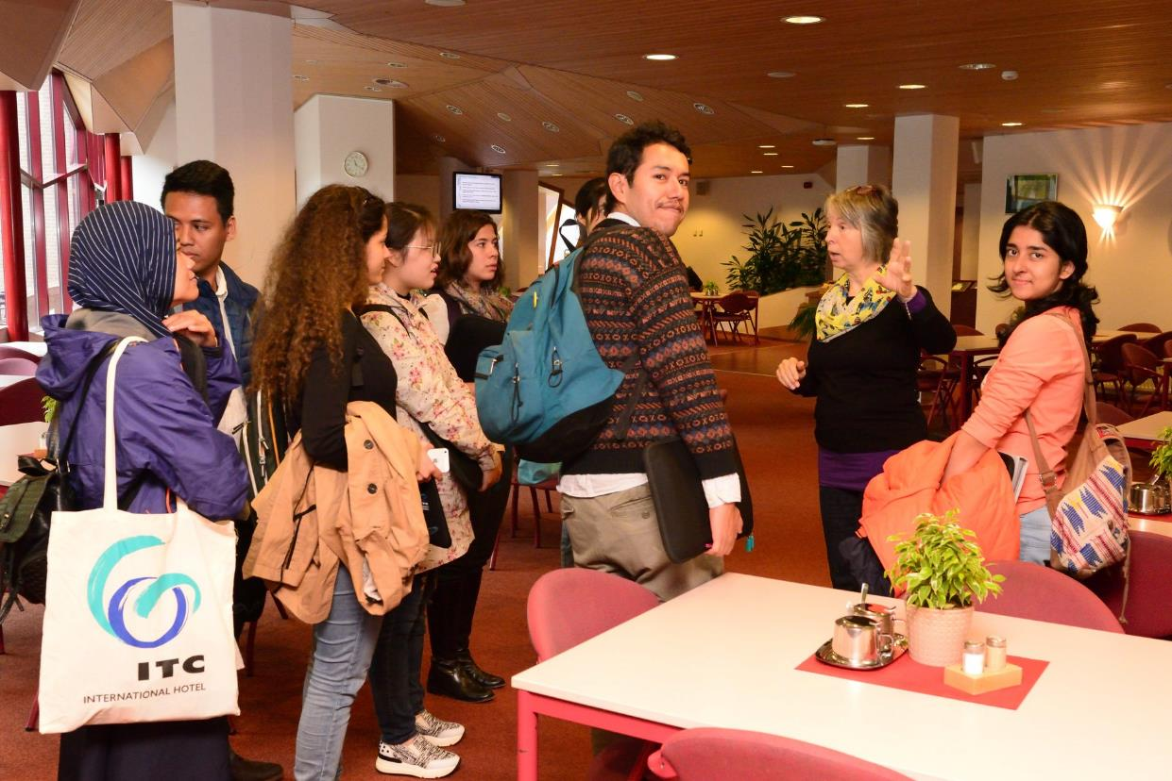
More information
VISIT WEBSITE: UTWENTE.NL/GO/SE
ALSO FOR ADMISSION & REGISTRATION
Introduction video by professor Jetten
Animation
Webinar Thursday, January 30th 2020 - 4:00 PM (CET)

Slide 41
GEO-INFORMATION SCIENCE AND EARTH OBSERVATION 1 Year Postgraduate diploma programme
A programme based on the first part of the Master’s programme
Serves as a basis for entering the second part of the Master’s programme
Entry level: Bachelor's degree
Specializations
Applied Remote Sensing for Earth Sciences
Natural Hazards and Disaster Risk Reduction
Geoinformatics
Land Administration
Natural Resources Management
Urban Planning and Management
Water Resources and Environmental Management.
Tailor-made specialization
4

Slide 42
CERTIFICATE PROGRAMME
Certificate courses and individual modules
Duration: 3 weeks to 3 months
Entry level: Bachelor's degree / Secondary School
Distance education courses
Duration: 6 weeks
Entry level: Bachelor's degree / Secondary School
Refresher courses
Duration: 2 weeks
Organized for alumni in their home country
4

Slide 43
NEW MSC COURSE
From September 2018 a new MSc in ‘Spatial Engineering’ has been introduced.
Aims to train engineers to solve large scale spatial problems related to natural disasters, use and extraction of natural resources and sustainable development of our environment.
Two academic year programme
Largely project based teaching

Slide 44
YOU NEED TO INTEGRATE
THREE KNOWLEDGE AREAS TO SOLVE WICKED PROBLEMS
TECHNICAL ENGINEERING
SPATIAL PLANNING &
GOVERNANCE
SPATIAL
INFORMATION
SCIENCE

Slide 45
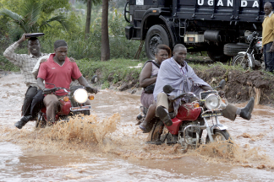
USE TECHNICAL ENGINEERING
TO MEASURE AND MODEL
TO DESIGN INTERVENTIONS
TO MATCH THESE INTERVENTIONS WITH EXPECTATIONS OF STAKEHOLDERS
TECHNICAL ENGINEERING
SPATIAL
INFORMATION

Slide 46
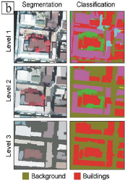
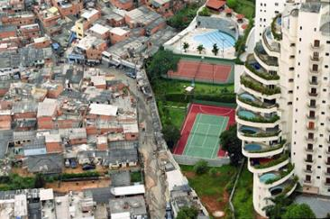
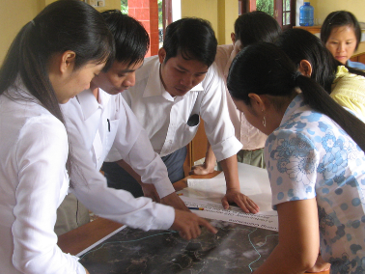
USE SPATIAL PLANNING & GOVERNANCE
TO ENSURE SOCIALLY ROBUST INTERVENTIONS
TO ANALYZE STAKEHOLDERS GROUPS
TO UNDERSTAND SOCIO-ECONOMIC DRIVERS OF CHANGE
SPATIAL PLANNING &
GOVERNANCE
SPATIAL
INFORMATION

Slide 47
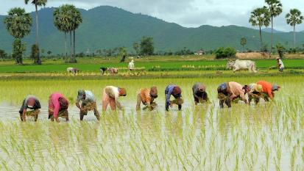
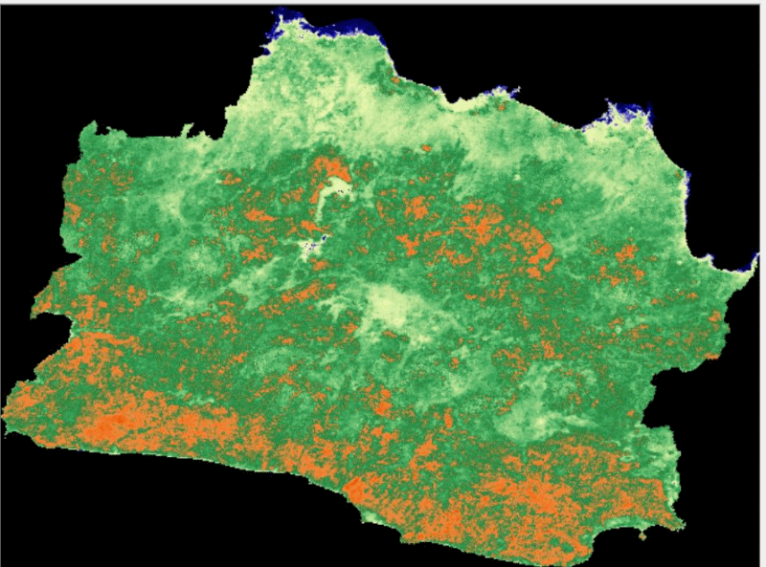
USE SPATIAL INFORMATION
TO QUANTIFY PROBLEMS
TO PROVIDE DATA FOR MODELLING & PREDICTIONS, ASSESS QUALITY
TO COMMUNICATE POSSIBLE SOLUTIONS
SPATIAL
INFORMATION

Slide 48
RECOGNITION OF DEGREES
The degrees awarded by the University of Twente are formally recognized by the Ministry of Education, Culture and Science, based on accreditation NVAO
For its degree programmes the University of Twente issues an internationally recognized document attached to diploma: the Diploma Supplement (DS)
SHANGHAI RANKING'S GLOBAL RANKING OF ACADEMIC SUBJECTS (GRAS) 2017
This global sub-ranking of subjects is a branch of the international Shanghai Ranking (ARWU).
Ranking Remote Sensing 2017: 6
Ranking Geography 2017: 51-75
4

Slide 49
Total students 1950-2018 24,429
Total countries 1950-2018 191
Asia 10,262
Africa 7,316
Europe 3,595
America 2,856 Australia & Oceania 263
Unknown 137
14%
42%
12%
30%
1%
COURSE PARTICIPANTS 1950-2018ORIGIN OF ITC STUDENTS
Notes:
SIS [de query:
Select distinct [Bedrijf ITC$Contact].No_, [Bedrijf ITC$Contact].Nationality, Continent, [Bedrijf ITC$Contact].[Country Code] from [Bedrijf ITC$Applicant] inner join [Bedrijf ITC$Contact] on [Bedrijf ITC$Contact].No_ = [Bedrijf ITC$Applicant].[Student Contact No_] Left outer join [Bedrijf ITC$Country] on [Bedrijf ITC$Country].Code = [Bedrijf ITC$Contact].[Country Code] where [Applicant status] >= 27
]

Slide 50
SEEKING THE SOURCE FELLOWSHIPS
Orange Knowledge Programme (OKP) – former NFP
ITC Excellence Scholarship – for full MSc (M.Geo)
ITC Foundation Scholarship – for full MSC (SE)
Holland Scholarship
Orange Tulip Scholarship
Joint Japan / World Bank Graduate Scholarship Programme*
United Nations agencies
International Fellowships Programme Ford Foundation
STUNED Scholarship Programme
4

Slide 51
ITC Scholarship Programmes
ITC has its own scholarship programmes exclusively for the two master courses
ITC Excellence Programme (ITCESP) for Masters in Geo-information Science
ITC Foundation Programme (ITCFSP) for Masters in Spatial Engineering
Both offer approximately 75% funding of total cost package.
Remaining 25% (approximately €12,500) from own contribution
Course admission required before fellowship application.
4

Slide 52
RESEARCH SPACE FOR GLOBAL DEVELOPMENT

Slide 53
RESEARCH
Objective:
Discovery of new knowledge in the field of geo-information science and earth observation and its applications, also supporting quality education and capacity development
Through:
Research programme
Graduate (PhD) programme (150 graduate students)
Visiting scientists
Joint research partnership agreements
5

Slide 54
RESEARCH THEMES
LED BY ITC PROFESSORS
4D Earth
Acquisition and Quality of Geo-spatial Information
Forest Agriculture and Environment in the Spatial Sciences
People, Land and Urban Systems
Spatio-temporal Analytics, Maps and Processing
Water Cycle and Climate

Slide 55
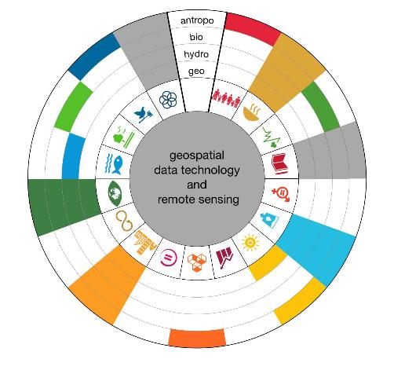
ENGINEERING FOR A RESILIENT WORLD Sustainable contribution to the long-term resilience of people, planet and profit
2
Notes:
The United Nation’s Sustainable Development Goals (SDGs), ambitious and inspiring as they are, reveal a vulnerable planet. Ending poverty; coping with climate change; responsible production and consumption, and sustainable cities and communities – goals like these call for new and broader perspectives, new tools, a new way of working. Technology, while sometimes disruptive and even causing new complications, plays a leading role in providing today’s solutions. The development of new technologies from an action-oriented design perspective, can sustainably contribute to the long-term resilience of people, planet and profit.

Slide 56
PHD STUDENTS REGISTERED AT ITC 1990-2017
PHD STUDENTS REGISTERED AT ITC 1990-2018

Slide 57
2014
2015
2016
2017
2018
ISI Journal articles
188
191
205
203
286
PhD Theses
26
15
18
15
25
Other scientific publications
60
72
60
131
68
Total
274
278
283
288
442
ACADEMIC OUTPUT

Slide 58
CAPACITY DEVELOPMENT
INTERNATIONAL COOPERATION

Slide 59
PROJECT SERVICES TAILORED TO THE NEEDS OF OUR CLIENTS
Institutional development
Advisory services
Contract training
Contract research and development

Slide 60
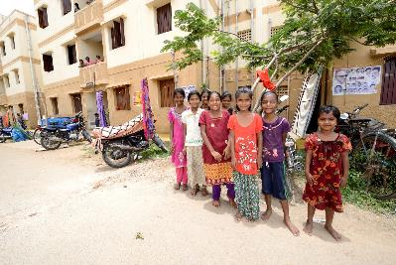
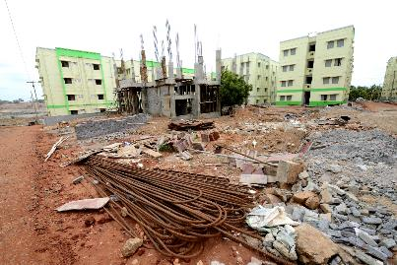
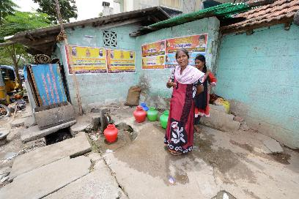
EXAMPLE PROJECT: BINUCOM (India) Building Inclusive Urban Communities
Partners: Danube University Krems, Austria, ITC, Lund University - Sweden, CEPT -Ahmedabad, KRIVA - Mumbai, SPAV - Vijayawada
Objectives
The project contributes to the capacity building of HEIs in India for cooperating nationally and internationally, and to improving their contribution to sustainable social housing and to inclusive urban community development

Slide 61
EXAMPLE PROJECT: EENSAT ETHIOPIAN EDUCATION NETWORK TO SUPPORT AGRICULTURAL TRANSFORMATION
Innovative capacity development project to strengthen the use of geo-data for agriculture and water to enhance food security and socio-economic development in Ethiopia in line with the Growth and Transformation Plan (GTP) priorities at the participating Higher Education and Technical Vocational Education and Training (TVET) institutes.

Slide 62
EXAMPLE PROJECT: SMARTSEEDS INDONESIA FUNDED BY NETHERLANDS SPACE OFFICE (NSO): ONE OF 17 GEODATA FOR AGRICULTURE AND WATER (G4AW) PROJECTS
Through this project, we plan to provide information services that supports 100,000 (chili, tomato and cucumber) farmers increase their production and food security, as well as reduce their inputs of water, fertilizers and pesticides in 3 Indonesian provinces and 14 regencies. The information services will be: Crop Calendar via SMS, Good Agricultural Practices (GAP) via Mobile App, as well as Market Information via SMS and Mobile App.

Slide 63
EXAMPLE PROJECT: INACHUS INTEGRATED WIDE AREA SITUATION AWARENESSS AND SURVIVOR LOCALIZATION IN SEARCH AND RESCUE OPERATIONS
Crisis incidents may result in difficult working conditions for Urban Search-and-Rescue (USaR) crews. INACHUS aims to achieve a significant time reduction related to the USaR phase by providing wide-area situation awareness solutions for improved detection and localization of the trapped victims assisted by simulation tools for predicting structural failures and a holistic decision support mechanism incorporating operational procedures and resources of relevant actors.

Slide 64
COLLABORATION IN A GLOBAL COMMUNITY

Slide 65
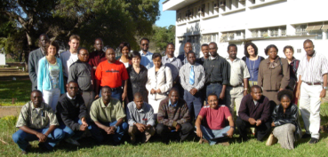
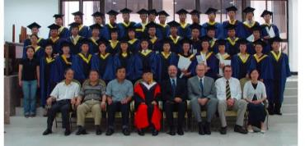
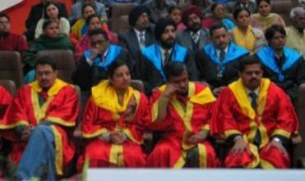
EDUCATION PARTNERSHIPS IN THE FRAMEWORK OF INSTITUTIONAL DEVELOPMENT
To address the increasing demand for flexibility in academic degree courses
Partnerships with reputable organizations and universities
Part or all of an education course accredited by ITC is conducted by these organizations
6

Slide 66
EDUCATION PARTNERSHIPS
6

Slide 67
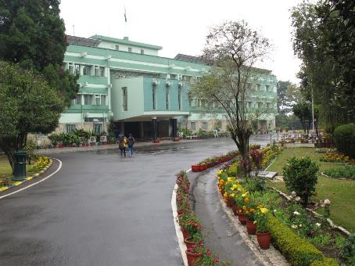
EDUCATION PARTNERSHIP EXAMPLE IIRS
MSc and Postgraduate courses in Geoinformatics
With Indian Institute of Remote Sensing, Dehra Dun
MSc Course – 2 years
commences in Dehra Dun
4 month stay at ITC
research and thesis at IIRS
ITC/UT degree awarded
Postgraduate Course – 1 year
Course fully taught at IIRS
ITC/UT diploma awarded

Slide 68
RESEARCH PARTNERSHIPS IN THE FRAMEWORK OF INSTITUTIONAL DEVELOPMENT
With research partners in:
The Netherlands
Europe
Emerging economies
Developing countries
… who contribute complementary scientific expertise
Research agreements, include:
Memorandum of understanding
Framework agreements
Partnership agreements supporting specified PhD students
7

Slide 69
ALUMNI A WORLDWIDE NETWORK
Worldwide community of over 20,000 individuals
Extensive network of international contacts
UN organizations
Universities
Research groups
Research survey and map production services
Various international professional associations
7

Slide 70
ITC ENSCHEDE, THE NETHERLANDS
Gateway to international knowledge exchange focusing on capacity building and institutional development

Slide 71
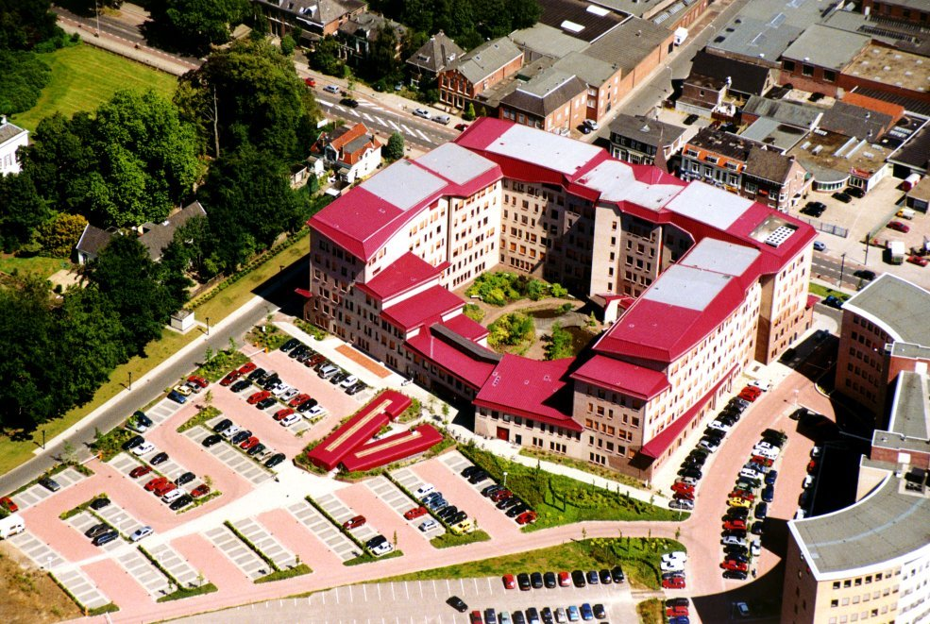
The end
Thank you

