Slide 1
Ecosystem Stability
Cruise control; an example of homeostasis
Cruise Control
http://en.wikipedia.org/wiki/Cruise_control
Notes:
The easiest way to illustrate homeostasis is the cruise control in a car.
Through all kind of feedback loops the systems maintains its speed.

Slide 2
Ecosystem Stability
At the same time all (agro)ecosystems are subject to pressure at various space time scales, caused by:
human activities (industrial and agricultural activities, deforestation, introduction of exotic plant or animal species etc.)
natural phenomena (fires, flooding, windstorms, insect population, volcanic eruptions competition, colonization, evolution, natural succession etc.).
Notes:
At the same time all ecosystems are subject to pressure at various space time scales, caused by human activities or natural phenomena.

Slide 3
Ecosystem Stability
The response of a system to pressure / disturbance can be:
Absorb / Maintain the equilibrium (resistance or persistence and resilience).
Gradual change
Sudden or catastrophic change
Disturbances of sufficient magnitude or duration can profoundly affect an ecosystem and may force an ecosystem to reach a threshold beyond which a different regime of processes and structures predominates.
Notes:
So .. let’s look at how a system can respond to that pressure.
A system can “absorb the pressure and maintain its equilibrium”.
Or … it can adapt to the new situation.
Strictly speaking this means that the old system ceases to exist. A new system will develop, with a new equilibrium, more suited to the new situation.
This can be a gradual adaptation or an abrupt and sudden change.
In general if the pressure exceeds a threshold, the ecosystem is forced to adapt to a new situation, where a different regime of processes and structures predominates.

Slide 4
Ecosystem Stability
Resilience
is the ability to maintain (or quickly re-assemble) a system’s core functions and general arrangement in response to changes.
“… an ecosystem ’s ability to recover and retain its structure and function following a shock event. If a stress or disturbance does alter the ecosystem, then it should be able to bounce back quickly to resume its former ability to yield a service or utility rather than transform into a qualitatively different state that is controlled by a different set of processes. In order for ecosystem resilience to be defined, the ecosystem must have a degree of stability prior to the perturbation. Resilience relates to return to stability following perturbation (Holling 1973; Dawson et al. )..." (in: Harrington, R. et al., 2010 )
Resistance/persistence
is the ability of communities or populations to remain essentially unchanged when subject to disturbance.
Notes:
A system can maintain its equilibrium through resilience and resistance (or persistence).
Resilience is the ability of an ecosystem to recover and retain its structure and function following a shock event.
Resistance or persistence is the ability of a system remain essentially unchanged when subject to disturbance.

Slide 5
Ecosystem Stability
Example
perturbation
Low resistance and
High resilience
(changes quickly and
shakes little)
High resistance and
High resilience
(changes little and
shakes little)
Low resistance and
Low resilience
(changes quickly and
shakes easily)
High resistance and
Low resilience
(changes little and
shakes easily)
Notes:
This is a graphical way of depicting the difference between resistance and resilience.
Note: Obviously the graphs are “snapshots” of a system since, given time, all systems eventually change and the system stability is only valid within a limited time frame.
What happens to the stability of each figure after the ‘example’ perturbation (shock) occurs ?

Slide 6
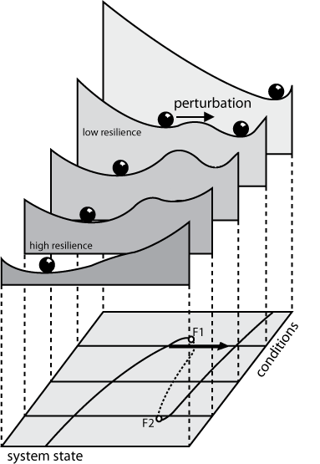
Ecosystem Stability
Changing
Landscape properties
Human activities influence ecosystem stability (resilience and resistance) by e.g.:
reduction of biodiversity
land-use and land conversion
exploitation of natural resources,
pollution
anthropogenic climate change
causing regime shifts in ecosystems, often to less desirable and degraded conditions.
Tipping
Point
Notes:
Human activities exert pressure on the resilience and resistance capacity of a system, by changing the properties of that system.
For instance by reducing the biodiversity, or by changing the hydrological regime of an area, within the framework of a flood control program..
If this intervention reaches a certain threshold, the ecosystems shifts to the new set of conditions.
A shift, caused by pressure which exceeds the resilience and/or resistance limits, can of course also be brought about by natural phenomena.

Slide 7
Ecosystem Stability
References:
http://en.wikipedia.org/wiki/Resilience_(ecology)
http://en.wikipedia.org/wiki/Resistance_(ecology)
* P. Trojan (1984) Ecosystem homeostasis, W. Junk Publishers.
* Dawson TP, Rounsevell MDA, Kluva´nkova´-Oravska´ et al (2010) Dynamic properties of complex adaptive ecosystems: implications for the sustainability of service provision. Biodivers Conserv
* Harrington, R. et al., 2010: Ecosystem services and biodiversity conservation: concepts and a glossary. Biodivers Conserv, DOI 10.1007/s10531-010-9834-9, Springer
* Holling CS (1973) Resilience and stability of ecological systems. Annu Rev Ecol Syst 4:1–23
Notes:
If you want to do some background reading on this topic I have included some references.

