Slide 1

EO AFRICA
Chapter 7.1 | Hyper-Temporal Mapping of Ecological Systems Part 3
Kees de Bie
ITC, UTwente

Slide 2

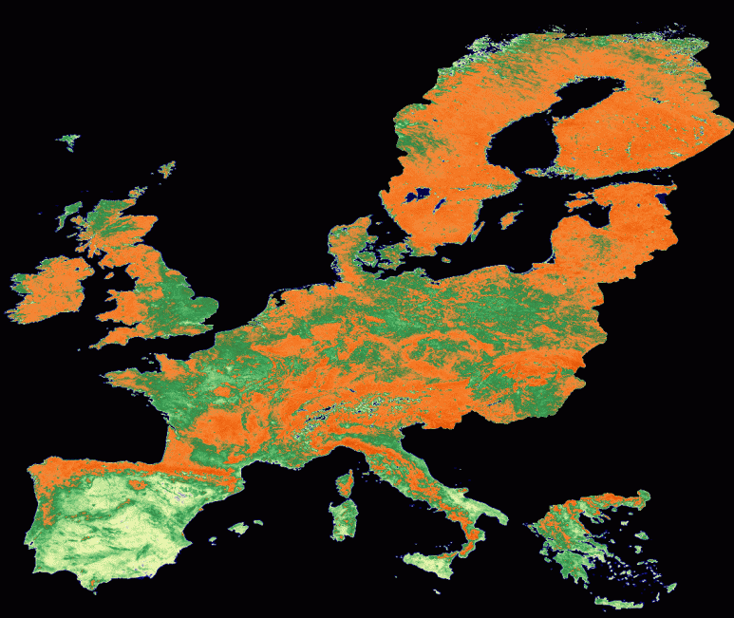
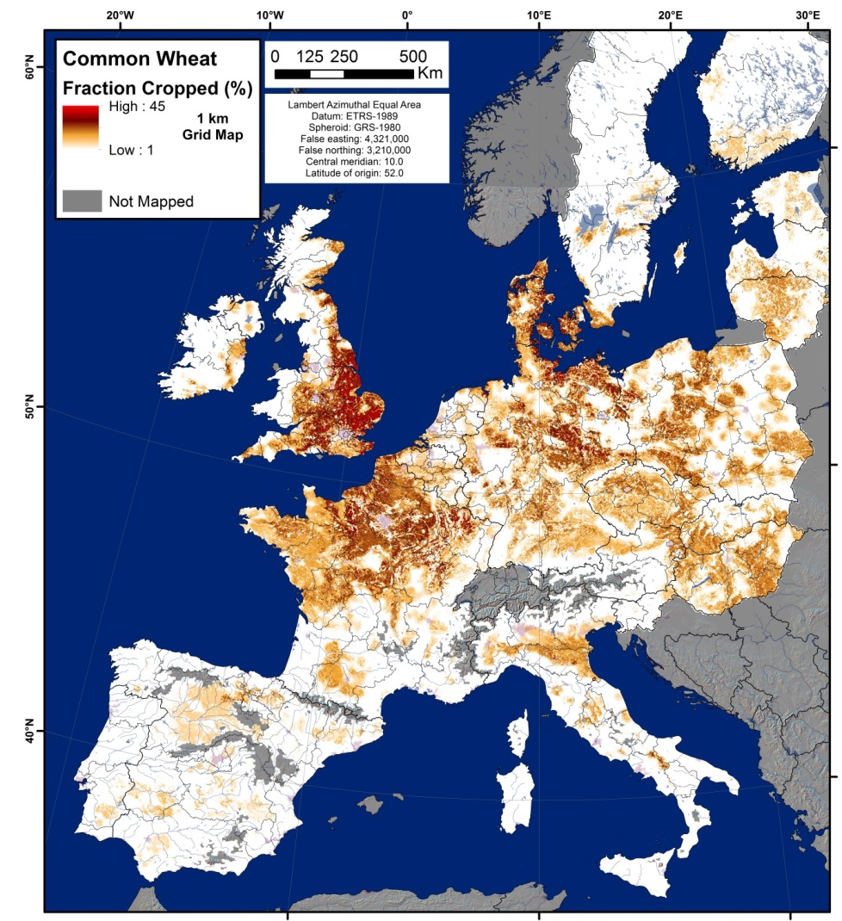
Steps to classify hyper-temporal NDVI-Imagery in Erdas
Time can be used as
a classifier
Variability in time relates to cover performance, species composition, vegetation phenology, cover density, followed crop calendars, etc.

Slide 3
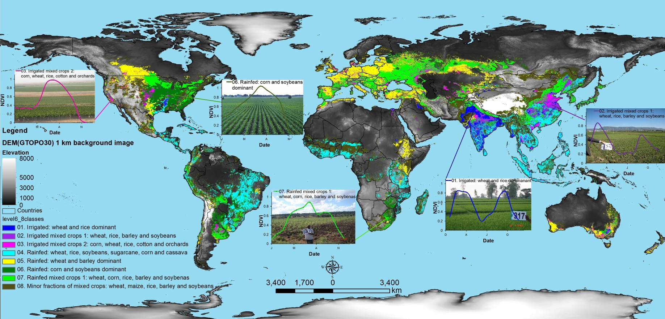
Examples of end-results: 1. Global, with an NDVI-based legend
Spatial distribution of global cropland areas (~1.5 billion hectares) and five dominant crop types (wheat, rice, maize, barley and soybeans).
Produced by Thenkabail et al., 2011, 2009a, 2009b.
The 5 crops constitute about 60% of all global cropland areas.
See also as example:
https://www.esa.int/ESA_Multimedia/Videos/2018/01/Changing_lands#.Xd0A3hqIBv4.link
Notes:
After clustering, experts relate the NDVI-profiles (behavior of NDVI over time) to different land cover types (or crops).
Best: sample each generated cluster in the field and translate the intermediate legend (of NDVI-profiles) into the final legend (containing items that YOU need).
Note that the NDVI-Profiles represent the INTERMEDIATE legend !!
Through clustering, the map has become static (1 layer containing classes or clusters), and the legend contains the “time-element” (NDVI-profiles).
The intermediate map can with 100% accuracy be reproduced. Map accuracy relates to the accuracy of the “final” legend, that YOU prepare.

Slide 4
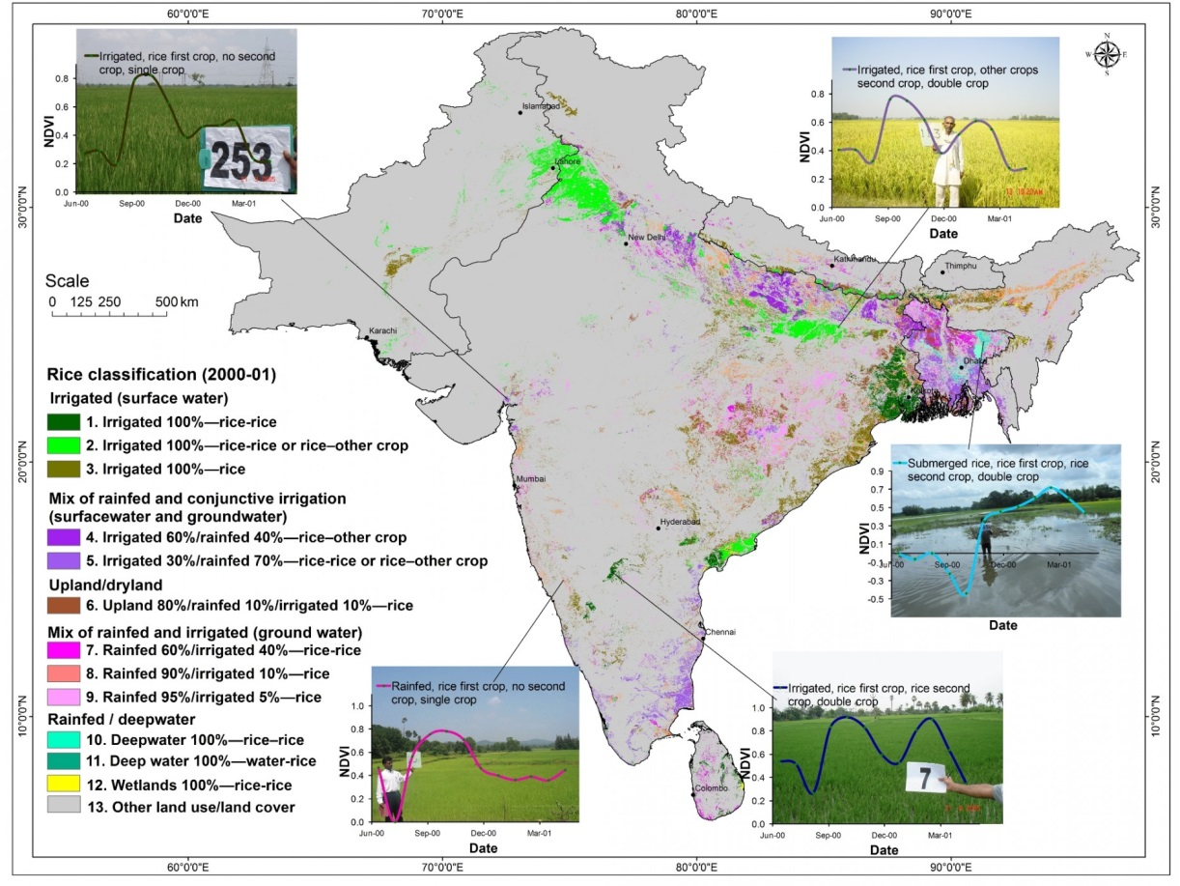
Examples of end-results: 2. National, with an NDVI-based legend
A map showing Rice-based crop calendars, mapped through the use of NDVI-Imagery of 2000-01.
Gumma, Murali & Nelson, Andy & Yamano, Takashi. (2018). Mapping drought-induced changes in rice area in India. International Journal of Remote Sensing. 40. 1-28. 10.1080/01431161.2018.1547456.

Slide 5
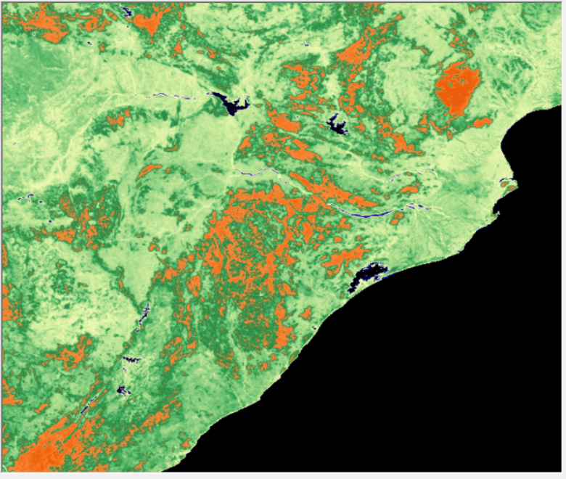
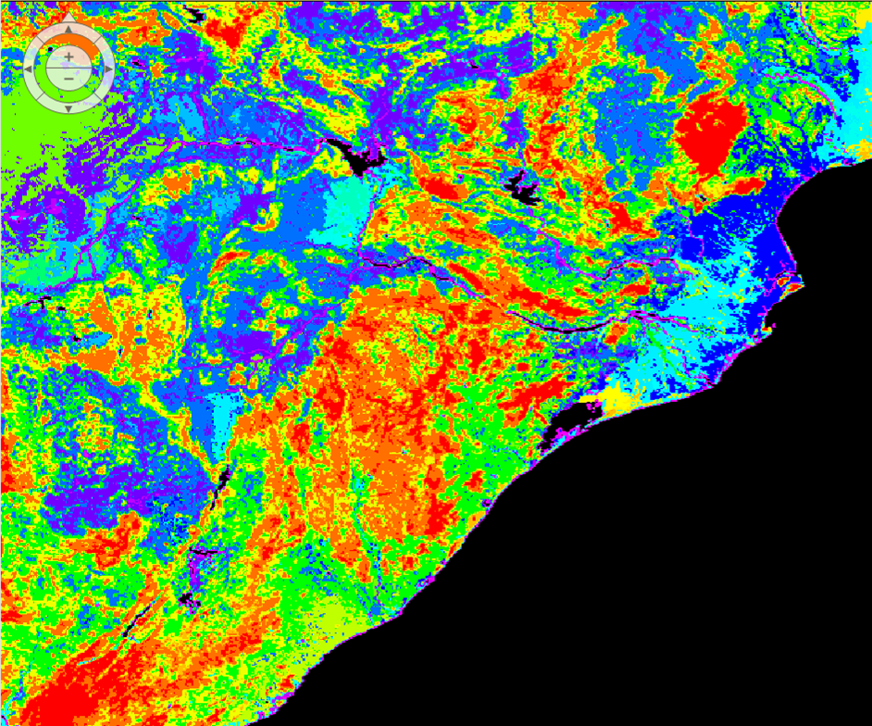
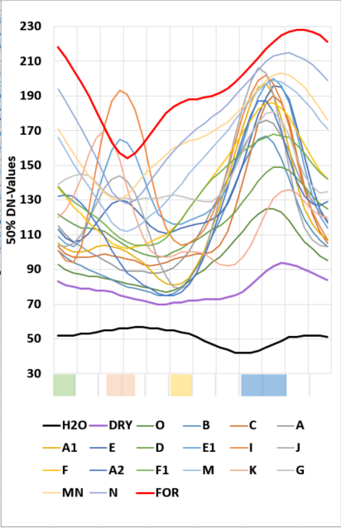
Examples of end-results: 3. Regional, with an NDVI-based legend
1 Classify time-series of 1km NDVI-Imagery in e.g. 100 classes of which each class has a unique greenness pattern (NDVI-Profile).
2 Group the 100 NDVI-Profiles so that groups relate to clearly perceived differences in Land Use and Land Cover (LULC) → 21 Groups.
3 Study the averaged NDVI-Profiles by group (21x) to identify the best time periods to differentiate those 21 LULC-types when using medium resolution imagery → 4 Periods.
1Km
Mapping Rice Systems of Odisha, India

Slide 6
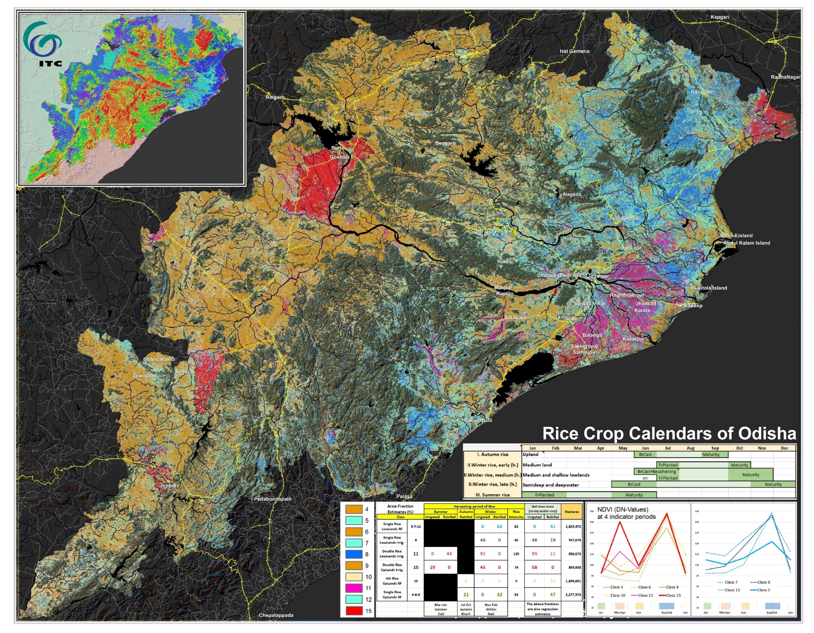
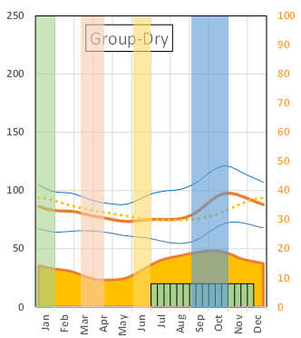
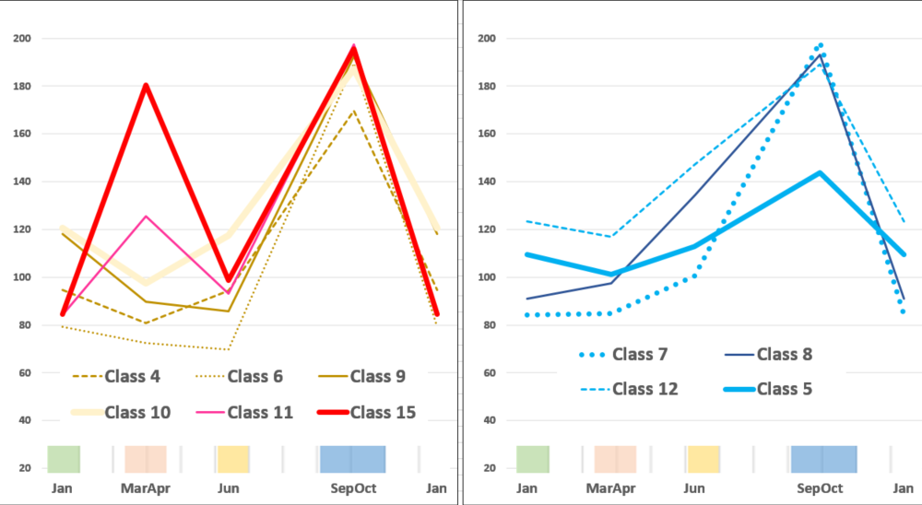
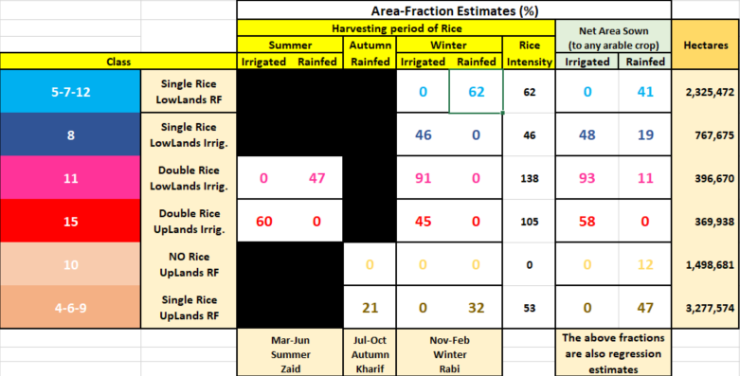
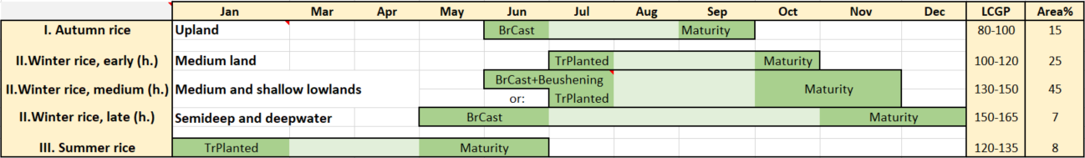
Examples of end-results: 4. Local, with a final, detailed legend
4 Extract for the 4-periods
NDVI-averages from many available cloud-free medium resolution imagery covering recent years, and re-create the 21 classes earlier identified, but now at a 30m resolution
1Km
5 Compare the extent of each class with the extend of reported cropped areas by administrative area and season, and report the quantities as part of the legend
30m
6 Match the created legend info with published crop calendar information

Slide 7


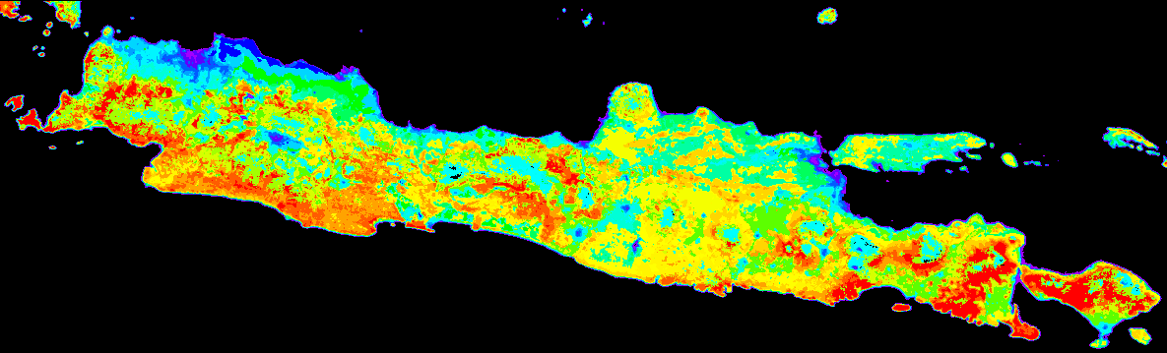
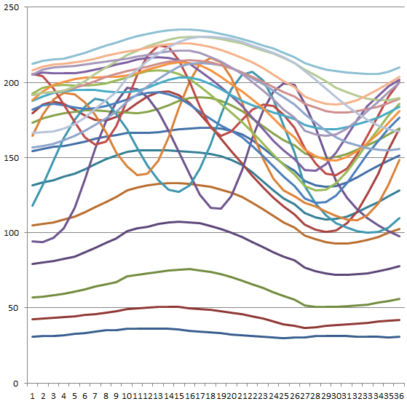
Examples of end-results: Regional, showing a great Gradient
NDVI changes across Java from Jan. to Dec.
Spatial-temporal differences relates to cover phenology and/or followed crop calendars
(driven by water availability)
Great gradient to “map”
Note that each year 2 crops are grown
Classified image (25 classes)
Notes:
Typical example of splitting a gradient into several clusters. The (annual) NDVI-profiles clearly displays this too.
It is important to decide if the 25 classes will do fine, or 26, or 27? What will be the gain, and what the loss?

Slide 8
Processing steps in Erdas-Imagine
Questions to address:
Which pixels behave similar?
Can we put those in classes?
How many classes do we need?
Can we use un-supervised classification techniques?
How will the legend look like?
How to get a ‘final’ legend?
Notes:
OK, now it’s time to get to “statistics” and “method” to “make our day”.
However: do you note the series of questions listed ?
It means: no way I will provide a cookbook with a standard recipe … YOU must know that a series of expert decisions are required, and only the case at hand, combined with your understanding and expertise, will provide proper results.
Example: after sharing the method, for one year a team of 10 statisticians worked on the given concepts. They concluded that basically “it does not work” … …. (for them). They did made the gross over-estimation, that statistics automatically solves all problems, and that “thinking” or “knowing the area and its systems” by them, was not truly required. They got it all wrong!

Slide 9
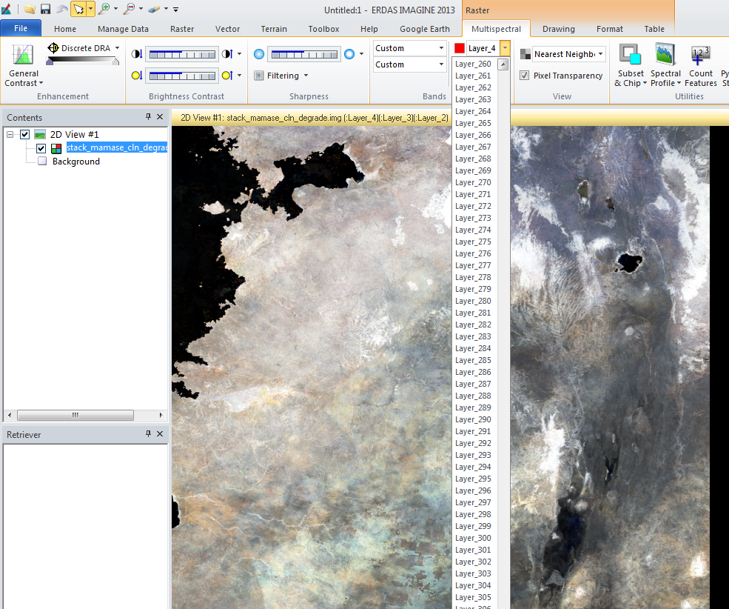
Processing steps in Erdas-Imagine
Hyper-Temporal NDVI-data are stacked into a single file; each “layer” contains NDVI data of one Maximum Value Composite (MVC).
Displayed is only the RGB of Layers 432.
Each “band” contains one 16 day MVC of MODIS-Terra.
MVC: the max value of 16 daily images is kept to reduce impacts of haze and clouds.
The stack [see option: Multispectral] can contain data of many years.
You can select Spectral Profile to inspect the NDVI Profile by pixel.
Notes:
I developed the habit to stack images that are taken sequentially in one file.
Thus, e.g. for a SPOT-Vegetation stack:
band 1 stands for the MVC of days 1-10
band 2 stands for the MVC of days 11-20
band 3 stands for the MVC of days 21-30
band 4 stands for the MVC of days 31-40
Etc.
Note that this simplifies your file management and classification. On the other hand, given that I got now 564 SPOT-NDVI images, the stack becomes a true burden to Erdas-Imagine.
Many other software keep each uniquely dated image in a separate file (e.g. Ilwis, Timesat, Spirits, etc.)

Slide 10
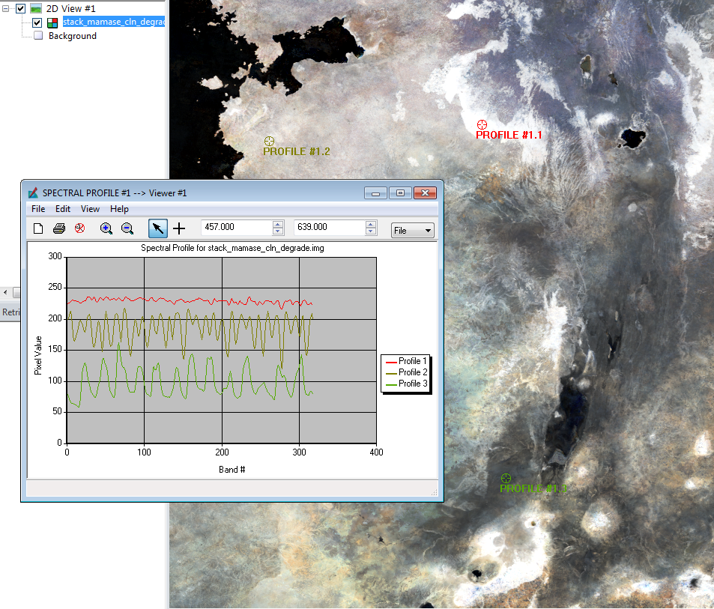
Processing steps in Erdas-Imagine
Visual inspection of the NDVI time-series by pixel
Clearly, different NDVI behavior over the period 2000-2013 can be observed between pixels.
The data of the shown pixels have already been ‘cleaned’ (see next slide).
Notes:
Erdas allows a very easy view, by pixel, how “over time” (i.e.: across bands) the indicator (NDVI) changes.

Slide 11
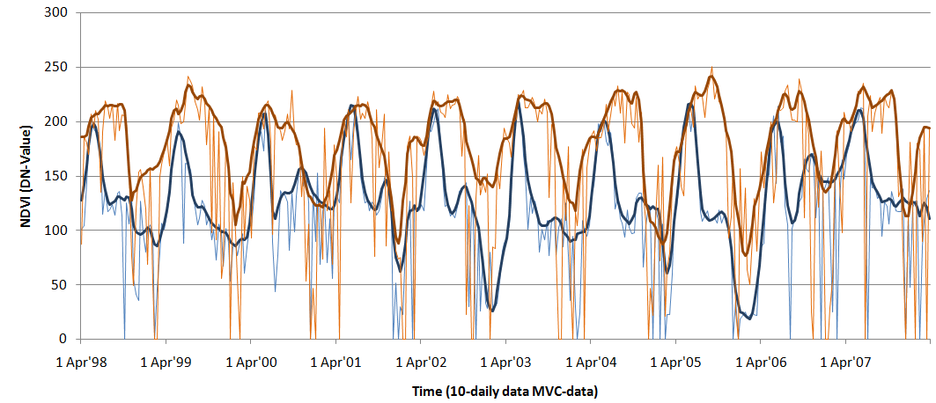
Processing steps in Erdas-Imagine (or in IDL-Envi, TimeSat, Ilwis, …)
Before you do any detailed processing, the time-series of data by pixel must be de-clouded and outliers removed.
The upper envelope filter replaces the NDVI values corresponding to irregular and unexpected dips by interpolated values and following ‘good’ measurements (estimates).
Filter used: Upper envelop filter with Savitsky Golay smoothing.
Ref:
TimeSat software (freeware), or
ITC-MSc thesis: Jose Maria Beltran-Abaunza, 2006.
TimeSat has 4 iterations, where each time, by pixel, the moving window increases: 3-5-7-9 dekads to estimate the ‘central’ dekad NDVI. Of the first 3 results the higher number is kept between present and estimated (forcing the upper envelop).
Often, quality flags are triggered when NO NDVI-measurement for a MVC is available. Then, in this example, the NDVI-value is set to “0” (=missing).
Notes:
Another function built to apply on the “raw” stack of images, is to clean (de-haze and further de-cloud), by pixel the NDVI data.
That function runs in IDL-Envi, and is called “NRS-Timeseries” or “TimeSat”.
The function uses the “Savitsky Golay” filter. It uses successively a window of 3, 5, and 7 readings (in time) to calculate a regression function. The estimated value and the actual values are then compared. For the 3 and 5 windows, always the highest is kept; for the 9 window, the final estimate. So, basically, negative anomalies are fully removed, curves aim to connect the upper part of the readings, and positive spikes are nicely cut-off.

Slide 12
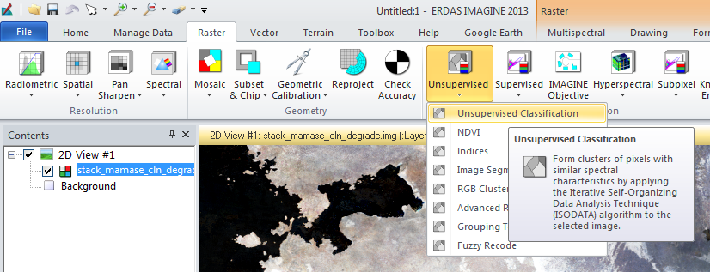
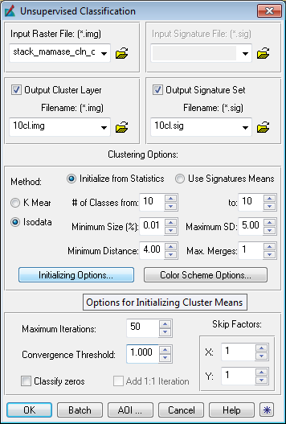
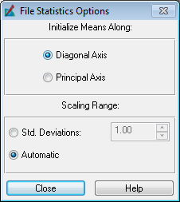
Processing steps in Erdas-Imagine
To do:
Select “Unsupervised Classification”.
Yes, you ‘do’ require the SIG file!
Specify many details for the “ISODATA” method (as shown).
Set the “Initialization option” to “diagonal axis” (has proven to work best).
Set Max.Iterations to 50 runs (and put convergence stats at 1). This is kind of an “over-kill” of iterations (allow proper convergence to an optimal solution).
Defining the required number of classes is hard to specify: if you make too many, you will have ‘many’ to study (costs time, effort, money), and if you make too few, you then likely loose important info due to over-generalization.
Notes:
In ERDAS-Imagine, please follow and digest the shown steps.
The ISODATA clustering method uses a minimum distance formula to form clusters. Initially arbitrarily specified cluster means are used as signature set, and by iteration, the means of these clusters are shifted (or clusters are merged and/or split). The new cluster means are used for the next iteration, and so on (conversion principles). The ISODATA utility repeats the clustering of the image until either:
a maximum number of iterations has been performed, or
a maximum percentage of unchanged pixels has been reached between two iterations.
Performing unsupervised classification is simpler than a supervised classification because the temporal signatures are automatically generated by the ISODATA algorithm.

Slide 13
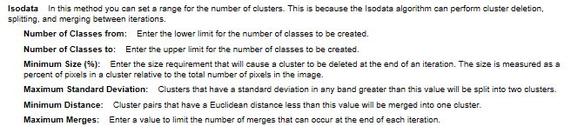
Processing steps in Erdas-Imagine
Hint: Keep the # of classes xx to xx identical (e.g. from 10 to 10.
Through experience, I often make ‘way’ too many classes, then extract from the SIG-file (legend file), the class-specific NDVI-profiles, and use my ‘expertise’ to group-cluster those profiles. It helps to get support from a k-means clustering effort before finalizing the ‘grouping’ (manually).
Hint: Just keep the defaults as proposed by Erdas.

Slide 14
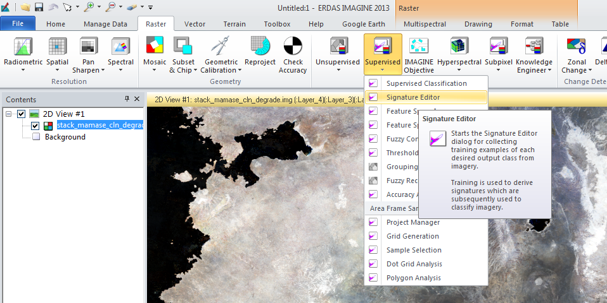
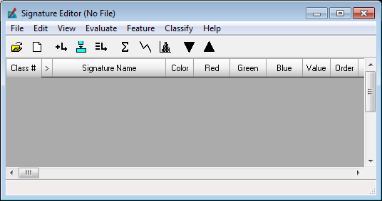
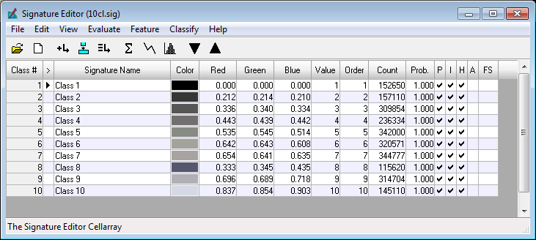
Processing steps in Erdas-Imagine
To see the signatures of prepared classes, open the generated SIG file.
Notes:
Once you have the stack classified, you should have a number of new IMG and SIG files on your hard drive.
Shown is “how to open the SIG file”.
Also open the IMG file, then
press TABLE and SHOW ATTRIBUTES
Then use the option COLOURS to make nice gradients of colours across classes
COPY the colours made
PASTE them then in the color column of the signature editor
Example results are shown in the next slide (color coordinated map and intermediate legend).

Slide 15
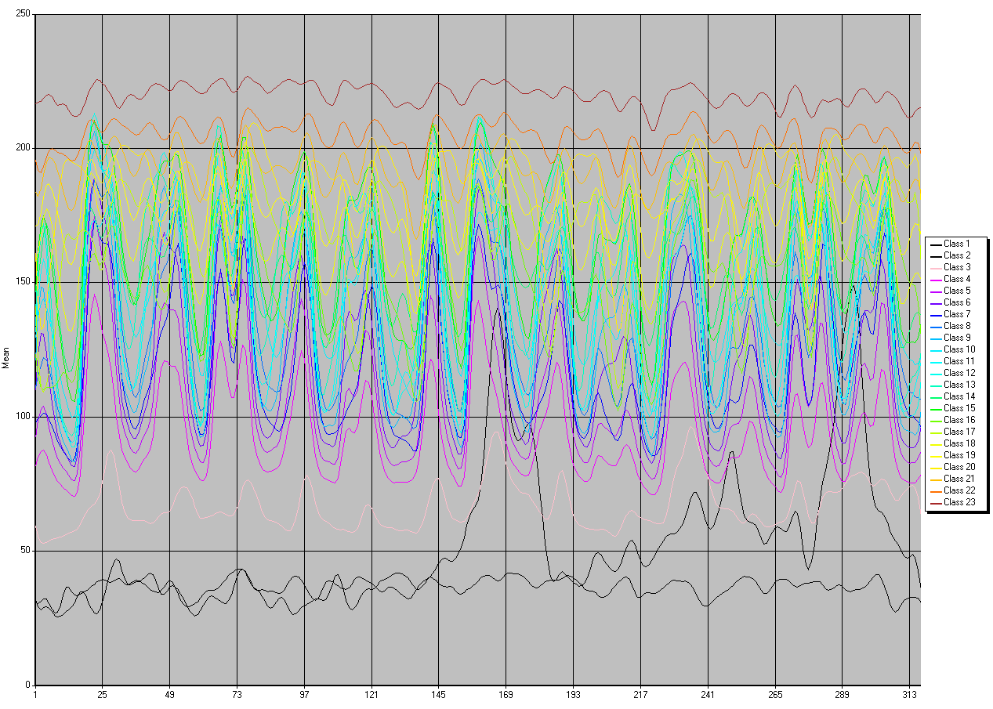
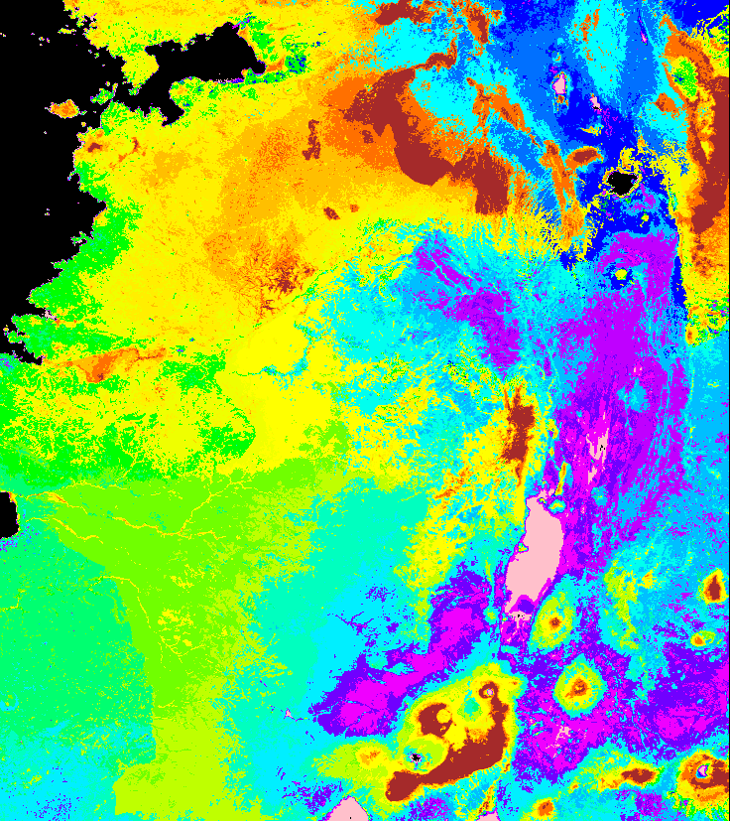
Processing steps in Erdas-Imagine
Greener
From SIG editor
From 2D View of IMG
13+ years
RESULTS: Imploded
Hyper-Temporal NDVI-data, i.e.: a ‘static’ map (e.g.: 23 classes)
A ‘dynamic’ (intermediate) legend of ‘greenness’ profiles (2000-2013)
Time (14 years)
Notes:
Be aware that simply not enough colors can be selected to properly visualize all class differences.
Therefore, it is recommended to ‘port’ the signatures (NDVI-Profiles) to Excel, for specific / further display and studies.
This means that from the SIG file, you must extract the class NDVI-readings over time… … (see next slide).

Slide 16
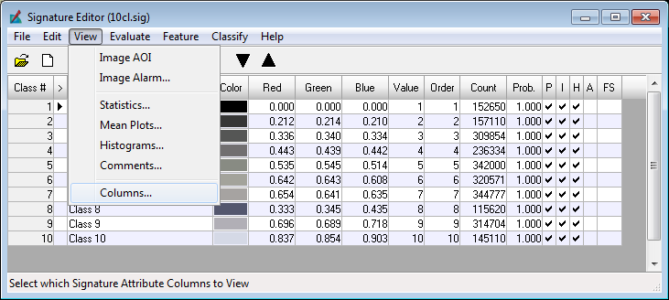
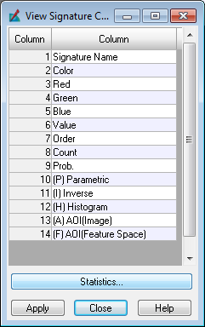
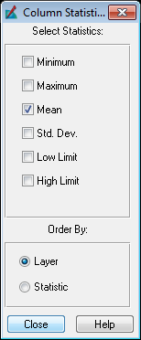
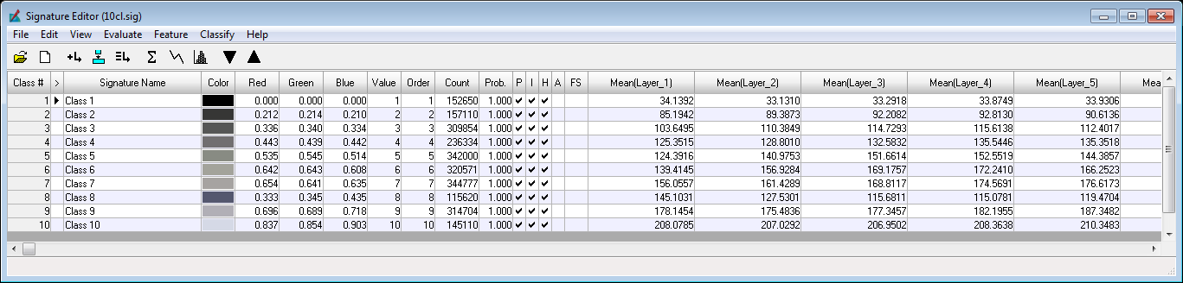
Processing steps in Erdas-Imagine
To “get” the data of the signatures to Excel, first display the ‘mean’ layer statistics.
Notes:
It becomes obvious that the SIG file contains way more data then you initially imagined.

Slide 17
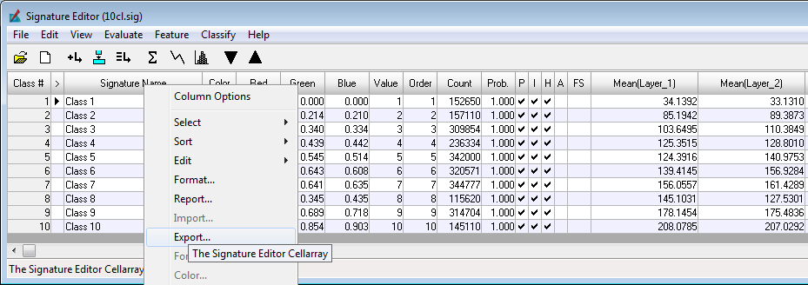
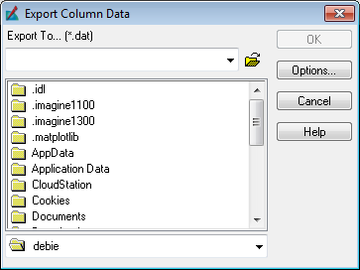
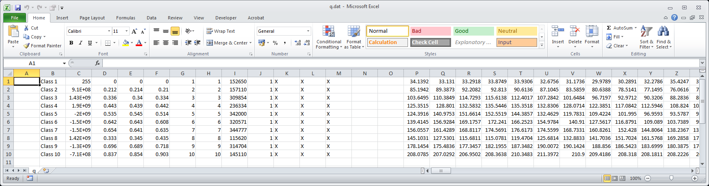
Processing steps in Erdas-Imagine
In MS-Excel you can further use/study/display the legend-data as required.
Then “export” the data of to a DAT file (can be opened in Excel).

Slide 18
Processing steps in Erdas-Imagine: key decision moments-1
Specify the data-cube to analyse
Greener
Implode the ‘raw’ data-cube to a 1-year representative data-cube using e.g. the medians of all annual repeats (produces a data-cube representing “climatology”).
Use that data-cube to run ISODATA.
Inter-annual cover changes and extreme variabilities will have limited impacts on results.
OR:
Periods of water-hyacinth ‘blooms’ in lakes
Jan Dec
13+ years
Assumes NO major land use / land cover-changes across covered years
Classify the ‘full’ data-cube, covering many years, to include cover changes over years in the legend?
→ Such maps are typical inputs to detecting land use – land cover changes (abruptly or gradual, like trends in system performance).

Slide 19
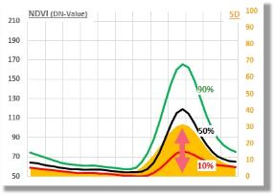
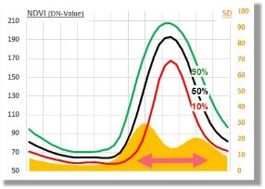
Processing steps in Erdas-Imagine: key decision moments-2
Are medians AND extremes important ?
Implode the ‘raw’ data-cube to a 1-year representative data-cube using e.g. the medians of all annual repeats (produces a data-cube representing “climatology”).
Use that data-cube to run ISODATA.
Inter-annual cover changes and extreme variabilities will have limited impacts on results.
→ This logic was used to prepare a map to correlate with published agricultural cropped-area statistics.
OR:
Create a 1-year representative data-cube containing by pixel, its 10-50-90% percentile plus SD-values (summary stats of annual repeats).
Thus, not only the ‘averages’ matter but by pixel the long-duration variability (not pin-pointed to any specific year).
→ This logic was used for a micro-insurance service, for which detecting extremes is essential.
Jan Dec
Assumes NO major land use / land cover-changes across covered years

Slide 20
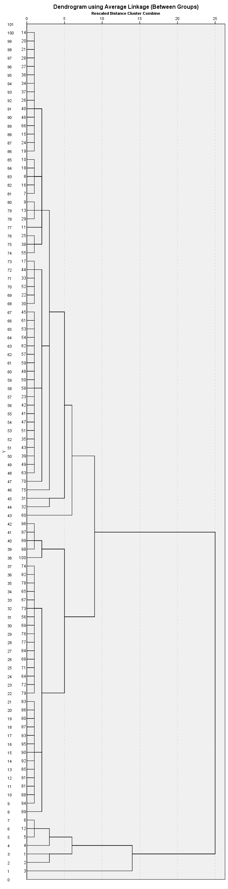

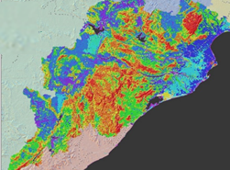

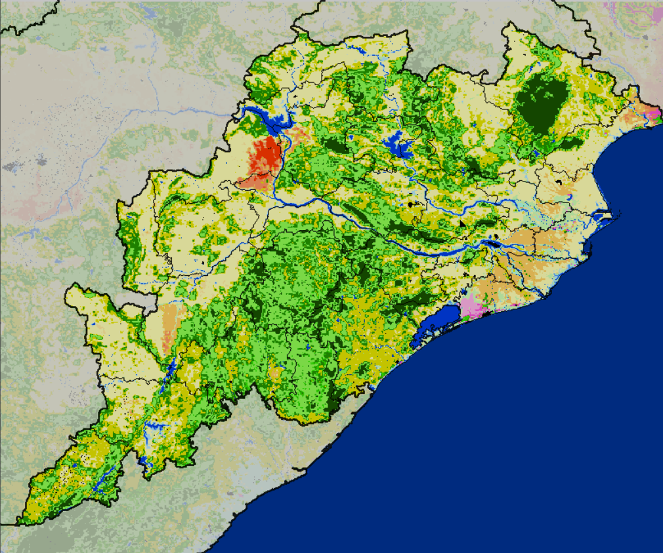
Processing steps in Erdas-Imagine: key decision moments-3
Imploding ISODATA classification results
Dendrogram
Intermediate
legend (100x)
Clusters map (100x)
+
Extract all 100 NDVI-profiles to a spreadsheet
Create from it a Dendrogram (k-means)
Use that and the Profiles to visually complete grouping
Annotate the groups (CPSZs)
Grouping of NDVI-Profiles
(k-means & visual)
+
Crop Production System Zones (CPSZ) map (21x)
21 Groups of
NDVI-profiles

Slide 21
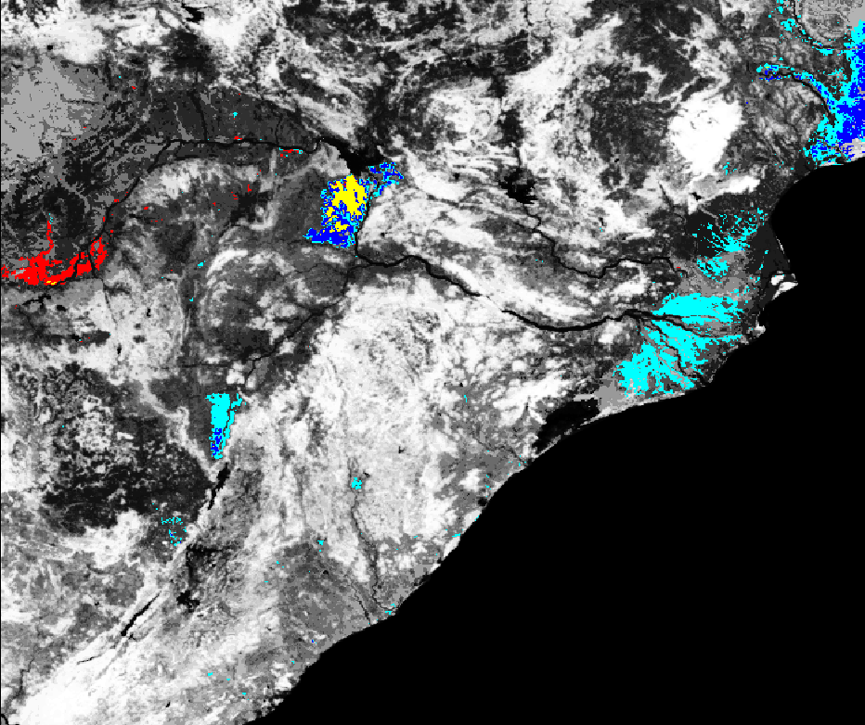
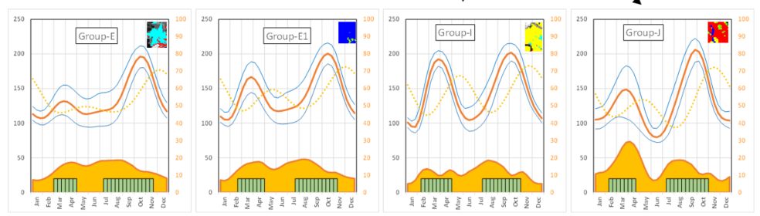
Processing steps in Erdas-Imagine: key decision moments-4
This process requires time and some experience
Besides comparing the ‘relevant’ parts of the NDVI-Profiles, also check ‘where’ a group occurs (and its extent). For the 4 groups with 2 growing seasons:
Groups [E-E1-I] form together a gradient (ref. profiles and map)
Group J stands separate.
Median profiles of the 4 groups
Summary statistics for each of the 4 groups.
Group E
Group E1
Group I
Group J
Map showing
the area for each
of the 4 groups

Slide 22
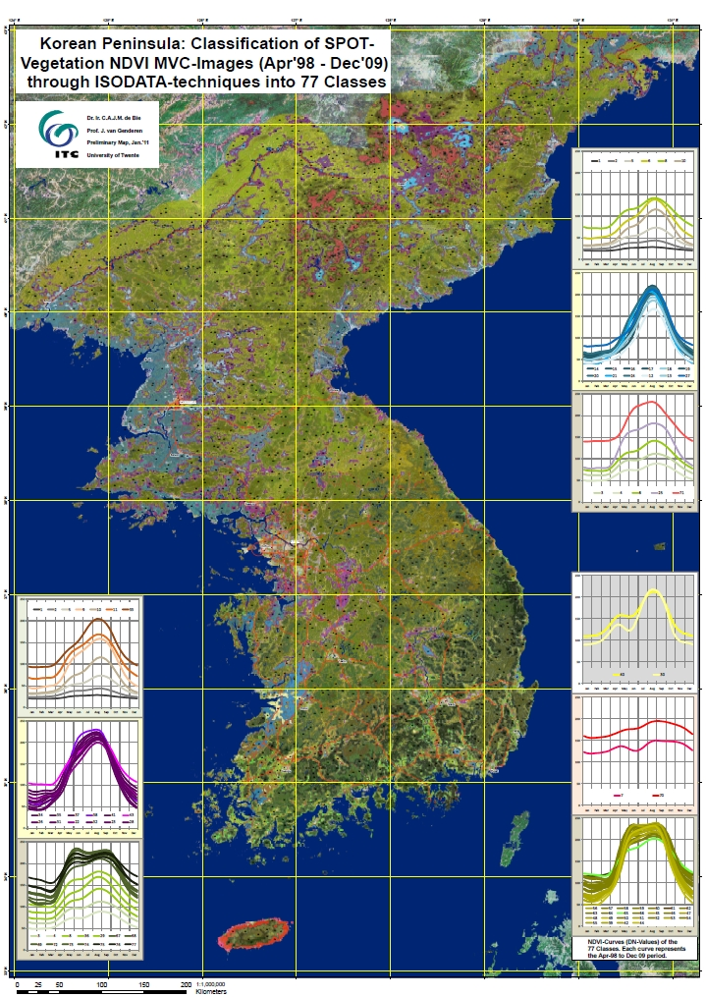
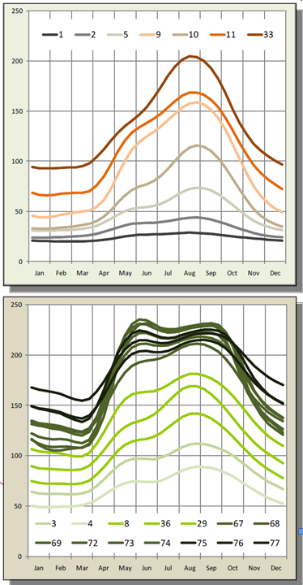
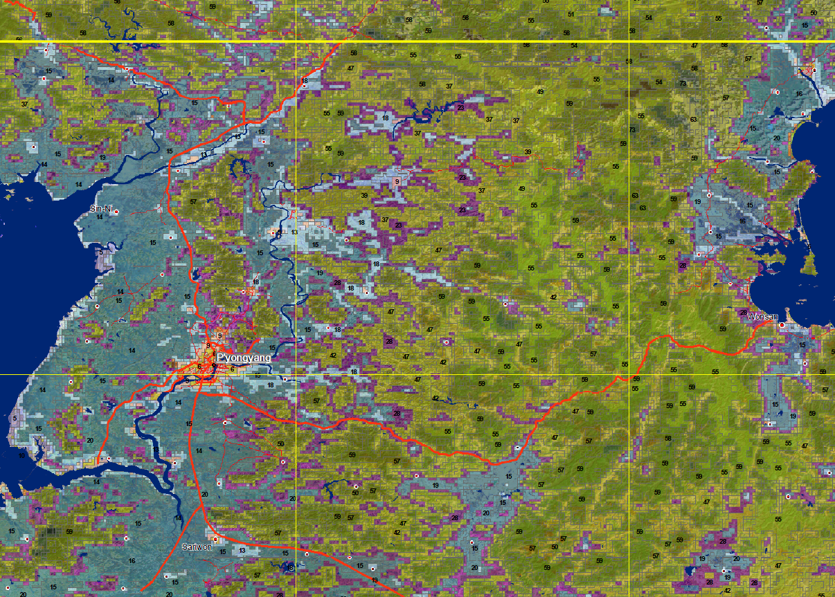
Example Intermediate HT-Maps 1
Korea-Peninsula Map
ISODATA is used to make 77 classes
that each covers a NDVI-profiles from Apr’98 – Dec’09.
The 11/5 years profiles were imploded to 1-year average profiles.
These 77 1-year profiles were grouped
(k-means + visual + map comparisons)
→ produced the map on the left side.
An enlargement is shown here:
Forests (Likely)
Long Growing season
Form a larger gradient following different cover-densities.
The mid-season dips are still remnants of impacts on NDVI by persistent and dense cloud/haze presence.
Inclusions in Forested areas (in the North)
Likely (partially) deforested with annual cropping.
Suspect poppy cultivation.
This group also forms a gradient from ‘still’ with trees to ‘fully’ degraded.

Slide 23
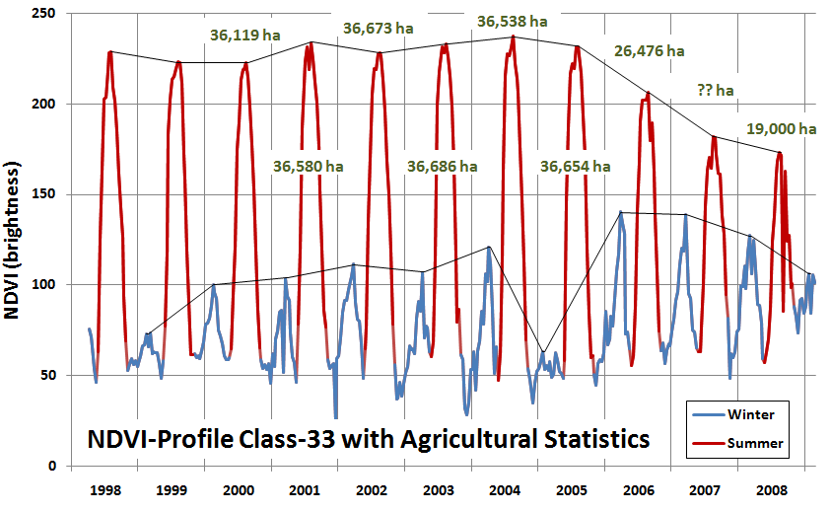
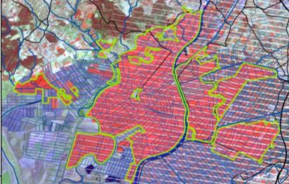
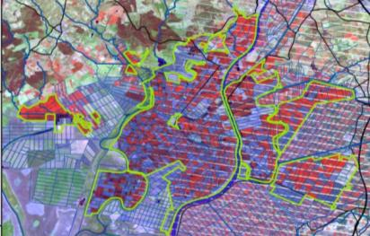
Example Intermediate HT-Maps 2
Rice in Sevilla, Spain (1998-2008; prelim.study)
An Irrigated area in Sevilla, Spain.
The whole of Andalucia was classified using NDVI-data from 1998-2008
Class-33 stood out as ‘defferent’
NDVI-Profiles are shown (DN-values), with specifically the summer-crop (in red) being ‘monitored’.
From 2004 onwards, the summer NDVI profile showed continuous decrease. Less performance or less area (by 1km pixel) cropped?
A check with agri.-stats AND with ETM-imagery proved that the latter was true: less area cropped.
The reason was a major overhaul of the irrigation scheme upstreams. The shown drop was thus only temporal.
IF we had created a “climatology” data-cube, we would never have detected the above.
ETM 2004
ETM 2008

Slide 24
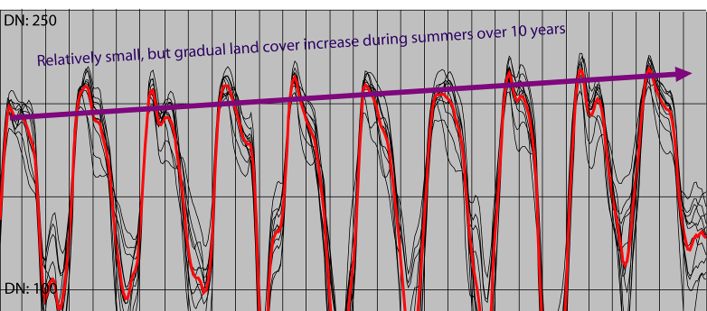
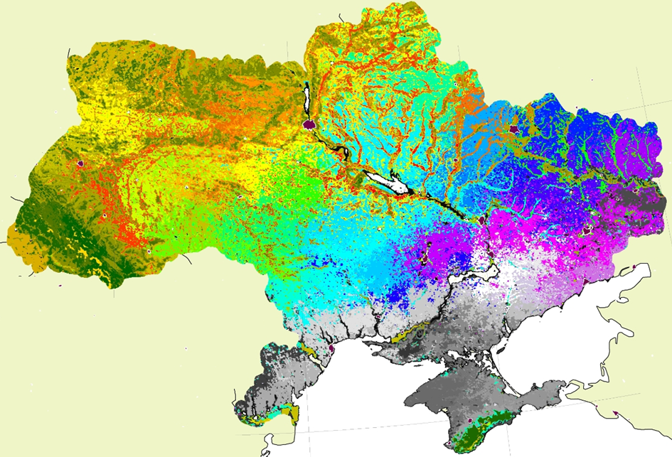
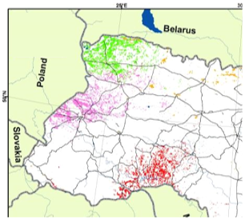
Example Intermediate HT-Maps 3
Various forested NDVI-classes on peatland in the Biebza National Park, Poland
The average ‘peak’-performance of the mid ‘season’ NDVI-values of all pixels classified to 11 NDVI-classes, showed all a gradual very-slow increasing trend across
all 10 years studied.
The reason relates to an increase
in forest density and vigor (as part
of reaching a climax vegetation).
Various crop-land classes in the Ukraine
Both the average ‘peak’-performance as the average ‘season’-performance of all pixels classified to an NDVI-class, showed gradual steady increasing trends over all 13 years of the studied data-cube.
The reason is still to be clarified.

Slide 25
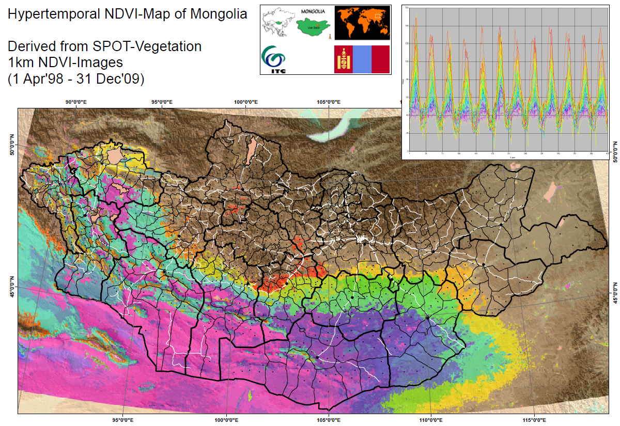
Example Intermediate HT-Maps 4
Salient additions-1: do you see the spatial-temporal gradients in Mongolia ??
Mongolia at country level:
Used is a data-cube of 11 years
The shown classes depict a gradient from very dry (Inner-Mongolia) to seasonal (steppe vegetation).
This gradient can never be mapped through medium to high resolution imagery; only HT-imagery (space AND time) allows mapping of that gradient.
The NDVI-profiles show that across years, the relative behavior between profiles remain as is (from very little vegetation to ample seasonal land cover). Differences in performance between years though do occur.

Slide 26

Example Intermediate HT-Maps 5
Post-disaster mapping of the Limpopo valley, Mozambique:
Early Febr. massive flooding occurred and NDVI-profiles IN the valley dropped immediately.
After the flooding, recovery time from water-inundation varied (different classes), and one class (no.6) showed an excess vegetation growth after standing water was drained.

Slide 27


Example Intermediate HT-Maps 6
Full resolution part of the prepared map, that shows that linear features, and other local patterns show. (Lahore is at the bottom-right)

Slide 28
EO AFRICA
Chapter 7.1 | Hyper-Temporal Mapping of Ecological Systems Part 3
Kees de Bie
ITC, UTwente
Thank you

