Slide 1



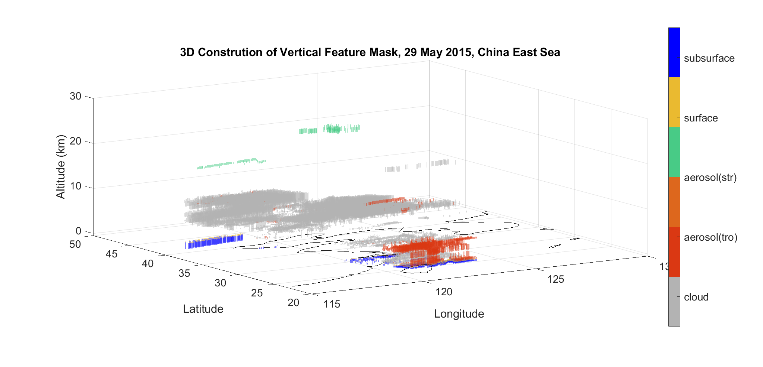
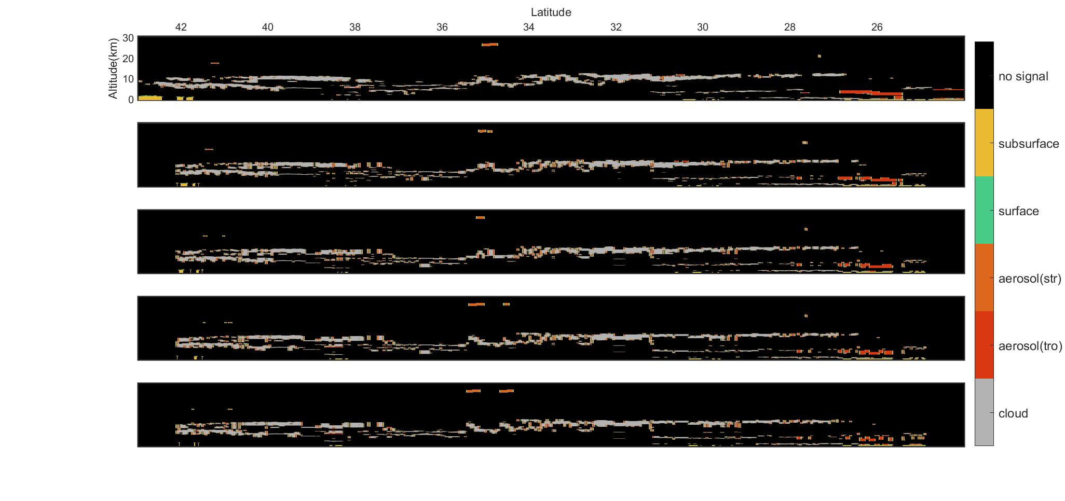
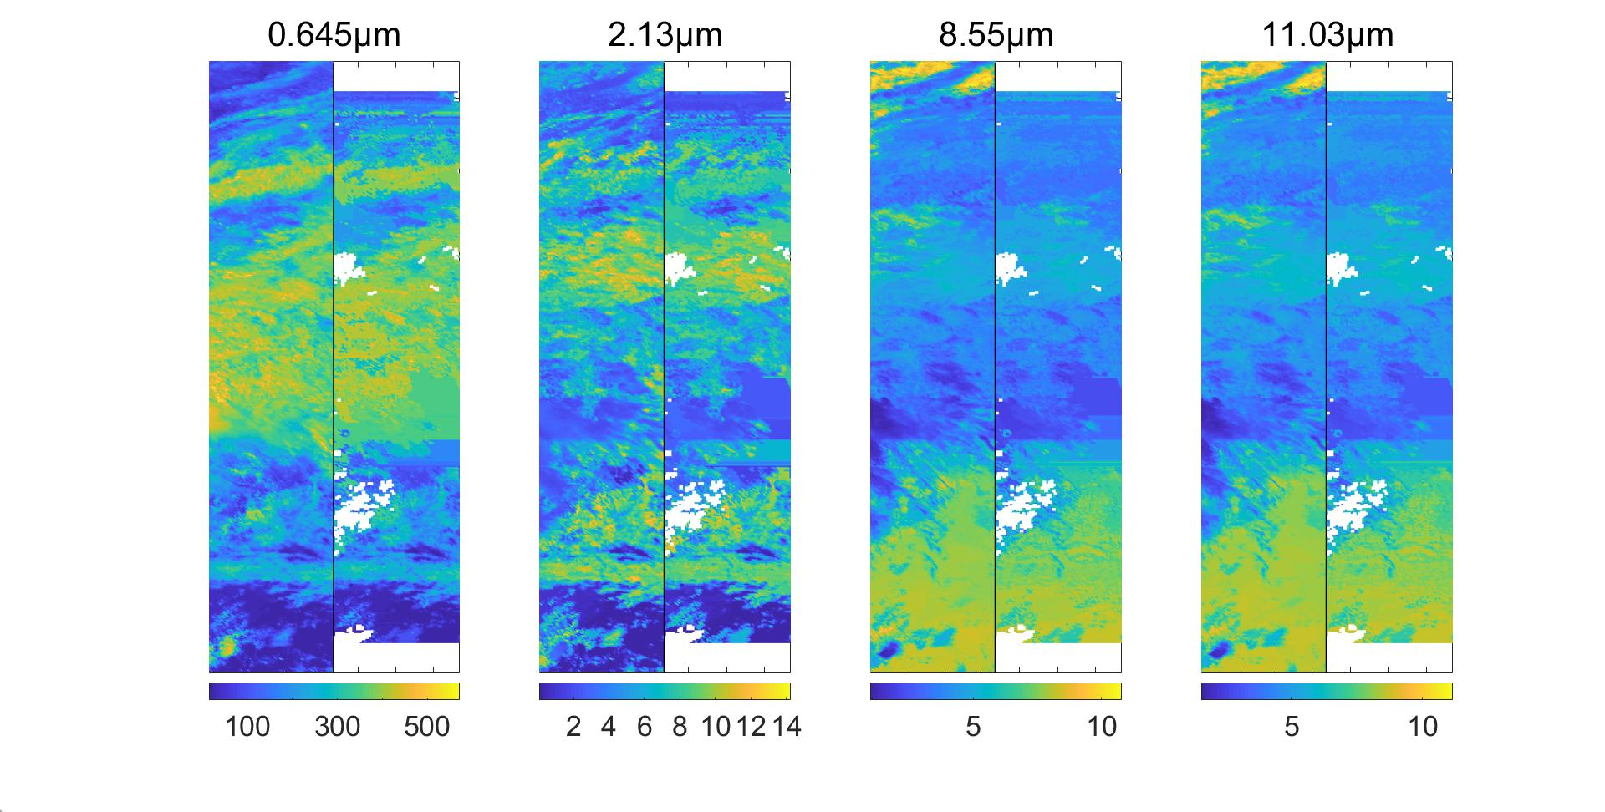
Estimating the 3D Cloud–aerosol Structure from Passive Satellite Imagery and Lidar Profile
¹Sijie Chen; Zhuofan Zheng; Ju Ke; Chonghui Cheng; Shuaibo Wang; Yupeng Zhang; Dong Liu
¹State Key Laboratory of Modern Optical Instrumentation, College of Optical Science and Engineering, Zhejiang University, Hangzhou, 310013 China.
Abstract
Results
The significant radiative impacts of cloud and atmosphere aerosol have been increasingly recognized but remain highly uncertain. Passive remote sensing sensors onboard various satellites have the ability to monitor the global distribution of cloud and aerosol with a good spatial and temporal frequency. Active sensors, such as the Cloud-Aerosol Lidar with Orthogonal Polarization (CALIOP) instrument, uses laser technique to provide high vertical resolution retrieval of cloud properties and aerosol profiles, but is limited by the nadir-only measurement geometry. Recognizing the limitations of using passive satellite imagery or laser profile only, we presented a radiance-similarity approach to match profile information from active sensors with nearby columns associated with passive imagery.
3D construction has been applied to areas 150km on the both side of CALIOP track for three months in 2015, both day and night.
Introduction
Figure 3. Demonstration of the 3D cloud–aerosol construction.
We constructed 3D distributions of cloud and aerosol using passive satellite imagery, collocated 2D nadir profiles from the simulation of the developing High Spectral Resolution Lidar (HSRL), cloud radar and imager data. The HSRL measurements simulated using observations from Cloud-Aerosol Lidar and Infrared Pathfinder Satellite Observation (CALIPSO) have shown better accuracy of backscatter coefficient and aerosol extinction retrievals in comparison with CALIOP products.
Discussion
To validate the algorithm:
Aerosol optical depth(AOD) measured by MODIS vs. AOD constructed
Cloud optical thickness(COT) measured by MODIS vs. COT constructed
Dead-zone reconstruction along CALIOP track
Figure 1. Demonstration of High Spectral Resolution Lidar (HSRL)
Methods and Materials
Figure 4. Comparison between important aerosol and cloud optical properties measured by MODIS and these constructed through algorithm.
The 3D cloud-construction adopted a spectral radiance matching (SRM) algorithm. Recipient pixels across MODIS imagery were matched with the best donor columns with multiple cloud characteristics observed by CALIOP/HSRL. The 3D aerosol-construction adopted a similar method using different aerosol column properties. The 3D construction effectively widens the active–passive retrieved cross-section (RXS) of cloud and aerosol properties, thereby enabling detailed observation with greater spacial coverage.
0km
10km
20km
30km
40km
Figure 5. A sequence of images represents the corresponding masks produced by the construction algorithm
for various dead-zone lengths as listed.
Conclusions
The 3D Cloud–aerosol construction algorithm provides a powerful way to estimate regional structure of cloud and aerosols, making it possible and more convenient to study topics such as vertical distribution, impact range, subtype occurrence of clouds and aerosols.
Figure.2 Radiance measured by MODIS vs. Radiance constructed.
Contact
References
Sijie Chen (Jessie)
Zhejiang University, Hangzhou, 310013 China.
Email: sijie1082@sina.com
Website: http://mypage.zju.edu.cn/en/liudong
Phone: (86) 0571-87951514(Office)
Barker, H. W., M. P. Jerg, T. Wehr, S. Kato, D. P. Donovan & R. J. Hogan (2011) A 3D cloud-construction algorithm for the EarthCARE satellite mission. Quarterly Journal of the Royal Meteorological Society, 137, 1042-1058.
Li, H. R. & X. J. Sun. 2014. Retrieving cloud base heights via the combination of CloudSat and MODIS observations. In Conference on Remote Sensing of the Atmosphere, Clouds, and Precipitation V. Beijing, PEOPLES R CHINA.
Miller, S. D., J. M. Forsythe, P. T. Partain, J. M. Haynes, R. L. Bankert, M. Sengupta, C. Mitrescu, J. D. Hawkins & T. H. Vonder Haar (2014) Estimating Three-Dimensional Cloud Structure via Statistically Blended Satellite Observations. Journal of Applied Meteorology and Climatology, 53, 437-455.
Sun, X. J., H. R. Li, H. W. Barker, R. W. Zhang, Y. B. Zhou & L. Liu (2016) Satellite-based estimation of cloud-base heights using constrained spectral radiance matching. Quarterly Journal of the Royal Meteorological Society, 142, 224-232.

