Slide 1
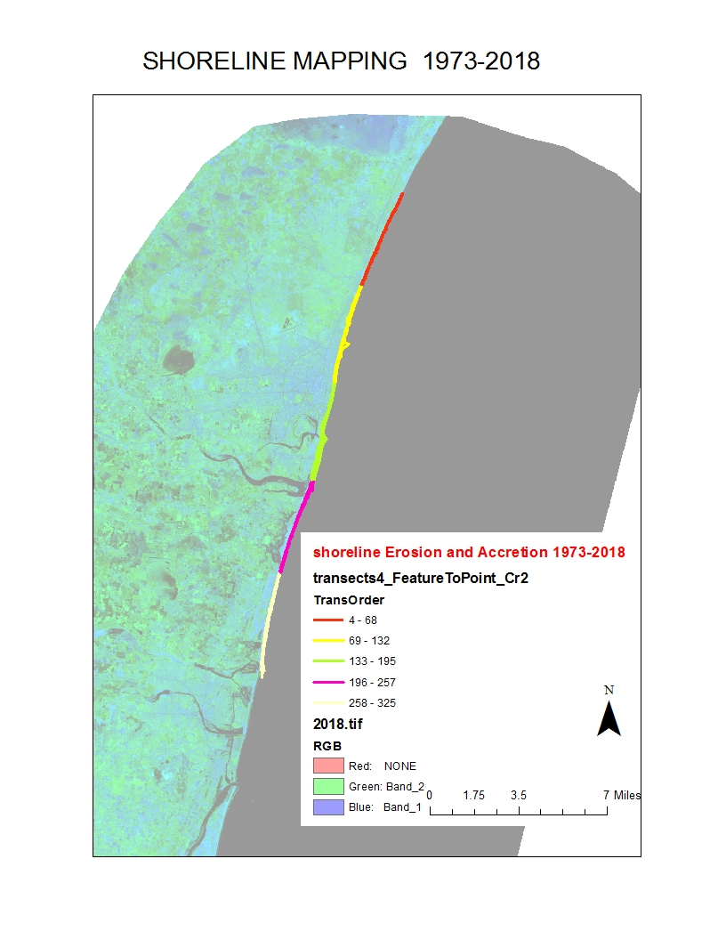
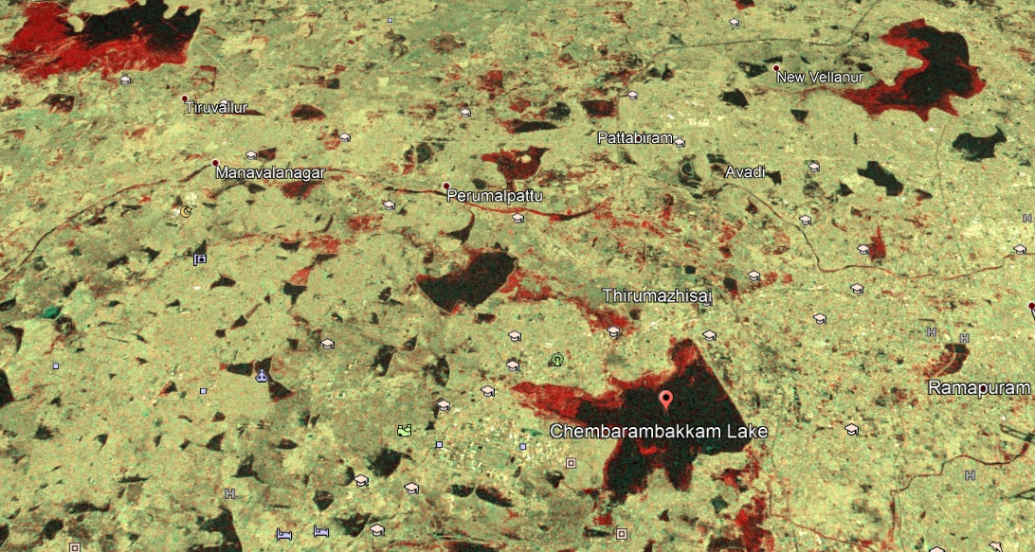
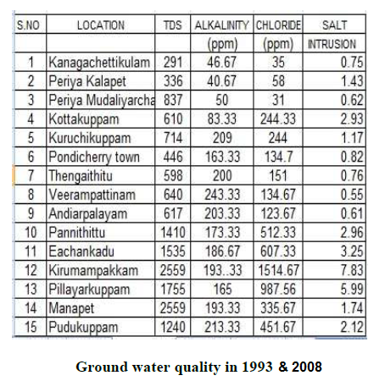
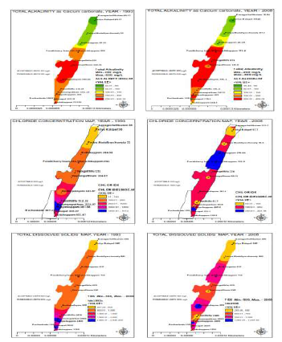
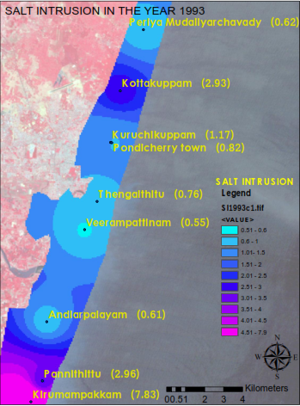
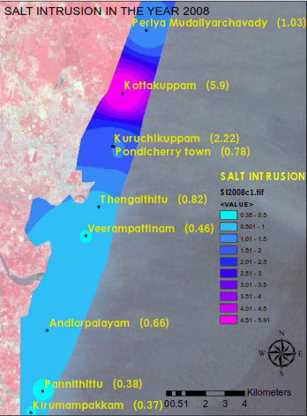
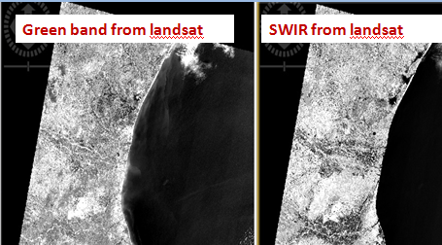
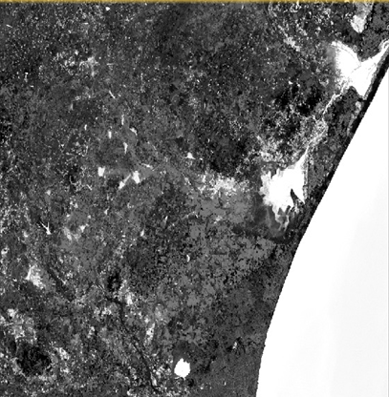
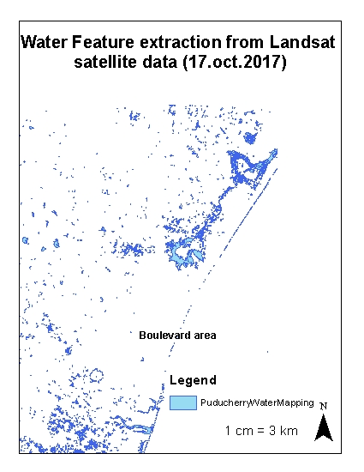
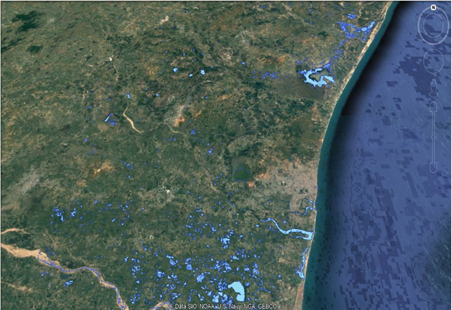
Brivio P.A. , Colombo R. , Maggi M. & Tomasoni R. Integration of remote sensing data and GIS for accurate mapping of flooded areas. Int J Remote Sens 2002, 23, (3), 429–441.
Gan T.Y. , Zunic F. , Kuo C.-C. & Strobi T. Flood mapping of Danube River at Romania using single and multi-date ERS2-SAR images. Int J Appl Earth Obs Geoinf 2012, 18, 69–81.
McFeeters S.K. The use of normalised difference water index (NDWI) in the delineation of open water features. Int J Remote Sens 1996, 17, 1425–1432.
Schumann G.J.P. , Bates P.D. , Horritt M.S. , Matgen P. & Pappenberger F. Progress in integration of remote sensing-derived flood extent and stage data and hydraulic models. Rev Geophys 2009, 47, RG4001.
Schumann G, Hostache R, Puech C, Hoffmann L, Matgen P, Pappenberger F and Pfister L 2007 High-resolution 3D flood information from radar imagery for flood hazard management IEEE Trans. Geosci. Remote Sens. 45 1715–25
Inundation mapping and monitoring the propagation of floods for forensic investigation
Study on impact of land use and land cover change on ground water quality for PONDICHERRY CITY
The study shows the land use and land cover change of the Pondicherry sity from 1993 to 2008. The landsat TM (1993) and landsat 8 (2008) satellite imagery was utlised for change detection and urban sqrawl. The spatial analysis and distribution of ground water quality was assessed for the period of 1993 and 2008. The results discusses the cause of changes in the ground water quality and salt intrusion in the coastal aquifers.
Water feature extraction by NDWI from sentinel 2 data for Pondicherry city
References:
Brivio P.A. , Colombo R. , Maggi M. & Tomasoni R. Integration of remote sensing data and GIS for accurate mapping of flooded areas. Int J Remote Sens 2002, 23, (3), 429–441.
Gan T.Y. , Zunic F. , Kuo C.-C. & Strobi T. Flood mapping of Danube River at Romania using single and multi-date ERS2-SAR images. Int J Appl Earth Obs Geoinf 2012, 18, 69–81.
McFeeters S.K. The use of normalised difference water index (NDWI) in the delineation of open water features. Int J Remote Sens 1996, 17, 1425–1432.
Schumann G.J.P. , Bates P.D. , Horritt M.S. , Matgen P. & Pappenberger F. Progress in integration of remote sensing-derived flood extent and stage data and hydraulic models. Rev Geophys 2009, 47, RG4001.
Schumann G, Hostache R, Puech C, Hoffmann L, Matgen P, Pappenberger F and Pfister L 2007 High-resolution 3D flood information from radar imagery for flood hazard management IEEE Trans. Geosci. Remote Sens. 45 1715–25

