Slide 1
Practical Session
Estimating AGB by using EO data
Zhihai Gao Bin Sun
Chinese Academy of forestry
sunbin@ifrit.ac.cn

Slide 2
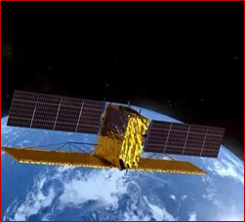
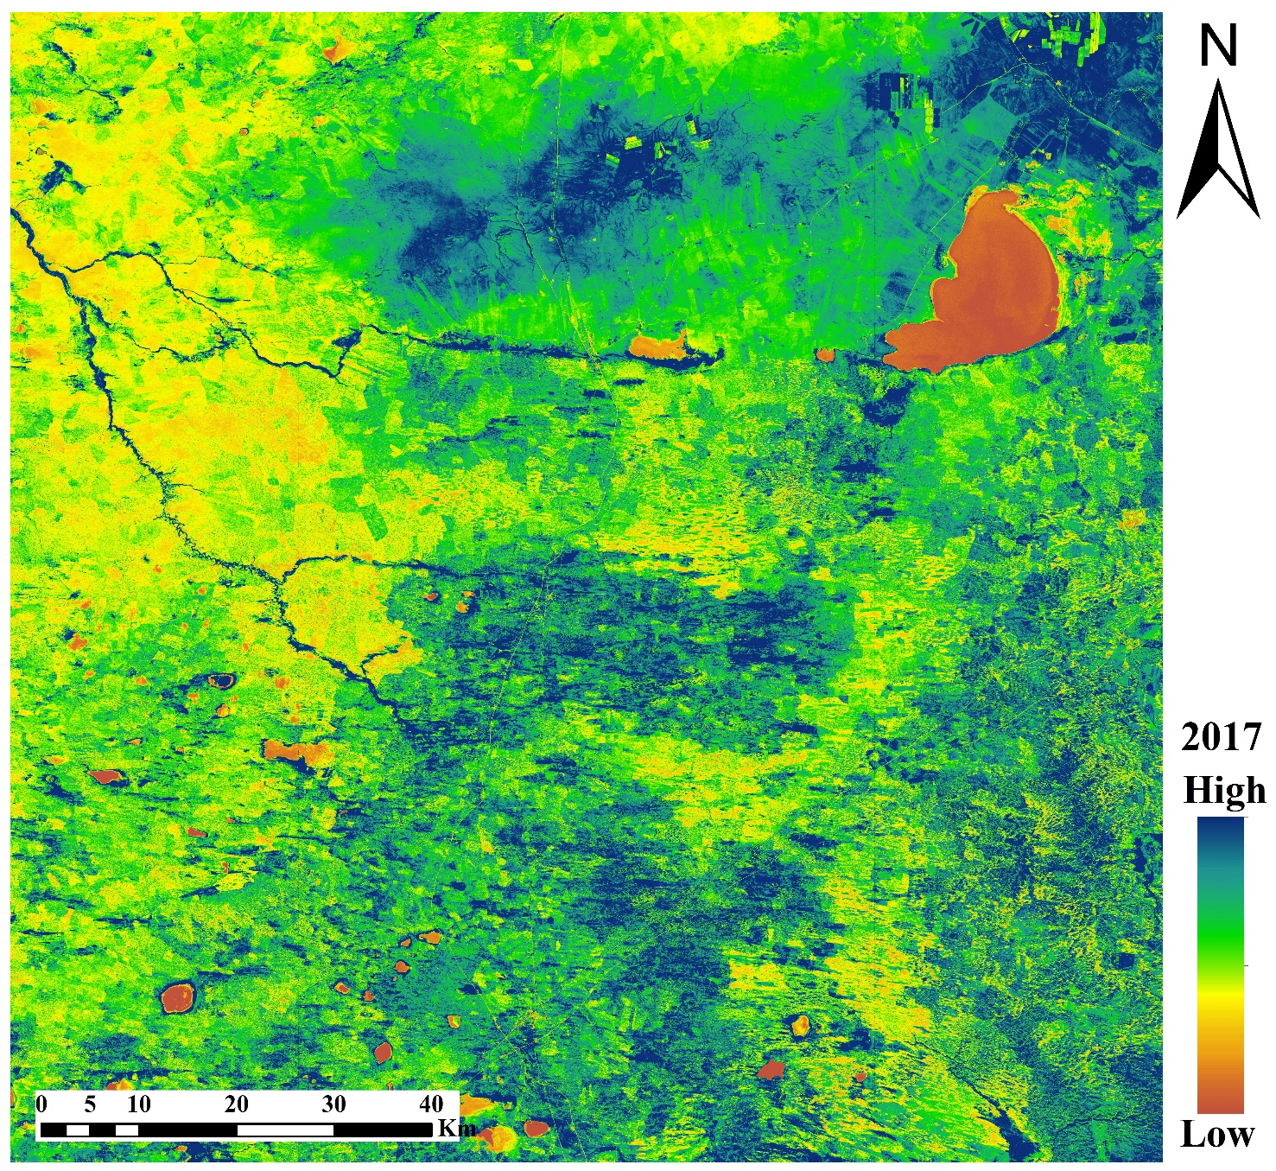
Exercise Objective: Learn how to extract information for AGB estimation using Sentinel-2 data and SNAP
Software required: SNAP

Slide 3
Flow Chart of AGB estimation
S2 data
We produced the S2MSI1C data by using the Sen2cor (http://step.esa.int/main/third-party-plugins-2/sen2cor/).
Batch processing
Atmospheric correction
Geometric correction
Bands export
SNAP
10m resolution
B2-8A
Open cmd :
Command Prompt (Windows +R, cmd)
Open Sen2Cor:
Cd C:\Users\Administrator\AppData\Local\Sen2Cor-02.05.05-win64
Batch processing:
/D %s in (H:1\1\S2A_MSIL1C*) do L2A_process -- refresh %s
Resampling
Mosaicing
VIs
Texture
Extraction
Modeling
Mapping

Slide 4
Display

Slide 5
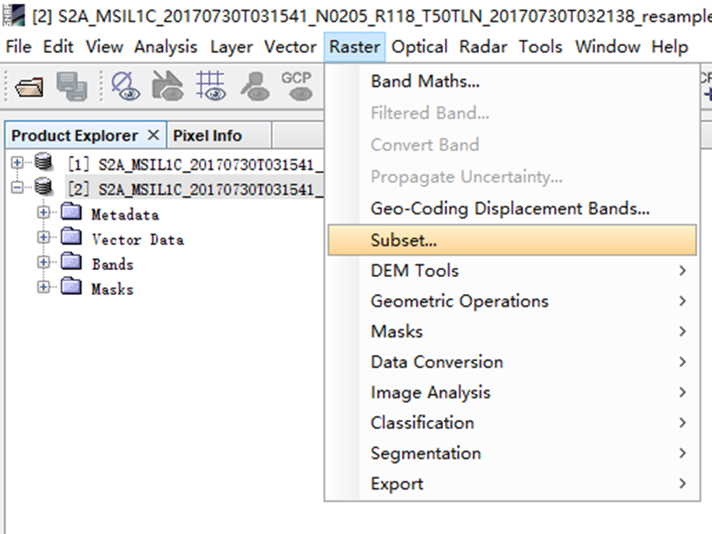
Step-1: Bands export

Slide 6
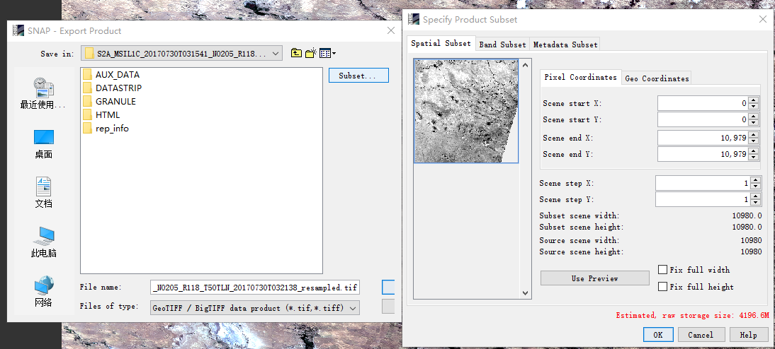
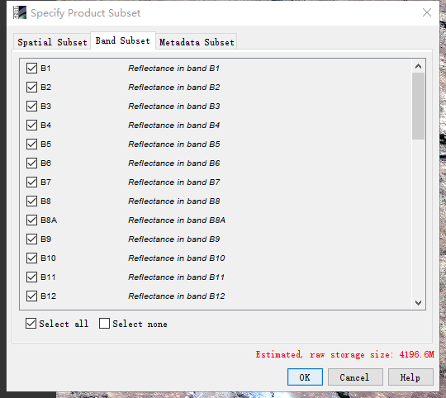
Step-1: Bands export

Slide 7
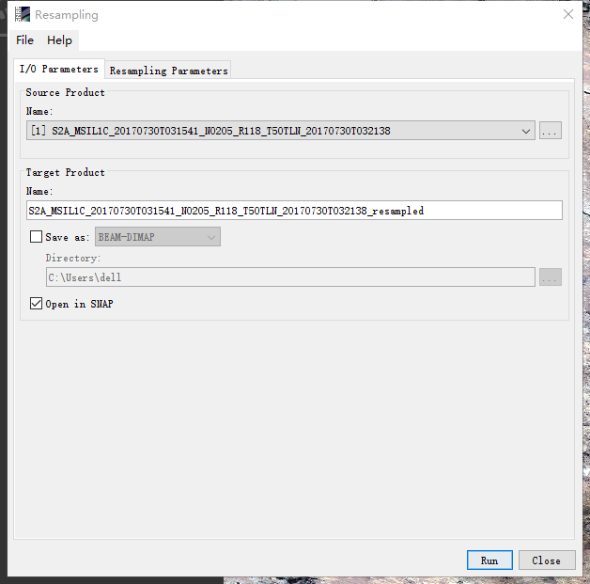
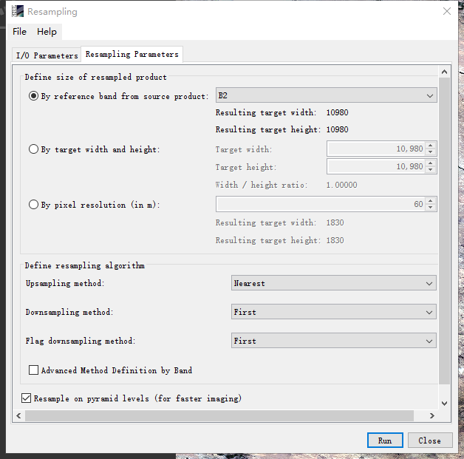
Step-2: Resampling

Slide 8
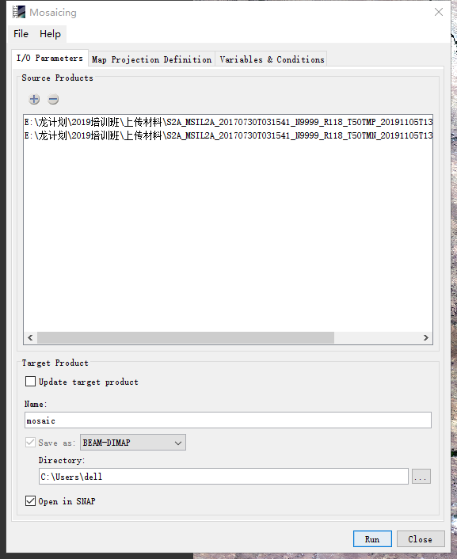
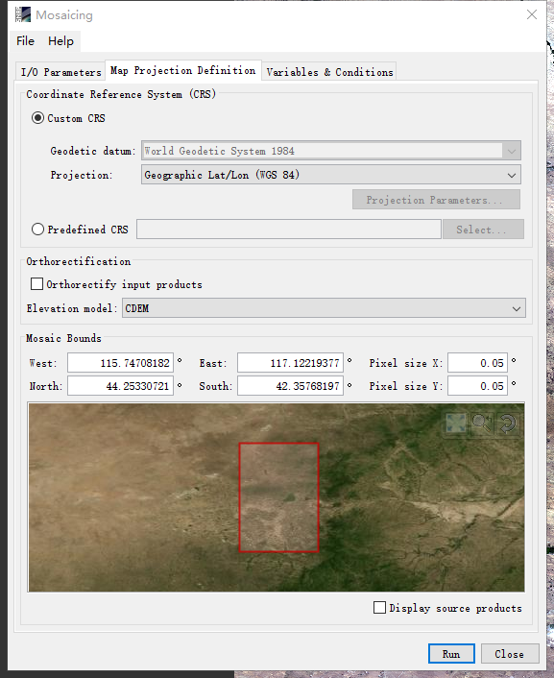
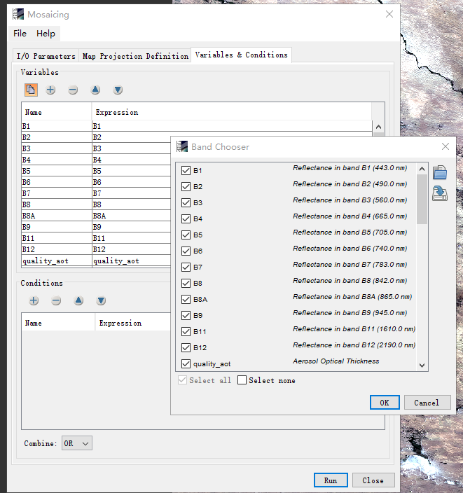
Step-3: Mosaicing

Slide 9
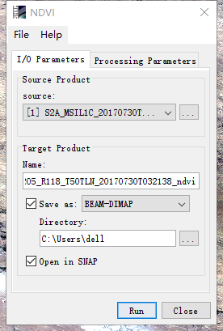
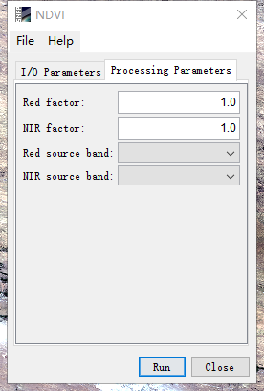
Step-4.1: VIs

Slide 10
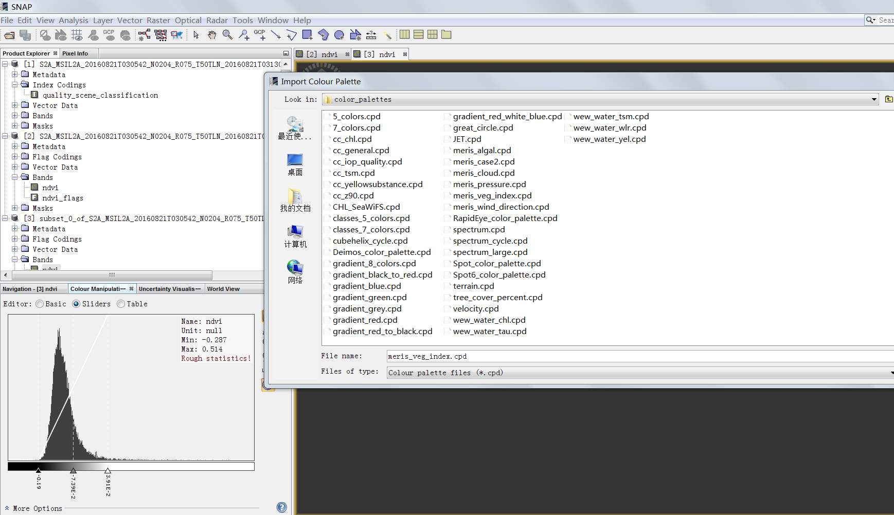
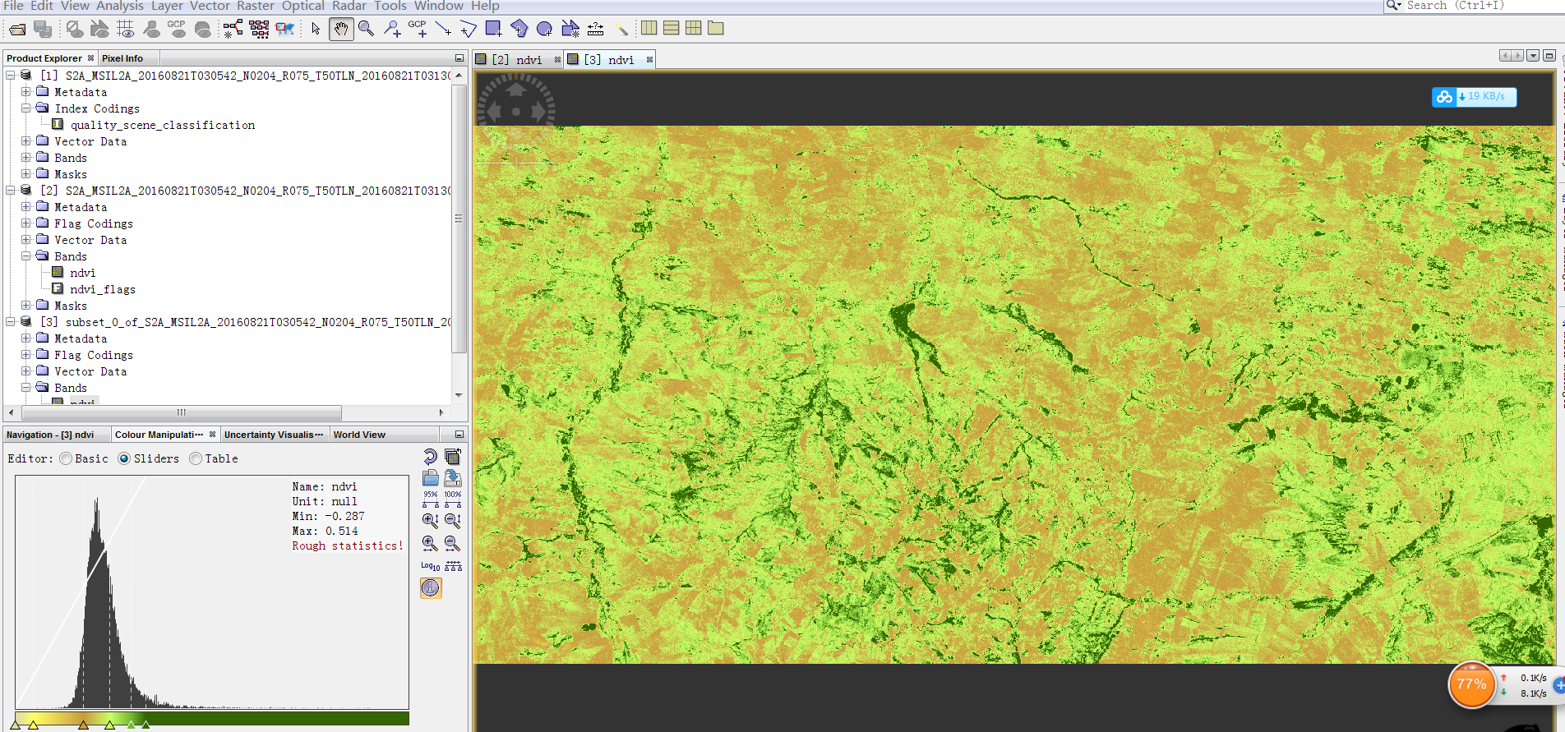
Step-4.1: VIs-Display

Slide 11
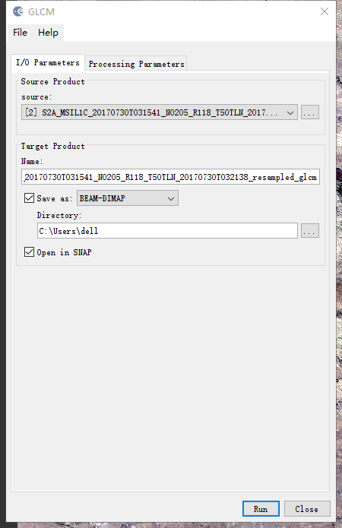
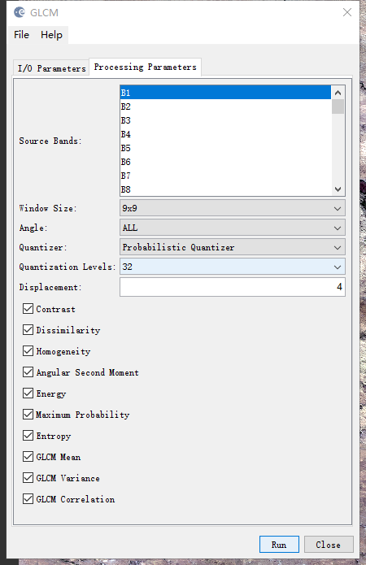
Step-4.2: Texture information

Slide 12
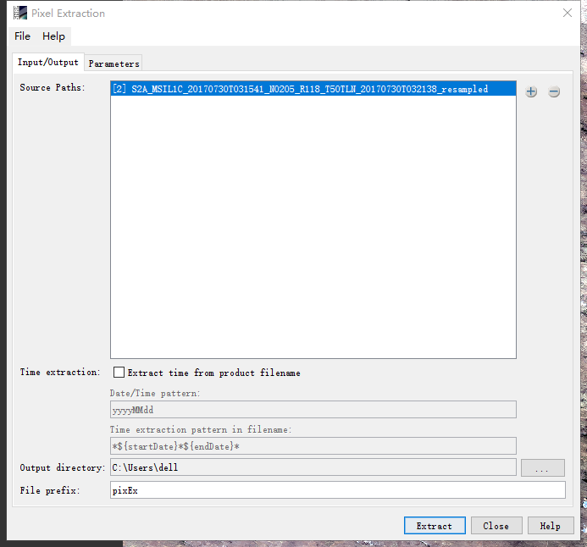
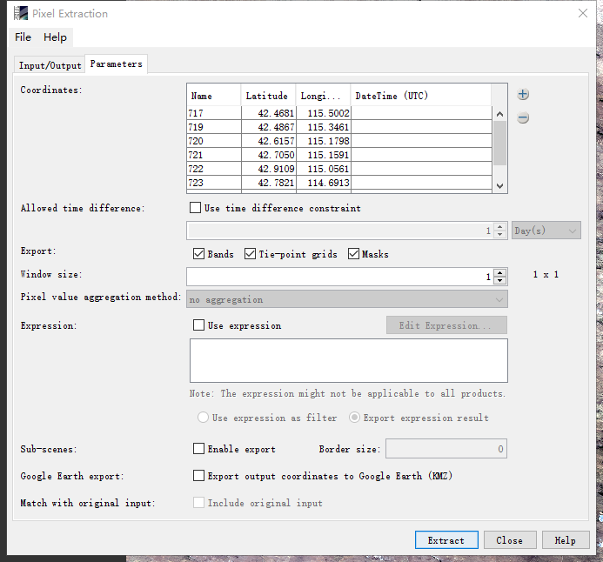
Step-5: Pixel information

Slide 13
Questions ?

