Slide 1
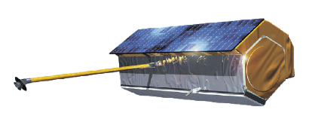

测绘遥感信息工程国家重点实验室
State Key Laboratory of Information Engineering in Surveying, Mapping and Remote Sensing
Synthetic Aperture Radar Tomography – practical course
Timo Balz, Stefano Tebaldini, Laurent Ferro-Famil

Slide 2



TomoSAR_Main.m
%%%%%%%%%%%%%%%%%%%%%%%%%%%%%%%%%%%%%%%%%%%%%%%%%%%%%%%%%%%%%%%%%%%%%%%%%%%%%%%%%%%%%%%%%%%%%%%%%
% DEMONSTRATIVE TOMOGRAPHIC SAR PROCESSING FOR FOREST ANALYSIS
% AUTHOR: STEFANO TEBALDINI, POLITECNICO DI MILANO
% EMAIL: stefano.tebaldini@polimi.it
% TEL: +390223993614
%
% THE FOLLOWING SCRIPT AND ALL RELATED SCRIPTS/FUNCTIONS AND DATA ARE INTENDED AS
% MATERIAL FOR THE TOMOSAR TRAINING COURSE HELD IN BEIJING IN FEBRUARY 2015
% BY LAURENT FERRO-FAMIL AND STEFANO TEBALDINI
%
% THIS SOFTWARE WAS DEVELOPED AND TESTED USING MATLAB R2011b
%
% SAR DATA USED IN THIS SCRIPT ARE PART OF THE SAR DATA-SET ACQUIRED BY DLR
% IN 2008 IN THE FRAME OF THE ESA CAMPAIGN BIOSAR 2008
% DATA FOCUSING, COREGISTRATION, PHASE FLATTENING, AND GENERATION OF KZ
% MAPS WERE CARRIED OUT BY DLR.
% DATA PHASE CALIBRATION WAS CARRIED OUT BY THE AUTHOR
%
% TERRAIN ELEVATION DATA USED IN THIS SCRIPT ARE EXTRACTED FROM
% THE LIDAR DATA-SET ACQUIRED BY THE SWEDISH DEFENCE RESEARCH AGENCY (FOI)
% AND HILDUR AND SVEN WINQUIST'S FOUNDATION IN THE FRAME OF THE ESA
% CAMPAIGN BIOSAR 2008
% PROCESSING OF LIDAR DATA AND PROJECTION ONTO SAR GEOMETRY WAS CARRIED OUT
% BY THE AUTHOR
%
% YOU ARE WELCOME TO ADDRESS ME QUESTIONS/COMMENTS/CORRECTIONS AT
% stefano.tebaldini@polimi.it
%%%%%%%%%%%%%%%%%%%%%%%%%%%%%%%%%%%%%%%%%%%%%%%%%%%%%%%%%%%%%%%%%%%%%%%%%%%%%%%%%%%%%%%%%%%%

Slide 3
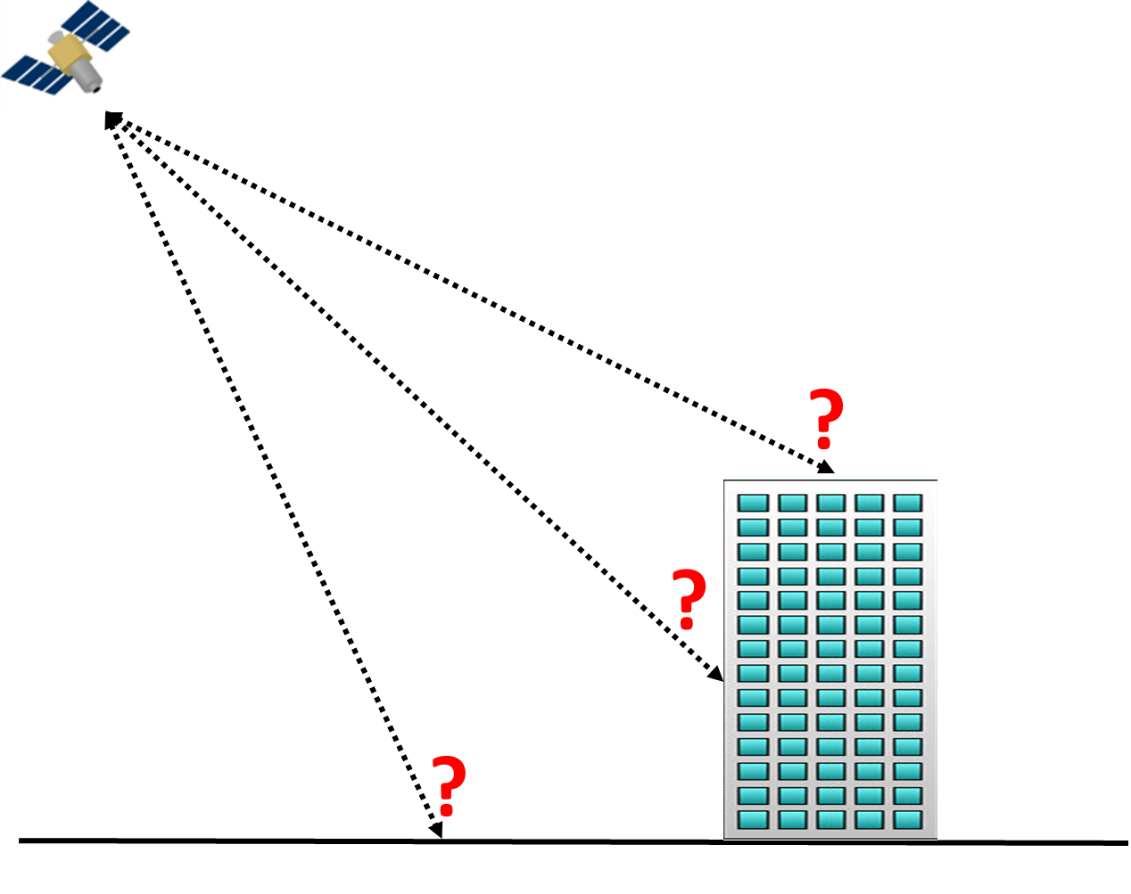
Ambiguities

Slide 4
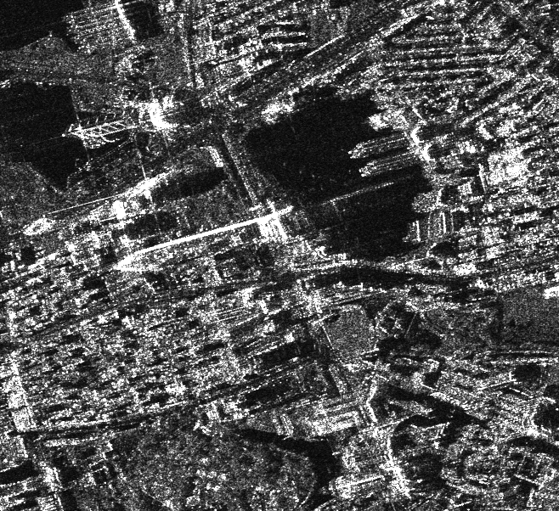

Slide 5
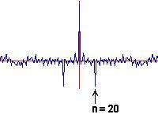




TomoSAR principle

Slide 6
TomoSAR principle

Slide 7
TomoSAR principle

Slide 8
TomoSAR principle

Slide 9
TomoSAR principle

Slide 10
Why multiple baselines?
  Because: more equations!
  Increased robustness against disturbances (temporal decorrelation…)
  and/or relaxation of hypotheses required in the single baseline case
  more unknowns are available to characterize the vertical structure of the scene
N=2
N=3
N is large
z
z
z
…
Top Height, Extinction
Mean, Std, Skewness
Tomographic Reconstruction
Backscattered Power
Backscattered Power
Backscattered Power
MB allow to pass from model-based inversion to full tomographic reconstruction
Tebaldini & Rocca

Slide 11
Rationale: Form a 2D synthetic aperture by collecting multiple SAR acquisitions acquired along parallel flight lines
  Vertical resolution ⬄ total normal baseline span
  Vertical ambiguity ⬄ normal baseline spacing
Multi-baseline (MB) systems:
Multiple pass systems:
  airborne and spaceborne SARs
Multiple antenna systems:
  ground based Radars
Slant range
resolution cell
Normal baseline
θ
MB campaigns involve:
Higher costs:
  spaceborne: ≈ x 1
  ground based: ≈ x N
More sophisticated processing:
  see single vs multi-baseline InSAR…
height
Replicas
Height of ambiguity
azimuth
ground range
Source:
Tebaldini & Rocca

Slide 12
Tomographic SAR
Rationale: Form a 2D synthetic aperture by collecting multiple SAR acquisitions acquired along parallel flight lines
  Vertical resolution ⬄ total normal baseline span
  Vertical ambiguity ⬄ normal baseline spacing
Multi-baseline (MB) systems:
Multiple pass systems:
  airborne and spaceborne SARs
Multiple antenna systems:
  ground based Radars
Slant range
resolution cell
Normal baseline
θ
height
Replicas
MB campaigns involve:
Higher costs:
  spaceborne: ≈ x 1
  ground based: ≈ x N
More sophisticated processing:
  see single vs multi-baseline InSAR…
Height of ambiguity
azimuth
ground range
Source: Tebaldini & Rocca

Slide 13
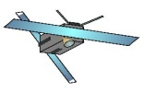



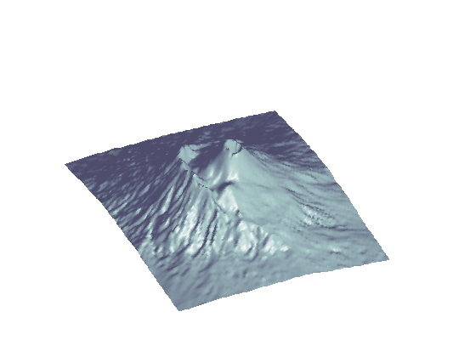

Basic concepts
Multiple baselines ⬄ Illumination from multiple points of view
Track n
Track n
cross range
baseline vector for the n-th track
cross range
Reference Track (Master)
π/2
Master
azimuth
Normal baseline for the n-th track
slant range
Track 1
θ
slant range
Flight tracks orthogonal
to the blackboard
height
By collecting several baselines it is possible to synthesize an antenna along the cross range direction as well
azimuth
3D focusing is possible in the coordinate system: slant range, azimuth, cross range
ground range
Source: Tebaldini & Rocca

Slide 14
Basic concepts
Resolution is determined by pulse bandwidth along the slant range direction, and by the lengths of the synthetic apertures in the azimuth and cross range directions
The SAR resolution cell is split into multiple layers, according to baseline aperture
Track N
B: pulse bandwidth
A_{v}: baseline aperture
A_{x}: azimuth aperture
λ: carrier wavelength
cross range, v
Track n
SAR Resolution Cell
Tomographic Res. Cell
Track 1
For most systems:
Δv >> Δr, Δx
Baseline aperture
slant range, r
height
height
Δv
ground range
azimuth
ground range
Δr
Source: Tebaldini & Rocca

Slide 15
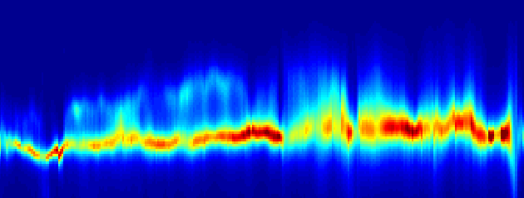
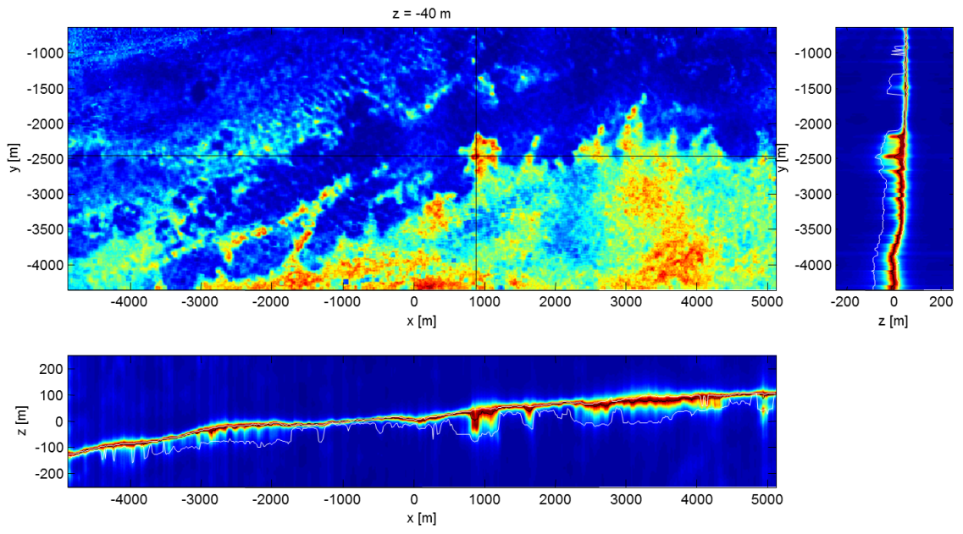
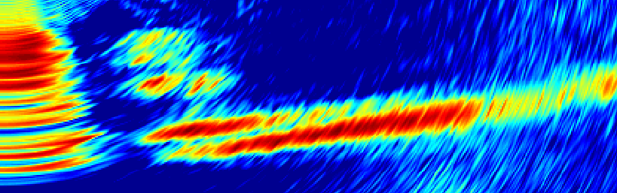
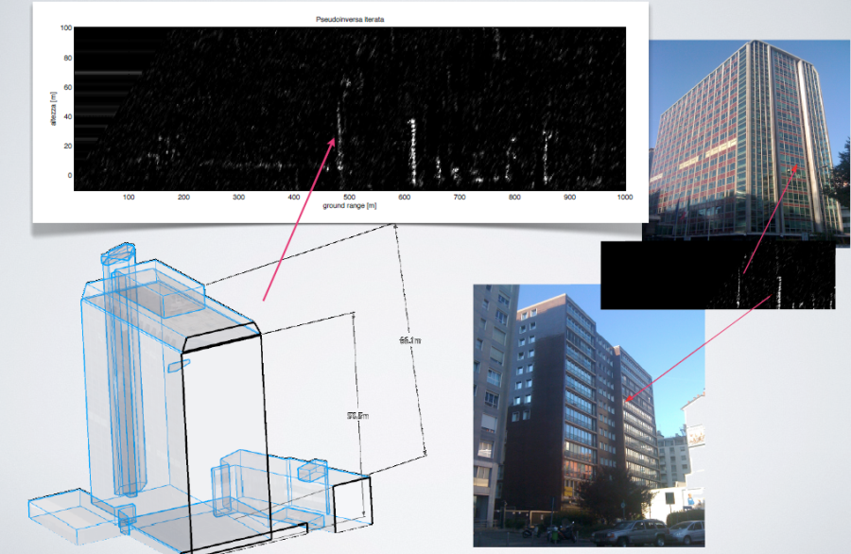
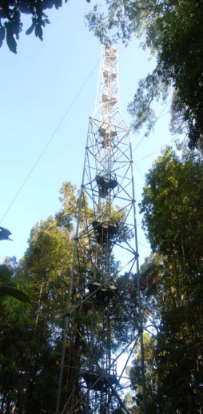
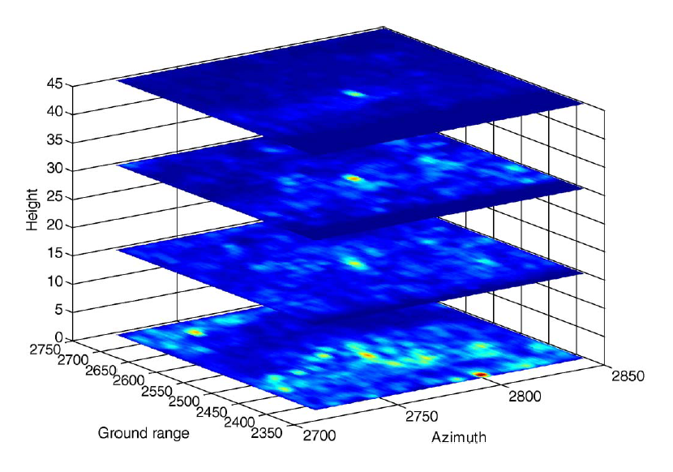
TomoSAR gives access to the 3D structure
60
Forested areas
Ice
50
40
30
height [m]
20
10
0
-10
200
600
1000
1400
1800
2200
slant range [m]
0.5
Snow
0
z [m]
-0.5
-1
-1.5
-2
0
1
2
3
4
5
6
7
y [m]
Man-made structures
Urban scenarios
Source: Tebaldini & Rocca

Slide 16
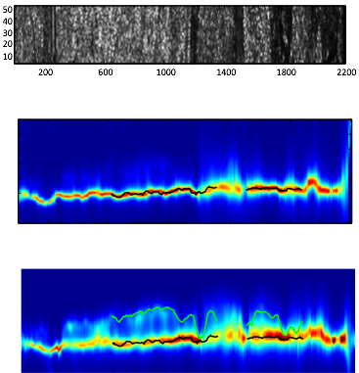
Polarimetric TomoSAR over Vegetation
Foliage penetration
Biomass estimation

Slide 17
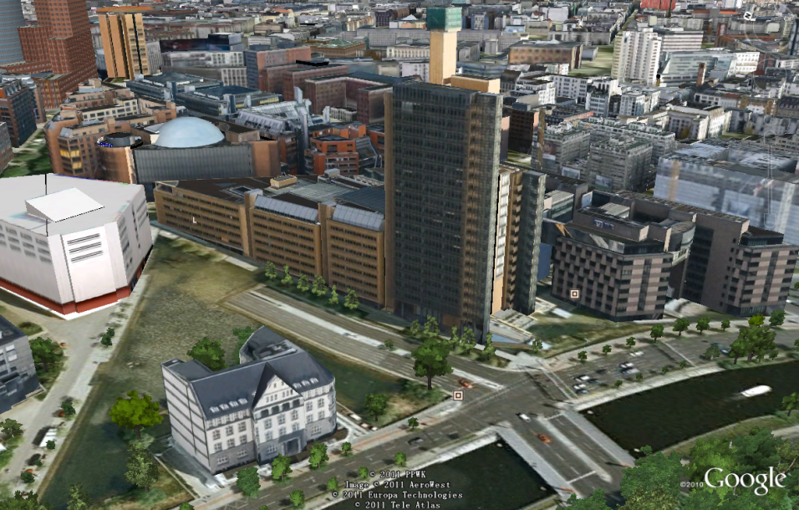
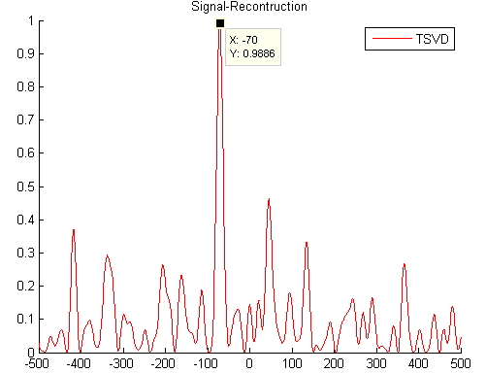
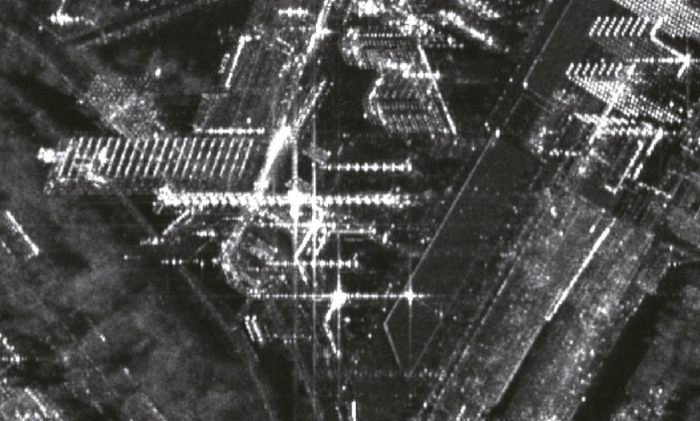
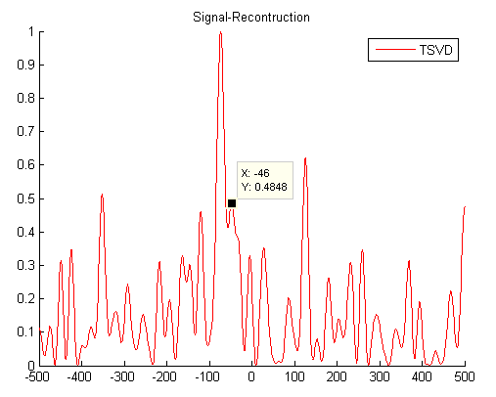
Urban TomoSAR
Finite number of scatterers

Slide 18
TomoSAR principle
Δb
Orbit uncertainties &
tropospheric delay
Irregular sampling &
Limited acquisitions
= low resolution in s
s
r

Slide 19
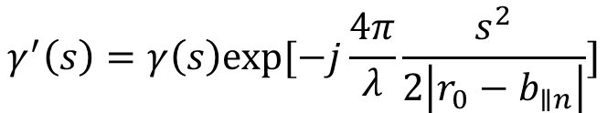
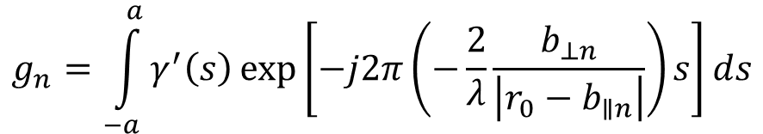
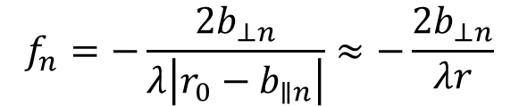
TomoSAR as spectral estimation problem
$$g_{n}=\int_{−a}^{a}{γ^{′}\left(s\right)\exp\left[−j2π\left(−\frac{2}{λ}\frac{b_{⊥n}}{\left|r_{0}−b_{∥n}\right|}\right)s\right]ds}$$
where
$$γ^{′}\left(s\right)=γ\left(s\right)exp⁡[−j\frac{4π}{λ}\frac{s^{2}}{2\left|r_{0}−b_{∥n}\right|}]$$
so, g_{n} is the Fourier transformation of $γ′(s)$ at position
$$f_{n}=−\frac{2b_{⊥n}}{λ\left|r_{0}−b_{∥n}\right|}≈−\frac{2b_{⊥n}}{λr}$$

Slide 20
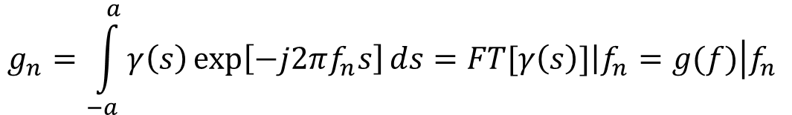
TomoSAR basics
The focused SAR image from the n^{th} pass of a specific cell is nothing else but the Fourier Transfer of the reflectivity function in the elevation direction at the position f_{n}.
$$g_{n}=\int_{−a}^{a}{γ\left(s\right)\exp\left[−j2πf_{n}s\right]ds=FT[γ\left(s\right)]\left|f_{n}=g(f)\right.\left|f_{n}\right. }$$

Slide 21
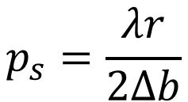

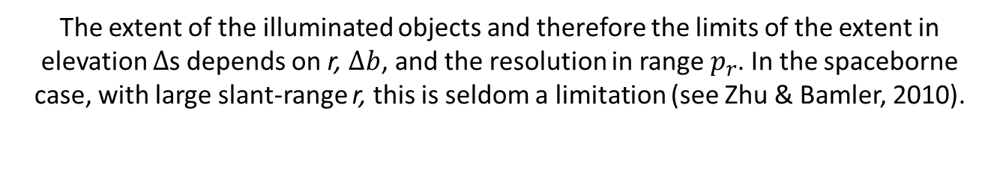
TomoSAR basics
The expected resolution in elevation $p_{s}$ depends on the slant-range r and the aperture size in elevation $∆b$
$$p_{s}=\frac{λr}{2Δb}$$
The extent of the illuminated objects and therefore the limits of the extent in elevation $∆$s depends on r, $∆b$, and the resolution in range $p_{r}$. In the spaceborne case, with large slant-range r, this is seldom a limitation (see Zhu & Bamler, 2010).
$$Δs≪\frac{p_{r}r}{Δb}$$

Slide 22
PS-InSAR for pre-processing
Using TomoSAR on a large area requires the removal of atmospheric effects
This can be done using PS-InSAR
  However, this requires a large number of PS to be found
  Therefore, this works best in urban areas
PS-InSAR is used for pre-processing
Afterwards, TomoSAR can be used

Slide 23
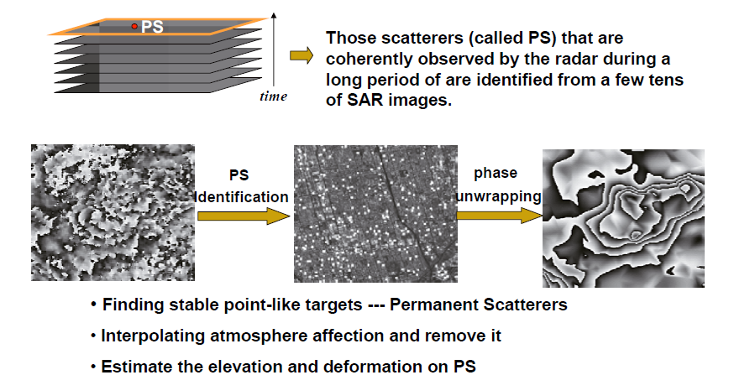
PS-InSAR

Slide 24
PS-InSAR steps
Import
Selection of the master image
Co-Registration
    Typically to a single-master
Interferogram processing
    Not in every implementation. Several PS-InSAR implementations only use the phases of the PS candidates
PS candidates selection
APS estimation
    Typically on a subset of the PS candidates
PS point processing
Post-processing
Visualization

Slide 25
Image co-registration
Identical to the co-registration described in the InSAR section:
Registration accuracy < 0.2 pixel is required
  This requirement is even much higher during TOPS processing
Different methods available
    Based on the amplitude
    Based on complex data – searching maximal coherence
Slave images are resampled to the master image
Results need to be checked and the parameters may need to be adjusted

Slide 26

PS candidate selection
Classical way: amplitude dispersion index
Other possible ways, e.g. based on coherence
Be aware: amplitude dispersion index not ideal for TomoSAR, because the existence of several scatterers in a resolution cell can increase the index
$$d_{a}=\frac{{StdDev}_{a}}{{Mean}_{a}}$$

Slide 27
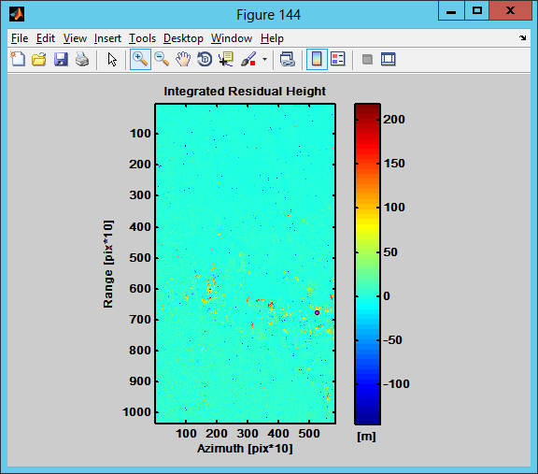
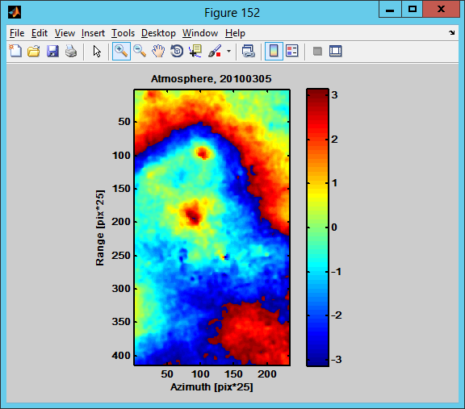
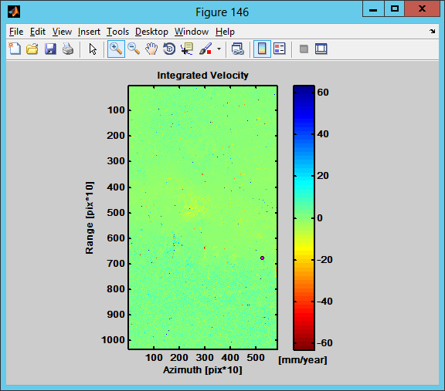
APS estimation
Example: SARProZ

Slide 28
Spectral estimators
Beamforming:
inverse Fourier Transform; coarse spatial resolution; radiometrically consistent
Capon Spectral Estimator:
spatial resolution is greatly enhanced, at the expense of radiometric accuracy;
Methods based on the analysis of the Eigenstructure of R (MUSIC, ESPRIT…):
determination of the dominant scatterering centers; mostly suited for urban scenarios
Methods based on sectorial information (Truncated SVD, PCT…):
optimal basis choice (e.g.: Legendre), depending on a-priori info about the scene vertical extent
Model based methods (NLS, COMET…):
model based; high radiometric accuracy; high computational burden; possible model mismatches
Compressive sensing:
localization of few scattering centers via L1 norm minimization; mostly suited for urban scenarios

Slide 29



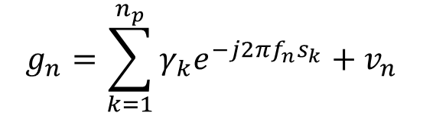



Multiple scatterers
$$g_{n}=\sum_{k=1}^{n_{p}}{γ_{k}e^{−j2πf_{n}s_{k}}+v_{n}}$$
$$n=0,…,n_{s}$$
where
g_{n} = complex value observed for the n^{th} pass
$γ_{k}$= complex amplitude of k^{th} scatterer
$s_{k}$= elevation of k^{th} scatterer
$n_{s}+1$= number of available images
$n_{p}$=number of scatterers inside a resolution cell
$v_{n}$=noise
$f_{n}$=frequency of sampled FT which depends on the baseline

Slide 30
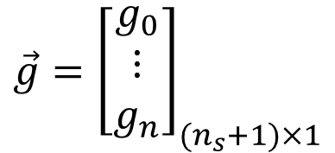
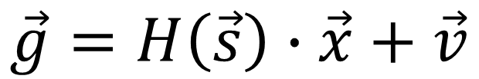
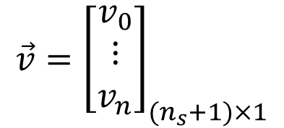
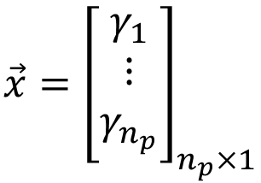
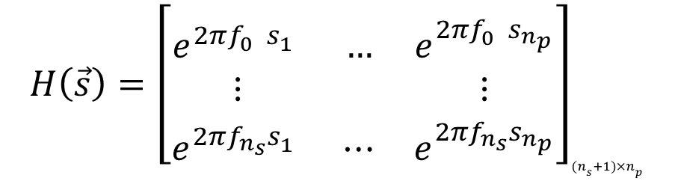
Non-linear least-square estimation
$$\vec{g}=H\left(\vec{s}\right)∙\vec{x}+\vec{v}$$
$$H\left(\vec{s}\right)={\left[\begin{matrix}e^{2πf_{0}^{}s_{1}^{}} & … & e^{2πf_{0}^{}s_{n_{p}}^{}} \\ ⋮ & & ⋮ \\ e^{2πf_{n_{s}}^{}s_{1}^{}} & ⋯ & e^{2πf_{n_{s}}^{}s_{n_{p}}^{}}\end{matrix}\right]}_{(n_{s}+1)×n_{p}}$$
$$\vec{g}={\left[\begin{matrix}g_{0} \\ ⋮ \\ g_{n}\end{matrix}\right]}_{(n_{s}+1)×1}$$
$$\vec{x}={\left[\begin{matrix}γ_{1} \\ ⋮ \\ γ_{n_{p}}\end{matrix}\right]}_{n_{p}×1}$$
$$\vec{v}={\left[\begin{matrix}v_{0} \\ ⋮ \\ v_{n}\end{matrix}\right]}_{(n_{s}+1)×1}$$

Slide 31

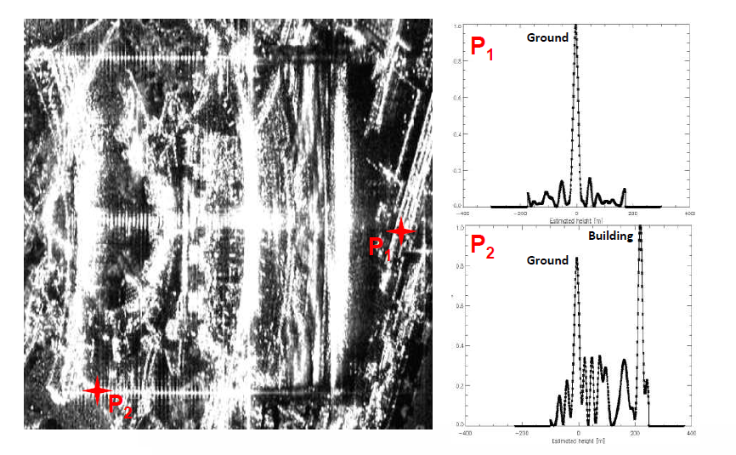
SVD on real data

Slide 32
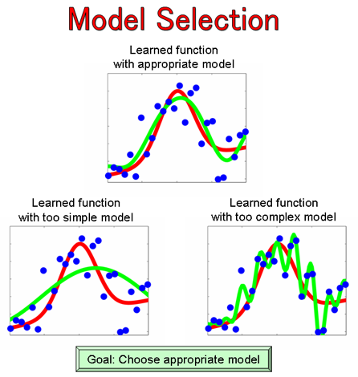
Model selection
Selecting a statistical model for given data
too simple –
order too low
too complex –
order too high
appropriate model
Selecting the correct model is the model selection problem

Slide 33
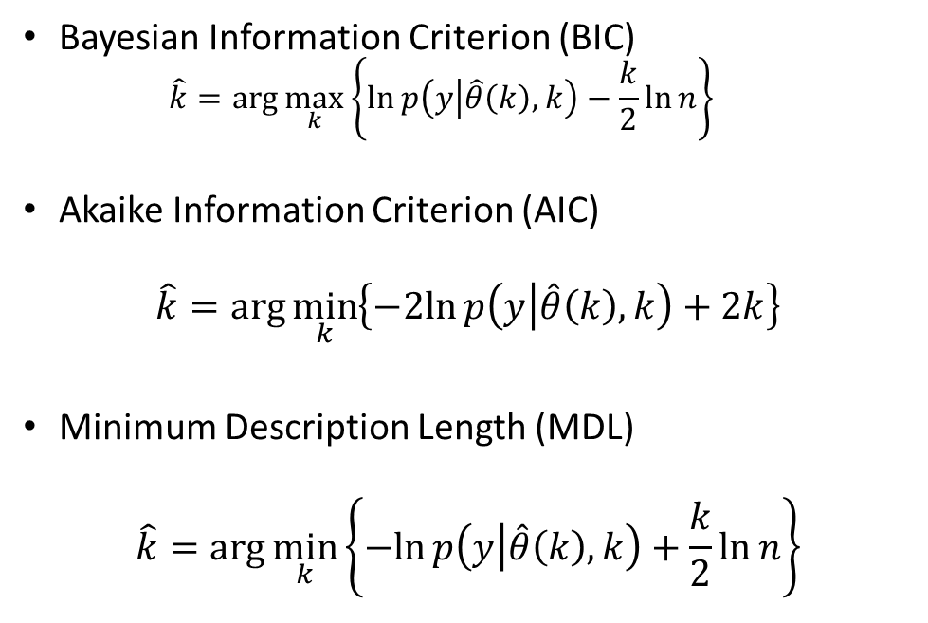
Model selection methods
Bayesian Information Criterion (BIC)
  $$\hat{k}=\arg{\max_{k}\left\{\ln{p\left(y | \hat{θ}\left(k\right),k\right)−\frac{k}{2}\ln{n}}\right\}}$$
Akaike Information Criterion (AIC)
$$\hat{k}=\arg{\min_{k}\left\{−2ln{p\left(y | \hat{θ}\left(k\right),k\right)+2k}\right\}}$$
Minimum Description Length (MDL)
$$\hat{k}=\arg{\min_{k}\left\{−ln{p\left(y | \hat{θ}\left(k\right),k\right)+\frac{k}{2}\ln{n}}\right\}}$$

Slide 34
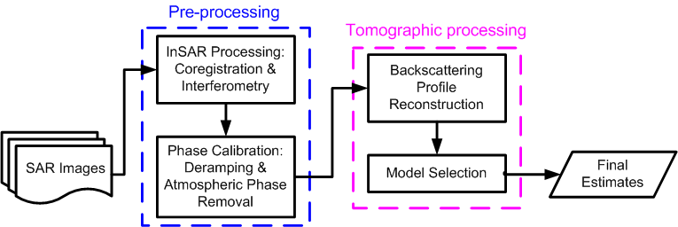
TomoSAR processing steps

Slide 35
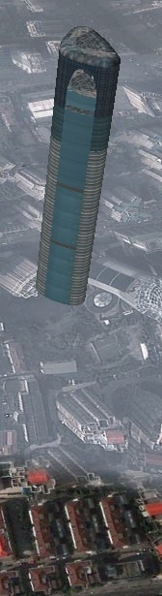
3D scatterer reconstruction

Slide 36
Urban TomoSAR different methods
SVD based methods
  SVD
  Truncated SVD (T-SVD)
  Wiener SVD
  Butterworth-SVD
Compressive Sensing based methods
  Basis Pursuit (BP)
  TWIST

Slide 37

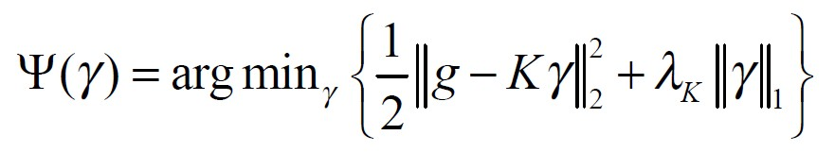
TWIST
Another solution to SAR tomography is by L1 norm minimization, which is also the core of compressive sensing:
The argument listed above can be stated by
where is a weighted value adjusted according to the noise level.

Slide 38
TWIST
SAR tomography with compressive sensing
  (see Zhu, Xiaoxiang’s work in the references)
Often, TomoSAR with compressive sensing is based on Basis Pursuit (BP)
  Very high super-resolution
  However, time-consuming
Alternatively: Two-Step Iterative Shrinkage Thresholding (TWIST) for TomoSAR
  Very efficient
  Less super-resolution capability

Slide 39

TWIST
When using TWIST, the least squares fitting is needed to calculate
Calculate according to
where is the normalization equation.
If
in which, are the weighting coefficients

Slide 40
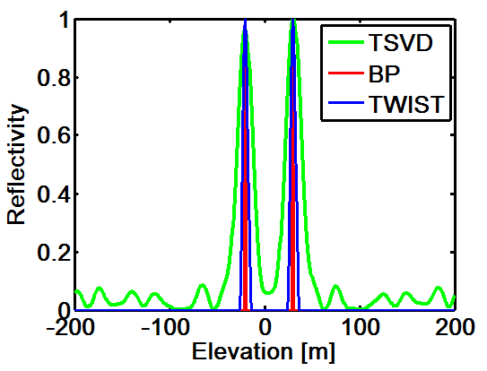
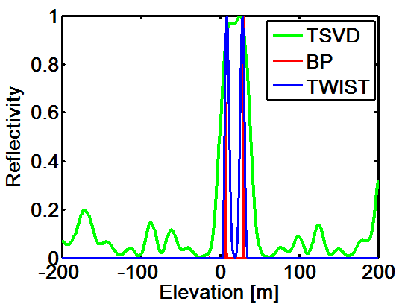
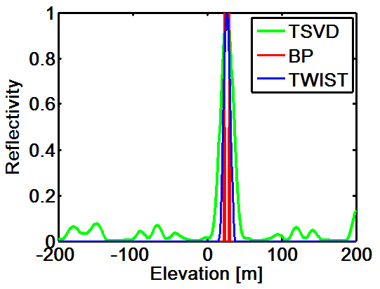
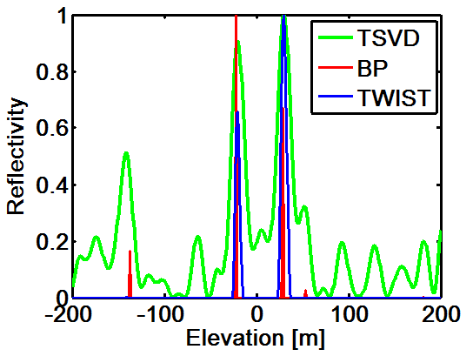
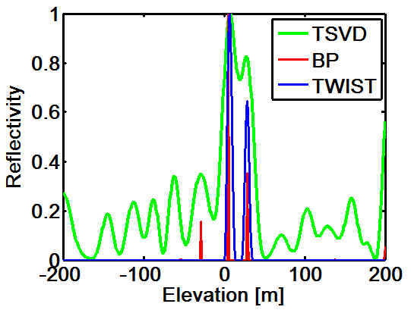
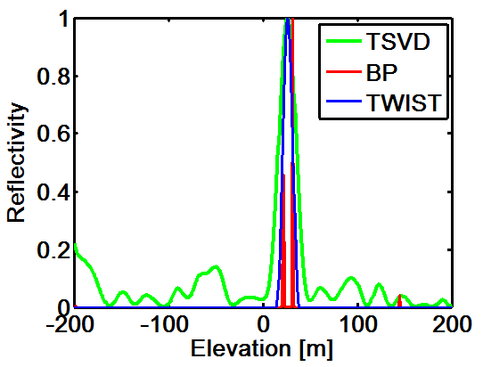
TomoSAR: different methods
(a) s_Sc1=-20m, s_Sc2=30m;
(b) s_Sc1=8m, s_Sc2=30m;
(c) s_Sc1=23m; s_Sc2=30m

Slide 41
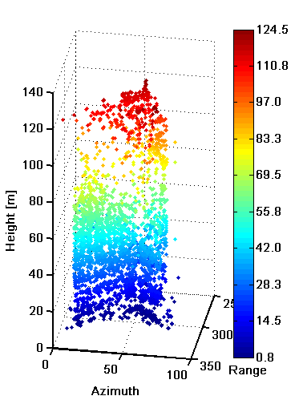
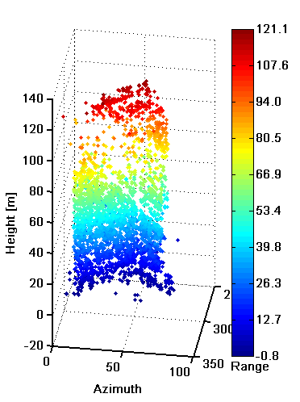
TSVD, Twist & BP
TSVD
TWIST
BP

Slide 42
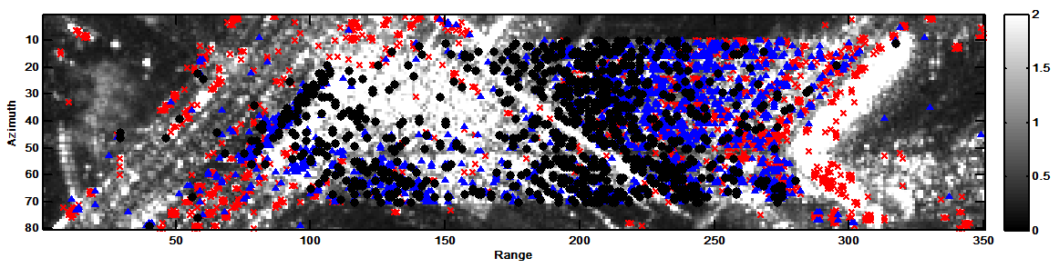


TSVD, Twist & BP
柏林实验区
（a）TSVD
85 seconds
red: single;
blue: double;
black: multi
（b）TWIST
89 seconds
（c）BP
1378 seconds

Slide 43
Differential TomoSAR
Extend the model to the time-domain and include an estimation of the deformation
  4D TomoSAR
Basically just an extension of the previously described method
  Including an additional dimension for the focusing
Can be further extended by including seasonal motion
  Sometimes called 5D TomoSAR

Slide 44
D-TomoSAR
Simulation results:
BSVD
TWIST
= for D-TomoSAR, the noise suppression gets even more important

Slide 45


D-TomoSAR
Example: TSX stack from Las Vegas:
BSVD
TWIST
= clear result in TWIST

Slide 46
Practical implementations
Due to the high computational demand for compressive sensing TomoSAR, the processing can be divided:
PS-InSAR for pre-processing – APS estimation
Basic TomoSAR processing for model estimation
Depending on the number of scatterers:
    One scatterer per resolution cell: use PS-InSAR for processing
    Two or more scatterer: use TomoSAR

Slide 47
Geodetic SAR tomography
Fusion of SAR imaging geodesy and TomoSAR
SAR imaging geodesy:
  Very high absolute geo-positioning capability of SAR
  Especially with TerraSAR-X due to the very precise orbit
  see Eineder et al, Cong et al, Balss et al….
The fusion allows getting precise absolute 3D positions

Slide 48
Geodetic SAR tomography
from Zhu et al, 2016 – 3D absolute positioned TomoSAR point cloud from Berlin
from Zhu et al, 2016 – Amplitude of the seasonal motion derived from one stack

Slide 49
References
  Reigber, A.; Moreira, A.; , "First demonstration of airborne SAR tomography using multibaseline L-band data," Geoscience and Remote Sensing, IEEE Transactions on , vol.38, no.5, pp.2142-2152, Sep 2000
  G. Fornaro, F. Serafino, and F. Soldovieri, “Three-dimensional focusing with multipass SAR data,” IEEE Trans. Geosci. Remote Sens., vol. 41, no. 3, pp. 507–517, Mar. 2003.
  F. Lombardini, “Differential tomography: a new framework for SAR interferometry,” IEEE Trans. Geosci. Remote Sens., vol. 43, no. 1, pp. 37–44, Jan. 2005.
  G. Fornaro and F. Serafino, “Imaging of Single and Double Scatterers in Urban Areas via SAR Tomography,” IEEE Trans. Geosci. Remote Sens., vol. 44, no. 12, pp. 3497–3505, Dec. 2006.
  F. Lombardini and M. Pardini, “3-D SAR Tomography: The Multibaseline Sector Interpolation Approach,” IEEE Geosci. Remote Sens. Lett., vol. 5, no. 4, pp. 630–634, Oct. 2008.
  G. Fornaro, D. Reale, and F. Serafino, “Four-Dimensional SAR Imaging for Height Estimation and Monitoring of Single and Double Scatterers,” IEEE Trans. Geosci. Remote Sens., vol. 47, no. 1, pp. 224–237, Jan. 2009.
  X. X. Zhu and R. Bamler, “Tomographic SAR Inversion by L1-Norm Regularization—The Compressive Sensing Approach,” IEEE Trans. Geosci. Remote Sens., vol. 48, no. 10, pp. 3839–3846, Oct. 2010.
  X. X. Zhu and R. Bamler, “Let’s Do the Time Warp: Multicomponent Nonlinear Motion Estimation in Differential SAR Tomography,” IEEE Geosci. Remote Sens. Lett., vol. 8, no. 4, pp. 735–739, 2011.
  X. X. Zhu and R. Bamler, “Very High Resolution Spaceborne SAR Tomography in Urban Environment,” IEEE Trans. Geosci. Remote Sens., vol. 48, no. 12, pp. 4296–4308, 2010.
  X. X. Zhu and R. Bamler, “Super-Resolution Power and Robustness of Compressive Sensing for Spectral Estimation With Application to Spaceborne Tomographic SAR,” IEEE Trans. Geosci. Remote Sens., vol. 50, no. 1, pp. 247–258, 2011.
  X. X. Zhu and R. Bamler, “Demonstration of Super-Resolution for Tomographic SAR Imaging in Urban Environment,” IEEE Trans. Geosci. Remote Sens., vol. 50, no. 8, pp. 3150–3157, Aug. 2012.
  F. Lombardini and M. Pardini, “Superresolution Differential Tomography: Experiments on Identification of Multiple Scatterers in Spaceborne SAR Data,” IEEE Trans. Geosci. Remote Sens., vol. 50, no. 4, pp. 1117–1129, 2012.
  D. Reale, G. Fornaro, and A. Pauciullo, “Extension of 4-D SAR Imaging to the Monitoring of Thermally Dilating Scatterers,” IEEE Trans. Geosci. Remote Sens., vol. 51, no. 12, pp. 5296–5306, 2013.
  G. Fornaro, A. Pauciullo, D. Reale, and S. Verde, “Multilook SAR Tomography for 3-D Reconstruction and Monitoring of Single Structures Applied to COSMO-SKYMED Data,” IEEE J. Sel. Top. Appl. Earth Obs. Remote Sens., vol. 7, no. 7, pp. 2776–2785, Jul. 2014.
  X. X. Zhu, S. Montazeri, C. Gisinger, R. F. Hanssen, and R. Bamler, “Geodetic SAR Tomography,” IEEE Trans. Geosci. Remote Sens., vol. 54, no. 1, pp. 18–35, Jan. 2016.

Slide 50
Tomographic scene reconstruction
Assuming typical airborne or spaceborne MB geometries, SAR Tomography can be formulated according to one simple principle:
Each focused SLC SAR image is obtained as the Fourier Transform of the scene complex reflectivity along the cross-range coordinate
Δr
Radar Line of Sight
y_{n}(r,x) : SLC pixel in the n-th image
s(r,x,v): average complex reflectivity of the scene within the SAR 2D resolution cell at (r,x)
b_{n} : normal baseline for the n-th image
λ : carrier wavelength
cross range, v
transmitted pulse
|s(r,x,v)|²
The cross-range distribution of the complex reflectivity can be retrieved through Fourier-based techniques
Source: Tebaldini & Rocca

Slide 51
Tomographic scene reconstruction
Example: Tomographic reconstruction of a forest scenario
Simulated Backscattered Power Distribution (BPD)
Simulated
Beamforming
40
40
N = 6
N = 12
Radar Line of Sight
30
30
Δr
20
20
height [m]
height [m]
10
10
height, z
0
0
-10
0
0.5
1
-10
0
0.1
0.2
cross range, v
BPD
Estimated BPD
Capon Spectrum
COMET - 2 Layers
40
N = 6
N = 12
40
N = 6
N = 12
transmitted pulse
|s(r,x,v)|²
30
30
|s(r,x,z)|²
20
20
height [m]
height [m]
Contributions from volume backscattering
Contributions from ground backscattering
Contributions from ground-trunk interactions
10
10
Source:
Tebaldini &
Rocca
0
0
-10
0
0.2
0.4
-10
0
0.5
Estimated BPD
Estimated BPD

Slide 52


BIOMASS tomographic phase
Track n
Cross range
Reference Track (Master)
π/2
Track 1
Slant range
θ
Elevation
Azimuth
Ground range
Source:
Tebaldini & Rocca

Slide 53
Tomographic analysis: TropiSAR
  A closer look…
Radar Line of Sight
Source: Rocca

Slide 54
Tomographic analysis: TropiSAR
  A closer look…
Radar Line of Sight
This resolution cell gathers contributions from terrain only.
=> Signal intensity in this cell is affected by terrain slope the same way as in traditional SAR images of bare surfaces
Source: Rocca

Slide 55
Tomographic analysis: TropiSAR
  A closer look…
Radar Line of Sight
This cell is completely within the volume layer, independently on volume orientation w.r.t. the Radar LOS.
=> Signal intensity in this cell is independent of terrain slope
This resolution cell gathers contributions from terrain only.
=> Signal intensity in this cell is affected by terrain slope the same way as in traditional SAR images of bare surfaces
Source: Rocca

Slide 56
Tomographic analysis: TropiSAR
  A closer look…
The scattering volume within cells at the boundaries of the vegetation layer depends on volume orientation w.r.t. the Radar LOS.
=> Signal intensity in this cell is affected by terrain slope in a similar way as the cell corresponding to the ground layer.
Radar Line of Sight
This cell is completely within the volume layer, independently on volume orientation w.r.t. the Radar LOS.
=> Signal intensity in this cell is independent of terrain slope
This resolution cell gathers contributions from terrain only.
=> Signal intensity in this cell is affected by terrain slope the same way as in traditional SAR images of bare surfaces
Source: Rocca

Slide 57


Tomographic analysis: TropiSAR
Co-polar signature at the ground layer reveals ground-trunk double bounce interactions dominate the signal from flat areas despite the presence of a 40 m dense tropical forest
Source: Rocca

Slide 58
Towards BIOMASS
The scattering mechanisms at P-band in a very dense tropical forest:
Ground scattering is strongly visible and double bounces in flat terrain topography are visible everywhere.
Volume scattering is significantly related to the high range biomass
It was found that scattering contributions from about 30 m above ground exhibit high sensitivity to forest biomass value ranging from 250 t/ha to 450 t/ha.
SAR tomography allows to map not only vertical forest structure but also biomass.

Slide 59

Forest temporal decorrelation
P-band SAR tomography
key tool to SEE through the forest
    suitable long wavelength to penetrate the dense forest layer
    key indicator to tropical forest biomass
Orbit constraint: temporal decorrelation
    Revisit time ≥ 1 day in a sun synchronous satellite configuration
    Forest scattering changes with time
GOAL: Study the temporal decorrelation of scattering mechanisms of the radar signal in a tropical forest as a function of height and polarization.

Slide 60
References
Polarimetric and tomographic phenomenology of forests
  Reigber, A.; Moreira, A.; , "First demonstration of airborne SAR tomography using multibaseline L-band data," Geoscience and Remote Sensing, IEEE Transactions on , vol.38, no.5, pp.2142-2152, Sep 2000
  Mariotti d'Alessandro, M.; Tebaldini, S.; , "Phenomenology of P-Band Scattering From a Tropical Forest Through Three-Dimensional SAR Tomography," Geoscience and Remote Sensing Letters, IEEE , vol.9, no.3, pp.442-446, May 2012
  Frey, O.; Meier, E.; , "3-D Time-Domain SAR Imaging of a Forest Using Airborne Multibaseline Data at L- and P-Bands," Geoscience and Remote Sensing, IEEE Transactions on , vol.49, no.10, pp.3660-3664, Oct. 2011
Multi-layer optimization
  S. Sauer, L. Ferro-Famil, A. Reigber, E. Pottier, “Multi-aspect POL-InSAR 3D Urban Scene Reconstruction at L-Band”, Eusar 2008
  Y. Huang, L. Ferro-Famil, A. Reigber, “Under Foliage Object Imaging Using SAR Tomography
  and Polarimetric Spectral Estimators”, Eusar 2010
Coherence optimization
  M. Neumann, L. Ferro-Famil, A. Reigber, “Multibaseline Polarimetric SAR Interferometry Coherence Optimization”, IEEE Geoscience and Remote Sensing Letters, 2008
  E. Colin, C. Titin-Schnaider, W. Tabbara, “An Interferometric Coherence Optimization Method in Radar Polarimetry for High-Resolution Imagery”, IEEE Transactions on Geoscience and Remote Sensing, 2006
SKP decomposition: theory, algorithms and physical implications
  S. Tebaldini, “Algebraic Synthesis of Forest Scenarios from Multi-Baseline PolInSAR Data”, IEEE Transactions on Geoscience and Remote Sensing, 2009
  Tebaldini, S.; Rocca, F.; , "Multibaseline Polarimetric SAR Tomography of a Boreal Forest at P- and L-Bands," Geoscience and Remote Sensing, IEEE Transactions on , vol.50, no.1, pp.232-246, Jan. 2012

Slide 61

Questions?
balz@whu.edu.cn

