Slide 1
Quality control of optical time series
and
temporal features computation
Pr. Pierre Defourny / Dr. Julien Radoux – UCLouvain, Belgium

Slide 2
Making good use of large time series
At least one image every 5 days
➔ more than 70 images per year
Consistency of the optical signal is a key
➔ We will focus on three questions
Are images usable or not ?
Fully cloudy images are discarded by preprocessing
How to check the quality of the time series ?
Cloud/cloud shadow flag
Atmospheric corrections
How to extract meaningfull information ?
Phenology metrics

Slide 3
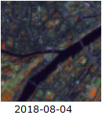
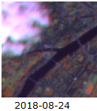
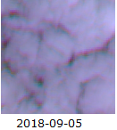
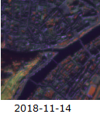
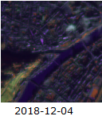
Visual check is useful, but strenuous
Completely cloudy
(image skipped by preprocessor)
OK
Partly cloudy
OK
Poor radiometry

Slide 4
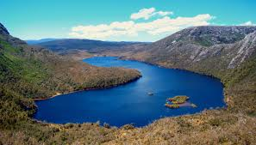
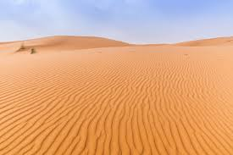
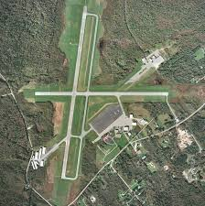
Automated quality check of reflectance
Use of pseudo-invariant targets
Examples:
Desert
Water
Impervious surfaces
Salt flats
Evergreen forests
…
Make sure that they are really invariance in YOUR area

Slide 5
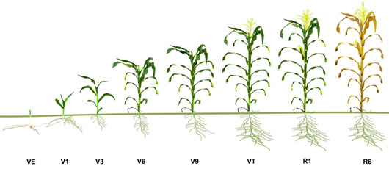
Temporal metrics to capture the time series info
Example of specific set of metrics (features) designed for crop monitoring
1
2
3
4
5
Maximum Red
(average of 3 max.)
Max. positive
slope
Maximum NDVI
(average of 3 max.)
Max. negative
slope
Minimum NDVI
(average of 3 max.)
Bare soil at sowing preparation
Fastest growth of vegetation
Maximum green
biomass
Fast reduction of
vegetation
Harvested crop or
non green residues
NDVI
First by pixels
Then by parcels
Time
(Matton et al., 2015, Waldner et al., 2016, Lambert et al., 2016)

Slide 6
Open your Jupyter notebook
You have a paper copy of the exercise
Interactive exercise is written in a Jupyter notebook
Double click on jupyter shortcut on your desktop
Load the notebook located in
/mnt/upload2/trainme/DATA/sessions/2_temporal_features/
jupyter_notebook/TrainingESA_TimeSeries_v2.ipynb

