Slide 1
Crop nitrogen management and satellite-derived information for crop monitoring and yield forecast
Mirco Boschetti CNR-IREA

Slide 2
Crop nitrogen management and satellite-derived information for crop monitoring and yield forecast
Part 2

Slide 3
Presentation outline
Satellite-derived information for yield forecast (1 h)
Theory
  2a: Phenometric from time series analysis
    SoS, Peak, EoS, integral
  2b: Yield estimation and forecast
    Empirical relation
    EO product in semi-empirical models (radiation use efficiency)
    EO data assimilation in crop model
    Crop Yield Forecasting System

Slide 4
Presentation outline
Satellite-derived information for yield forecast (1 h)
Theory
  2a: Phenometric from time series analysis
    SoS, Peak, EoS, integral
  2b: Yield estimation and forecast
    Empirical relation
    EO product in semi-empirical models (radiation use efficiency)
    EO data assimilation in crop model
    Crop Yield Forecasting System

Slide 5
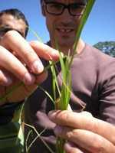
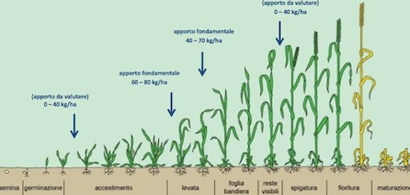

Phenology and field observation
Plant phenology deals with the definition of the development phases (or phenological phases) of plants in particular phenological scales and the recording of dates in which they occur in different environments.
If the plants under observation are cultivated, we are in the field of agricultural phenology or agrophenology. Conventional systems like the BBCH are used

Slide 6
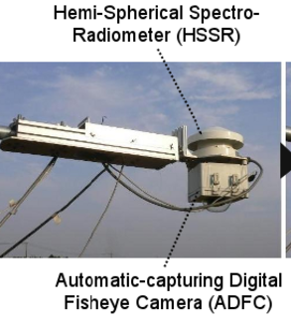
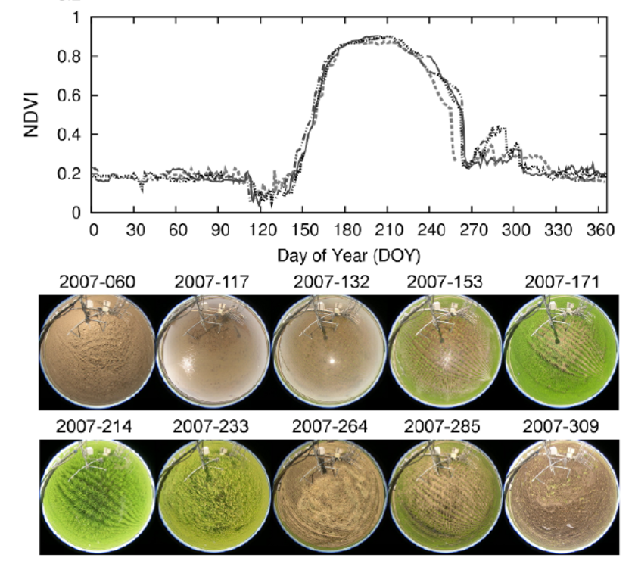
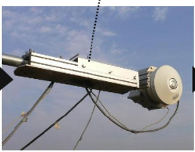
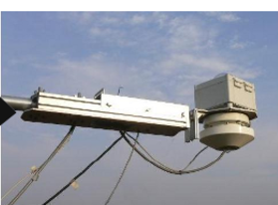
Land surface phenology and remote sensing

Slide 7
Monitoring phenology and agro practices
Study the multi-temporal signal provided by satellite data (time series analysis) to Identify
  distribution of a given crop (where it is grown) and
  Timing of agropractices of a given crop (when it is grown) and
  Crop development (occurrence of phenological phases)
The process is based on the ability to recognize specific characteristics of the crop given by the interaction G x E x M:
G: (Genotype) structural characteristics of the plant/variety and its phenological phases / Long or short cycle varieties / Difference in biomass development
E: (environment) Development environment (climate dynamics and seasons) Continental climates / tropical / microclimate
M: (management) Agro-practices adopted flooding of rice fields / Crop shift / Presence of crop cover / Winter or summer sowing

Slide 8
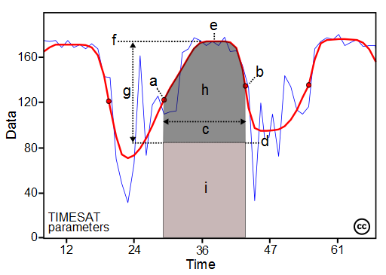
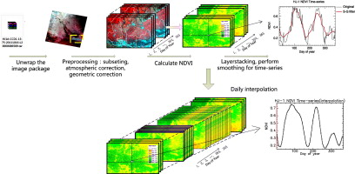
Time series analysis
Process the signal of a VI (BV) image stack to estimate information on plant dynamics
d
a
b
c
e
Eklundh and Jonsson (2015)
Pre-processing steps:
a) Data Dowload, b) pre-processing, c) VI/BV calculation (e.g. NDVI or LAI), d) signal smoothing, e) interpolation
Curve analysis: Parameter estimation
(a) beginning of season, (b) end of season, (c) length of season, (d) base value, (e) time of middle of season, (f) maximum value, (g) amplitude, (h) small integrated value, (h+i) large integrated value.

Slide 9
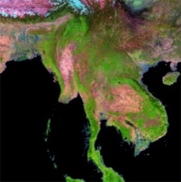
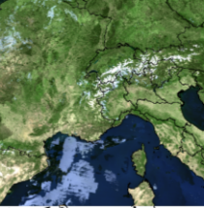
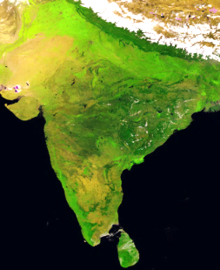
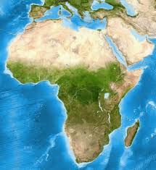


Existing data available: operational satellite systems
1998
1999
2002
2014
2016
Today
SPOT4- VGT
SPOT5-VGT
TERRA-MODIS
AQUA-MODIS
PROBA-V
SENTINEL 3
Daily
Composite
SPOT-VGT
MODIS
PROBA-V
Sentinel-3
VIS-NIR
1000 m
250 m
333 m
300 m
500 m 1000 m
SWIR
1000 m
500 m
333 m
TIR
1000 m
Spectra
Indices
Vegetation growth: NDVI, EVI, etc.-
Moisture/water condition: NDWI, NDFI, etc.

Slide 10
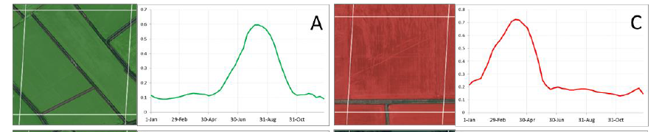
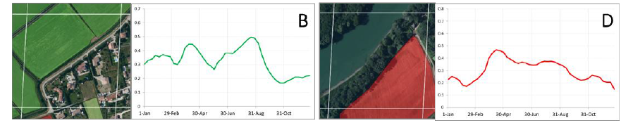
Scale and mixture issue
Research activities have highlighted the importance of having adequate space / time resolutions during the monitoring of agricultural systems from time series of satellite data. Duveiller et al 2008 defined a method to identify the appropriate resolution in a given agricultural landscape
Good results where the cultures were uniformly present in the pixel
Discrepancies in case of mixed pixels

Slide 11

Information needs and solution
Solution at farm/field level
Historical time series at farm level
→ land use reconstruction, agropratices climate impact assessments on productions
Seasonal time series at field level
→ crop mapping, PA support, crop damage assessment
Information
Product
Reconstruction of long-term dynamics
NRT seasonal monitoring system
Fusion of EO HR data available with almost daily LR EO data
Integration of regularly acquired decametric data S2A and B + OLI
Solution
TM5
OLI
S2A
S2B
MODIS
1993
2000
2013
2015
S3
2016
2017

Slide 12
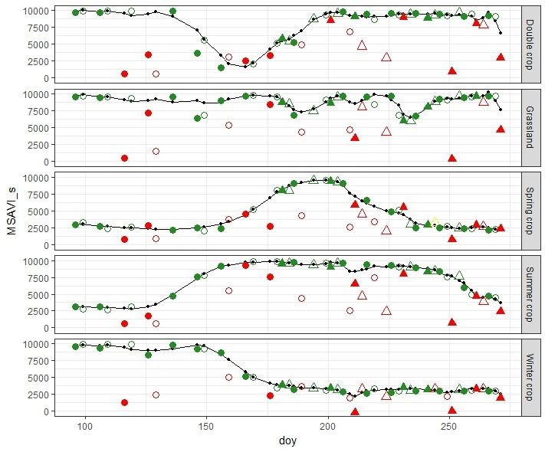
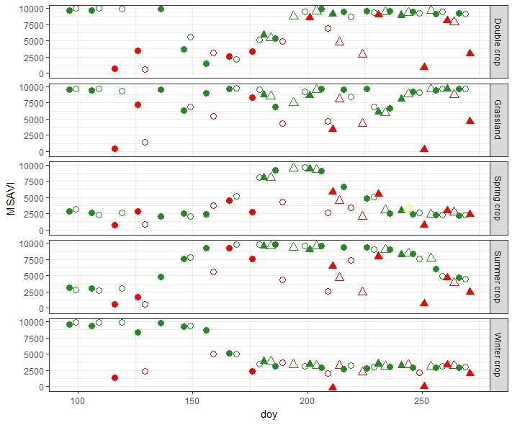
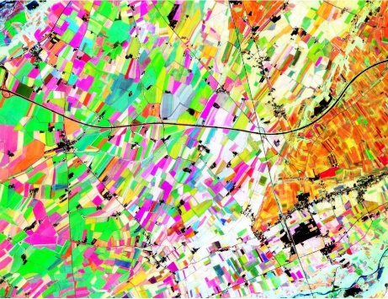





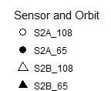
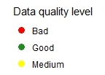
Sentinel 2 constellation era → field level monitoring
RGB MSAVI
R = Mar.
G = Jun.
B = Aug.

Slide 13
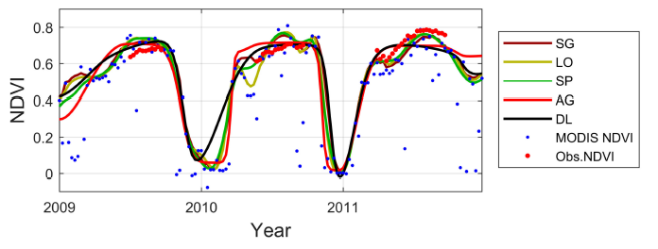
Time-Series Smoothing Methods
two broad categories of local (LM) vs global (GM) smoothing methods.
LM → e.g. adaptive Savitzky-Golay filtering (SG) and adaptive LOESS filtering (LO)
→ PROS: adapt to data; CONS: problem with missing and noise data
GM → e.g. asymmetric Gaussian functions (AG) and double logistic functions (DL) fitting → PROS: clear signal deal with missing data CONS: force to a temporal behavior
LM & GM → e.g. Spline smoothing (SP) has capacity to act both as a local and a global smoother.
Cai et al., 2017

Slide 14
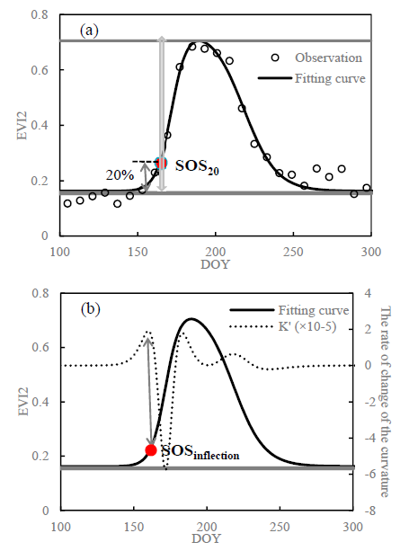
Key phenometric estraction: Start of Season (SoS)
Local threshold criteria
  Identification of specific condition of VI/BV values in relation to the curve.
  For example, SOS is defined as the date when VIs reach a threshold level
    Absolute (according to knowledge or test)
    Relative (e.g. about 10–20% of the seasonal maximum amplitude)
Curve analysis
  Changes in derivative to identify inflection points.
  For example SOS estimation identify as the inflection point corresponding to the onset of rapid vegetative growth
Max
Comparison of extraction of SOS₂₀ and SOS_{inflection} from the fitted curve of EVI2.
Local thresholds according to curve min max value
Min
(first) Max value of the first-order derivative of the curvature of the fitted EVI2 curve (K’).
Dong et al. 2019

Slide 15
REGIONAL level application
MODIS based dynamic crop calendars

Slide 16
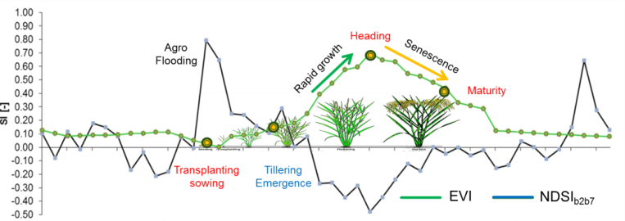
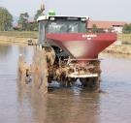
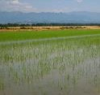


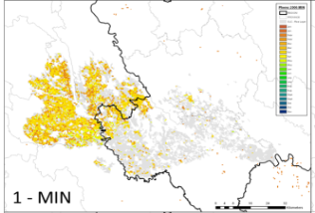
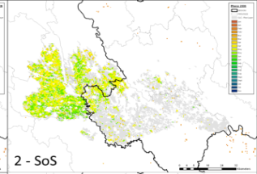
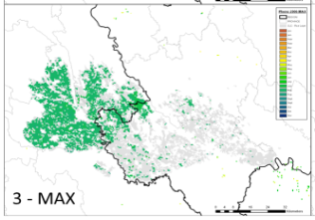
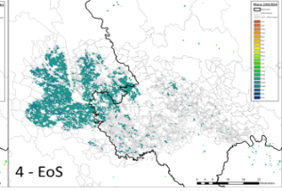
An example for rice: Phenorice: concept
Boschetti et al. 2017
MODIS
VIs
Flooding index
Time
Apr
Apr-May
Sep
July
Flooding/sowing
Emergence
Heading/Flowering
Maturity

Slide 17

Exportability in different rice agro-ecosystems
Spain
Winter crop and summer Rice
45
Temperate
Turkey
40
Egypt
35
Flooding
+
Crop establishment
Lat [°]
+
Emergence
30
India
+
China
Heading
+
Maturity
25
Bangladesh
20
Tropical
Philippines
Benin
Vietnam
15
10
Single season
Double season
Triple season

Slide 18
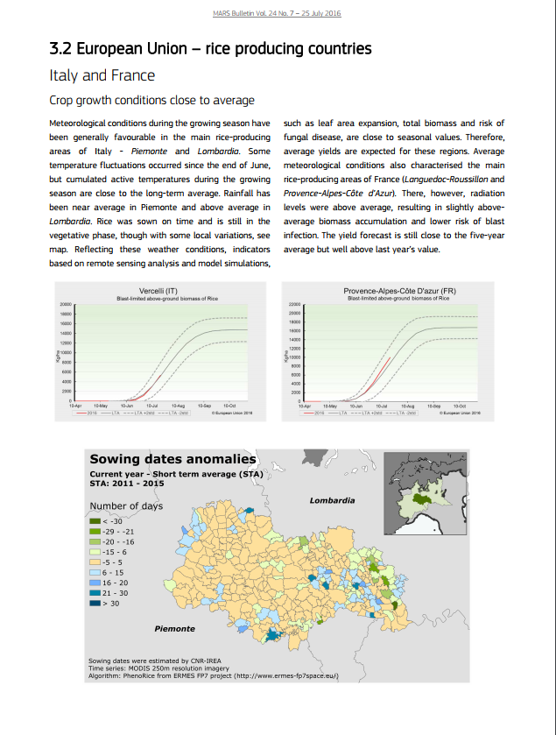
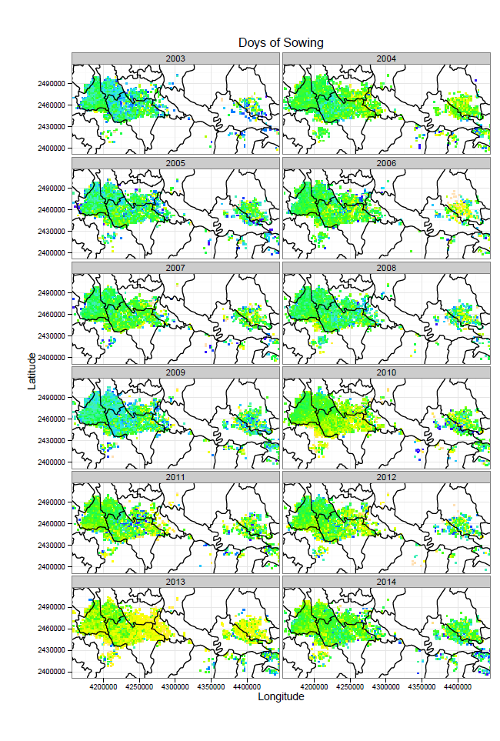
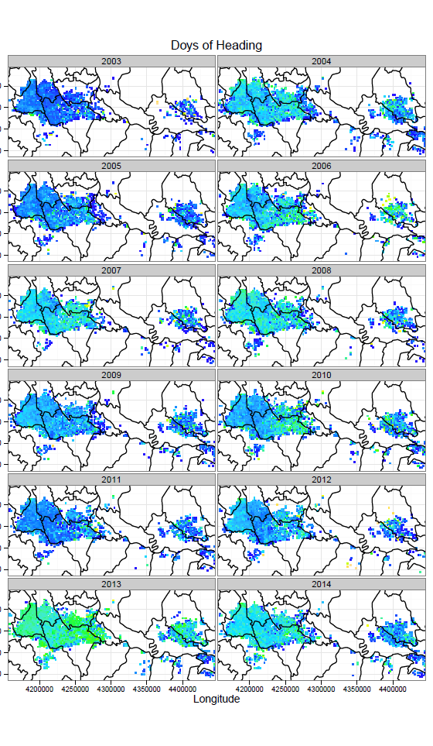
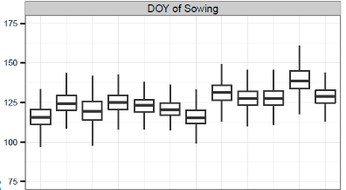

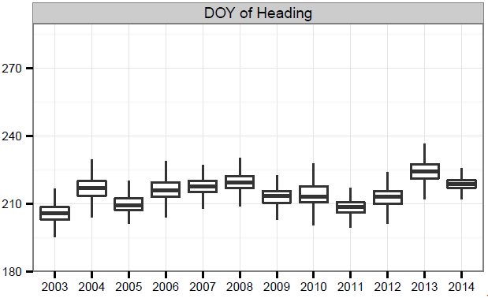



PhenoRice output: from “static crop calendar” to seasonal dynamics
Retrospective analysis with MODIS data can be used for regional studies and crop model forcing
Seasonal retrieval provides NRT information for operational crop monitoring systems (MARS)

Slide 19
Farm level application
Fusion of decametric multisource data

Slide 20
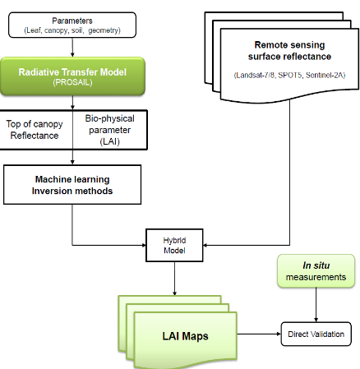
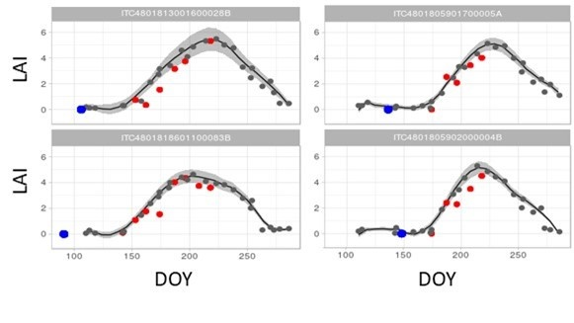
From moderate to HR → Landsat-7/8 & S2 data
Images: Sentinel 2A and Landsat-7/8 optical data from early May up to the end of September for the year 2016.
EO product: LAI time series produced by inverting the PROSAIL radiative transfer model with Gaussian process regression techniques (Campos-Taberner et al. , 2015)
Time series generation: LAI maps at 10-30 m resolution were co-registered and resampled to Sentinel 2 resolution providing a 26 bands multitemporal dataset (average difference between acquisition of about 7 days )
Campos-Taberner, 2016
EO LAI time series over selected parcels

Slide 21
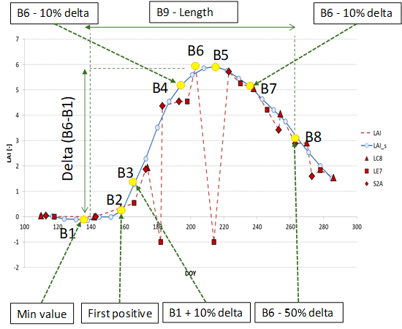
PhenoRiceK: Estimation of phenological dates
Metric | Phenological stage | DVS
B1 | Sowing | 0
B2 | Emergence | 1
B3 | Tillering | 1.3
B4 | Flowering (beginning → 10% before peak) | 1.8
B5 | Flowering (mean) | 2
B6 | Flowering (Peak) | 2
B7 | Flowering (end→ 10% after peak) | 2.4
B8 | Maturity | 4
B9 | Length – Sowing to Maturity
B10 | Length – Tillering to Maturity
Estimated phenometrics and their relationship with developent stages (DVS)

Slide 22
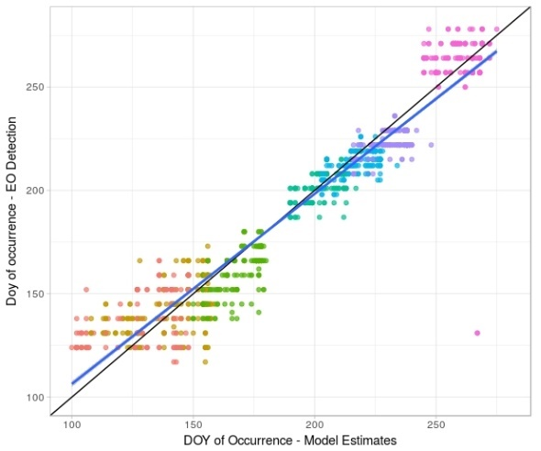
Results: DVS estimation from LAI time series
Dates of occurence of main phenological stages computed for each pixel, and compared with modelling results.
Phenological stage | DVS | RMSE
Sowing | 0 | 16.4
Emergence | 1 | 14
Tillering | 1.3 | 11
Flowering (beginning → 10% before peak) | 1.8 | 5.3
Flowering (mean) | 2 | 7.5
Flowering (Peak) | 2 | 7
Flowering (end→ 10% after peak) | 2.4 | 10.1
Maturity | 4 | 9.8
All |  | 11
Estimated DVS over selected parcels

Slide 23
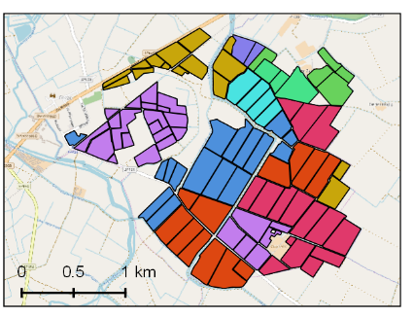
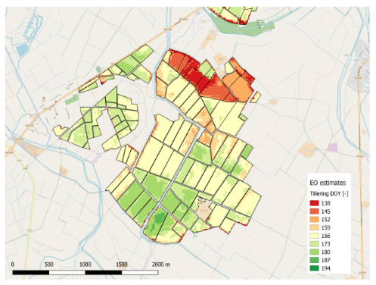
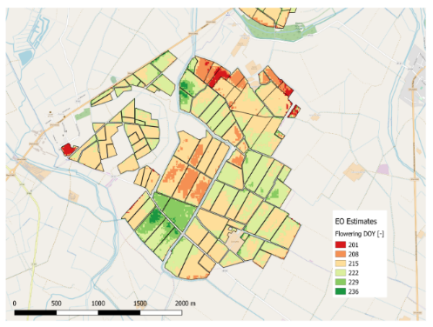

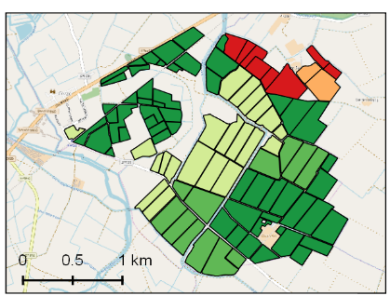
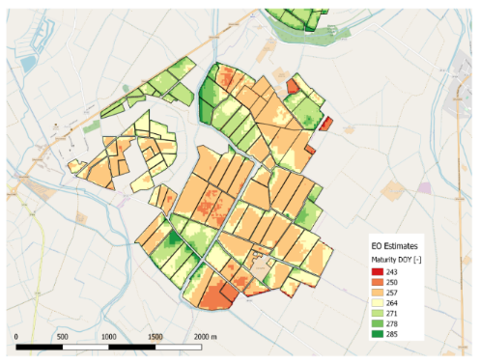
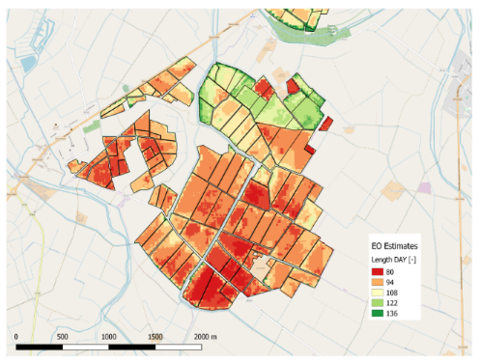

Results: mapping results at field level
Decametric time series allow parcel-level mapping of phenological development
Cultivated variety
EO: Tillering
EO: Flowering
Sowing date
EO: Maturity
EO: Length
Estimated PhenoMetrics - raster

Slide 24
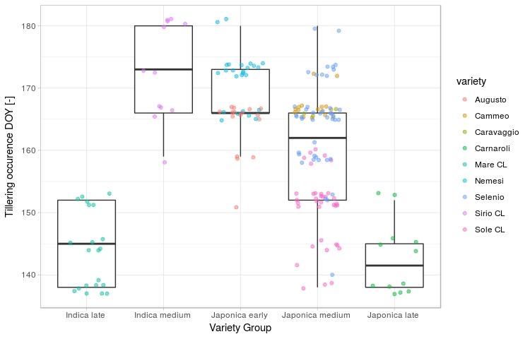
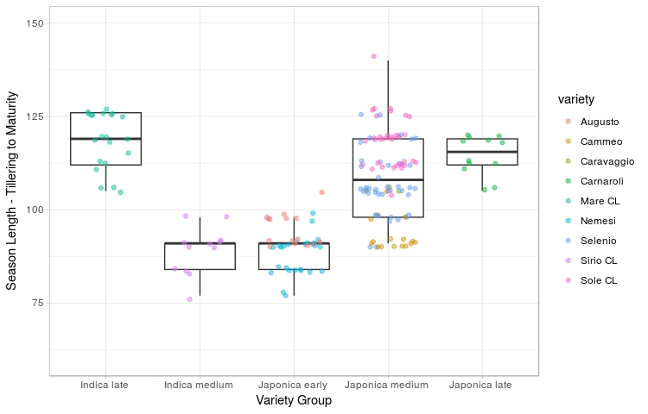
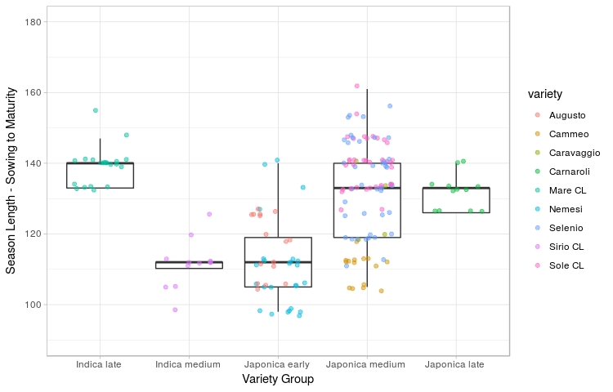
Phenometrics as diagnostic “tools” for identifying variety groups
EO decametric results show that
detection of tillering date (Start of Season) can split long from short cycle variety
Season length (Tillering to Maturity) is in agreement with known physiological characteristics of varieties
PhenoMetrics vs Variety

Slide 25
Reference
Boschetti et al 2018 Testing Multi-Sensors Time Series of Lai Estimates to Monitor Rice Phenology: Preliminary Results. IGARSS 2018 - 2018 IEEE International Geoscience and Remote Sensing Symposium. DOI: 10.1109/IGARSS.2018.8518494
Boschetti et al. 2017 PhenoRice: A method for automatic extraction of spatio-temporal information on rice crops using satellite data time series. Remote Sensing of Environment. Volume 194, 1 June 2017, Pages 347–365 https://doi.org/10.1016/j.rse.2017.03.029Boschetti 2018
Cai et al. 2017 “Performance of Smoothing Methods for Reconstructing NDVI Time-Series and Estimating Vegetation Phenology from MODIS Data. Remote Sens,9, https://doi.org/10.3390/rs9121271
Campos et al. 2016 Multitemporal and multiresolution leaf area index retrieval for operational local rice crop monitoring. Remote Sensing of Environment 187, 102-118. https://doi.org/10.1016/j.rse.2016.10.009
Duveiller et al 2008 A Method To Determine The Appropriate Spatial Resolution Required For Monitoring Crop Growth In A Given Agricultural Landscape. IGARSS 2008 - 2008 IEEE International Geoscience and Remote Sensing Symposium. DOI: 10.1109/IGARSS.2008.4779409
Eklundh and Jonsson (2015) TIMESAT: A Software Package for Time-Series Processing and Assessment of Vegetation Dynamics in Remote Sensing Time Series. Ed. Claudia Kuenzer, Stefan Dech and Wolfgang Wagner. Springler. https://www.springer.com/gp/book/9783319159669

