Slide 1
Biophysical variables retrieval and time series smoothing
GAI/fAPAR
Marie Weiss
marie.weiss@inra.fr

Slide 2

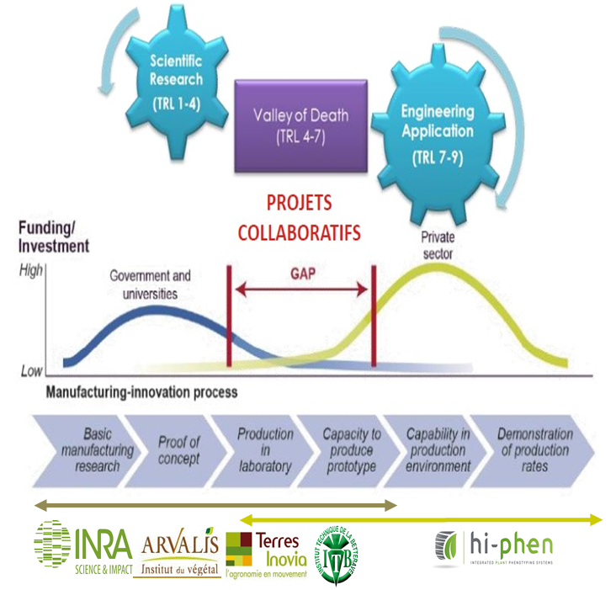



My working environment
French National Institute of Agronomic Research
Mediterranean Environment and Modelling of Agro-Hydrosystems
Sensor &
Remote Sensing

Slide 3
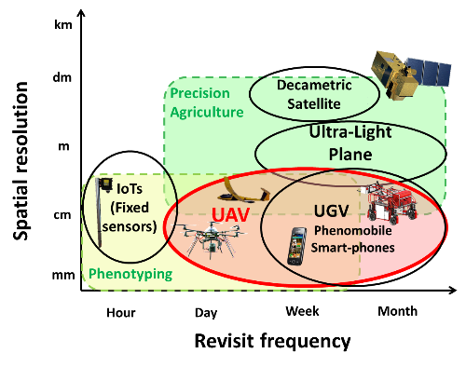
My Area of Interest
Expertise
  Radiative Transfer Modelling, Coupling with Crop functioning models
  Model Inversion (Machine learning)
  Validation
  Software development
Applications
  Phenotyping
  Support for decision making
  Resource management at the territory scale

Slide 4
Outline
Biophysical Variables of interest for agriculture: some definitions
Estimating Biophysical Variables from optical data
  Vegetation Indices
  Radiative transfer model inversion
Estimating Biophysical Variables from optical data
  Empirical Methods
  Radiative transfer model inversion
Generating temporal series
  Statistical temporal smoothing
  Smoothing & Prediction with a crop functioning model
  Temporal sampling impact
Generating temporal series
  Statistical temporal smoothing
  Smoothing & Prediction with a crop functioning model
  Temporal sampling impact

Slide 5
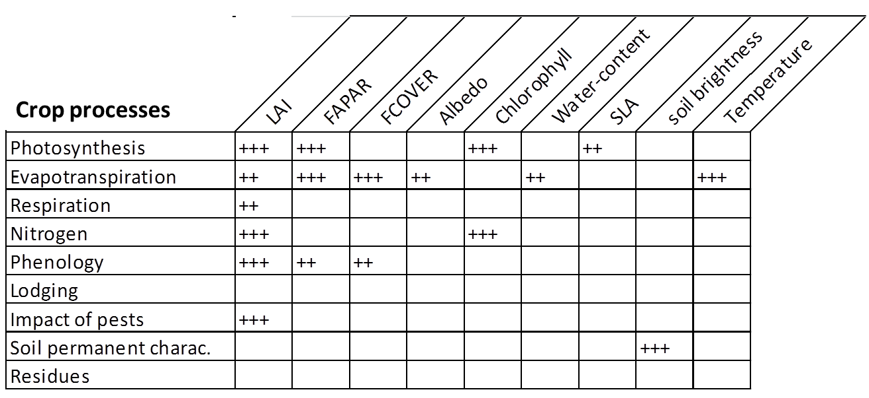
Biophysical Variables of interest for agriculture

Slide 6
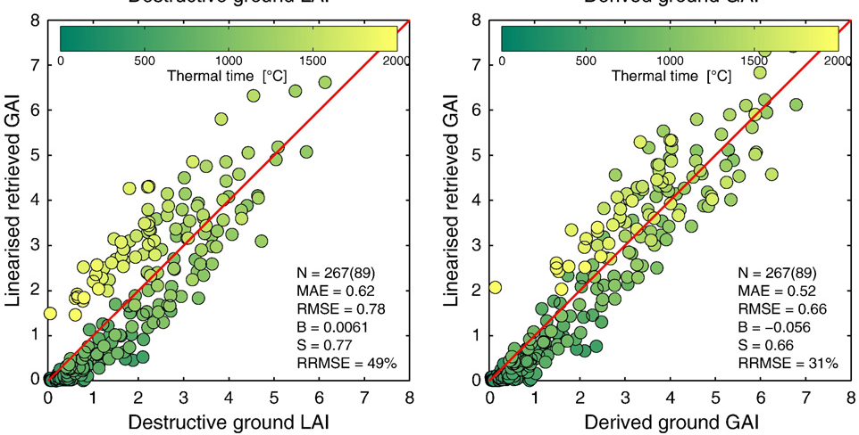
Leaf area index: several definitions (1)
 | Only leaf | All vegetation elem.
Green+non green | LAI | PAI
Green | GLAI | GAI
Upward looking Indirect methods
DHP, LAI2000, TRAC…
downward looking Indirect methods
Remote Sensing …
Destructive measurements
Destructive measurements
SPOT GAII
SPOT GAII
Duveiller et al, 2011, RSE

Slide 7
Leaf area index: several definitions (2)
Leaf Clumping
True GAI: half the developed area of green elements per unit horizontal ground area (Destructive measurements)
Effective GAI: the value retrieved from green fraction (gap fraction) measurements based on turbid medium assumption (DHP, LAI2200)
Apparent GAI: the value retrieved from remote sensing observations that depends on the assumptions associated to the estimation algorithm

Slide 8





fAPAR: several definitions, as well (1)
fAPAR: fraction of PAR (400-700nm) absorbed by the (green) vegetation elements: PAR radiation balance measurements
${fAPAR}_{} \left(θ_{s}\right)=1−\frac{{PAR}_{r}\left(θ_{s}\right)}{{PAR}_{i}\left(θ_{s}\right)}−\left(1−R_{s}\right)$ $\frac{{PAR}_{t}\left(θ_{s}\right)}{{PAR}_{i}\left(θ_{s}\right)}$
PAR_{i}
PAR_{r}
Canopy
Reflectance
Soil
Reflectance
Canopy
transmittance
PAR_{t}

Slide 9


fAPAR: several definitions, as well (2)
fIPAR: fraction of PAR (400-700nm) intercepted by the (green) vegetation elements (DHP/Gap Fraction)
$$fAPAR≈0.96 fIPAR$$
$$fIPAR=1−P_{0}$$
$${fAPAR}_{}\left(θ_{s}\right)=1−\frac{{PAR}_{t}\left(θ_{s}\right)}{{PAR}_{i}\left(θ_{s}\right)}− \frac{{PAR}_{r}\left(θ_{s}\right)}{{PAR}_{i}\left(θ_{s}\right)}+Rs\frac{{PAR}_{t}\left(θ_{s}\right)}{{PAR}_{i}\left(θ_{s}\right)}$$
PAR_{i}
PAR_{r}
LAI2000, DHP
$≈P_{0}\left(θ_{s}\right)$ Gap Fraction
Black Leaves
PAR_{t}

Slide 10

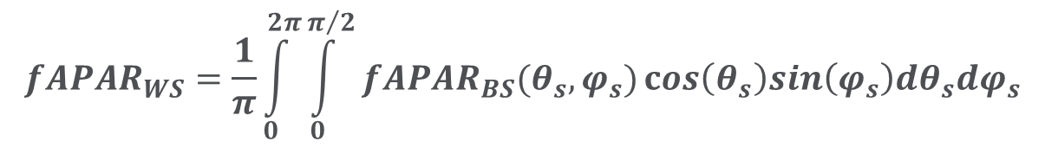
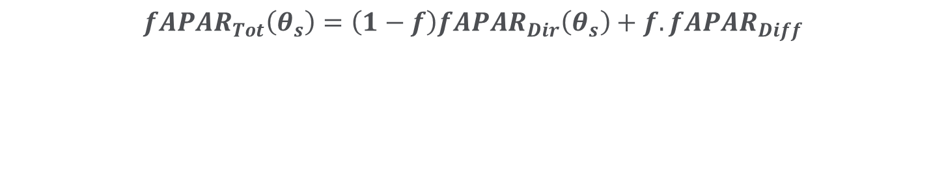
fAPAR: several definitions, as well (3)
$$Biomass=\int_{time}{{PAR}_{i}.fAPAR(time)}.ε_{b}$$
$ε_{b}$=Light Use Efficiency (LUE)
$${fAPAR}_{Tot}\left(θ_{s}\right)=\left(1−f\right){fAPAR}_{Dir}\left(θ_{s}\right)+f.{fAPAR}_{Diff}$$
Sun Position
(time & location)
Fraction of diffuse
Incident radiation
(atmospheric condition)
$${fAPAR}_{WS}=\frac{1}{π}\int_{0}^{2π}{\int_{0}^{π/2}{{fAPAR}_{BS}(θ_{s},φ_{s})}}cos\left(θ_{s}\right)sin\left(φ_{s}\right)dθ_{s}dφ_{s}$$
fAPAR is not an intrinsic surface property!

Slide 11
Outline
Biophysical Variables of interest for agriculture: some definitions
Estimating Biophysical Variables from optical data
  Empirical Methods
  Radiative transfer model inversion
Generating temporal series
  Statistical temporal smoothing
  Smoothing & Prediction with a crop functioning model
  Temporal sampling impact

Slide 12
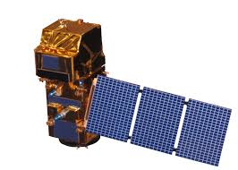
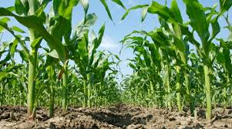
Remote Sensing crops
Remote Sensing
  Spectral Information (wavebands)
  Directional information (orbitography/geometry)
  Spatial information (resolution/PSF)
  Revisit frequency
Traits are not directly measured by remote sensing!
Crop trait: morphological, biochemical, physiological, structural, phenological or behavioral characteristics that influence organism performance or fitness (Nock et al, 2016)
  Typological (crop type)
  Physical (soil moisture, evapotranspiration)
  Chemical (leaf chlorophyll or nitrogen content))
  Structural (LAI, leaf inclination)

Slide 13
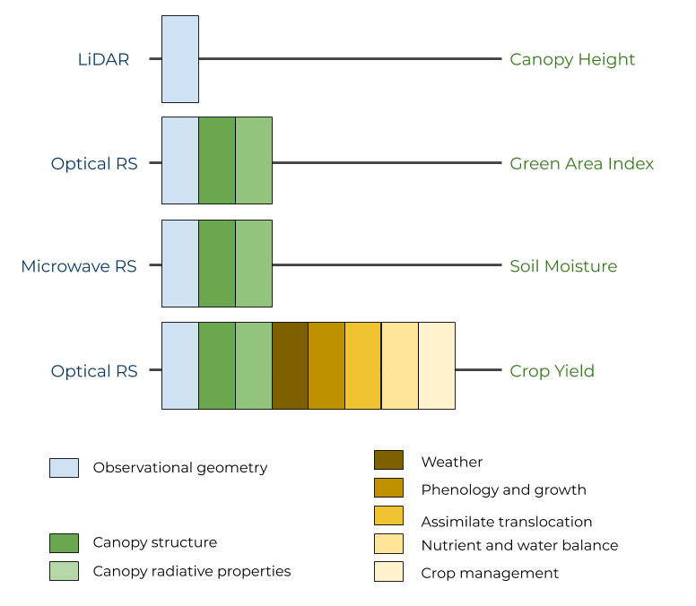
Relating remote sensing data and crop traits
Weiss et al, 2019 RSE
The relationship is more or less complex depending on the trait of interest
Canopy primary variables
Canopy secondary
variables
Directly
involved
in RT
Indirectly
linked
to RT

Slide 14
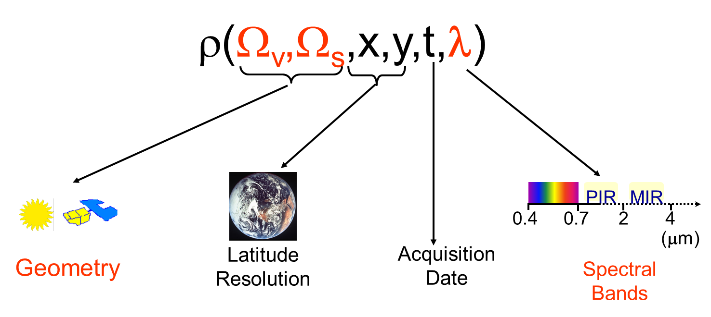
Relating remote sensing data and crop traits
? INVERSE PROBLEM
Canopy variables
DIRECT PROBLEM
Radiative Transfer Modeling

Slide 15
The ill-posed nature of the inverse problem (1)
80
0.3
Simulated
reflectance
60
0.2
Reflectance
Chlorophyll (µg.cm⁻²)
0.1
40
Estimated
Canopy
Characteristics
Measured
reflectance
0
20
400
600
800
0
0.5
1
1.5
2
Wavelength (nm)
LAI
Several combination of variables provide similar match with the observed reflectance
Some uncertainties
Reflectance + Model

Slide 16
The ill-posed nature of the inverse problem (2)
Regularization is mandatory
  Several bands only & Few directions
  Noise (radiometric, atmospheric, resampling, PSF,…)
  Inversion algorithm (model & method uncertainty)
Regularization = constraints and prior information
  Generic Products
  Minimum prior information
  Mainly temporal constraints
Specific Products
  More detailed and reliable information
  Temporal & spatial constraints
Large Scale
Regional/Local Scale

Slide 17
Relating remote sensing data and crop traits (1)
RADIATIVE TRANSFER MODEL
Canopy primary variables
INVERSION
Directly
involved
in RT
Canopy secondary
variables
Indirectly
linked
to RT
EMPIRICAL
EMPIRICAL

Slide 18
Relating remote sensing data and crop traits (3)
RADIATIVE TRANSFER MODEL
Canopy primary variables
INVERSION
Directly
involved
in RT
RADIATIVE TRANSFER + CROP FUNCTIONNING
CROP FUNCTIONNING
ASSIMILATION
ASSIMILATION
Canopy secondary
variables
Indirectly
linked
to RT
EMPIRICAL

Slide 19
Empirical Methods
Canopy primary variables
Directly
involved
in RT
Canopy secondary
variables
Indirectly
linked
to RT
EMPIRICAL
EMPIRICAL

Slide 20
Empirical Methods
How to build the training
dataset?
Calibration
Primary
Or
Secondary Variables
Fitting
Technique
Observations
Choice of
Configuration
measurement?
Choice of fitting
technique?

Slide 21
Empirical Methods
Observational Configuration
Use of Reflectances or Vegetation Indices & possibly other explanatory variables (geometry of observation, location)
Any output variable can be considered (primary or secondary)
  “The index should be particularly sensitive to vegetative covers, insensitive to soil brightness, insensitive to soil color, little affected by atmospheric effects, environmental effects and solar illumination geometry and sensor viewing conditions“ Jackson et al, 1983
See the index database: https://www.indexdatabase.de/
Or Reviews:
    Baret and Guyot, RSE, 1991
    Bannari, IJRS, 1995

Slide 22
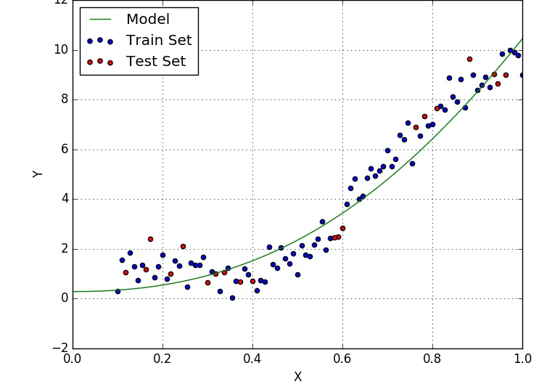
Empirical Methods
Fitting Technique
Simple regression
  The shape of the function is known
  Only few explanatory variables can be considered
Machine learning
  The shape of the function is more complex
  More explanatory variables can be considered
Independent training & validation datasets are required

Slide 23
Empirical Methods
Calibration
Many relationships depending on the calibration dataset!
MODIS LAI
Backup
Algorithm

Slide 24
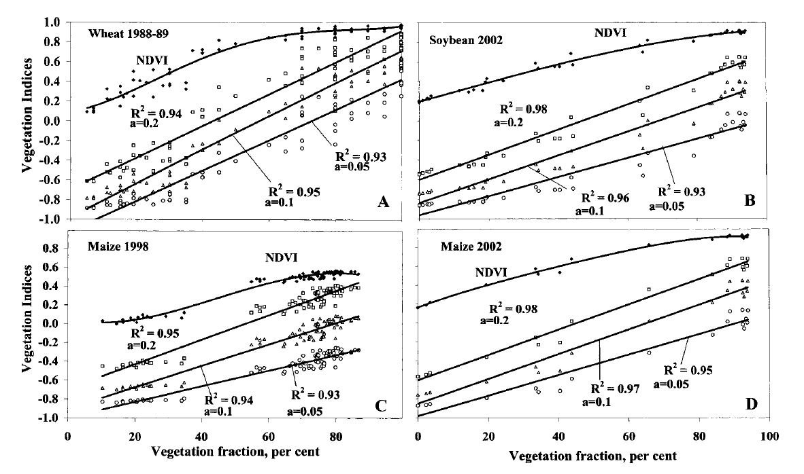


Empirical Methods
Calibration: regression
NDVI
NDVI
$$NDVI=\frac{ρ_{NIR}−ρ_{RED}}{ρ_{NIR}+ρ_{RED}}$$
$$WRDVI=\frac{\left({aρ}_{NIR}−ρ_{RED}\right)}{\left({aρ}_{NIR}+ρ_{RED}\right)}$$
NDVI
NDVI
same crop
2 years
From Gitelson, J. Plant Physiol,2004

Slide 25
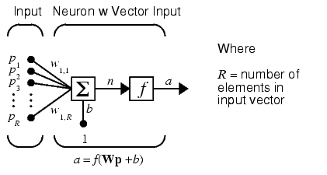
Empirical Methods
Calibration : machine learning Neural net example
Architecture of an ANN
2 hidden layers, 5-3
Artificial Neural Networks (ANN)
  Ensemble of elementary functions (neurons)
  characterized by weights, bias, transfer function
R₁
N
R₂
N
S
S
S
Biophysical
Variable
S
S
L
N
.
.
.
S
S
S
Data
Normalization
R_{n}
N

Slide 26
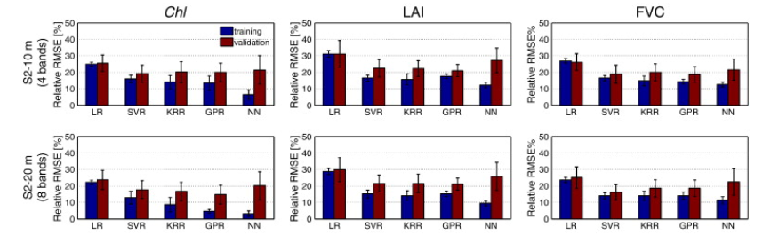
Empirical Methods
Calibration : machine learning comparison
From Verrelst et al, RSE, 2012
LR: Least Square multilinear regression
SVR: support vector regression
KRR: Kernel Ridge Regression
GPR: Gaussian Process Regression
NN: Neural Networks
Machine Learning perform better
Decreased Performances on validation dataset

Slide 27
Calibrating empirical relationships: regressions
Advantages
  Very fast when applied
  Training for machine learning may be time demanding depending on the size of the training dataset
  Optimised set of parameters to be found: some tuning is mandatory
Drawbacks
  Training data set & Domain definition are the key!
    Representativeness (variability, acquisition conditions, noise, ….)
  Only focus on the variable of interest

Slide 28
Relating remote sensing data and crop traits
RADIATIVE TRANSFER MODEL
Canopy primary variables
INVERSION
Directly
involved
in RT
Canopy secondary
variables
Indirectly
linked
to RT

Slide 29
Radiative Transfer Model Inversion (1)
Other
Characteristics
Choice of TR model?
Radiative
Transfer
Model
LAI
Observations
Inversion
technique
Choice of
Configuration
measurement?
Choice of inversion
Technique?
Which prior information
How to use it in the inverse process?
A priori information

Slide 30
Radiative Transfer Model Inversion (2)
Choice of the RT model
  Minimizing model uncertainties
Choice of the inversion method
  Minimization on reflectances or variable?
Choice of obervational configuration
  Limited dimensionality, maximum sensitivity
Exploiting all the information
  Integration of prior information
  Exploiting temporal constraints
  Exploiting Spatial constraints

Slide 31
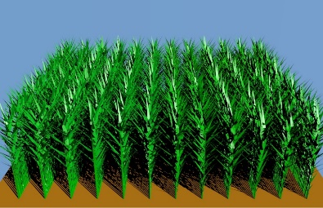
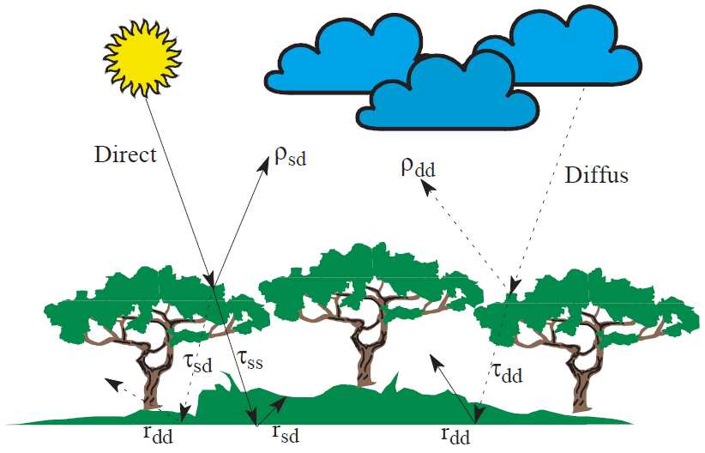
RTM Inversion
What is a radiative transfer model (RTM)?
Boundary Conditions
Illumination
(direction/diffuse)
Soil Background
reflectance
Canopy Description
Structure
Vegetation elements
architecture
Optical properties
Driven by biochemical
content

Slide 32
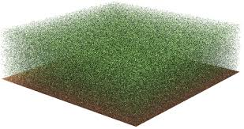
RTM Inversion
RTM: Canopy Structure Description (1)
Realistic
Simplified
Leaf area index
Leaf Inclination
Leaf Size
Leaf Shape
Plant density
Crown Diameters
…
Leaf Area Index
Leaf Inclination
Relative leaf size

Slide 33
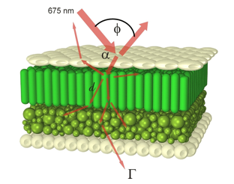
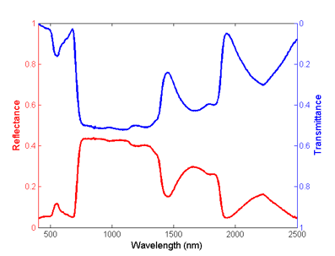
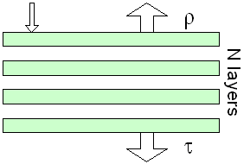
RTM: canopy optical properties model
PROSPECT
Leaf Biochemical content:
Chlorophyll, Water, Dry Matter,
Brown pigments, …
Leaf Refraction Index: n
Leaf Structure : N
More information on modelling leaf otical properties: Jacquemoud and Ustin, 2008, Photobiological Science

Slide 34
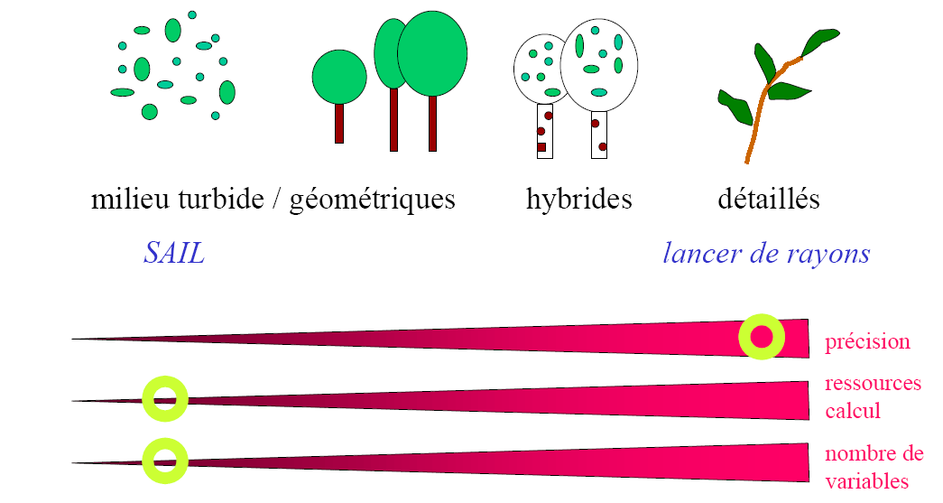
RTM Inversion
RTM: Canopy Structure Description (2)
Turbid medium Geometrical
Hybrids
3D
Ray Tracing/Radiosity
Balance between realism and complexity!
Accuracy
Computing
Power
Number of
variables

Slide 35
RTM Inversion
Radiative Transfer Model Inversion
Choice of the RT model
  Minimizing model uncertainties
Choice of the inversion method
  Minimization on reflectances or variable?
Choice of obervational configuration
  Limited dimensionality, maximum sensitivity
Exploiting all the information
  Integration of prior information
  Exploiting temporal constraints
  Exploiting Spatial constraints

Slide 36
RTM Inversion
Choice of the inversion method
Training Dataset
Surface*
variables
RTM
Réflectance*
Surface
variables
RTM
Reflectance
DR
DS
Coefficients
Réflectance
Surface*
variables
Inverse
Model
Minimizing on biophysical variables
Minimizing on radiometric variables
Experimental
Calibration
Machine learning regression
Calibration on
simulations
Optimisation
Look-Up-Tables
Machine Learning regression
23-Janvier-2009
Cours M2 - Estimation de variables biophysiques
36

Slide 37
RTM Inversion
Choice of the inversion method: minimizing on radiometric variables
Allow assessing all the variables involved in RTM
Optimisation
  Iterative method => time demanding (adjoint?)
  Sensitive to local minima => several initial guess must be tested
  Flexible (spectral & directional configuration)
Look-Up-Table
  Training data set & Domain definition are the key!
    Representativeness (variability, acquisition conditions, noise, ….)
  Only focus on the variable of interest

Slide 38
RTM Inversion
Choice of the inversion method
Method Intercomparison results
largely depends on the way the
inversion method is implemented
Prior Information
Model Uncertainties
Constraints (e.g. Computing time)

Slide 39
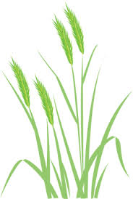
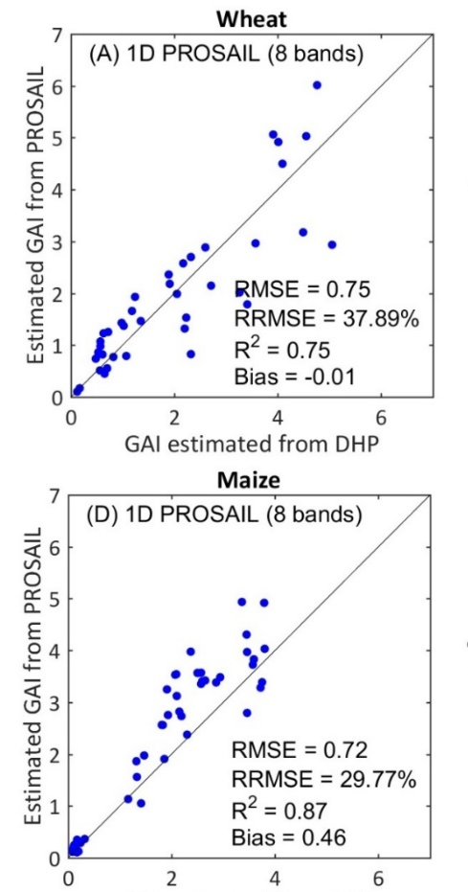
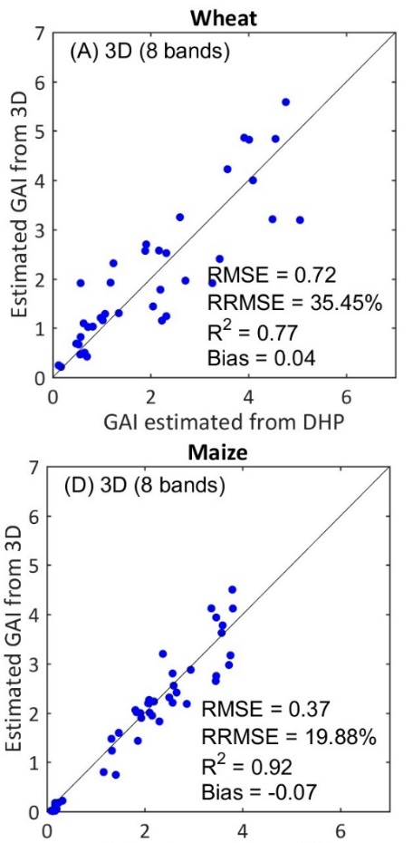
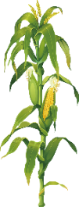
RTM inversion
Generic Model vs Crop specific Model: experiment
NNETS Trained on 1D and 3D
1D =40mns
3D = 1 month + 3D architecture model
Similar results on wheat
3D Significant improvement on maize
From Jiang et al, in prep

Slide 40
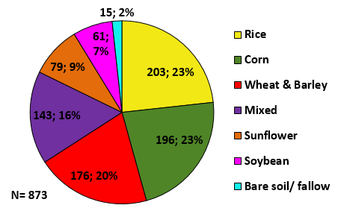
Generic Model vs Crop specific Model: experiment (1)
IMAGINES database
  LANDSAT8 + Ground: DHP,LAI2200, ACCUPAR
  (CEOS protocol): GAI, fAPAR, 20 sites
  PROSAIL Simulations
Several algorithms
  NDVI
  Ordinary Least Square
  Machine Learning: Gaussian Process Regression (GPR)/ Support Vector Machine (SVM)/Neural Networks (NN)
  Training 2/3, Validation 1/3: statistics computed
  PROSAIL: size of the learning database optimized for each method

Slide 41
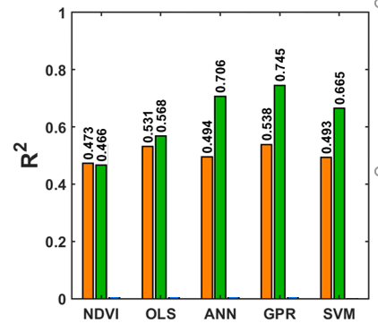
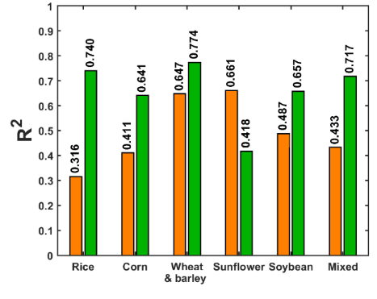
Emprirical vs Model inversion: machine learning (2)
GAI per crop
(GPR)
GAI crops
Learning on ground data
Learning on PROSAIL
No water background
In PROSAIL
Generic algorithms perform better when trained on ground data
Larger scattering for high GAI values when trained on simulations
GPR outperforms the other methods

Slide 42
RTM Inversion
Radiative Transfer Model Inversion
Choice of the RT model
  Minimizing model uncertainties
Choice of the inversion method
  Minimization on reflectances or variable?
Choice of obervational configuration
  Limited dimensionality, maximum sensitivity
Exploiting all the information
  Integration of prior information
  Exploiting temporal constraints
  Exploiting Spatial constraints

Slide 43
RTM Inversion
Choice of observational configuration
Choice is limited when using satellite data
Noise (atmosphere for blue band)
Use the most sensitive spectral bands and directionnal observations

Slide 44
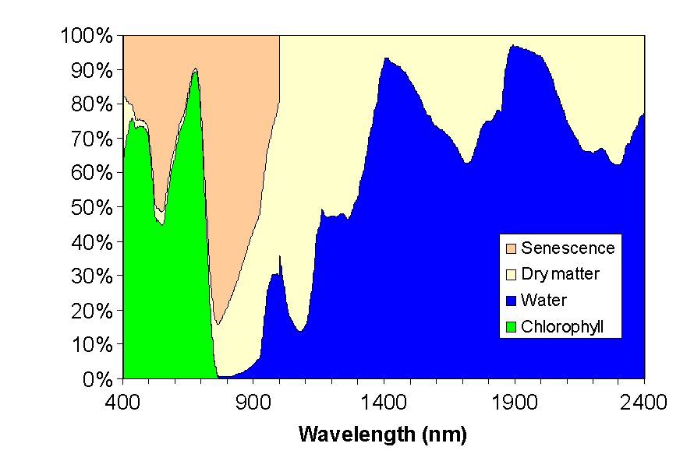
RTM Inversion
Choice of observational configuration
Leaf Optical Properties

Slide 45
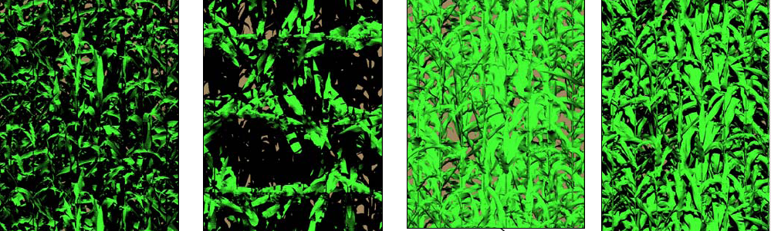
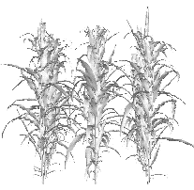
RTM Inversion
Choice of observational configuration
Shadow
Soil/leaf contrast
MultipleScattering
nir
Reflectance

Slide 46
RTM Inversion
Radiative Transfer Model Inversion
Choice of the RT model
  Minimizing model uncertainties
Choice of the inversion method
  Minimization on reflectances or variable?
Choice of obervational configuration
  Limited dimensionality, maximum sensitivity
Exploiting all the information
  Integration of prior information
  Exploiting temporal constraints
  Exploiting Spatial constraints

Slide 47
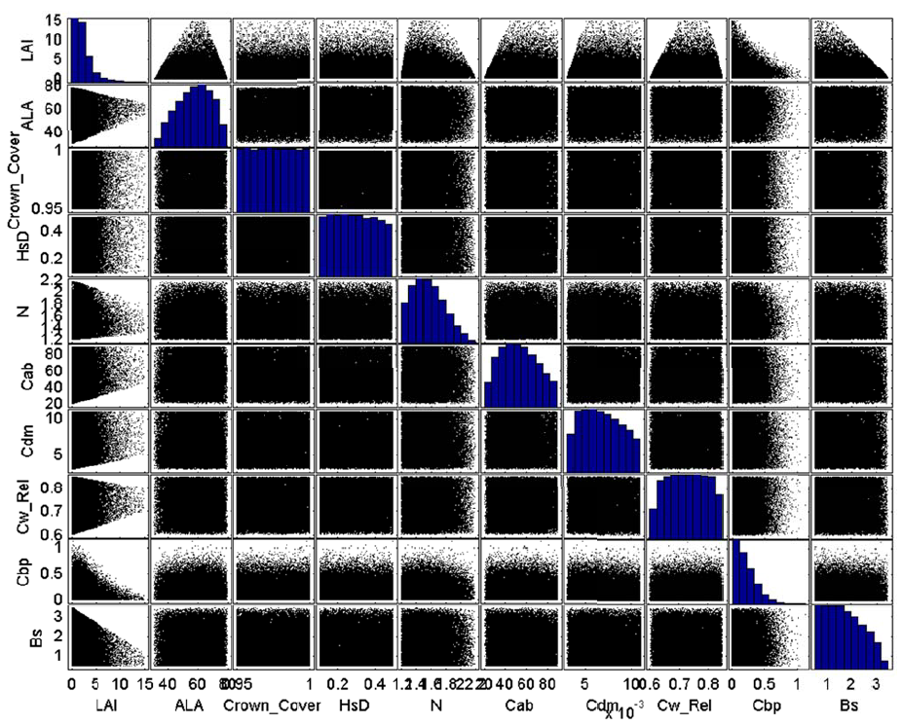
RTM Inversion
Exploitating prior information: regressions
Optimizing the training
Dataset
Distribution of variables
  Prior Distributions & Co
  Streamlining the distributions based on reflectance measurements
Uncertainties on the radiometric data (model, measurements)

Slide 48
RTM Inversion
Exploitating prior information: optimization/LUT
Bayesian Methods: cost function
Radiometric Part
Prior information Part
J(v) = (R-R)^{t}.W⁻¹.(R-R) + (V-Vp)^{t}.C⁻¹.(V-Vp)
Covariance matrix
of uncertainties
Covariance matrix
on variables
Main Problem: how to get these priors?
Capitalizing on past observations / dedicated experiments /phenotyping

Slide 49
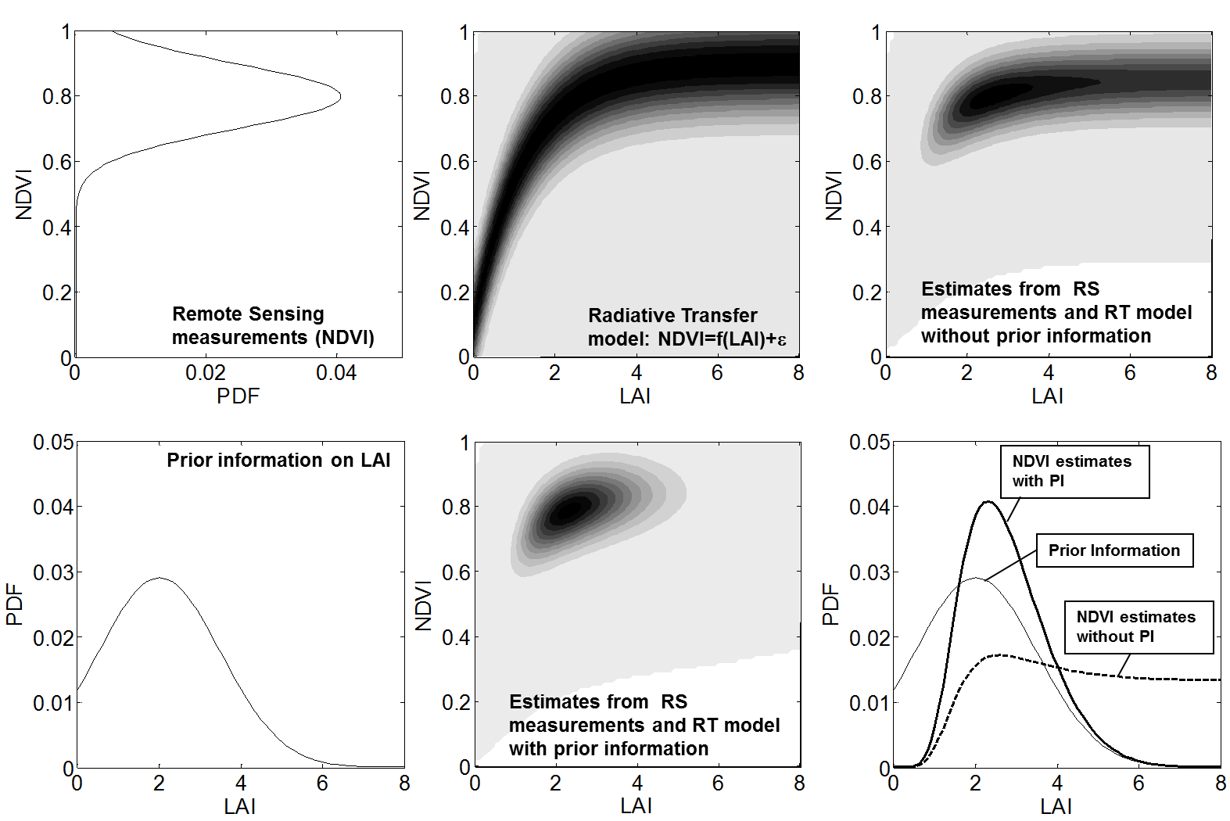
RTM Inversion
Exploitating prior information: optimization/LUT

Slide 50
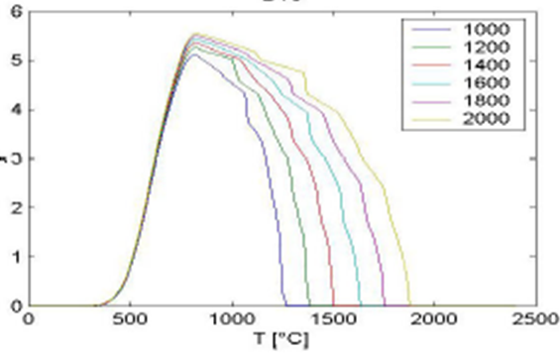
RTM Inversion
Temporal constraints (1)
Vegetation structure (LAI) results from incremental processes : smooth dynamics
LAI(t) = LAI(t-1) + Δ DM.SLA - ΔLAI_{sen}
Daily Biomass produced & allocated to the leaves
Specific Leaf Area
Leaf duration
GAI

Slide 51
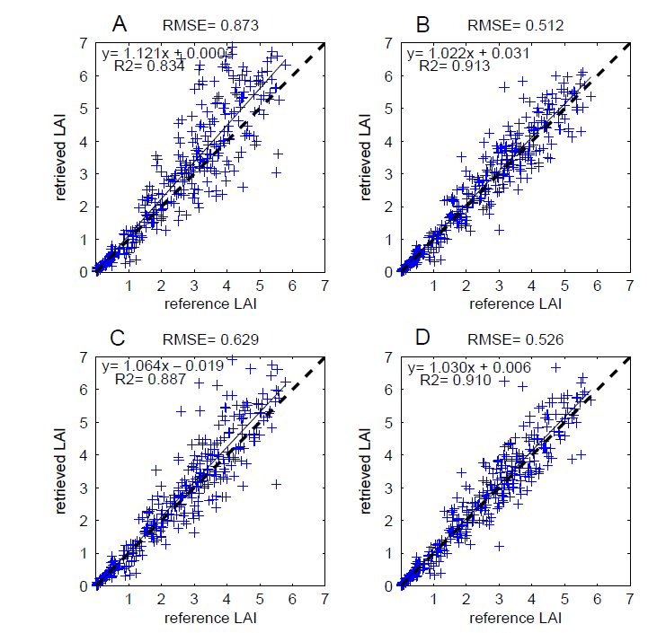
RTM Inversion
Temporal constraints (2)
From Koetz et al, RSE, 2005
Independent Estimation
For each
Observation date
Estimation using
a model describing
LAI dynamics
Simple
Temporal
smoothing

Slide 52
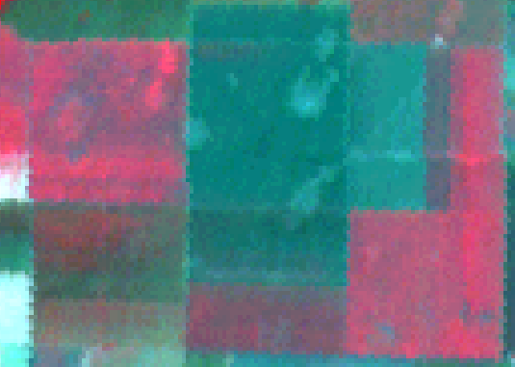
RTM Inversion
Spatial constraints
In a patch (few pixels of the same object), pixels show generally a local gradient of their properties due to:
  Local factors of variability (soil …)
  Instrument and Processing (PSF, reprojection)
working per patch (3x3, 5x5 …) reduces registration problems within multi-temporal approaches and reduces the effect of measurement errors

Slide 53
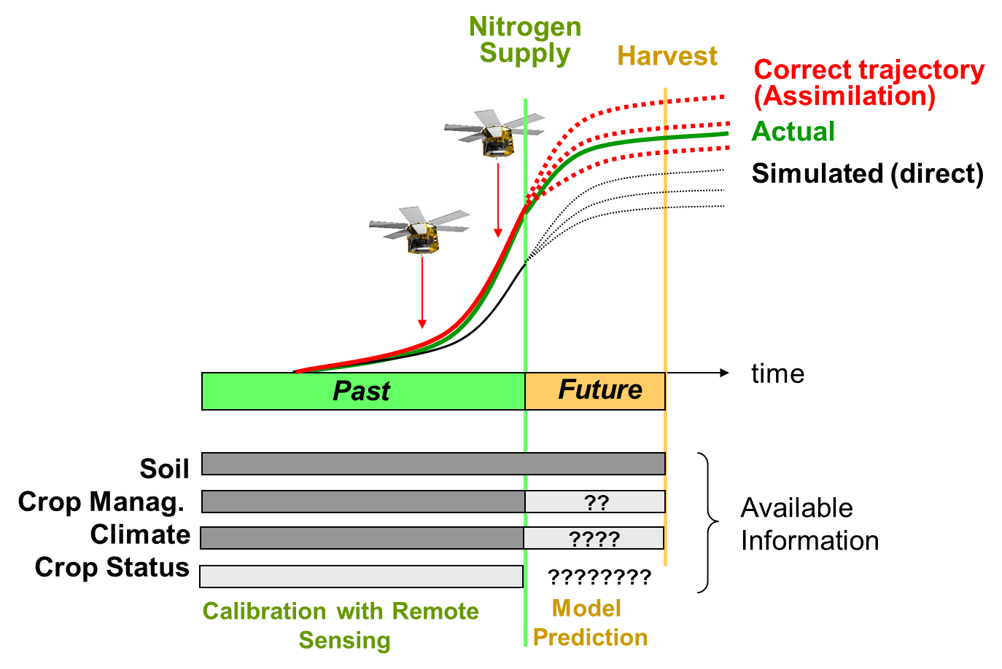
Few words about data assimilation in crop functioning models

Slide 54
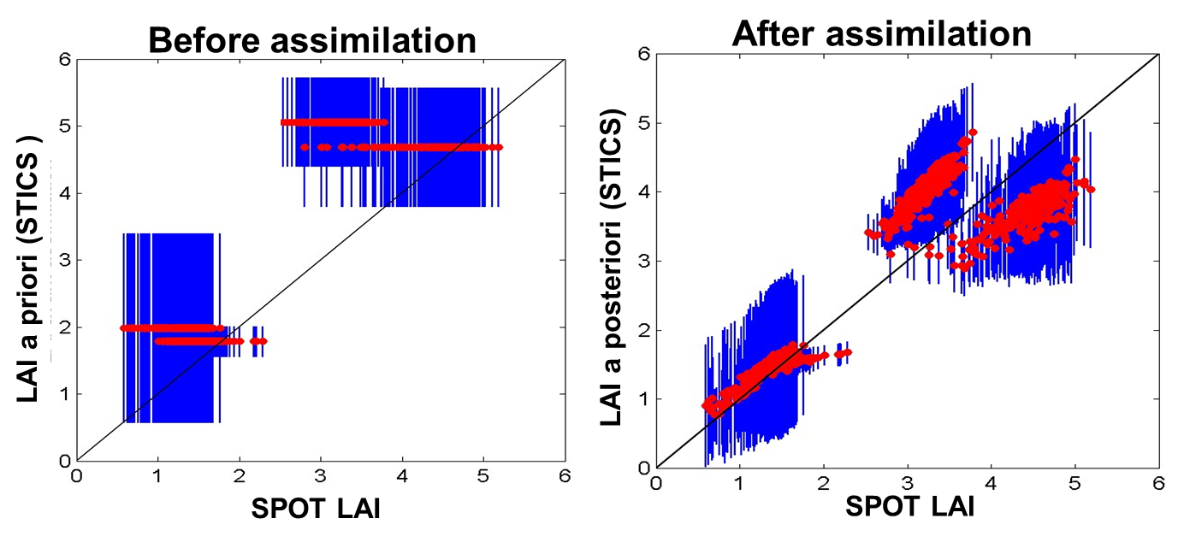
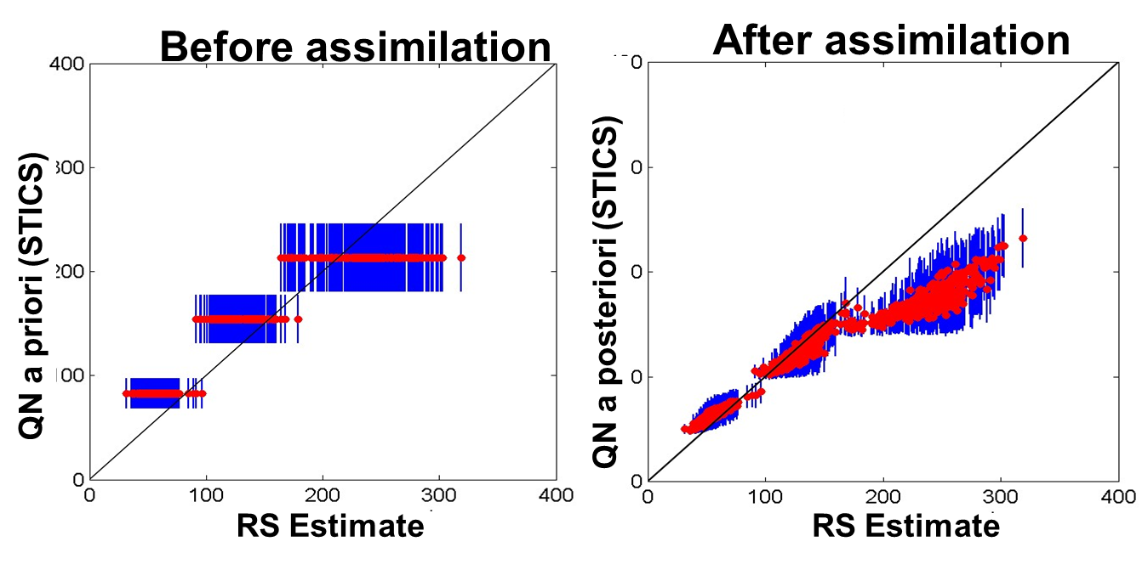
Few words about data assimilation in crop functioning models (some results)
Reduce Bias
Intrafield variability

Slide 55
Outline
Biophysical Variables of interest for agriculture: some definitions
Estimating Biophysical Variables from optical data
  Vegetation Indices
  Radiative transfer model inversion
Estimating Biophysical Variables from optical data
  Empirical Methods
  Radiative transfer model inversion
Compositing : Generating temporal series
  Statistical temporal smoothing
  Smoothing & Prediction with a crop functioning model
  Temporal sampling impact
Generating temporal series
  Statistical temporal smoothing
  Smoothing & Prediction with a crop functioning model
  Temporal sampling impact

Slide 56
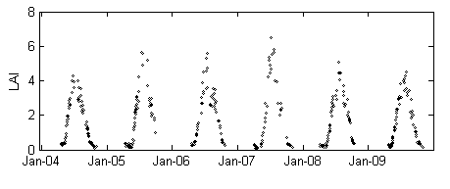
Compositing
Objectives & Problematic
A Smooth temporal profile is expected!
Acquisition dates are discontinuous: Revisit frequency combined with cloud (snow) occurrence)
Noise in the data: pre-processing, inversion algorithm, mis-cloud detection

Slide 57
Compositing
Temporal smoothing
No assumption on the LAI temporal profile (coarse resolution): Statistical Methods
  Interpolators (spline)
  Decomposition methods (whole time series)
    Split the signal into additive components
    Retain informative component (remove noise = high frequency)
  Curve fitting on limited temporal window
    Optimization
    Savistsky Golay: local polynomial fitting (window size & polynomial order)
    Asymmetric Gaussian Filtering (timesat toolbox)

Slide 58
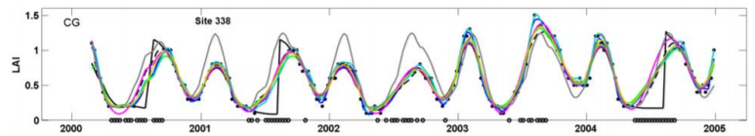
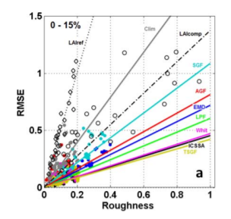
Compositing
Temporal smoothing
From Kandasamy et al, BG, 2013
Compromise to be found between smoothness and accuracy
Decomposition
technique
Curve Fitting
Climatology

Slide 59
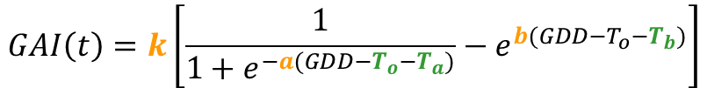
Compositing
Temporal smoothing
The crop type is known, a LAI temporal profile is expected (S2-Crops):
  Climatology (if available)
  Canopy Structural Dynamic Model (Koetz et al, RSE, 2005 – Duveiller et al, AFM, 2012)
  Basic crop functionning model (Growth & Senescence based on thermal time)
scaling
$$GAI\left(t\right)=k\left[\frac{1}{1+e^{−a(GDD−T_{o}−T_{a})}}−e^{b(GDD−T_{o}−T_{b})}\right]$$
To : GDD at emergence
Ta: GDD at mid-growth
Tb: GDD at end senescence
Growth rate
Senescence rate

Slide 60
Recommendation
What do you need to check when using a product?
Definition of the product : is it in agreement with your own objective?
Inversion Algorithm:
  Are your observation conditions in adequation with the training data set?
  Are the model assumptions in adequation with the structure of the observed canopy?
  If prior information is used, is this prior information realistic?
  Was the algorithm validated? Which acuracy can I expect?
Sensor spatial resolution
  Footprint of the pixel (PSF)
Check the flags!

Slide 61
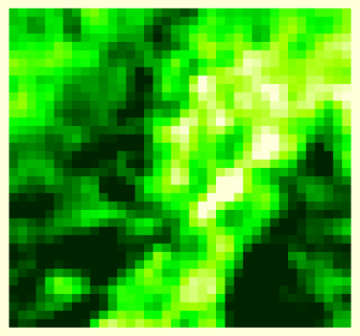
PSF
Sensor Actual
Resolution
Sensor Grid
Coarse resolution sensor

Slide 62
SENTINEL2 ALGORITHM (SNAP/SEN2-AGRI)
NEURAL NETS TRAINED ON 1D SIMULATIONS
RTM= PROSAIL model
1D – Turbid medium
Inputs (20m)
Reflectances + geometry (cosine)
Acronym | Central (nm) | Width (nm) | Spatial resolution (m)
B3 | 560 | 35 | 10
B4 | 665 | 30 | 10
B5 | 705 | 15 | 20
B6 | 740 | 15 | 20
B7 | 783 | 20 | 20
B8a | 865 | 20 | 20
B11 | 1610 | 90 | 20
B12 | 2190 | 180 | 20
Biophysical Variables: GAI, fAPAR, fCover
Canopy Chlorophyll Content, Canopy Water Content

Slide 63
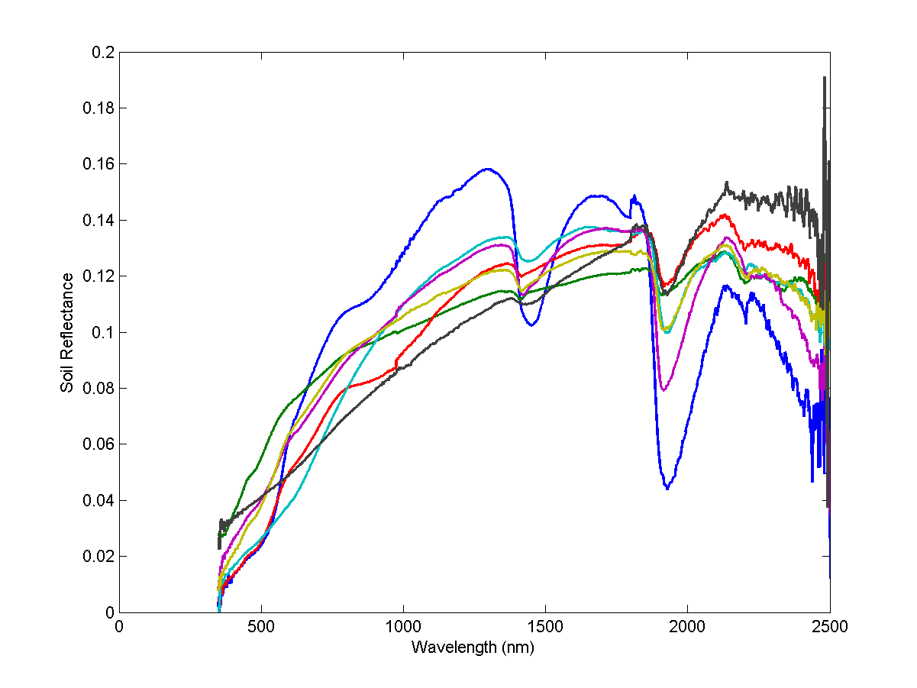
SENTINEL2 ALGORITHM (SNAP/SEN2-AGRI)
Composition of the training dataset
Soil Background: 7 reference spectra & Brightness index
GAI, Inclination, Leaf Optical properties:
distribution parameters taken from littérature
Co-distribution based on a simple assumption (saturation)

Slide 64
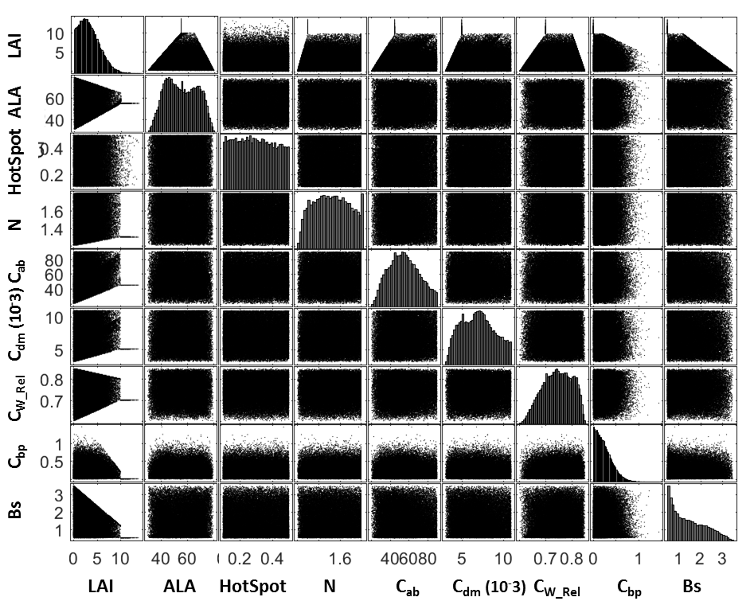

Slide 65
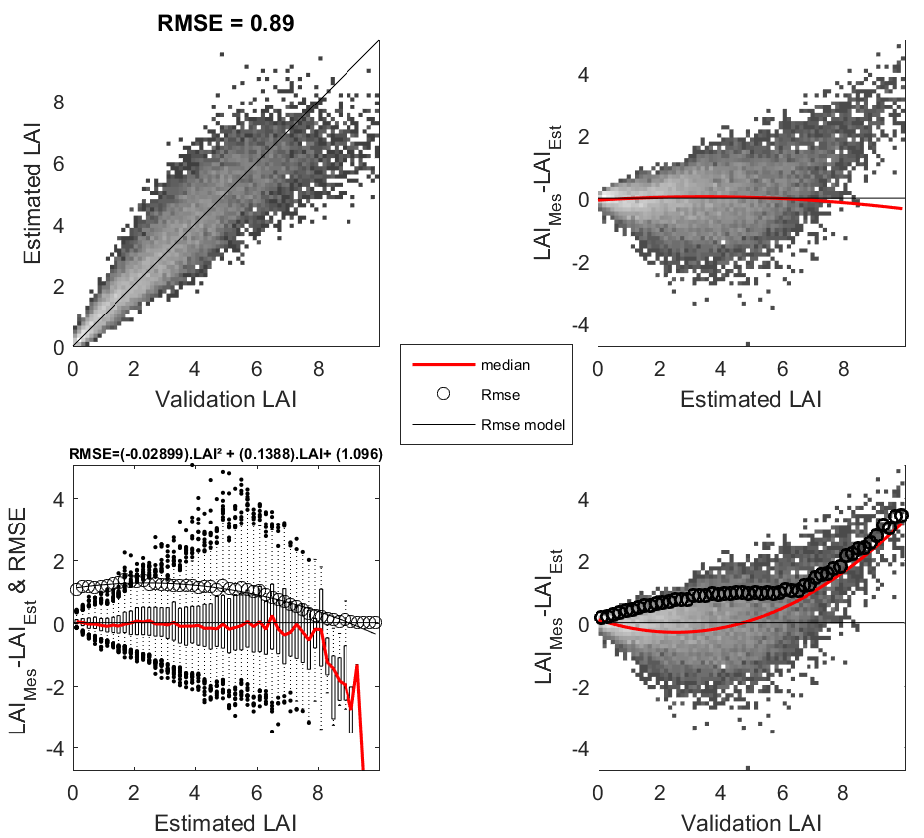
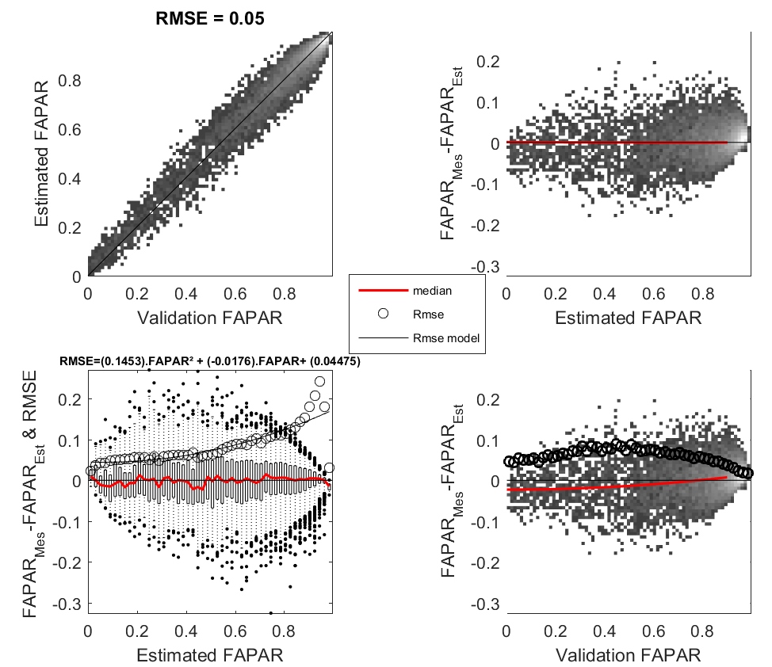
Theoretical performances
Pseudo-independent database, still simulated with SAIL

Slide 66
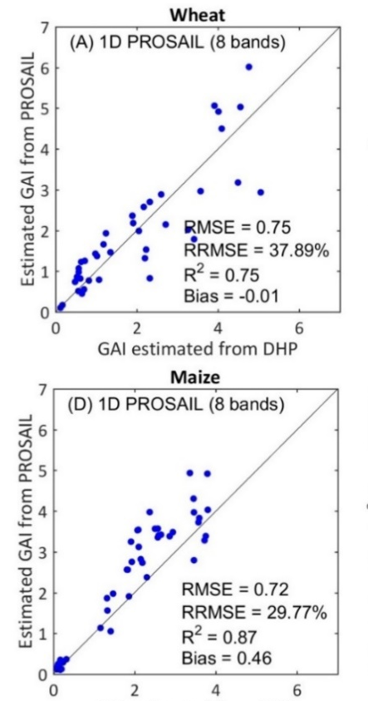
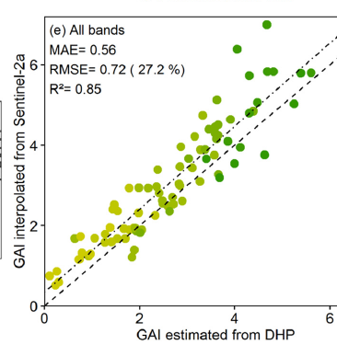

Validation against measurements (GAI)
wheat
From Delloye et al, RSE, 2018
From Vuolo et al, RS, 2016
From Jiang et al, in prep

Slide 67
Flag Meaning
Definition Domain
Adequation with the training dataset
Output out of range
Is the estimated product in the range
of the training data set
Input 2
2)
Inuput
0
0
1
0
0
0
0
0
0
0
0
0
1
0
0
0
0
0
0
0
Max(
0
1
1
0
0
0
0
0
0
0
0
1
1
1
0
0
0
0
1
1
0
1
1
1
1
0
0
1
1
1
0
1
1
1
1
1
1
1
1
1
0
1
1
1
1
1
1
1
0
0
0
1
1
1
1
1
1
0
0
0
2)
0
1
1
1
1
1
1
0
0
0
1
1
1
0
0
0
0
0
0
0
Inuput
Min(
Inuput
1)
Max (
Inuput
1)
Min(
Input 1

