Slide 1
Concepts and methods for optical pre-processing and time series quality analysis
Pierre Defourny, Fabrizio Ramoino, Olivier Hagolle

Slide 2
Overview
Pre-processing of optical data
Why & when use time series
Quality analysis

Slide 3
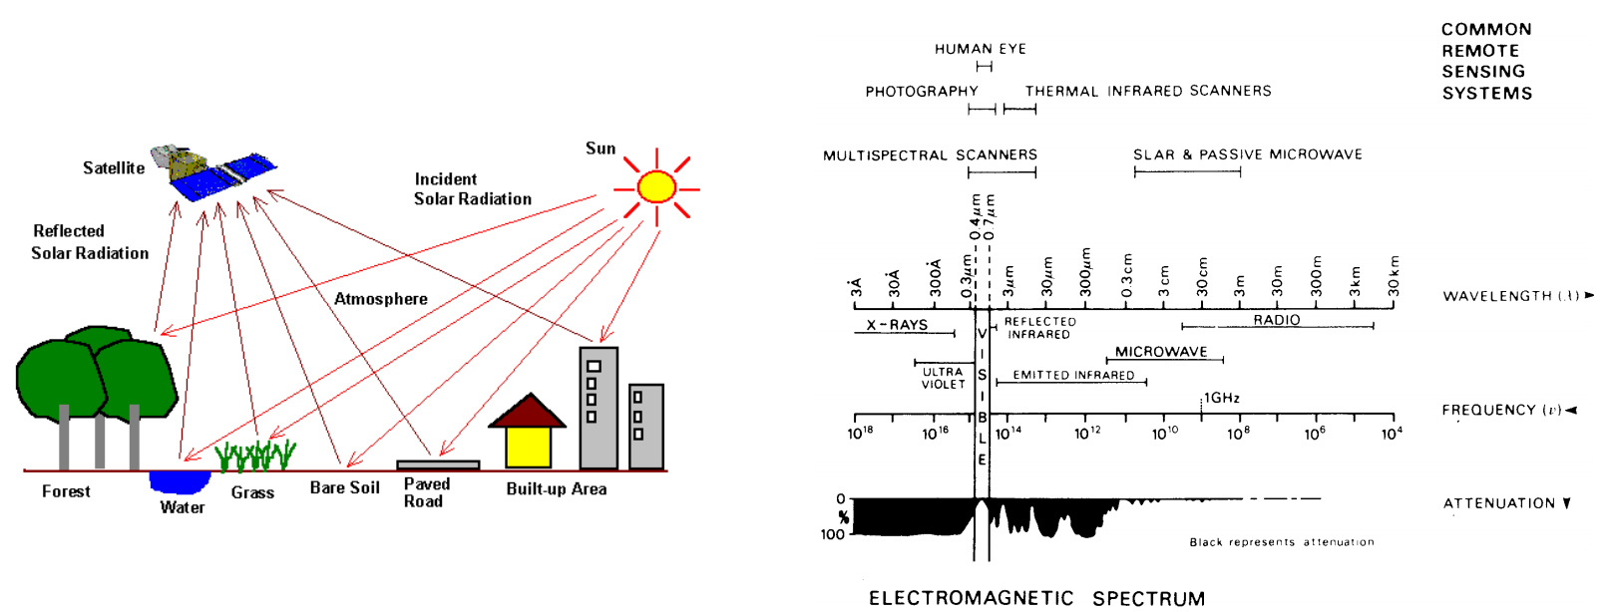
Optical Sensors
Measure light from blue (~400 nm) to shortwave infrared (SWIR; ~2500 nm).
Passive sensors where the energy source is the Sun.

Slide 4
Pre-processing of optical data
Pre-processing chain includes all the steps needed to generates cloud-free surface reflectance products taking as input Top Of Atmosphere data. For each of the module in the pre-processing chain different methods and algorithm can be applied.
Cloud detection and removal (mono-temporal or multi-temporal)
Atmospheric correction
Reprojection
Resampling
Co-registration

Slide 5
Cloud detection and removal
A large portion of the earth surface is covered by clouds, consequently, most earth observation images in the visible spectral domain include a significant amount of cloudy pixels.
An image pixel can be:
cloud free (there are no water droplets or ice crystals in the atmosphere which change the surface reflectance)
partly cloudy (comprises all intermediate situations where the measured reflectance is a mixture of a significant portion of the surface reflectance, but modified due to the presence of a cloud)
totally cloudy (the optical thickness is so high that the portion of surface reflectance at the signal measured by the satellite is negligible)
Cloud detection methods can be categorized in the following classes [Brockmann et al., 2008]:
Spectral threshold methods (spectral characteristics, such as temperature, brightness, whiteness or height of the scatterer are tested against a threshold value)
Feature extraction and classification (the spectral data space, if transformed into a feature space, can be statically or dynamically separated into cloud or clear classes)
Learning algorithms (cloud probability or cloudiness index values are generated after training the algorithm with simulated or measured data)
Multi-temporal analysis (Pixels are not always cloud covered and a time series of data is used to separate cloudy from clear cases)
Multi-sensor approach (where multiple sensors are on the same platform and perform simultaneous measurements, the synergetic algorithms can be used to better identify clouds)

Slide 6
Interactions with the Atmosphere
Before radiation used for remote sensing reaches the Earth's surface it has to travel through some distance of the Earth's atmosphere
Particles and gases in the atmosphere can affect the incoming light and radiation:
Scattering occurs when particles or large gas molecules present in the atmosphere interact with and cause the electromagnetic radiation to be redirected from its original path.
Absorption causes molecules in the atmosphere to absorb energy at various wavelengths.

Slide 7
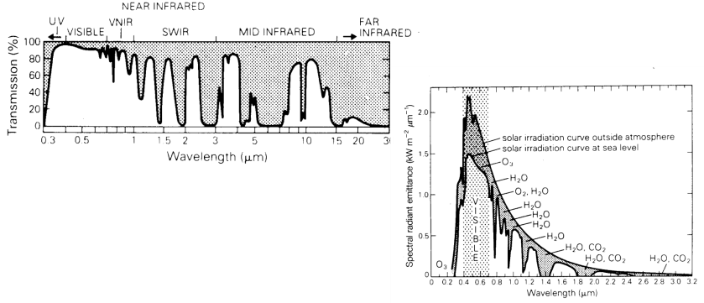
Atmospheric Windows
Some wavelengths are more effected by the atmosphere than others.
Those with little effect on signal are ‘windows’ for remote sensing.

Slide 8
Retrieval of Surface Reflectance
For further analysis we want to use a surface reflectance product
Allows comparison between images
Allows repeatable measurements (e.g., ground spectra comparison to satellite observations)
Represents a known physical unit.
To retrieve surface reflectance we need to ‘add back’ the component ‘lost’ in the atmosphere.
At Sensor Refl = Surface Refl + Atmospheric Refl

Slide 9
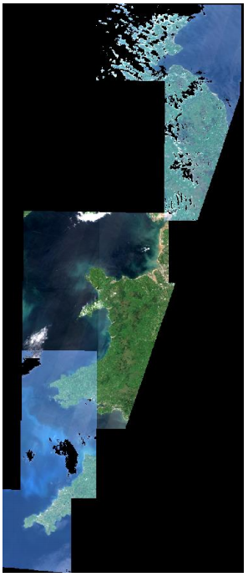
What is in the atmosphere?
Aerosols
E.g., fine dust, sea salt, water droplets, smoke, pollen, spores, bacteria.
Has a significant effect on the visible wavelengths (Blue, Green and Red).
Aerosol Optical Depth (AOD)
Aerosol Optical Thickness (AOT)
Water Vapour
Particularly, effects the SWIR bands

Slide 10
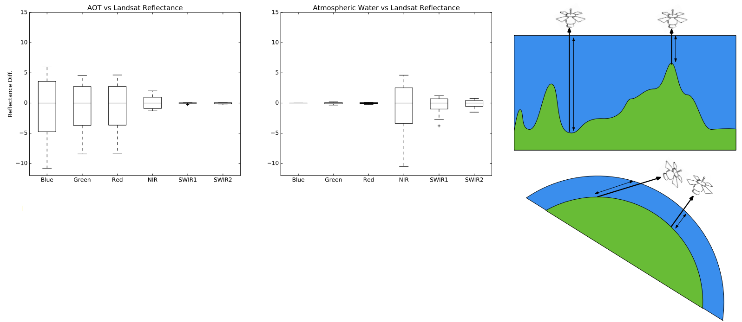
What effects atmospheric correction?
Relative contributions:
AOT = 80%
Water Vapour = 15%
Altitude = 4%

Slide 11
Cloud detection and removal
Sen2Cor (developed by Telespazio Germany)
It is a mono-temporal processor for Sentinel-2 L2A product generation and formatting. Uses a single L1C product as input data. The algorithm can create 4 different classes of clouds, together with classifications of shadows and ice. Additional outputs are Aerosol Optical Thickness (AOT) map, Water Vapour map, and Scene Classification map. The program is available as SNAP plugin.
MAJA (developed by CESBIO/CNES)
The most significant difference of MAJA is being a multi-temporal processor, which means that it uses multiple L1C images of the same area in time series, this method improves the accuracy of masking. It can process Landsat, Sentinel-2, and Venus products.
IdePix (developed by Brockmann Consult)
IdePix (Identification of Pixel) is a pixel identification tool. It needs a Sentinel-2 L1C product for masking. Like Sen2Cor, it is available as a SNAP plugin. So that it has similar advantages of Sen2Cor in terms of user-friendliness. In the output, the program provides one class for each pixel.
Fmask (developed by USGS)
It is a pixel-based mono-temporal processor. Single L1C product is the input. It was initially developed for Landsat images but later extended for S2 images. Cloud, cloud shadow, snow, and water masking are possible with it. The program needs MATLAB environment.
Sentinel Hub’s Cloud Detector
It is a single scene, a pixel-based program by a combination of Fmask, Sen2Cor, MAJA, and machine learning. It is available as a python package and doesn’t have a GUI. The code is easy to follow with Jupyter-Notebook.

Slide 12
Sen2Cor: Overview
Single image processing algorithm with orthorectified L1C granule in input
Cloud Screening and Classification
Atmospheric Correction over land surface (inherited from ATCOR DLR)
Radiative Transfer code: LibRadtran (Look-Up-Tables)
Python application:
Command line tool
Plug-in of S2 toolbox
Integrated in S2 Ground Segment
Processing configuration: 3 XML files

Slide 13
Sen2Cor: Main Processing Steps

Slide 14
Sen2Cor: Cloud Screening and Classification

Slide 15
Sen2Cor: Cloud Screening and Classification
ESA CCI Support

Slide 16
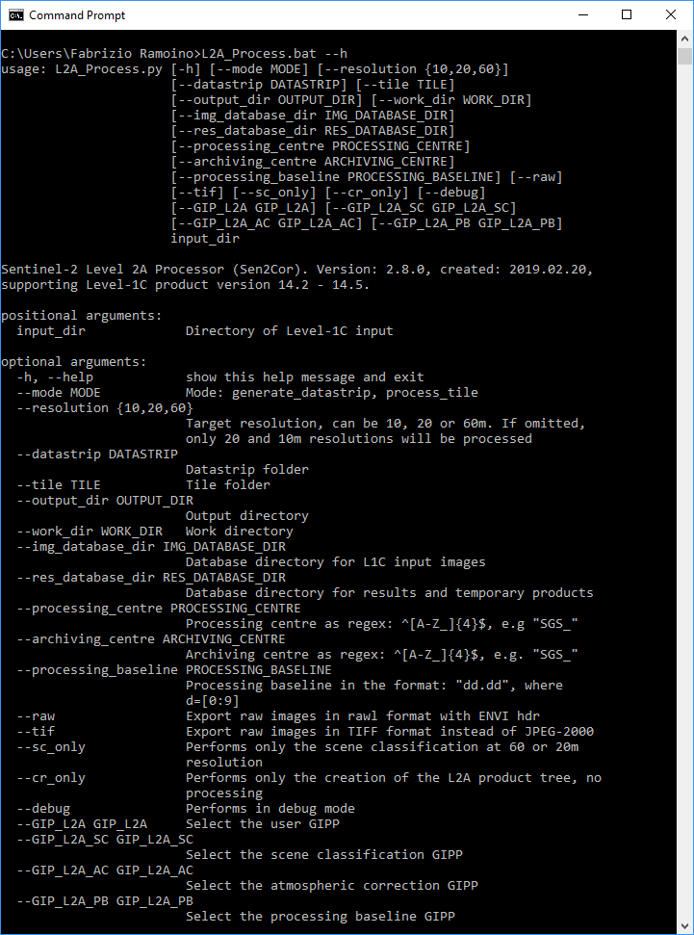
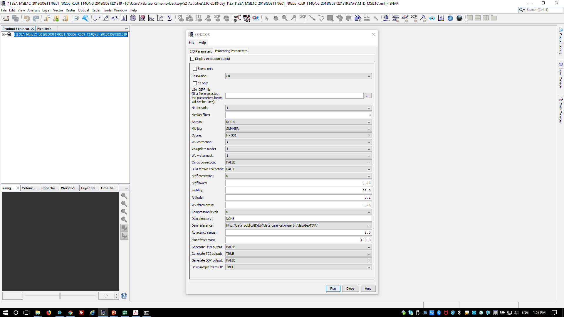
Sen2Cor
The user can run Sen2Cor via command line or as plug-in of SNAP

Slide 17
MAJA: History and Implementations
MAJA L2A processor
History
Started with the definition of L2A processor for Venµs (2 days revisit satellite)
2006: Research to use time dimension to detect clouds and aerosols
2008: MACCS : Multisensor Atmospheric Correction and Cloud Screening
2017: MAJA : MACCS ATCOR Joint Algorithm, with DLR
Implementations
Within THEIA (French land data center)
Process and distribute L2A for Sentinel-2, Landsat-8 and Venµs
Within PEPS (French collaborative ground segment)
On demand processing of Sentinel-2 data
Within Mundi and Sobloo DIAS (soon)
Within Sen2Agri platform (ESA), European Snow and Ice cover (EEA)
As a free software for Linux, to run on client side (1200 downloads)

Slide 18
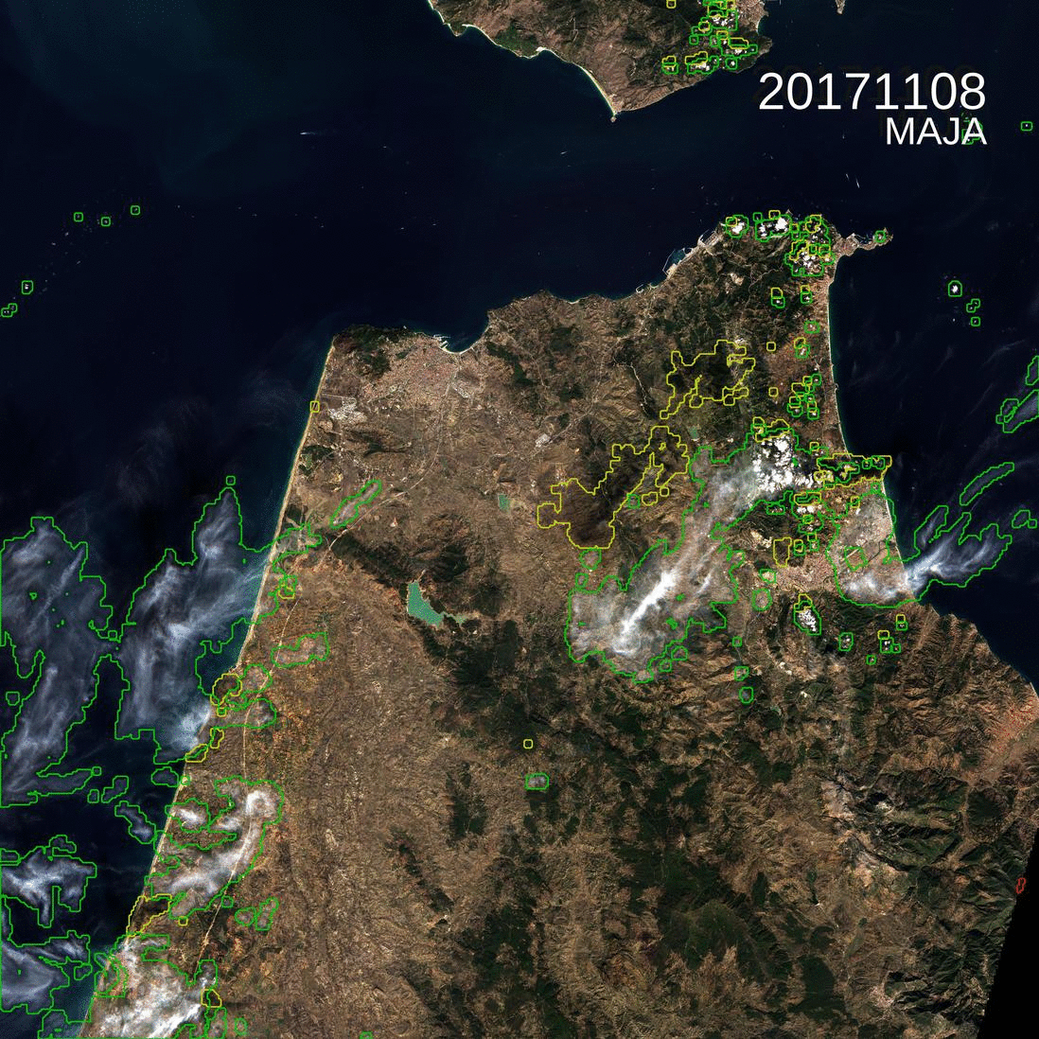
MAJA: Methods and Validation
Interest of using multi-temporal methods
Clouds and shadows are easy to spot thanks to the time dimension
Surface reflectances change slowly with time (with exceptions)
Quick variations can be classified as clouds/shadows or explained by a change in aerosol content
Multi-spectral criteria can be used to solve ambiguities
(Tile T30STE, Tanger, Morocco)

Slide 19
MAJA: Methods and Validation
MAJA methods in one slide
Main steps:
Cloud and shadow detection
Estimates of water vapour and aerosol content
Atmospheric correction including adjacency and terrain effect correction
Correction of thin cirrus clouds (imperfect, pixels are still flagged)
Implementations
MAJA combines multi-temporal and multi-spectral criteria:
to detect clouds, shadows, water and snow at a coarse resolution
to compute aerosol optical thickness (AOT) and water vapour (WV)
the aerosol type is an exogenous data or parameter: aerosol model of Copernicus atmosphere since Version 3.0
MAJA cloud detection works at 240m resolution

Slide 20
MAJA: L3A (Wasp processor)
L3A - Monthly syntheses of cloud free surface reflectance
Standard L3 based on Best Available Pixel (BAP) method
Pick the best date during the synthesis period
Artifacts from one pixel to the other, because date changes
But minimization of Cloud/Atmosphere effects
Such as EU, Sentinel-2 Global Mosaics (S2GM)
Weighted Average Synthesis Processor (WASP)
First developed for Venµs Satellite
New tool developed within Sen2Agri project
Adapted to CNES context => WASP
Available as open source (soon on CNES github)
L3A available within THEIA soon (France is already available)
Needs (and validates) MAJA L2A quality
Errors from cloud detection or atmospheric correction are included in L3A product
Reduced frequency of artefacts, but still some…

Slide 21
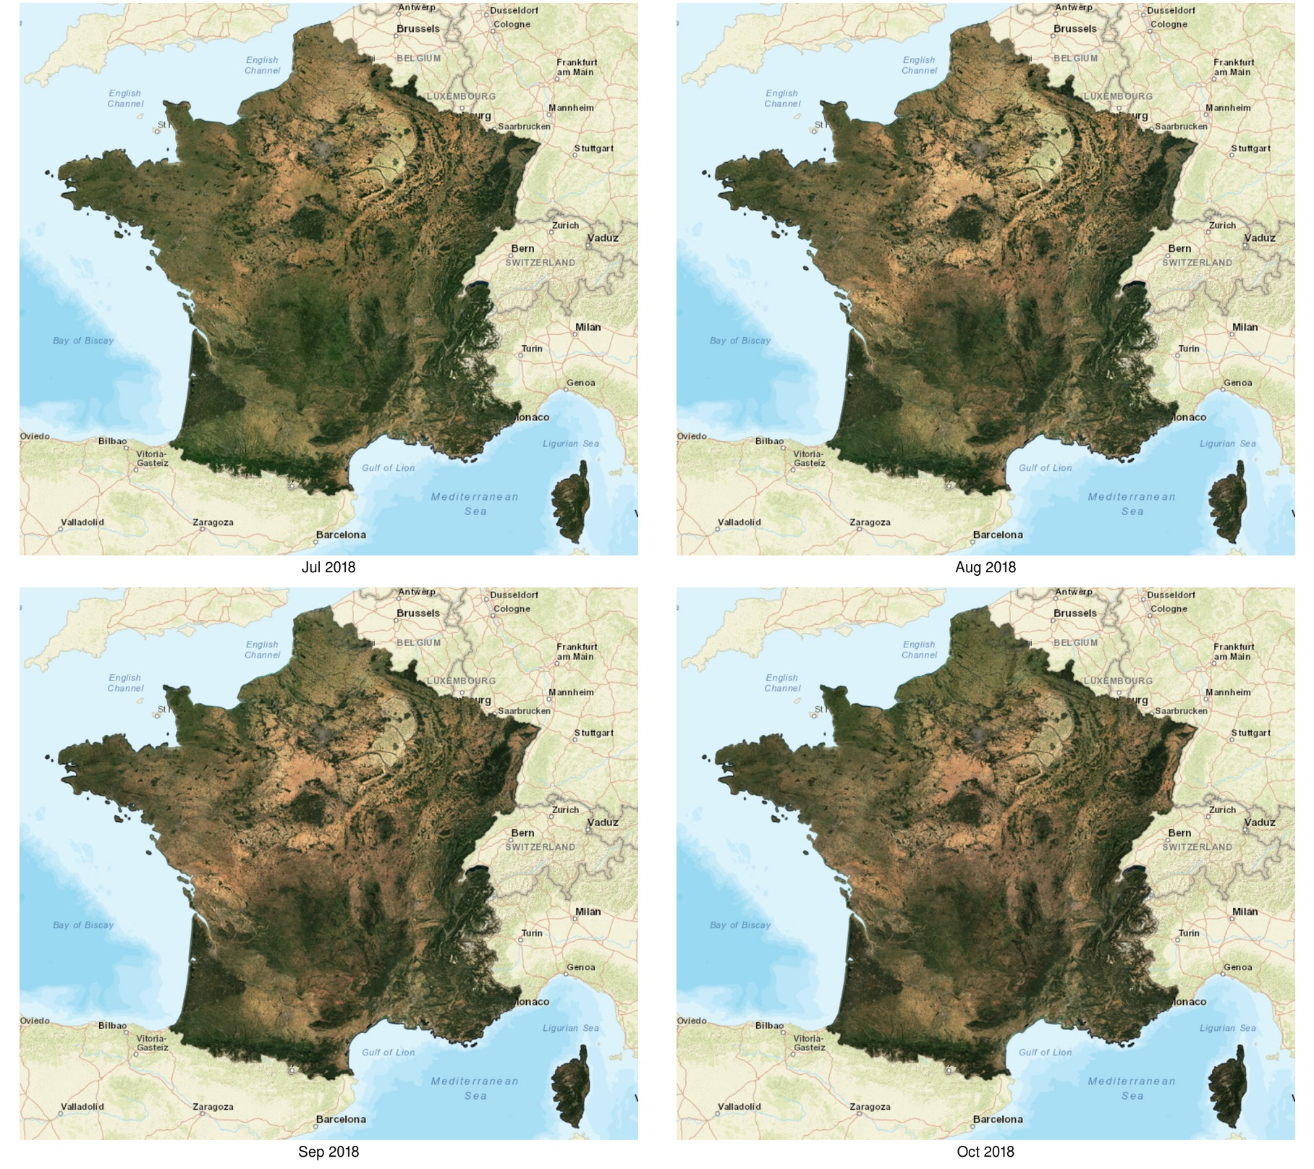
MAJA: L3A (Wasp processor)

Slide 22
Reprojection, resampling and co-registration
Reprojection
If the input of the time series come from several sources with different CRS the reprojection to a common CRS is needed.
Resampling
Data coming from different sources could have different spatial resolution, therefore in this case before to analyse the time series a resampling is necessary.
Nearest Neighbour:
Pros: Very simple and fast; No new values are calculated by interpolation
Cons: Some pixels get lost and others are duplicated; Loss of sharpness
Bi-linear interpolation:
Pros: Extremas are balanced; Image losses sharpness compared to Nearest Neighbour
Cons: Less contrast compared to Nearest Neighbour; New values are calculated which are not present in the input product
Cubic convolution:
Pros: Extremas are balanced; Image is sharper compared to Bi-linear Interpolation
Cons: Slow and less contrast compared to NN; New values are calculated which are not present in the input product
Co-registration
In order to maximise the geolocation accuracy, even if the input data come from the same satellite/constellation, the co-registration is need especially if you work with VHR and HR data.
1 pixel shift can affect drastically your results!

Slide 23
Why use time series
A time series is defined as a set of satellite images taken over the same area of interest at different times
It makes use of different satellite sources to obtain a larger data series with short time interval between two images
Time Series of Satellite observations offer opportunities:
for understanding how Earth is changing
for determining the causes of these changes
for predicting future changes
Remotely sensed data, combined with information from ecosystem models, offers an opportunity for predicting and understanding the behaviour of the Earth's ecosystem.
Temporal components integrated with spectral and spatial dimensions allows the identification of complex patterns concerning applications connected with environmental monitoring and analysis of land-cover dynamics.

Slide 24
Theewaterskloof Dam change by S2 time series

Slide 25
Rondônia deforestation by Landsat time series

Slide 26
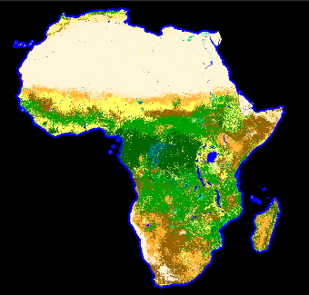
ESA Land Cover maps
Medium Resolution Land Cover products [300m]
High Resolution Land Cover products
GlobCover 2005
GlobCover 2009
S2A Prototype LC map - Africa 2016 @20m
CCI LC epoch maps
2000 – 2005 - 2010
CCI LC yearly maps
1992 » 2015
S2A/B Prototype LC map
Mexico & Central America 2016-2017 @10m

Slide 27
Key elements
Preprocessing quality assessment needed – ever evolving performances
Compositing algorithms to build cloud free surface reflectance synthesis
Temporal metrics as features derived from cloud free time series
+ Logistics - groups for computing lab rooms
- icebreaker
- poster session

Slide 28
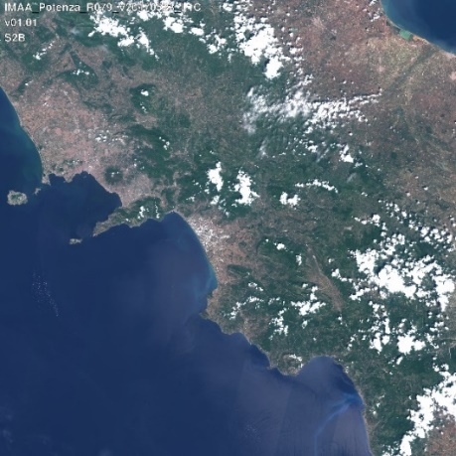
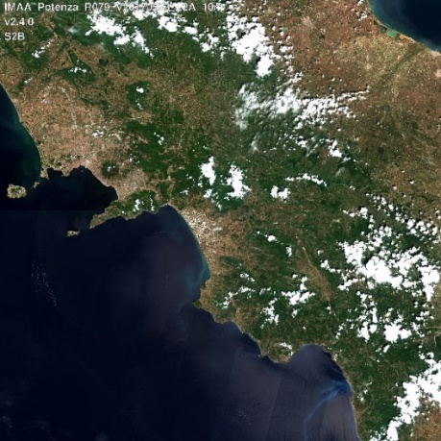
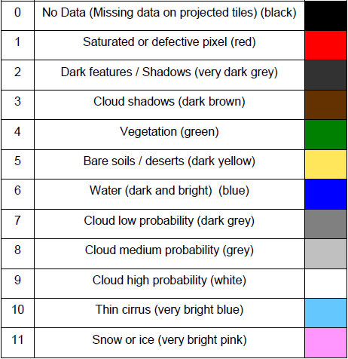
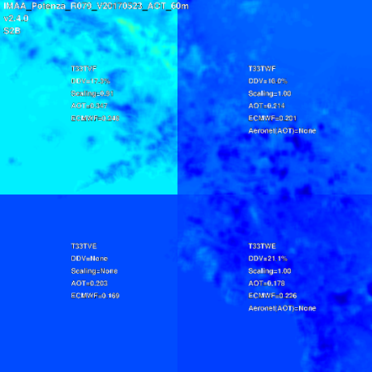
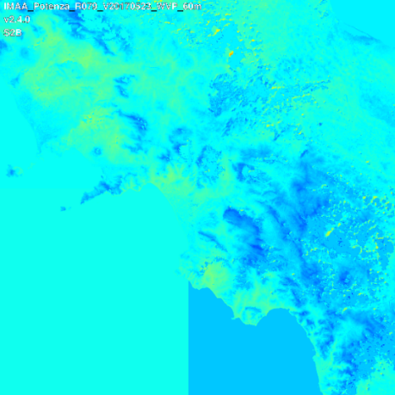
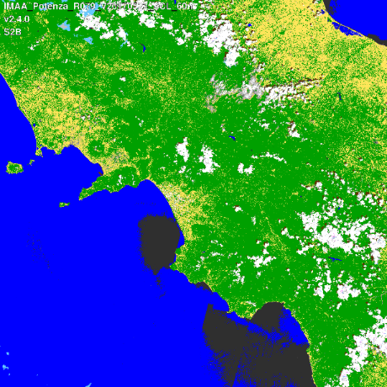
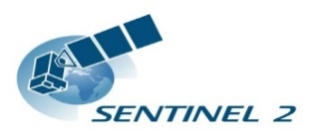
Preprocessing output – L2A processor (e.g. Sen2Cor)
L1C
L2A
L1C
Aerosol Optical Thickness
Water Vapour
Scene Classif.
Used for the clouds and clouds shadow mask and in the atmospheric correction algorithm
Notes:
The SCL map does not constitute a land cover classification map in a strict sense !

Slide 29
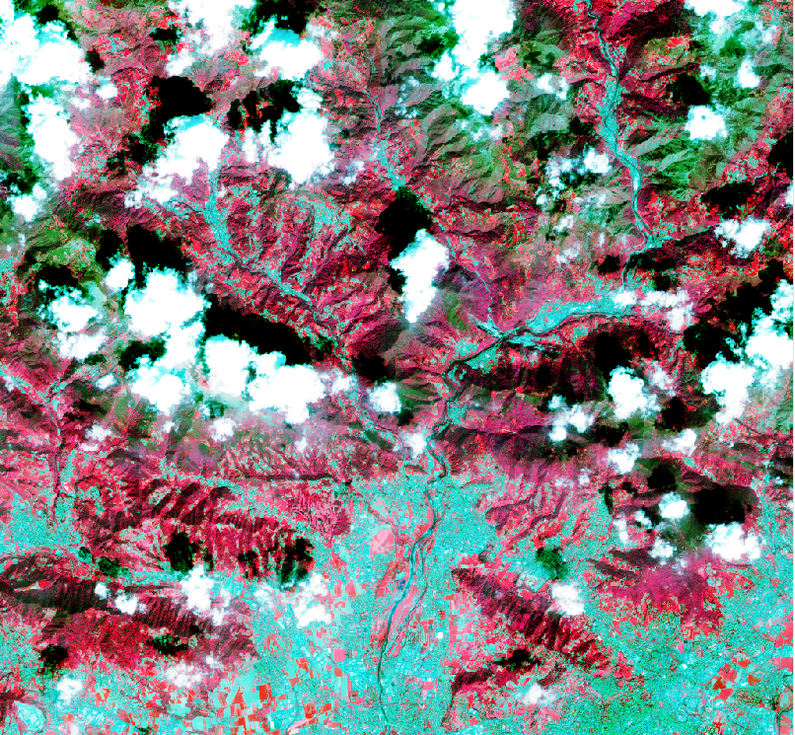
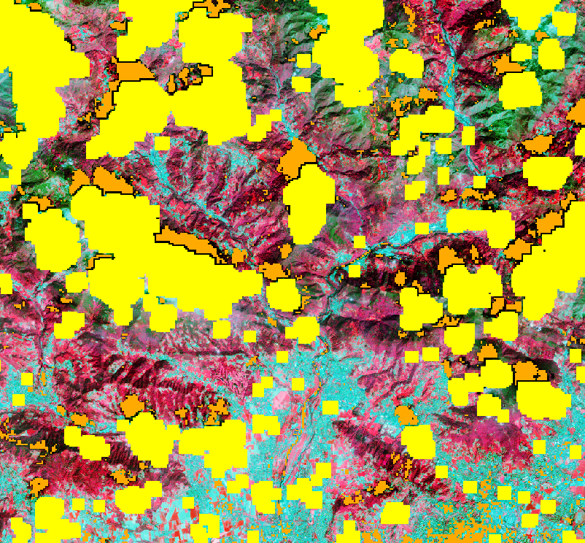
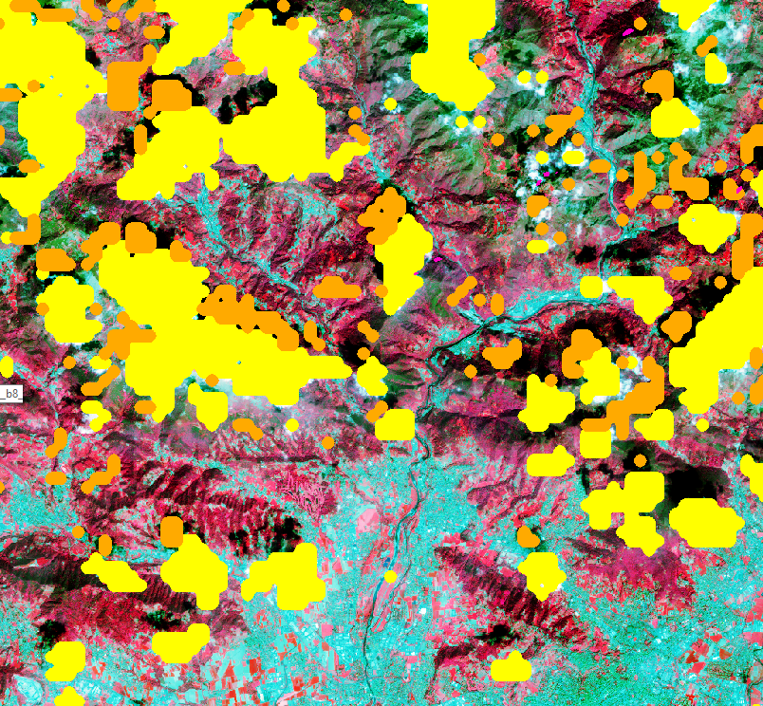
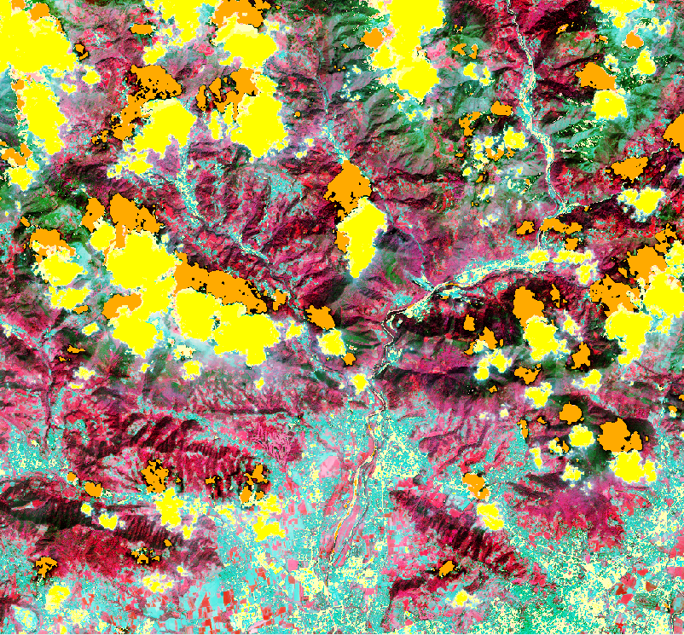
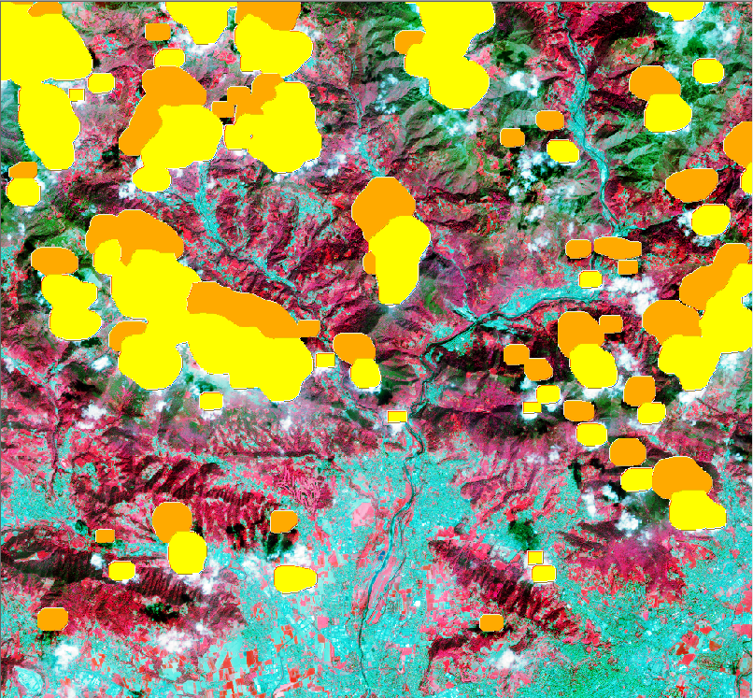
Cloud and shadow masks getting better: challenge of topo shadow
L1C
BC
MAJA
Telespazio
GFZ
Cloud
Cloud shadow
Several benchmarking studies for
- S2 atmospheric correction (ACIX)
- S2 cloud and shadow detection
but challenge of validation !
Notes:
CNES/DLR negative values - Telespazio negative set to 0 => information lost for water bodies detection
Important not to compress signal dynamic range during ATCOR
BC larger dynamic range, linked to higher st dev (in the RE & NIR bands)
Telespazio: could lead to difficult discrimination between broadleaved and needle-leaved forests
strange behavior for the SWIR-1 band over the bare soil class for Brockman algorithm

Slide 30
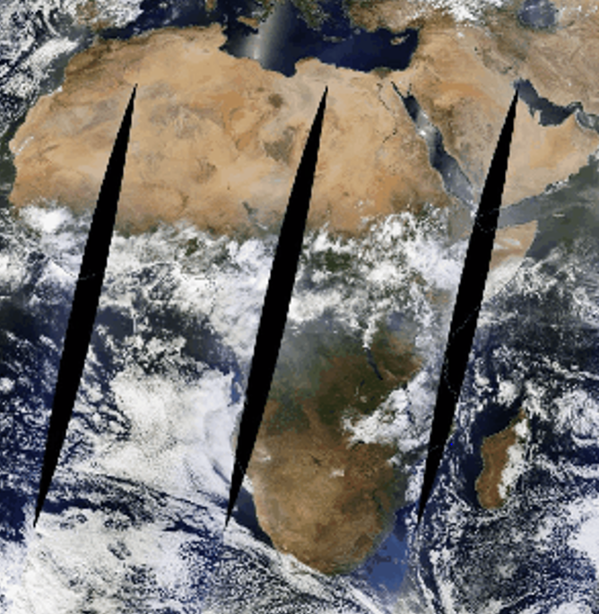
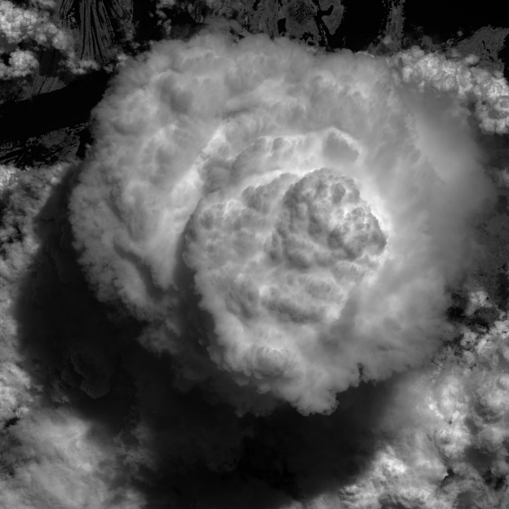
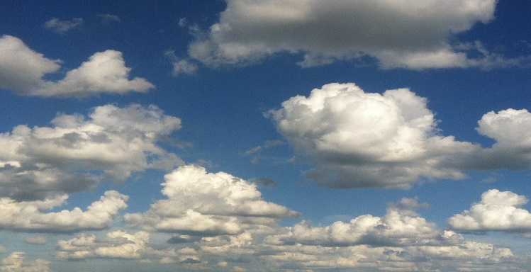
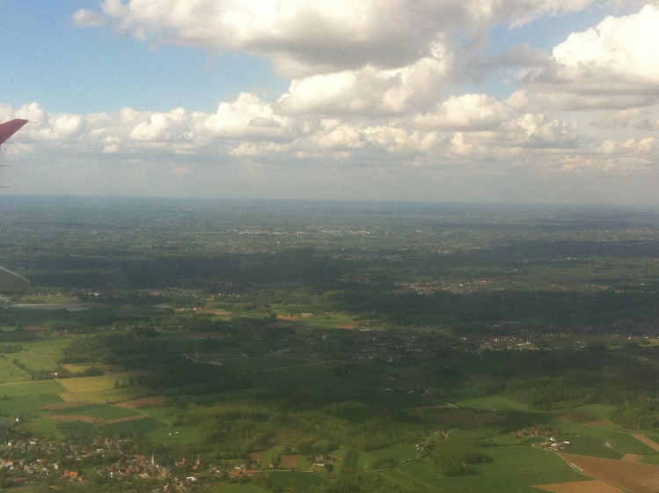
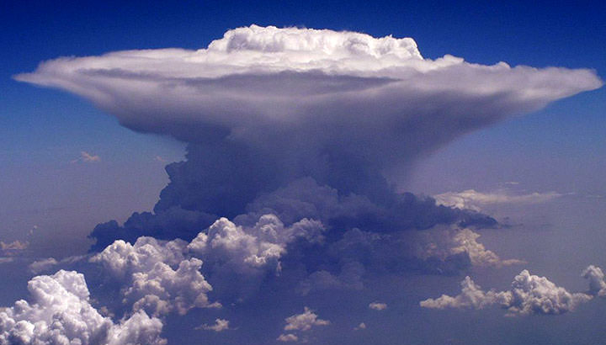
Most clouds easy to detect … but only few errors can impact !
Sentinel-2A L1C
Date: 2017-06-12
Time: 20:43:31 (UTC)
Abs. Orbit: 010303
Tile: 20MRB
Band:B08
(from Sentinel_2 Mission
Performance Center)

Slide 31
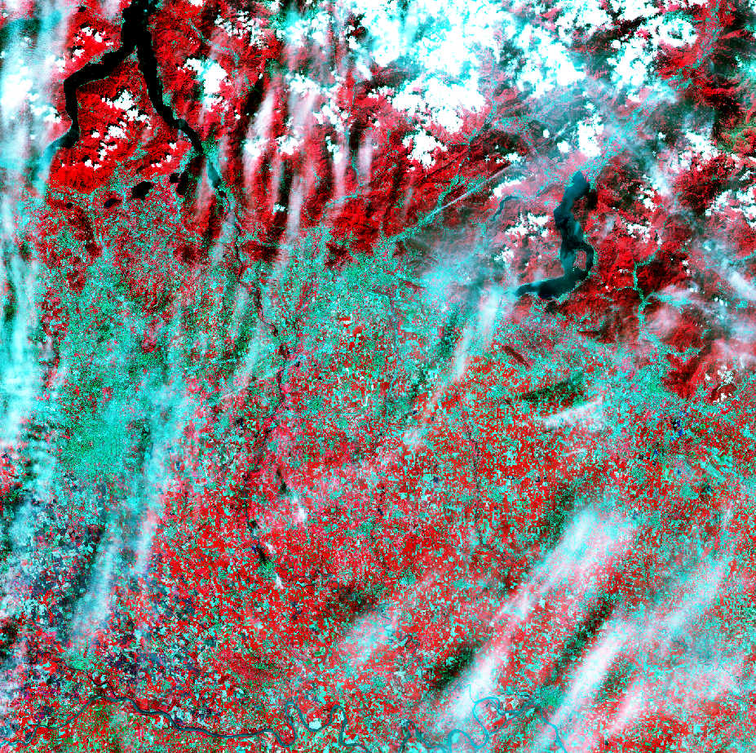
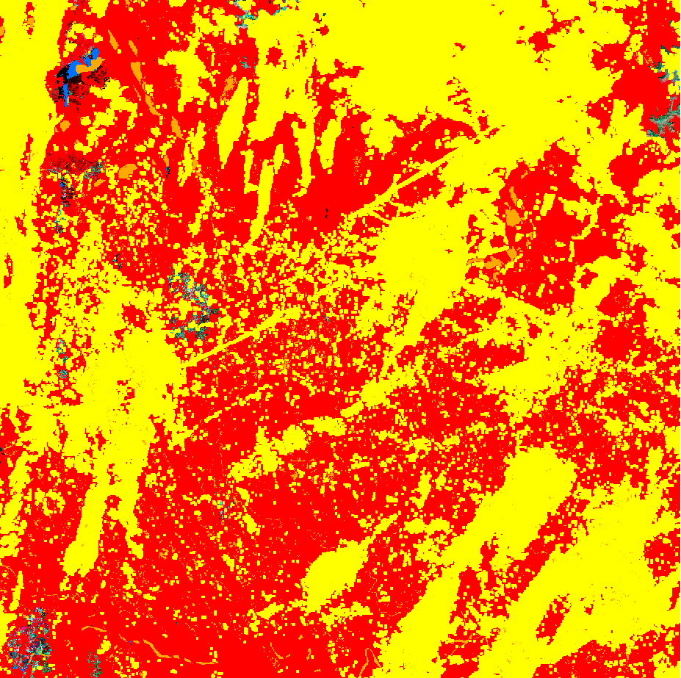
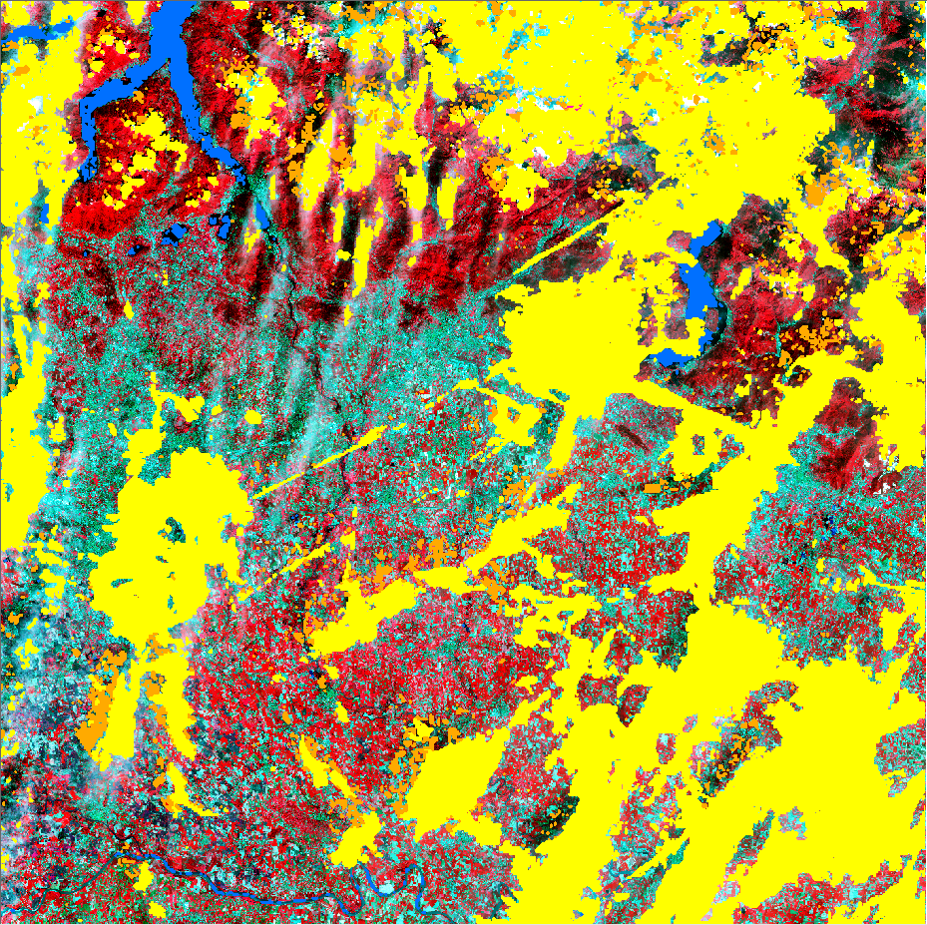
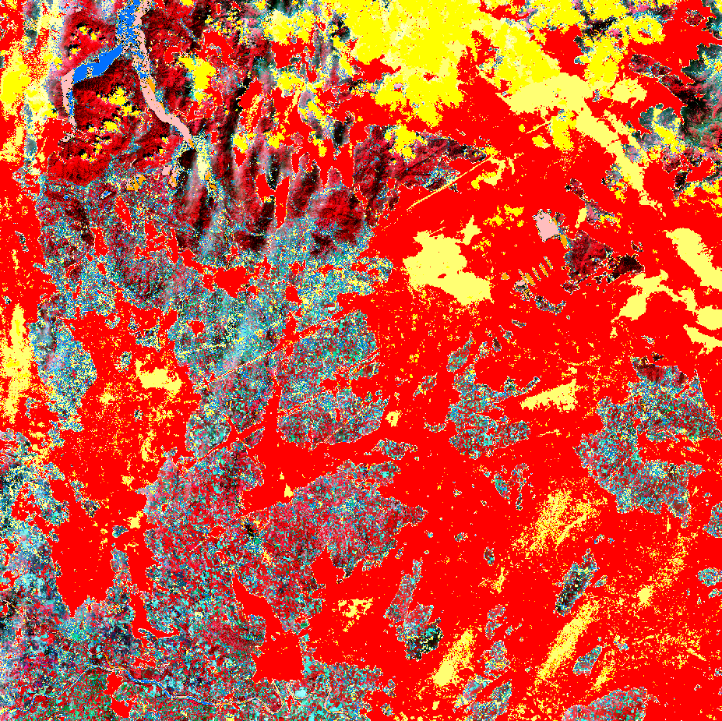
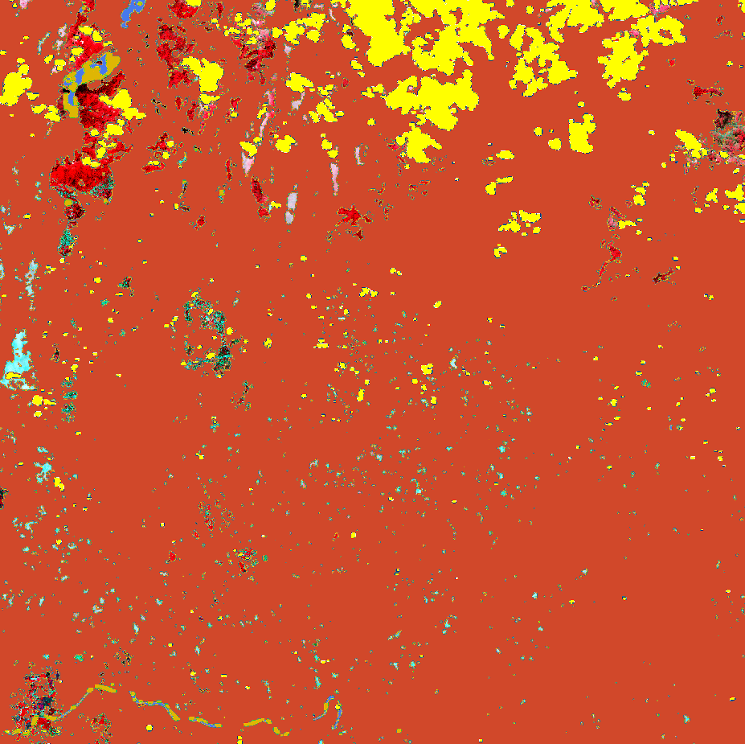
Cloud and shadow masks still challenging: cirrus, haze
L1C
BC
MAJA
Cloud
Telespazio
GFZ
Cloud shadow
Haze - cirrus
Notes:
CNES/DLR negative values - Telespazio negative set to 0 => information lost for water bodies detection
Important not to compress signal dynamic range during ATCOR
BC larger dynamic range, linked to higher st dev (in the RE & NIR bands)
Telespazio: could lead to difficult discrimination between broadleaved and needle-leaved forests
strange behavior for the SWIR-1 band over the bare soil class for Brockman algorithm

Slide 32
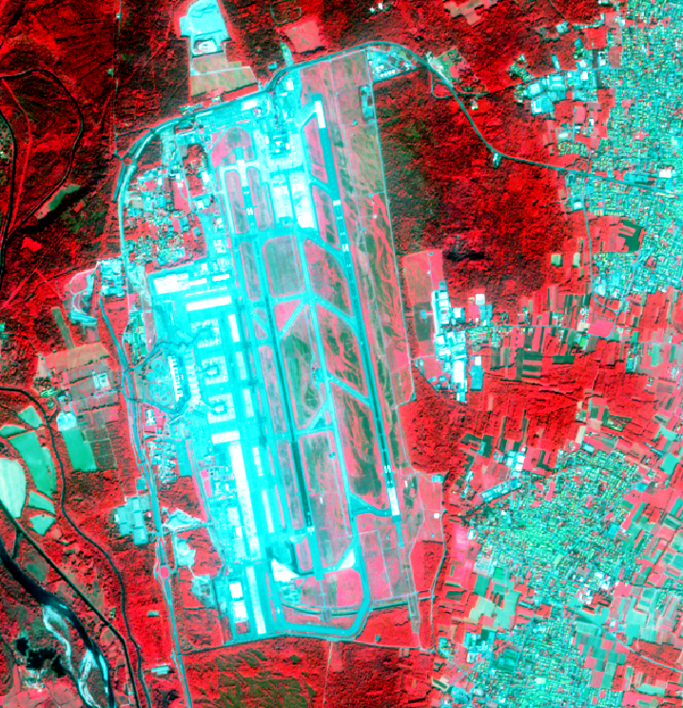
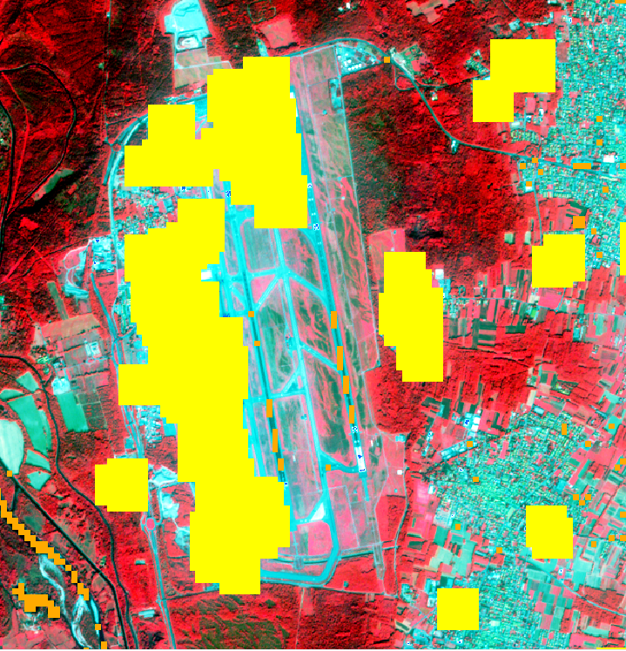
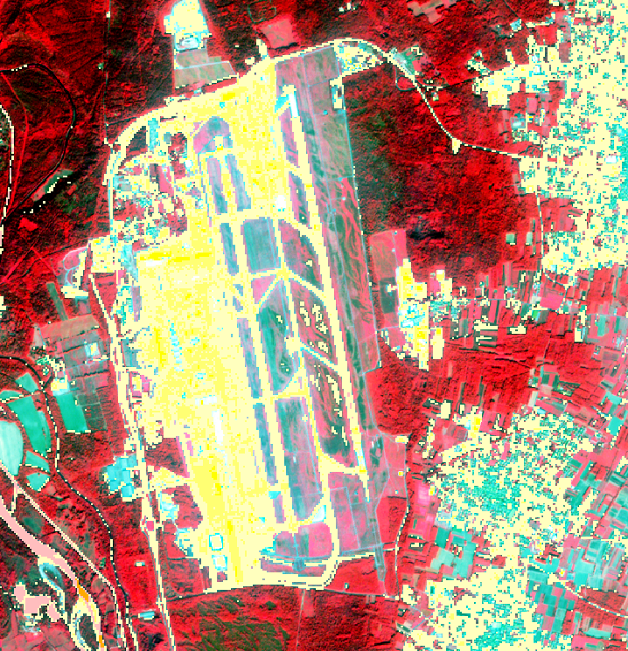
Cloud and shadow masks still challenging: bright surfaces
L1C
BC
MAJA
Cloud
Telespazio
GFZ
Cloud (medium probability)
Cloud (low probability)
No perfect algorithm !
=> Importance to assess L2A time series
quality for your area before
operational use (visual check,
pseudo-invariant targets, …)
Notes:
CNES/DLR negative values - Telespazio negative set to 0 => information lost for water bodies detection
Important not to compress signal dynamic range during ATCOR
BC larger dynamic range, linked to higher st dev (in the RE & NIR bands)
Telespazio: could lead to difficult discrimination between broadleaved and needle-leaved forests
strange behavior for the SWIR-1 band over the bare soil class for Brockman algorithm

Slide 33
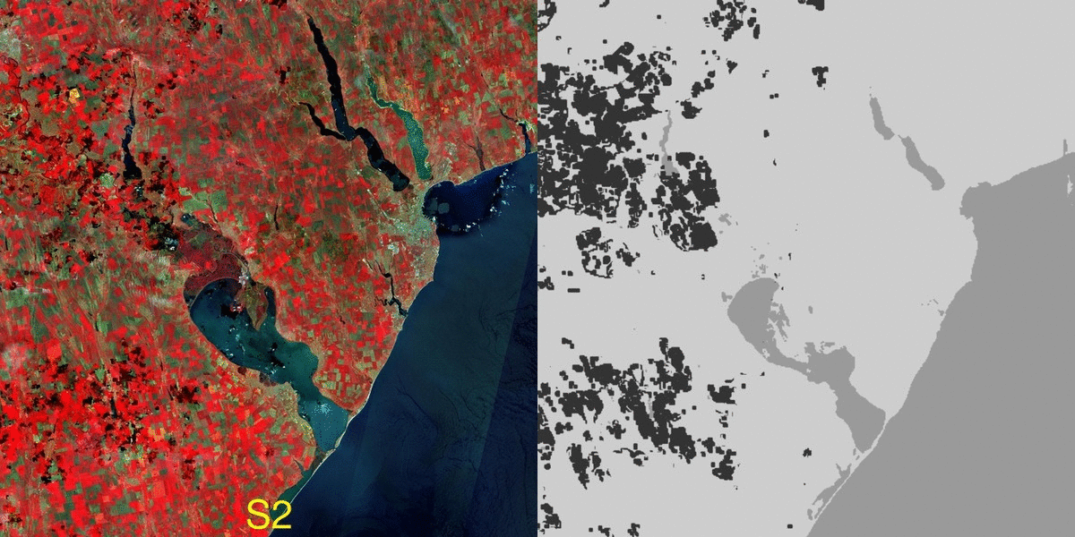
Sentinel-2 and Landsat-8 facing similar cloud detection challenges => use of same atmospheric algo. allows fusing their surface reflectance
Cloud-free monthly composites Cloud and cloud shadow masks
combining S2 and L8 – Southern France site

Slide 34
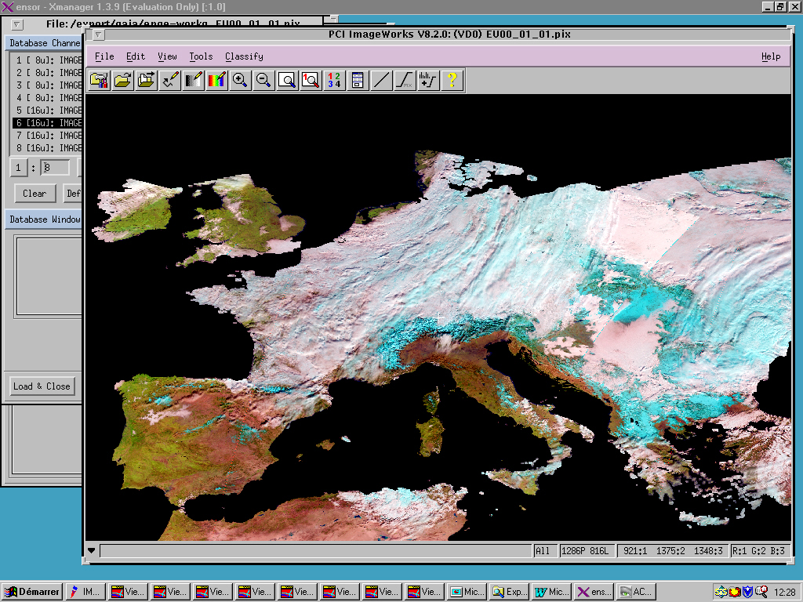
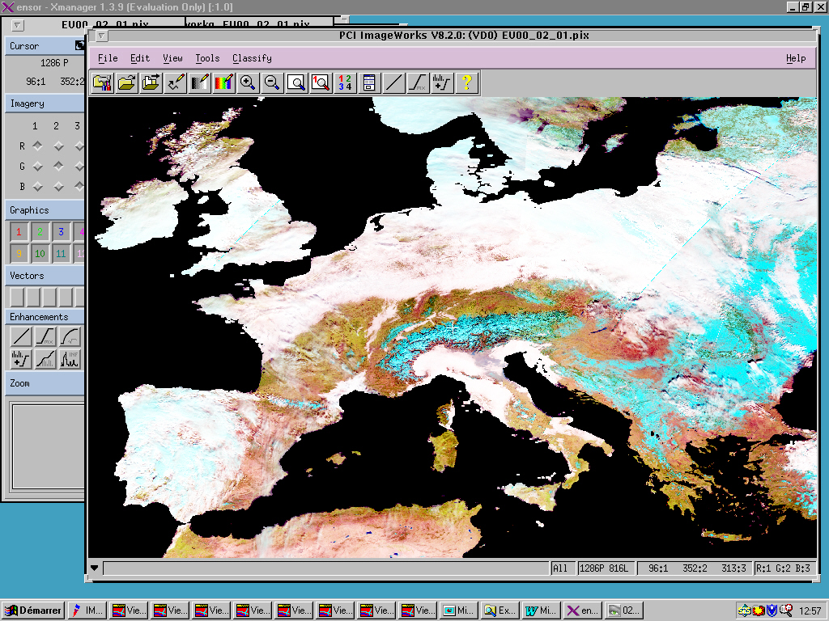
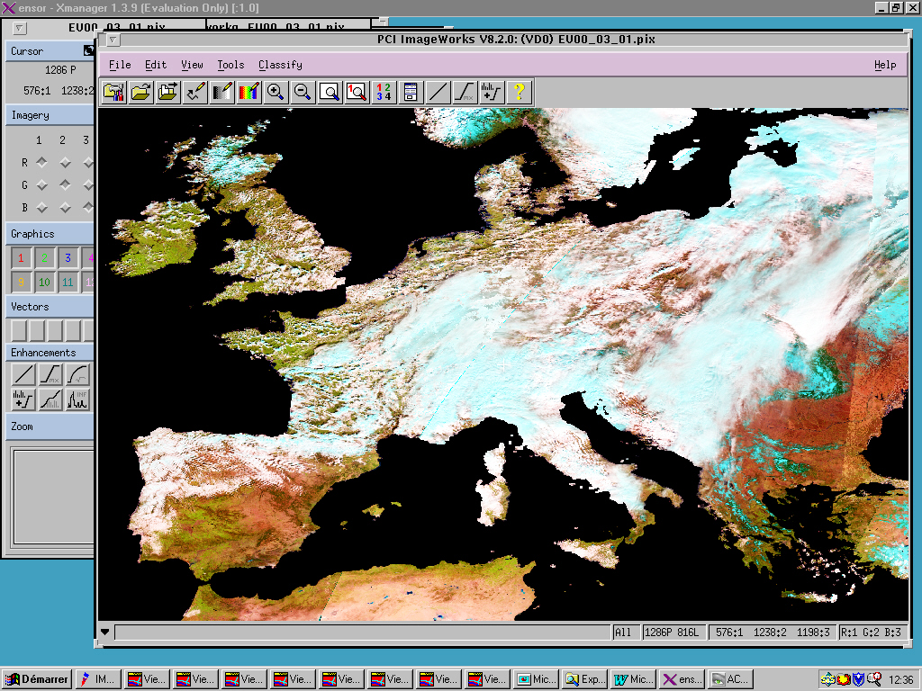
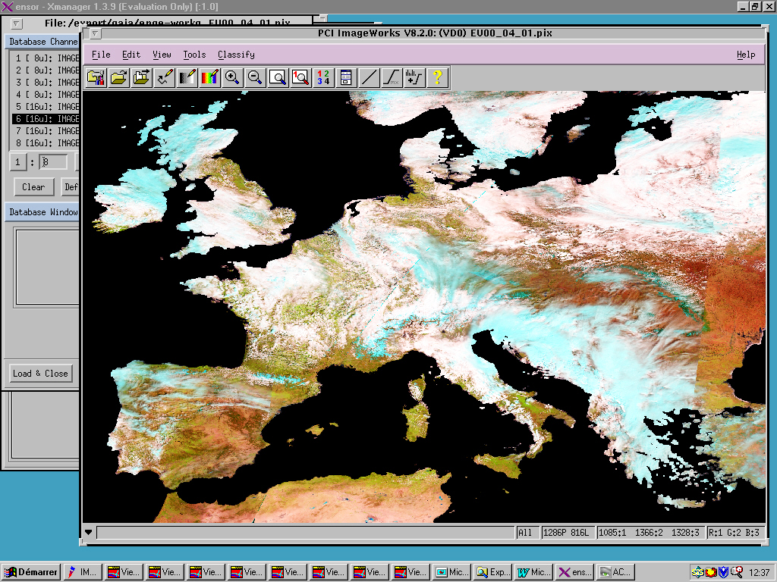
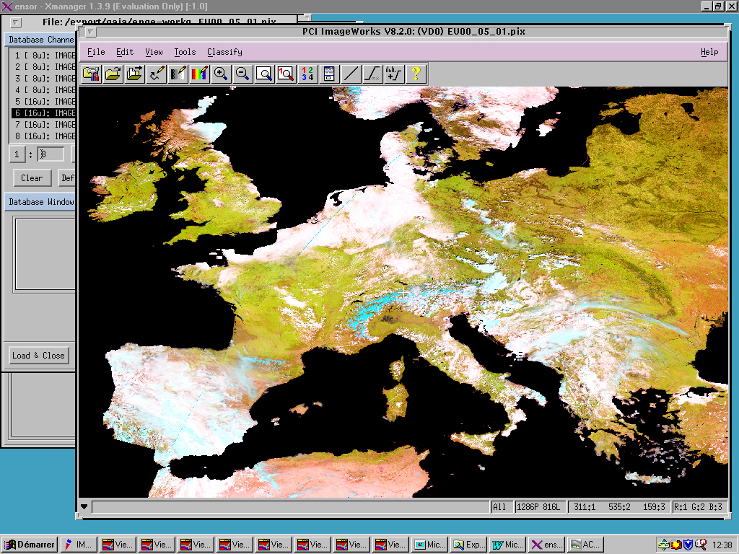
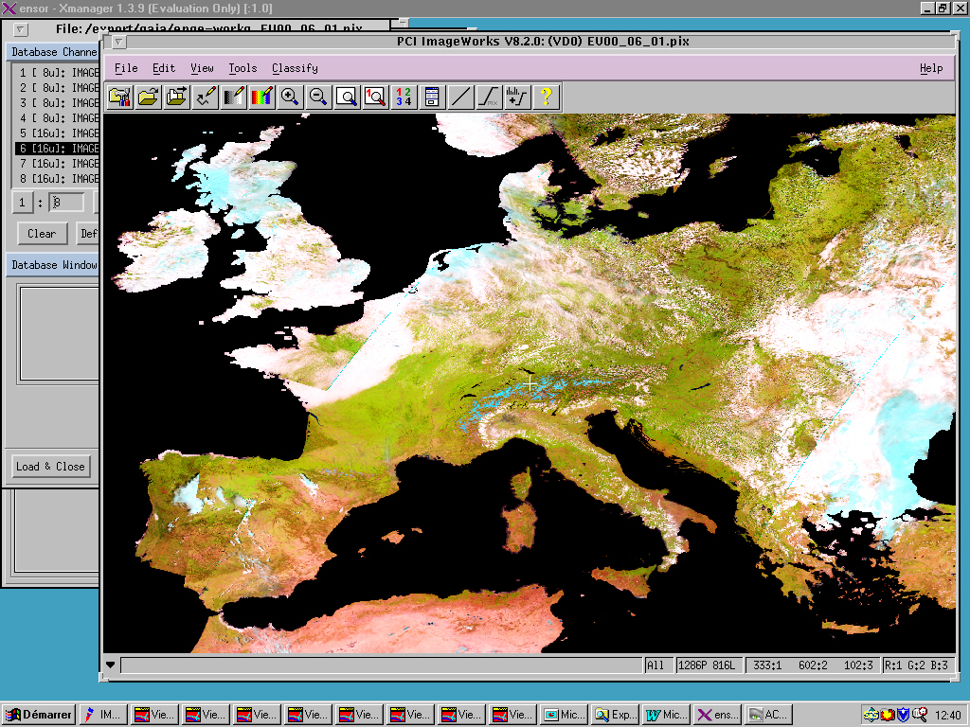
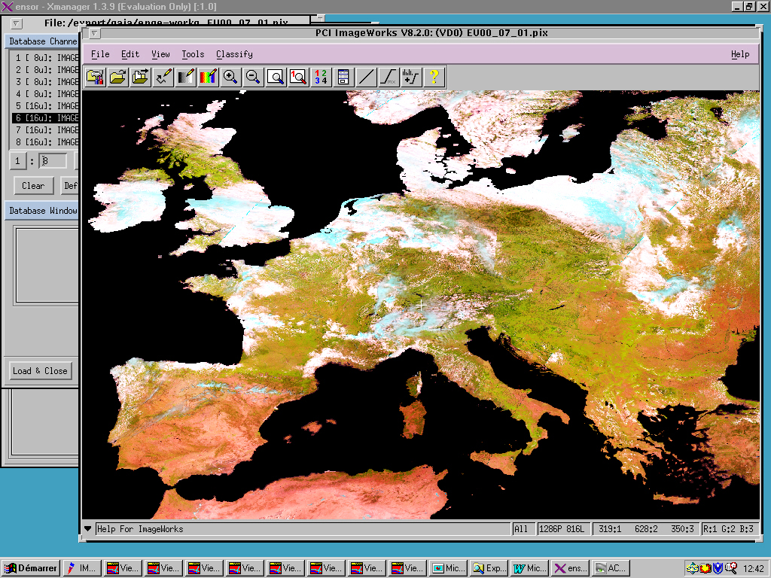
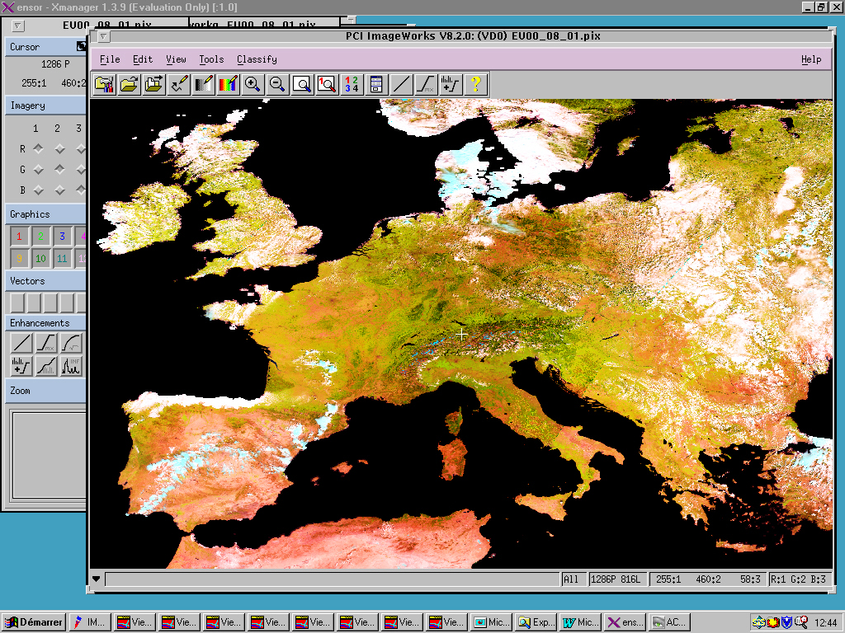
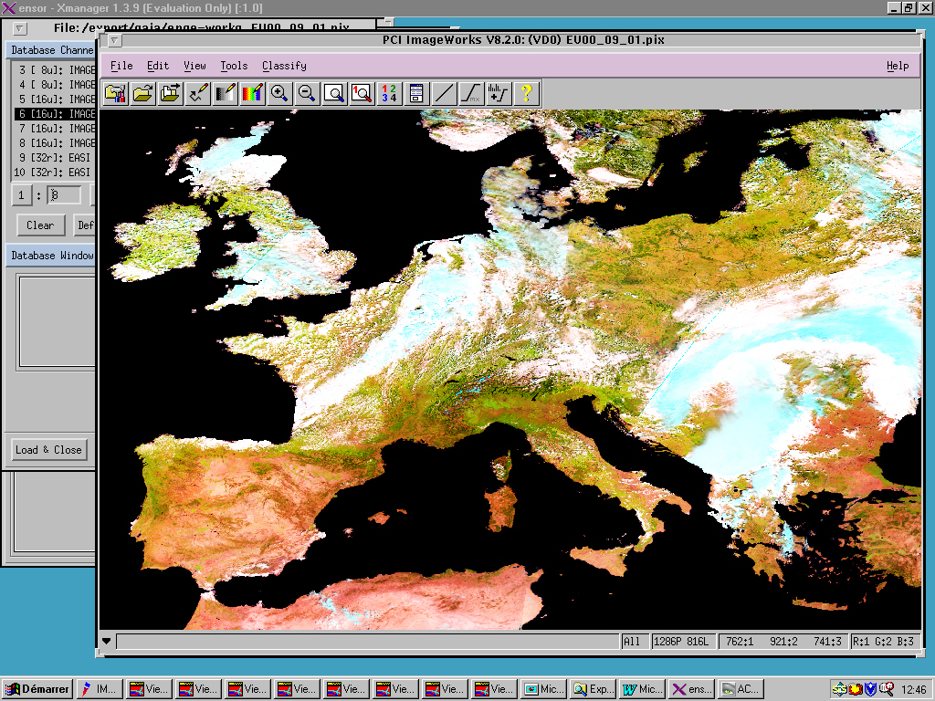
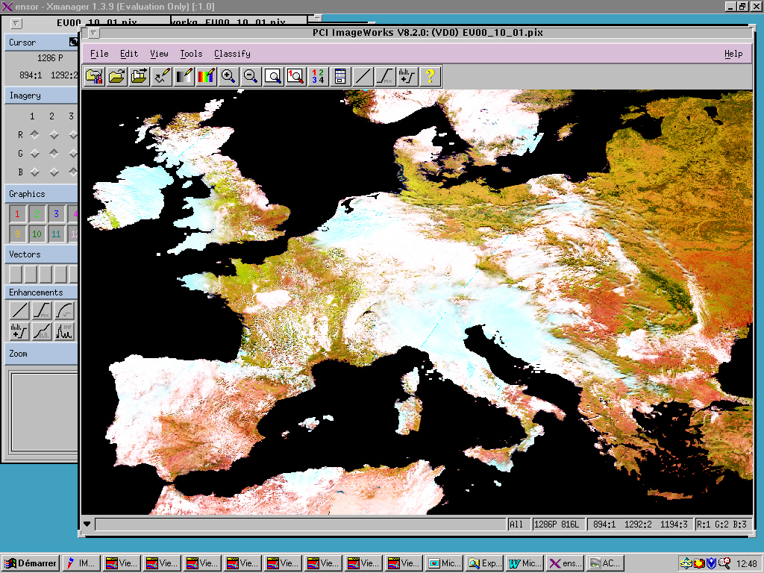
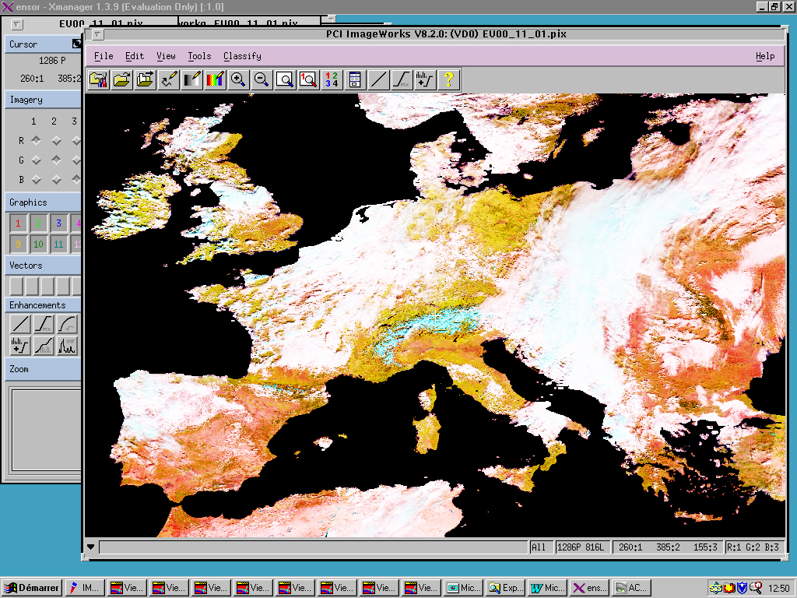
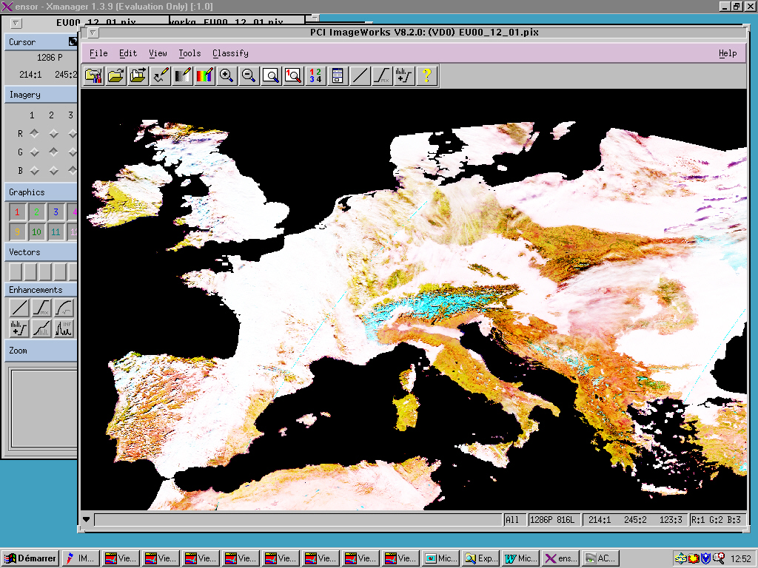
SPOT-Végétation
1st January 2000
1st February 2000
1st March 2000
1st April 2000
1st May 2000
1st June 2000
1st July 2000
1st August 2000
1st September 2000
1st October 2000
1st November 2000
1st December 2000
Notes:
Toutefois la difficulté de l’observation de la surface de la terre par satellite, c’est bien mais les image prises à 800 km d’altitude c’est d’abord de l’atmosphère, il a fallut d’abord s’affrancher des perturbations atmosphériques liés à la vapeur d’eau, à l’ozone et aux aérosols.
Cette dia est une animation réalisée au départ de la première image de chaque mois.
Elle met en évidence:
-La fréquence et l’importance de la couverture nuageuse
-Les problèmes du MIR
-La présence de neige permanente et temporaire
-(Plus difficile: la saisonnalité)
-> nécessité de réaliser des composites

Slide 35
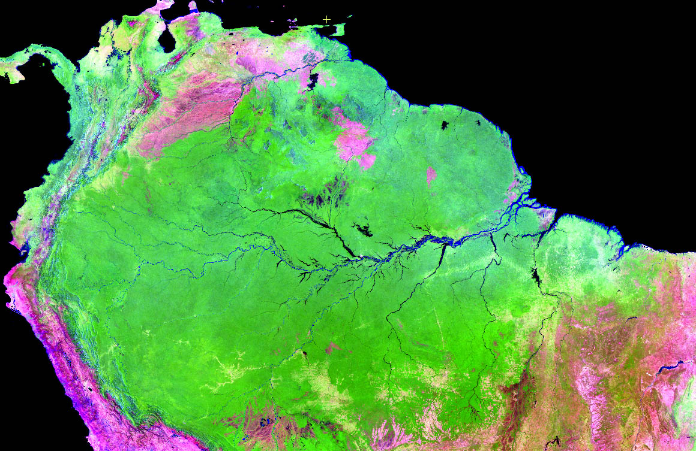
GlobalWatch project (UCL-SP PPS)

Slide 36
Compositing cloud free pixels from each image into a composite
7 x 1 daily obs.
Weekly composite
Annual
composite
Notes:
En effet, l’image que l’on a pour 1 jour (celle du dessus), meme si elle est corrigée pour un grand nombre de perturbattion atmosphérique, présente toujours des artefacts:
On voit qu’il y a des endroits ou il n’y a pas de donnés
Et d’autres endroits qui sont cachés par des nuages
Cette image est trop bruitée et on va faire une synthèse de 7 image journalières afin de créer une image de meilleure qualité (voir ci-dessous)

Slide 37
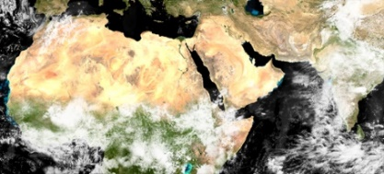
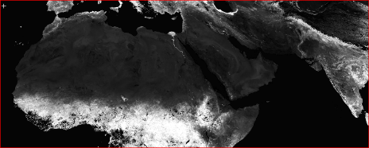
Compositing algo. to combine the cloud free surface reflectance
NDVI
Compositing algo. comparison
Compositing algo
Max NDVI Value
Best Available Pixel
Mean compositing
Daily data
In
0ut
Surface Reflectance Composite
(Vancutsem et al., 2007, Bicheron et al., 2009)
Clouds, hazes and pixel anomalies
Notes:
The compositing process intends to minimize cloud contamination and reduces the variations in reflectance values due to image acquisition with varying geometries
The daily images are composited with a frequency of ten day in near real time using the mean compositing (MC) algorithm that averages reflectance values after a quality control - Composite (SWIR, NIR, RED)
For VEGEATION, we use a home made cloud screening
For MODIS, we use the NASA cloud screening, completed by some home made verifications
we produce decadal composite at 250m, 500m, 1000m.

Slide 38
Compositiong algo. to average cloud free surface reflectance
https://maps.elie.ucl.ac.be/CCI/viewer/
Sen2Agri : Weighted Average Synthesis Processor
-weight as function of date (central date distance)
-weight as function of Aerosol Optical Tickness
-weigth as function of distance to clouds
-weight as function of sensor (S2>L8)
=> Reduction of the compositing artefacts
Adoption of Sen2Agri processor by Theia (CNES)
(Vancutsem et al., IJRS2007, Hagolle et al., Sen2Agri2014)
Notes:
Adoption of the Sen2

Slide 39
Sen2-Agri system using automatically MAJA and WASP algo.
Before the monitoring period
Monitoring period
System initialization
Start of the season
End of the season…
Sen2-Agri : parameters settings
Area of Interest | Shapefile to be uploaded
Monitoring period | Start and end dates to be defined
S2 or S2 + L8 | To be selected
Other parameters | …
Mali stratification (PIRT)
Sen2-Agri : field campaign
Sampling design | Stratification and sampling
Field visit | In situ data collection – early survey
 | In situ data collection – mid-season survey
Data upload | Field data quality control and formating

Slide 40
First cloud free composite series over Mali
at 10m resolution from Sentinel-2 and Landsat 8
July 2016
August 2016
September 2016
October 2016

Slide 41
First national S2a surface reflectance composite (Ukraine 2016)

Slide 42
Western Cape Province monitored by Sentinel 2 in 2016
Winter grain production region (South Africa)
June
July
August
September
October
November
Juillet 2016
Août 2016
Cape Town
Septembre 2016
Octobre 2016

Slide 43
Temporal metrics to capture the time series info
Example of specific set of metrics (features) designed for crop monitoring
1
2
3
4
5
Maximum Red
(average of 3 max.)
Max. positive
slope
Maximum NDVI
(average of 3 max.)
Max. negative
slope
Minimum NDVI
(average of 3 max.)
Bare soil at sowing preparation
Fastest growth of vegetation
Maximum green
biomass
Fast reduction of
vegetation
Harvested crop or
non green residues
NDVI
Time
(Matton et al., 2015, Waldner et al., 2016, Lambert et al., 2016)

Slide 44
Sen2Agri: advanced extraction of temporal features from gap filled TS
L2A time series
Gap filling and regular temporal sampling
Gap filled regular L2A time series
Extraction of temporal fetaures
Dates of max/min NDVI, max/min NDVI slope, max red
Extraction of Surface Reflectance values
Surface Reflectance values on key dates
NDVI example

Slide 45
Monday 16 at 14:00 – Praticals in 2 computer rooms

Slide 46
Tonight - icebreaker
Tomorrow – your poster !
Notes:
Vésale, Mercator,
Erasme, George Lemaître

Slide 49
Musée L

Slide 50
1777

Slide 51
Louvain-la-Neuve - a pioneer urban project designed 45 years ago as an ecofriendly town and built from scratch in the farm fields

