Slide 1
Introduction to ESA toolboxes
Fabrizio Ramoino

Slide 2
SNAP
SNAP
SeNtinel Application Platform
Download it at
step.esa.int
Sentinel-1 Toolbox
Free and open source software
Common Java core framework
Joint development of SNAP platform for Sentinel and other toolboxes
Interchangeable Java/Python plugins
Portable engine to Cloud infrastructure
User friendly: single installation, intuitive GUI, online help, tutorials, active user forum
Sentinel-2 Toolbox
Sentinel-3 Toolbox
SMOS Toolbox
PROBA-V Toolbox

Slide 3
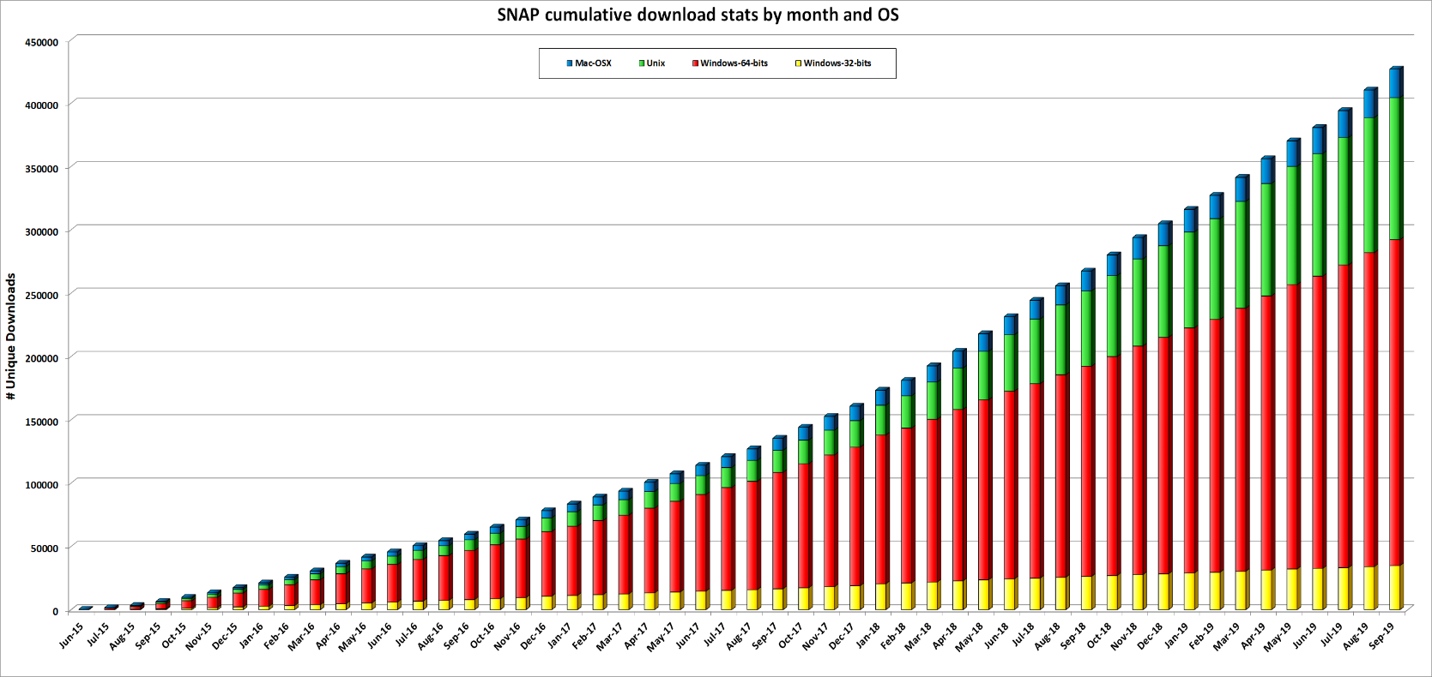
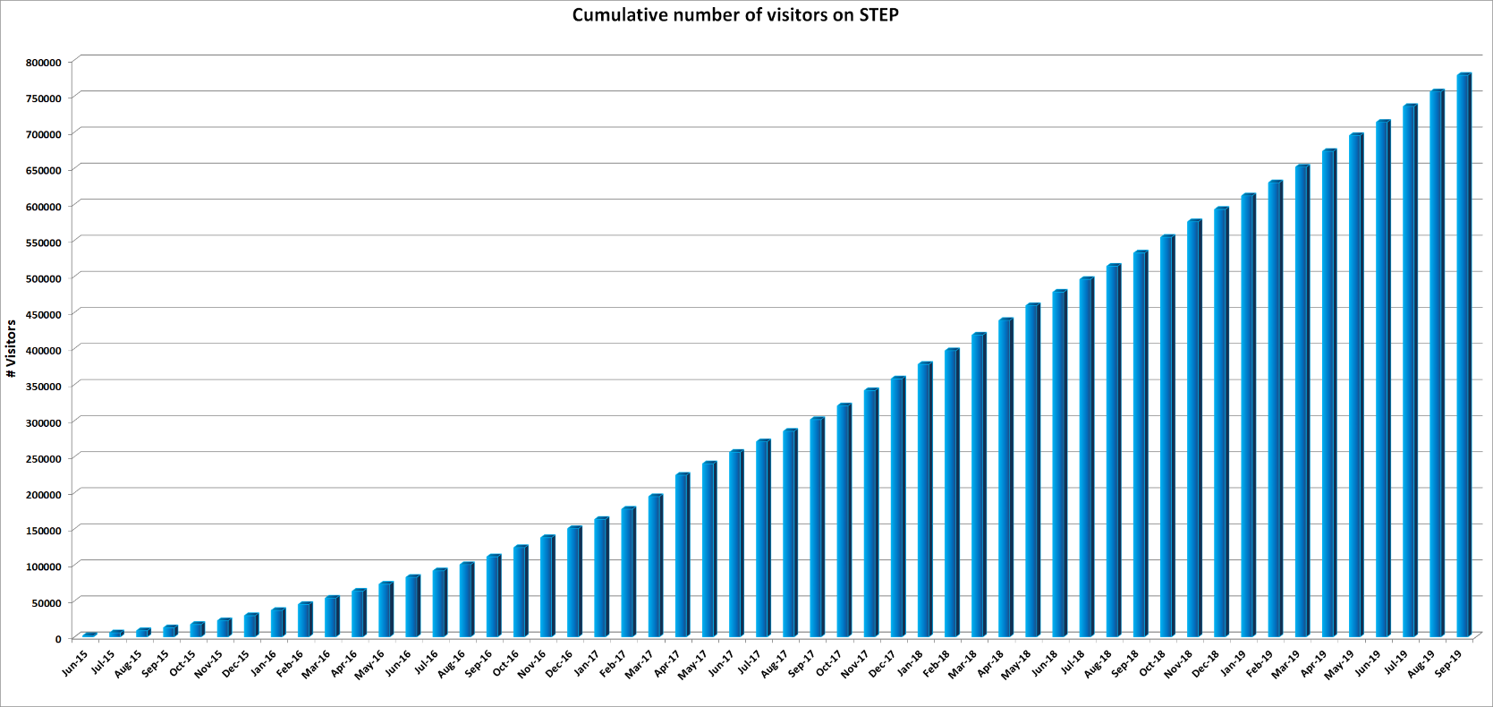
SNAP downloads & STEP visits
STEP website exceeded 775.000 visit sessions from June 2015 until today
SNAP download exceeded 425.000 from June 2015 until today

Slide 4
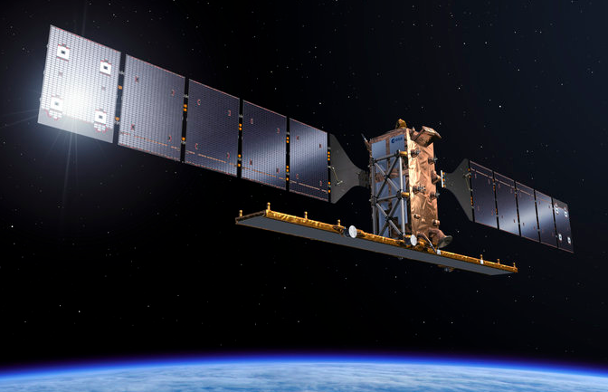
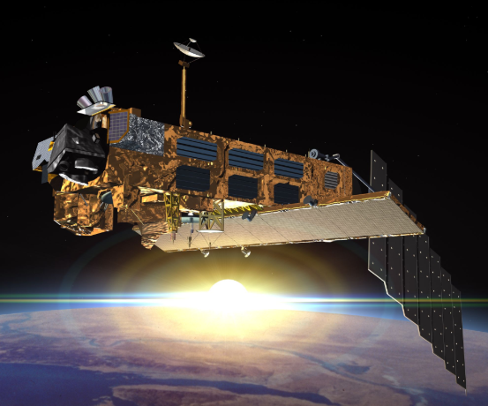
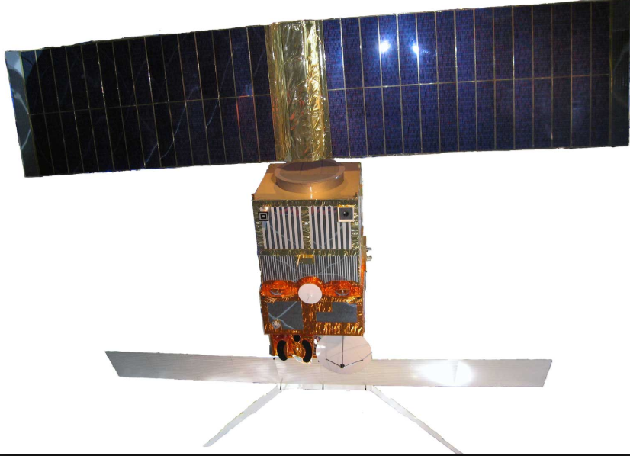
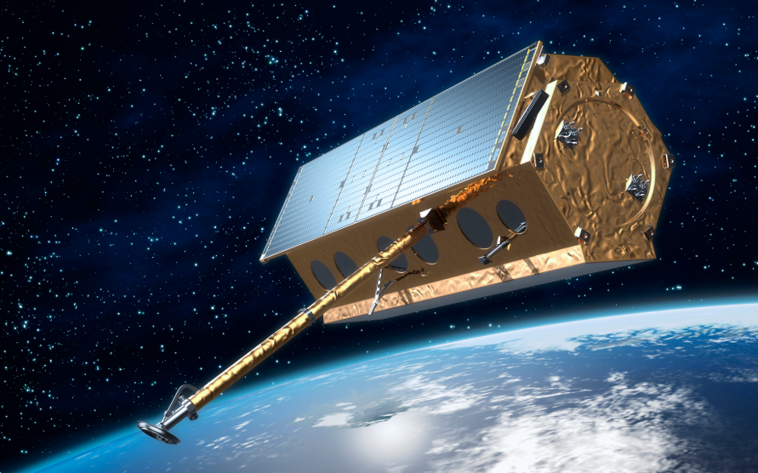
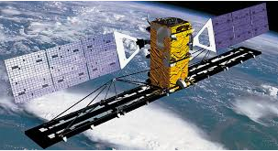
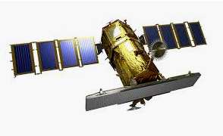
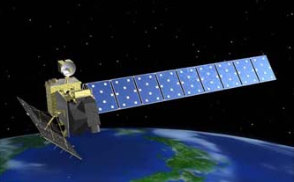
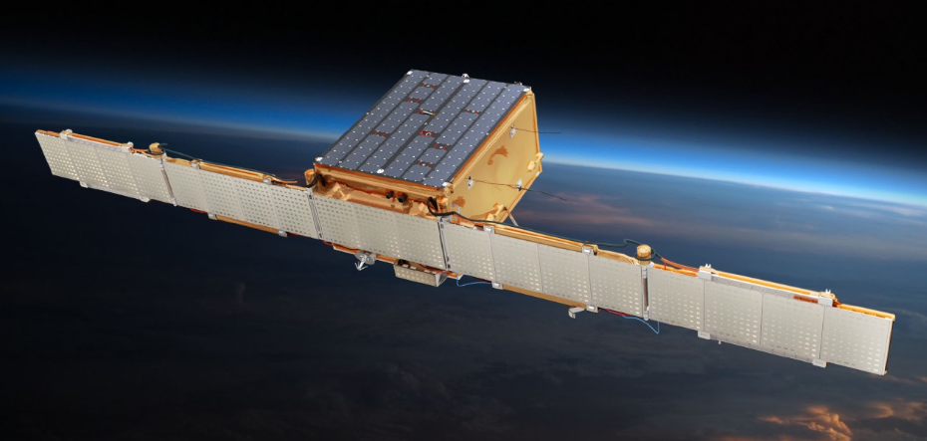
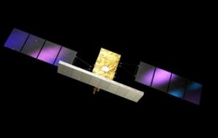
SNAP & SAR (Sentinel-1 Toolbox)
Sentinel-1
ENVISAT
ERS-1
TerraSAR-X
RADARSAT
KOMPSAT-5
ALOS 1&2
ICEYE
COSMO-SkyMed
Main features: Absolute calibration, Multilooking, Speckle filtering, Precise orbits handling
Coregistration of detected and complex products
Full support of Sentinel-1 TOPS interferometry, debursting, slice assembly
Terrain Correction
SAR simulation and Layover and shadow masks
Applications: oil spill detection, ship detection, wind field estimation etc.
Fully integrated and featured InSAR tools for Stripmap and Zero-Doppler focused data
Compatibility with PolSARpro Toolbox (Reader, Writer)
Integrated Export to SNAPHU (interferometric phase unwrapping) and STAMPS (PS InSAR)

Slide 5
Sentinel-1 characteristics
Main features:
C-band (5.4 GHz) SAR
Daily coverage of high priority areas
Bi-weekly global coverage
12 days repeat cycle (6 days with both Sentinels 1A and 1B operational)
7 years design life time (consumables for 12 years)
Applications:
Ice and marine/land monitoring
Mapping in support of humanitarian aid in crisis situations

Slide 6
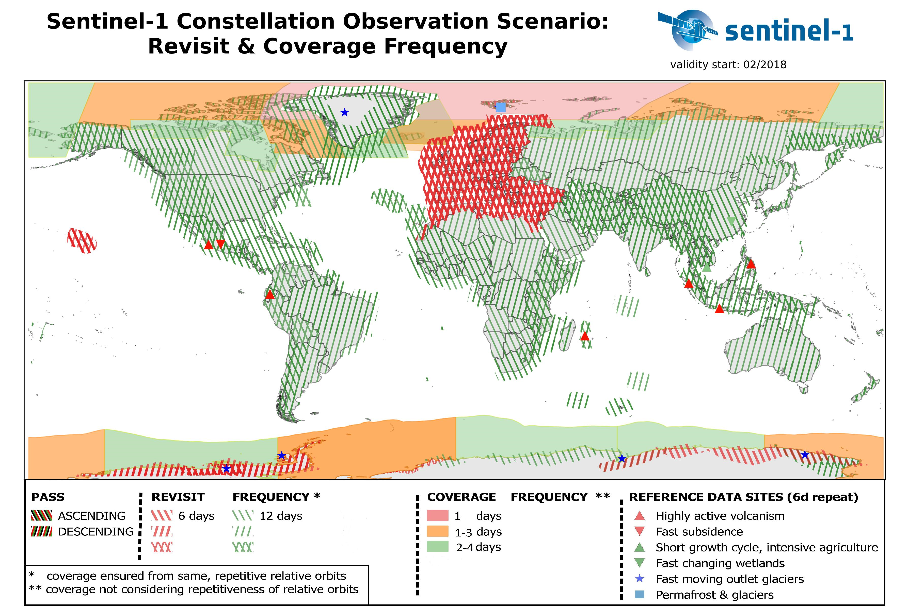
Sentinel-1A & B data
Available products
Level 0 (L0-RAW)
Level 1 Ground Range, Multi-Look, Detected Medium Resolution (L1-GRDM) and High Resolution (L1-GRDH)
Level 1 Single-Look Complex (L1-SLC)
Level 2 Ocean (L2-OCN)
2018
S-1 A/B
S-1 A/B
S-1 A/B
1,304,078 published products
(2.3 PB)
S-1 A/B
3,282,679 published products
from start of Ops to the end Y2018 (~5.8 PB)

Slide 7
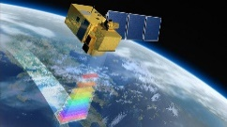
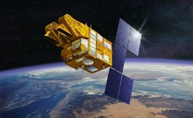
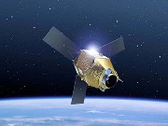
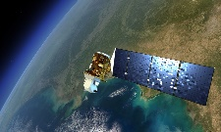
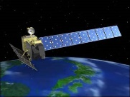
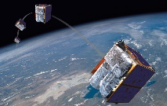
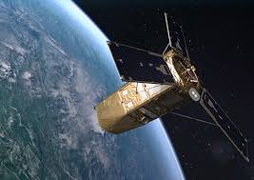
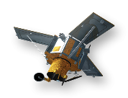
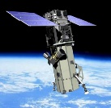
SNAP & Optical HR (Sentinel-2 Toolbox)
……
Sentinel-2
SPOT
Pleiades
Landsat
ALOS AVNIR
RapidEye
Kompsat
Ikonos
Worldview
Main features:
Sen2Cor and i-Cor for Atmospheric Correction
L2B biophysical processor (LAI, fAPAR, …)
Reflectance to Radiance Processor
Radiometric Indices
Vegetation indices: DVI, RVI, PVI, IPVI, WDVI, TNDVI, GNDVI, GEMI, ARVI, NDI45, MTCI, MCARI, REIP, S2REP, IRECI, PSSRa
Soil indices: SAVI, TSAVI, MSAVI, MSAVI2, BI, BI2, RI, CI
Water indices: NDWI, NDWI2, MNDWI, NDPI, NDTI
IdePix Processor: pixel classification
OTB tools: Pansharpening, Rasterization, Segmentation, …

Slide 8
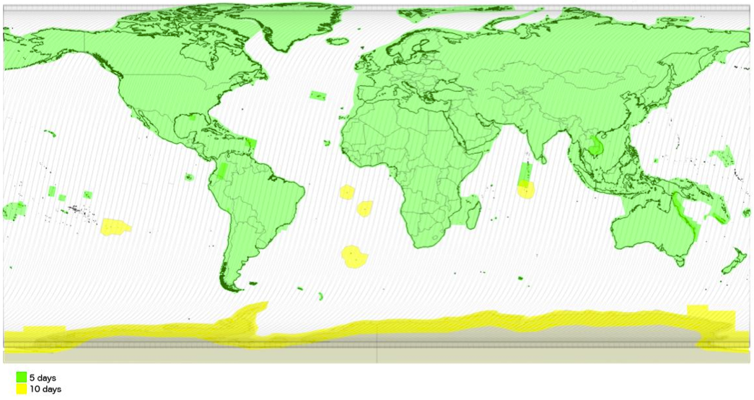
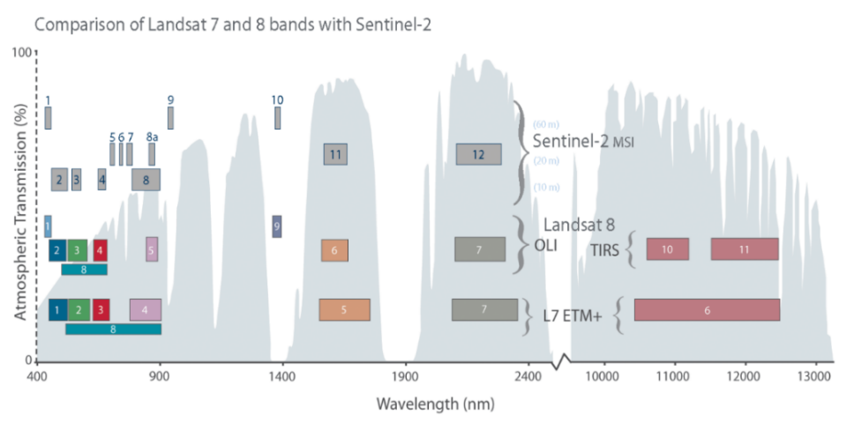
Sentinel-2 characteristics
Optical mission for the monitoring of land and coastal regions
Main features:
Constellation of two satellites (Sentinel-2A and Sentinel-2B)
Multi-Spectral Instrument (MSI)
Polar, sun-synchronous orbit at 786km and LTDN 10h30
10 days repeat cycle (5 days with both Sentinels 2A and 2B operational)
Swath of 290km

Slide 9
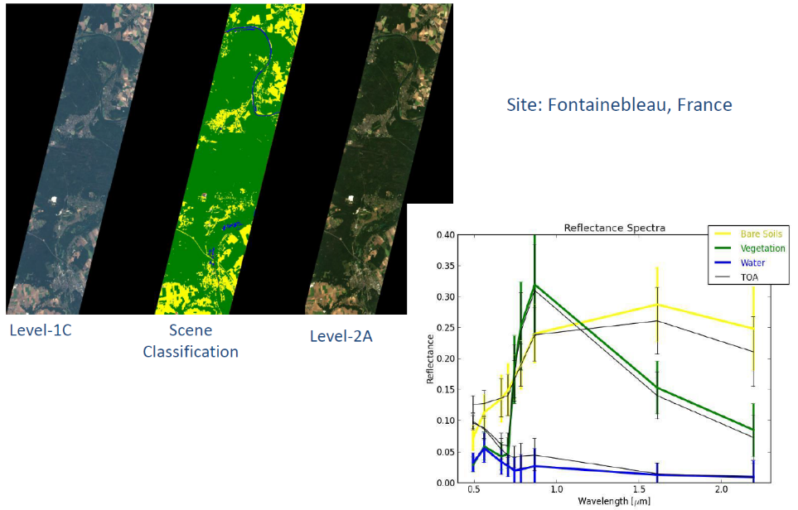
Sentinel-2 products
SENTINEL-2 products available for users (either generated by the ground segment or by the SNAP) are:
Level-1C
Top-Of-Atmosphere reflectances in cartographic geometry
Systematic generation and online distribution
~600MB (each 100km x 100km)
Level-2A
Bottom-Of-Atmosphere reflectances in cartographic geometry
Systematic and on-User side (using SNAP)
~600MB (each 100km x 100km)
Products are a compilation of elementary granules of fixed size, along with a single orbit. A granule is the minimum indivisible partition of a product (containing all possible spectral bands).
For Level-1C and Level-2A, the granules, also called tiles, are 100x100 km² ortho-images in UTM/WGS84 projection.

Slide 10
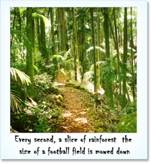
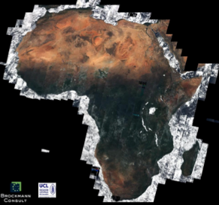
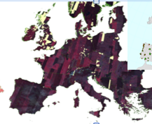
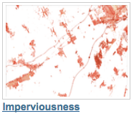
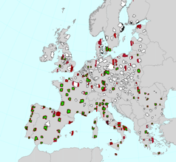
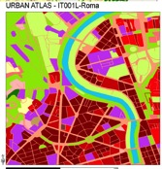
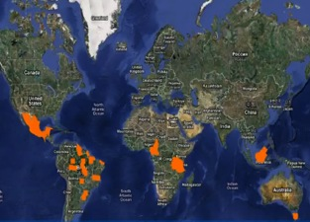
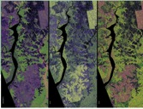
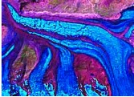
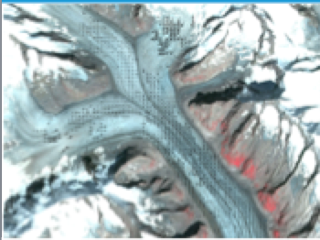
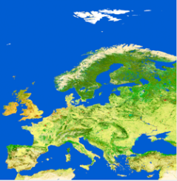
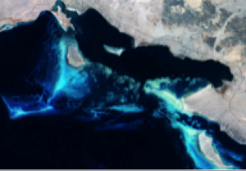
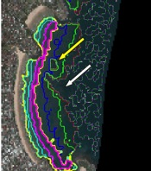
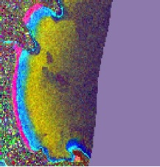
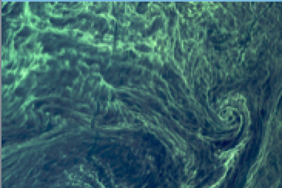
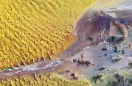
Sentinel-2 applications
Agriculture, Forests & Carbon, Vegetation monitoring
Land cover classification, high resolution layers & change
Regional to Urban Applications
Global Land use
& change
Glaciers & Ice
Emergency management
B11
Band 11
Geology
Water quality
Coastal zones/bathymetry

Slide 11
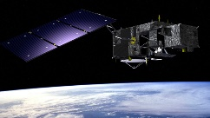
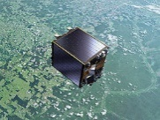
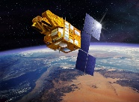
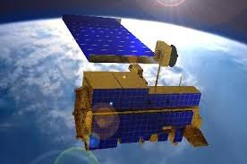
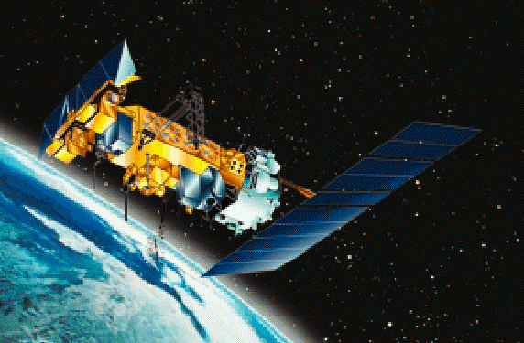
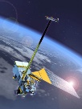
SNAP & Optical/Thermal MR (S3 Toolbox)
……
Sentinel-3
ENVISAT
ERS
Proba-V
SPOT VGT
MODIS
AVHRR
VIIRS
Main features:
Visualizing spectrum of pixels
Uncertainty visualization and propagation of uncertainty in BandMaths
Pixel extraction tool
Specific sensor processors:
S3 OLCI Radiometry, S3 SLSTR PDU stitching
AATSR/SLSTR Regridding
Performs radiometric corrections on MERIS
Optical water type classification based on atmospherically corrected reflectances
FU (Forel-Ule) Classification used to derive the hue angle and FU value
IdePix Processor: pixel classification
FLH (Fluorescence Line Height) / MCI (Maximum Chlorophyll Index) retrieval
FUB/WeW processor

Slide 12
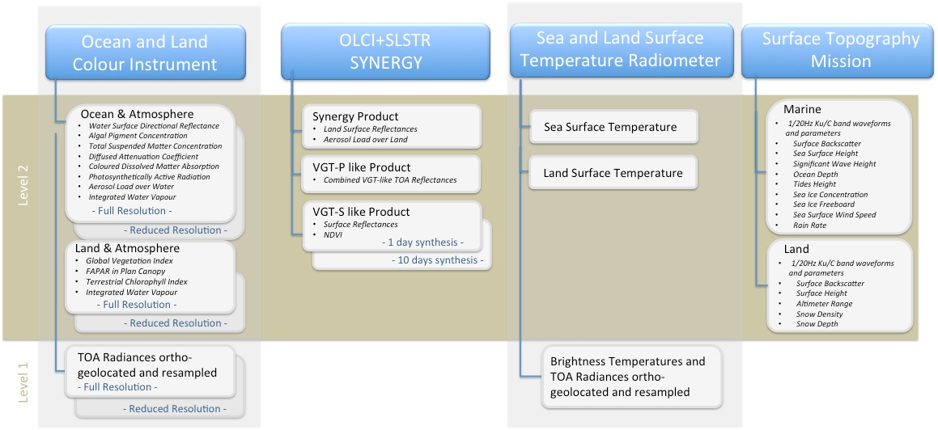
Sentinel-3 products
Sentinel-3 is an ocean and land mission and provides data continuity for the ERS, ENVISAT and SPOT-VGT satellites.
SENTINEL-3 makes use of multiple sensing instruments to accomplish its objectives:
SLSTR (Sea and Land Surface Temperature Radiometer)
OLCI (Ocean and Land Colour Instrument)
SRAL (SAR Altimeter)
DORIS (Doppler Orbitography and Radiopositioning Integrated by Satellite)
MWR (Microwave Radiometer)

Slide 13
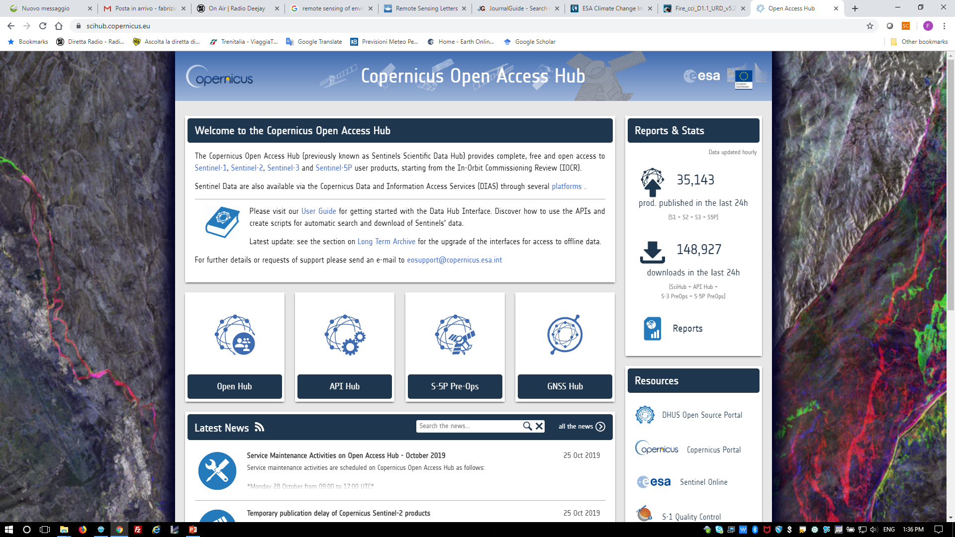
Access to Sentinels data
The Copernicus Open Access Hub provides complete, free and open access to Sentinel-1, Sentinel-2 and Sentinel-3 user products.
Go to https://scihub.copernicus.eu/

Slide 14
Sentinel-2 spectral bands

Slide 15
Sentinel-2 L2A data overview
Sen2Cor is the Atmospheric Correction processor used in the ESA Payload Data Ground Segment to generate S2 L2A data and it is distributed via STEP to be used as SNAP plug-in or via command line.
Bottom-of-atmosphere (BOA) reflectances in cartographic geometry (UTM/WGS84)
Products additionally include:
Scene Classification Map
Water Vapor Map
Aerosols Optical Thickness Map
Algorithm includes:
Cloud and cloud shadow detection
Cirrus detection and correction
Slope effect correction
BRDF effect correction
Beyond Sen2Cor, Sentinel-2 data can be atmospherically corrected using others processors:
MAJA (developed by CESBIO/CNES)
i-COR (developed by VITO)
CorA (developed by Brockmann Consult)
LaSRC (developed by NASA GSFC/USA)
……

Slide 16
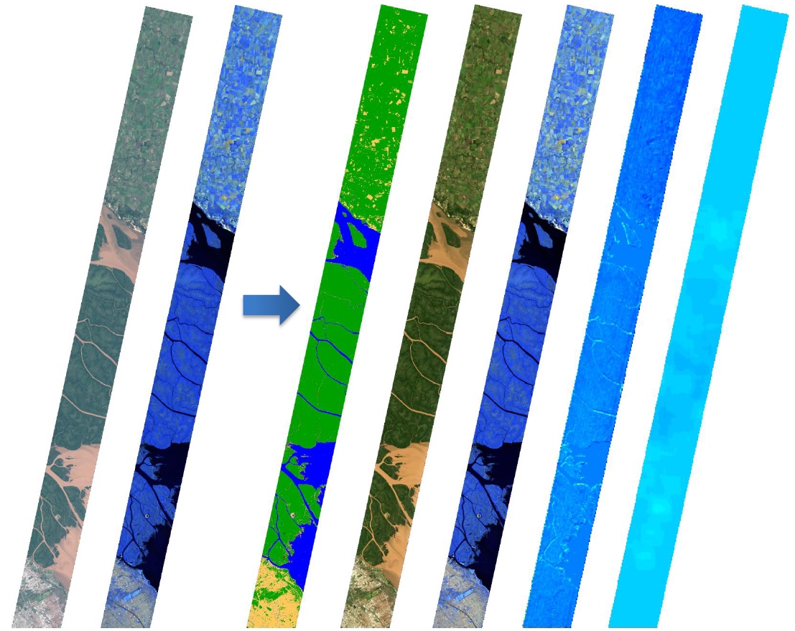
Sentinel-2 L2A data overview
From left to right:
Level-1C [TOA]
[RGB] B4-B3-B2
[RGB] B12-B11-B8a
Level-2A [BOA]
Scene Classification
[RGB] B4-B3-B2
[RGB] B12-B11-B8a
Water Vapour
Aerosols Optical Thickness

Slide 17
Sentinel-2 pre-processing
Essential pre-processing steps:
Resampling
The S2 products are multi-size
B2, B3, B4 and B8 @ 10m
B5, B6, B7, B8A, B11 and B12 @ 20m
B1, B9 and B10 @ 60m
Needed if the user wants to combine bands with different spatial resolution
Subset (spatially/spectrally)
The S2 data are distributed in tiles 100x100 km² ortho-images in UTM/WGS84 projection.
Needed if the AOI covers a portion of the S2 scene or if only a subset of bands are useful in the next step (this will reduce the computation time)
Re-projection
If the AOI covers more than one S2 tile in different UTM zones the user needs to re-project in a common CRS before to mosaic them.
If the user wants to merge different data sources projected in different CRS.
To export the view in KMZ and visualise your output in Google Earth.

Slide 18
Practical on Sentinel-2 data using SNAP
Overview of Sentinel-2 data
Spectral bands
Level 1C & 2A products intercomparison
Pre-processing steps
Graph builder
Burned area estimation
Normalized Burn Ratio (NBR) calculation
Burn severity estimation
Water change detection
Second Normalized Difference Water Index (NDWI-2) calculation
Sentinel Water Mask (SWM) calculation
Create water mask based on NDWI2 and SWM
Water change detection

