Slide 1




Landslide frequency assessment
Cees van Westen
Faculty of Geo-Information Science and Earth Observation
ITC, University of Twente, The Netherlands
E-mail: westen@itc.nl

Slide 2
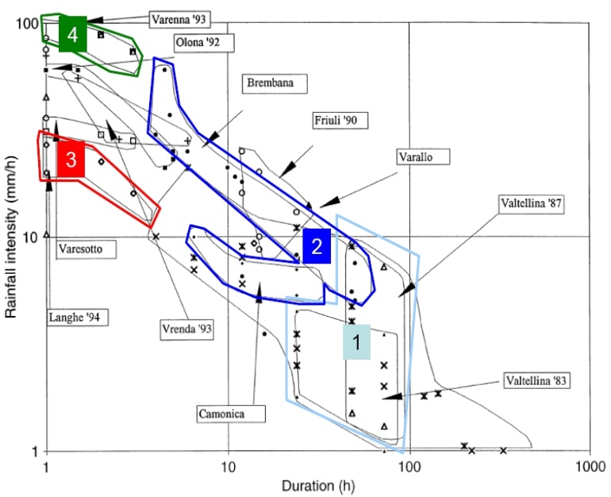
Contents of the lecture
Frequency assesment
Landslide frequency: what is it?
Methods that can be used?
Heuristic method
Landslide inventories (how are they made)
How to get date information?
Rainfall thresholds
Physically based modelling
Problems
Conclusions
Key publication:
Corominas, J. and Moya, Engineering Geology
Volume 102, Issues 3-4, 1 2008,193-213

Slide 3
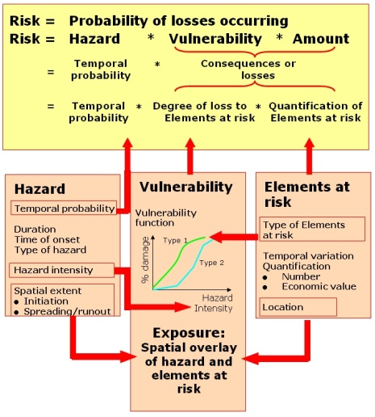
Framework of risk assessment
RISK = HAZARD * VULNERABILITY * AMOUNT
Hazard = Probability of event with a certain magnitude
Spatial probability: probability of a hazard event with a certain intensity happening at a particular location (e.g. pixel)
Temporal probability: probability that an event with a certain intensity happens within a given period of time.
Magnitude probability: probability that an event happening has a certain magnitude/intensity
Sometimes these 3 are evaluated separately, sometimes jointly

Slide 4
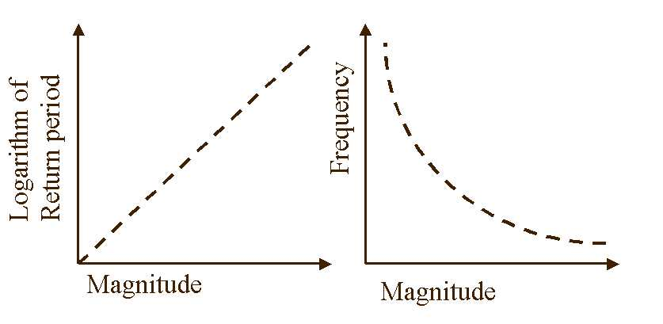
M-F relationship
Magnitude-frequency relationship is a relationship where events with a smaller magnitude happen more often than events with large magnitudes.
Magnitude is related to the amount of energy released during the hazardous event, or refers to the size of the hazard.
Frequency is the (temporal) probability that a hazardous event with a given magnitude occurs in a certain area in a given period of time.
ISL 2004
Notes:
Introduction to GIS
4

Slide 5
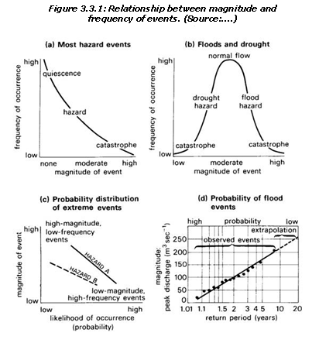
Relationship between Magnitude-Frequency
Example:
The higher the magnitude the worse it gets
Rainfall: exception: too little or too much is bad
Probability distribution of extreme events
Relation return period and magnitude
Why doesn’t this often not apply to landslides?

Slide 6
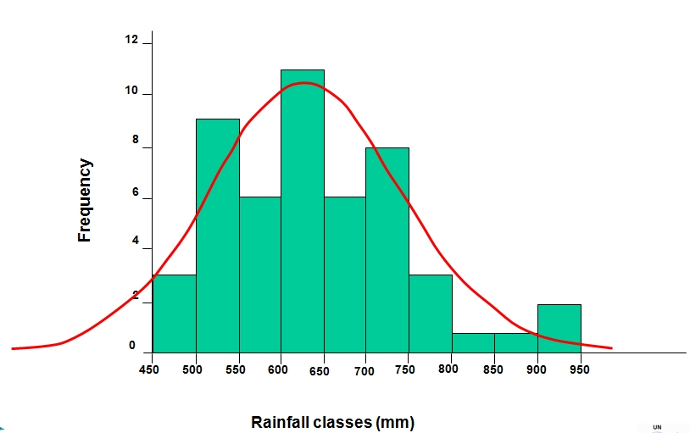
Frequency Analysis

Slide 7
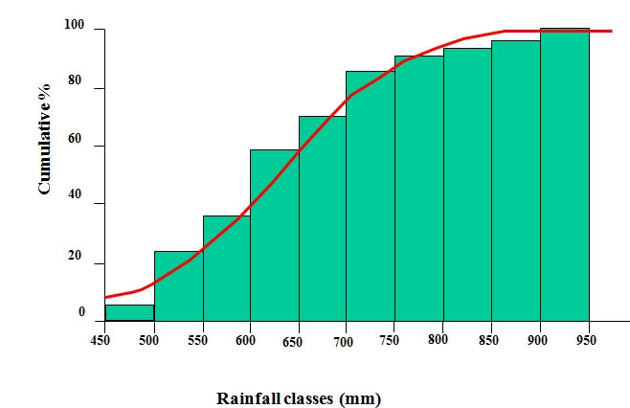
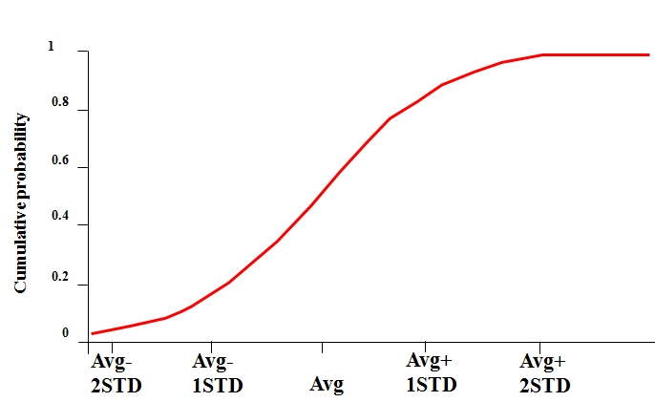
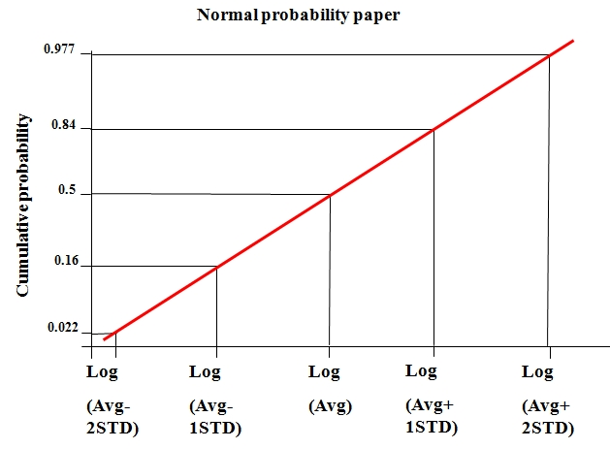
Cumulative frequency
Cumulative probability curve for a normal distribution
Rank the values from the smallest to the largest value.
Calculate the cumulative probabilities: P=R/(N+1)
Plot the values against the cumulative probability on probability paper and draw a straight line (best fit) through the points
From the line, estimate the standard deviation and mean
Estimate all other required probabilities versus values

Slide 8
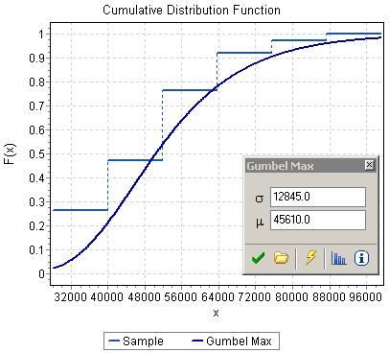
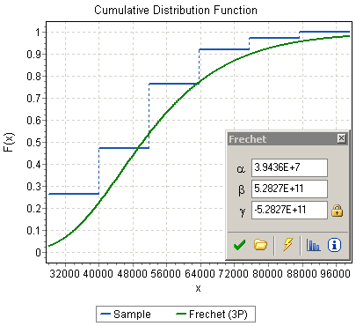
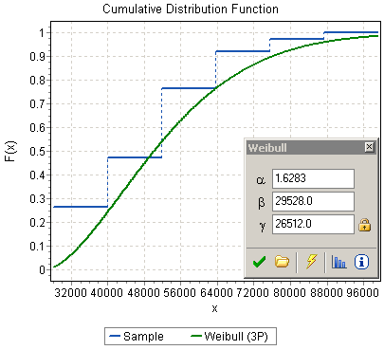
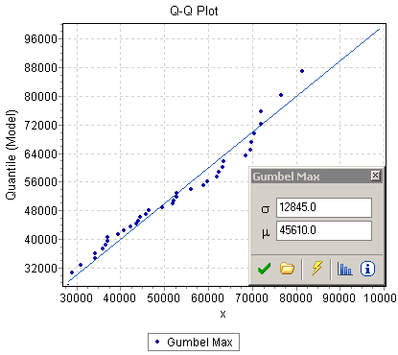
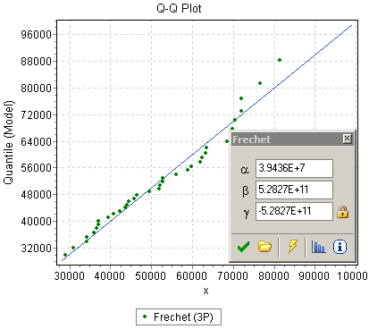
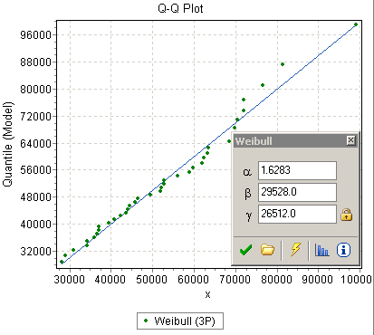
Fitting distribution functions
Gumbel
Frechet
Weibull

Slide 9
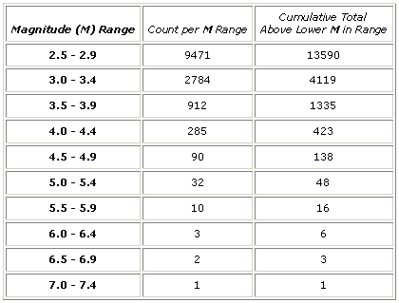
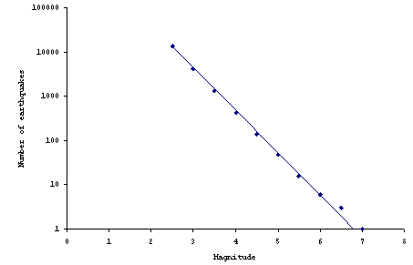
Earthquakes
The Gutenberg-Richter Relation
Log(N)
Magnitude
log N(M) = a – bM
Gutenberg-Richter plots are made for various data sets all over the world, and most of them end up having a b value very close to 1, usually slightly less.

Slide 10
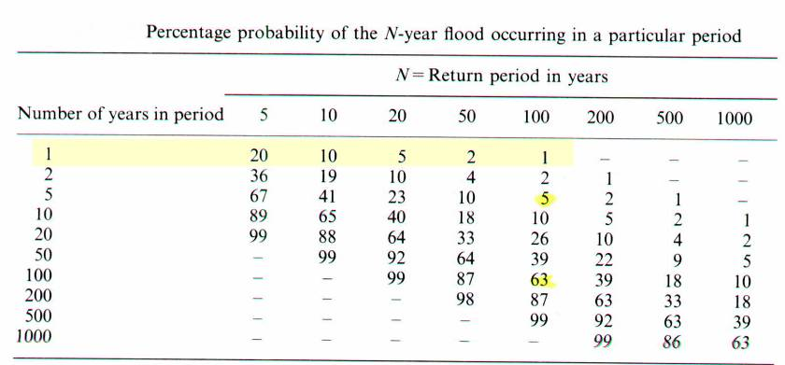
Return period / exceedance probability.
For the average annual risk!
The probability that an event will occur at least once in n successive year:
R = 1- (1 - 1/T)^{n}
Percentage probability of the N-year event occurring in a particular period
E₁₀₀ has a greater probability of occurring during the next 100 yrs (63%) than during the next 5 years ( 5%)

Slide 11
Why is this difficult for landslides?
In general landslides do not occur in the same location with different magnitudes.
Exceptions:
  debrisflows / rockfall. Even then the occurrence of a past event alters the situation.
  Reactivation of landslides (e.g. mudflows)
Probability of landslide occurrence is seldom computed in regional scale analyses.
What is the magnitude / intensity of landslides?

Slide 12
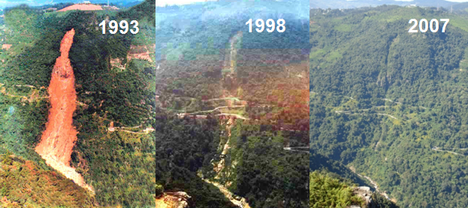
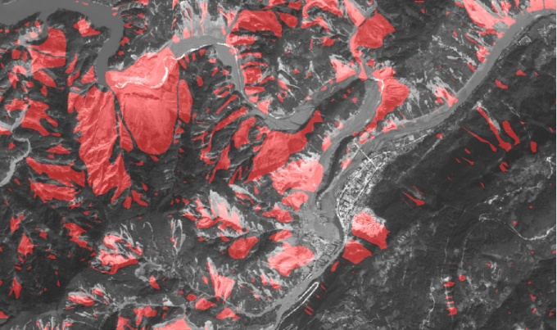
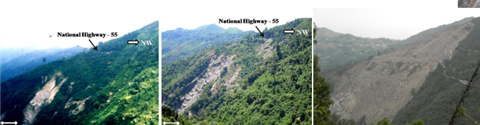
Landslide frequency
Frequency of what?
Single landslides?
  First time failure
  Reactivation.
  Successive events in the same location (e.g. rockfall, debrisflow)
Many landslides?
  Density of landslides within terrain units over time.
Triggering events?
  Rainfall / earthquakes
  Soil moisture /acceleration

Slide 13
Frequency: Absolute or relative
Absolute frequency expresses the number of observed events in a terrain unit (i.e. slope, debris fan).
  repetitive occurrence of first-time slope failures,
  reactivation events of dormant landslides, or
  acceleration episodes (surges) of active landslides.
  Rock falls and debris flows are typical landslide types treated as repetitive events.
Relative frequency is a normalized frequency.
  the ratio of the number of observed landslide events to the unit area or length (i.e. landslides/km²/year).
  appropriate when working with large areas and/or at small scale.

Slide 14
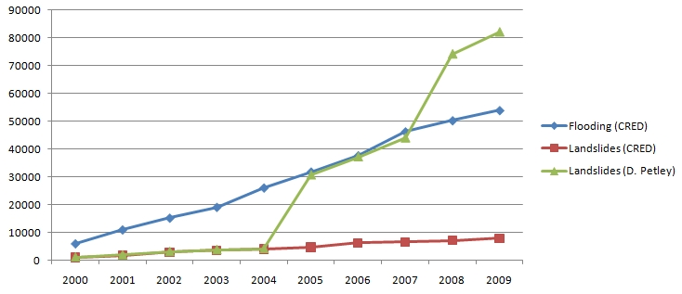

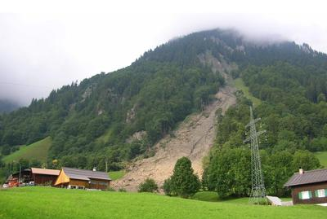
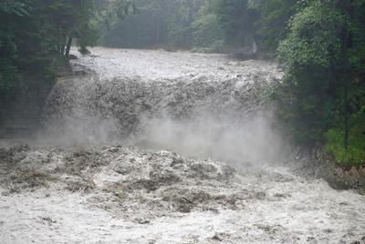
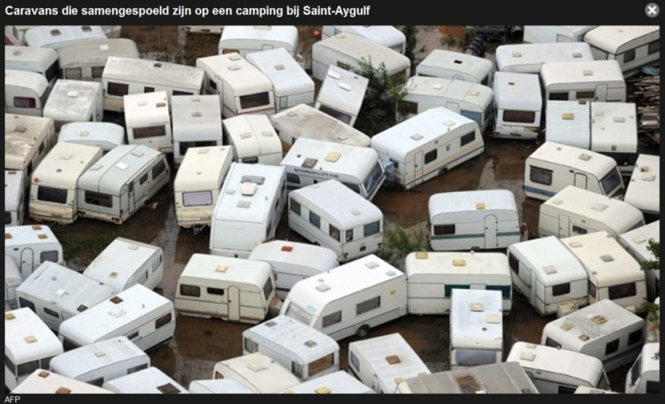
Landslide data are scarce
Other disasters 2000-2009 (CRED database)
Earthquake: 453,626 River flood: 54,012
Storm: 172,220 Volcano: 237

Slide 15
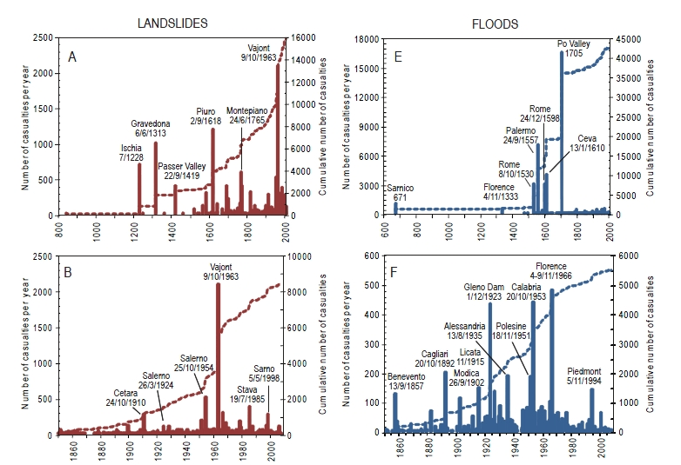
Example: Historical analysis of landslides and floods in Italy
In Italy a database was constructed of historical damaging events over the last 2000 years, with 3139 landslide events and 2595 flood events.
the number of landslide and flood events per unit time (i.e., per year) increases with time
the severity varies with time
Same sites are affected but damage in same site is less frequent
P. Salvati, C. Bianchi, M. Rossi, and F. Guzzetti, Societal landslide and flood risk in Italy. NHESS 10, 2010

Slide 16
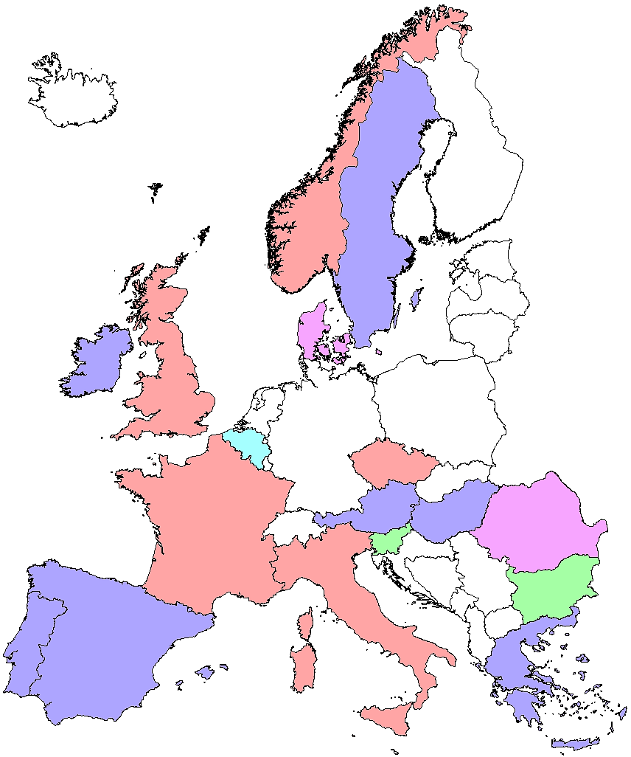












Example: Europe
>100,000 landslide locations collected by 6/11 from various sources with different levels of detail
Data sources
National level inventories, detailed
Regional level inventories, detailed
National level compilations, sparse
Map picked locations
Googled locations

Slide 17
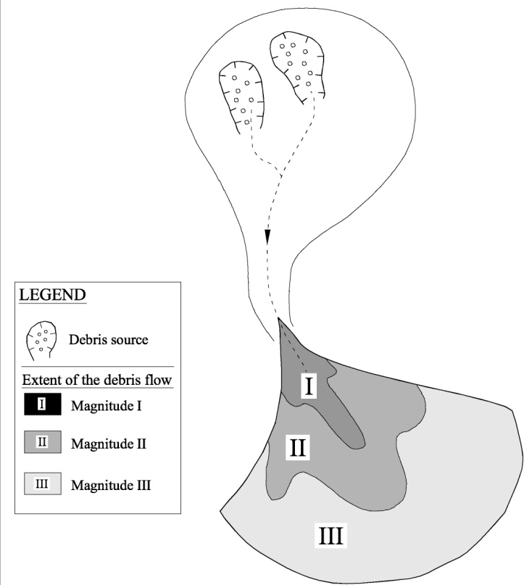
Two approaches
Forward looking:
  the analysis of the present conditions and evaluation of the potential for instability of both the slopes and the existing landslides
Backward looking:
  the observation of the occurrence of past landslide events, which are considered as repetitive events.
Extent of debris flow events with different magnitude M (MI < MII<MIII) and probability of occurrence (PI > PII>PIII). The combination of both parameters will define the levels of hazard in the debris fan and their boundaries
(from Corominas and Moya, 2008)

Slide 18
Approaches for the assessment of probability of occurrences
Heuristic approach (expert judgement). Use of geomorphological evidence
Historic data. Magnitude – frequency relations (m-F)
  Complete inventories
  Event-based landslide maps
Correlation with triggers. Frequency of the critical thresholds
Probabilistic modelling. Probability analysis taking into account the uncertainty in slope parameters (geometry, shear strength, etc) and the modelling of slope hydrology/slope stability
Picarelli et al. 2005. Hazard characterization and quantification.
In O. Hungr, R. Fell, R. Couture and E. Eberthardt (editors)
Landslide Risk Management. Taylor and Francis, London. pp. 27-61

Slide 19
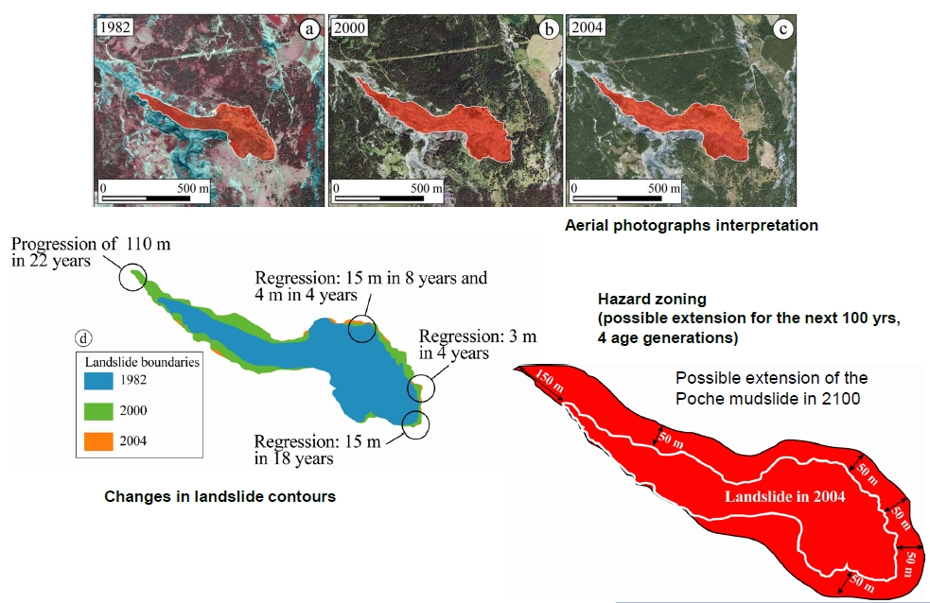
Heuristic methods /mapping

Slide 20
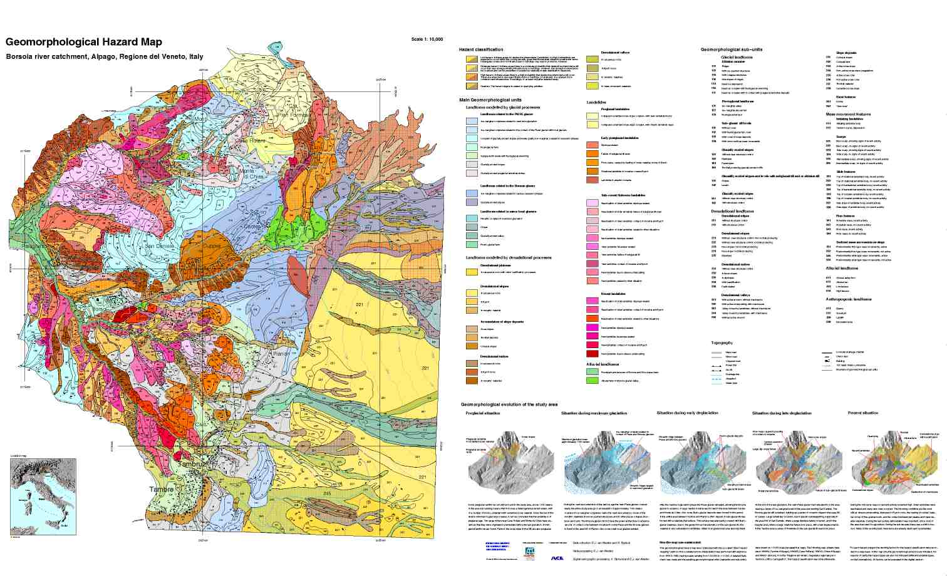
Detailed geomorphological mapping

Slide 21
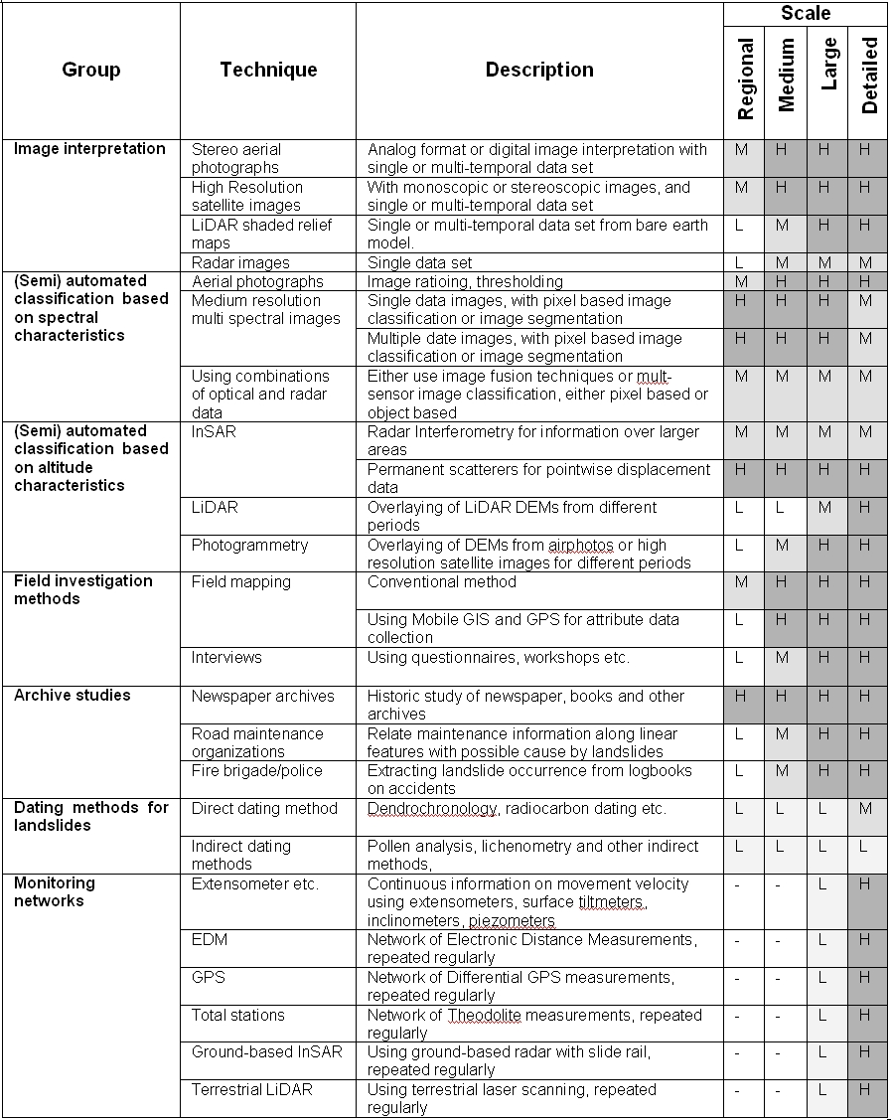
Methods for landslide inventory
Image interpretation
(Semi) automatic classification
Based on spectral information
Based on altitude information
Field investigation
Archive studies
Dating methods
Monitoring networks

Slide 22
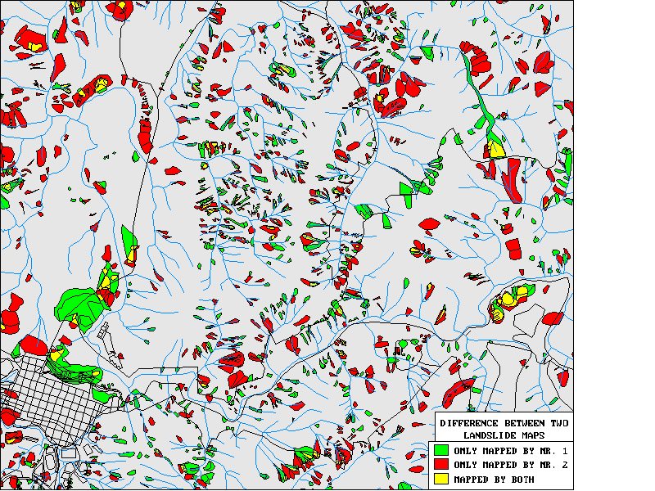
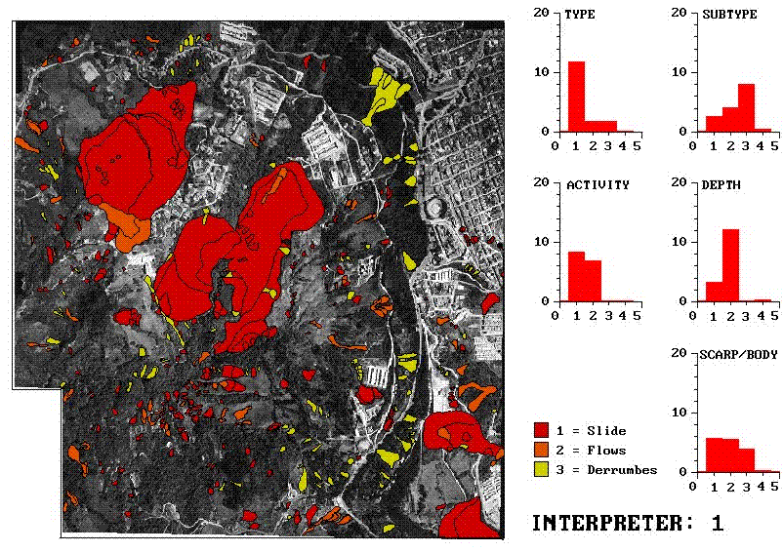
Landslide mapping is not straightforward
To know the frequency of landslides, we first need to know the location of landslides
That is not so easy as you would think…..

Slide 23
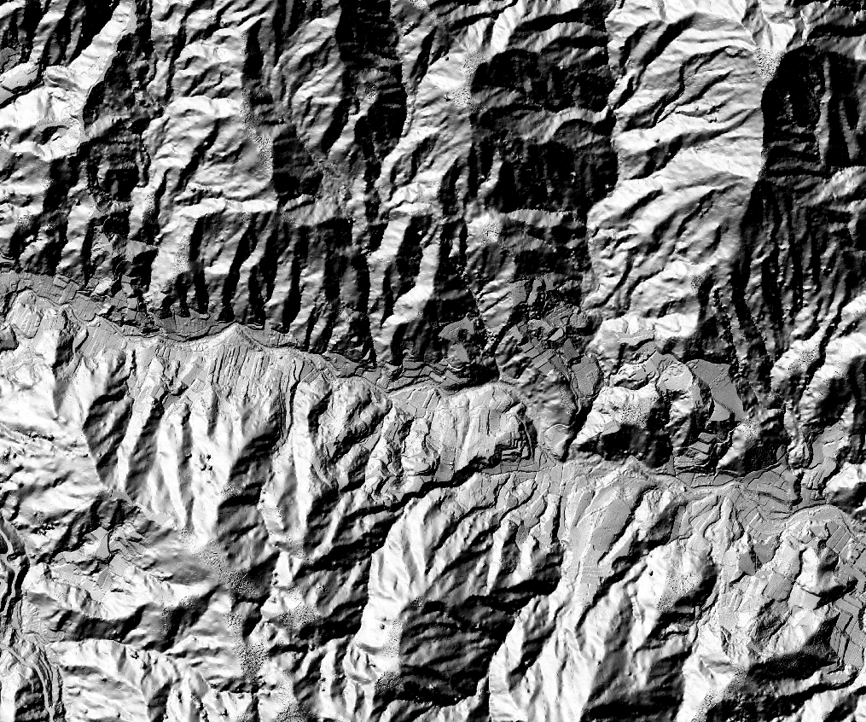
Test : mapping landslides from LiDAR images
6 different interpretations from the same area in Malaysia
A LiDAR based hillshade image was given to 6 different interpreters with the aim to map the landslides. Experts:
Local versus not-local
Monoscopic / stereoscopic
Field checking or not.

Slide 24
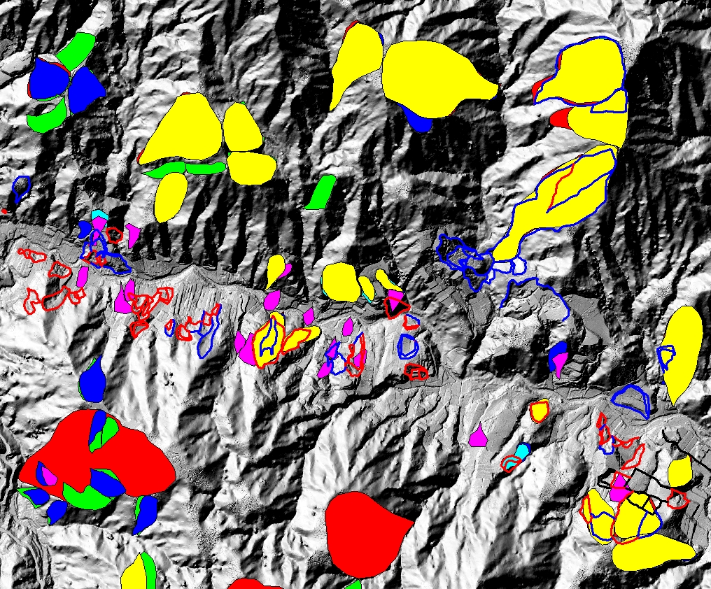
Test : mapping landslides from LiDAR images
6 different interpretations from the same area in Malaysia
A LiDAR based hillshade image was given to 6 different interpreters with the aim to map the landslides. Experts:
Local versus not-local
Monoscopic / stereoscopic
Field checking or not.

Slide 25
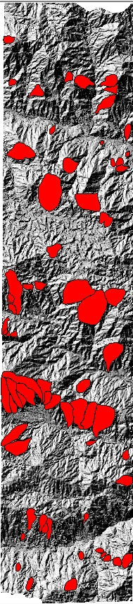
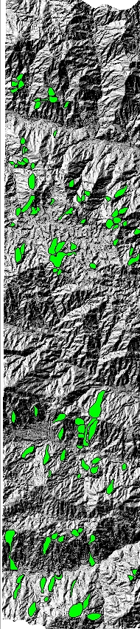
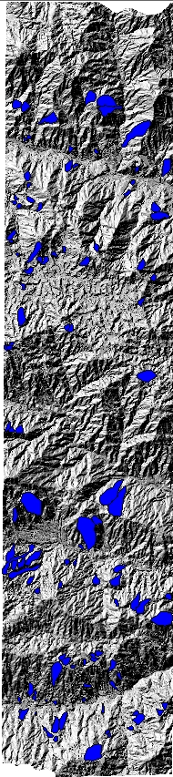
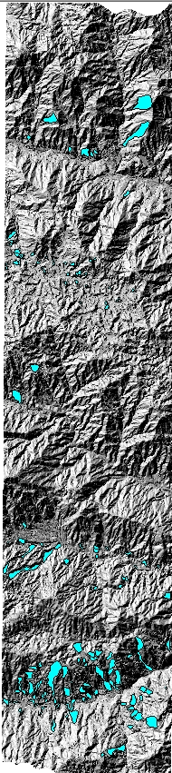
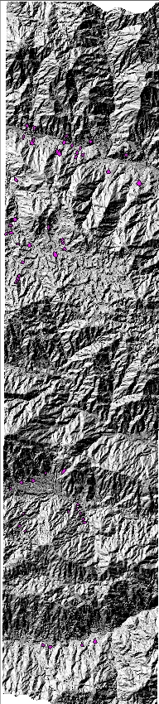
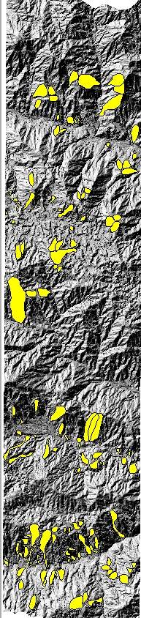
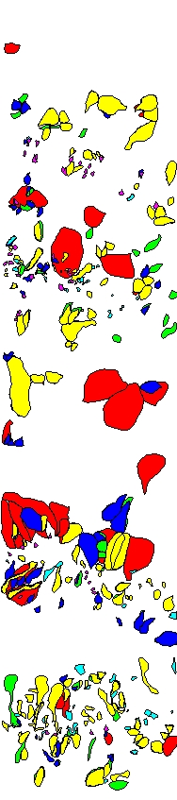
Test : mapping landslides from LiDAR images
6 different interpretations from the same area in Malaysia

Slide 26
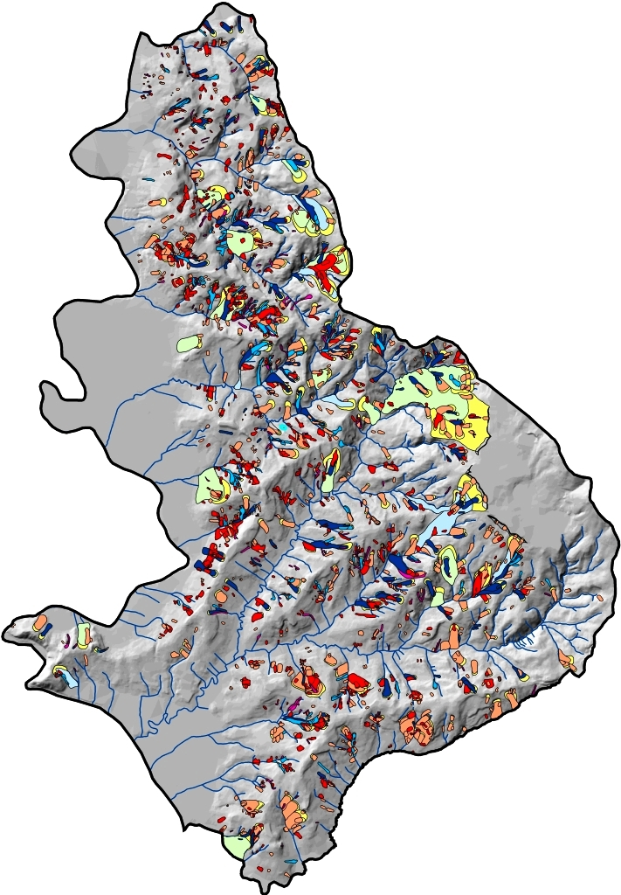
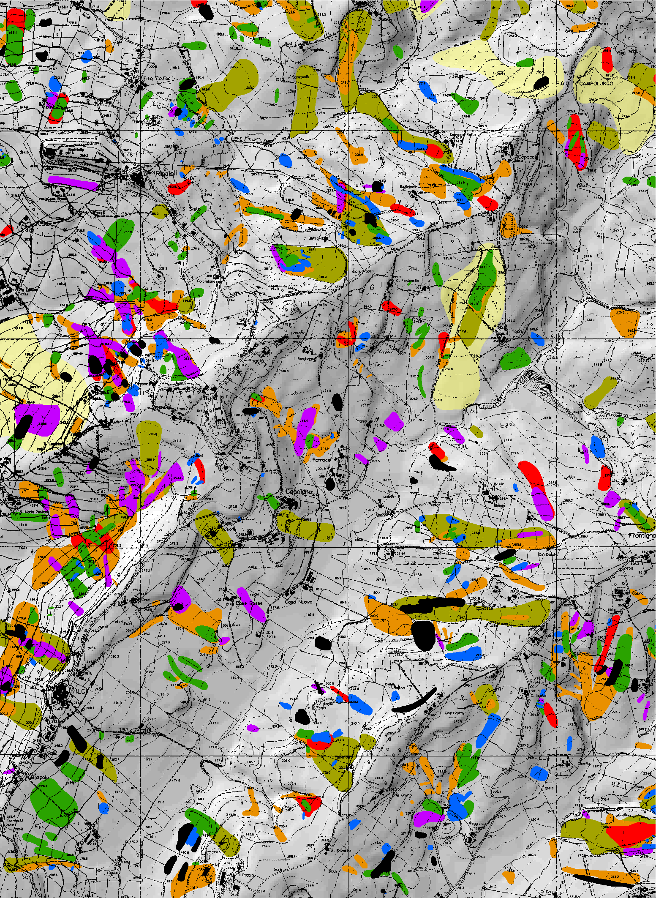
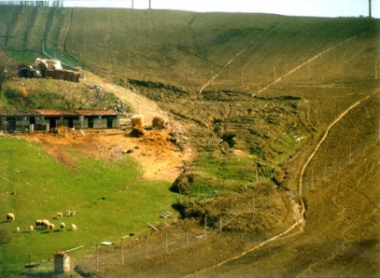
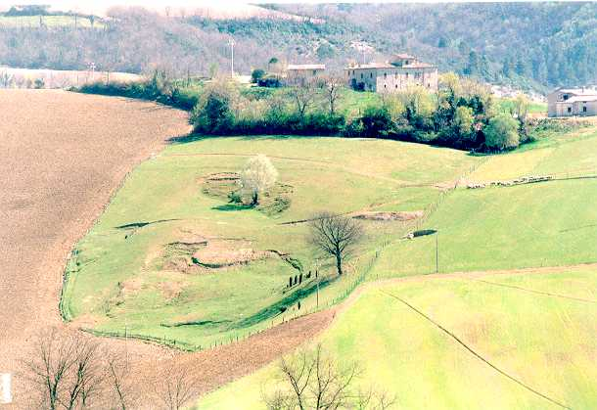
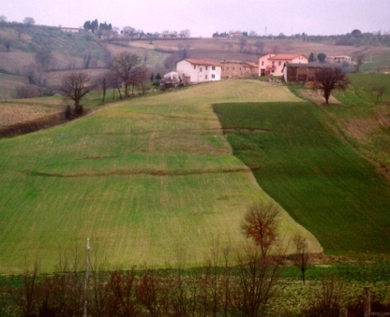
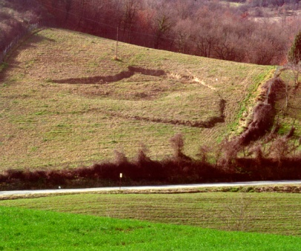
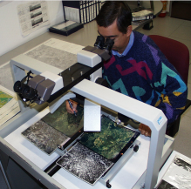
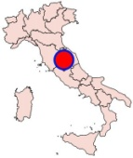
MULTI-TEMPORAL INVENTORY
very old
old
1941
1954
1977
1985
1997
2004
0
2 km
0
1 km
Guzzetti et al.
Notes:
To obtain estimates for the three probabilities we need information on where landslides are located.
This is information available form landslide inventory maps.
The images show a multi-temporal landslide inventory prepared for the Collazzone study area in Umbria, central Italy. ► In this area landslides are mostly of the slide type.
The inventory was prepared by interpreting 5 sets of aerial photographs taken from 1941 to 1997, and through field surveys in 2004.

Slide 27
Event-based landslide inventories
Map all landslides related to a triggering event.
Analyze the frequency of the triggering event
Express the density of landslides within susceptibility zones in a return period.

Slide 28
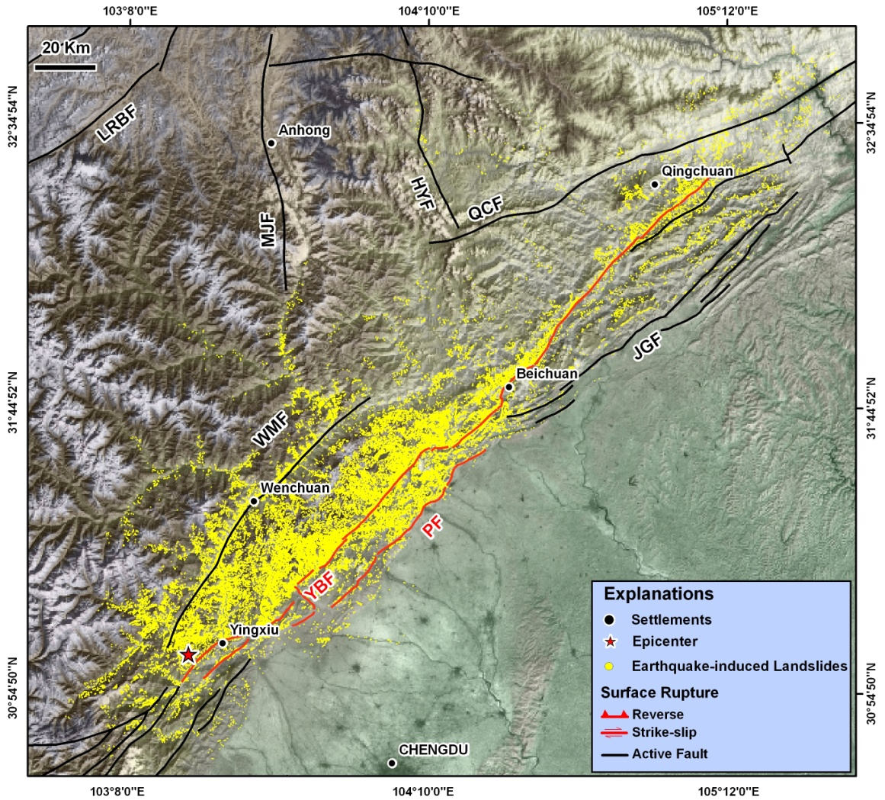


Event-based landslide inventory: Wenchuan
What is the return period of this earthquake?

Slide 29


Earthquake-induced landslide inventories
Digital complete earthquake-induced landslide inventories are scarce.
Correlation between density and seismic factors is only in the initial stage.

Slide 30



Event-based landslide mapping: common problem

Slide 31





Event-based landslide inventory maps

Slide 32

Object oriented image classification
Event-based landslide maps
Time consuming
Pixel-based methods limited use
Object Oriented Analysis: image segmentation on basis of spectral & altitude characteristics.
Data used:
Indian remote sensing satellite (IRS) P6 LISS-IV Mx : 5.8 meters, 3 spectral bands
IRS-P5 data with 2.5 m spatial resolution were used to calculate the texture and to derive the elevation information.

Slide 33




Characterisation of false positives
Stream network derived from CartoDEM is used to classify rivers
GLCM texture is used to classify agr. terraces
Orthogonal relationship between flow direction linear objects is used to classify roads

Slide 34



Characterisation of landslide types
Image interpretation keys normally used by experts during landslide identification manually are transferred into rule sets.

Slide 35










Results (semi) automated landslide detection
Yellow corresponds to landslides
Landslide candidate objects
Elimination of waterbodies
5.8 m LISS IV Mx
10 m CartoDEM
LCRC: Landslides correctly recognised and classified,
LCRWC: Landslides correctly recognised but wrongly classified,
TLCR: Total landslides correctly recognised (LCRC+LCRWC),
LNR: Landslides not recognised (i.e. error of omission),
LOR: Landslides over recognised (i.e. error of commission).
Landslide Detection Prototype
Detection accuracy: 76.4%

Slide 36



Improvement of method

Slide 37

Dating methods
Corominas and Moya, 2008

Slide 38


Slide 39


Probability of landslide size
Pelletier et al., 1997; Guzetti et al. 2009, Malamud et al, 2004, Picarelli, 2005
10⁻³
10⁻⁴
Probability density, p(A_{L}) (m⁻²)
10⁻⁵
Double Pareto
(Stark and Hovius 2001)
10⁻⁶
Inverse Gamma
(Malamud et al. 2004)
10⁻⁷
10¹
10²
10³
10⁴
10⁵
Landslide Area, A_{L} (m²)
Notes:
The plot shows the probability density of landslide area obtained from the multi-temporal inventory available for Collazzone.
► The empirical data are reasonably well fitted by the Inverse Gamma and the Double Pareto distributions.
The two curves can be used to estimate the probability that a landslide will exceed a given size.
But, how reliable is the prediction?

Slide 40
Landslide area and volume
Landslide Area, A_{L} (km²)
10
-5
10
-3
10
-1
10
1
10
3
10
5
5
10
10
13
Slide
12
3
Rock slide, rock avalanche
10
10
11
Debris slide, debris flow
7
8
Subaqueous
6
10
1
10
9
9
-1
10
10
7
α = 1.5
Landslide Volume, V_{L} (m³)
Landslide Volume, V_{L} (km³)
10
-3
(1) Guzzetti et al. (2009)
10
5
(2) Simonett (1967)
5
11
10
-5
(3) Innes (1983)
10
3
4
(4) Hovius et al. (1997)
10
-7
(5) Guthrie & Evans (2004)
1
10
(6) Korup (2005)
10
(7) ten Brick et al. (2006)
2
3
10
-9
1
(8) Guzzetti et al. (2007)
10
-1
(9) Whitehouse (1983)
10
0
10
2
10
4
10
6
10
8
10
10
10
12
(10) Larsen &Torres (1998)
Landslide Area, A_{L} (m²)
(11) Martin et al. (2002)
(12) Haflidason et al. (2005)
Guzetti et al. 2009
Notes:
This plot shows 677 failures of the slide type worldwide for which the area and volume were determined.
► There is a distinct linear trend in the data.
► These are other relationships linking landslide area and volume that can be used to determine a different measure of landslide magnitude from inventory maps.

Slide 41

Example : rockfall magnitude

Slide 42
Landslide frequency in mapping units
Poisson probability model
t = time period
λ = mean landslide rate of occurrence
μ = mean recurrence interval
Crovelli , 2000.

Slide 43



Landslide hazard analysis: based on historical records: example from India

Slide 44




Inventory from historical records
Prepared from railroad and road maintenance records and technical reports of landslide investigation

Slide 45


Multi-temporal landslide inventory
Probability density of landslide volumes for different years.

Slide 46
Landslide hazard along the railroad
JTC-1 guideline on hazard and risk (Fell et al. 2008) defines hazard in cut slopes as the number of landslides of a given magnitude per annum per kilometer of cut slopes.
The method requires estimation of:
A. The total number of landslides per kilometer in a given return period using Gumbel distribution.
B. The probability that a landslide is of a given magnitude class using magnitude-frequency statistics.
e.g. of Gumbel result along railroad
Landslide magnitude class
Class Volume Probability
I <10² m³ 0.72
II 10² - 10³ m³ 0.25
III 10³ – 10⁴ m³ 0.03
Hazard H = A x B
(# slides of a given mag. class/km/return period)

Slide 47


Hazard along the railroad
The results indicate that a five kilometer stretch along the railway line (from km-9 to km-13) is relatively more prone to be hit by landslides, as is the 10 km section (from km-390 to km-399) along the road.

Slide 48
Method : Correlation with triggers
Assumptions
  Frequency of the landslides is that of the triggering event
Drawbacks
  Different triggers may cause landslides in a region (rainfall, snow melt, earthquakes, flooding-slope undermining, etc)
  Triggering events of similar intensity may have different consequences on the slopes (exhaustion of debris in very close consecutive events, etc.)
  Large generalization: many landslide types in an area, caused by different combinations of factors, will behave differently under a triggering event.
  Can only be applied if sufficient data available on landslide occurrence dates.

Slide 49


Method 2: Correlation with triggers
A
Threshold defined as a lower bound to landslide-triggering conditions (”+” symbols)
Threshold defined as an upper bound to conditions that did not trigger any landslides (”-” symbols). Very useful for an initial calibration of thresholds in newly instrumented regions.
Threshold defined as a boundary between triggering and non-triggering conditions.
  This is the preferred approach for calibrating thresholds for use in EWS.
  The challenge in optimising the threshold model is to minimize the number of false alarms (”-” symbols above the threshold) and missed events (”+” symbols below the threshold).
B
C

Slide 50
Rainfall and climate variables used in the literature for the definition of rainfall thresholds (http://rainfallthresholds.irpi.cnr.it/)
VARIABLE | DESCRIPTION | UNITS | FIRST INTRODUCED
D | Rainfall duration. The duration of the rainfall event or rainfall period. | h, or days | Caine (1980)
D_{C} | Duration of the critical rainfall event. | h | Aleotti (2004)
E_{(h),(d)} | Cumulative event rainfall. The total rainfall measured from the beginning of the rainfall event to the time of failure. Also known as storm rainfall. “h” indicates the considered period in hours; “d” indicates the considered period in days. | mm | Innes (1983)
C | Critical rainfall. The total amount of rainfall from the time of a distinct increase in rainfall intensity (t₀) to the time of the triggering of the first landslide (t_{f}). | mm | Govi and Sorzana (1980)
R | Daily rainfall. The total amount of rainfall for the day of the landslide event. | mm | Crozier and Eyles (1980)
I | Rainfall intensity. The amount of precipitation in a period, i.e., the rate of precipitation over the considered period. Depending on the duration of the measuring period, rainfall intensity measures peak or average precipitation rates. | mm/h | Caine (1980)
I_{MAX} | Maximum hourly rainfall intensity. The maximum hourly rainfall intensity. | mm/h | Onodera et al. (1974)
I_{P} | Peak rainfall intensity. The highest rainfall intensity (rainfall rate) during a rainfall event. Available from detailed rainfall records. | mm/h | Wilson et al. (1992)
Î_{(h)} | Mean rainfall intensity for final storm period. “h” indicates the considered period, in hours, most commonly from 3 to 24 hours. | mm/h | Govi and Sorzana (1980)
I_{C} | Critical hourly rainfall intensity. | mm/h | Heyerdahl et al. (2003)
I_{f} | Rainfall intensity at the time of the slope failure. Available from detailed rainfall records. | mm/h | Aleotti (2004)
A_{(d)} | Antecedent rainfall. The total (cumulative) precipitation measured before the landslide triggering rainfall event. “d” indicates the considered period in days. | mm | Govi and Sorzana (1980)
A_{(y)} | Antecedent yearly precipitation up to date of the event. The total (cumulative) yearly precipitation measured before the landslide triggering rainfall event. | mm | Guidicini and Iwasa (1977)

Slide 51

Rainfall thresholds
Three type-C threshold models based on antecedent rain
A_{n} = α_{n} : single value of antecedent rain (calibration of n parameter and α threshold value)
A_{n} = α_{n} and A_{p} = α_{p} : two values for two different periods (use of classification tree)
1 + α₁A_{n} + α₂A_{p} = 0 : linear combination of 2 antecedent rain conditions
A_{n} and A_{p}: antecedent n-day and p-day precipitation
α_{n},α_{p},α₁,α₂: constants of the model

Slide 52

Rainfall threshold analysis: antecedent rainfall
R (t) = ƒ[R_{d}(t), R_{ad}(t)]
where R(t) = amount of rainfall
in a given period (e.g. daily); and
R_{ad} (t) = antecedent rainfall.
This function of R defines the probabi-
lity of occurrence of the
landslide L: P{L}. If RT is the threshold
value of R then
P[L│R> RT] = 1
P[L│R≤ RT] = 0
Probability of landslide occurrences can be given by the intersection
of two probabilities:
P{(R>RT)∩L}=P{R>RT}P{L│R>RT}

Slide 53



Rainfall threshold analysis
Different thresholds for different sectors
Threshold validation
2001
Rainfall threshold distribution
2006
2007

Slide 54

Temporal probability distribution
Natural slopes lack sufficient data on events, we have assumed that in future
landslides can occur when rainfall is high and more than the threshold
pertaining to the scenario of entire route.
Estimated temporal probability is 0.08 with a RP of once in 12.5 years.

Slide 55



Event-based landslide inventory maps (Objective 2)
DA
Pdf

Slide 56

Method: correlation with triggers
Most commonly used
type-C threshold model
(I-D model, power law)
I = α D^{-β}
Caine (1980):
I = 14.82 D^{-0.39}
where I, in mm/h D, in hr

Slide 57

Intensity, duration and antecedent rain

Slide 58

Case study: barcelonnette, france
50 known landslide dates and locations
50 known debris flow occurences

Slide 59


Slide 60

Landslide hazard analysis: based on rainfall thresholds
Different thresholds for different sectors

Slide 61

Method: using probabilistic modeling
Haneberg, 2004

Slide 62
Dynamic modeling
(Kuriakose et al., 2006, 2008a)

Slide 63




Soil depth: sampling & interpolation
Application of various geostatistical technique for predicting soil depth:
feature-space linear models with environmental predictors (LM),
block ordinary kriging (BOK),
block regression kriging with the environmental predictors (BRK)
stochastic simulation (SRK) with the best BRK model.

Slide 64

Results: Failure probability for different return periods of rainfall
1913
1973
2001
2008
2016
2058
Area with FOS<1 and the probability of failure corresponding to the land use scenarios of 1913, 1973, 2001, 2008, 2016, 2058

Slide 65


Quantitative risk analysis
In which
P_{(T│HS)} = the temporal probability of a certain hazard scenario (HS);
P_{(S│HS)} = the spatial probability that a particular pixel in the susceptible areas is affected given a certain hazard scenario;
A_{(ER│HS)} = the quantification of the amount of exposed elements at risk, given a certain hazard scenario (e.g. expressed as the number or economic values); and
V_{(ER│HS)} = the vulnerability of elements at risk given the hazard intensity under the specific hazard scenario

Slide 66
Quantitative risk analysis
In which
P_{(T│HS)} = the temporal probability of a certain hazard scenario (HS);
P_{(S│HS)} = the spatial probability that a particular pixel in the susceptible areas is affected given a certain hazard scenario;
A_{(ER│HS)} = the quantification of the amount of exposed elements at risk, given a certain hazard scenario (e.g. expressed as the number or economic values); and
V_{(ER│HS)} = the vulnerability of elements at risk given the hazard intensity under the specific hazard scenario

Slide 67


Total Risk displayed as risk curves
Specific risk to landslide initiation
A: Tea/coffee plantations;
B: Horticulture plantations;
C: Railroad;
D: Road and
E: Buildings
Expected monetary losses due to landslide initiations in US$ per pixel over a 10 year period.
A: shows distribution of the average loss in the study area. B and C: show minimum and maximum loss, respectively around Katteri.

Slide 68
Conclusions
Problems
Magnitude-frequency relations are difficult to obtain in a single site (except for debris flows and rockfalls)
It is often impossible for a region
Determining landslide frequency requires accurate and detailed landslide catalogues
Landslide frequency models may not be applicable if conditions change:
  Climate change
  Major changes in an area (e.g. Wenchuan earthquake)
Do contact me:
Westen@itc.nl

