Slide 1
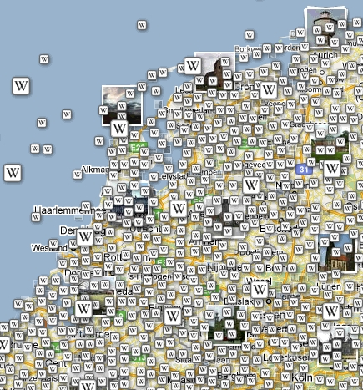
VGIRisk - Research interests ITC-GIP department
VGIRisk Workshop, ITC Enschede, 7-8 April 2011
Rob Lemmens
Rob Lemmens

Slide 2
Geo-Information
Operating Environment
Communities
Planning, Utilities, Farming, Emergency, Tourism, ...
Integrating
Processing
Visualising
Acting
Societal
Processes
Markets, Technology & Standards
Infrastructures
Spatial Services, Commercial Services, Social Networks, ...
Resources (GI-Providers, ...)
Traditional, Private, Volunteer, Tagged, Real-time, ...

Slide 3
ITC Department of Geo-information Processing – Core research topics
Smarter systems and applications built from semantically annotated data and computational resources.
Questions such as fitness-for-use, quality-of-service of both the data and the computational resources.
Methods of design and realization of systems
The accommodation of new data sources
New modes and models of user interaction to support in visual decision-making
Novel analytics to work on new data sources and data types
Novel graphic data representations

Slide 4
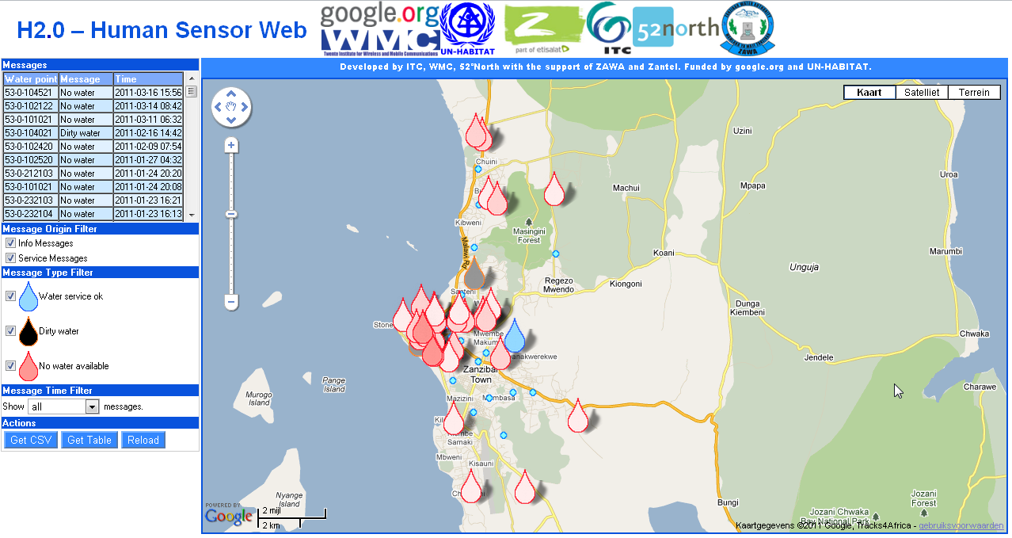
Human Sensor Web
http://geonetwork.itc.nl/zanzibar/

Slide 5
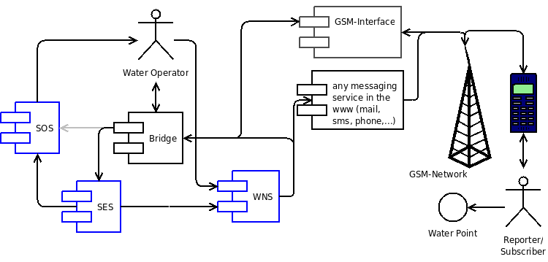
Human Sensor Web - Architecture

Slide 6
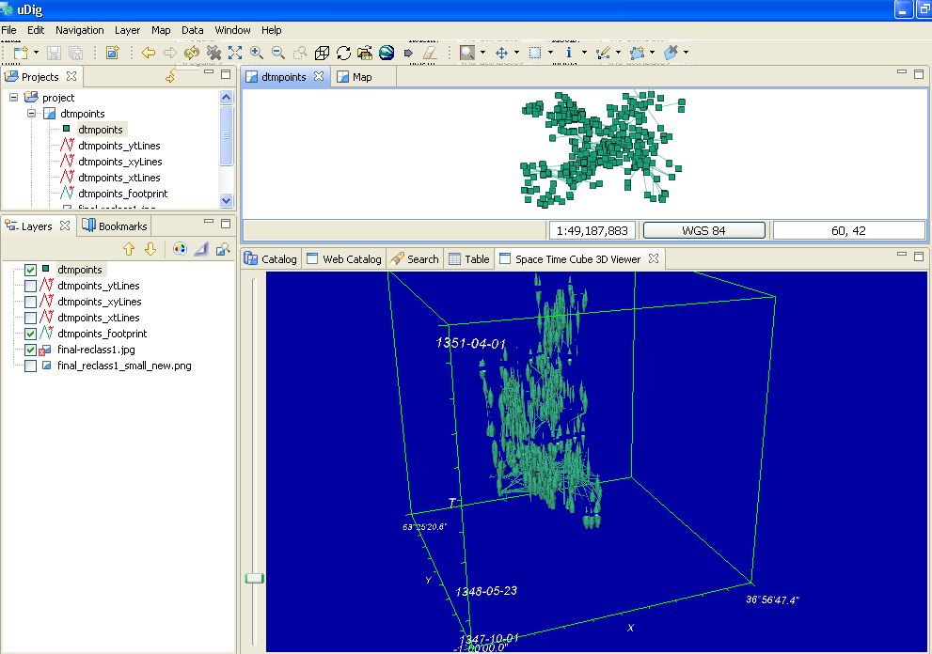
Space-time cube

Slide 7
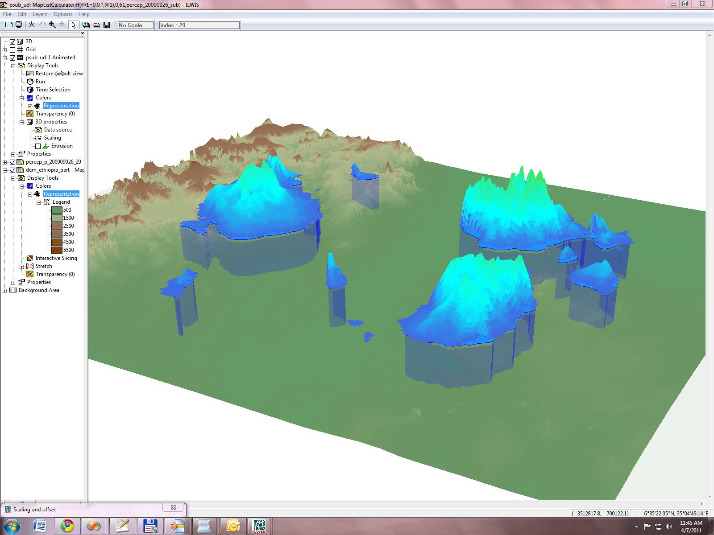
Open Source software development at 52North-ILWIS

Slide 8
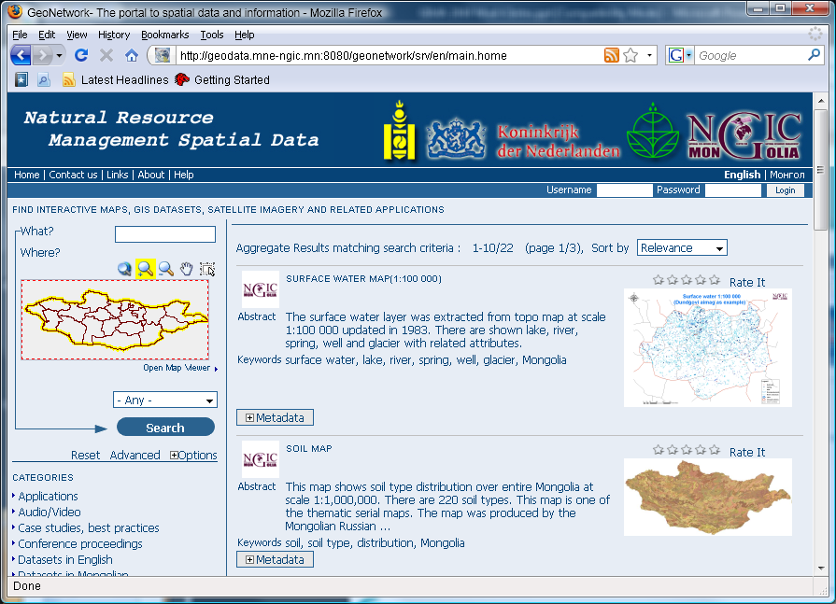
Finding Geo-information – Catalog service

Slide 9
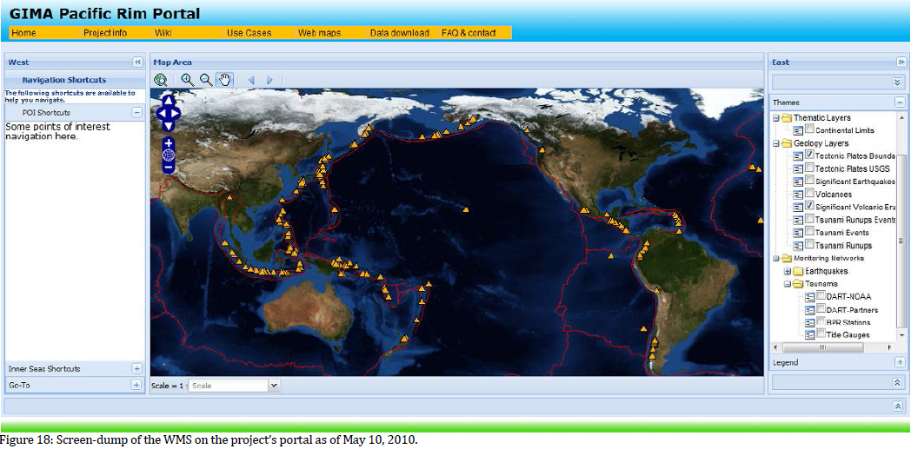
Example student web portal GIMA 2010

Slide 10
THE GIP Software stack
..currently...
users
Service Portal
administration services
design
services
workflow
services
digital rights
services
management
services
registry services
(publish, discover, interpret, qualify, bind, maintain)
encoding layer
core services
data
services
processing
services
sensor
services
portrayal
services
resources
services

Slide 11
THE GI Software stack
Looking ahead
Application as a Container
product
Services as plugins

Slide 12
THE GI Software stack
Looking ahead - 2020
Handler as a Service
JavaScript
python
. . .
Application Logic as a Service
Expertise as a Service
workflow
. . .
. . .
Software as a Service
visualization
integration
. . .
Data as a Service
volunteer
real-time
tagged
. . .
Platform as a Service
google engine
microsoft cloud
. . .

Slide 13
Software as a Service
visualisation
simulation
analysis
processing
modelling
integration
mash-ups
. . .
interpretation
indexing
searching
recommending

Slide 14
Towards a modular VGI system architecture
Input
Application logic
Output
Gateways
APIs
SMS
Smart phone application
Sensor Web Enablement
Twitter
Web application
Web Processing
Smartphone GIS client
Google Maps
Discovery & metadata handling
ArcGIS
External VGI applications
Ushahidi, OSM, Google Map Maker, ...

Slide 15
Project scope
WOTRO
User context/profiling
Spatio-temporal analysis
Semantics and metadata
VGI
Interoperability standards
Saas
Software system architecture
VGIRisk

