Slide 1
An Earth Observation and Integrated Assessment (EOIA) approach for the sustainable governance of the Lake Naivasha basin, Kenya
Earth Observation (EO)
Integrated Assessment (IA)
Pieter R. van Oel,
Vincent O. Odongo, Dawit W. Mulatu, Jane Ndungu, Francis K. Muthoni, Job Ogada,
George Khroda, Jude M. Mathooko, Robert Becht, Nzula Kitaka, Japheth O. Onyando, Anne van der Veen

Slide 2
INTEGRATED ASSESSMENT (IA)
Integration over scientific disciplines in ways and at temporal and spatial scales meaningful to stakeholders
The design of appropriate model structures (e.g. extent, resolution) depends on the spatial and temporal resolutions of
available data
process interactions
the desired output
Quality relies on extensive datasets:
Explore Earth Observation (EO)

Slide 3
Lessons from IWRM
There is no single optimal scale for water management (e.g. Van der Zaag and Gupta, 2008)
Suitability of scale for water management depends on the perspective chosen (e.g. Molle, 2006)
So, models and assessments should account for multiple scales and perspectives relevant to decision-makers
van der Zaag, P. and J. Gupta (2008). Scale issues in the governance of water storage projects. Water Resources Research 44(10).
Molle, F. (2006). Planning and managing water resources at the river-basin level: Emergence and evolution of a concept. International Water Management Institute. Colombo, Sri Lanka

Slide 4
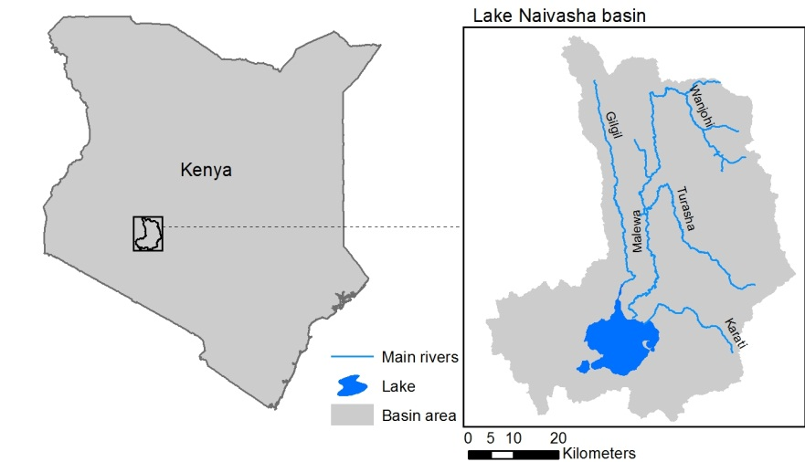

Slide 5
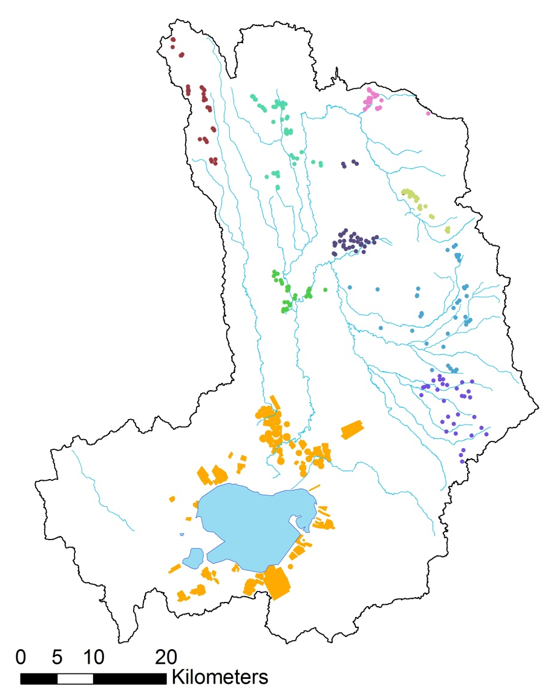
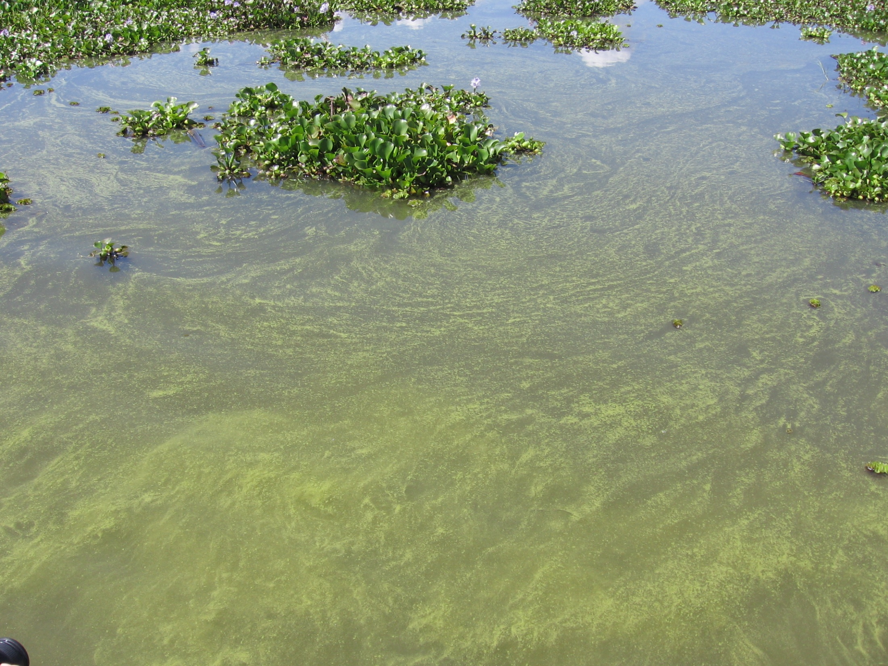
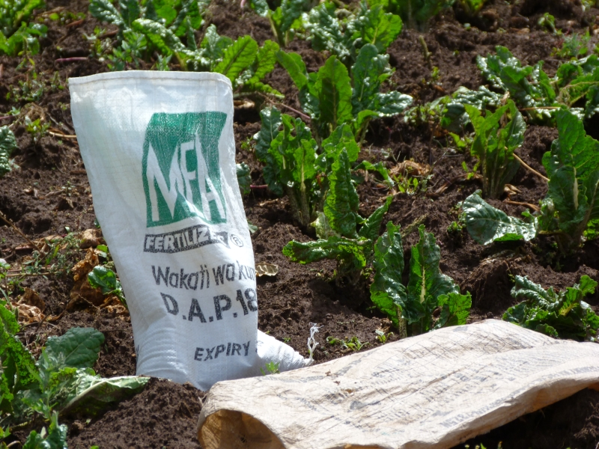
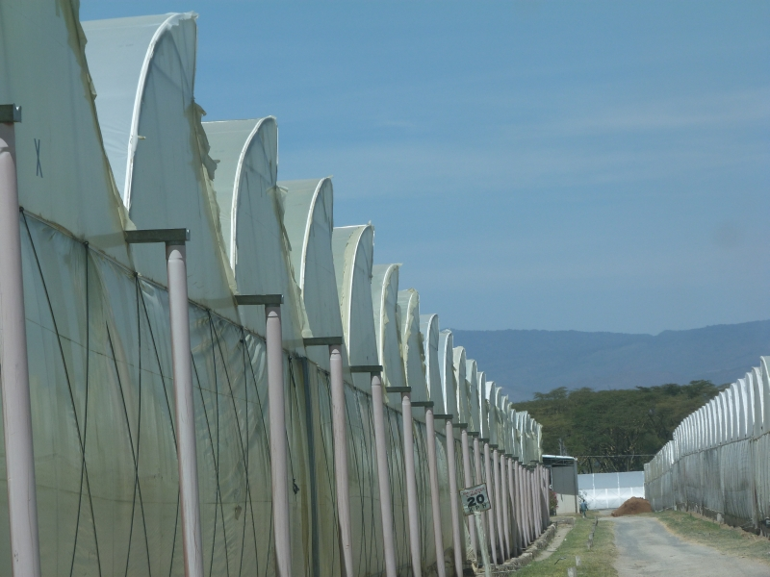
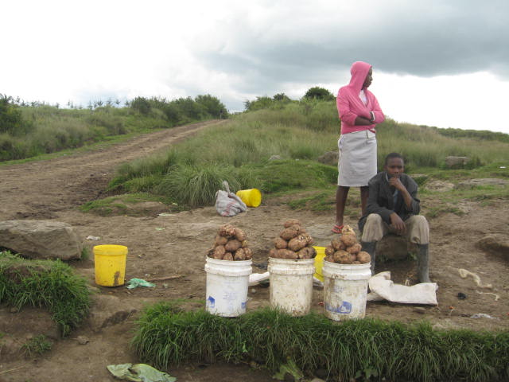
Downstream ⬅➔ Upstream
Sustainability ⬅➔ Development
Large companies ⬅➔Poor communities
sustainability ISSUES
Up
Down

Slide 6
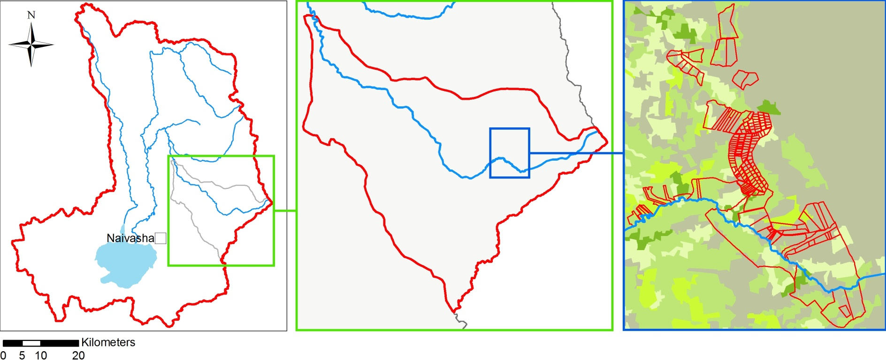
Water Governance At DIFFERENT levels
Collective action
Devolution of power
6

Slide 7
Research question
How can Earth Observation (EO) and Integrated Assessment (IA) be used to effectively support water governance towards improving environmental and socio-economic indicators of sustainability?

Slide 8
METHOD
Scientists
Stakeholders
discussions
Research focus
determines
Approach
IA modeling
Visualization

Slide 9
Scientists
Stakeholders
discussions
Research focus
determines
Approach
IA modeling
Visualization

Slide 10
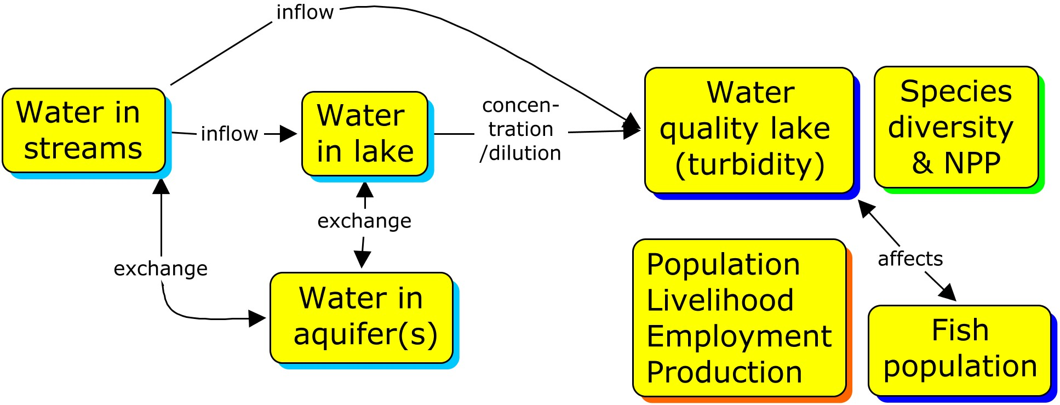
indicators for sustainable governance
WATER QUANTITY, NUTRIENTS, SEDIMENTS

Slide 11
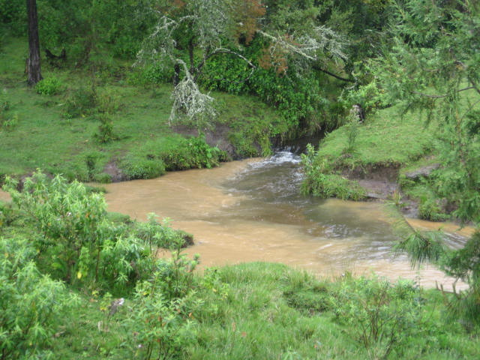
Hydrological System
Human influence on hydrology
How do field, surface and ground water hydrology relate?

Slide 12
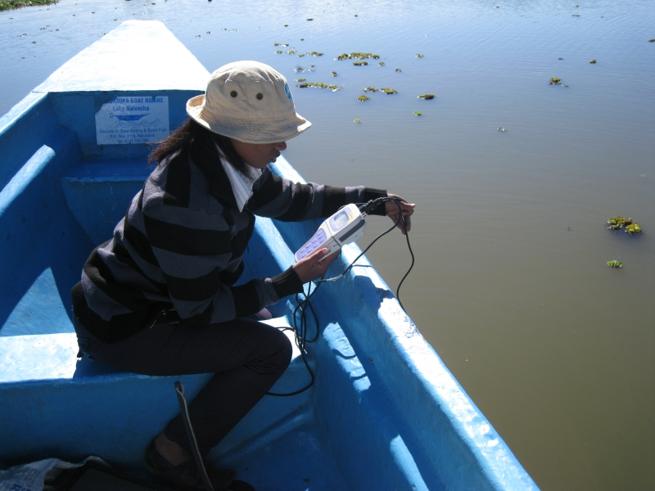
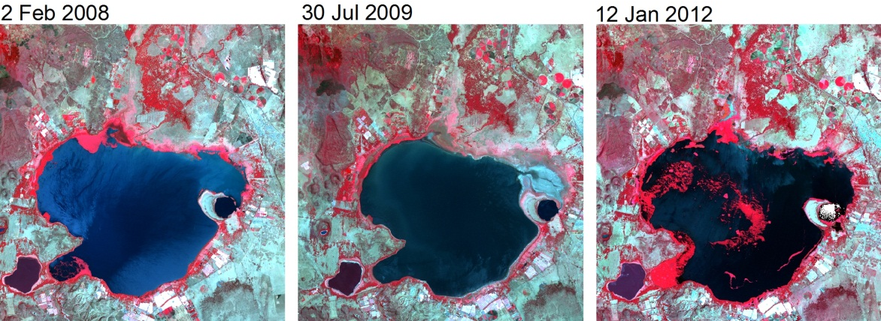
Aquatic Ecological system
Turbidity dynamics
How does the lake respond to perturbations and interventions?
sediments
water quantity
nutrients

Slide 13
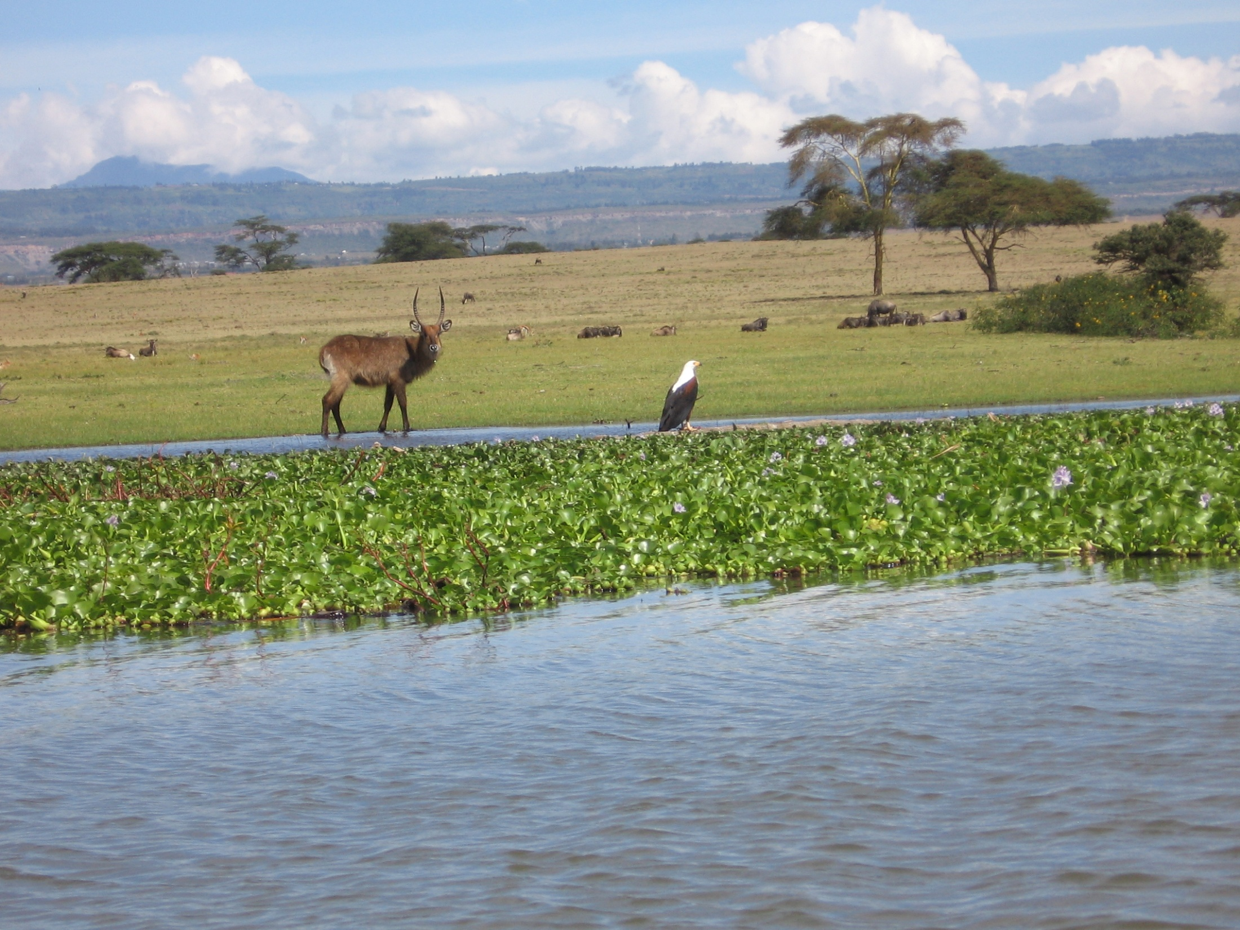
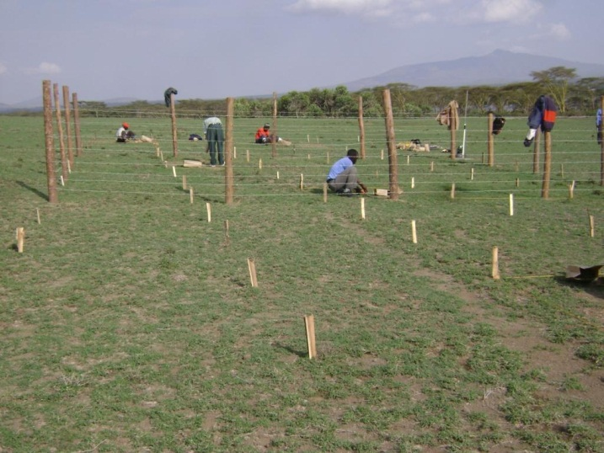
Terrestrial ecological system
Productivity and species diversity
What is the role of lake level fluctuations?

Slide 14
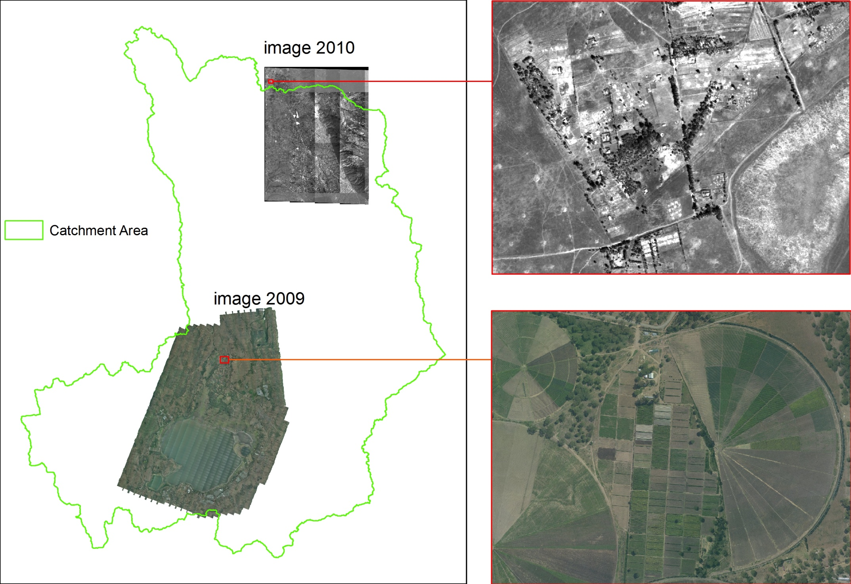
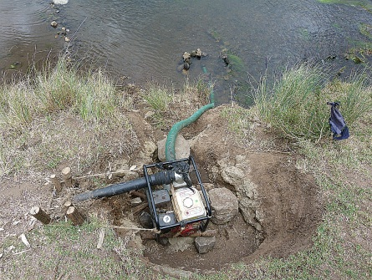
Socio-economical system
Links economy-environment
How do livelihoods relate to ecosystem services?
water
quantity
nutrients

Slide 15
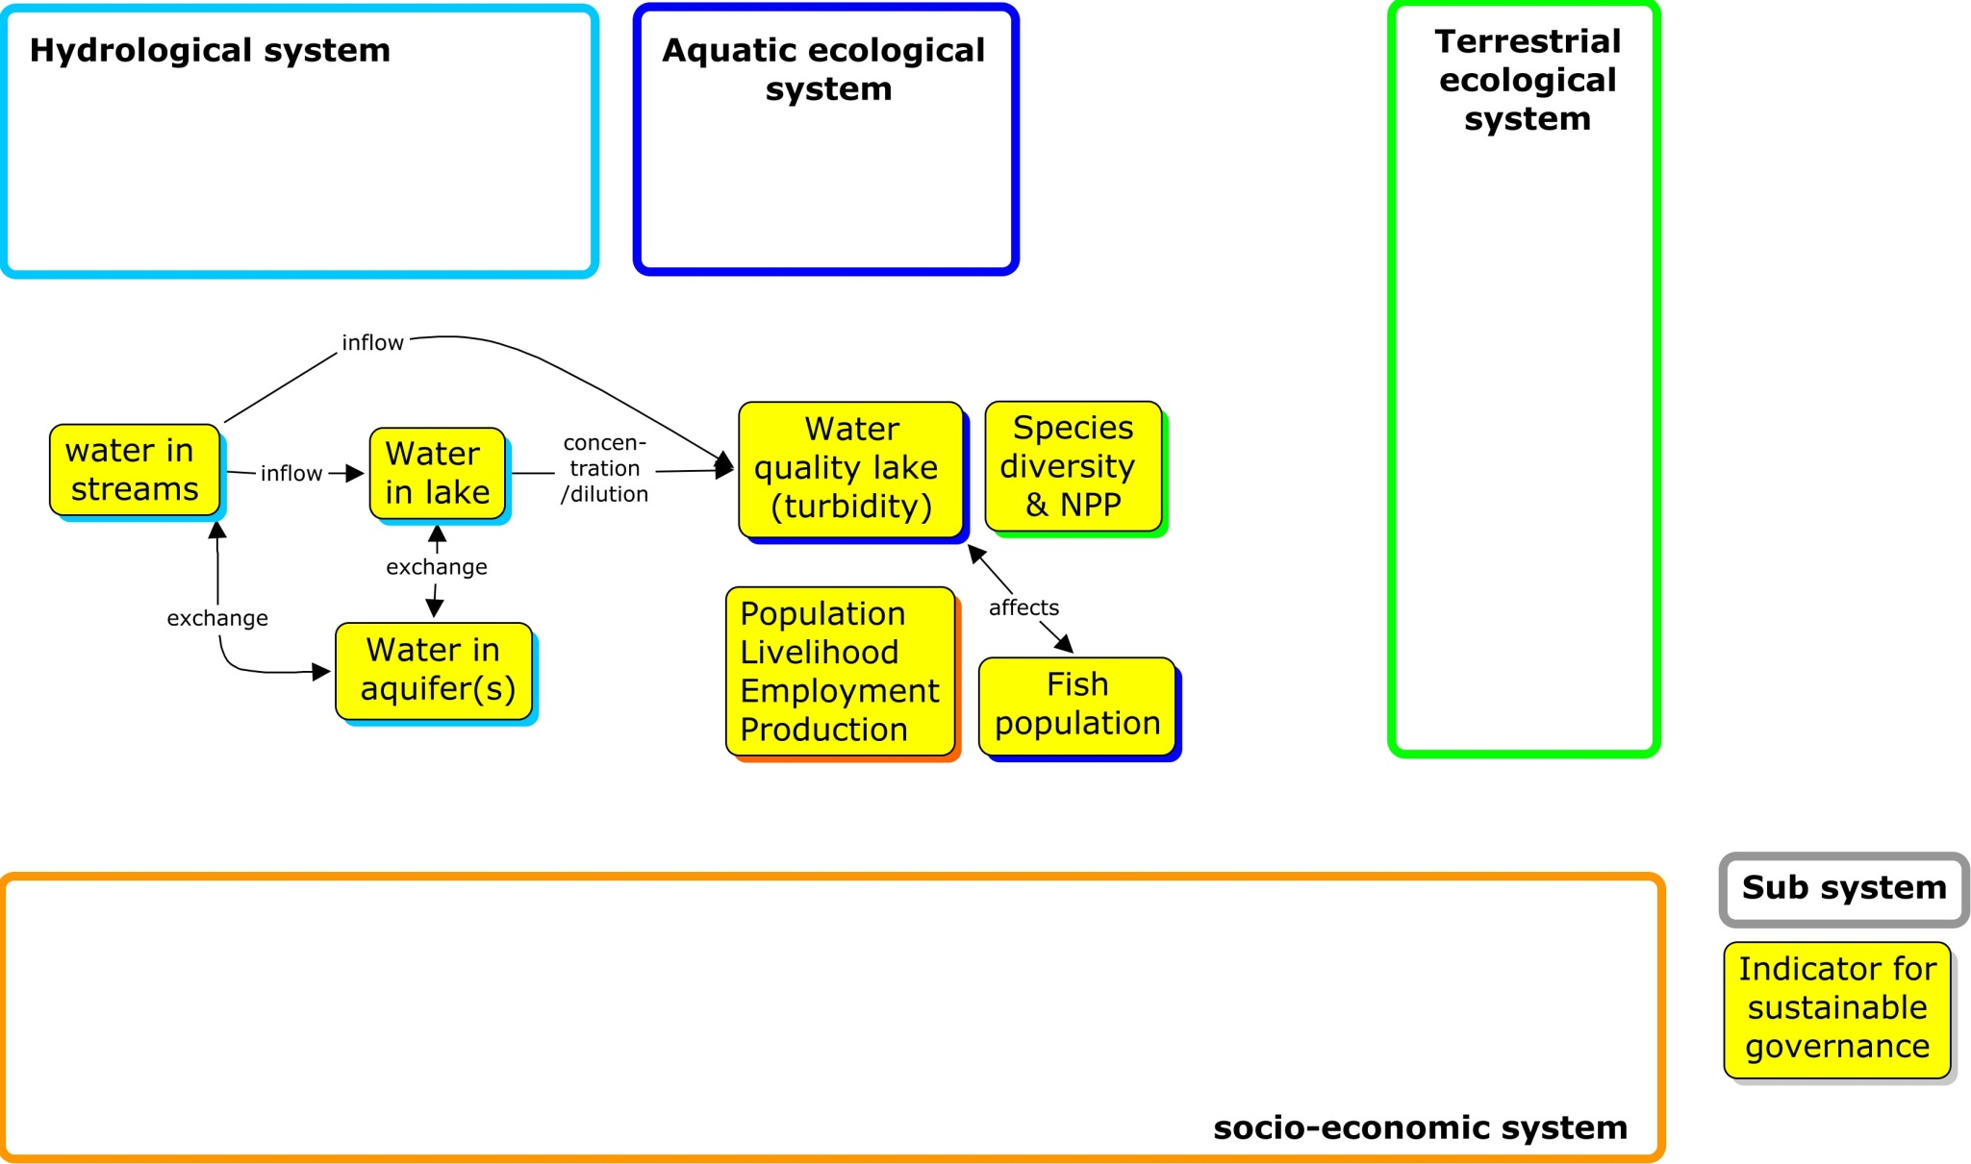
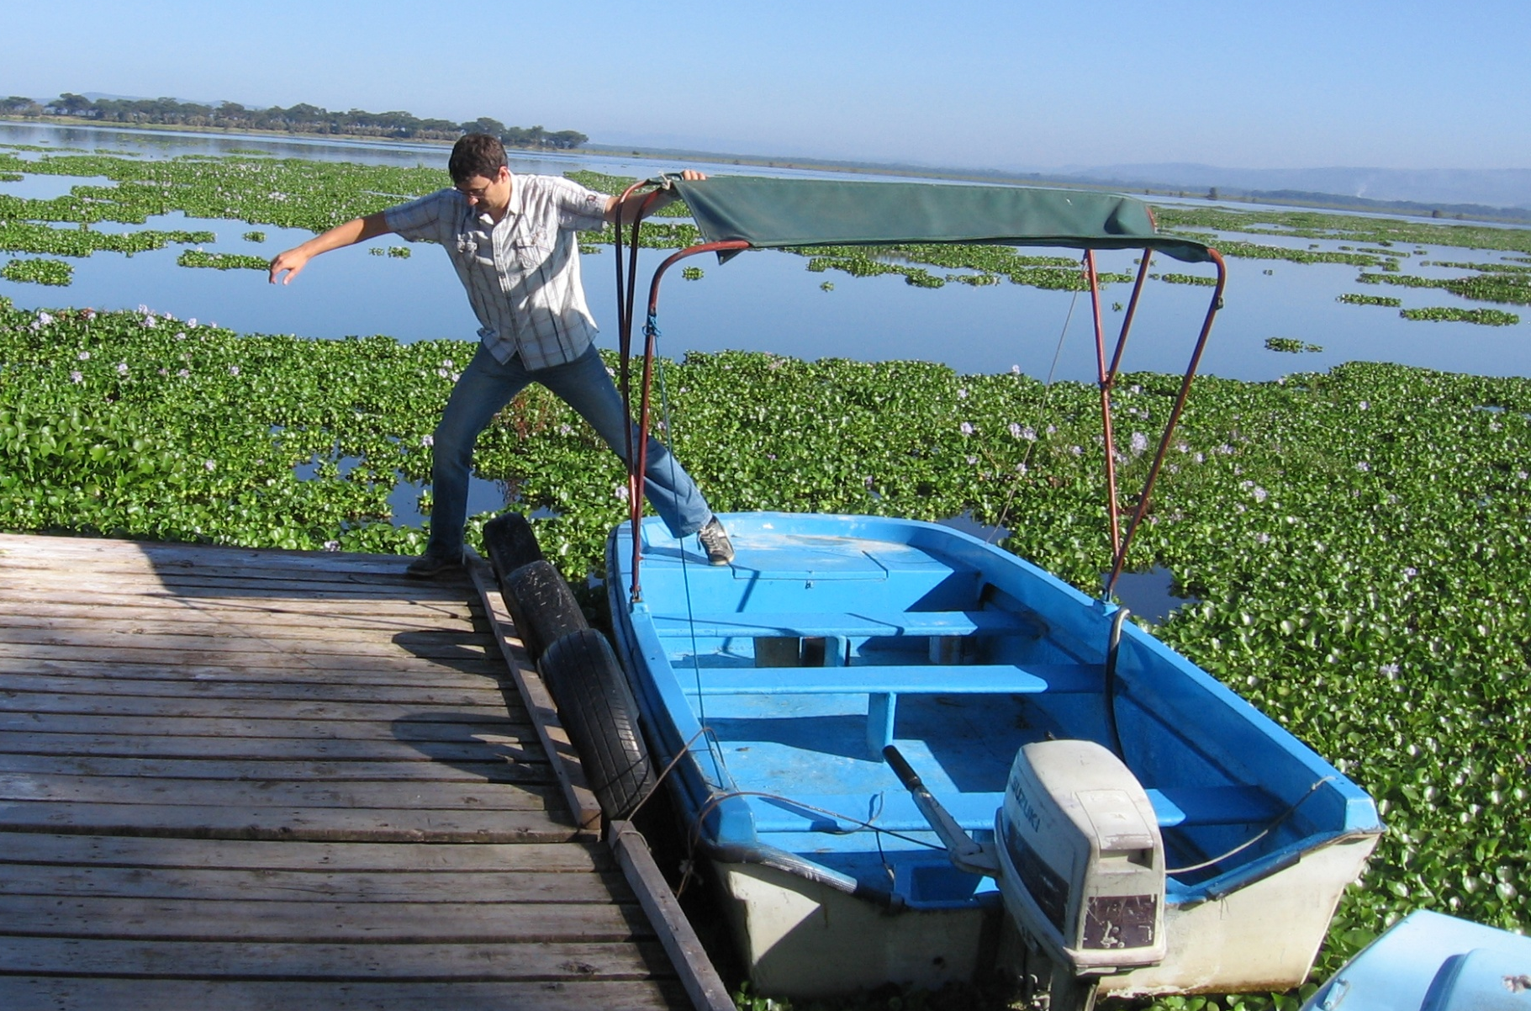
INTEGRATED ASSESSMENT

Slide 16
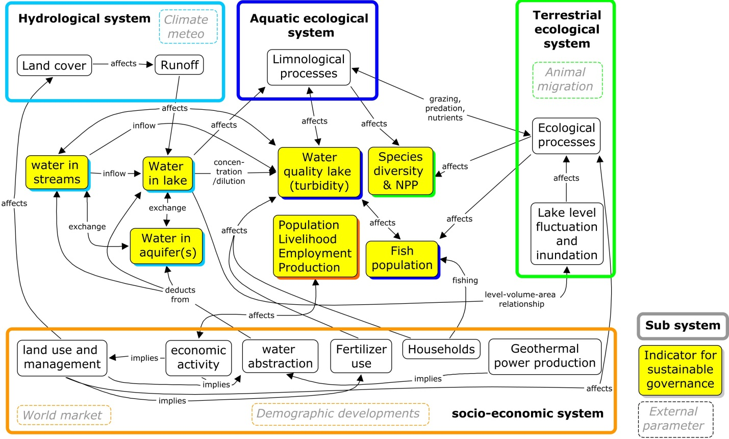
INTEGRATED ASSESSMENT

Slide 17
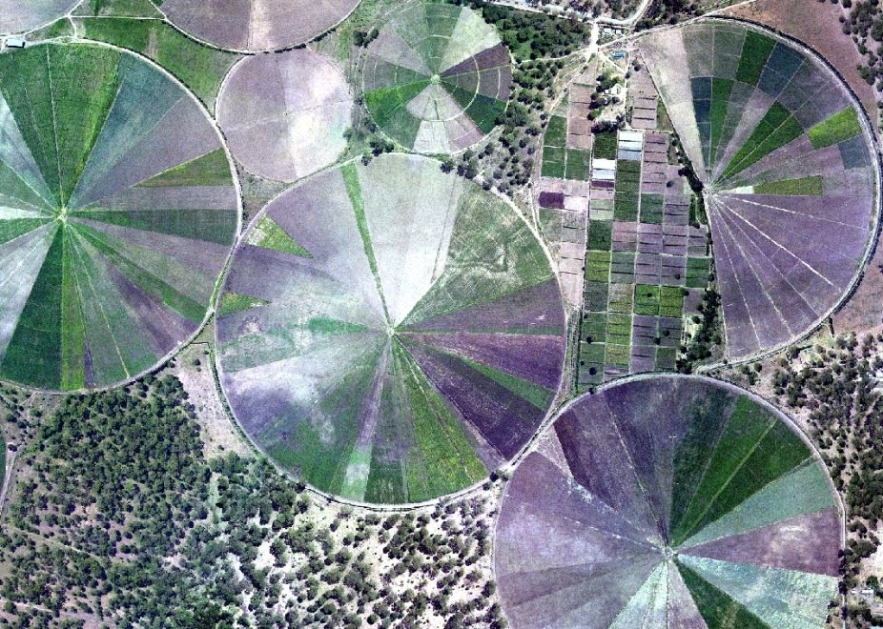
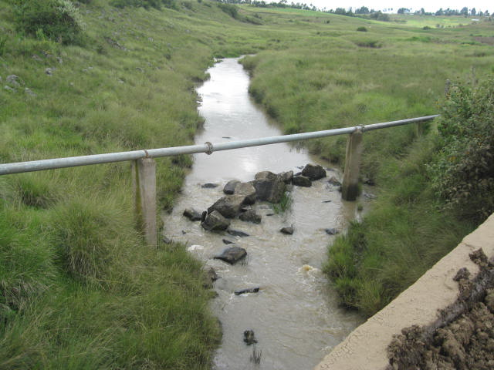
2 perspectives

Slide 18
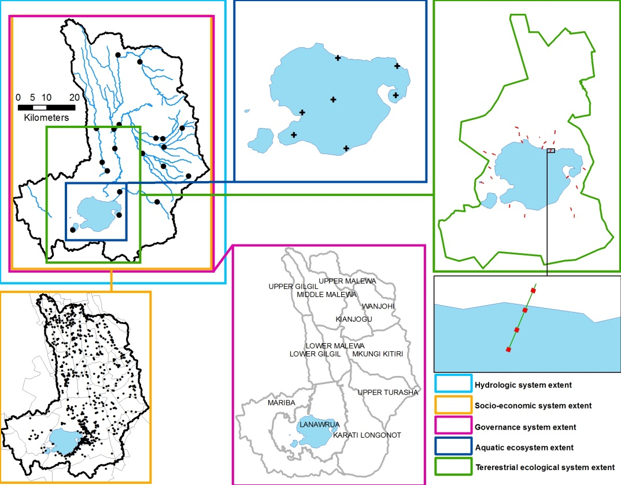

Slide 19
Scientists
Stakeholders
discussions
Research focus
determines
Approach
IA modeling
Visualization

Slide 20
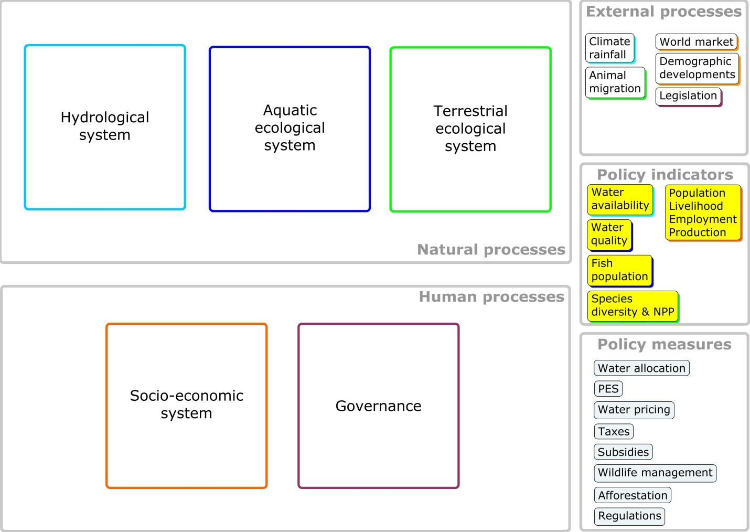
model
models
model
model
Visualization

Slide 21
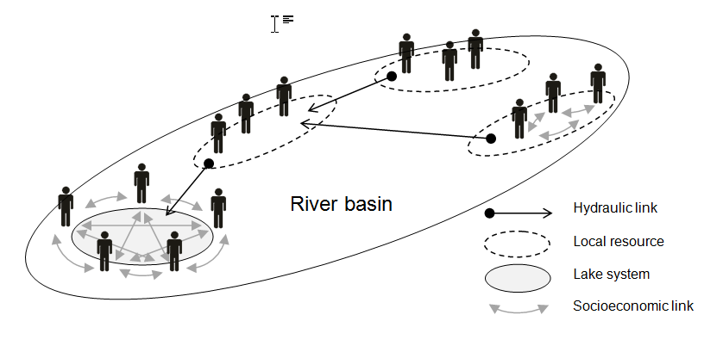
TWO OPTIONS FOR INTEGRATED ASSESSMENT MODELING
LINKED MODELS
OpenMI to link models (SWAT, MODFLOW, DELFT3D and others)
INTEGRATED MODEL
Agent-based modeling (ABM) using knowledge from sub-projects

Slide 22
Agent-based modelling
ABMs involve
Local processes that lead to emergent patterns at a global level
Autonomous (interacting) agents
Agent rules:
Agents satisfy goals through rules, leading to decisions and actions
Advantages of ABM:
Evaluate emergent phenomena at relevant scales (levels of analysis)
Allow for analysis from multiple perspectives
environment

Slide 23
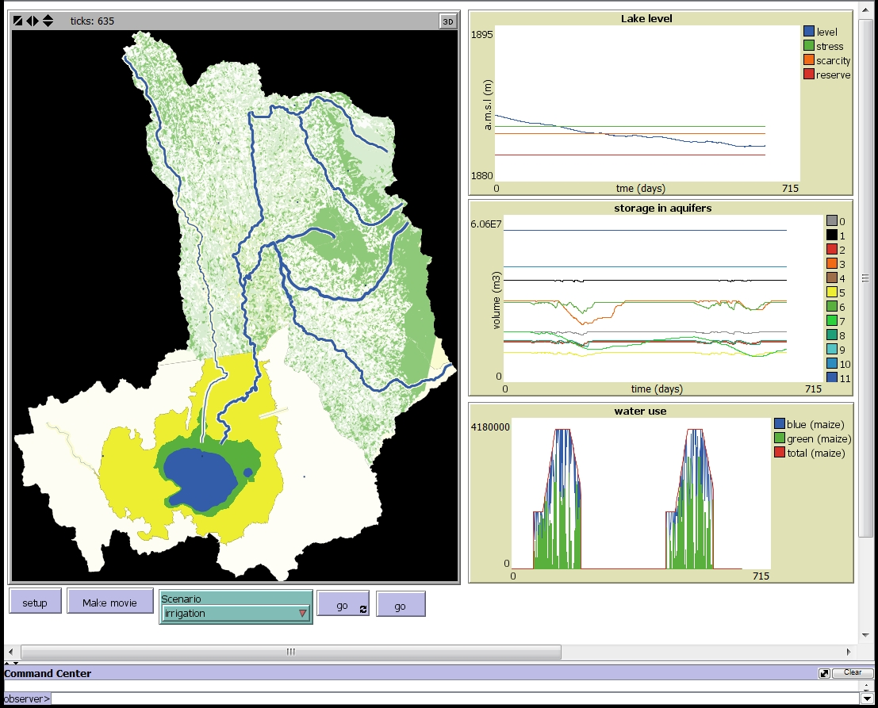
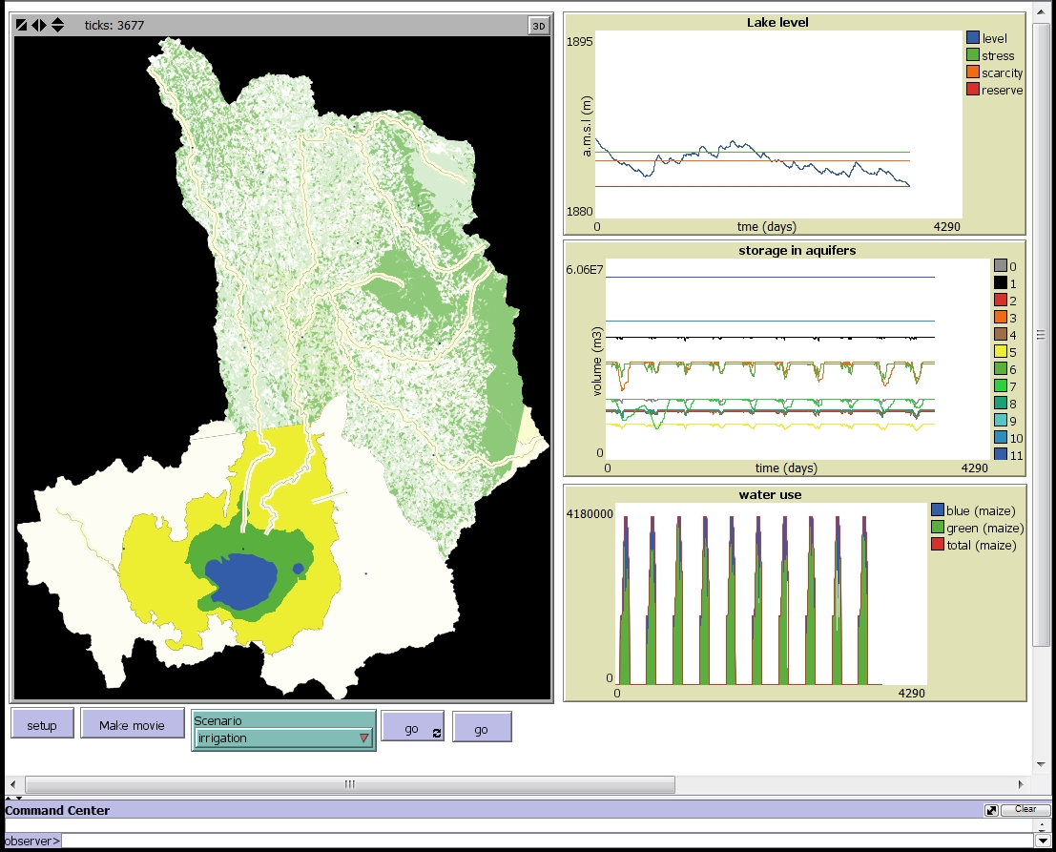
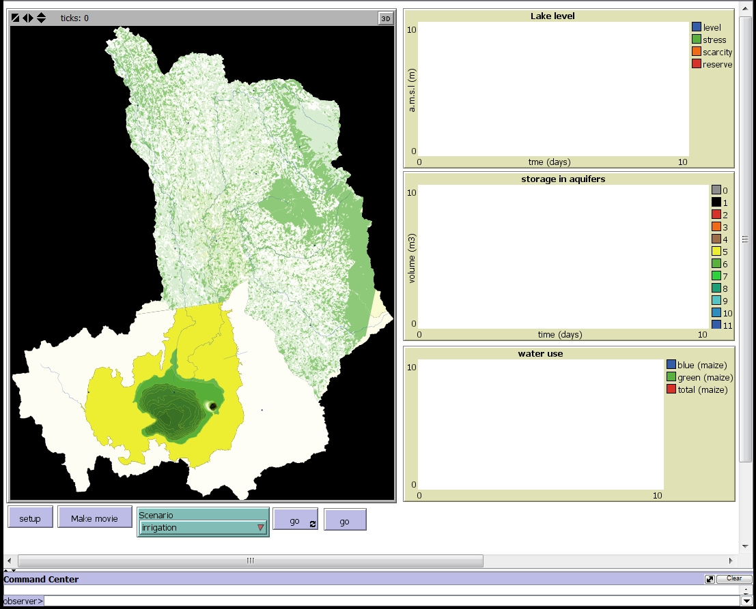
ABM model

Slide 24
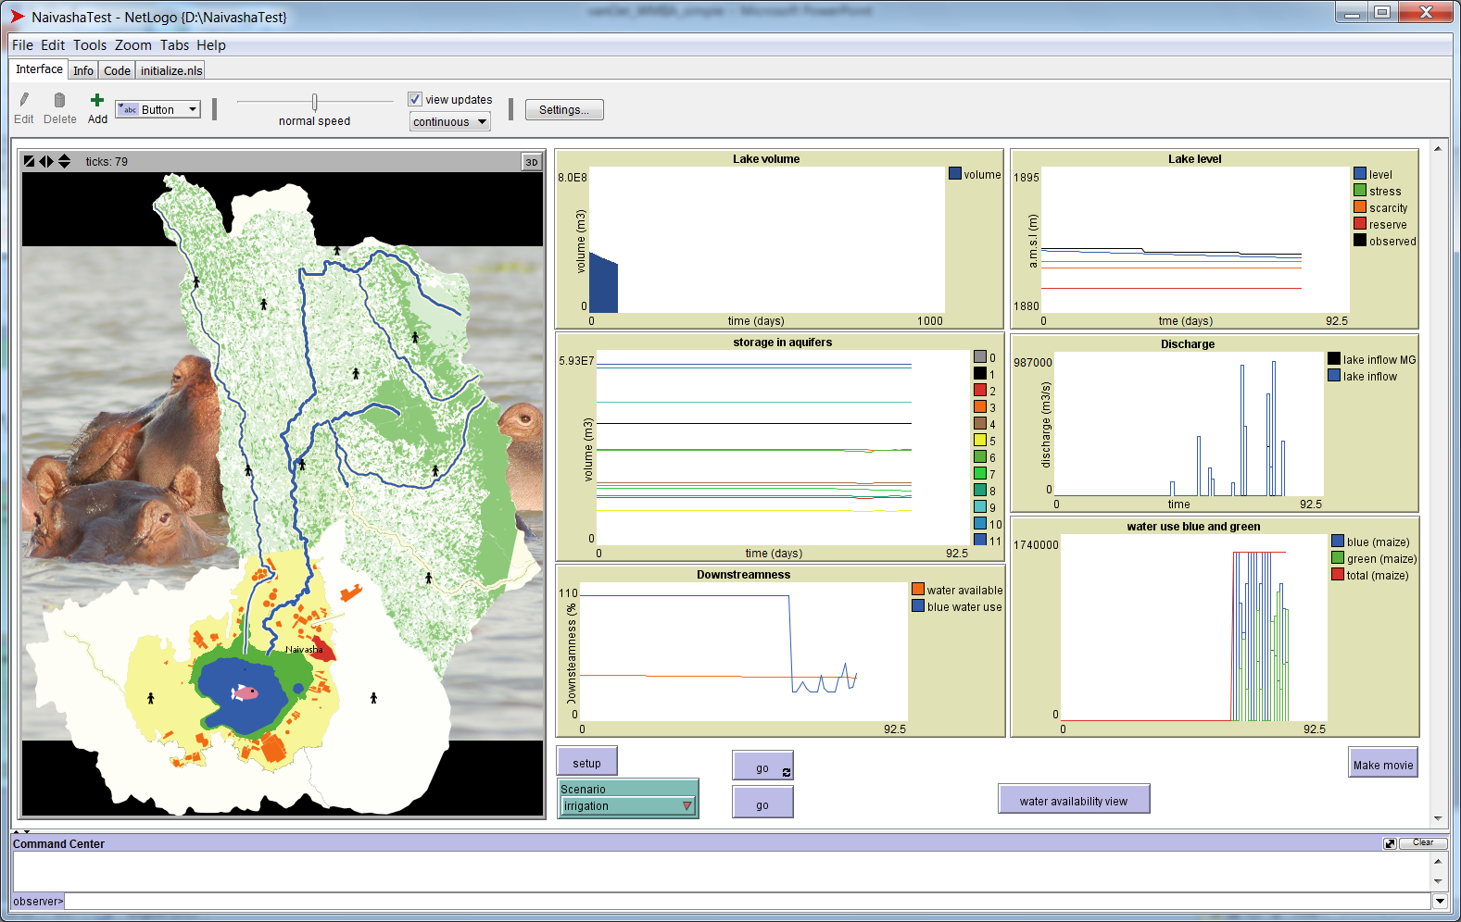
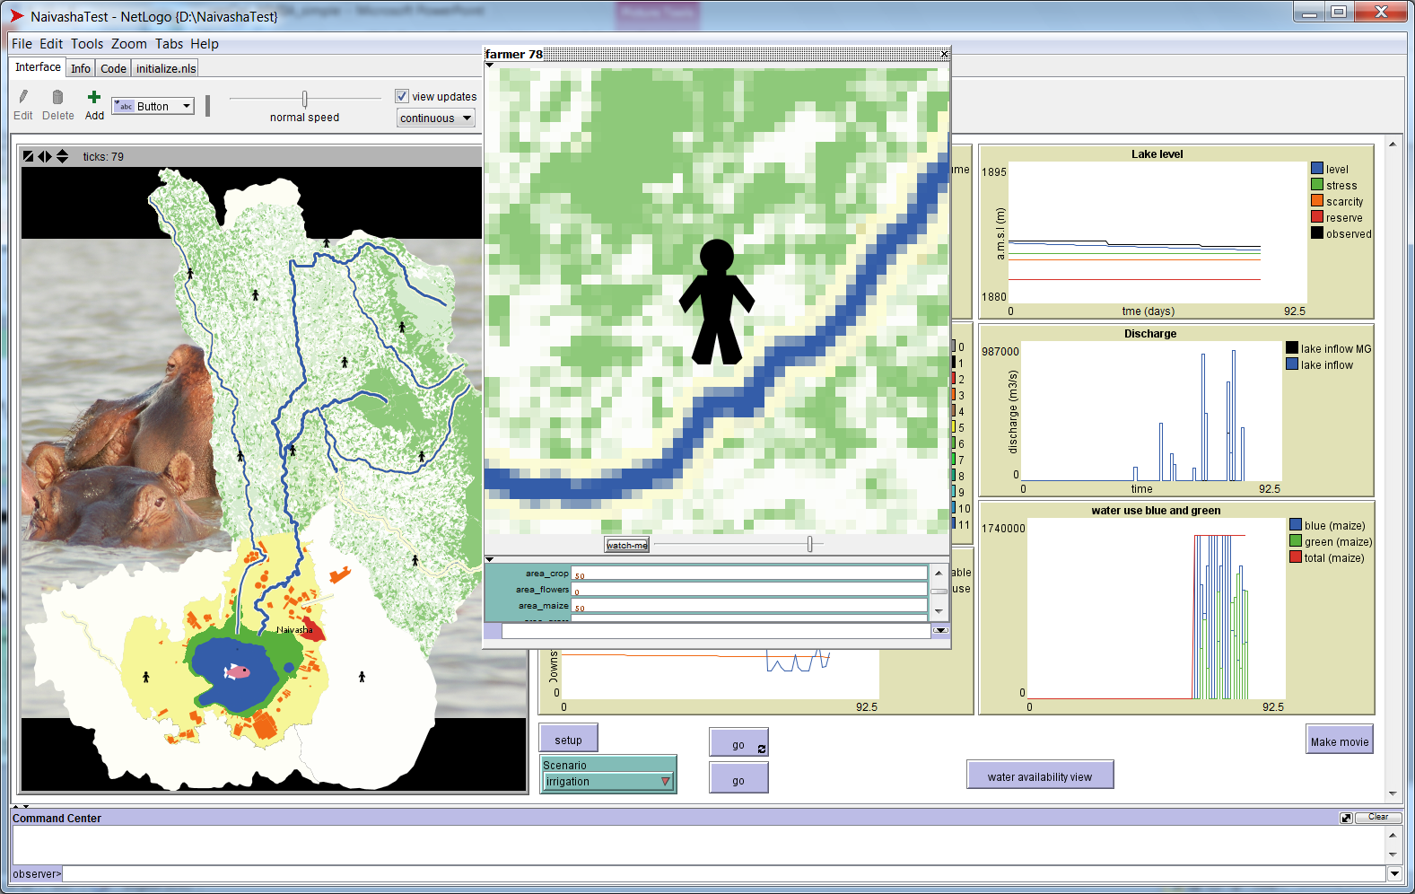
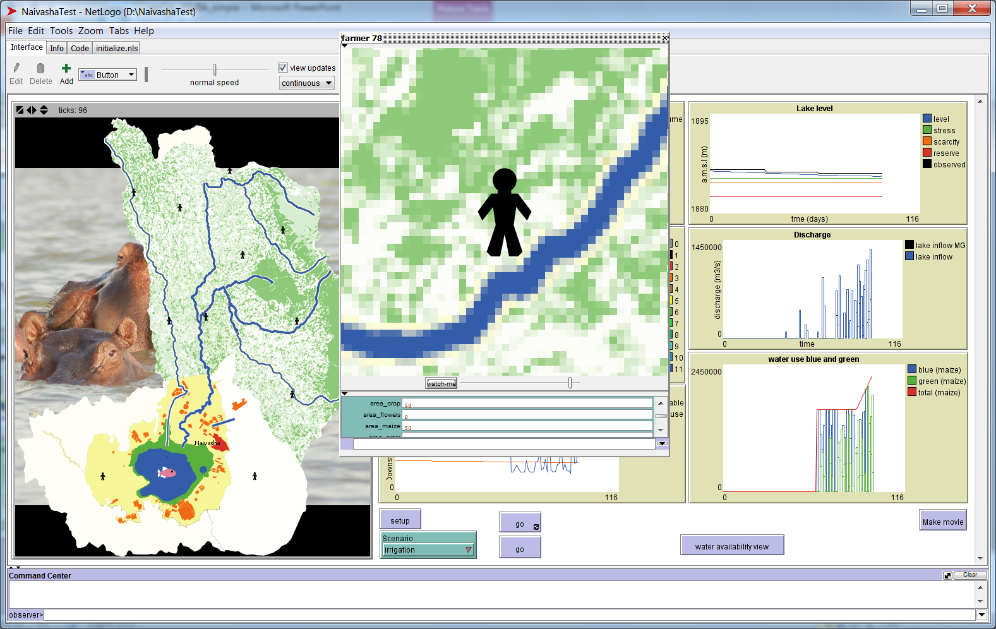
Agent-based modelling

Slide 25
Scientists
Stakeholders
discussions
Research focus
determines
Approach
IA modeling
Visualization

Slide 26
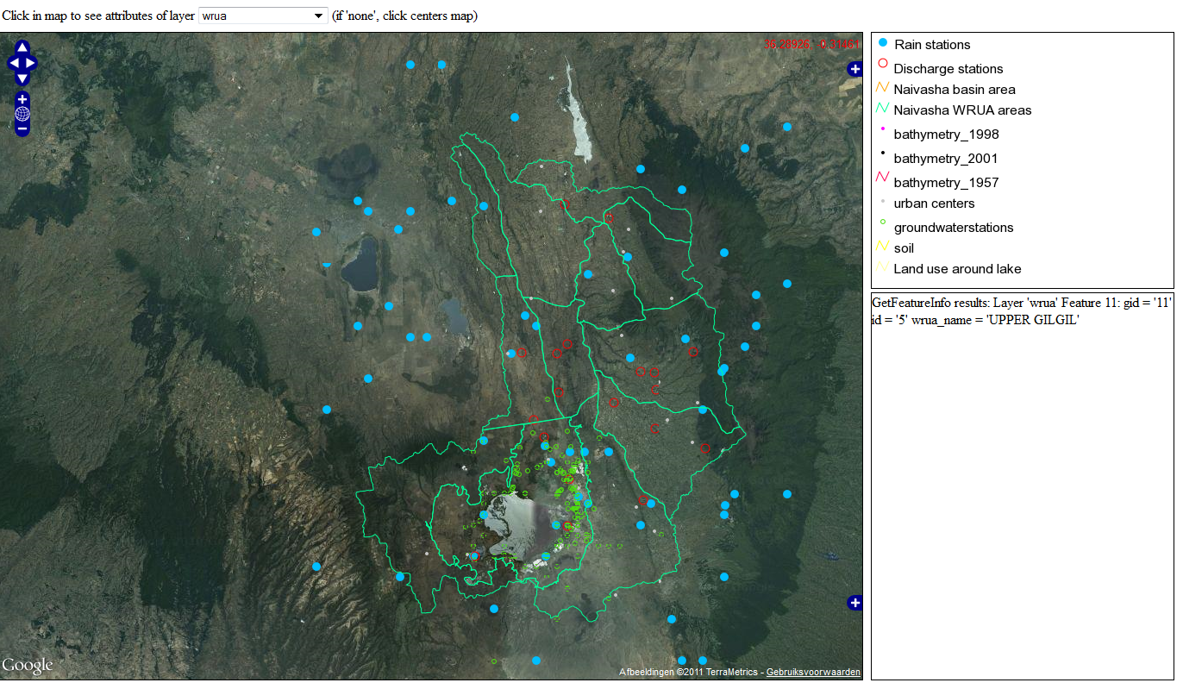
ONLINE Data view

Slide 27
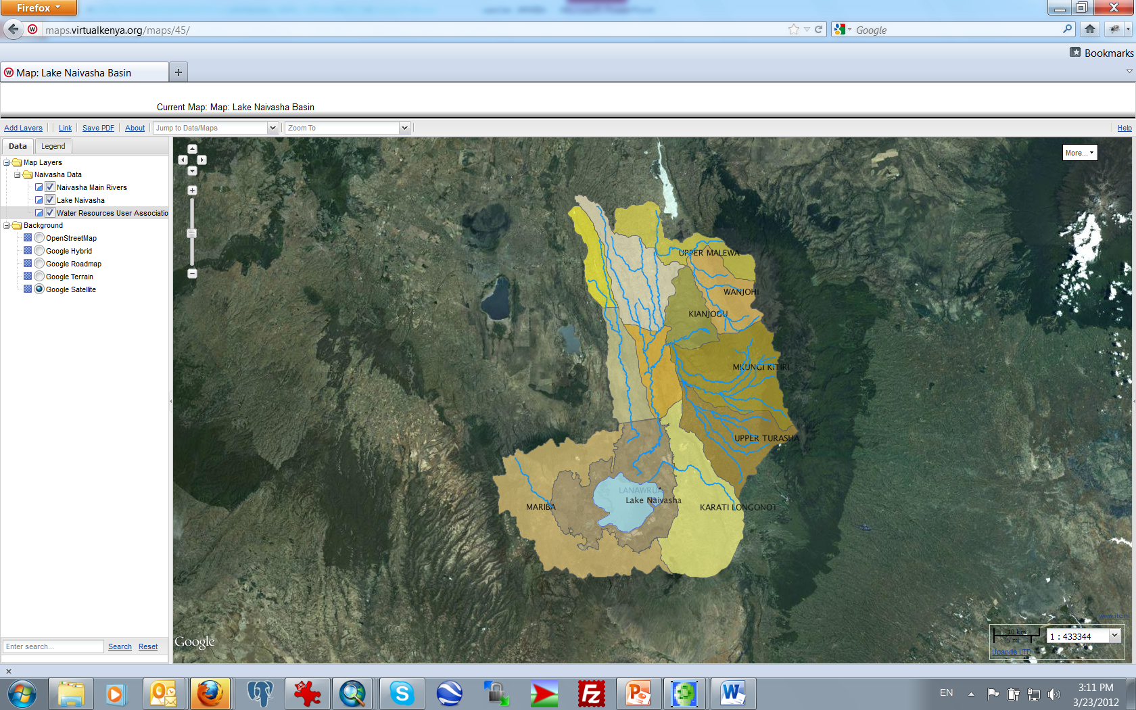
VirtualKenya (www.Virtualkenya.org)

Slide 28
Final remarks on IA for sustainable governance
Subsystems should be studied in depth while accounting for the main interdependencies
The role of resource users should be explicitly addressed in space and time
Because many human and environmental systems are linked by their geographical overlap, geographical information is particularly helpful for IA

Slide 29
Thank you!

Slide 30
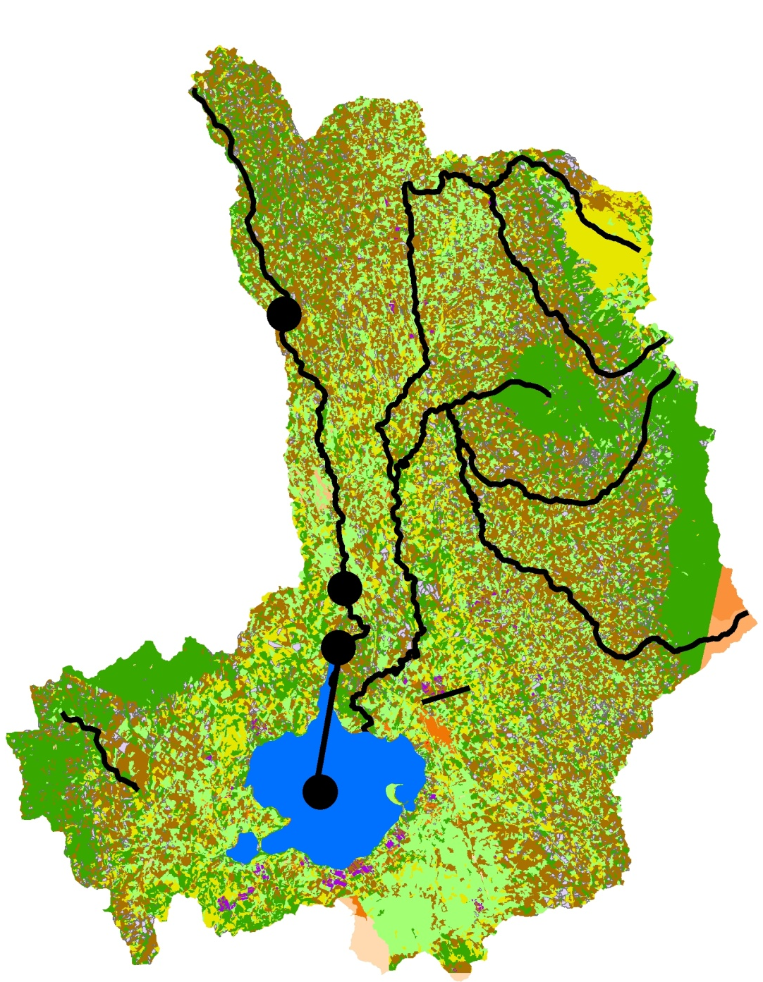
Q
W
R
R
P
ET
S
P
E
Inundation
zone

Slide 31
‘images of Naivasha’
~1980
Historic analysis
Modelling
~1990
~2000
~2010
Backcasting
~2020 A
~2020 B
~2020 C
~2030 A
~2030 B
~2030 C

Slide 32
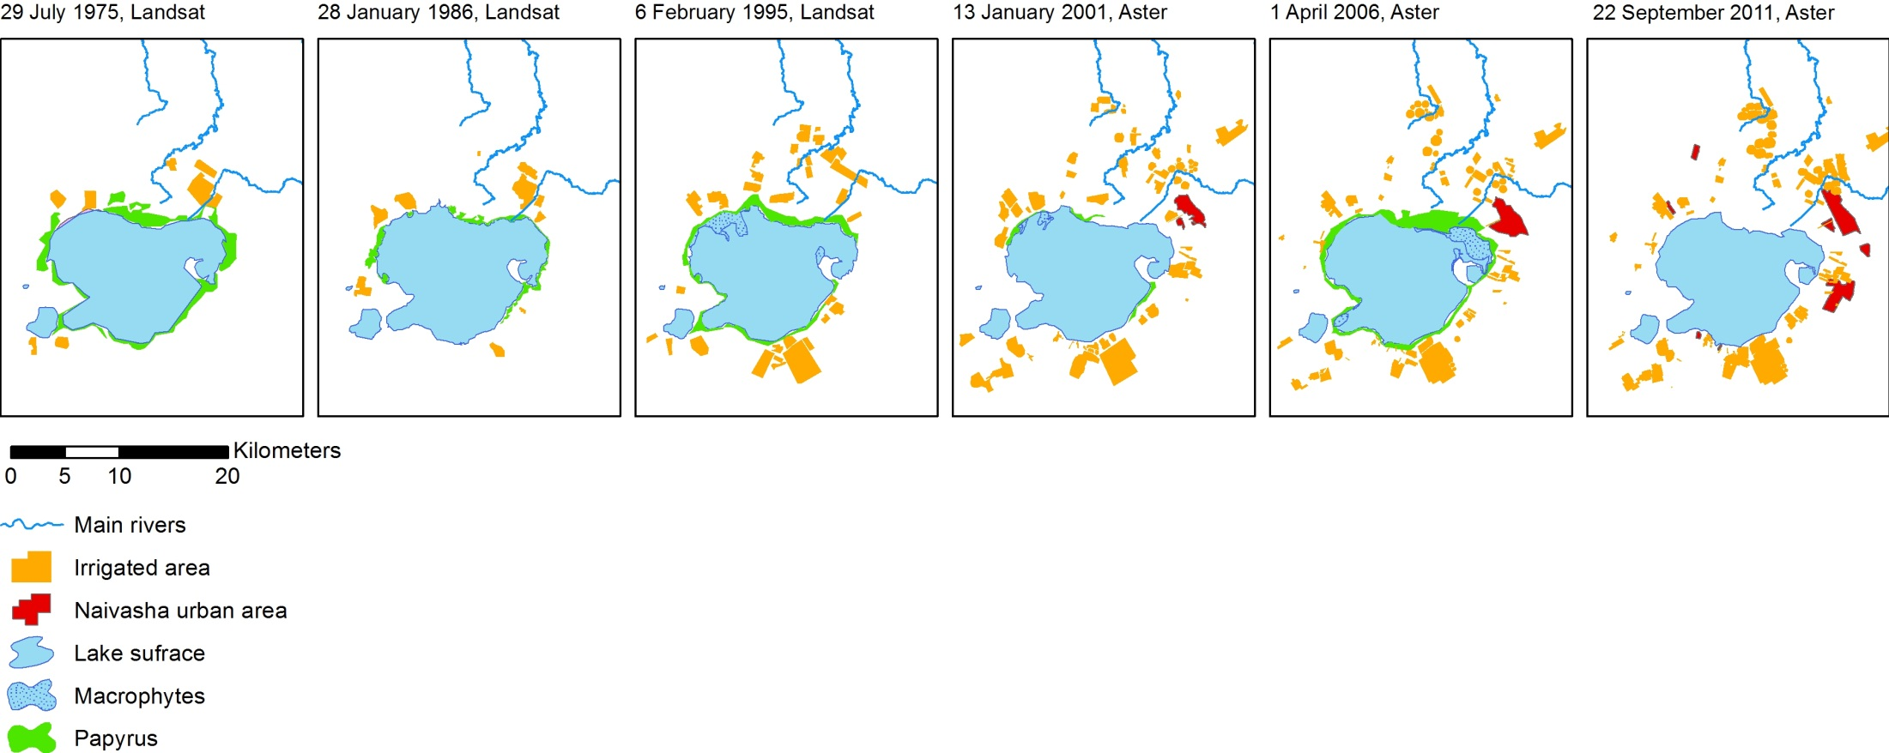
Example: historical reconstruction

Slide 33
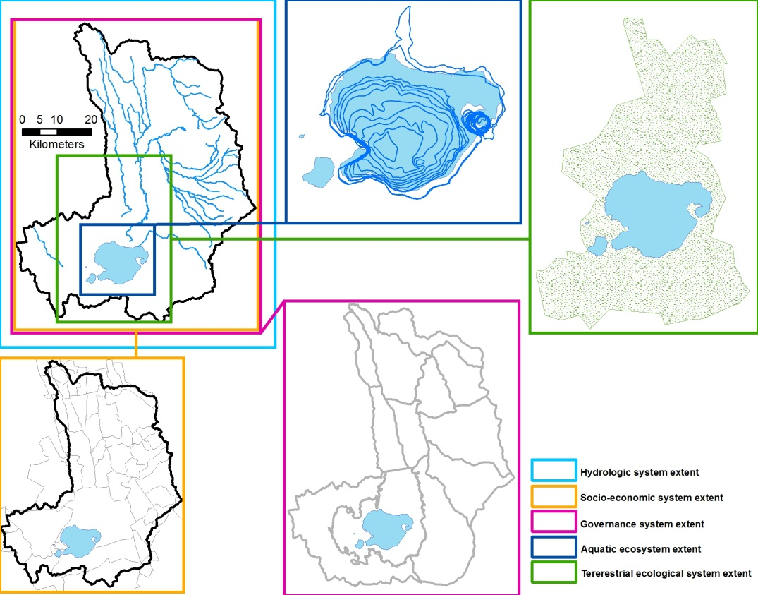

Slide 34
NETLOGO
SWAT
MODFLOW
DELFT3D
Linked models or integrated model
NETLOGO

