Slide 1
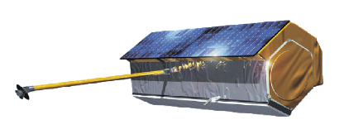
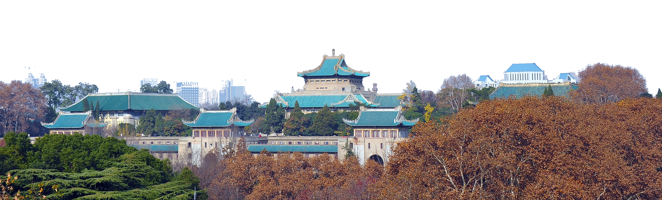
测绘遥感信息工程国家重点实验室
State Key Laboratory of Information Engineering in Surveying, Mapping and Remote Sensing
Synthetic Aperture Radar Tomography – practical course
Timo Balz, Stefano Tebaldini, Laurent Ferro-Famil

Slide 2



TomoSAR_Main.m
%%%%%%%%%%%%%%%%%%%%%%%%%%%%%%%%%%%%%%%%%%%%%%%%%%%%%%%%%%%%%%%%%%%%%%%%%%%%%%%%%%%%%%%%%%%%%%%%%
% DEMONSTRATIVE TOMOGRAPHIC SAR PROCESSING FOR FOREST ANALYSIS
% AUTHOR: STEFANO TEBALDINI, POLITECNICO DI MILANO
% EMAIL: stefano.tebaldini@polimi.it
% TEL: +390223993614
%
% THE FOLLOWING SCRIPT AND ALL RELATED SCRIPTS/FUNCTIONS AND DATA ARE INTENDED AS
% MATERIAL FOR THE TOMOSAR TRAINING COURSE HELD IN BEIJING IN FEBRUARY 2015
% BY LAURENT FERRO-FAMIL AND STEFANO TEBALDINI
%
% THIS SOFTWARE WAS DEVELOPED AND TESTED USING MATLAB R2011b
%
% SAR DATA USED IN THIS SCRIPT ARE PART OF THE SAR DATA-SET ACQUIRED BY DLR
% IN 2008 IN THE FRAME OF THE ESA CAMPAIGN BIOSAR 2008
% DATA FOCUSING, COREGISTRATION, PHASE FLATTENING, AND GENERATION OF KZ
% MAPS WERE CARRIED OUT BY DLR.
% DATA PHASE CALIBRATION WAS CARRIED OUT BY THE AUTHOR
%
% TERRAIN ELEVATION DATA USED IN THIS SCRIPT ARE EXTRACTED FROM
% THE LIDAR DATA-SET ACQUIRED BY THE SWEDISH DEFENCE RESEARCH AGENCY (FOI)
% AND HILDUR AND SVEN WINQUIST'S FOUNDATION IN THE FRAME OF THE ESA
% CAMPAIGN BIOSAR 2008
% PROCESSING OF LIDAR DATA AND PROJECTION ONTO SAR GEOMETRY WAS CARRIED OUT
% BY THE AUTHOR
%
% YOU ARE WELCOME TO ADDRESS ME QUESTIONS/COMMENTS/CORRECTIONS AT
% stefano.tebaldini@polimi.it
%%%%%%%%%%%%%%%%%%%%%%%%%%%%%%%%%%%%%%%%%%%%%%%%%%%%%%%%%%%%%%%%%%%%%%%%%%%%%%%%%%%%%%%%%%%%

Slide 3
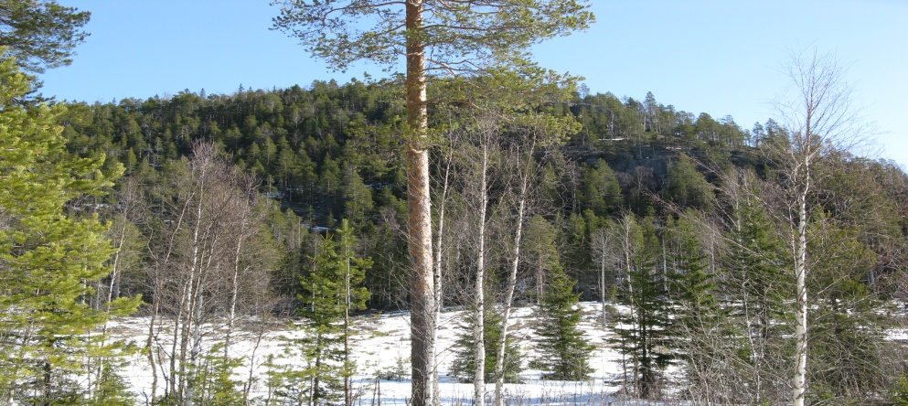
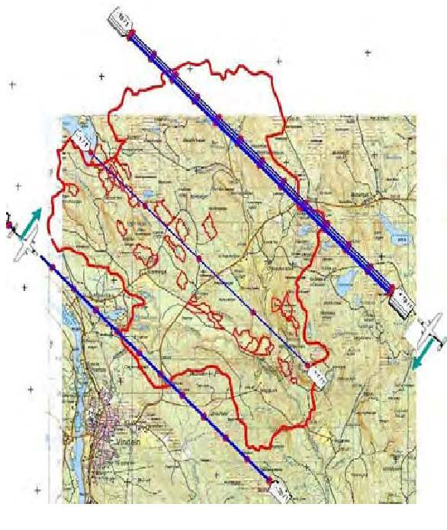
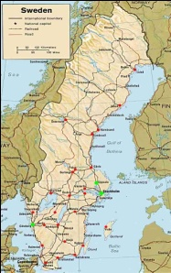
Data
Campaign | BioSAR 2008 - ESA
System | E-SAR - DLR
Site | Krycklan river catchment, Northern Sweden
Scene | Boreal forest Pine, Spruce, Birch, Mixed stand
Topography | Hilly
Tomographic Tracks | 6 + 6 – Fully Polarimetric (South-West and North-East)
Carrier Frequency | P-Band and L-Band
Slant range resolution | 1.5 m
Azimuth resolution | 1.6 m
Vertical resolution (P-Band) | 20 m (near range) to >80 m (far range)
Vertical resolution (L-Band) | 6 m (near range) to 25 m (far range)

Slide 4
Forward model
Resolution is determined by pulse bandwidth along the slant range direction, and by the lengths of the synthetic apertures in the azimuth and cross range directions
The SAR resolution cell is split into multiple layers, according to baseline aperture
Track N
cross range, v
Track n
SAR Resolution Cell
Tomographic Res. Cell
Track 1
For most systems:
Δv >> Δr, Δx
Baseline aperture
slant range, r
height
height
Δv
ground range
azimuth
ground range
Δr

Slide 5
Vertical wavenumber
Each focused SLC SAR image is obtained as the Fourier Transform of the scene complex reflectivity along the cross-range coordinate
y_{n}(r,x) : SLC pixel in the n-th image
s(r,x,v): average complex reflectivity of the scene within the SAR 2D resolution cell at (r,x)
b_{n} : normal baseline for the n-th image
λ : carrier wavelength
Change of variable from cross range to height
Δr
cross range, v
height, z
Radar Line of Sight
k_{z} is usually referred to as vertical wavenumber or phase to height conversion factor
transmitted pulse

Slide 6
Reference height
Note: z is always intended as height with respect to a Digital Elevation Model (DEM)
“zero” of the resulting Tomographic profiles
Track N
Track n
Track 1
Δr
θ
Radar Line of Sight
cross range, v
height, z
height
DEM error
azimuth
ground range
Red = Reference terrain elevation
Orange = True terrain elevation

Slide 7
DEM subtraction
The dependence on height is limited to the phase terms k_{z}z
Passing from one reference DEM to another ⬄ phase steering from Z₁ to Z₂
Track N
Tomographic profile from
y_{n}(r,x;Z₁)
Tomographic profile from
y_{n}(r,x;Z₂)
Track n
Track 1
Δr
height, z
height, z
θ
Radar Line of Sight
height
DEM error
Red = Z₁ = Reference terrain elevation
Orange = Z₂ = True terrain elevation
azimuth
ground range

Slide 8
Phase calibration
Phase jitters in different passes result in signal defocusing
    Spaceborne: tropospheric and ionospheric phase screens
    Airborne: uncompensated platform motions on the order of a fraction of a wavelength
Slant range
resolution cell
θ
height
Replicas
height
Height of ambiguity
Replicas
Defocusing
azimuth
ground range
azimuth
ground range

Slide 9
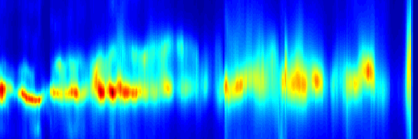
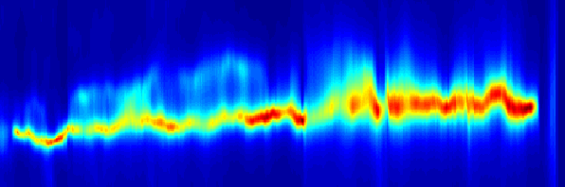
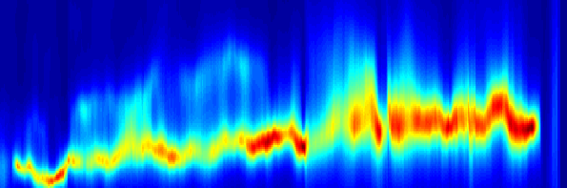
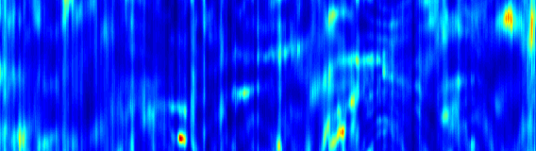
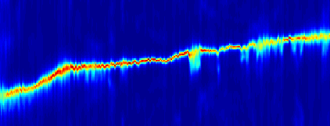
Phase calibration
Current navigational systems employed by airborne SARs do not provide, in general, sub-wavelength accuracy concerning the location of one flight line with respect to another
Need for a data-driven Phase Calibration procedure
TomoSAR at Remningstorp, Sweden – from BioSAR 2007
Original data
Phase calibrated data
60
60
50
50
40
40
30
30
20
height [m]
20
10
height [m]
0
10
-10
0
200
600
1000
1400
1800
2200
-10
200
600
1000
1400
1800
2200
slant range [m]
slant range [m]
TomoSAR at Kangerlussuaq, Greenland – from IceSAR 2012
Original data
Phase calibrated data
200
200
100
100
Height [m]
0
Height [m]
0
-100
-100
-200
-200
-4000
-3000
-2000
-1000
0
1000
2000
3000
4000
5000
-4000
-3000
-2000
-1000
0
1000
2000
3000
4000
5000
Azimuth [m]
Azimuth [m]

Slide 10
Phase calibration
Current navigational systems employed by airborne SARs do not provide, in general, sub-wavelength accuracy concerning the location of one flight line with respect to another
Need for a data-driven Phase Calibration procedure
TomoSAR at Remningstorp, Sweden – from BioSAR 2007
Original data
Phase calibrated data
60
60
50
50
40
40
30
30
20
height [m]
20
10
height [m]
0
10
-10
0
200
600
1000
1400
1800
2200
-10
200
600
1000
1400
1800
2200
This data-set: phase calibration by PoliMi
slant range [m]
slant range [m]
TomoSAR at Kangerlussuaq, Greenland – from IceSAR 2012
Original data
Phase calibrated data
200
200
100
100
Height [m]
0
Height [m]
0
-100
-100
-200
-200
-4000
-3000
-2000
-1000
0
1000
2000
3000
4000
5000
-4000
-3000
-2000
-1000
0
1000
2000
3000
4000
5000
Azimuth [m]
Azimuth [m]

Slide 11
TomoSAR_Main.m
%%%%%%%%%%%%%%%%%%%%%%%%%%%%%%%%%%%%%%%%%%%%%%%%%%%%%%%%%%%%%%%%%%%%%%%%%%%%%%%%%%%%%%%%%%%%%%%%%
% LOAD DATA
if not(exist('I'))
load('BioSAR_2_L_Band_sample_data')
Master = 1
[Nr,Na,N] = size(I{1})
N_pol = length(I)
rem_dem_flag = 1
if rem_dem_flag % remove dem phases (optional)
for pol = 1:N_pol
for n = 1:N
dem_phase = kz(:,:,n).*(DEM - DEM_avg);
I{pol}(:,:,n) = I{pol}(:,:,n).*exp(1i*dem_phase);
end
end
end
Ch = {'HH','HV','VV'}
end
%%%%%%%%%%%%%%%%%%%%%%%%%%%%%%%%%%%%%%%%%%%%%%%%%%%%%%%%%%%%%%%%%%%%%%%%%%%%%%%%%%%%%%%%%%%%%%%%%
Notes:
Data can be referenced to a flat DEM (DEM_avg) or to the Lidar DEM (DEM)

Slide 12
TomoSAR_Main.m
%%%%%%%%%%%%%%%%%%%%%%%%%%%%%%%%%%%%%%%%%%%%%%%%%%%%%%%%%%%%%%%%%%%%%%%%%%%%%%%%%%%%%%%%%%%%%%%%%
% Let's look at the data first....
for pol = 1:N_pol
figure, imagesc(az_ax,rg_ax,sum(abs(I{pol}),3)), colorbar
title(Ch{pol})
xlabel('azimuth [m]')
ylabel('range [m]')
end
figure, imagesc(az_ax,rg_ax,DEM), colorbar
title('DEM [m]')
xlabel('azimuth [m]')
ylabel('range [m]')
figure, imagesc(az_ax,rg_ax,FOR_H,[0 35]), colorbar
title('Forest height [m]')
xlabel('azimuth [m]')
ylabel('range [m]')
%%%%%%%%%%%%%%%%%%%%%%%%%%%%%%%%%%%%%%%%%%%%%%%%%%%%%%%%%%%%%%%%%%%%%%%%%%%%%%%%%%%%%%%%%%%%%%%%%
Notes:
DEM = Lidar DEM
FOR_H= Lidar forest height

Slide 13
Results

Slide 14
Results

Slide 15
Results

Slide 16
Results

Slide 17
Results

Slide 18
TomoSAR_Main.m
%%%%%%%%%%%%%%%%%%%%%%%%%%%%%%%%%%%%%%%%%%%%%%%%%%%%%%%%%%%%%%%%%%%%%%%%%%%%%%%%%%%%%%%%%%%%%%%%%
% COHERENCE EVALUATION
% estimation window (in meters)
Wa_m = 30
Wr_m = 30
[COV_4D,a_sub,r_sub] = Generate_covariance_matrix(I{1},az_ax,rg_ax,Wa_m,Wr_m);
figure, InSAR_view(abs(COV_4D),[0 1]), colorbar
title('InSAR coherences')
figure, InSAR_view(angle(COV_4D),[-pi pi]), colorbar
title('InSAR phases')
%%%%%%%%%%%%%%%%%%%%%%%%%%%%%%%%%%%%%%%%%%%%%%%%%%%%%%%%%%%%%%%%%%%%%%%%%%%%%%%%%%%%%%%%%%%%%%%%%
Notes:
COV_4D is a 4D data structure representing the complex coherence as a function of each interferometric pair, i.e.: y_{nm}(r,x)
Generate_covariance_matrix.m = function to evaluate COV_4D from SLC images
InSAR_view = function to view COV_4D as a big 2D matrix

Slide 19
Generate_covariance_matrix.m
function [Cov,x_sub,y_sub] = Generate_covariance_matrix(F,x_ax,y_ax,Wx_m,Wy_m)
%%%%%%%%%%%%%%%%%%%%%%%%%%%%%%%%%%%%%%%%%%%%%%%%%%%%%%%%%%%%%%%%%%%%%%%%%
[Ny,Nx,N] = size(F);
% pixel sampling
dx = x_ax(2)-x_ax(1);
dy = y_ax(2)-y_ax(1);
% filter along x
Lx = round(Wx_m/2/dx);
filter_x = hamming(2*Lx+1);
% sub-sampling along x
x_sub = Lx+1:max(round(Lx/2),1):Nx-Lx;
% filter along y
Ly = round(Wy_m/2/dy);
filter_y = hamming(2*Ly+1);
% sub-sampling along y
y_sub = Ly+1:max(round(Ly/2),1):Ny-Ly;
%%%%%%%%%%%%%%%%%%%%%%%%%%%%%%%%%%%%%%%%%%%%%%%%%%%%%%%%%%%%%%%%%%%%%%%%%

Slide 20
Generate_covariance_matrix.m
%%%%%%%%%%%%%%%%%%%%%%%%%%%%%%%%%%%%%%%%%%%%%%%%%%%%%%%%%%%%%%%%%%%%%%%%%
% Covariance matrix evaluation
Nx_sub = length(x_sub);
Ny_sub = length(y_sub);
Cov = ones(Ny_sub,Nx_sub,N,N);
for n = 1:N
In = F(:,:,n); % n-th image
% second-order moment
Cnn = filter_and_sub_sample(In.*conj(In),filter_x,filter_y,x_sub,y_sub);
for m = n:N
Im = F(:,:,m);
Cmm = filter_and_sub_sample(Im.*conj(Im),filter_x,filter_y,x_sub,y_sub);
Cnm = filter_and_sub_sample(Im.*conj(In),filter_x,filter_y,x_sub,y_sub);
% coherence
coe = Cnm./sqrt(Cnn.*Cmm);
Cov(:,:,n,m) = coe;
Cov(:,:,m,n) = conj(coe);
end
end
%%%%%%%%%%%%%%%%%%%%%%%%%%%%%%%%%%%%%%%%%%%%%%%%%%%%%%%%%%%%%%%%%%%%%%%%%
%%%%%%%%%%%%%%%%%%%%%%%%%%%%%%%%%%%%%%%%%%%%%%%%%%%%%%%%%%%%%%%%%%%%%%%%%
function Cnm = filter_and_sub_sample(Cnm,filter_x,filter_y,x_sub,y_sub)
% filter and sub-sample
t = Cnm;
t = conv2(t,filter_x(:)','same');
t = t(:,x_sub);
t = conv2(t,filter_y(:),'same');
t = t(y_sub,:);
Cnm = t;
%%%%%%%%%%%%%%%%%%%%%%%%%%%%%%%%%%%%%%%%%%%%%%%%%%%%%%%%%%%%%%%%%%%%%%%%%

Slide 21
InSar_View.m
function InSAR_view(DX,cax)
[Nx_out,Ny_out,N,a] = size(DX);
if a == N
flag_4D = 1;
else
flag_4D = 0;
end
DDX = zeros(N*Nx_out,N*Ny_out);
for n = 1:N
ind_n = [1:Nx_out] + Nx_out*(n-1);
for m = 1:N
ind_m = [1:Ny_out] + Ny_out*(m-1);
if flag_4D
DDX(ind_n,ind_m) = DX(:,:,n,m);
else
DDX(ind_n,ind_m) = DX(:,:,m) - DX(:,:,n);
end
end
end
if exist('cax')==1
if max(abs(cax-[-pi pi]))==0
disp('phase')
DDX = angle(exp(1i*DDX));
end
imagesc(DDX,cax)
else
imagesc(DDX)
end
axis off

Slide 22
Results – InSAR coherence – DEM subtracted

Slide 23
Results – InSAR coherence – DEM not subtracted
Notes:
Noticeable topographic phases
Lower coherence magnitudes

Slide 24
TomoSAR_Main.m
%%%%%%%%%%%%%%%%%%%%%%%%%%%%%%%%%%%%%%%%%%%%%%%%%%%%%%%%%%%%%%%%%%%%%%%%%%%%%%%%%%%%%%%%%%%%%%%%%
% TOMOGRAPHIC PROCESSING (3D focusing)
% vertical axis (in meters)
if rem_dem_flag % height w.r.t. DEM
dz = 0.5;
z_ax = [-20:dz:40];
else % % height w.r.t. average DEM
dz = 1;
z_ax = [-150:dz:150];
end
Nz = length(z_ax);
% half the number of azimuth looks to be processed
Lx = 10
% azimuth position to be processed (meters)
az_profile_m = 590;
az_profile_m = 678
az_profile_m = -92
% Focus in SAR geometry
TomoSAR_focusing
if rem_dem_flag == 0
% the following routines have been written assuming DEM phases are removed
return
end
% Geocode to ground geometry and compare to Lidar forest height
Geocode_TomoSAR
%%%%%%%%%%%%%%%%%%%%%%%%%%%%%%%%%%%%%%%%%%%%%%%%%%%%%%%%%%%%%%%%%%%%%%%%%%%%%%%%%%%%%%%%%%%%%%%%%

Slide 25
TomoSAR_Focusing.m
%%%%%%%%%%%%%%%%%%%%%%%%%%%%%%%%%%%%%%%%%%%%%%%%%%%%%%%%%%%%%%%%%%%%%%%%%%%%%%%%%%%%%%%%%%%%% pixel index
[t,a0] = min(abs(az_ax-az_profile_m));
az_ind = a0 + [-Lx:Lx];
% Focusing
for pol = 1:N_pol
Tomo_3D{pol} = zeros(Nz,Nr,length(az_ind));
for z = 1:Nz
t = I{pol}(:,az_ind,:).*exp(1i*kz(:,az_ind,:).*z_ax(z));
Tomo_3D{pol}(z,:,:) = mean(t,3);
end
end
%%%%%%%%%%%%%%%%%%%%%%%%%%%%%%%%%%%%%%%%%%%%%%%%%%%%%%%%%%%%%%%%%%%%%%%%%%%%%%%%%%%%%%%%%%%%
Notes:
Just a discrete Fourier Transform

Slide 26
Results – Tomographic Profiles
Lidar DEM not subtracted (rem_dem_flag=0)
Reference height = DEM_avg = 200 m
LIDAR DEM subtracted (rem_dem_flag=1)
Reference height = LIDAR DEM

Slide 27
Geocoding
Tomographic profiles have been generated in the coordinate system (r,z):
r = (Zero-Doppler) distance from the Master track
z = height w.r.t. the reference DEM
A point at coordinates (Y,Z) in the ground range plane is found at
Master Track
θ
Δr
z
Radar Line of Sight
r
Height, Z
Red = z_{ref}(r) = Reference terrain elevation
azimuth
ground range, Y

Slide 28
Geocode_TomoSAR.m
%%%%%%%%%%%%%%%%%%%%%%%%%%%%%%%%%%%%%%%%%%%%%%%%%%%%%%%%%%%%%%%%%%%%%%%%%%%%%%%%%%%%%%%%%%%%% pixel index
[t,a0] = min(abs(az_ax-az_profile_m));
% Master position
Sy = interp1(S{Master}.x,S{Master}.y,az_profile_m);
Sz = interp1(S{Master}.x,S{Master}.z,az_profile_m);
% Terrain elevation
dem = DEM(:,a0)';
% Forest height
for_h = FOR_H(:,a0)';
% ground range as a function of slant range
y_of_r = sqrt(rg_ax.^2 - (Sz-dem).^2) + Sy;
%%%%%%%%%%%%%%%%%%%%%%%%%%%%%%%%%%%%%%%%%%%%%%%%%%%%%%%%%%%%%%%%%%%%%%%%%%%%%%%%%%%%%%%%%%%%
%%%%%%%%%%%%%%%%%%%%%%%%%%%%%%%%%%%%%%%%%%%%%%%%%%%%%%%%%%%%%%%%%%%%%%%%%%%%%%%%%%%%%%%%%%%%% absolute ground range axis
dy = 1;
y_ax_abs = [min(y_of_r)-5:dy:max(y_of_r)+5];
% absolute height axis
z_ax_abs = [min(dem)-10:dz:max(dem)+30];
% ground range as a function of slant range
y_of_r = sqrt(rg_ax.^2 - (Sz-dem).^2) + Sy;
% resample lidar dem and lidar forest height from range to ground range
dem_gr = interp1(y_of_r,dem,y_ax_abs,'linear',nan);
for_h_gr = interp1(y_of_r,for_h,y_ax_abs,'linear',nan);
%%%%%%%%%%%%%%%%%%%%%%%%%%%%%%%%%%%%%%%%%%%%%%%%%%%%%%%%%%%%%%%%%%%%%%%%%%%%%%%%%%%%%%%%%%%%

Slide 29
Geocode_TomoSAR.m
%%%%%%%%%%%%%%%%%%%%%%%%%%%%%%%%%%%%%%%%%%%%%%%%%%%%%%%%%%%%%%%%%%%%%%%%%%%%%%%%%%%%%%%%%%%%% ground range, height coordinates
[Za,Ya] = ndgrid(z_ax_abs,y_ax_abs);
% slant range
R = sqrt( (Sy-Ya).^2 + (Sz-Za).^2 );
% reference dem
Z_ref = interp1(rg_ax,dem,R,'linear','extrap');
% height w.r.t. reference dem
Z = Za - Z_ref;
%%%%%%%%%%%%%%%%%%%%%%%%%%%%%%%%%%%%%%%%%%%%%%%%%%%%%%%%%%%%%%%%%%%%%%%%%%%%%%%%%%%%%%%%%%%%
%%%%%%%%%%%%%%%%%%%%%%%%%%%%%%%%%%%%%%%%%%%%%%%%%%%%%%%%%%%%%%%%%%%%%%%%%%%%%%%%%%%%%%%%%%%%% Geocode tomograms
for pol = 1:3
tomo_sar = Tomo_filt{pol};
tomo_sar = tomo_sar./max(tomo_sar(:));
% Geocoded tomogram
tomo_geo = interp2(rg_ax,z_ax,tomo_sar,R,Z);
% Geocoded tomogram - height w.r.t. Lidar
tomo_geo(isnan(tomo_geo)) = 0;
for y = 1:length(y_ax_abs)
tomo_geo_rel(:,y) = interp1(z_ax_abs,tomo_geo(:,y),z_ax + dem_gr(y));
end
%%%%%%%%%%%%%%%%% Draw pictures here%%%%%%%%%%%%%%%%%%%%%%5
end
%%%%%%%%%%%%%%%%%%%%%%%%%%%%%%%%%%%%%%%%%%%%%%%%%%%%%%%%%%%%%%%%%%%%%%%%%%%%%%%%%%%%%%%%%%%%

Slide 30
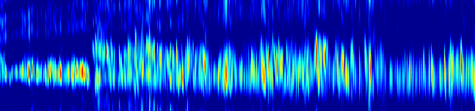
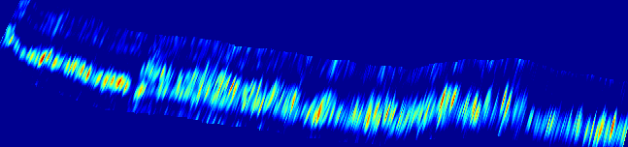
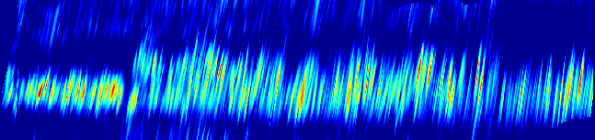
Geocoding - Results
40
VV SAR Geometry
SAR geometry
Slant range – height w.r.t. reference DEM
Note: Lidar forest height not matched
20
height [m]
0
-20
4400
4600
4800
5000
5200
5400
range [m]
VV Ground Geometry
Ground geometry
Ground range – height
280
260
height [m]
240
220
200
180
2200
2400
2600
2800
3000
3200
3400
3600
3800
Ground geometry w.r.t. reference DEM
Ground range – height w.r.t. reference DEM
Note: Lidar forest height well matched
ground range [m]
40
VV Ground Geometry relative to DEM
20
height [m]
0
-20
2200
2400
2600
2800
3000
3200
3400
3600
3800
ground range [m]
Red = Lidar terrain Black = Lidar forest height

Slide 31
%%%%%%%%%%%%%%%%%%%%%%%%%%%%%%%%%%%%%%%%%%%%%%%%%%%%%%%%%%%%%%%%%%%%%%%%%%%%%%%%%%%%%%%%%%%%%%%%%%%%%%%%%%%%%%%%%%%%%%%%%%%%%%%%%%%%%%%%%%%%%%%%%%%%%%%%%%%%%%%%%%%%%%%%%%%%%%%%%%%%%%%%
%%%%%%%%%%%%%%%%%% THANK YOU %%%%%%%%%%%%%%%%% %%%%%%%%%%%%%%%%%%%%%%%%%%%%%%%%%%%%%%%%%%%%%%%%%%%%%%%%%%%%%%%%%%%%%%%%%%%%%%%%%%%%%%%%%%%%%
% FEEL FREE TO CONTACT ME AT:
% EMAIL: stefano.tebaldini@polimi.it
% TEL: +390223993614
%%%%%%%%%%%%%%%%%%%%%%%%%%%%%%%%%%%%%%%%%%%%%%%%%%%%%%%%%%%%%%%%%%%%%%%%%%%%%%%%%%%%%%%%%%%%

Slide 32
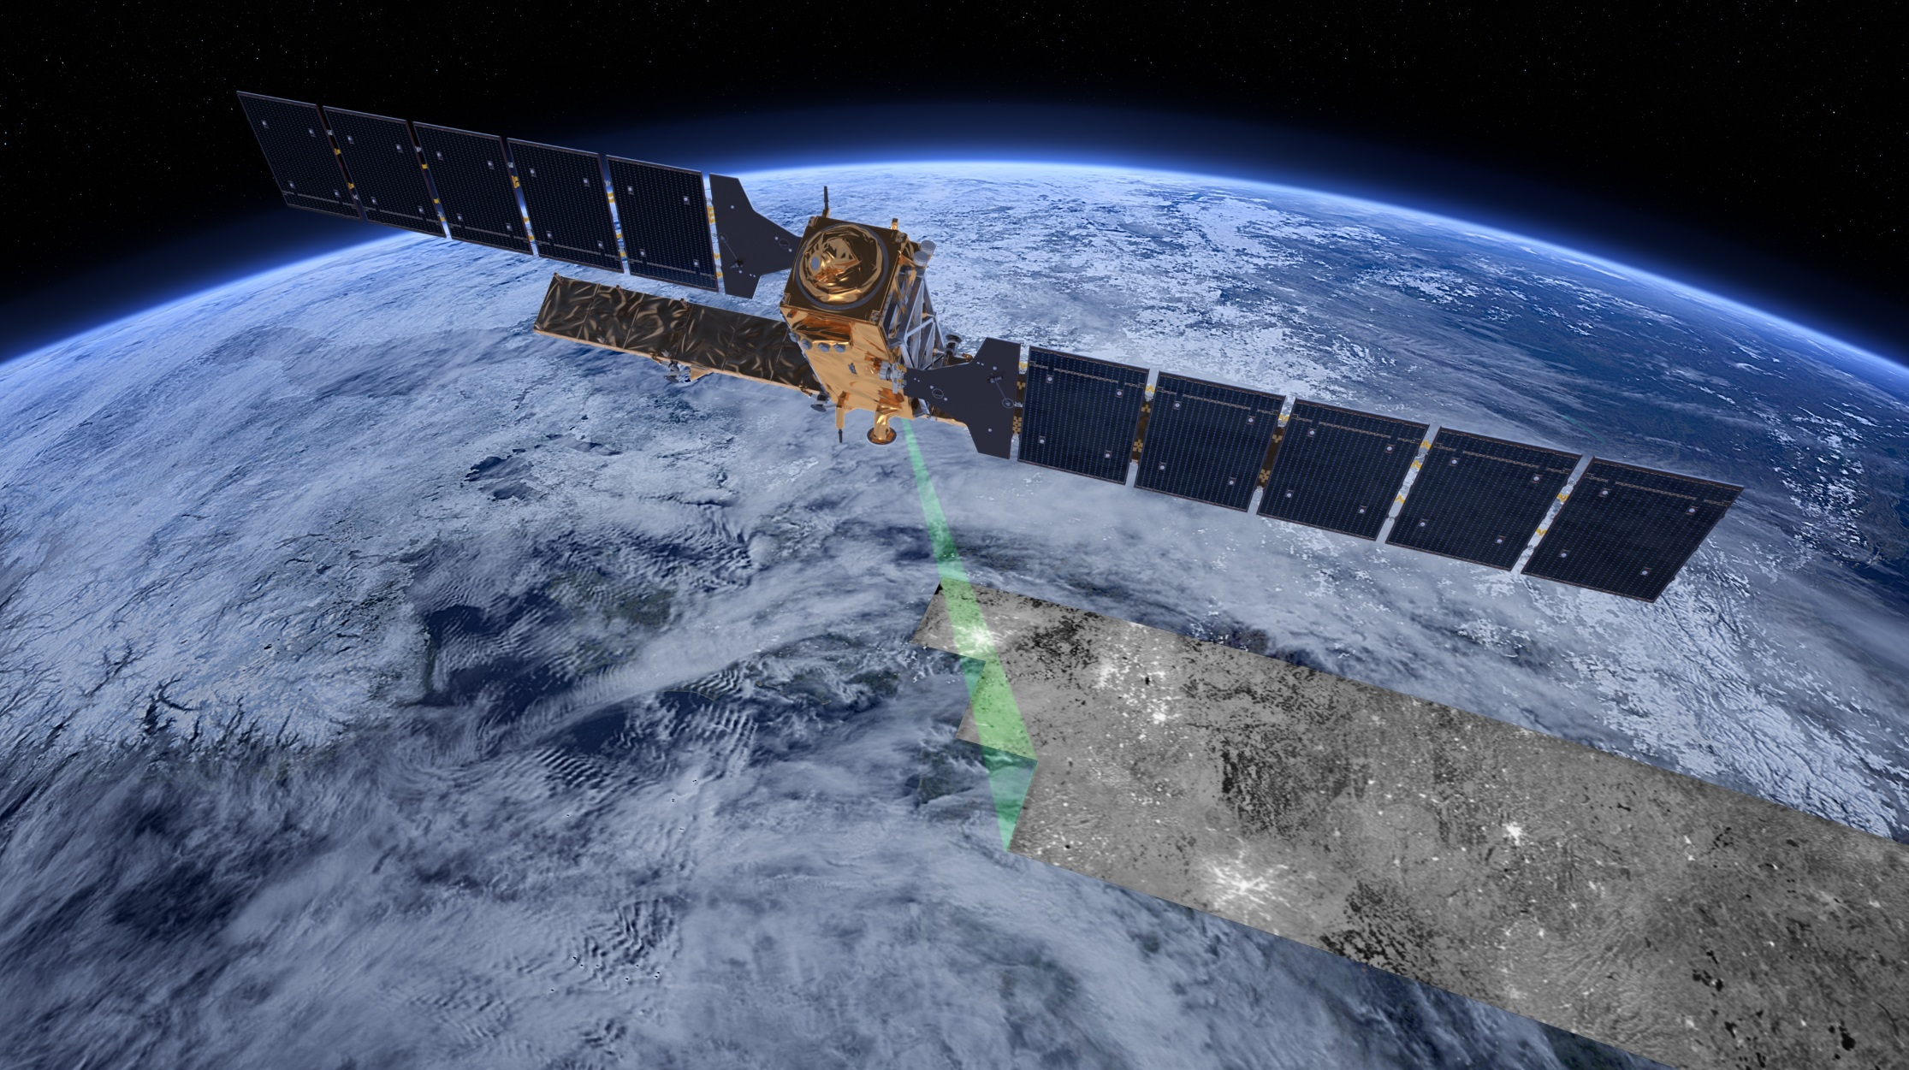
Questions?
balz@whu.edu.cn

