Slide 2
GLACIER - SAR InSAR DATA PROCESSING IN SNAP
By Zhou Jianmin & Li Zhen
lizhen@radi.ac.cn
Institute of Remote Sensing and Digital Earth, Chinese Academy of Sciences, Beijing, China

Slide 3
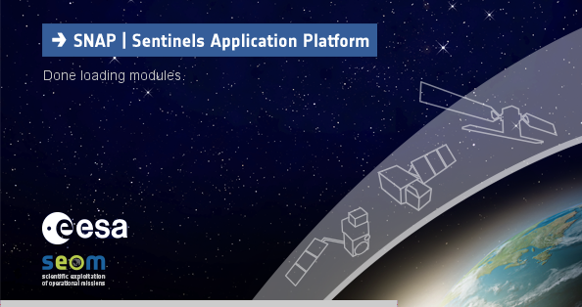
Goals of the Exercise
— Familiarize with ESA SNAP
— Training on Glacier InSAR data Using Differential Interferometry (DInSAR)
— Provide instruction on stey-by-step processing of ALOS1 data
(incl. parameters, tips etc.)
— End-to-End show case

Slide 4
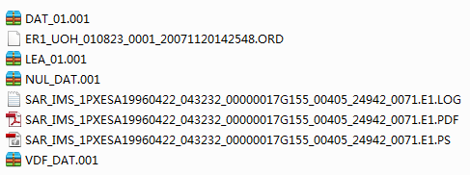
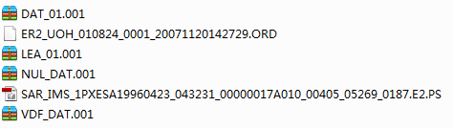
Input Dataset
— A set of ERS SLCs
— Digital Elevation Model (DEM) dataset from SRTM 3 arc-sec covering the Area of Interest(auxiliary data)
srtm_55_06.zip
[stored locally @ C:\Users\#username#\.snap\auxdata\dem\SRTM 3Sec]

Slide 5

Interferometric Processing
Processing Steps
Open a pair of ERS SLC Products
Apply InSAR Optimized Coregistration
Generate Interferogram and Coherence
Apply Topographic Phase Removal
Goldstein Phase Filtering
Phase Unwrapping(SANPHU)
Convert Differential Phase to glacier velocity

Slide 6
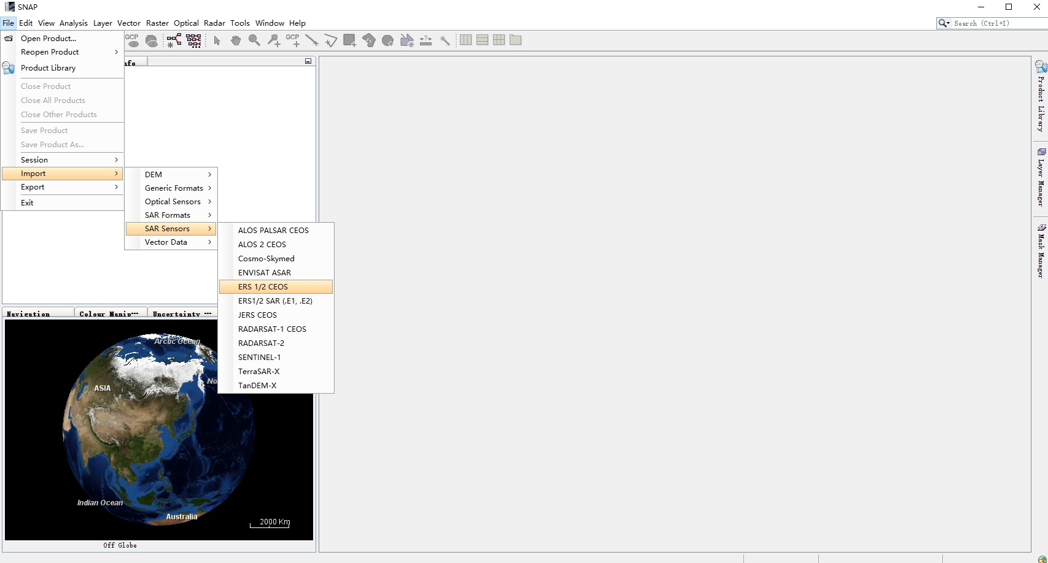
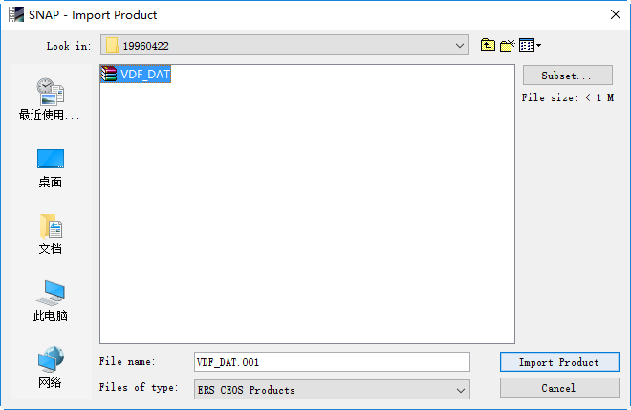
Part one: Open a pair of ERS SLC products
Step1-Open the products: Use the Import button in the top toolbar and browse for the location of the products. Select the ERS 1/2 CEOS file from the product folder and press Import Product.

Slide 7
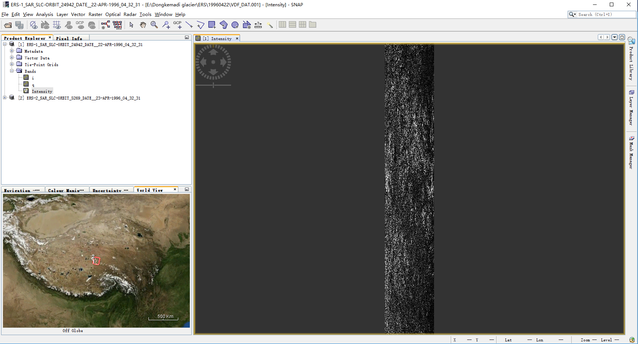
Part one: Open a pair of ERS SLC products
Step2-View the product: In the Products View you will see the opened products. Within the product bands, you will find three bands containing the real(i) , imaginary(q) and intensity .
Products View

Slide 8
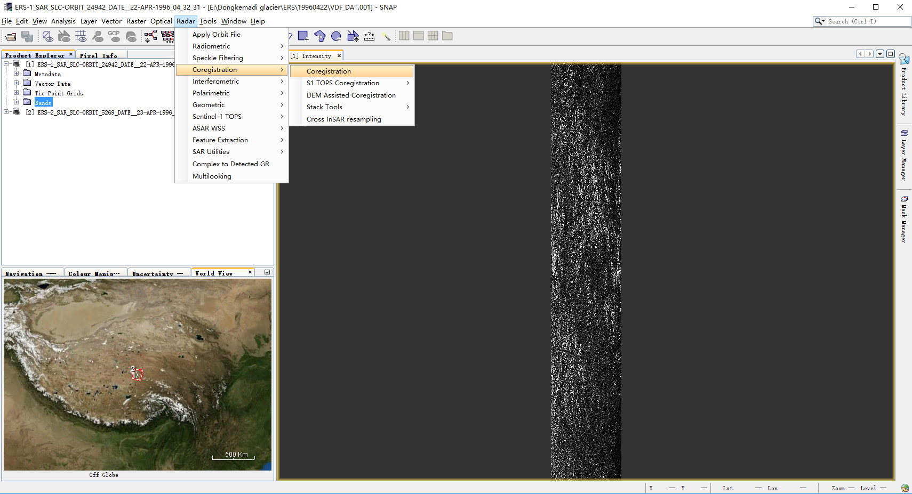
Part two: Coregistering the Data
Step3-Coregister the images into a stack: Select Coregistration in the Coregistration menu.
Select Coregistration

Slide 9
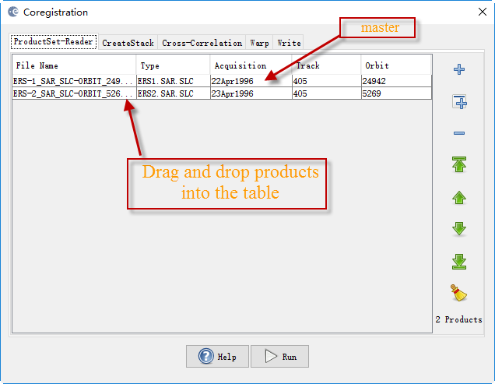
Part two: Coregistering the Data
Drag and drop first the subset product. This will be your master image. Then drag and drop the other product. This will be your slave image.
Add products into the Coregistration Dialog

Slide 10
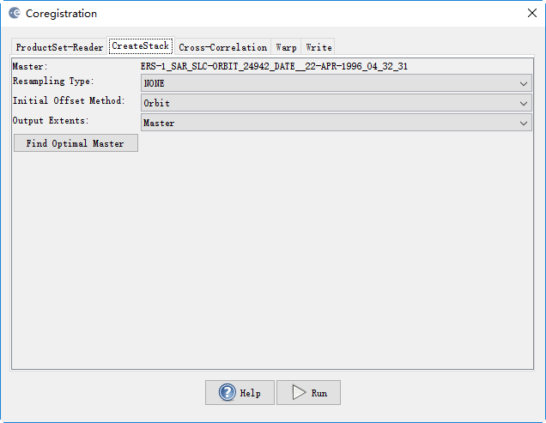
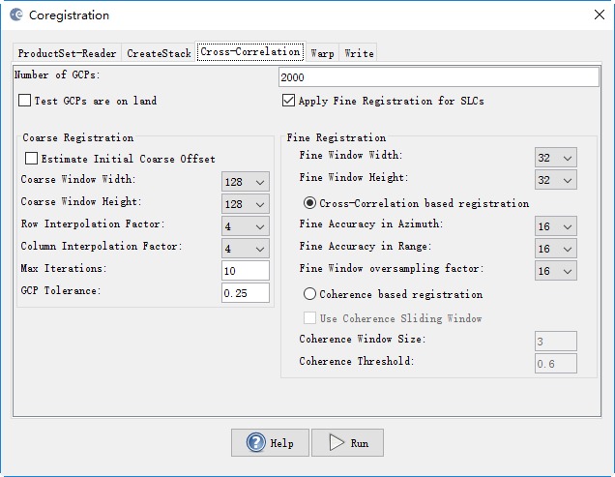
Part two: Coregistering the Data
In the Create Stack tab, the bands for master image and slave images should already be selected for you based on the order of the products given in the previous table.
In the Cross-Correlation tab, specify the number of Ground Control Points (GCPs) to use. The GCPs will be used as the center of a cross correlation window which will find the corresponding position from the slave image to the master image.
Create Stack
Define the Correlation Windows

Slide 11
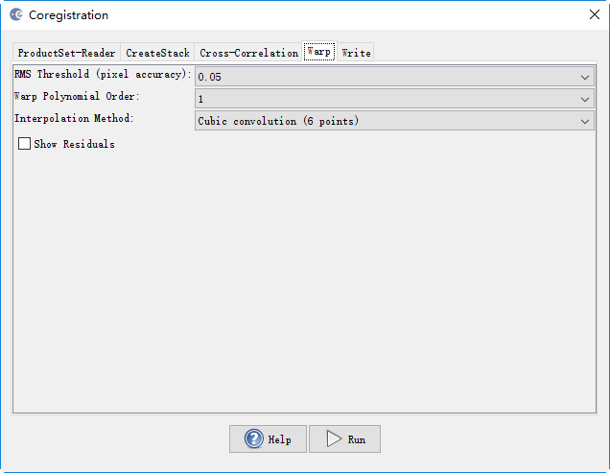
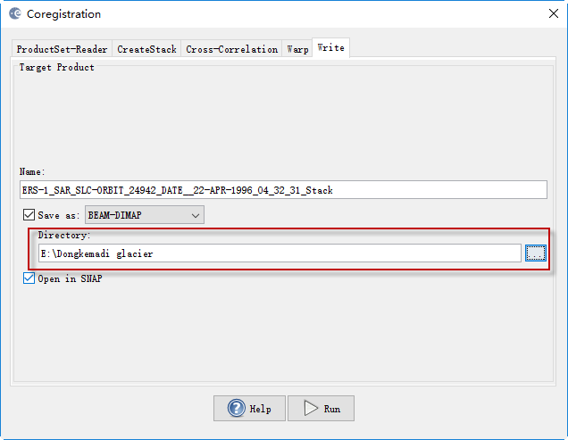
Part two: Coregistering the Data
In the Warp tab, the warp polynomial order applies a linear translation for order 1. Higher order warps should only be used when the images have been greatly distorted.
In the Write tab, specify the output folder and the target product name.
Specify the Significance Level via the RMS Threshold
Specify the output name, format and folder

Slide 12
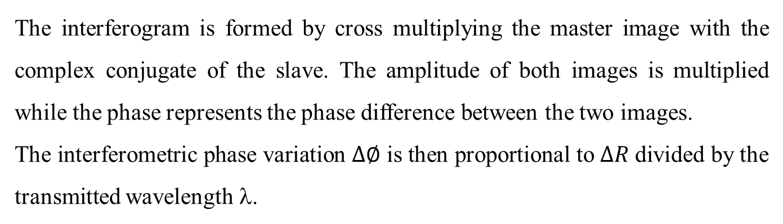



Part three: Interferogram Formation and Coherence Estimation

Slide 13
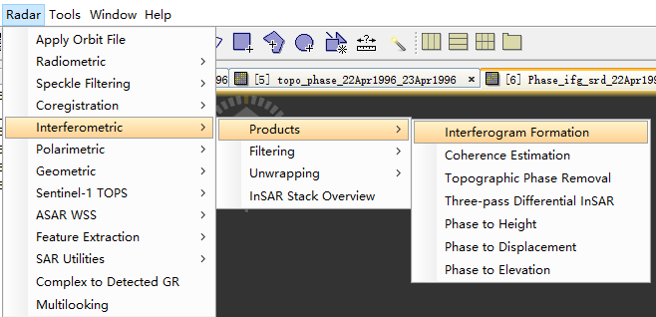
Part three: Interferogram Formation and Coherence Estimation
Step4-Form the Interferogram: Select the stack and select Interferogram Formation from the InSAR Products menu
Select Interferogram Formation

Slide 14
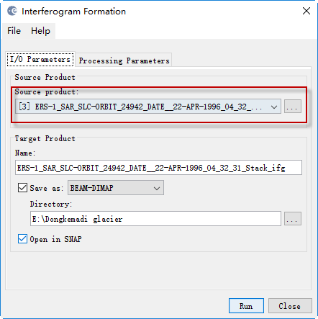
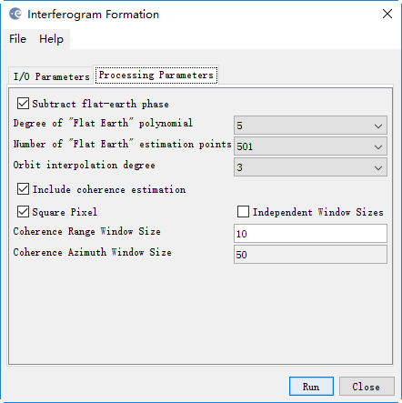
Part three: Interferogram Formation and Coherence Estimation
In the interferogram formation step we shall remove the flat-Earth phase. The flat-Earth phase is the phase present in the interferometric signal due to the curvature of the reference surface.
Interferogram Dialog

Slide 15
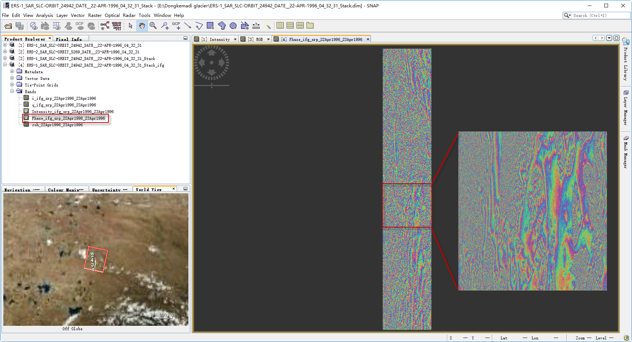
Part three: Interferogram Formation and Coherence Estimation
The interferogram product produced will contain a band for the interferometric phase.
Interferometric Phase Band

Slide 16
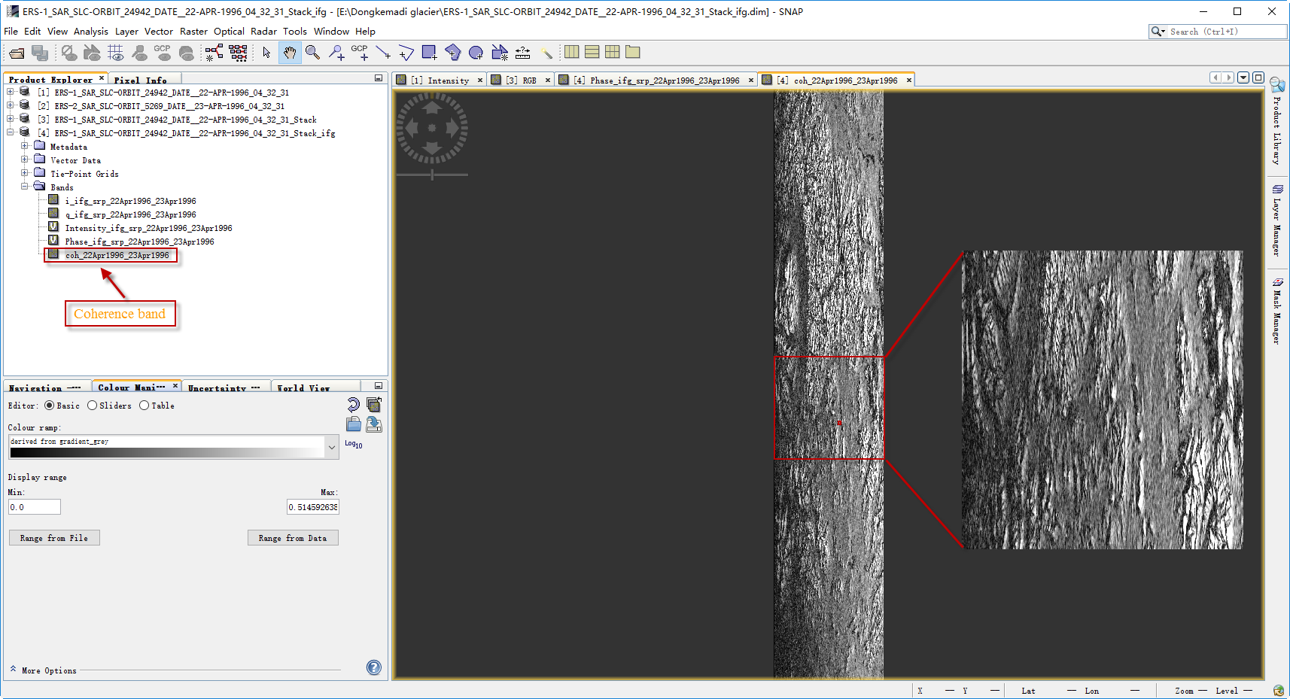
Part three: Interferogram Formation and Coherence Estimation
The interferogram product produced will contain a band for the coherence phase.
Coherence Band

Slide 17
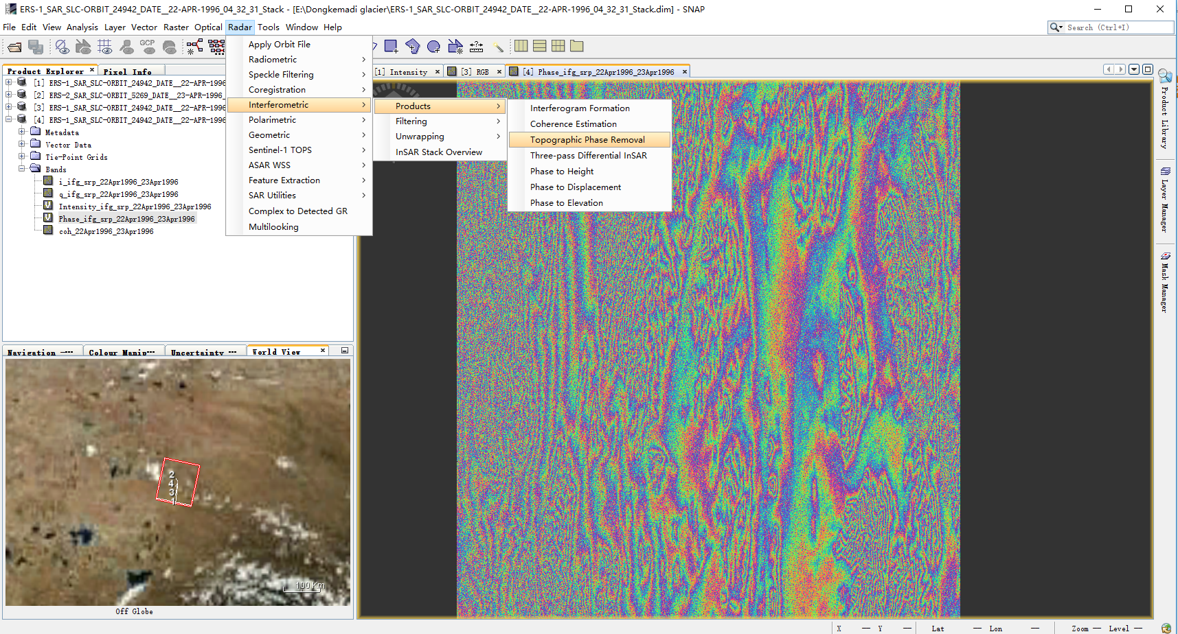
Part four: Topographic Phase Removal
Step5-Remove Topographic Phase: Select the interferogram product and go to the Interferometric Products menu. Select Topographic Phase Removal.
Select Topographic Phase Removal

Slide 18
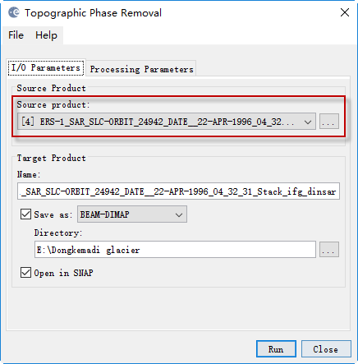
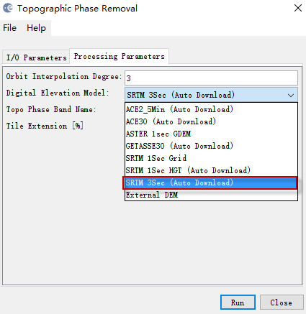
Part four: Topographic Phase Removal
Topographic Phase Removal Dialog

Slide 19
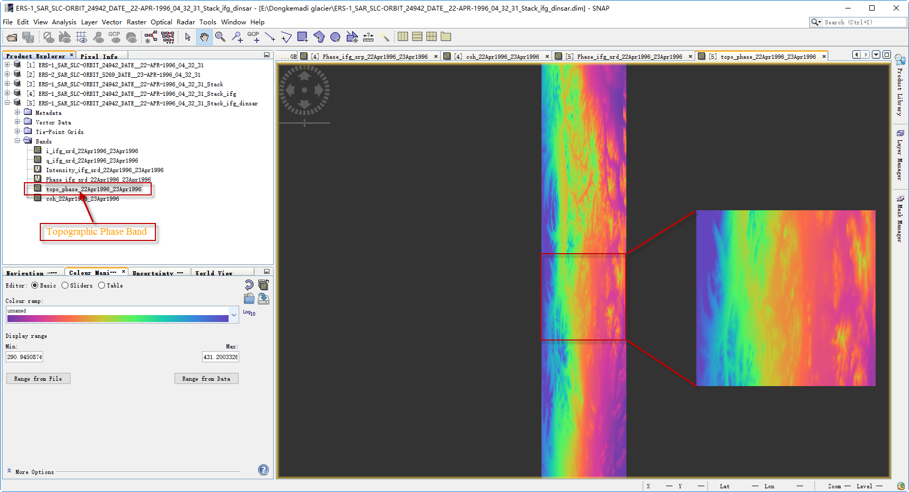
Part four: Topographic Phase Removal
Topographic Phase Band

Slide 20
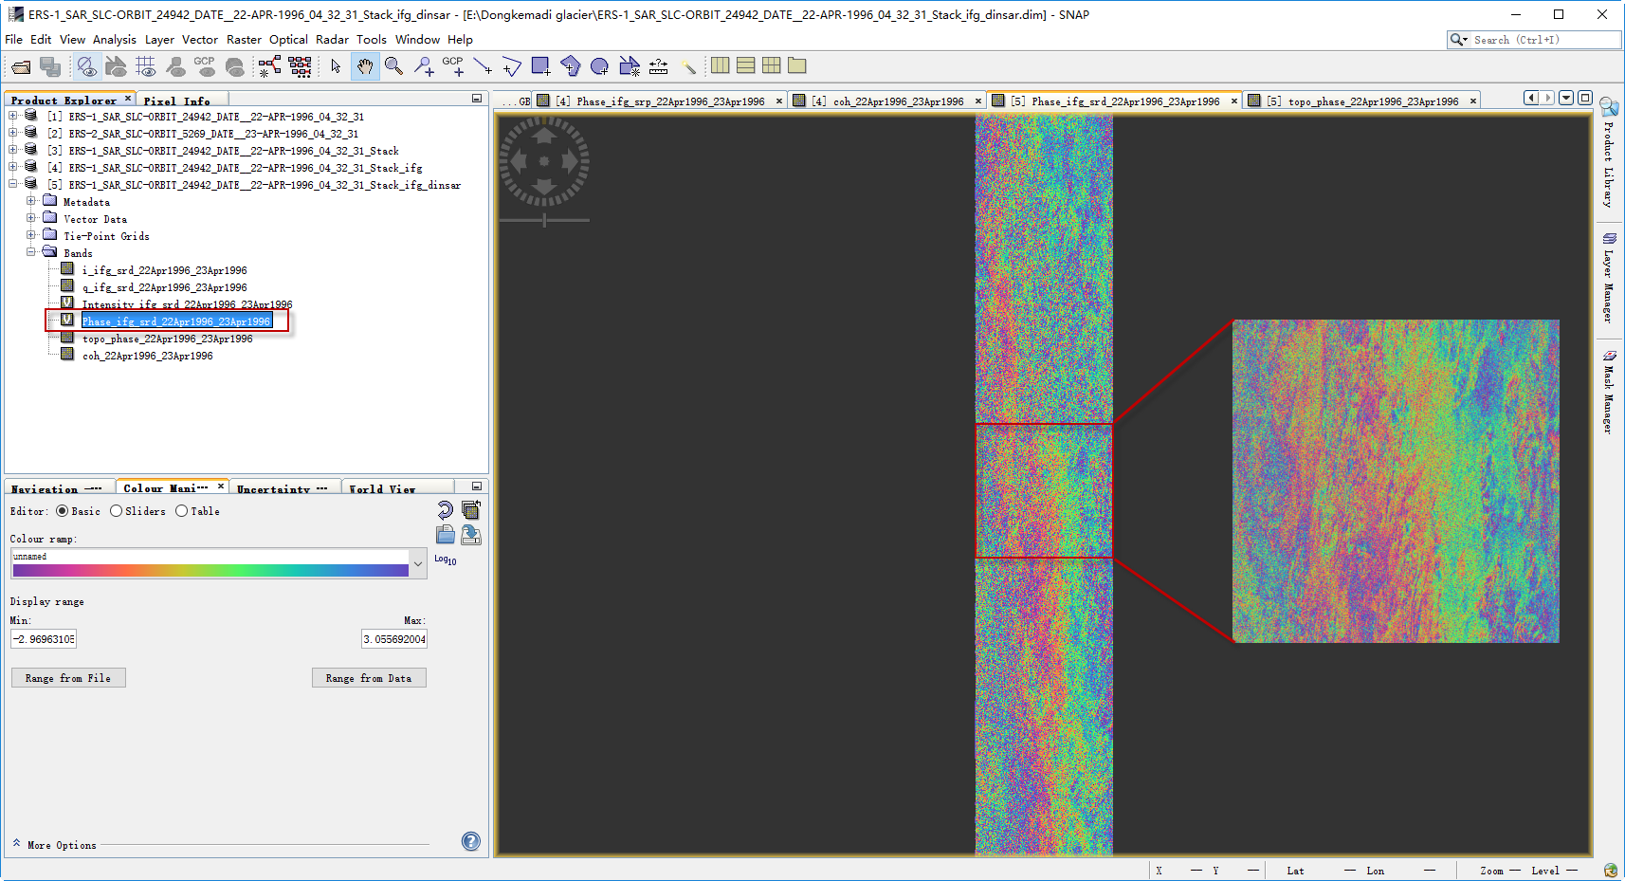
Part four: Topographic Phase Removal
Topographic Phase Removal

Slide 21
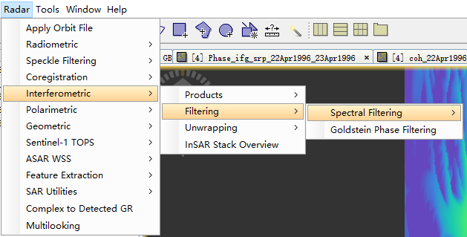
Part five: Phase Filtering
Step6-Phase Filtering: Select the Interferogram product and go to the InSAR Tools menu. Select Goldstein Phase Filtering.
Select Phase Filtering

Slide 22
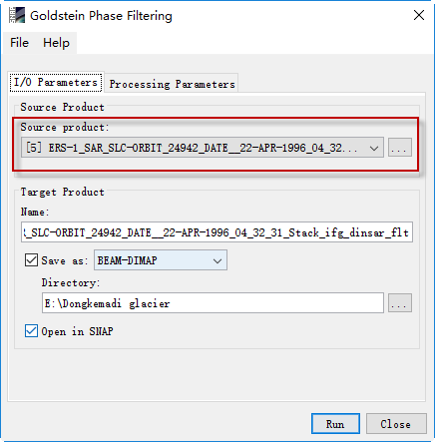
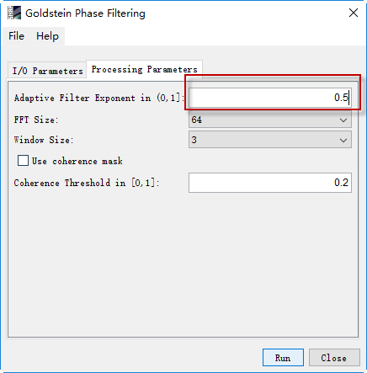
Part five: Phase Filtering
Phase Filtering Dialog

Slide 23
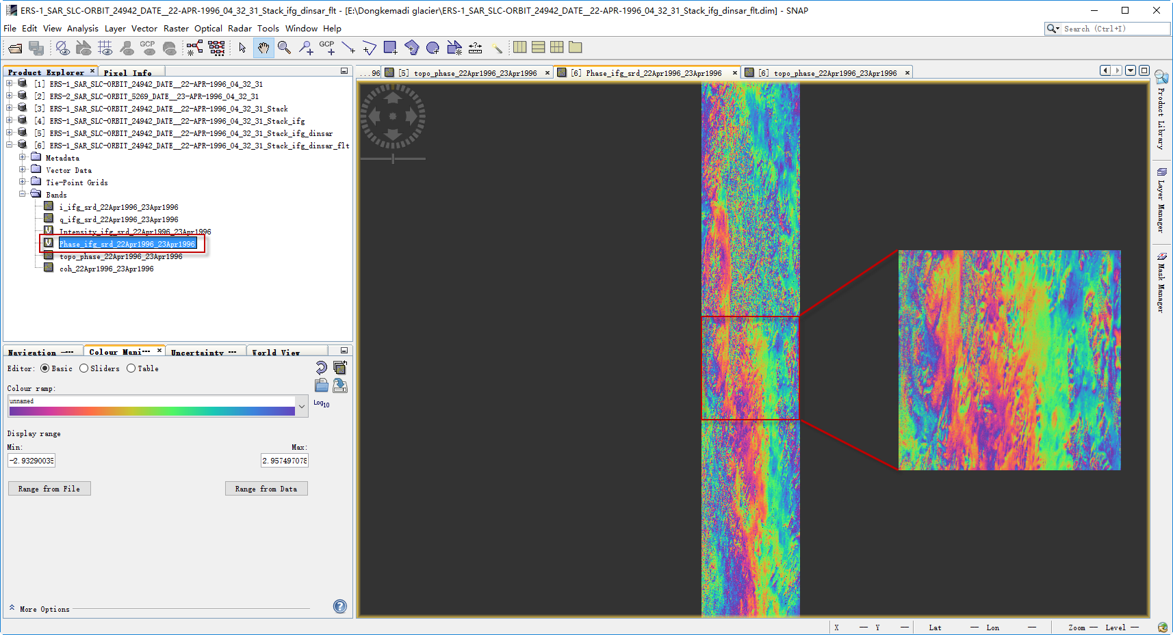
Part five: Phase Filtering
Filtered Phase Band

Slide 24
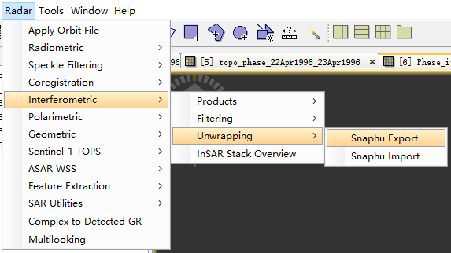
Part six: Phase Unwrapping
Step7-Export to Snaphu: Export the filtered flattened interferogram to SNAPHU.
Export to Snaphu

Slide 25
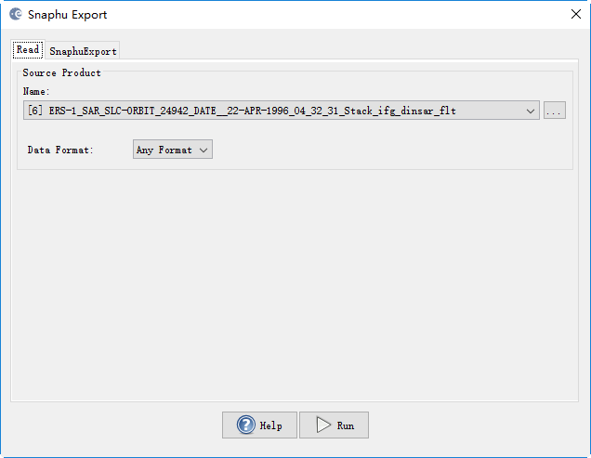
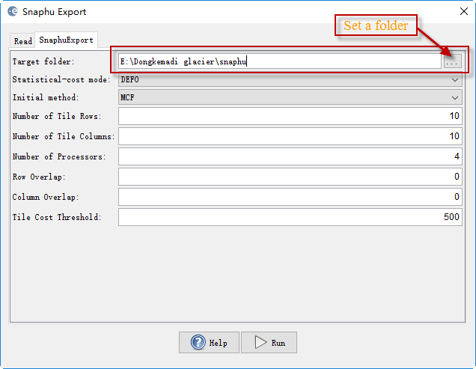
Part six: Phase Unwrapping
Select DEFO for deformation mapping.
Snaphu Export

Slide 26
Part seven: Unwrapping with SNAPHU
Snaphu is available for Linux only. Linux users simply need to install the software package by
apt-get install snaphu
Windows users can download a Linux VMWare virtual machine and use it to unwrap the phase.
http://sourceforge.net/projects/s1tbx/files/snaphu_vm/SAR%20Mint%2064.zip/download
The free VMWare Workstation Player can be downloaded from
https://my.vmware.com/web/vmware/downloads
Open the VMware player and browse for the virtual machine.

Slide 27
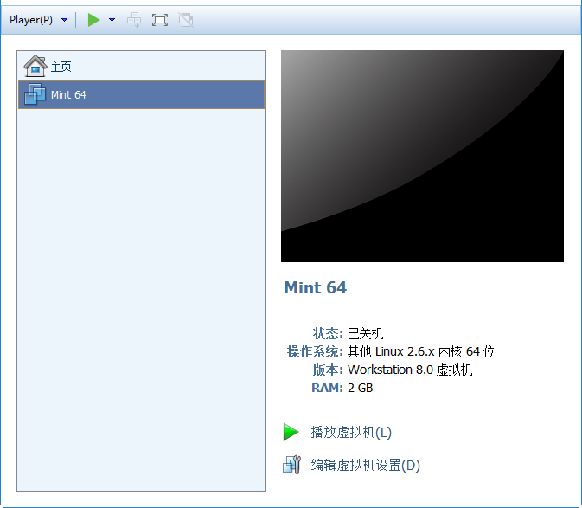
Part seven: Unwrapping with SNAPHU
Edit Virtual Machine Settings

Slide 28
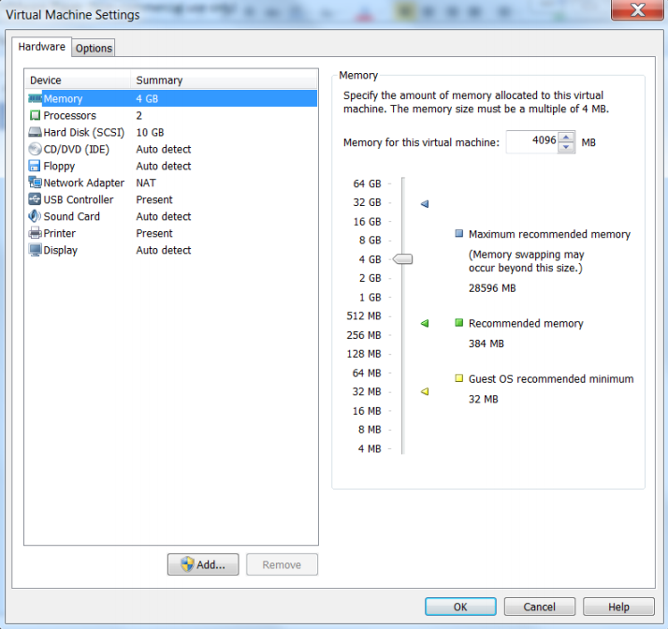
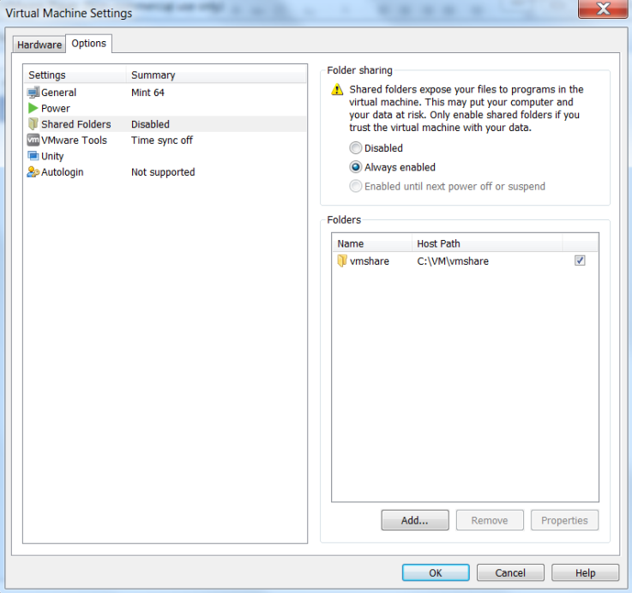
Part seven: Unwrapping with SNAPHU
Increase the memory to suit your computer. Depending on the size of your images, you may need at least 8GB.
Under the options tabs, add a shared folder. Select ‘Always Enable’.
Increase Memory
Enable a Shared Folder

Slide 29
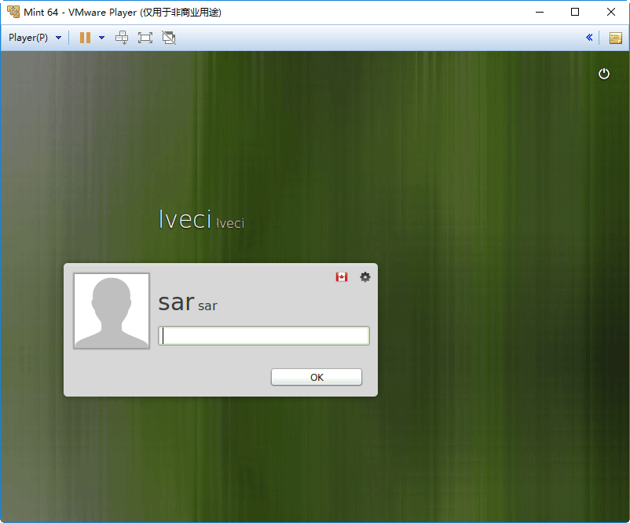
Part seven: Unwrapping with SNAPHU
Login: sar
Password: sar01

Slide 30
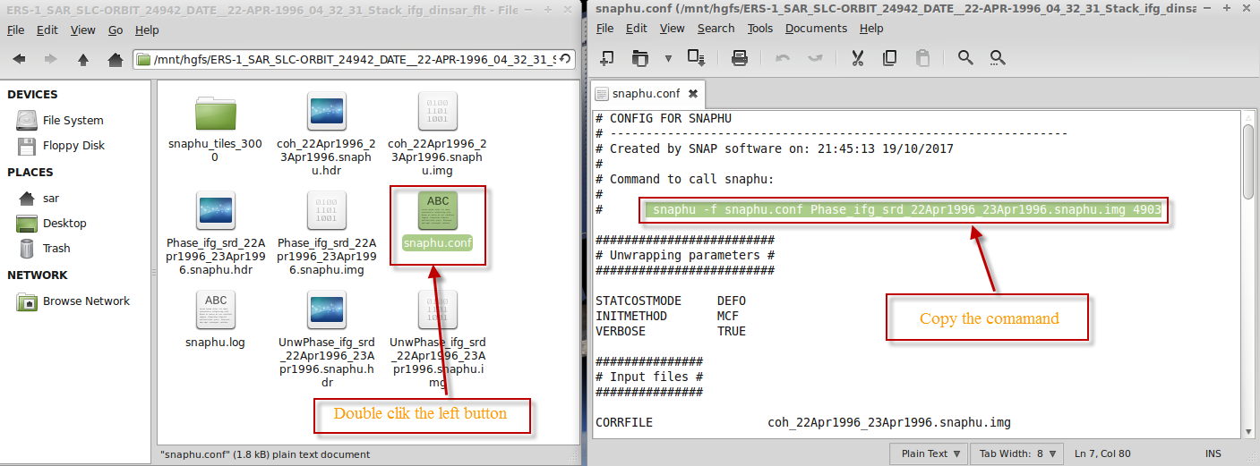
Part seven: Unwrapping with SNAPHU
Go to the data folder in /mnt/hgfs/ and open the snaphu.conf file.
cd /mnt/hgfs/vmshare/data/target_snaphu/
gedit snaphu.conf

Slide 31
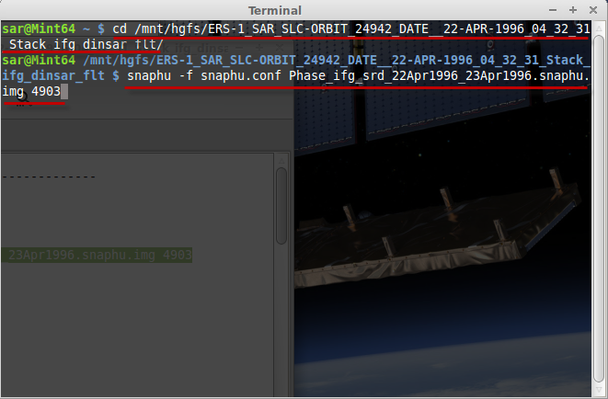
Part seven: Unwrapping with SNAPHU
Copy the snaphu command and paste it into the command terminal and then run it.
snaphu -f snaphu.conf Phase_ifg_srd_22Apr1996_23Apr1996.snaphu.img 4903

Slide 32
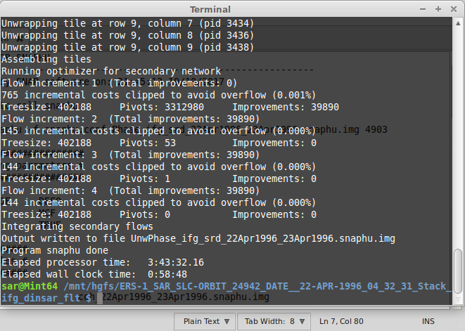
Part seven: Unwrapping with SNAPHU
SNAPHU uses an iterative optimization procedure; its execution time depends on the difficulty of the interferogram.
Unwrapping can use a lot of memory. If the unwrapping fails due to there being not enough memory, you could create a subset of your area of interest and try with SNAPHU again.

Slide 33
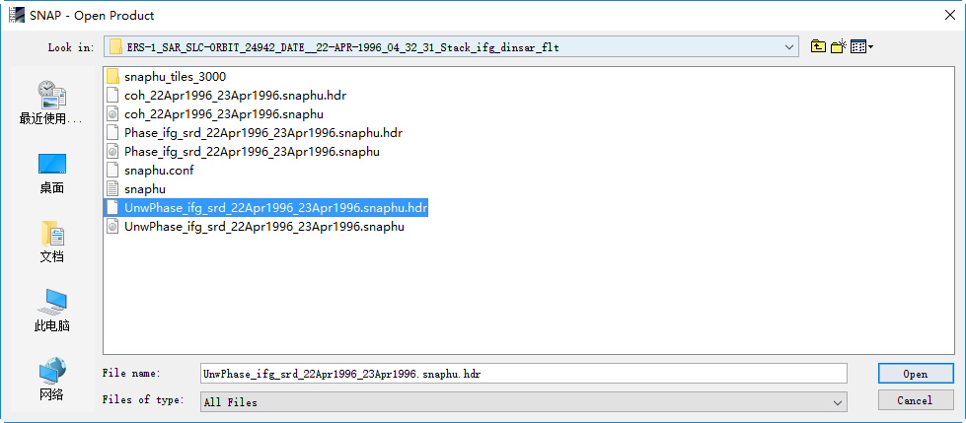
Part eight: Import Snaphu Umwrapped Phase
Step8-Open the Unwrapped phase hdr file
Open Unwrapped Phase Dialog

Slide 34
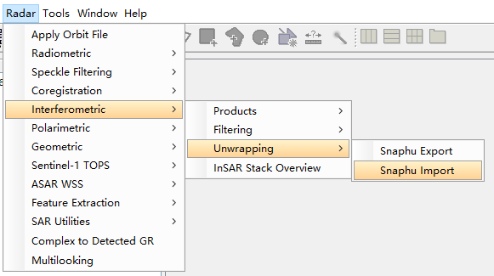
Part eight: Import Snaphu Umwrapped Phase
Step9-Import the Unwrapped phase: Select Snaphu Import from the interferometric menu
Import Unwrapped Phase Dialog

Slide 35
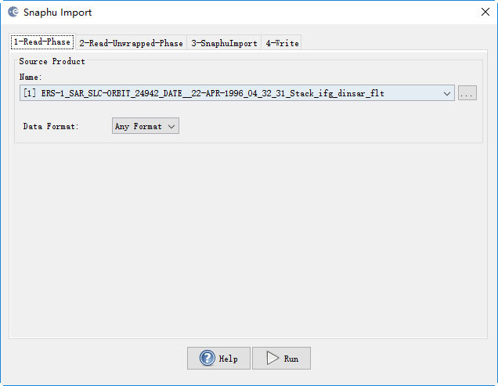
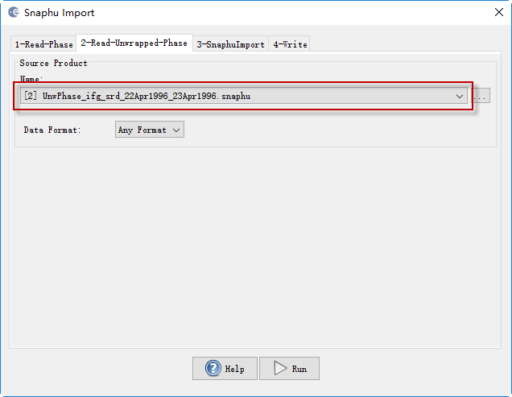
Part eight: Import Snaphu Umwrapped Phase
Select the wrapped phase in the read phase tab.
Select the unwrapped phase product in the read unwrapped phase tab.
Snaphu Import Dialog

Slide 36
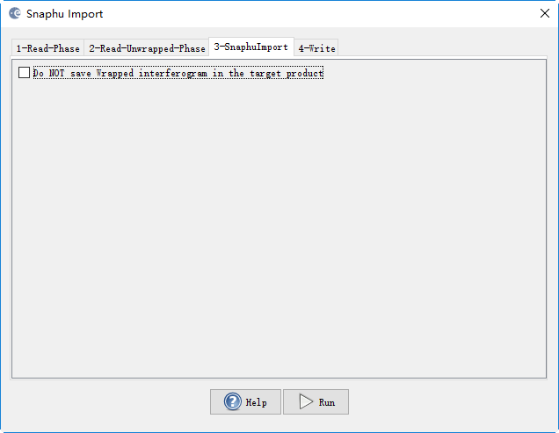
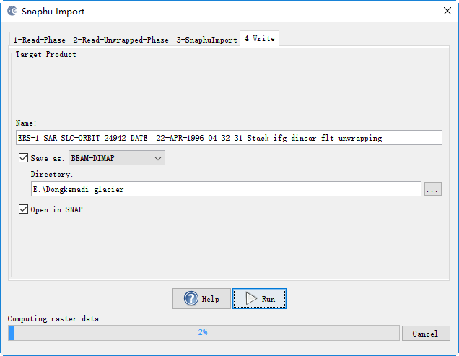
Part eight: Import Snaphu Umwrapped Phase
Snaphu Import Dialog

Slide 37
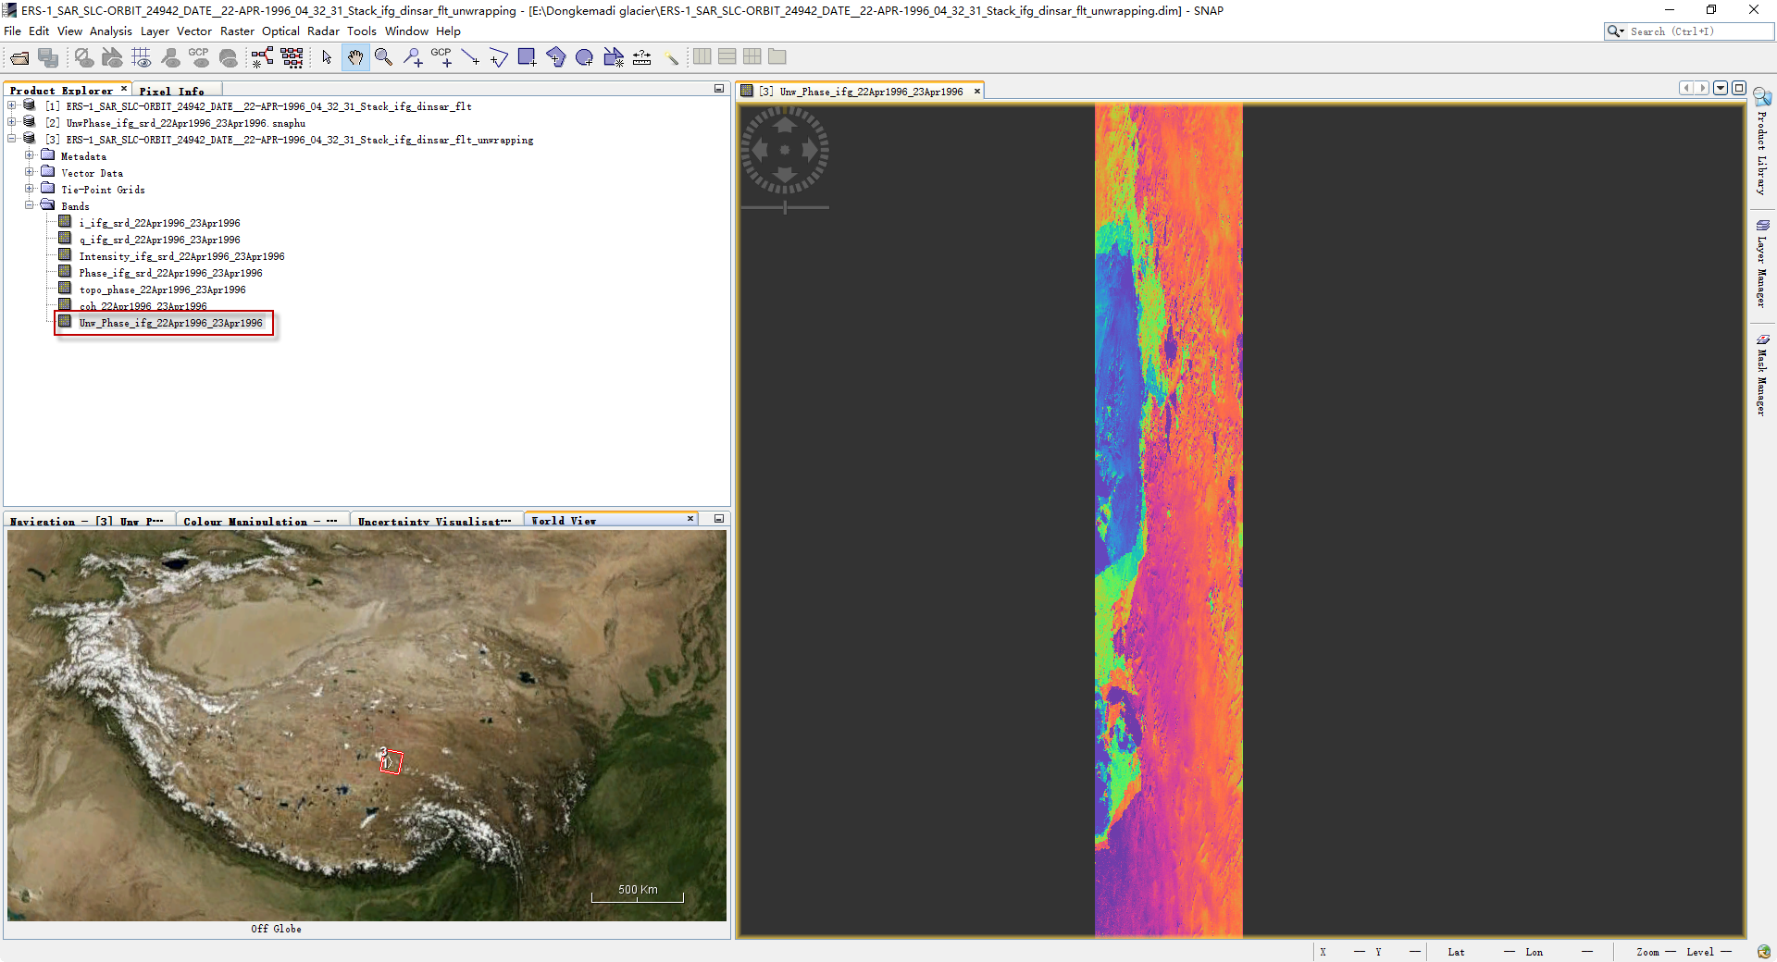
Part eight: Umwrapped Phase
Process and display the output unwrapped phase
Unwrapped Phase

Slide 38
Part nine: Convert the Differential phase to glacier velocity
Using the ENVI bandmath tools to process

Slide 39
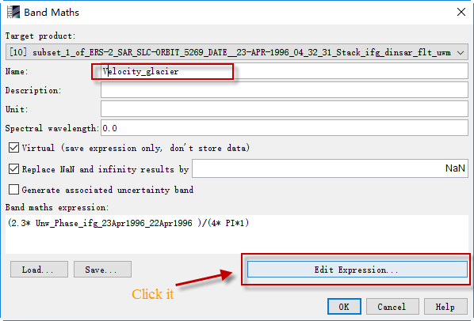
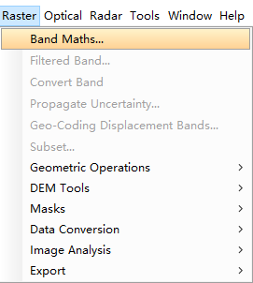
Part nine: Convert the Differential phase to glacier velocity

Slide 40
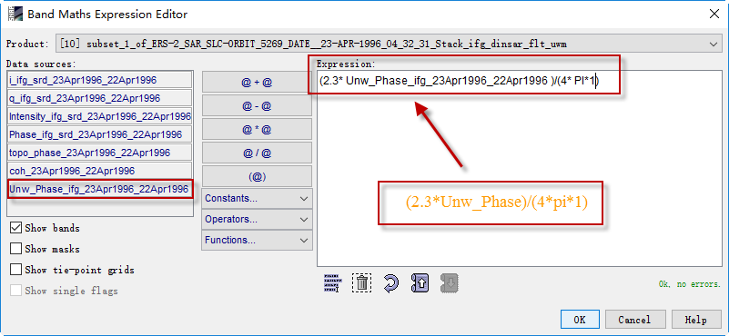
Part nine: Convert the Differential phase to glacier velocity
Band Maths Expression Editor Dialog

Slide 41
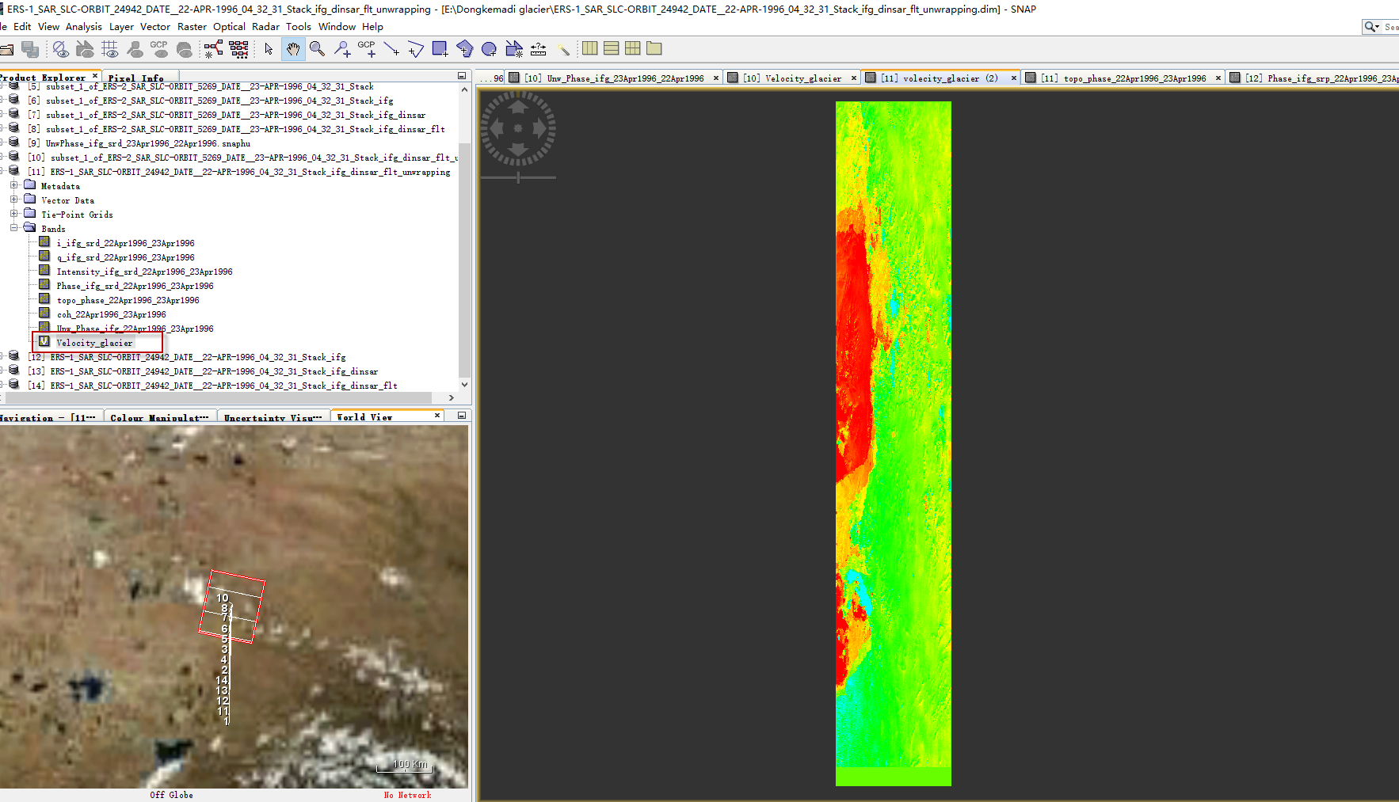
Part nine: Convert the Differential phase to glacier velocity
Glacier Velocity

Slide 42
THANKS

