Slide 1


Slide 2
Drought Monitoring and Assessment
Z. (Bob) Su
ITC, University of Twente
The Netherlands
z.su@utwente.nl
www.itc.nl/wrs

Slide 3
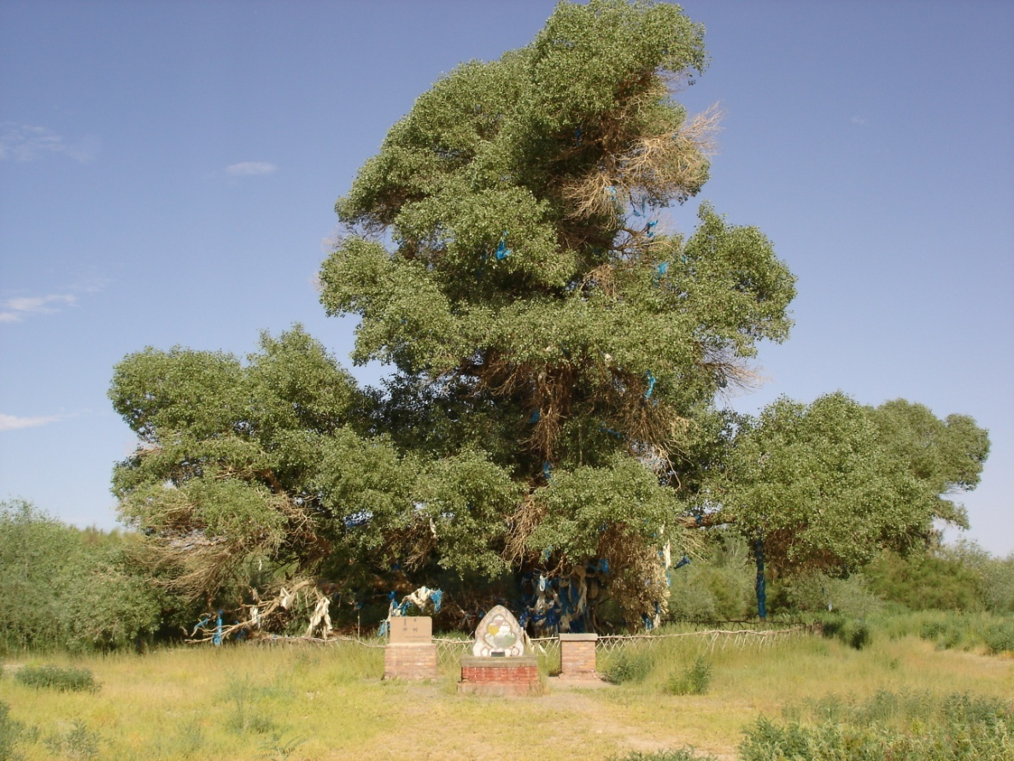
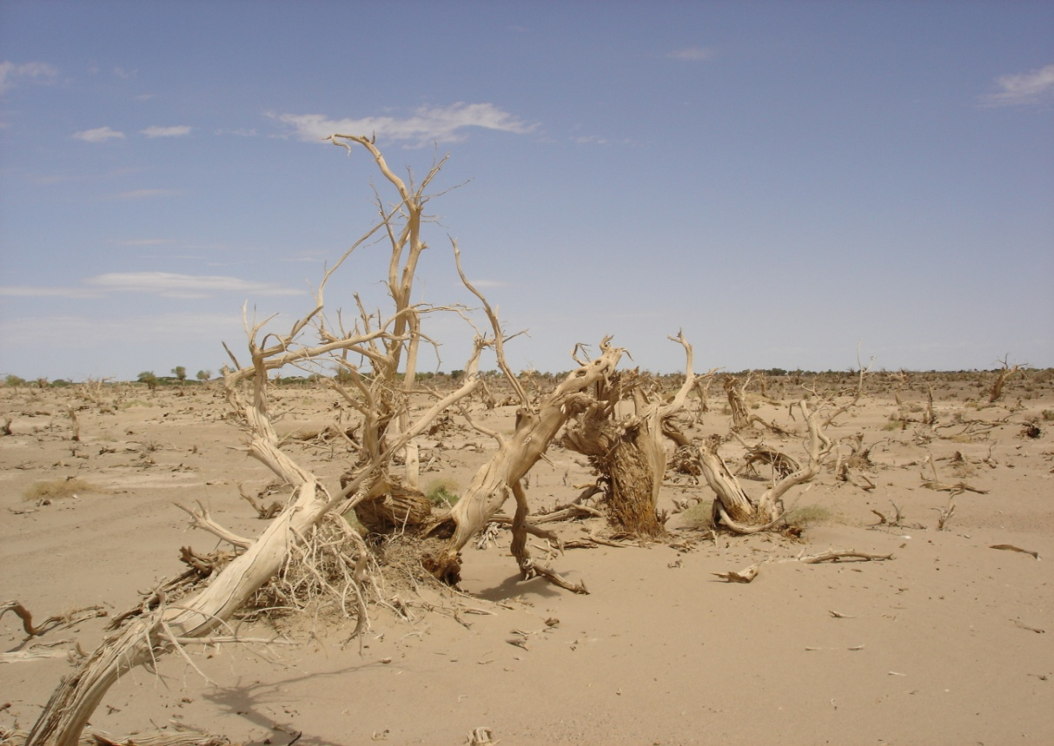
What is the difference?

Slide 4
Learning Objectives
1. Understand basic ideas for estimating water availability
2. Be able to identify methods & data products for deriving different water availability terms
3. Familiarize with the applications

Slide 5
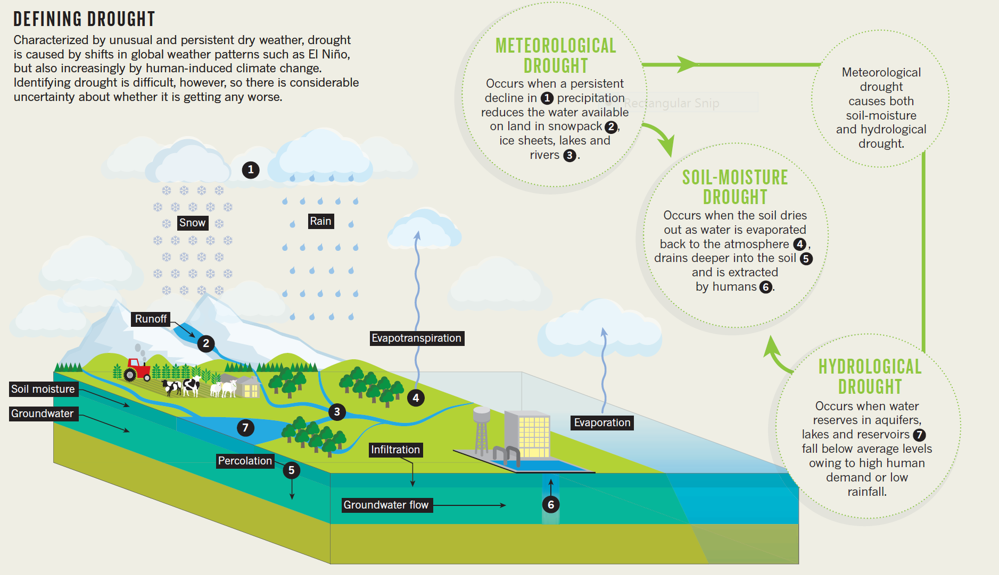
(O. Heffernan)

Slide 6
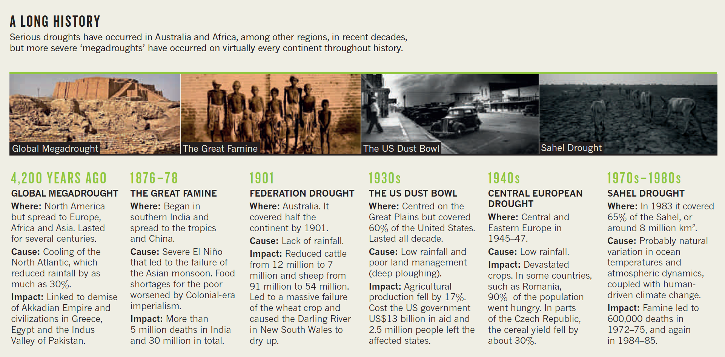
(O. Heffernan)

Slide 7
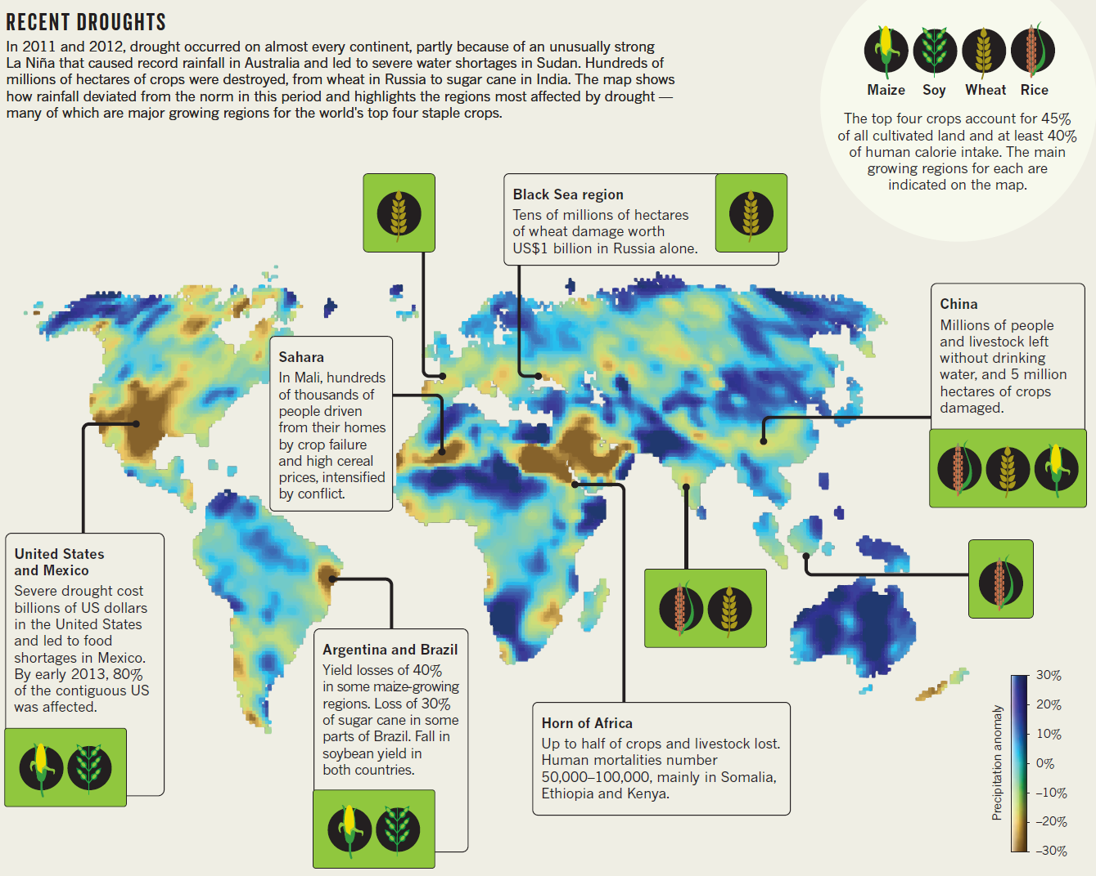
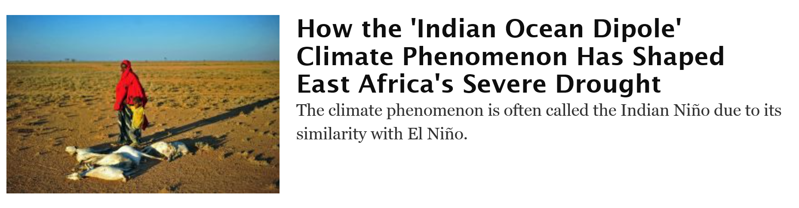
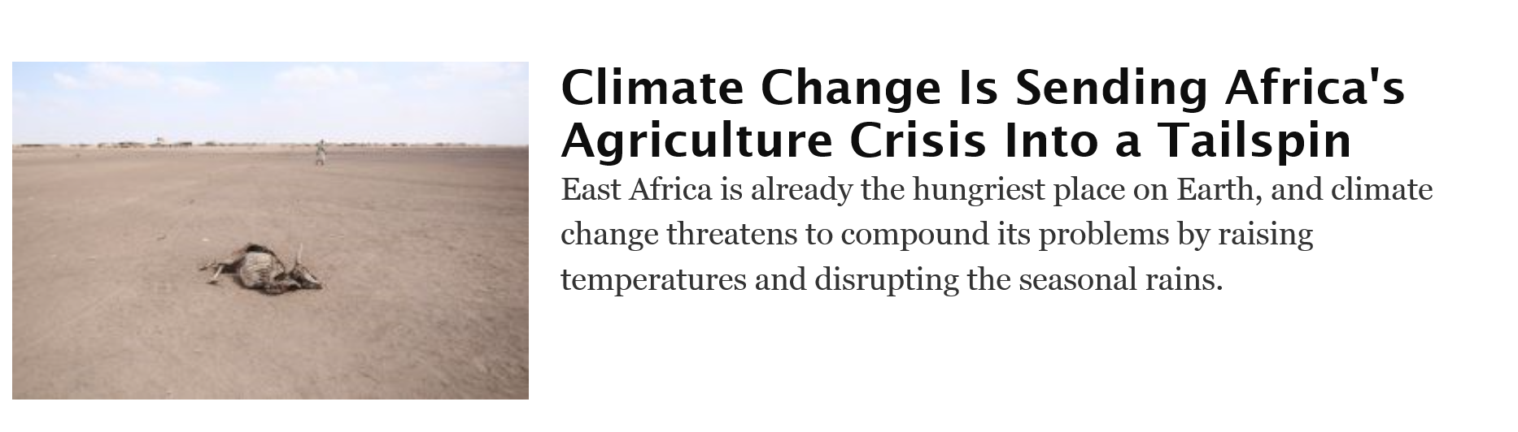
(O. Heffernan)

Slide 8
What Is Drought and How To Detect It?
Drought may be defined as the lack of water of a certain location in a certain period compared to a climatic average.
From a climatic perspective, we may distinguish meteorological, soil moisture and hydrological drought.

Slide 9
What is drought and how to detect it?
Meteorological drought refers to a shortage of precipitation compared to a climatic average;
Soil moisture drought can be caused by a shortage of precipitation, excessive evaporation and transpiration due to dry weathers and lack of irrigation.
Hydrological drought is caused by a combination of lack of precipitation and excessive use of available water resources.
When the impact of drought is also taken into consideration, four types of droughts are usually defined such as meteorological drought, agricultural drought, hydrological drought and socioeconomic drought.

Slide 10
Remote Sensing Provides Real-time Spatial Observations
Assessment and monitoring of drought characteristics: its intensity, duration and spatial extent in terms of:
  atmospheric and land surface variables - precipitation, evapotranspiration, soil moisture and vegetation conditions
Prediction of drought:
  Spatial observations coupled to modelling and forecasting of the water cycle -> information on future drought for drought preparedness
Q&A:
How shall we detect & predict drought?

Slide 11
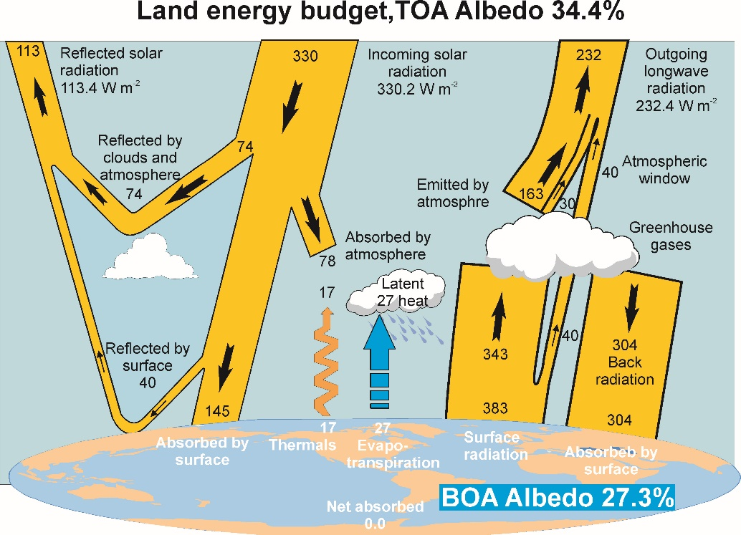
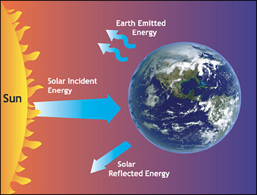
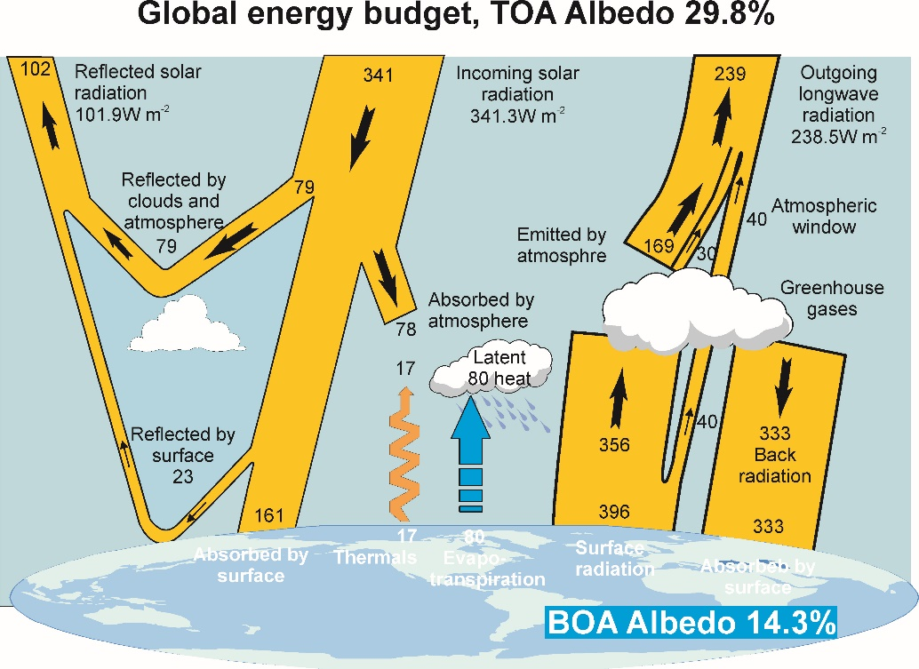
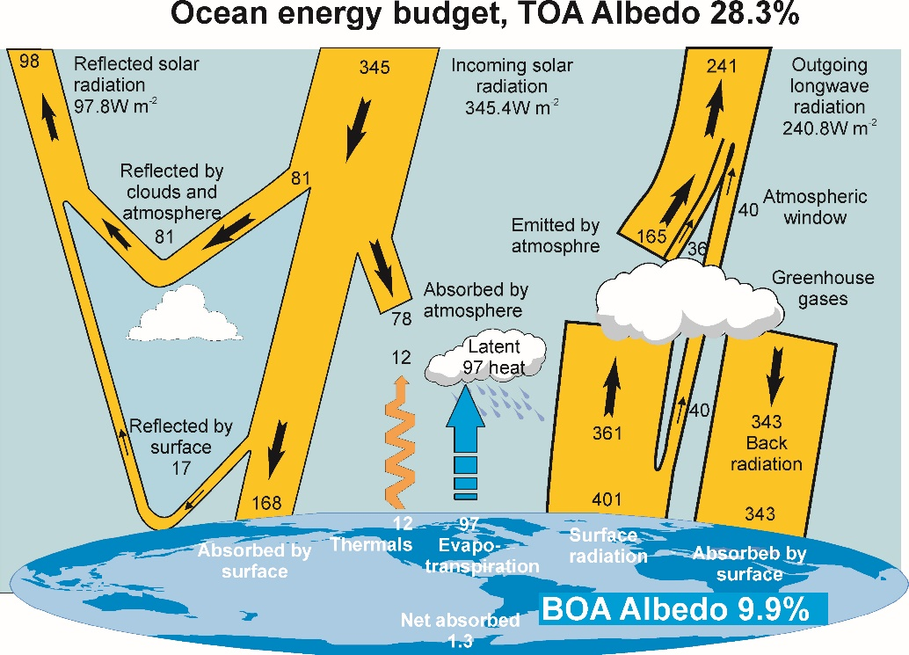
Let there be light
(NASA)

Slide 12
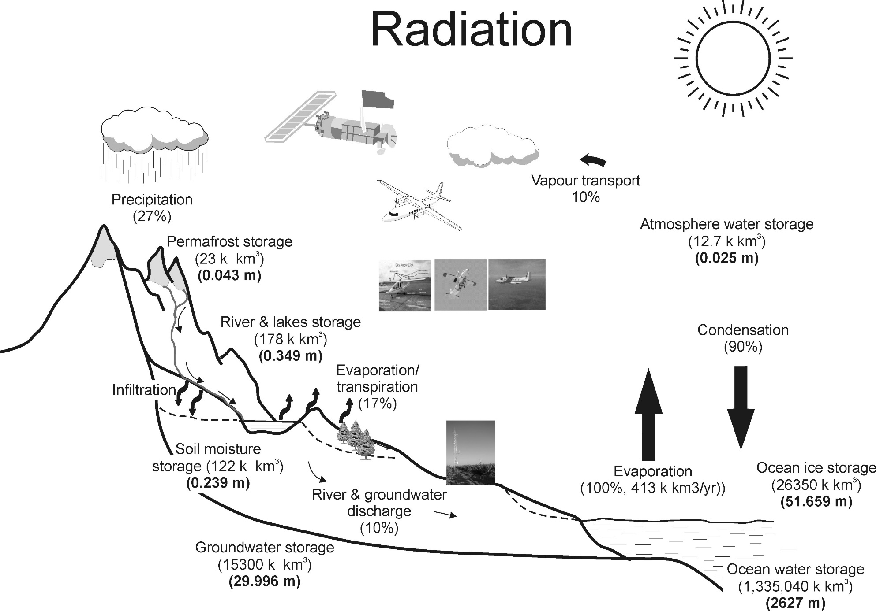
Water cycle and its link to climate
(Su, et al., 2010, Treatise on Water Science)

Slide 13
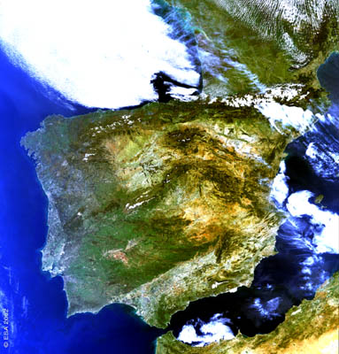
Land-Atmosphere Interactions
- Terrestrial Water, Energy and Carbon Cycles
Solar Radiation
Wind
Thermal radiation
Sensible Heat
(diffusion/convection)
Latent Heat
(Phase change)
Precipitation
Gases
Advection
Soil Heat
(Conduction)
Water &
vapour
Biochemical
Processes

Slide 14
Drought indices (lots of them)
Percent of Normal (PN)
Standard Precipitation Index (SPI)
Palmer Drought Severity Index (PDSI)
Crop Moisture Index (CMI)
Surface Water Supply Index (SWSI)
Reclamation Drought Index (RDI)
Evapotranspiration Deficit Index (ETDI)
Eden, U. (2012) Drought assessment by evapotranspiration mapping in Twente, the Netherlands. Enschede, University of Twente Faculty of Geo-Information and Earth Observation (ITC), 2012.

Slide 15

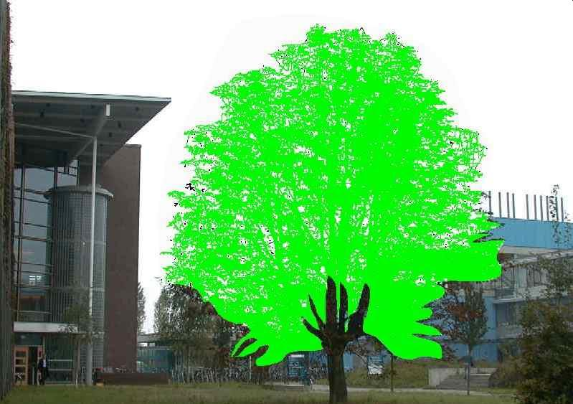
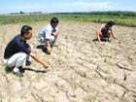
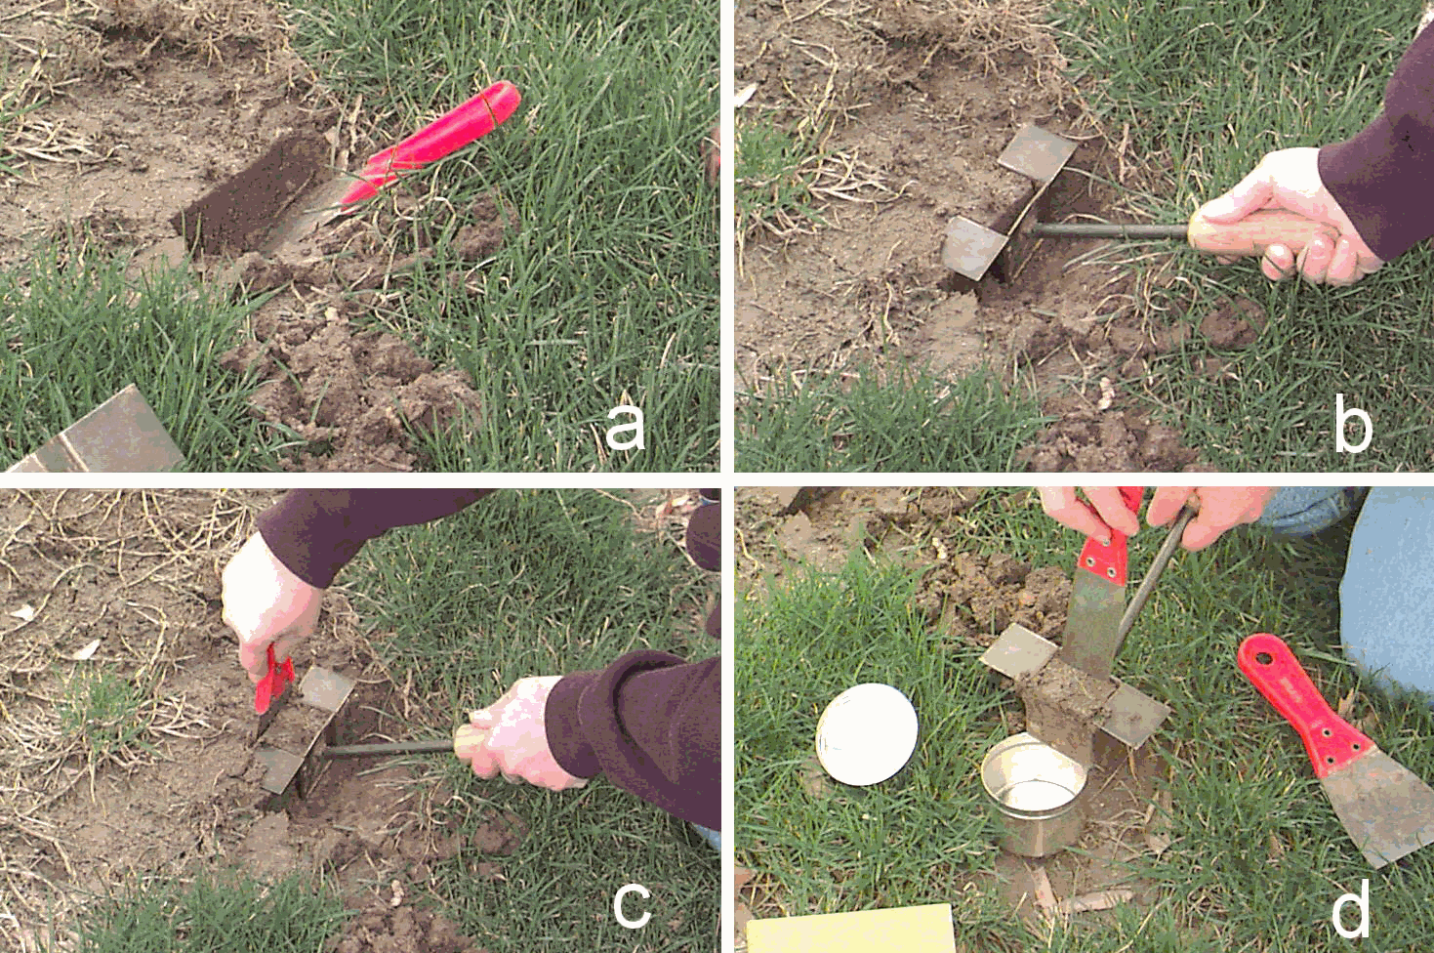


What is Drought ?
Dry Condition: No transpiration
Transpiration limited by plant water availability in the root zone
Wet Condition: Maximum Transpiration

Slide 16
Quantitative Approaches for Drought Monitoring and Prediction
Approach 1: Surface Energy Balance
  To derive relative evaporation & relative soil moisture in the root zone from land surface energy balance
  To define a quantitative drought severity index (DSI) for large scale drought monitoring
Approach 2: Soil Moisture Retrieval
  To determine surface soil moisture
  To assimilate surface SM into a hydrological model to derive root zone soil moisture
Approach 3: Total water budget

Slide 17
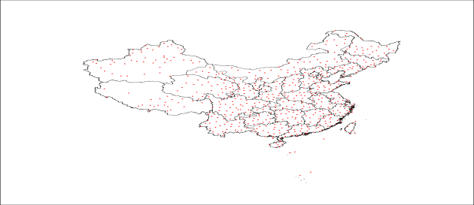
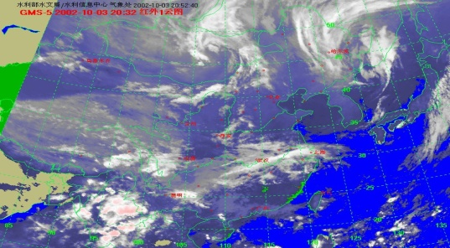
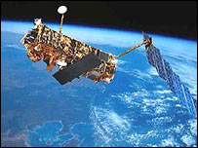
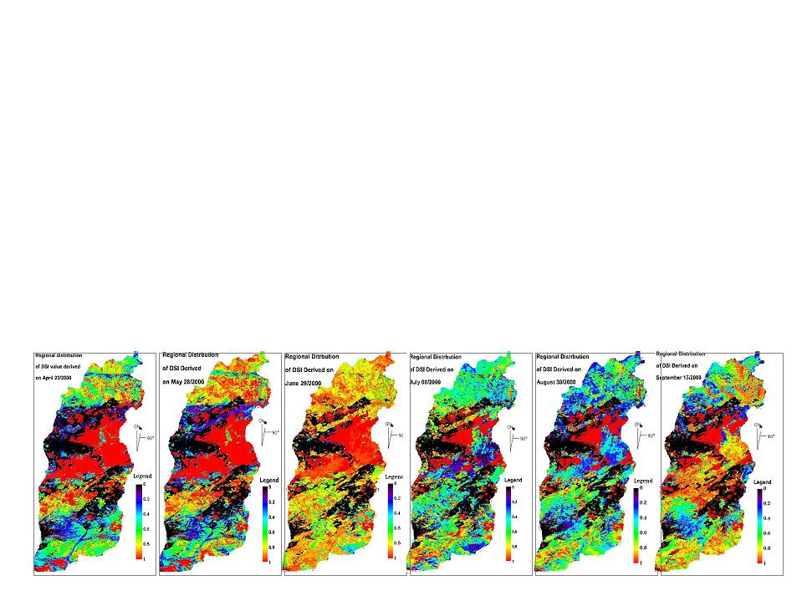
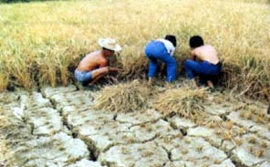
Drought Monitoring & Prediction
Climate & Satellite Information System
Meteorological Data
Surface Energy Balance System (SEBS)
Surface Soil Moisture
Data Assimilation
(to infer root zone water availability)
Drought Information System
(Drought Severity Distribution)
Decision Makers
Internet

Slide 18
From Energy Balance to Water Balance
R: Relative Plant Available Soil Water Content
DSI: Drought Severity Index
(Su et al., 2003)

Slide 19
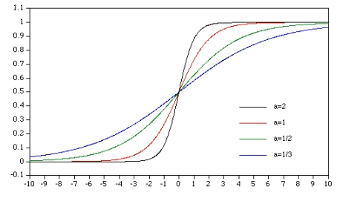
Relationship of evaporative fraction to surface variables
(albedo, fractional vegetation coverage and surface temperature)
The relative evaporation is given as

Slide 20

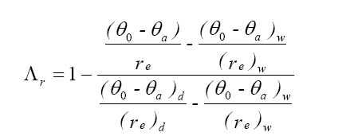
Relationship of evaporative fraction to surface variables
(albedo, fractional vegetation coverage and surface temperature)
The relative evaporation is given as
The SEBS algorithm (Su, 2002)

Slide 21

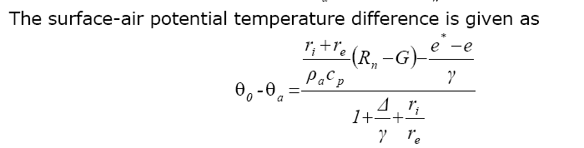
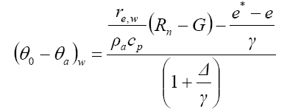

Relationship of evaporative fraction to surface variables
(albedo, fractional vegetation coverage and surface temperature)
Q&A:
What else shall we do?
What other information can we use?

Slide 22
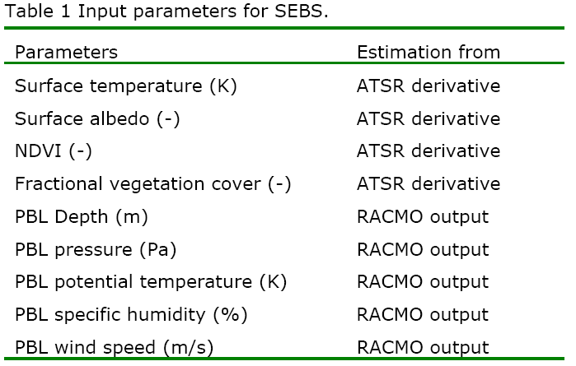
Relation of evaporative fraction to surface variables
(an example)

Slide 23
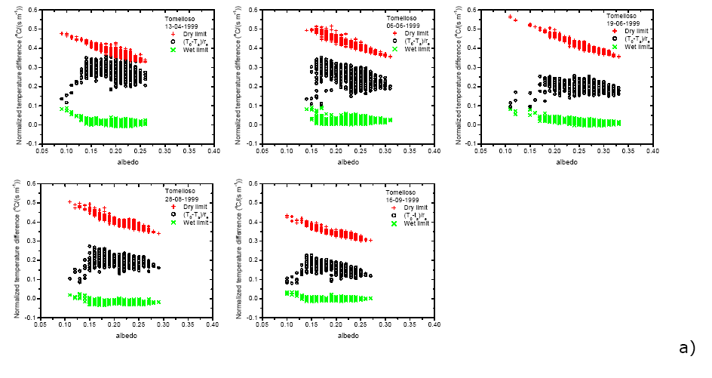
Normalized temperature difference versus albedo

Slide 24
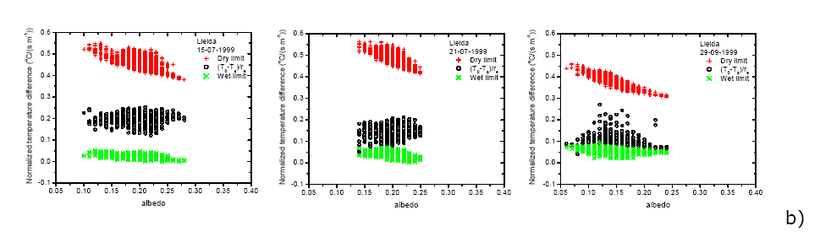
Normalized temperature difference versus albedo

Slide 25
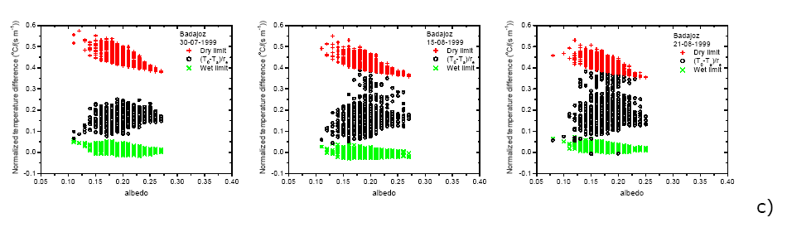
Normalized temperature difference versus albedo

Slide 26
Comparison to Soil Moisture Measurements
Relative evaporation vs relative soil moisture
Time Series of Drought Severity Index

Slide 27
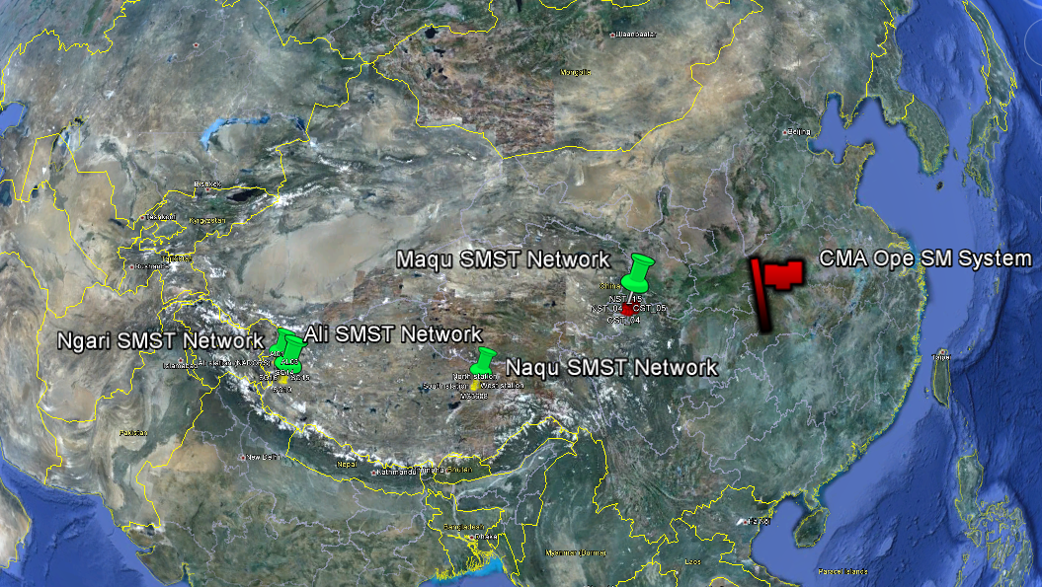
Tibetan Plateau observatory of plateau scale soil moisture and soil temperature (Tibet-Obs)
(Su et al., 2011, HESS)
ESA Dragon programme
EU FP7 CEOP-AEGIS project
Su, Z., et al. 2011, Hydrol. Earth Syst. Sci.
www.hydrol-earth-syst-sci.net/15/2303/2011/

Slide 28
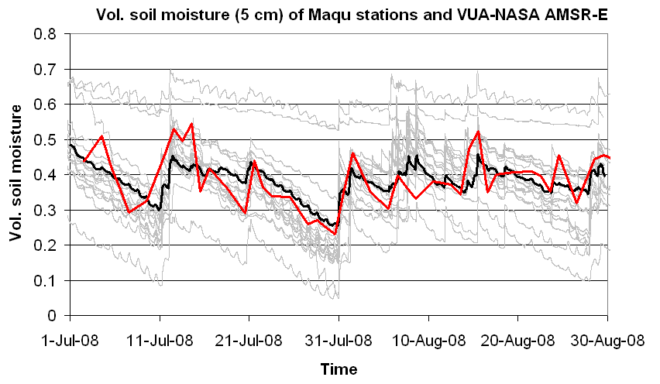
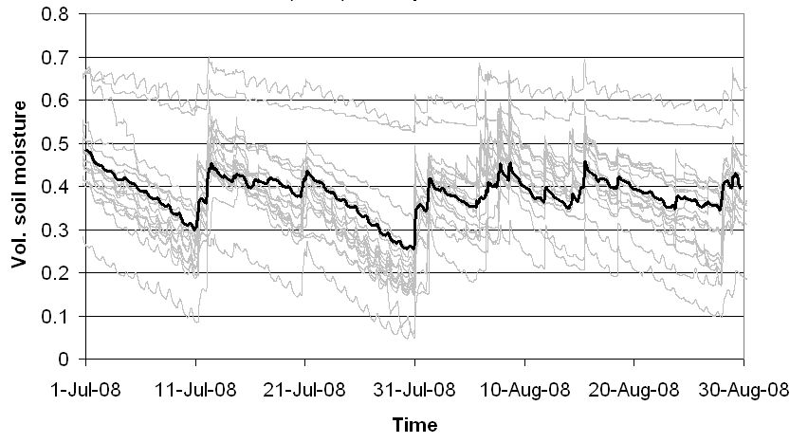
Preliminary validation results
Mean sm at Maqu site (depth of 5 cm)
Organic soils
Sandy loam soil
VUA-NASA sm from AMSR-E data

Slide 29
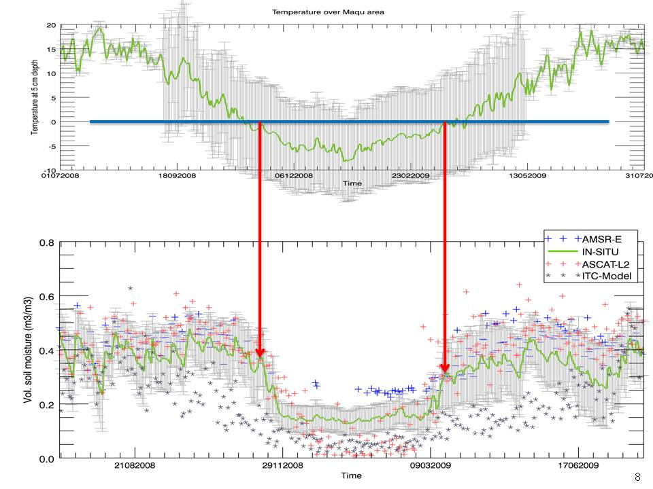
Quantification of uncertainties in global products
(Su, et al., 2011)
(Su et al., 2011, HESS)

Slide 30
Maqu SMST Network – validation results

Slide 31
Ngari SMST Network – validation results

Slide 32
How can we use this information for drought monitoring and prediction?
Q/A: any other way to combine information?

Slide 33
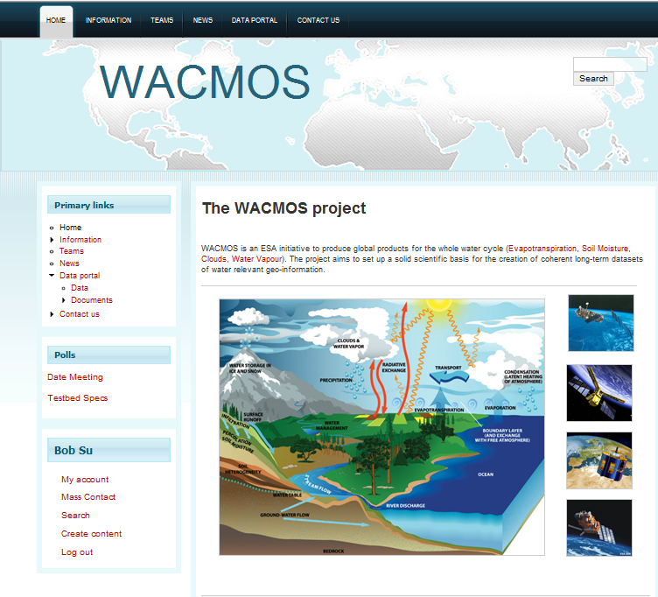

WACMOS.org

Slide 34
Water Budget Closure
Rain
Snow
evaporation
Land Surface & Water Use
Surface Water
Groundwater
River Outflow

Slide 35
Water Budget Closure
Rain
Snow
evaporation
SPI
SPEI,
SDSI-ETDI,
Land Surface & Water Use
Surface Water
SVCI
Groundwater
STWSI
River Outflow

Slide 36
Standardised Indices
SPI: Standardised Precipitation Index,
SPEI: Standardised Precipitation Evaporation Index,
SDSI-ETDI: the Standardised Drought Severity Index-Evapotranspiration Deficit Index,
SVCI: Standardised Vegetation Condition Index,
STWSI: the Standardised Terrestrial Water Storage Index,
  all calculated on weekly or monthly time interval from 1 to N time intervals (e.g. for 48 months) (i.e. as anomalies and cumulative anomalies)

Slide 37
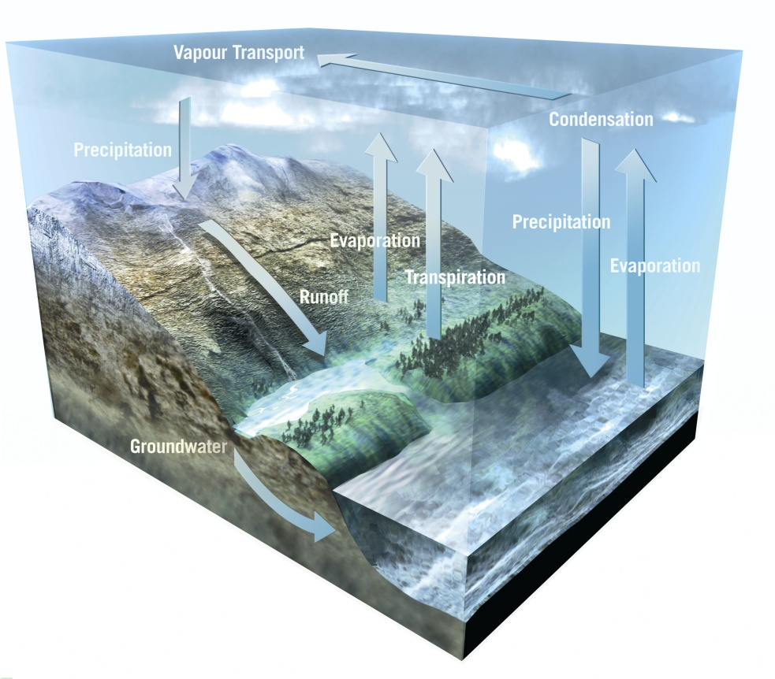
Consistency among different physically interrelated variables
(Spatial Water budget of the Yangtze River Basin)
dS/dt

Slide 38
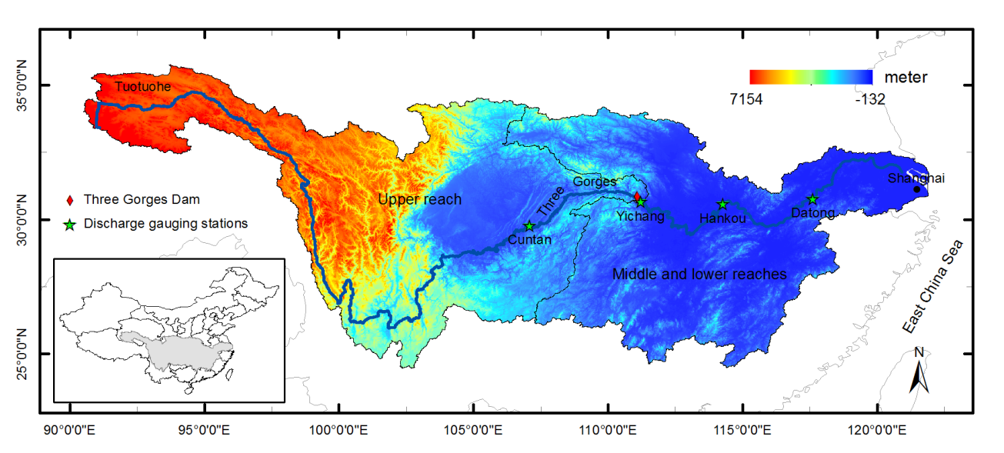
Yangtze River Basin
Upper Yangtze reach, from Tuotuohe, to Yichang.
Middle reach from Yichang to Hukou.
Lower reach extends from Hukou to the river mouth near Shanghai.
Cuntan, Yichang, Hankou, and Datong are four gauging stations located along the mainstream of the Yangtze.

Slide 39
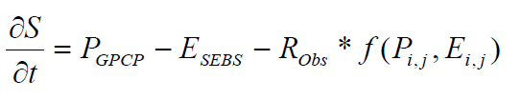
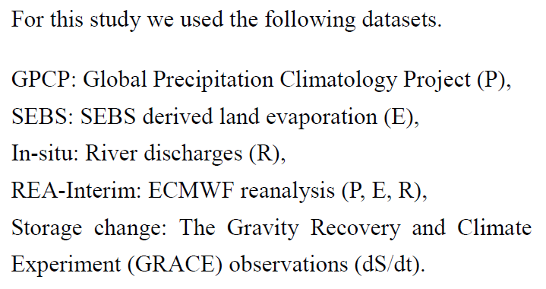
Closure of Water Cycle over a river basin
Total water Storage(TWS)
In-situ & satellite Observations
Reanalysis
Satellite Observations
Notes:
For water balance issue, this equation is usually used.
The left hand side of the equation represents the change of total water storage, the right hand side says that the total water storage change equals to precipitation minus evaporation and minus runoff.
In this calculation, the precipitation is from GPCP, the evaporation is calculated by SEBS, the runoff is from in-situ observation. This results represent the consistency validation among in-situ observation datasets.
Except for in-situ observation datasets, ERA-Interim has these three variables as well, so era-interim results will be applied with this equation to calculate the total water storage change as well, from reanalysis point of view.
On the other hand, the total water storage can be measured by using GRACE, which is from remote sensing point of view.
So, by this approach, we can assess if different source of data are consistent to each other or not.

Slide 40
Seasonal average maps of sensible heat flux (H)
(a) Mar-May, (b) Jun-Aug,(c) Sep-Nov, (d) Dec-Feb

Slide 41
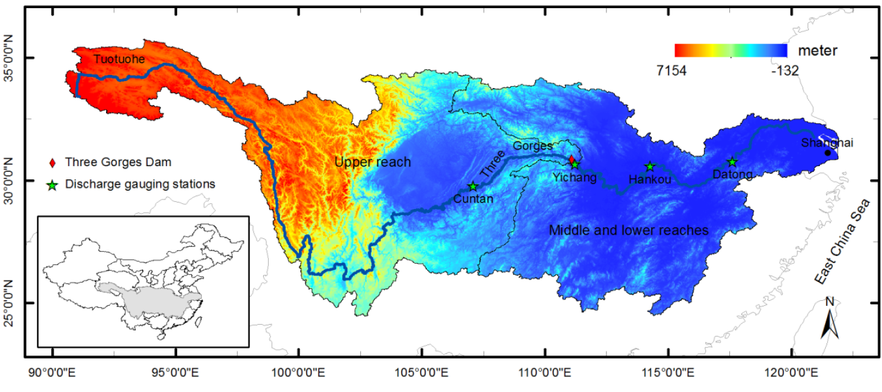
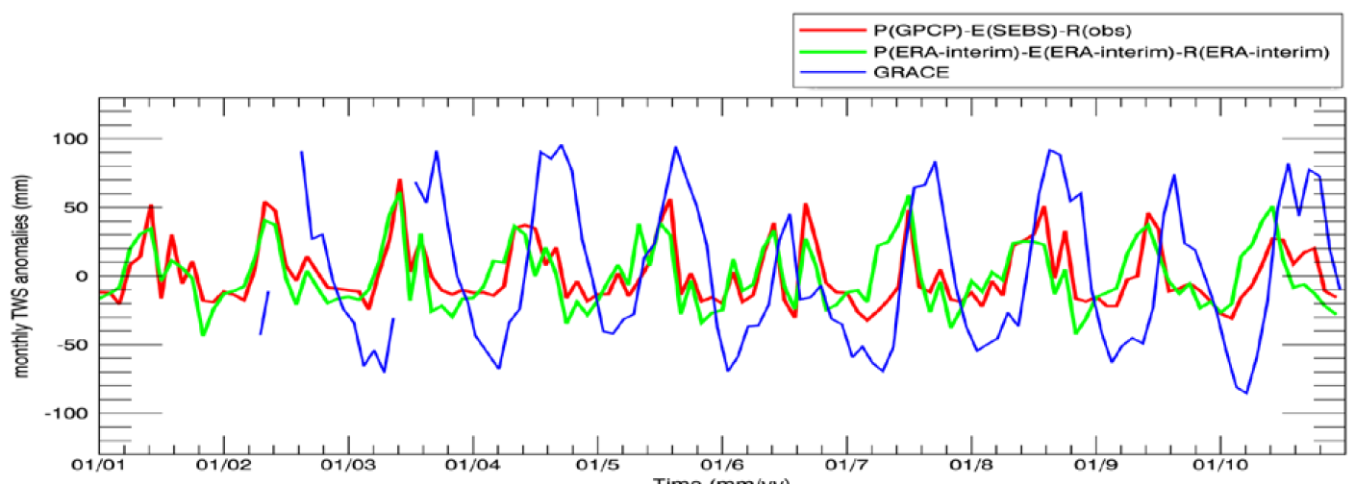
TWS Anomaly (Yichang)
Notes:
Ok, then, this is the result for Yichang station. From here, we can see that the total water storage anomaly derived from the observation data and from ERA reanalysis data are consistent with each other, indicating both datasets capture the surface dynamics of the water cycle fluxes.
However, the GRACE derived anomaly has somehow larger amplitudes than the other two, which may be indicating deep groundwater contribution.

Slide 42
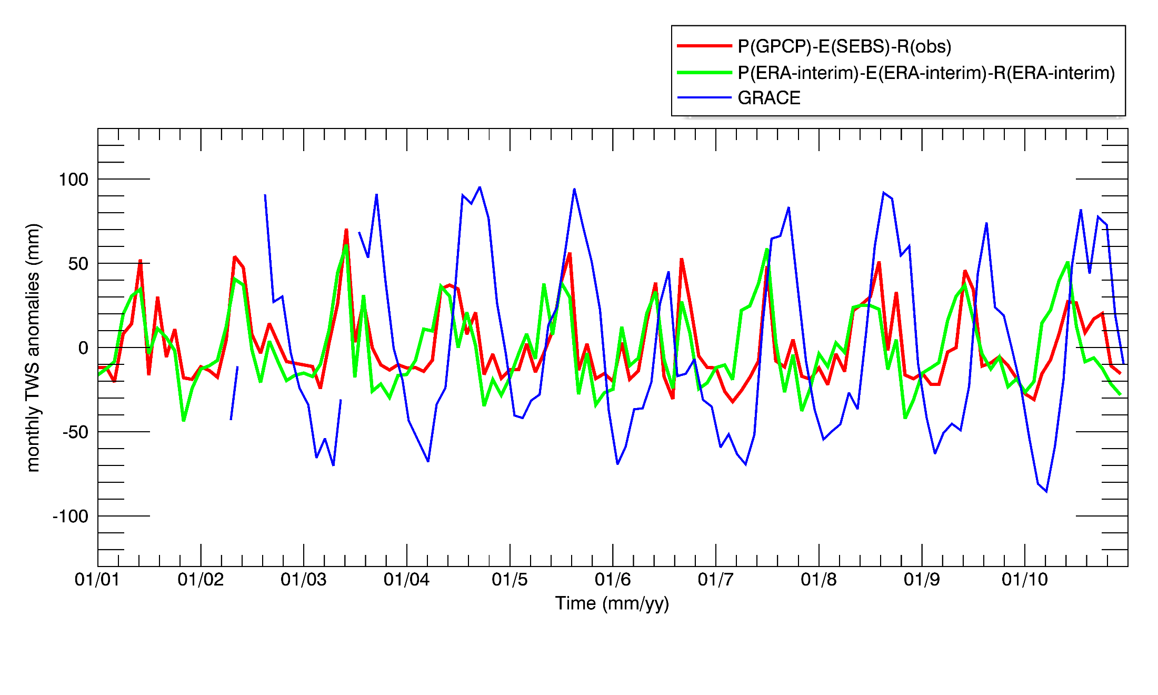
Upper reach TWS anomaly
(ver: RL04 ssv201008)
GRACE data
(ver: RL05.DSTvSCS1401)

Slide 43
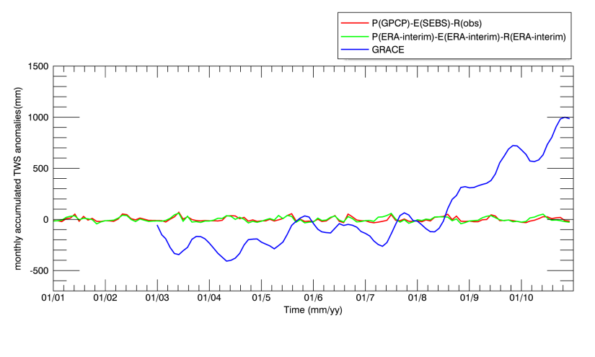
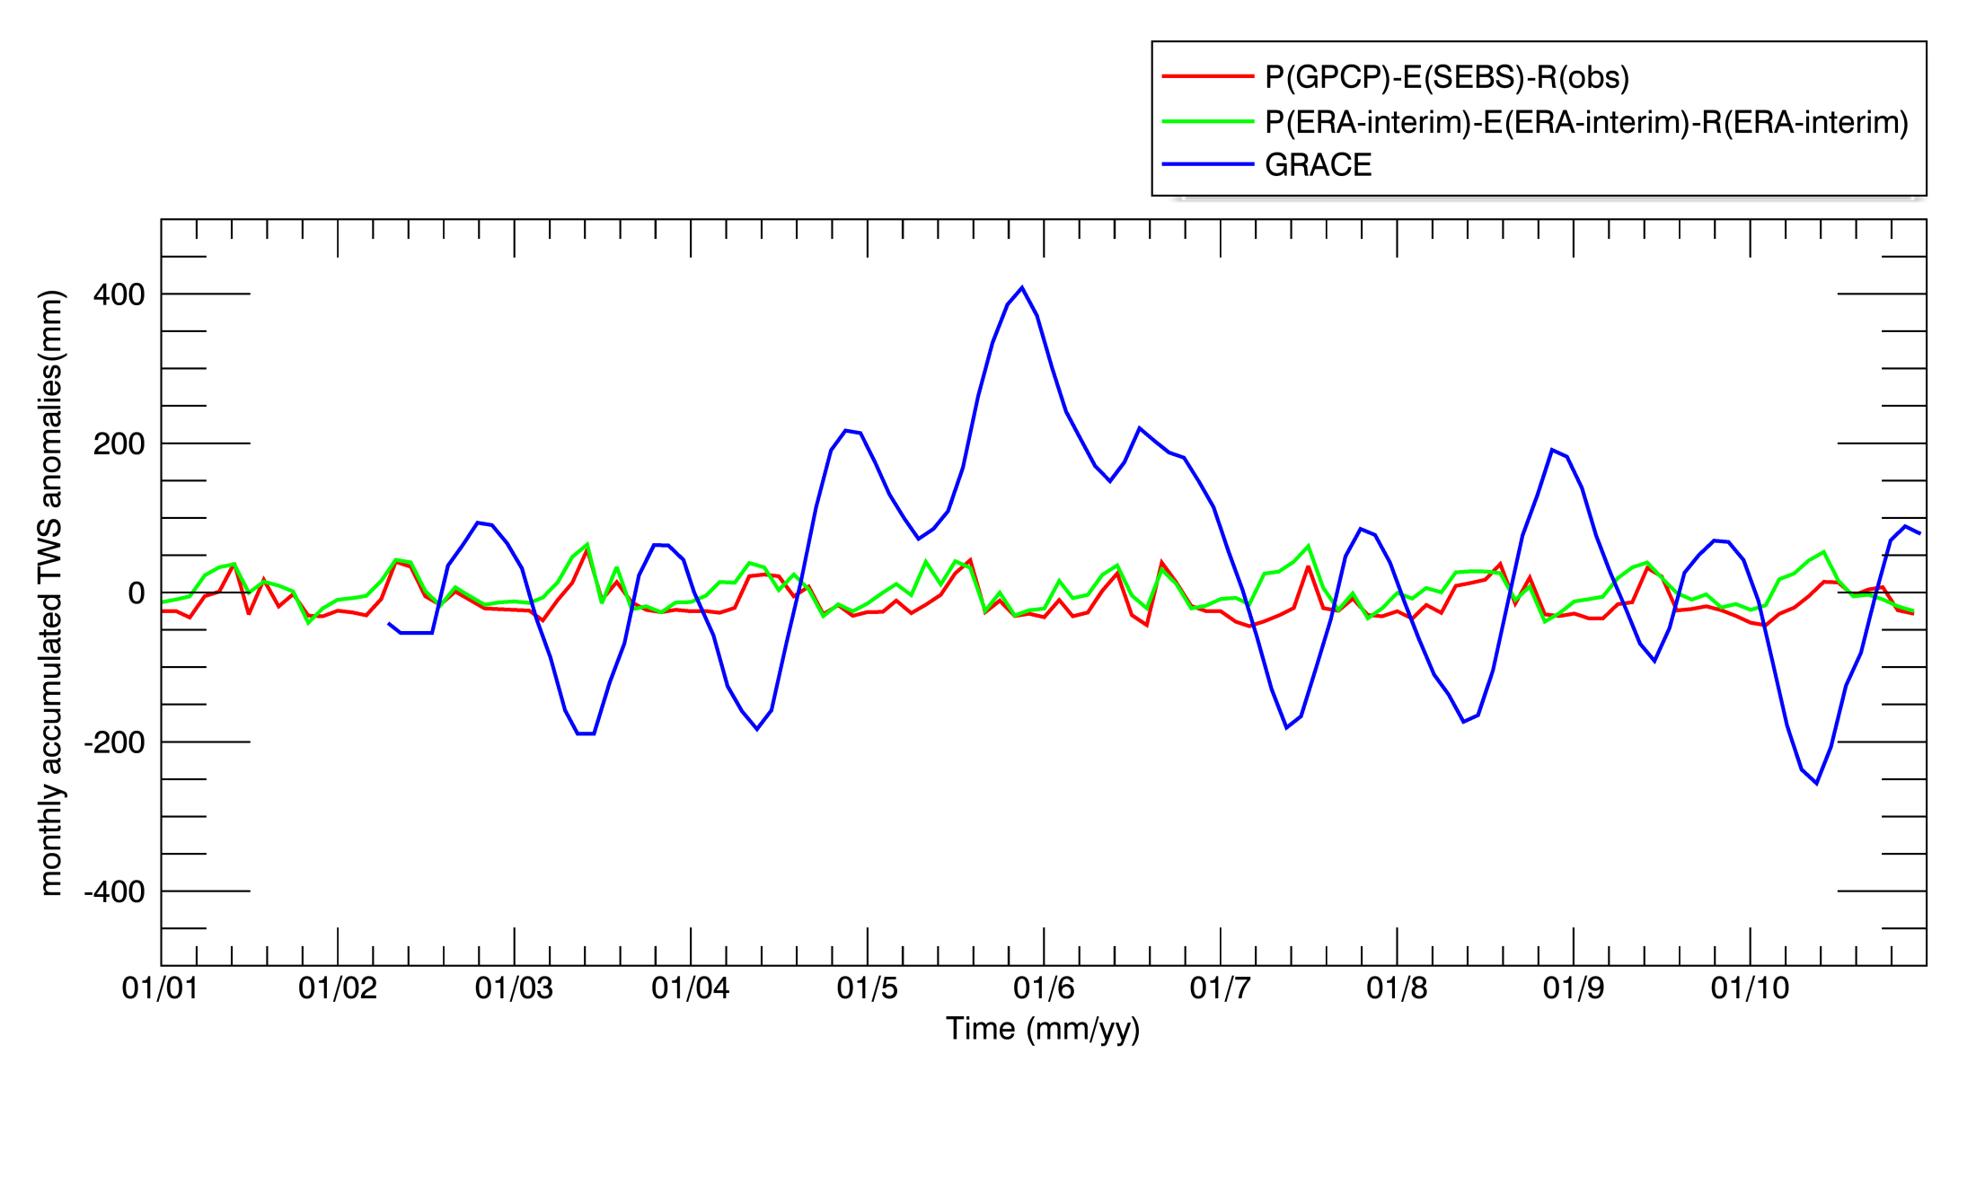
Cumulative TWS anomaly at Upper Reach (Yichang station)
(ver: RL04 ssv201008)
GRACE data
(ver: RL05.DSTvSCS1401)

Slide 44
Q/A: how to put up a real time system?
How do we decide if there is a drought?

Slide 45
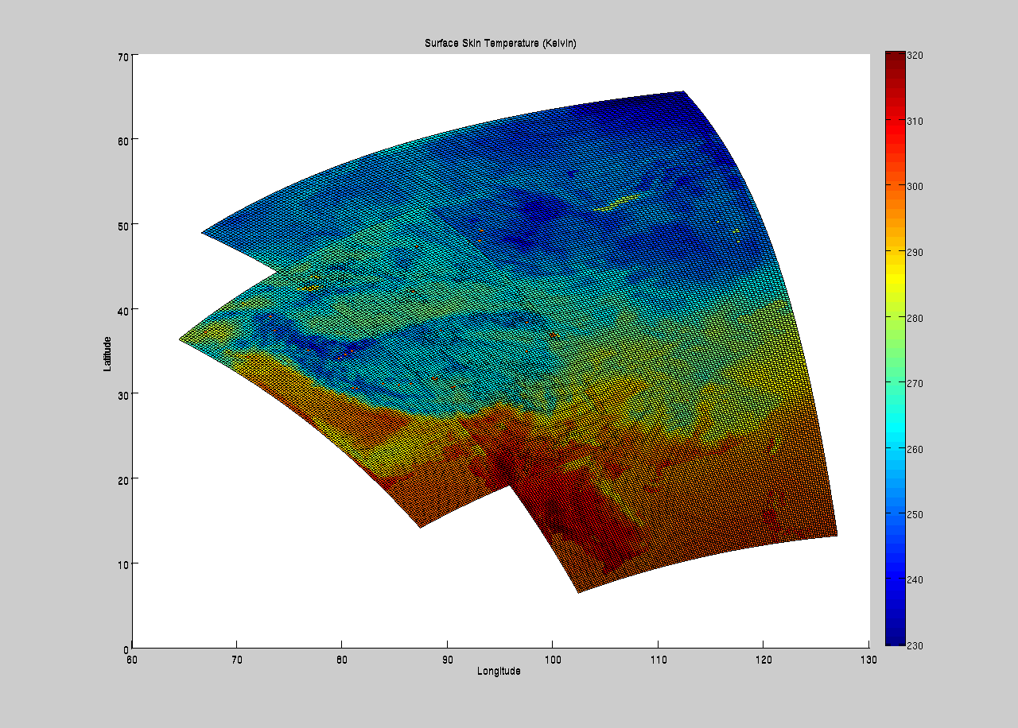
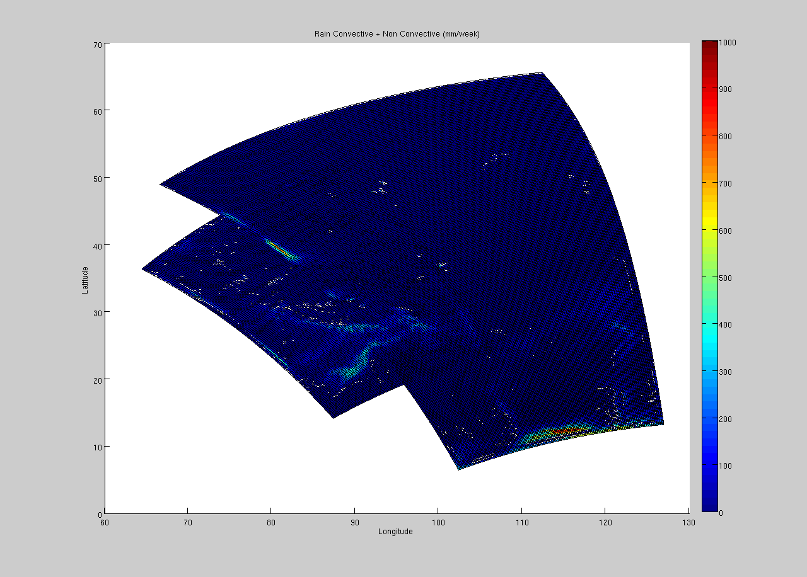
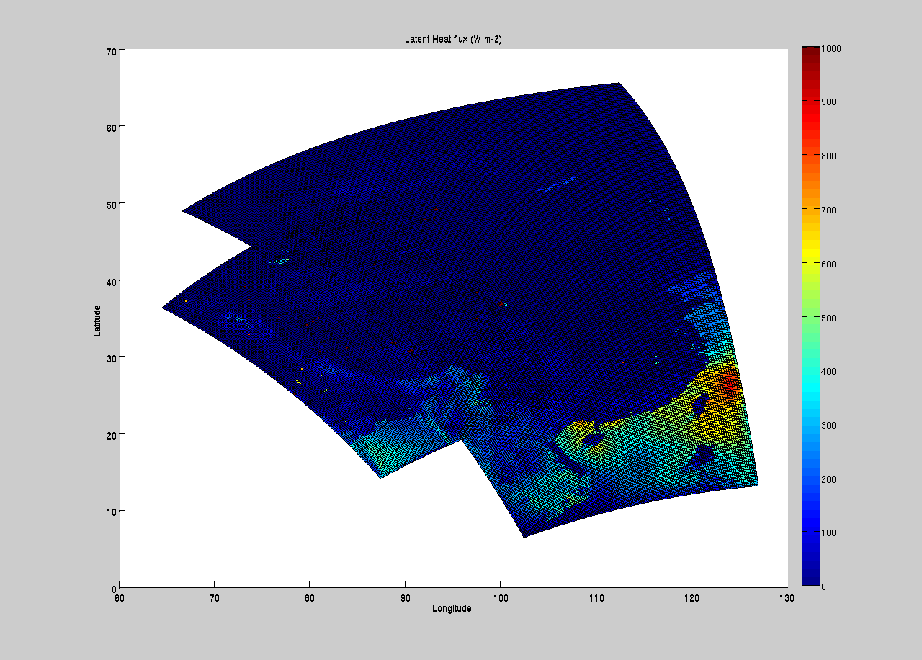
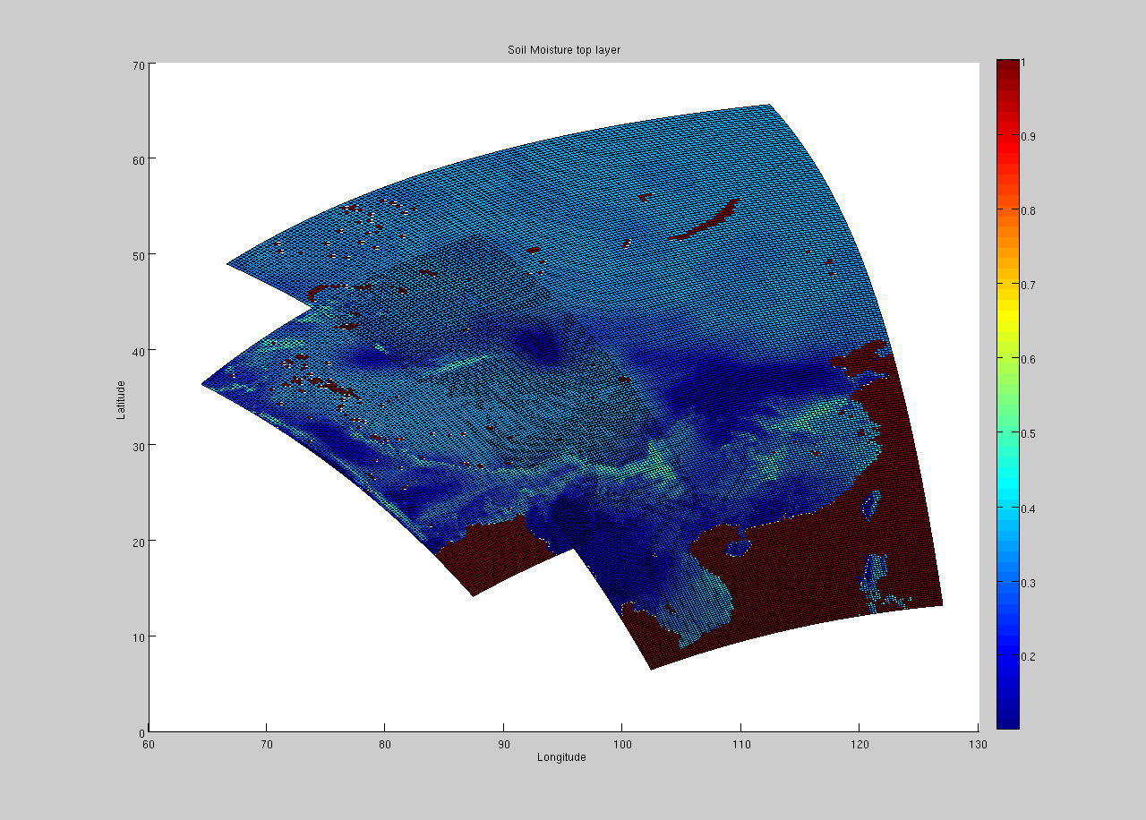
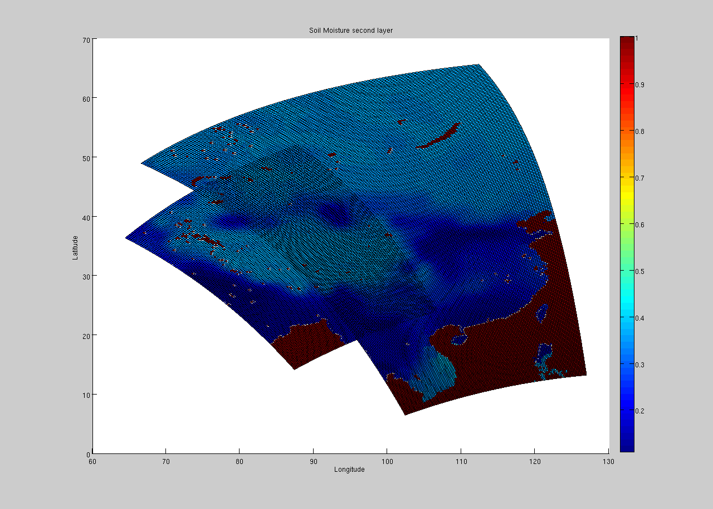
Continental scale simulations
1 Jan – 9 Dec 2009, grid resolution 25 KM
Skin temperature | Precipitation (convective + non-convective) |  | Latent heat flux (Evaporation/transpiration)
Soil moisture of top layer |  | Soil moisture of second layer

Slide 46
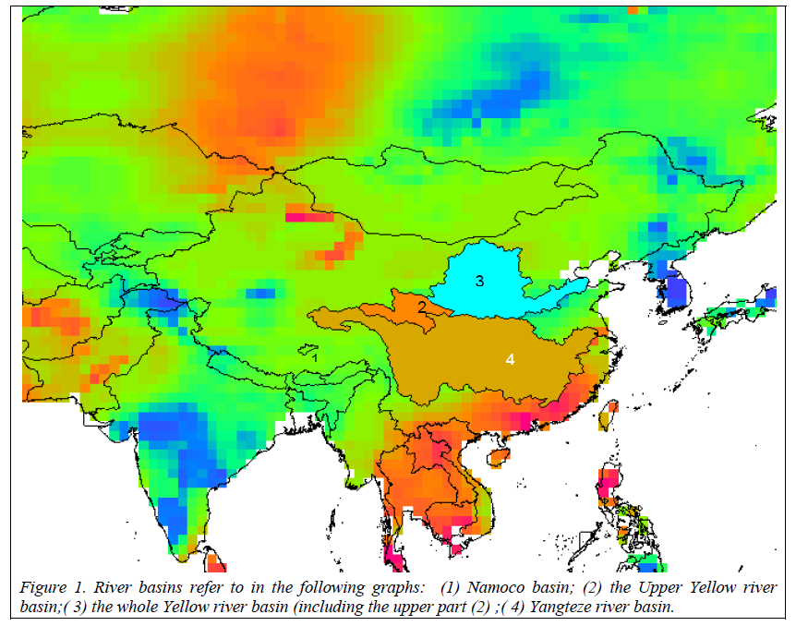
Climate change impacts and adaptation in River Basins
ESA Dragon project

Slide 47
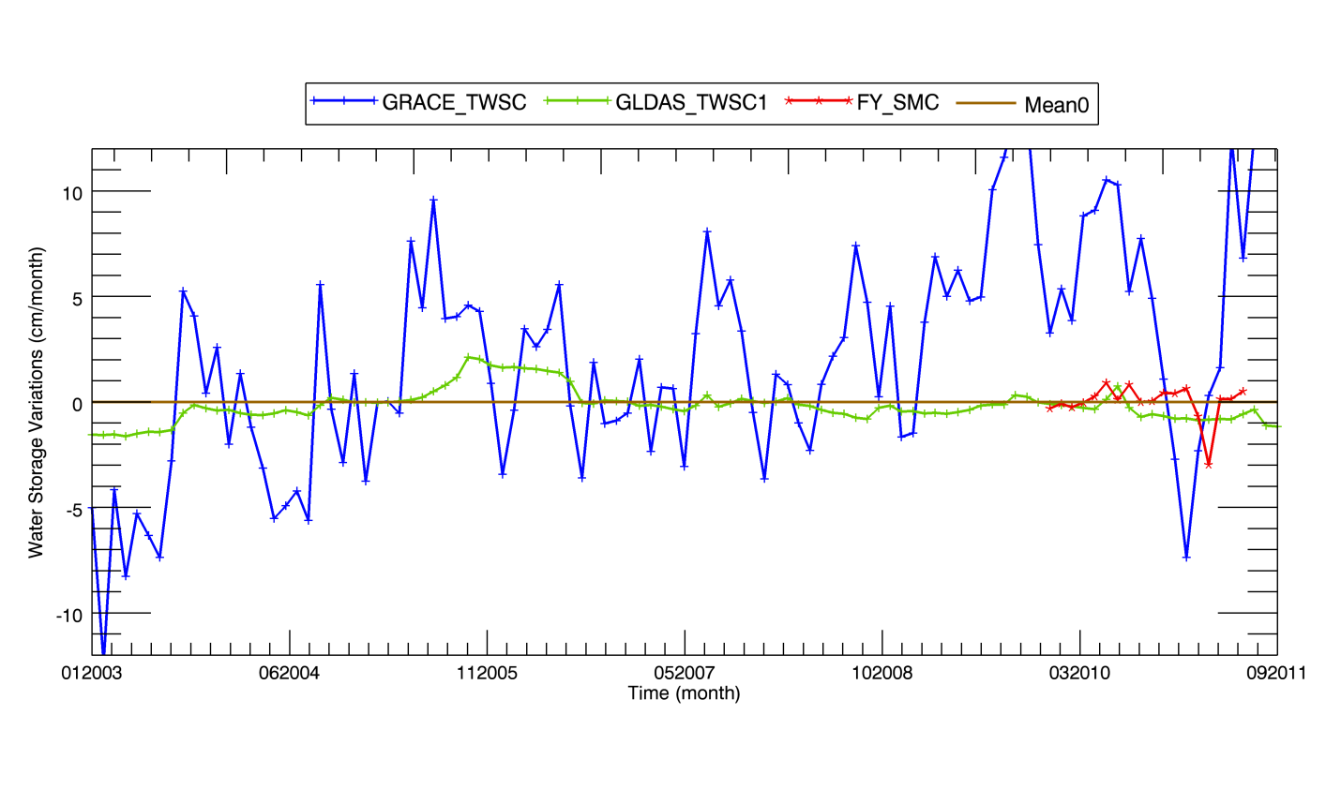

Example of the Yellow River Basin (upper basin vs whole basin)
Notes:
GRACE_TWSC: GRACE derived TWSC
GLDAS_TWSC1= SM+SWE+CWS, where SM, SWE and CWS are GLDAS derived sum of total soil moisture of 4 layers, snow water equivalent, and CWS-canopy water storage.
GRACE_TWSC: total water storage change derived from GRACE, the monthly value subtracting the time series mean over 2003-2007.
GLDAS-TWSC1 is the sum of total Soil moisture of 4 layer (with 2 m column depth), snow water equivalent (SWE) and canopy water storage (CWS).
GLDAS-TWSC2 is estimated using this equation: GLDAS-TWSC2(t)=Pt)-ET(t)-R(t) where P is precipitation, R is runoff and ET is evapotranspiration.
GLDAS-TWSC1 and GLDAS-TWSC2 are also the anomalies as GRACE_TWSC (the monthly value subtracting the time series mean over 2003-2007)
FY_SMC: soil moisture anomalies.

Slide 48


Example of the Yellow River Basin (upper basin vs whole basin)
GLDAS_TWSC2 = P - ET - R
(Anomaly)
TWSC3 = TRMM_PC – GLDAS_ETC – In-situ_ RC
(anomaly of total water storage change)
Notes:
Figure 11. TWSC3 = TRMM_PC – GLDAS_ETC – In-situ_ RC total water storage change over Upper yellow river basin.
TRMM_PC is the TRMM precipitation anomalies
GLDAS_ETC is the GLDAS derived ET anomalies
In-situ_RC is the in-situ runoff measurement anomalies
Figure 12. TWSC3 = TRMM_PC – GLDAS_ETC – GLDAS_ RC total water storage change over yellow river basin.
TRMM_PC is the TRMM precipitation anomalies
GLDAS_ETC is the GLDAS derived ET anomalies
GLDAS_RC is the GLDAS derived runoff anomalies

Slide 49



How shall we define droughts?
Dark blue is less than one standard deviation from the mean. For the normal distribution, this accounts for 68.27% of the set; while two standard deviations from the mean (medium and dark blue) account for 95.45%; and three standard deviations (light, medium, and dark blue) account for 99.73%. (wikipedia)

Slide 50


How shall we define droughts?
The probability that a normal deviate lies in the range μ − nσ and μ + nσ is,
Value range | category
μ−1σ < F > μ+1σ | Near normal
μ−2σ < F <= μ-1σ | Moderately dry
μ−3σ < F <= μ-2σ | Severely dry
F <= μ-3σ | Extremely dry
μ+1σ <= F < μ+2σ | Moderately wet
μ+2σ <= F < μ+3σ | Severely wet
μ+3σ <= F | Extremely wet

Slide 51

GLDAS derived Standardized total water storage index – drought situation

Slide 52
A Roadmap From Process Understanding To Adaptation
Describe
• Trends (change)
• Variability (natural cycle)
• Outliers
Understand
Attribution (variability vs. error)
Consistency Process (e.g. Volcanic eruption, fire/aerosol)
Feedback links (e.g. ENSO teleconnection)
Detect
• Hot Spot
• Quality issue
• Outside Envelope
Predict
Impacts
Adapt
Consequences

Slide 53

Impacts and projections in water resources
Q1: What are observed impacts to water resources in Yangtze due to climate and human changes ?
Q2: Will the changes in the Yangtze River Basin influence the East Asian monsoon patterns?
Q3: What will be the spatial/temporal distribution of water (sediment) resources in 21st century ?
Water resource shift?

Slide 54


Referances/Further Readings
Chen, X. Z.Su et al, 2014, Development of a 10-year (2001–2010) 0.1-degree dataset of land-surface energy balance for mainland China, ACP, 14 (2014)23, pp. 13,097-13,117.
Su, Z., 2002, The Surface Energy Balance System (SEBS) for estimation of turbulent heat fluxes, Hydrol. Earth Syst. Sci.,, 6(1), 85-99.
Su, Z., A. Yacob, Y. He, H. Boogaard, J. Wen, B. Gao, G. Roerink, and K. van Diepen, 2003, Assessing Relative soil moisture with remote sensing data: theory and experimental validation, Physics and Chemistry of the Earth, 28(1-3), 89-101.
Su, Z., Fernández-Prieto, D., Timmermans, J., Xuelong Chen, Hungershoefer, K., Roebeling, R., Schröder, M., Schulz, J., Stammes, P., Wang, P. and Wolters, E. (2014) First results of the earth observation Water Cycle Multi - mission Observation Strategy (WACMOS). Int. J. Appl. Earth Obs. Geoinfor., 26 (2014) pp. 270-285.
Su, Z., Y. He, X. Dong, L. Wang, 2017, Chapter 8, Drought Monitoring and Assessment Using Remote Sensing, V. Lakshmi (ed.), Remote Sensing of Hydrological Extremes, Springer Remote Sensing/Photogrammetry, DOI 10.1007/978-3-319-43744-6_8

Slide 55
Yes, it is water availability!
Final Q/A,
proposals for a real case study, readings

